Slide 1
Statistics – O. R. 892
Object Oriented Data Analysis
Steve Marron
Dept. of Statistics and Operations Research
University of North Carolina

Slide 2
Administrative Info
Details on Course Web Page
https://stor892fall2014.web.unc.edu
Or:
  Google: “Marron Courses”
  Choose This Course
Go Through These

Slide 3
Who are we?
Varying Levels of Expertise
  2nd Year Graduate Students
  …
  Faculty Level Researchers
Various Backgrounds
  Statistics
  Computer Science – Imaging
  Bioinformatics
  Pharmacy
  Others?

Slide 4
Course Expectations
Grading Based on:
“Participant Presentations”
5 – 10 minute talks
By Enrolled Students
Hopefully Others

Slide 5
Class Meeting Style
When you don’t understand something
Many others probably join you
So please fire away with questions
Discussion usually enlightening for others
If needed, I’ll tell you to shut up
(essentially never happens)

Slide 6
Object Oriented Data Analysis
What is it?
A Sound-Bite Explanation:
What is the “atom of the statistical analysis”?
1st Course: Numbers
Multivariate Analysis Course : Vectors
Functional Data Analysis: Curves

Slide 7
Functional Data Analysis
Active new field in statistics, see:
Ramsay, J. O. & Silverman, B. W. (2005) Functional Data Analysis, 2nd Edition, Springer, N.Y.
Ramsay, J. O. & Silverman, B. W. (2002) Applied Functional Data Analysis, Springer, N.Y.
Ramsay, J. O. (2005) Functional Data Analysis Web Site, http://ego.psych.mcgill.ca/misc/fda/

Slide 8
Object Oriented Data Analysis
What is it?
A Sound-Bite Explanation:
What is the “atom of the statistical analysis”?
1st Course: Numbers
Multivariate Analysis Course : Vectors
Functional Data Analysis: Curves
More generally: Data Objects

Slide 9
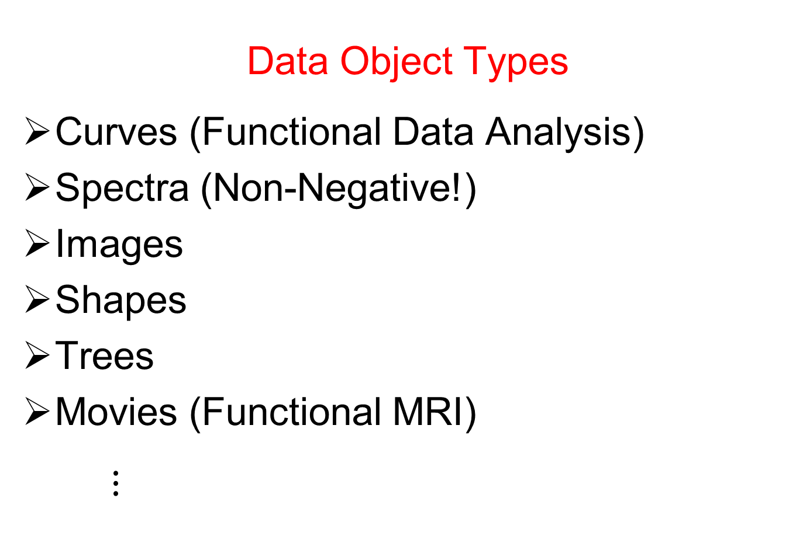
Object Oriented Data Analysis
Data Object Types
Curves (Functional Data Analysis)
Spectra (Non-Negative!)
Images
Shapes
Trees
Movies (Functional MRI)
$⋮$

Slide 10
Object Oriented Data Analysis
Nomenclature Clash?
Computer Science View:
Object Oriented Programming:
Programming that supports encapsulation, inheritance, and polymorphism
(from Google: define object oriented programming,
my favorite: www.innovatia.com/software/papers/com.htm)

Slide 11
Object Oriented Data Analysis
Some statistical history:
John Chambers Idea (1960s - ):
Object Oriented approach to statistical analysis
Developed as software package S
  Basis of S-plus (commerical product)
  And of R (free-ware, current favorite of Chambers)
Reference for more on this:
Venables, W. N. and Ripley, B. D. (2002) Modern Applied Statistics with S, Fourth Edition, Springer, N. Y., ISBN 0-387-95457-0.
Notes:
11

Slide 12
Object Oriented Data Analysis
Another take: J. O. Ramsay
http://www.psych.mcgill.ca/faculty/ramsay/ramsay.html
“Functional Data Objects”
(closer to C. S. meaning)
Personal Objection:
“Functional” in mathematics is:
“Function that operates on functions”

Slide 13
Object Oriented Data Analysis
Current Motivation:
In Complicated Data Analyses
Fundamental (Non-Obvious) Question Is:
“What Should We Take as Data Objects?”
Key to Focussing Needed Analyses

Slide 14
Object Oriented Data Analysis
Reviewer for Annals of Applied Statistics:
Why not just say:
“Experimental Units”?
Useful for some situations
But misses different representations
E.g. log transformations …

Slide 15
Object Oriented Data Analysis
Comment from Randy Eubank:
This terminology:
"Object Oriented Data Analysis"
First appeared in Florida FDA Meeting:
http://www.stat.ufl.edu/symposium/2003/fundat/

Slide 16
Object Oriented Data Analysis
References:
Wang and Marron (2007)
Marron and Alonso (2014)

Slide 17
Object Oriented Data Analysis
What is Actually Done?
Major Statistical Tasks:
Understanding Population Structure
Classification (i. e. Discrimination)
Time Series of Data Objects
“Vertical Integration” of Datatypes

Slide 18
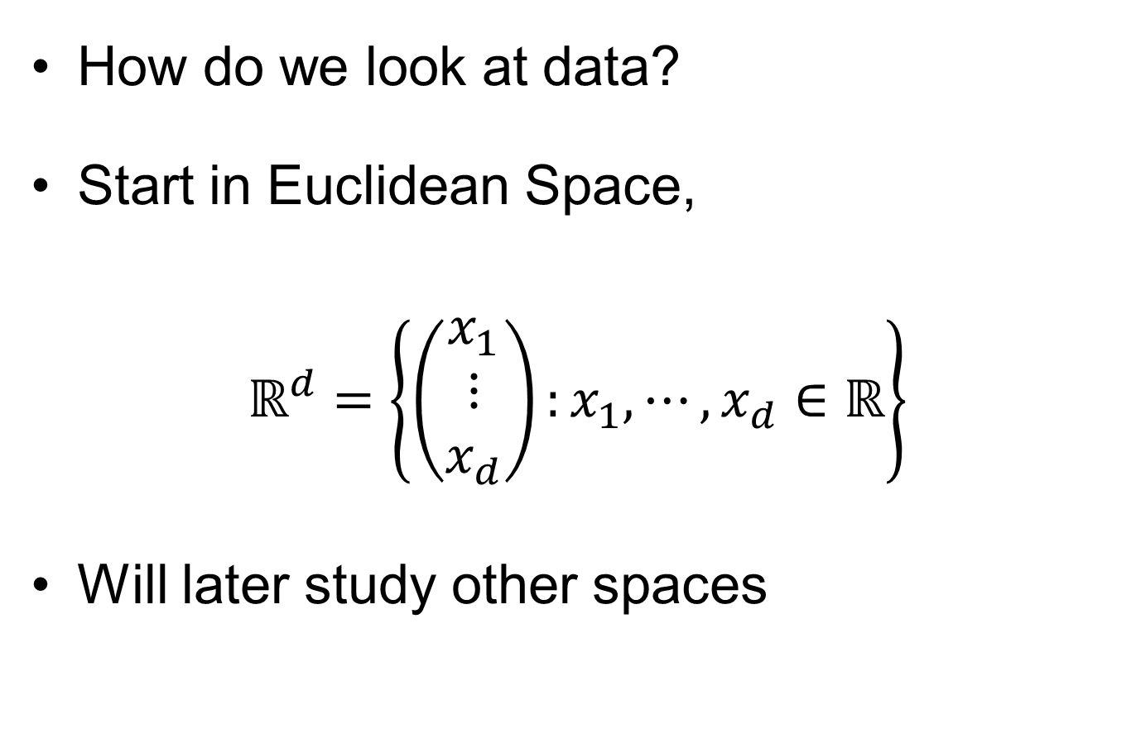
Visualization
How do we look at data?
Start in Euclidean Space,
$$ℝ^{d}=\left\{\left(\begin{matrix}x_{1} \\ ⋮ \\ x_{d}\end{matrix}\right):x_{1},⋯,x_{d}∈ℝ\right\}$$
Will later study other spaces

Slide 19
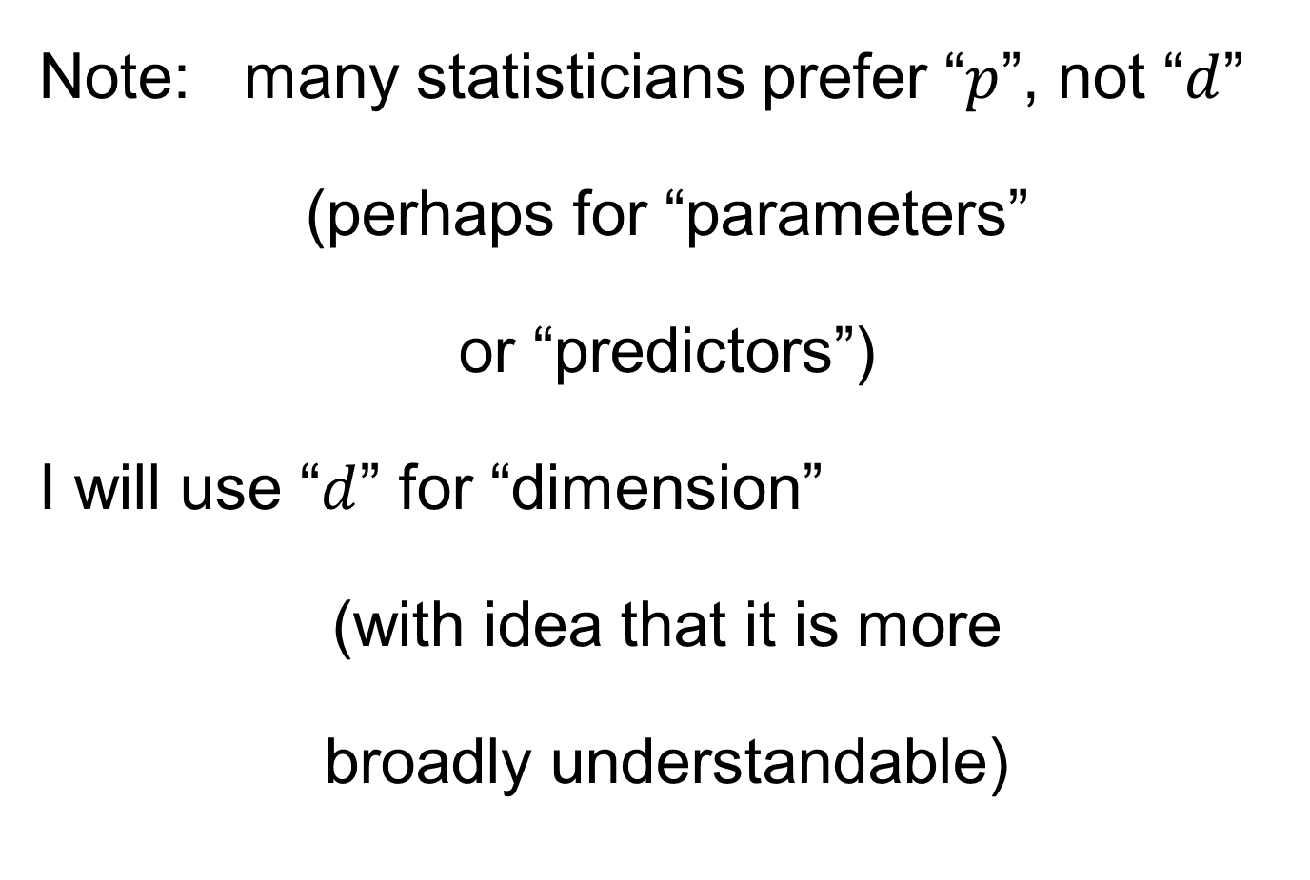
Notation
Note: many statisticians prefer “$p$”, not “$d$”
(perhaps for “parameters”
or “predictors”)
I will use “$d$” for “dimension”
(with idea that it is more
broadly understandable)

Slide 20
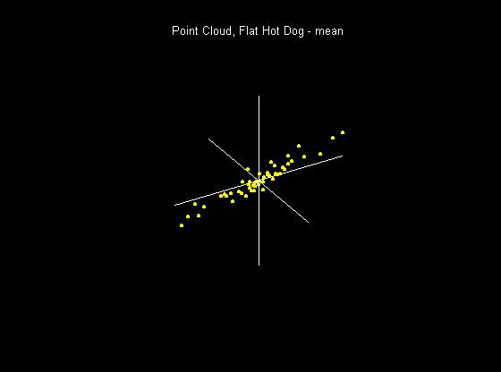
Visualization
How do we look at Euclidean data?
1-d: histograms, etc.
2-d: scatterplots
3-d: spinning point clouds

Slide 21
Visualization
How do we look at Euclidean data?
Higher Dimensions?
Workhorse Idea: Projections

Slide 22
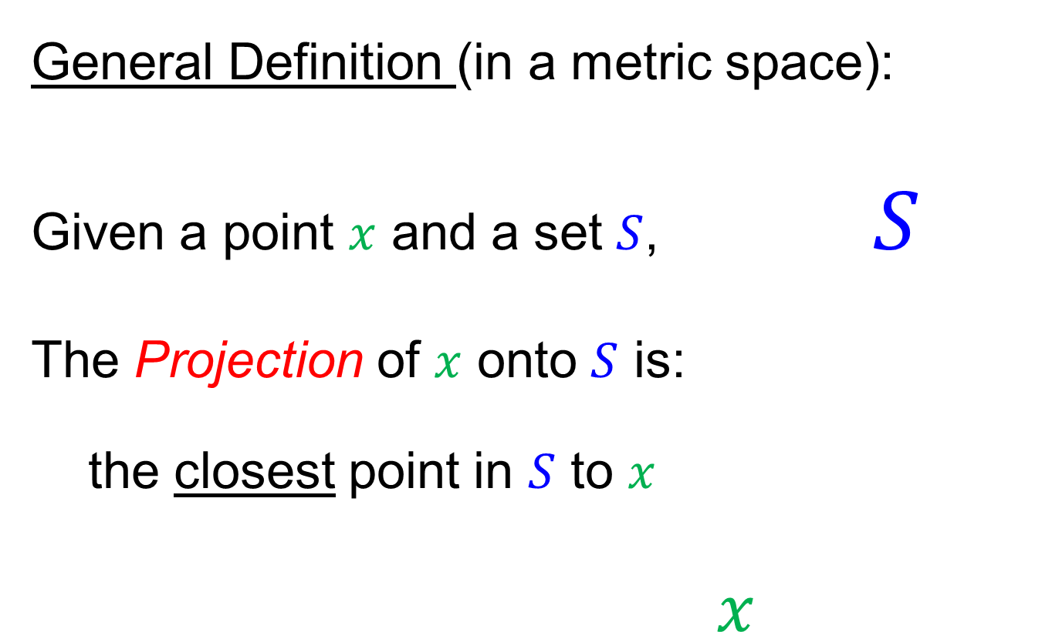
Projection
General Definition (in a metric space):
Given a point $x$ and a set $S$, $S$
The Projection of $x$ onto $S$ is:
the closest point in $S$ to $x$
$x$

Slide 23
Projection
Important Point
There are many “directions of interest” on which projection is useful
An important set of directions:
Principal Components

Slide 24
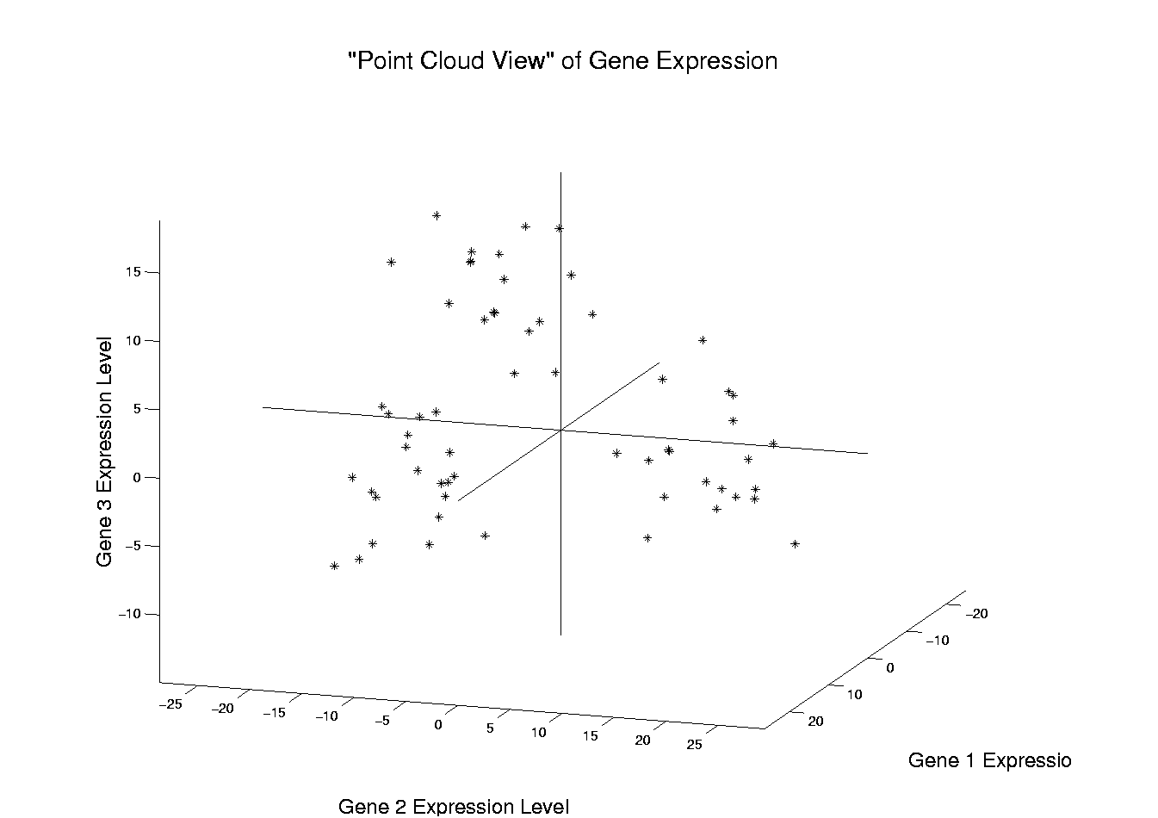
Illustration of Multivariate View: Raw Data
Notes:
EgView1p1RawData.ps

Slide 25
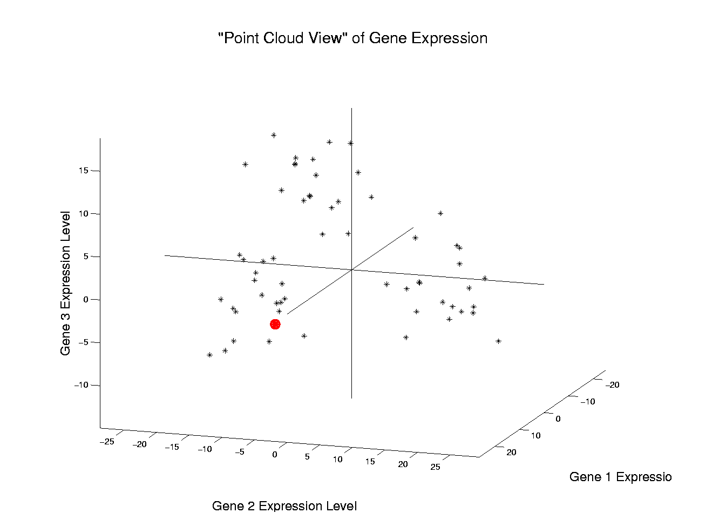
Illustration of Multivariate View: Highlight One
Notes:
EgView1p2RawDataHiLite1.ps

Slide 26
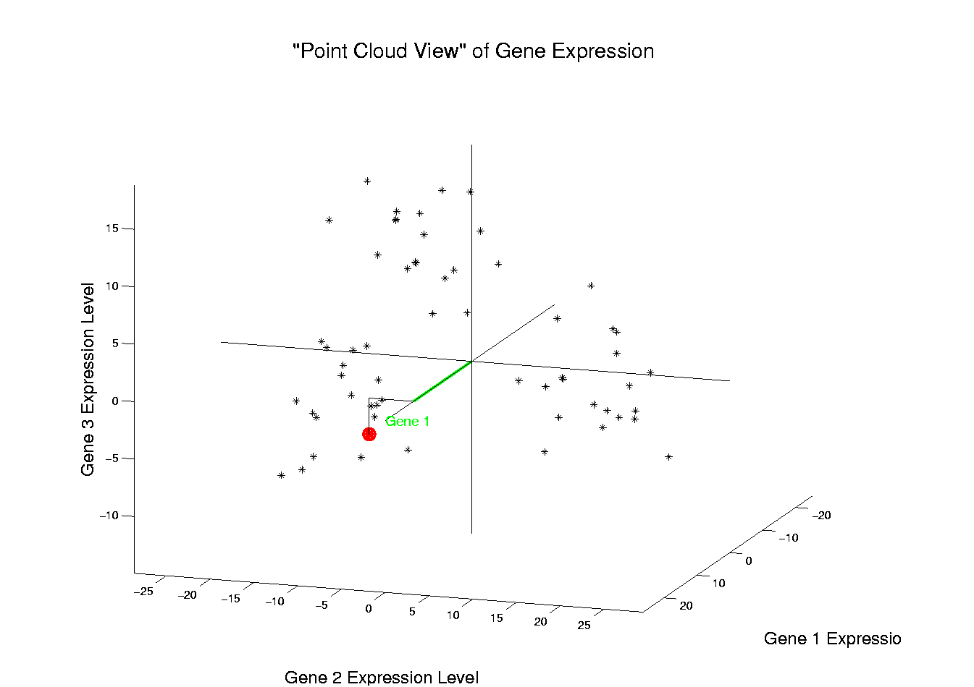
Illustration of Multivariate View: Gene 1 Express’n
Notes:
EgView1p3RawDataHL1CoordX.ps

Slide 27
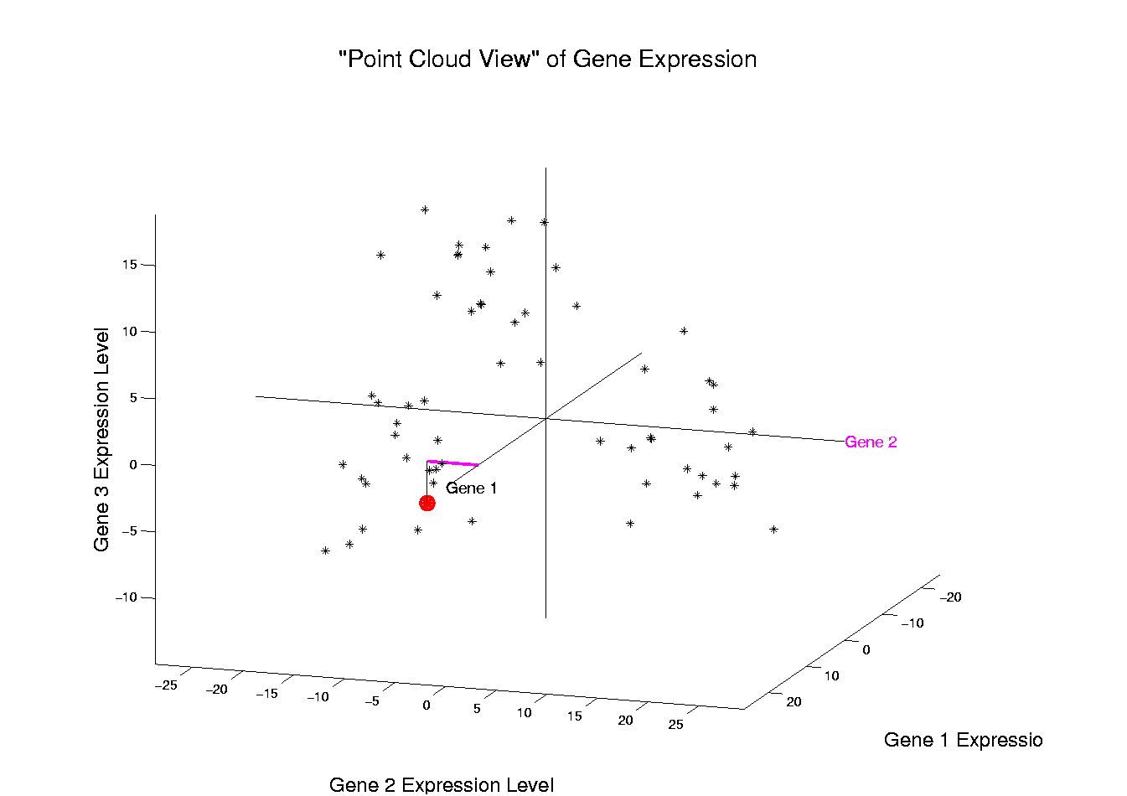
Illustration of Multivariate View: Gene 2 Express’n
Notes:
EgView1p3RawDataHL1CoordY.ps

Slide 28
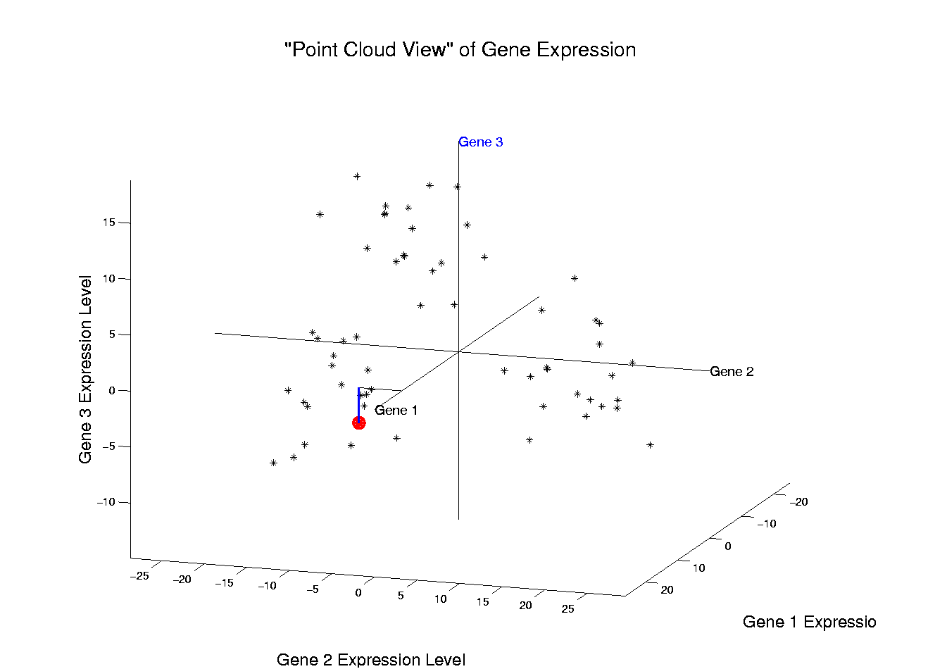
Illustration of Multivariate View: Gene 3 Express’n
Notes:
EgView1p3RawDataHL1CoordZ.ps

Slide 29
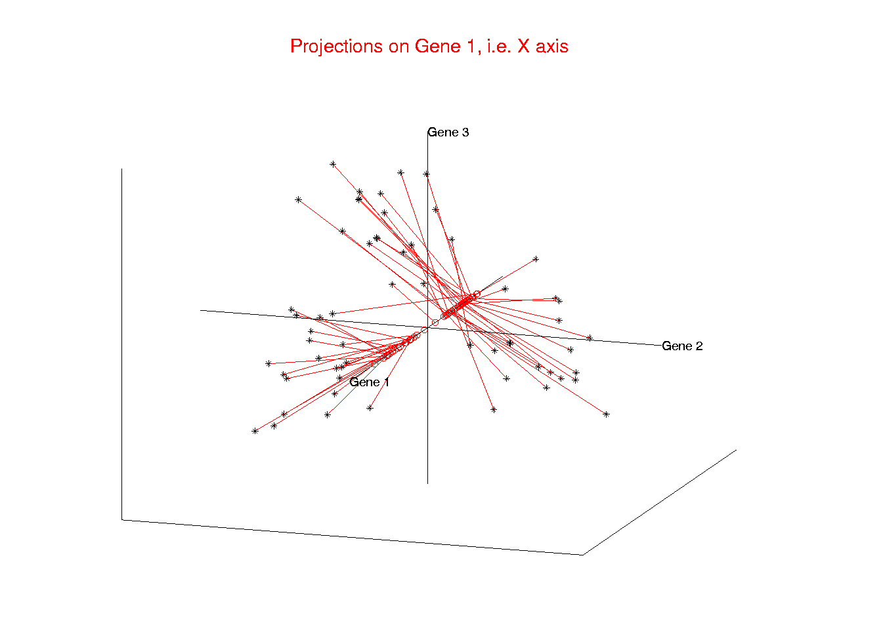
Illust’n of Multivar. View: 1-d Projection, X-axis
Notes:
EgView1p21proj3DX.ps

Slide 30
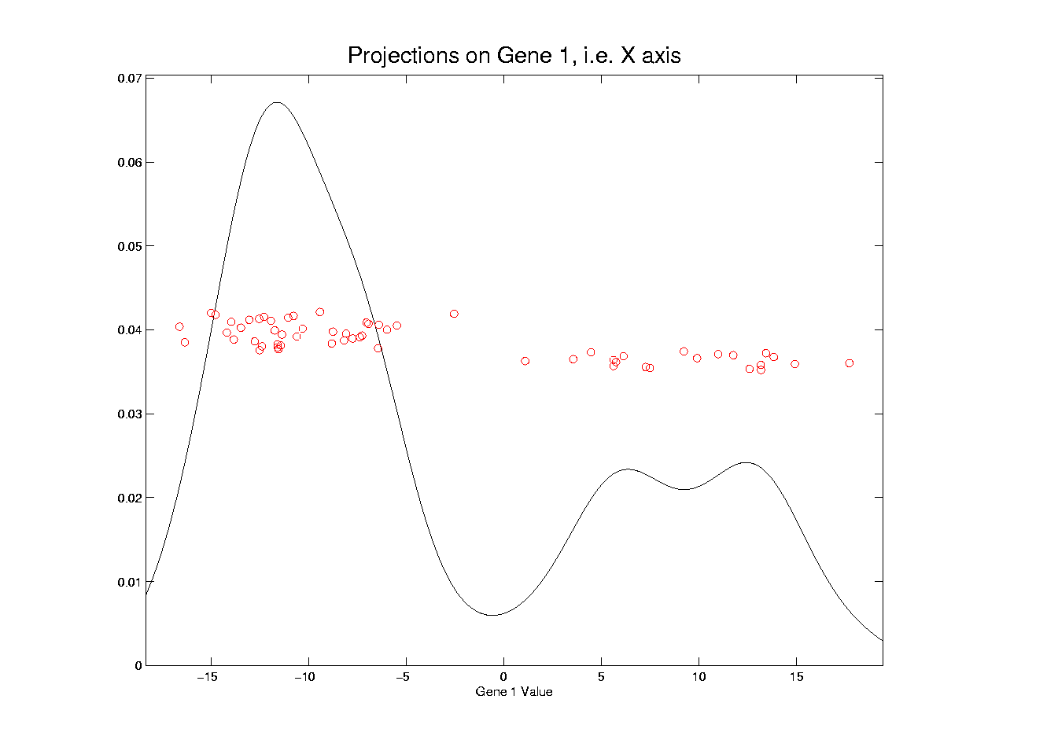
Illust’n of Multivar. View: X-Projection, 1-d view
Notes:
EgView1p31Proj1dX.ps

Slide 31
Illust’n of Multivar. View: X-Projection, 1-d view
X Coordinates
Are Projections
Notes:
EgView1p31Proj1dX.ps

Slide 32
Illust’n of Multivar. View: X-Projection, 1-d view
Y Coordinates Show
Order in Data Set
(or Random)
Notes:
EgView1p31Proj1dX.ps

Slide 33
Illust’n of Multivar. View: X-Projection, 1-d view
Smooth histogram =
Kernel Density Estimate
Will Study in Detail Later
Notes:
EgView1p31Proj1dX.ps

Slide 34
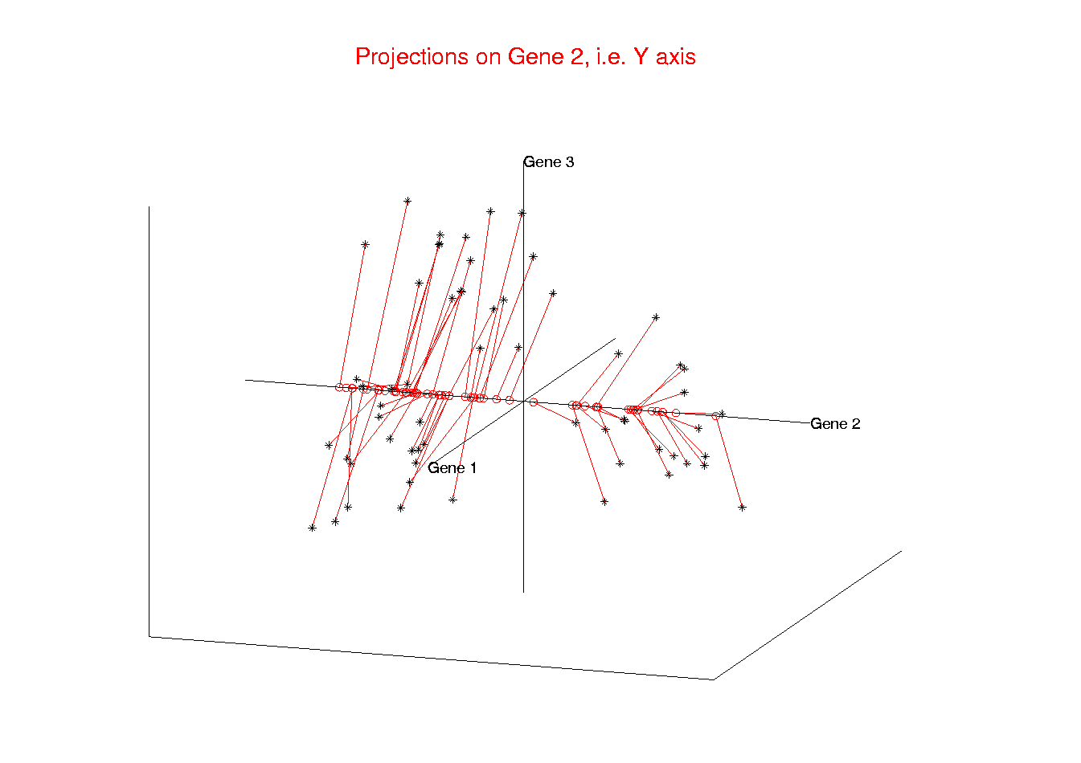
Illust’n of Multivar. View: 1-d Projection, Y-axis
Notes:
EgView1p22proj3DY.ps

Slide 35
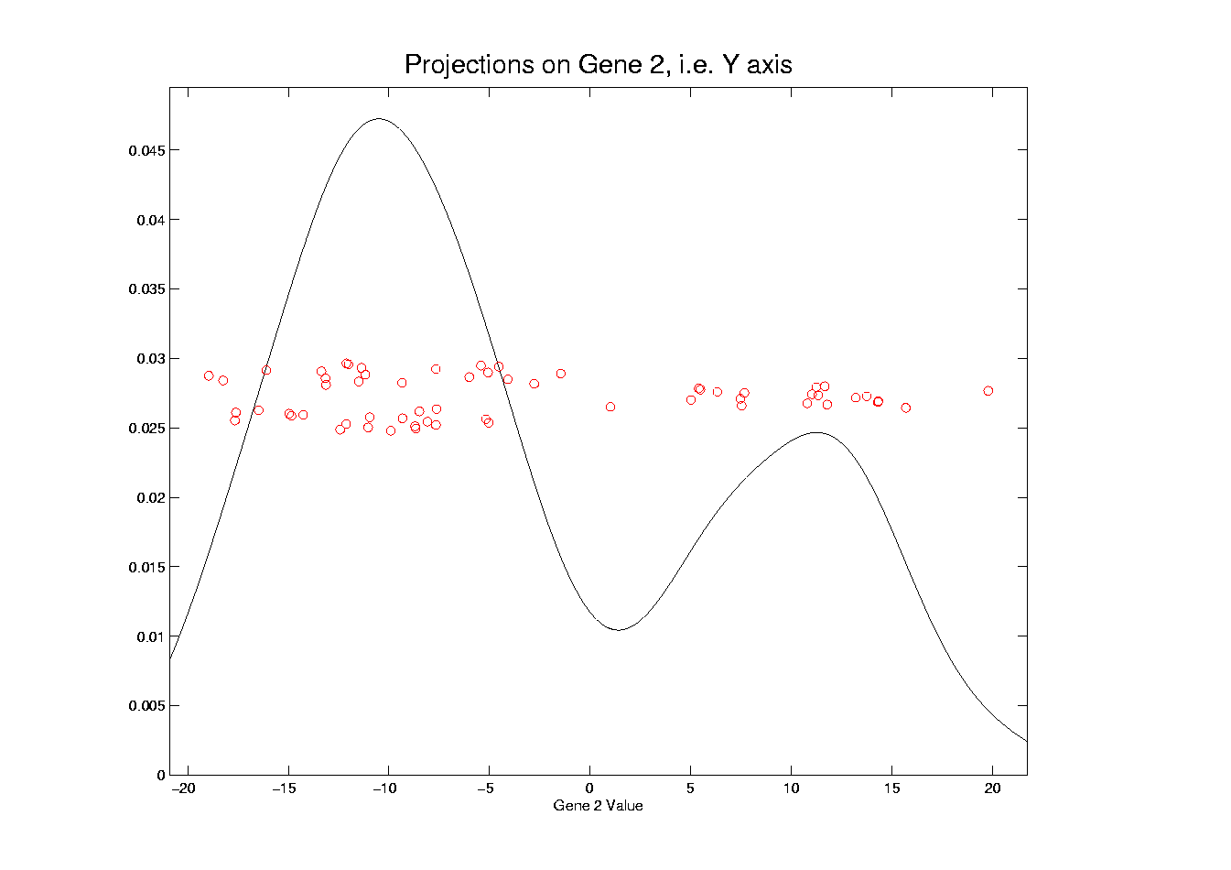
Illust’n of Multivar. View: Y-Projection, 1-d view
Notes:
EgView1p32Proj1dY.ps

Slide 36
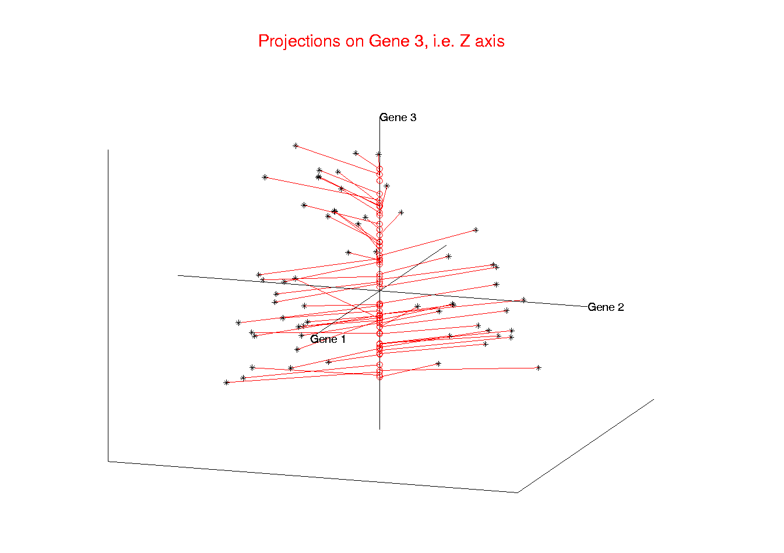
Illust’n of Multivar. View: 1-d Projection, Z-axis
Notes:
EgView1p23proj3DZ.ps

Slide 37
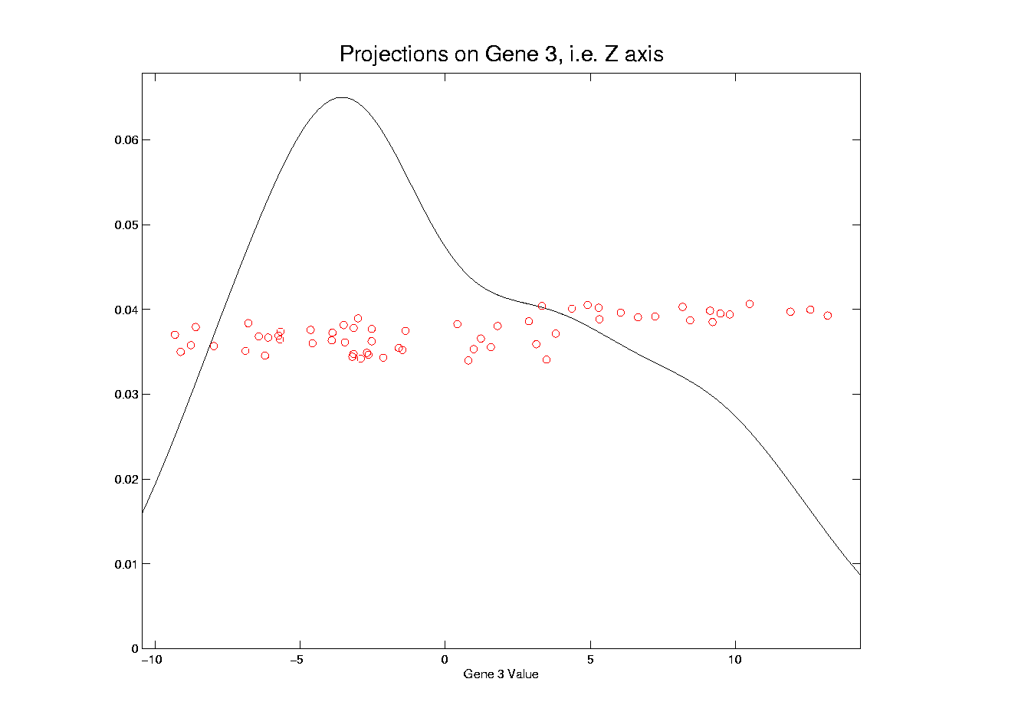
Illust’n of Multivar. View: Z-Projection, 1-d view
Notes:
EgView1p33Proj1dZ.ps

Slide 38
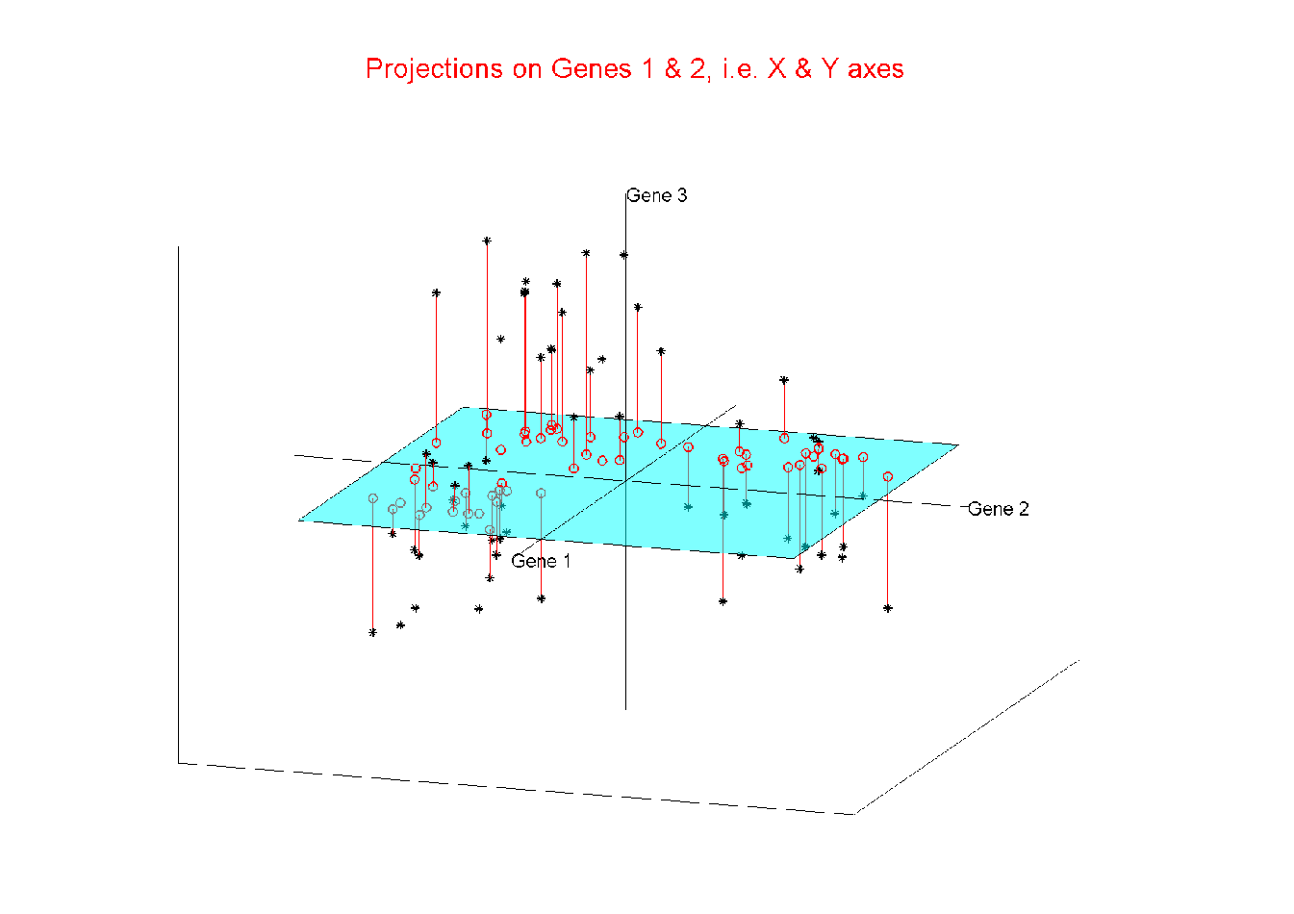
Illust’n of Multivar. View: 2-d Proj’n, XY-plane
Notes:
EgView1p24proj3DXY.ps

Slide 39
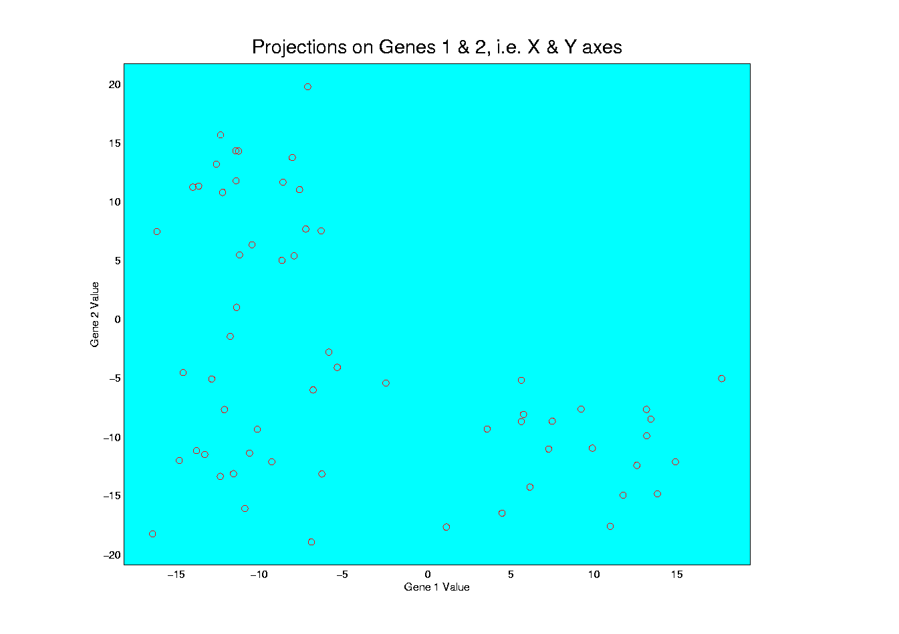
Illust’n of Multivar. View: XY-Proj’n, 2-d view
Notes:
EgView1p34proj2DXY.ps

Slide 40
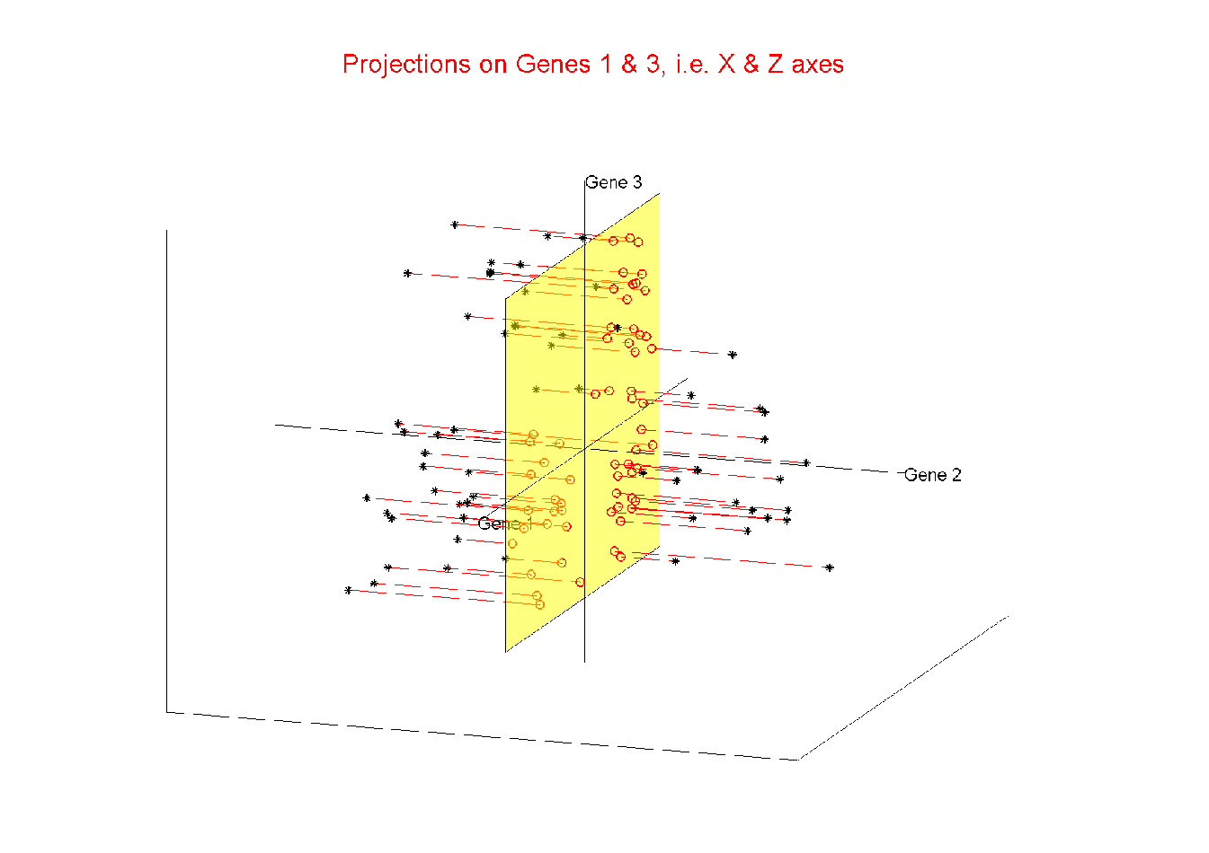
Illust’n of Multivar. View: 2-d Proj’n, XZ-plane
Notes:
EgView1p25proj3DXZ.ps

Slide 41
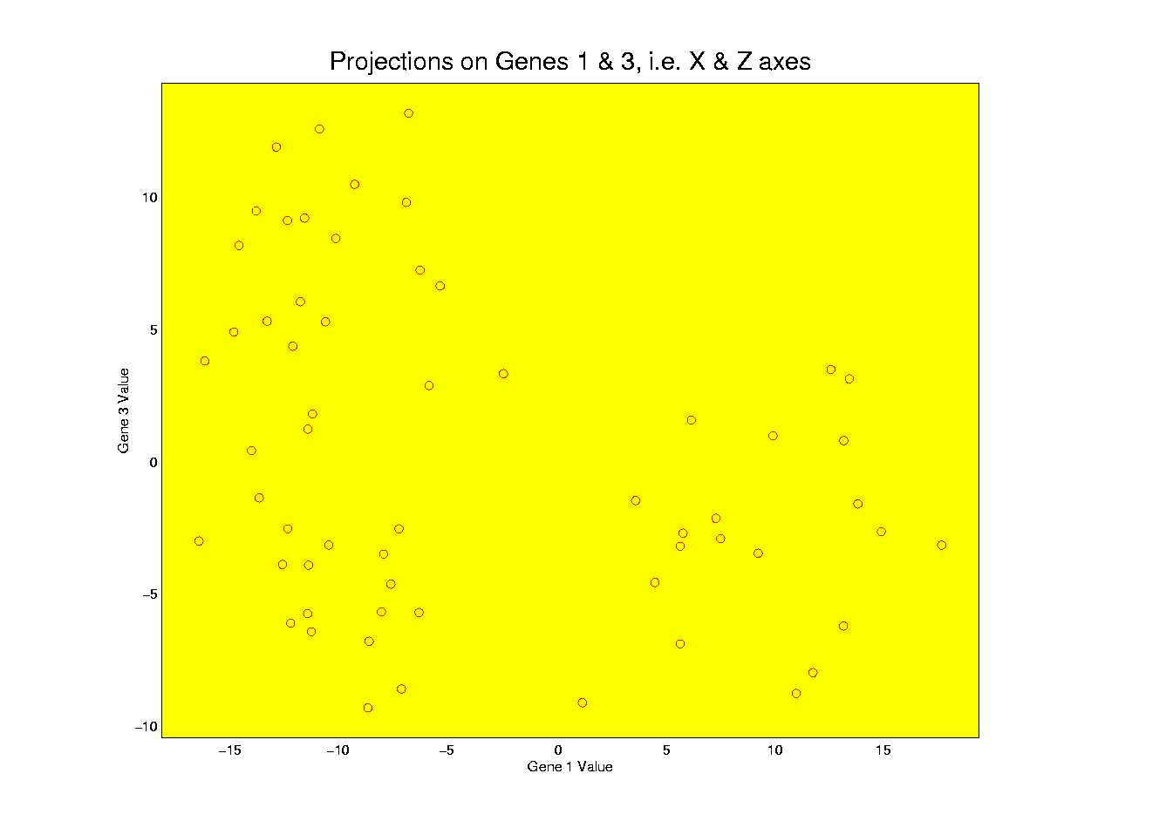
Illust’n of Multivar. View: XZ-Proj’n, 2-d view
Notes:
EgView1p35proj2DXZ.ps

Slide 42
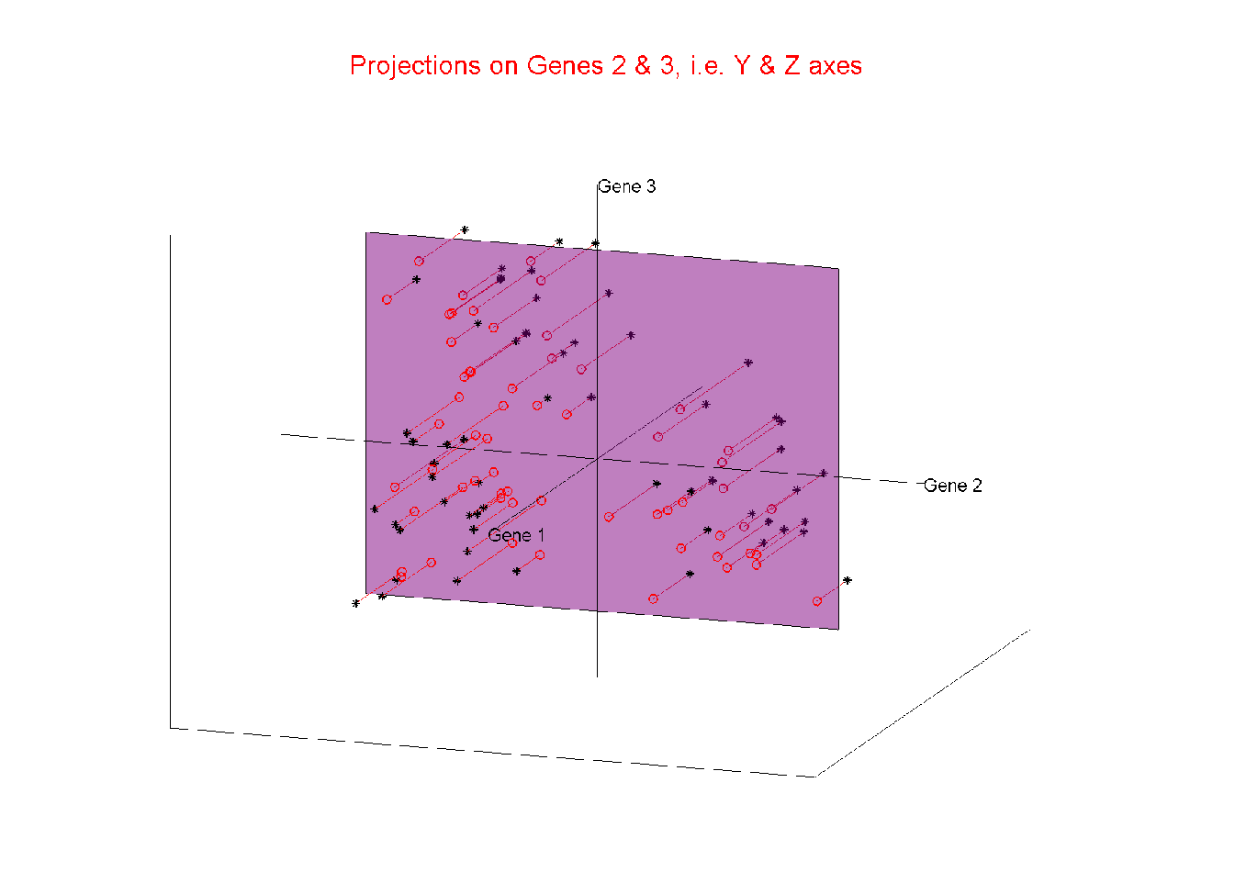
Illust’n of Multivar. View: 2-d Proj’n, YZ-plane
Notes:
EgView1p26proj3DYZ.ps

Slide 43
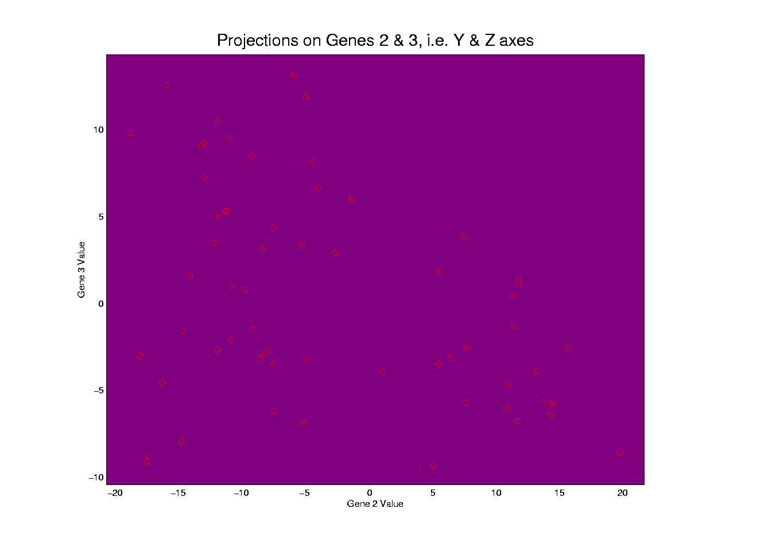
Illust’n of Multivar. View: YZ-Proj’n, 2-d view
Notes:
EgView1p36proj2DYZ.ps

Slide 44
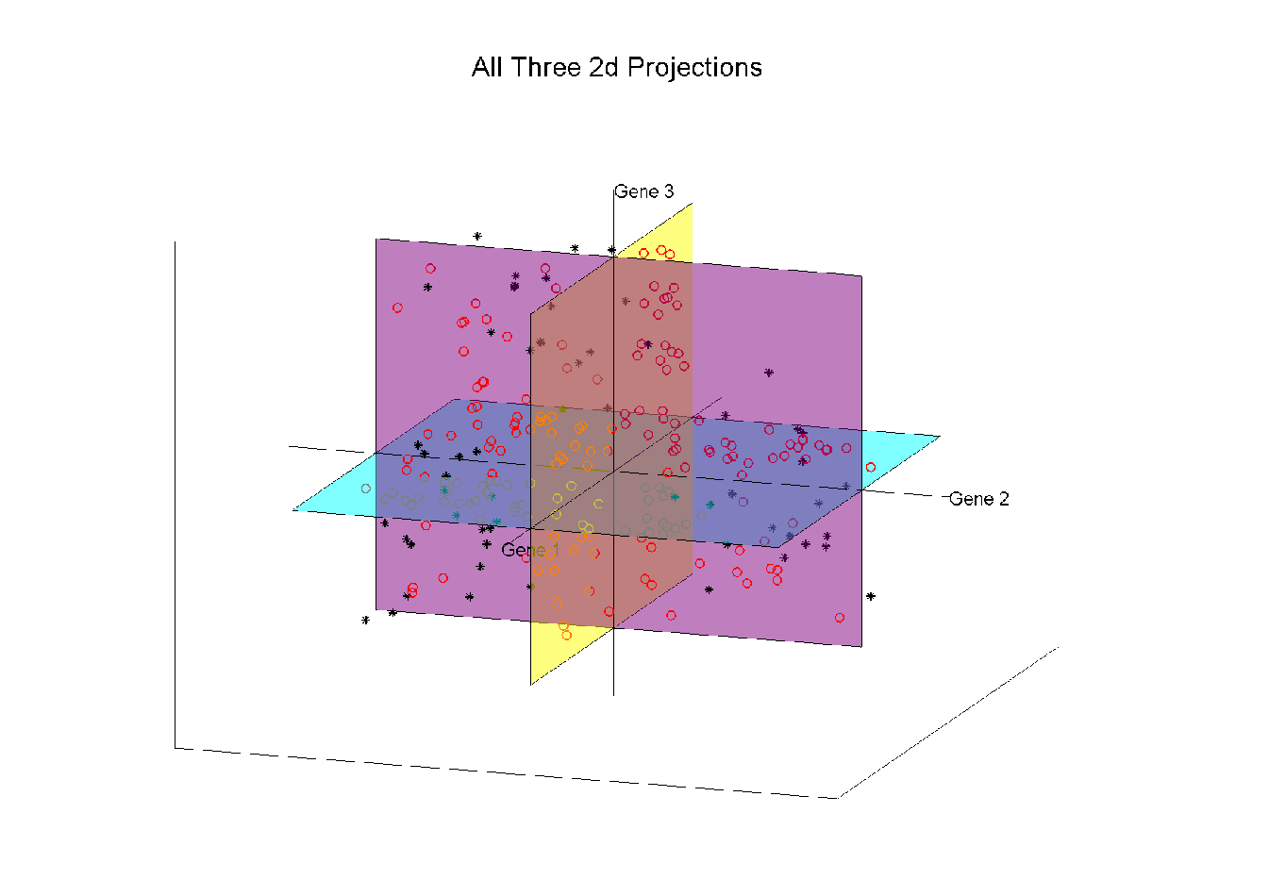
Illust’n of Multivar. View: all 3 planes
Think:
Front
Top
Side
Views
Notes:
EgView1p27proj3Dall.ps

Slide 45
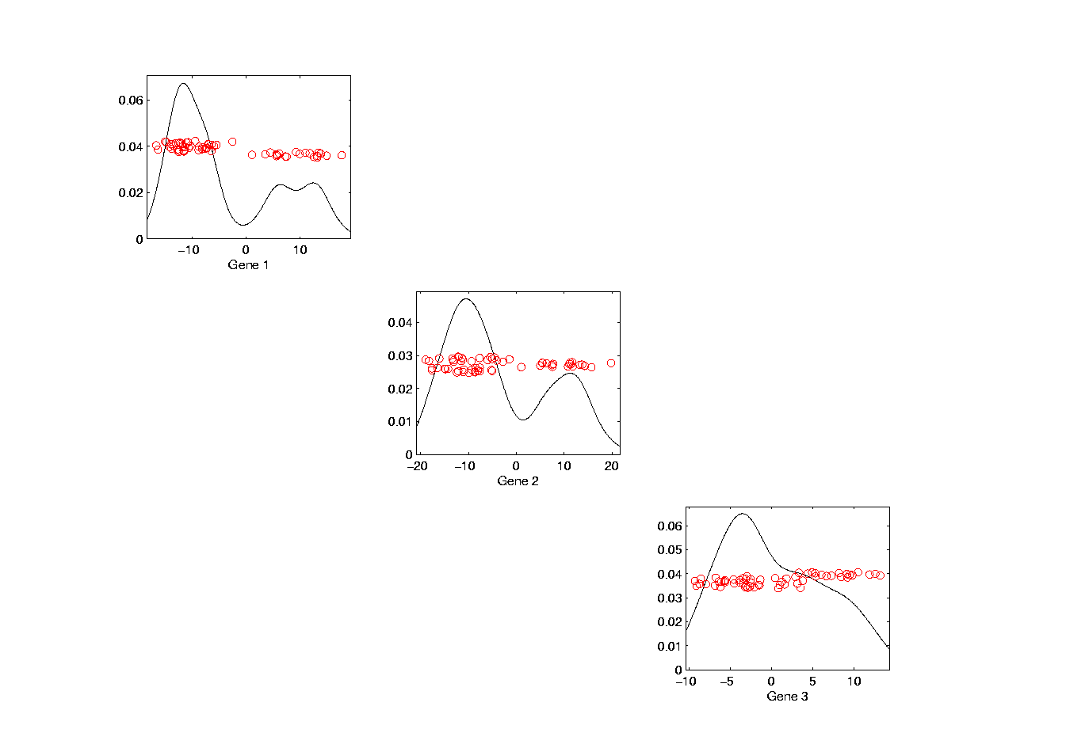
Illust’n of Multivar. View: Diagonal 1-d proj’ns
Notes:
EgView1p37proj1Ddiag.ps

Slide 46
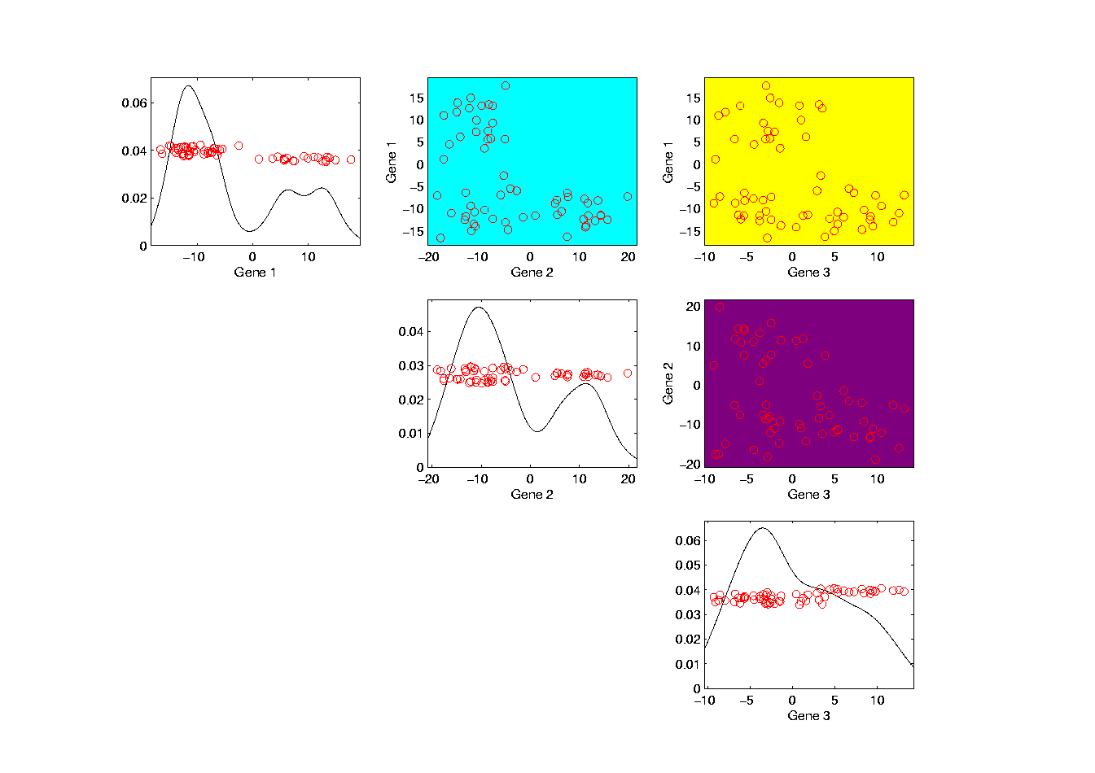
Illust’n of Multivar. View: Add off-diagonals
Notes:
EgView1p38proj1n2Dcolor.ps

Slide 47
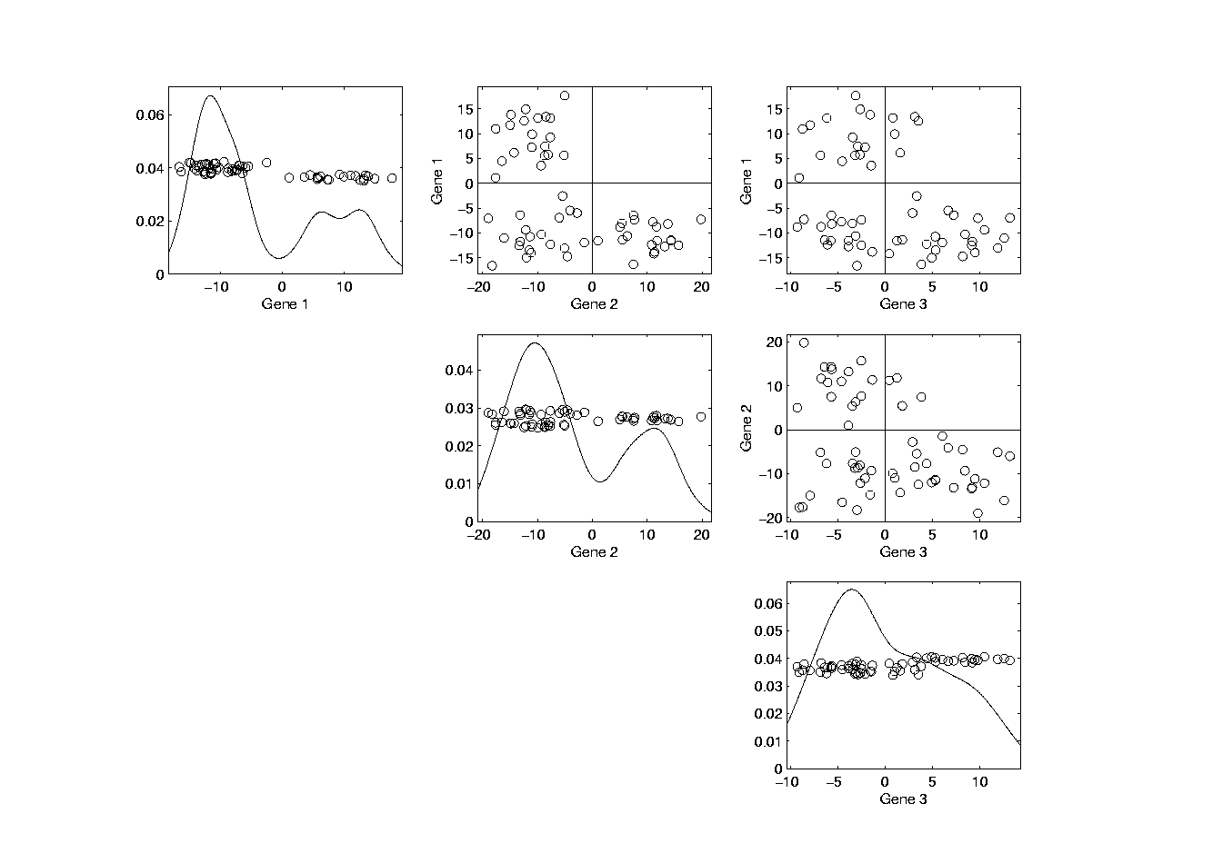
Illust’n of Multivar. View: Typical View
Notes:
EgView1p39ScatPlot.ps

Slide 48
Illust’n of Multivar. View: Typical View
Note Linkage of Axes
Notes:
EgView1p39ScatPlot.ps

Slide 49
Illust’n of Multivar. View: Typical View
Note Linkage of Axes
Notes:
EgView1p39ScatPlot.ps

Slide 50
Illust’n of Multivar. View: Typical View
Note Linkage of Axes
Notes:
EgView1p39ScatPlot.ps

Slide 51
Illust’n of Multivar. View: Typical View
Note Correspondence
of Points
Notes:
EgView1p39ScatPlot.ps

Slide 52
Illust’n of Multivar. View: Typical View
Note Correspondence
of Points
Notes:
EgView1p39ScatPlot.ps

Slide 53
Projection
Important Point
There are many “directions of interest” on which projection is useful
An important set of directions:
Principal Components

Slide 54
Principal Components
Find Directions of:
“Maximal (projected) Variation”
Compute Sequentially
On Orthogonal Subspaces
Will take careful look at mathematics later

Slide 55
Principal Components
For simple,
3-d toy data,
recall raw
data view:
Notes:
55

Slide 56
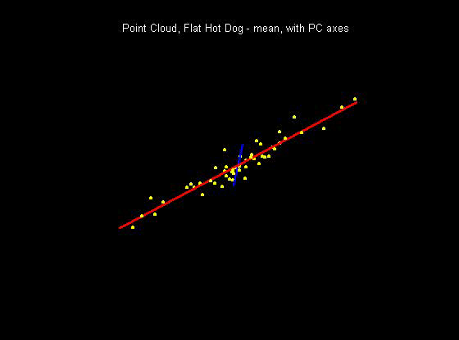
Principal Components
PCA just
gives rotated
coordinate
system:
Notes:
56

Slide 57
Principal Components
Early References:
Pearson (1901)
Hotelling (1933)
Notes:
57

Slide 58
Illust’n of PCA View: Recall Raw Data
Notes:
EgView1p1RawData.ps

Slide 59
Illust’n of PCA View: Recall Gene by Gene Views
Notes:
EgView1p27proj3Dall.ps

Slide 60
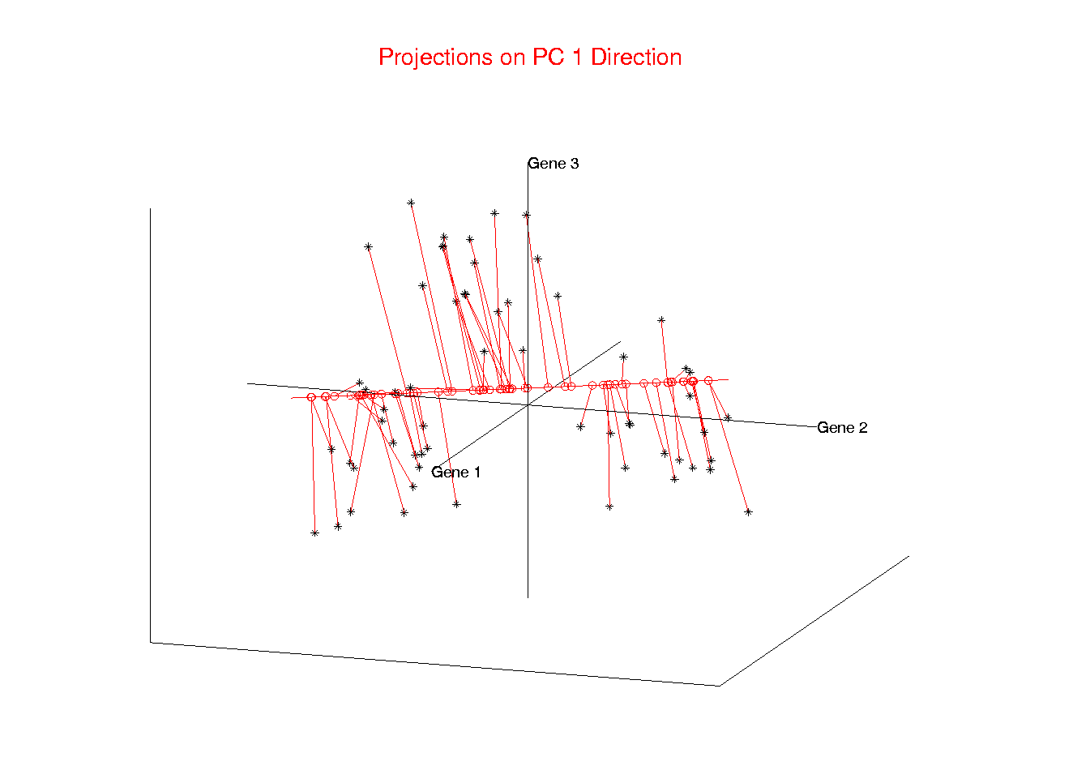
Illust’n of PCA View: PC1 Projections
Notes:
EgView1p51proj3dPC1.ps

Slide 61
Illust’n of PCA View: PC1 Projections
Note Different Axis
Chosen to
Maximize Spread
Notes:
EgView1p51proj3dPC1.ps

Slide 62
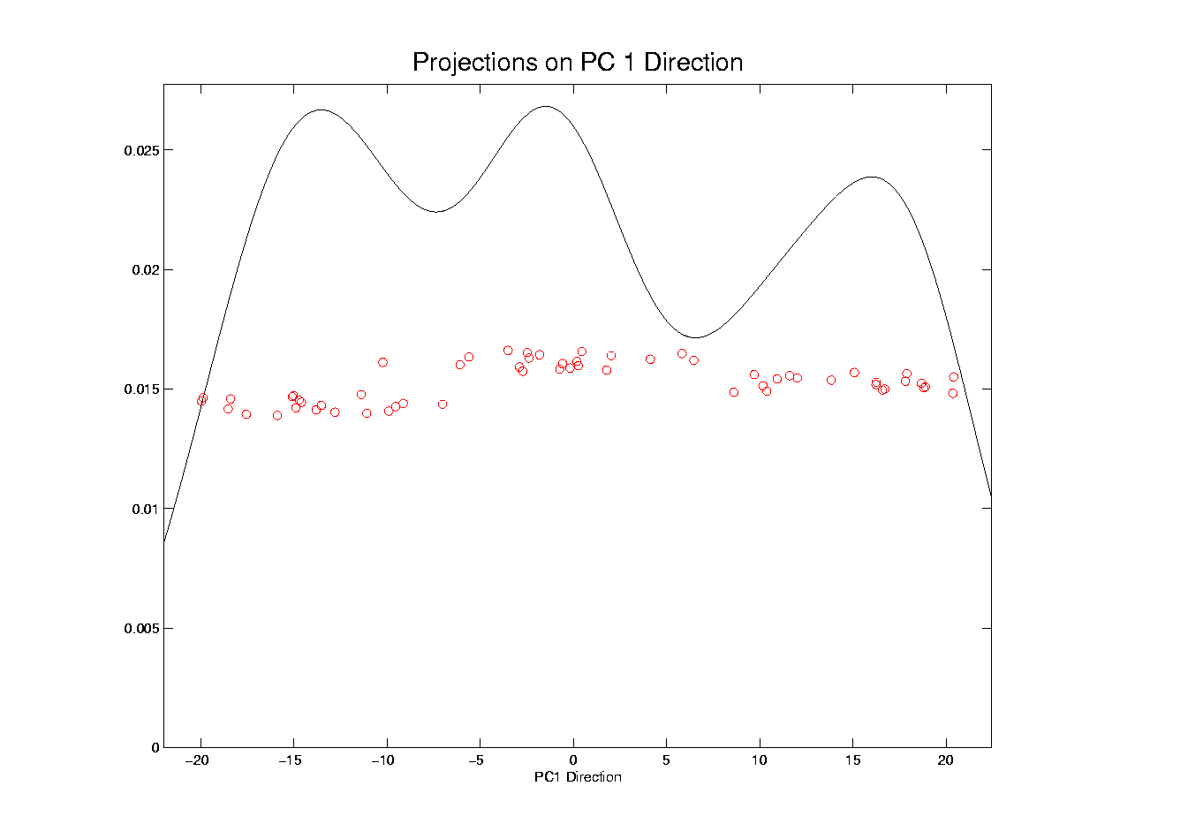
Illust’n of PCA View: PC1 Projections, 1-d View
Notes:
EgView1p61Proj1dPC1.ps

Slide 63
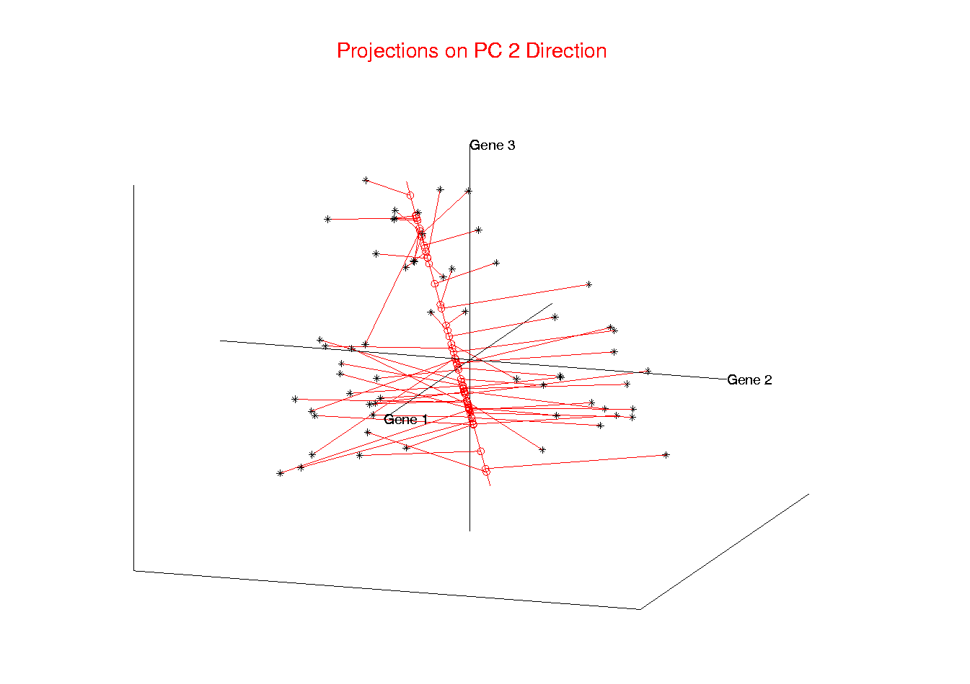
Illust’n of PCA View: PC2 Projections
Notes:
EgView1p52proj3dPC2.ps

Slide 64
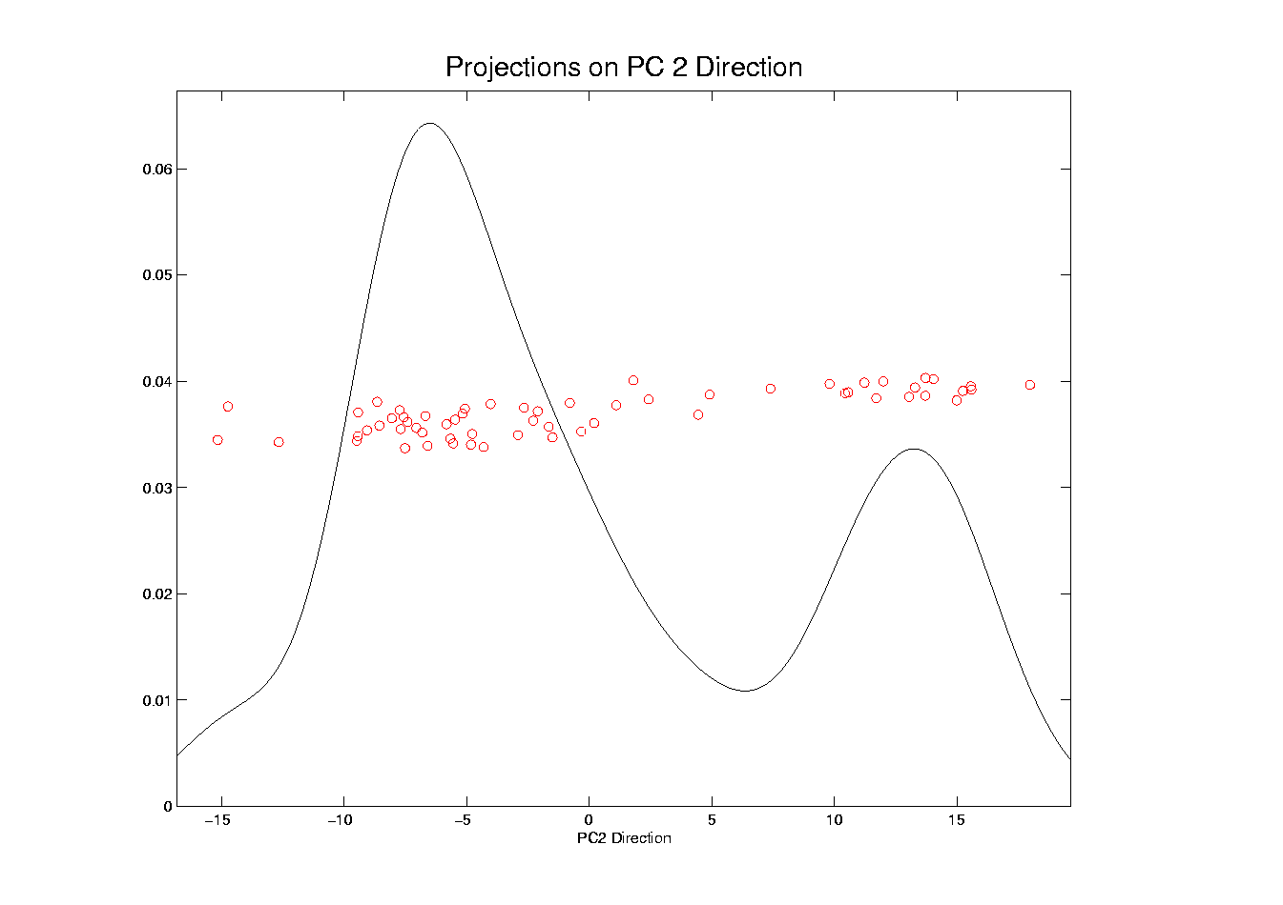
Illust’n of PCA View: PC2 Projections, 1-d View
Notes:
EgView1p62Proj1dPC2.ps

Slide 65
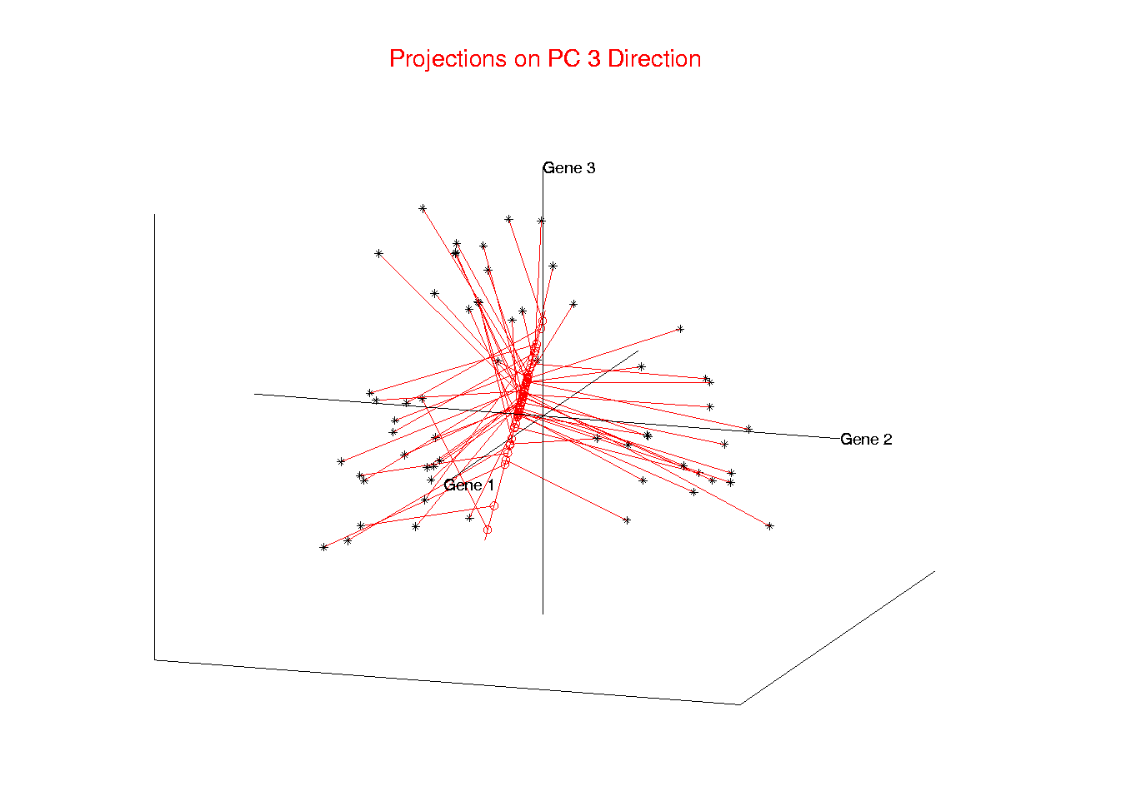
Illust’n of PCA View: PC3 Projections
Notes:
EgView1p53proj3dPC3.ps

Slide 66
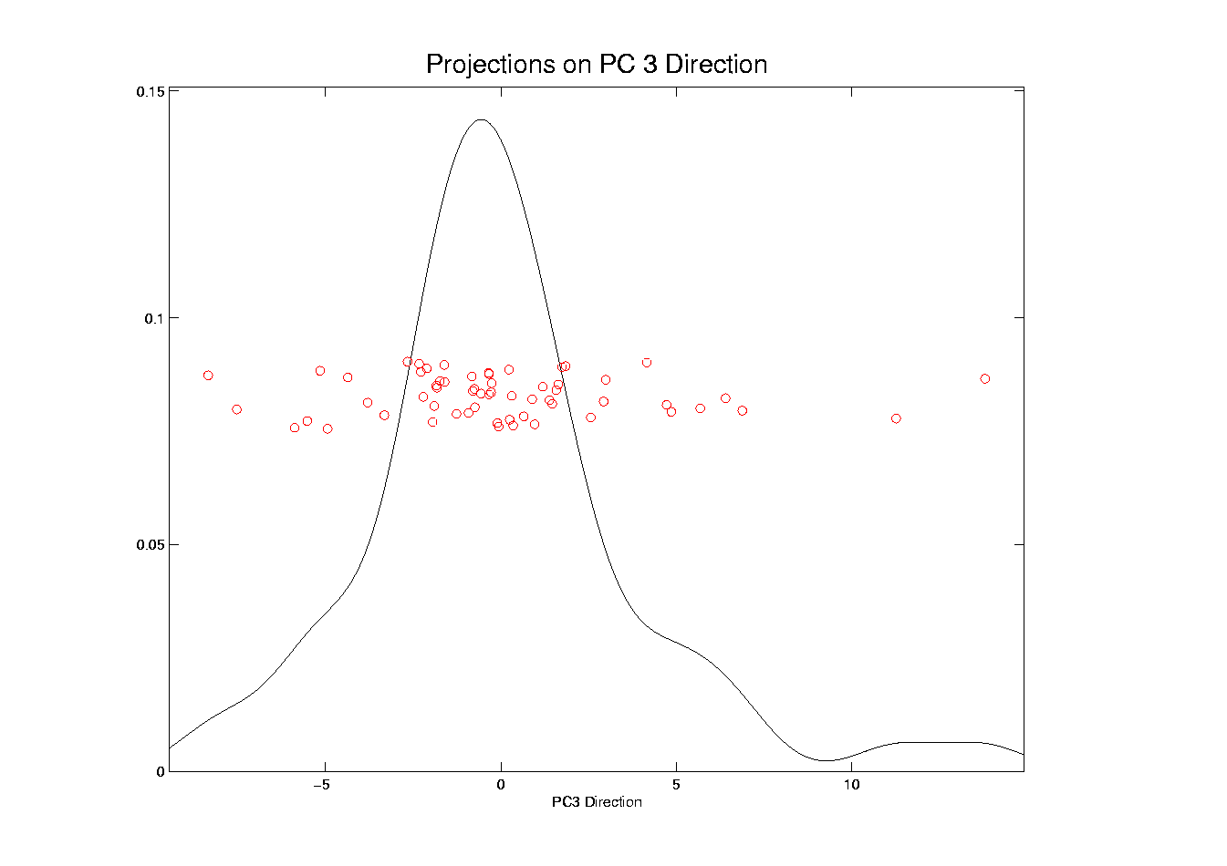
Illust’n of PCA View: PC3 Projections, 1-d View
Notes:
EgView1p63Proj1dPC3.ps

Slide 67
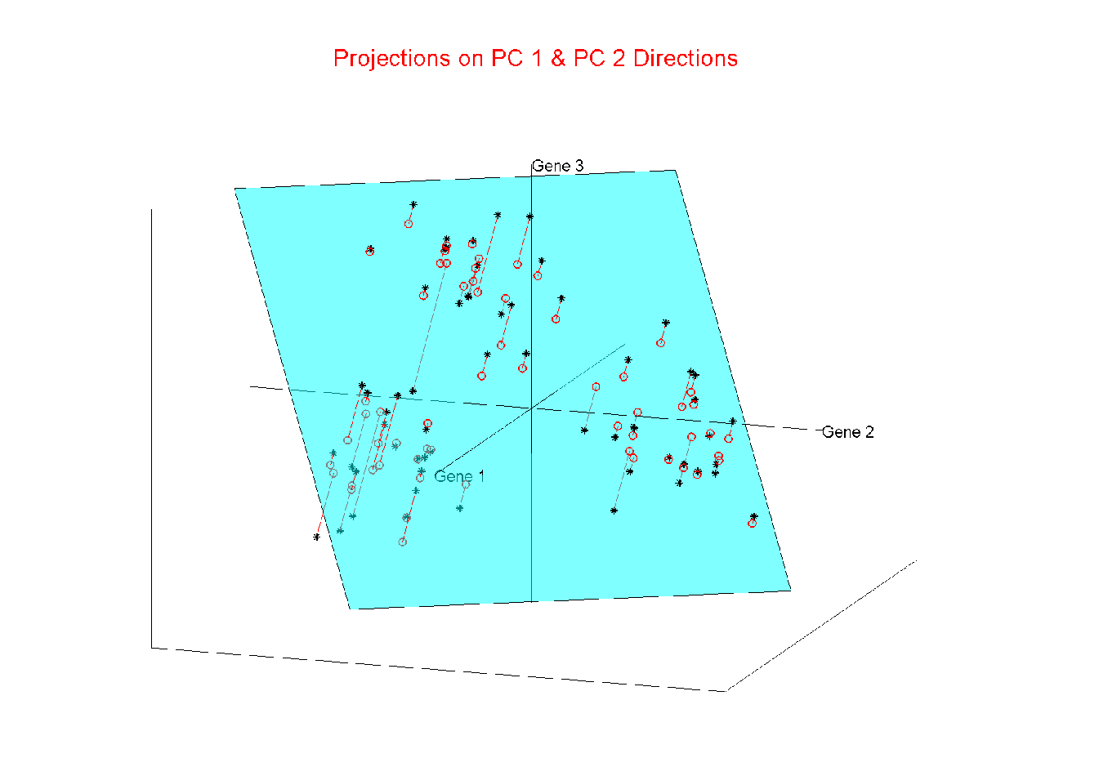
Illust’n of PCA View: Projections on PC1,2 plane
Notes:
EgView1p54proj3dPC12.ps

Slide 68
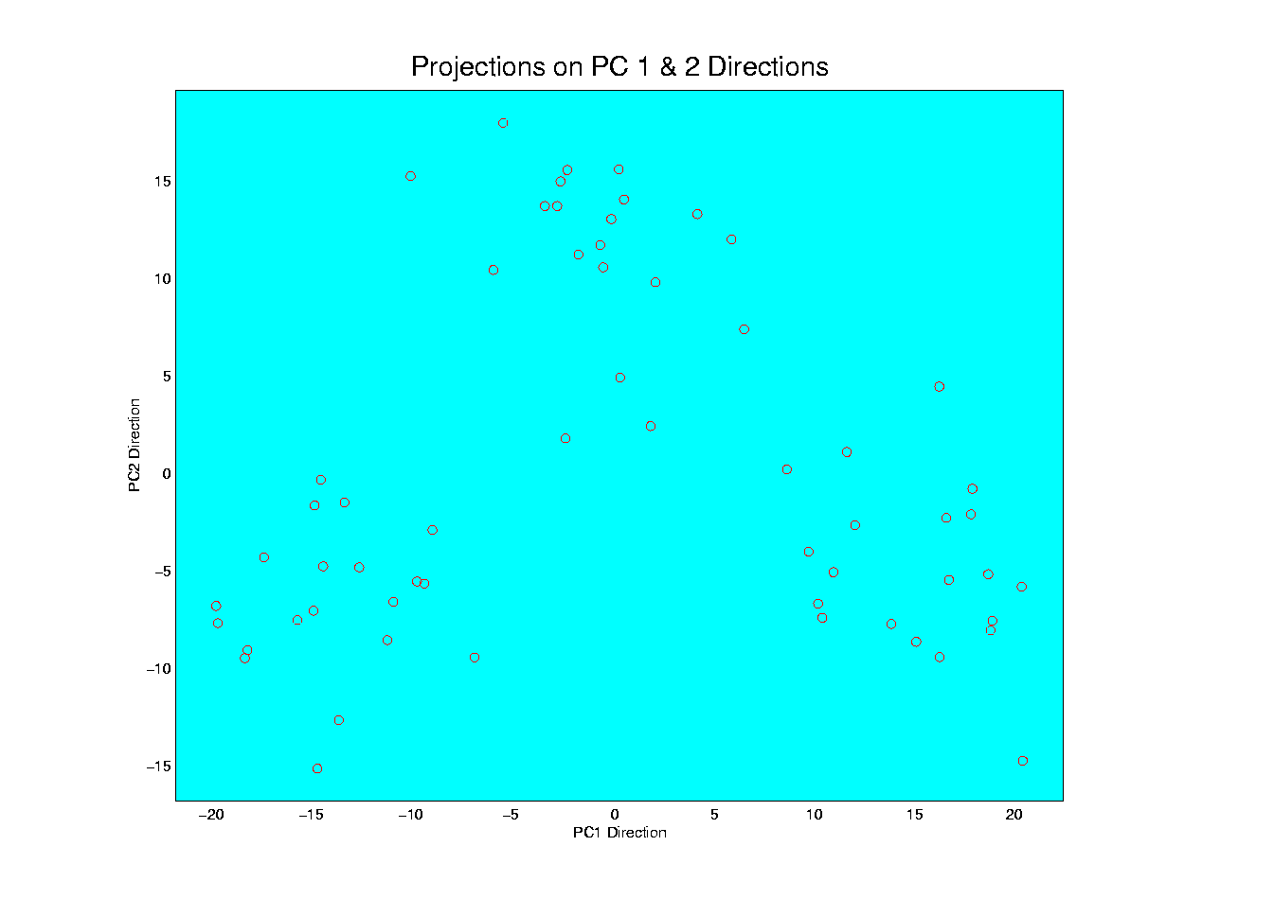
Illust’n of PCA View: PC1 & 2 Proj’n Scatterplot
Notes:
EgView1p64proj2dPC12.ps

Slide 69
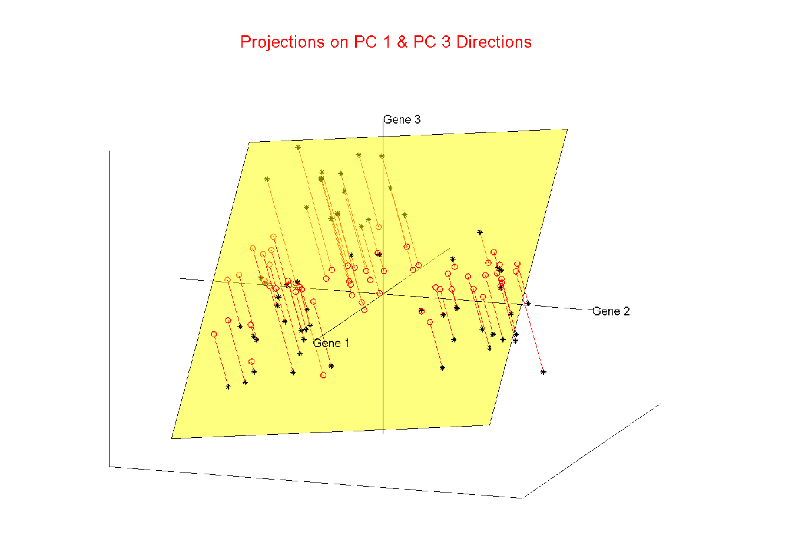
Illust’n of PCA View: Projections on PC1,3 plane
Notes:
EgView1p55proj3dPC13.ps

Slide 70
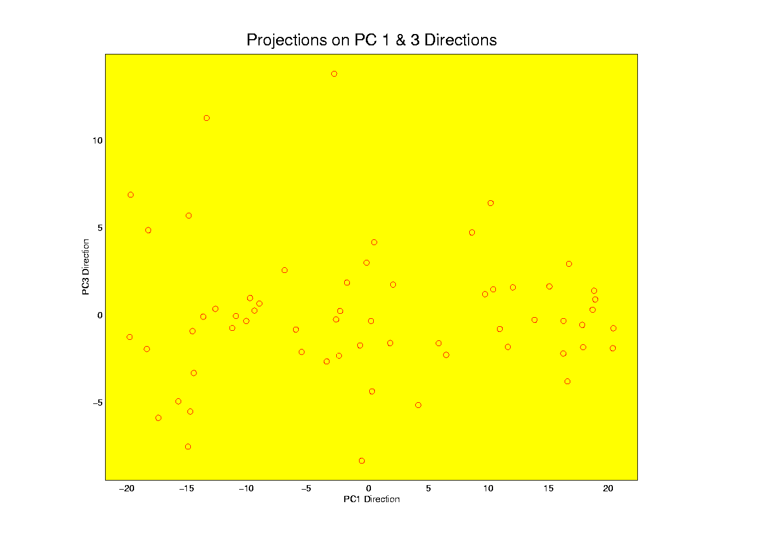
Illust’n of PCA View: PC1 & 3 Proj’n Scatterplot
Notes:
EgView1p65proj2dPC13.ps

Slide 71
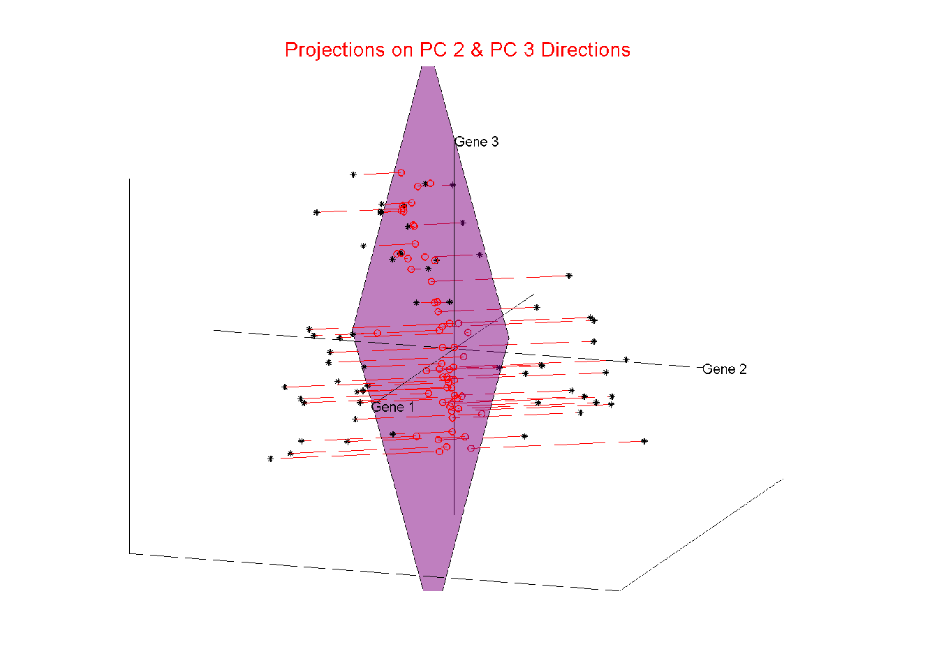
Illust’n of PCA View: Projections on PC2,3 plane
Notes:
EgView1p56proj3dPC23.ps

Slide 72
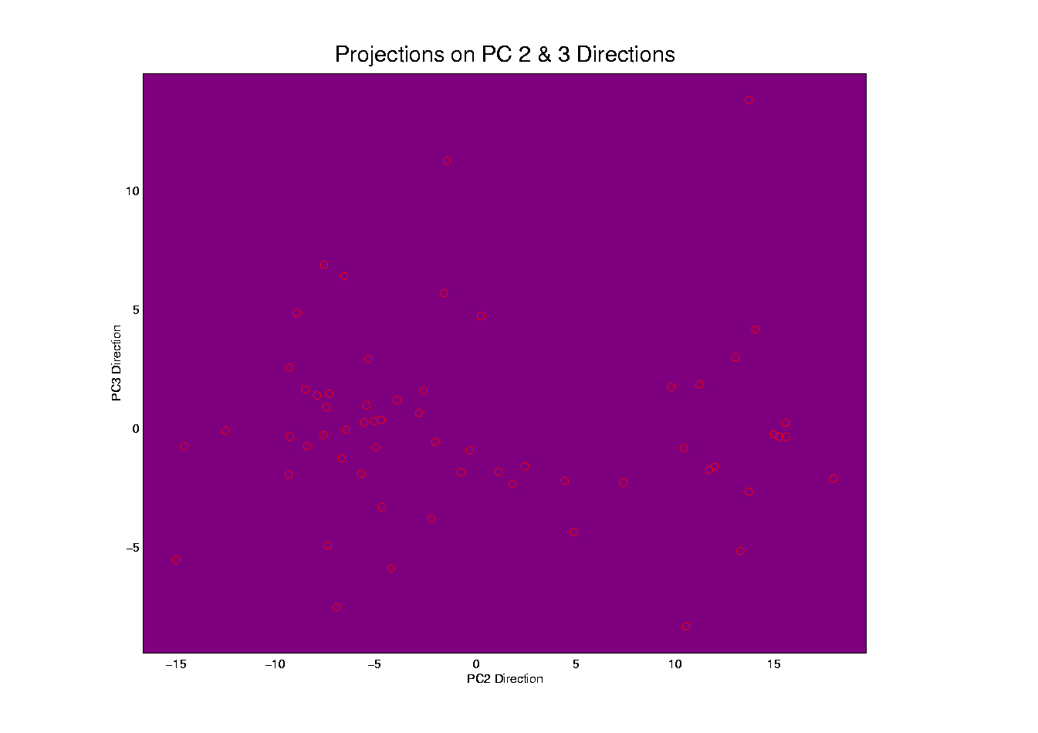
Illust’n of PCA View: PC2 & 3 Proj’n Scatterplot
Notes:
EgView1p66proj2dPC23.ps

Slide 73
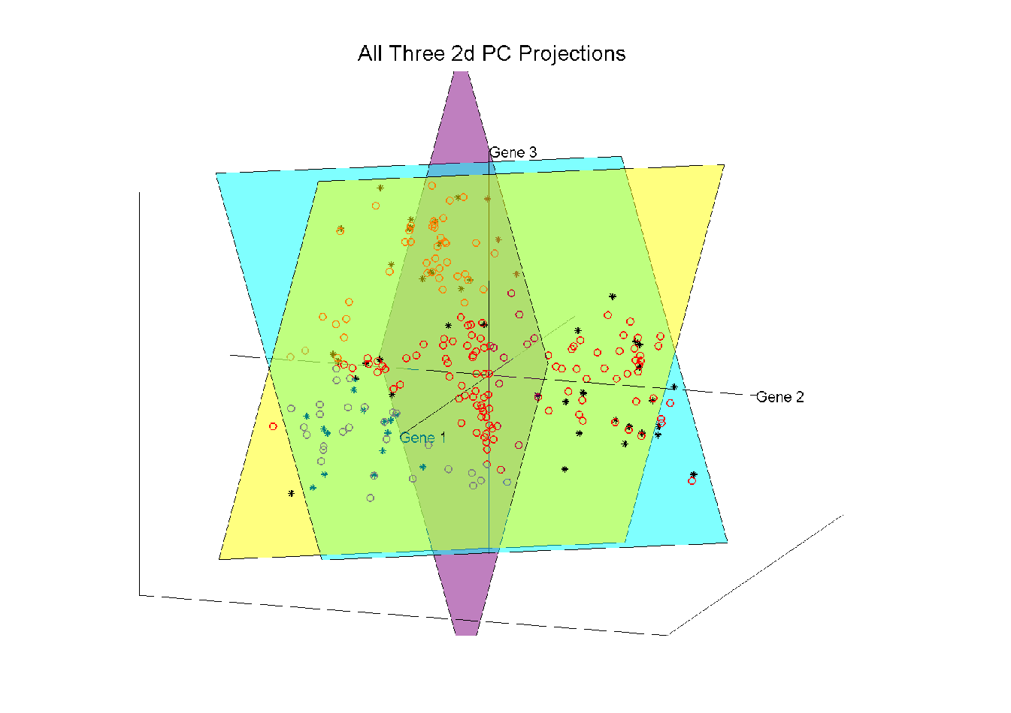
Illust’n of PCA View: All 3 PC Projections
Notes:
EgView1p57proj3dPCall.ps

Slide 74
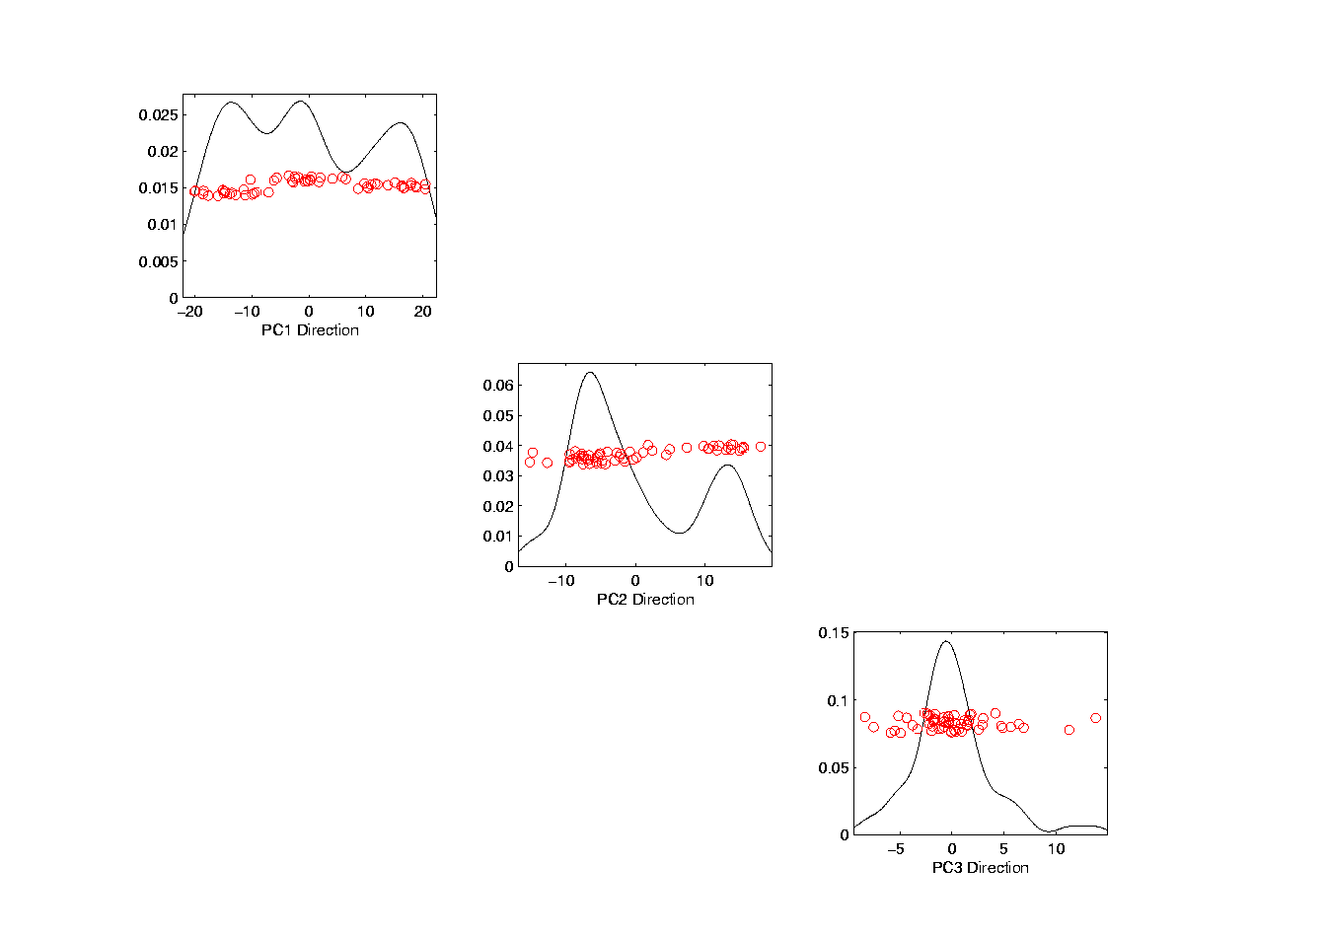
Illust’n of PCA View: Matrix with 1-d proj’ns on diag.
Notes:
EgView1p67proj1dPCAdiag.ps

Slide 75
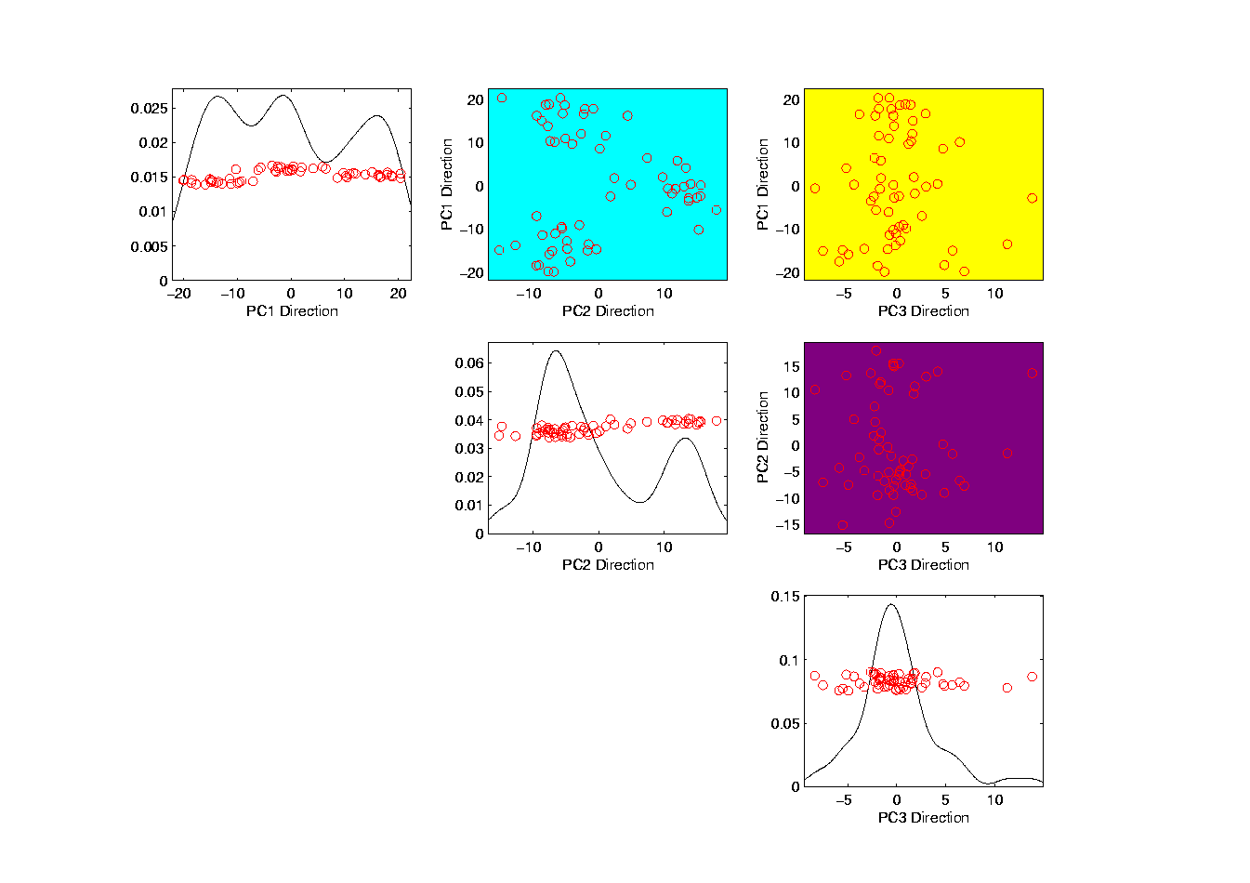
Illust’n of PCA: Add off-diagonals to matrix
Notes:
EgView1p68proj1n2dPCAcolor.ps

Slide 76
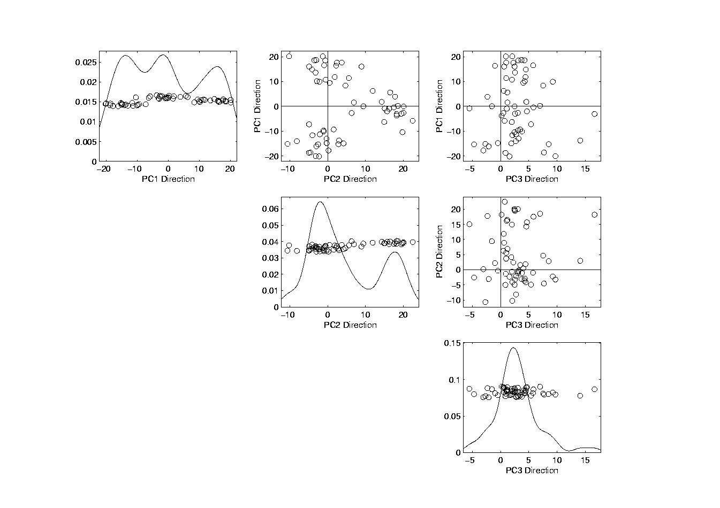
Illust’n of PCA View: Typical View
Notes:
EgView1p69PCAScatPlot.ps

Slide 77
Comparison of Views
Highlight 3 clusters
Gene by Gene View
  Clusters appear in all 3 scatterplots
  But never very separated
PCA View
  1st shows three distinct clusters
  Better separated than in gene view
  Clustering concentrated in 1st scatterplot
Effect is small, since only 3-d

Slide 78
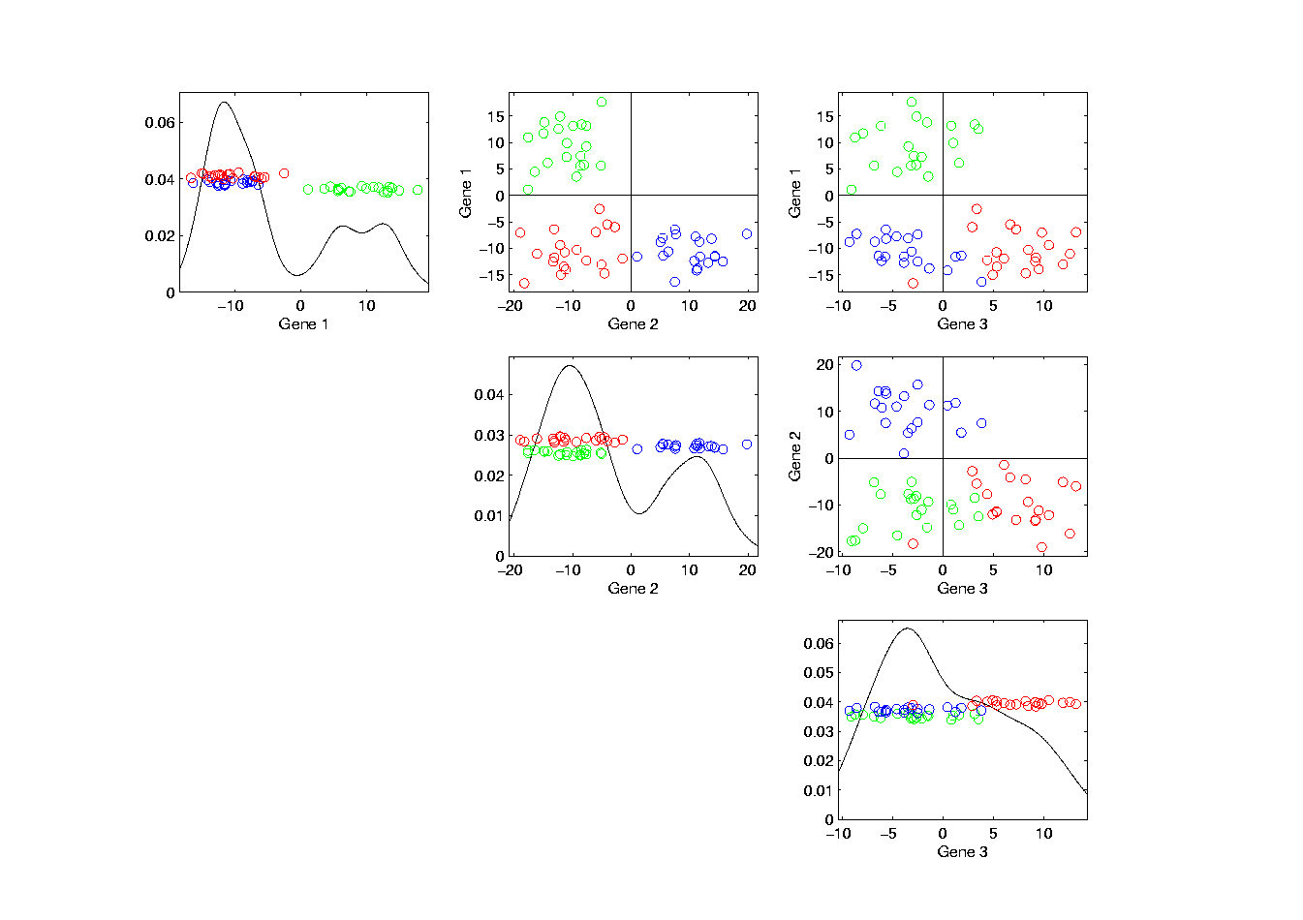
Illust’n of PCA View: Gene by Gene View
Note Colors Enhance
Impressions of Clusters
Notes:
EgView1p71GeneViewClustColor.ps

Slide 79
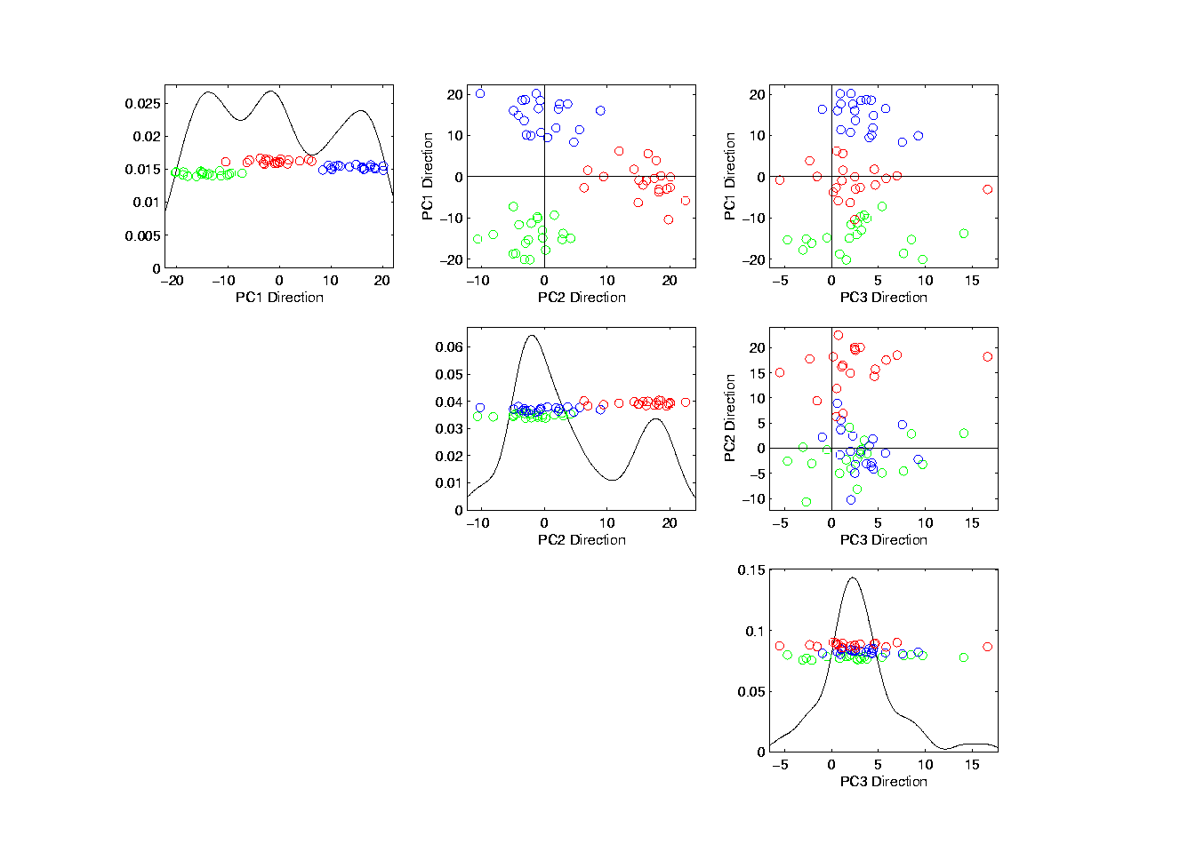
Illust’n of PCA View: PCA View
Notes:
EgView1p72PCAViewClustColor.ps

Slide 80
Illust’n of PCA View: PCA View
Clusters are “more distinct”
Since more “air space”
In between
Notes:
EgView1p72PCAViewClustColor.ps

Slide 81
Another Comparison of Views
Much higher dimension, # genes = 4000
Gene by Gene View
Simulation:
50% N(0.1,1) (marginals)
50% N(-0.1,1) (marginals)

Slide 82
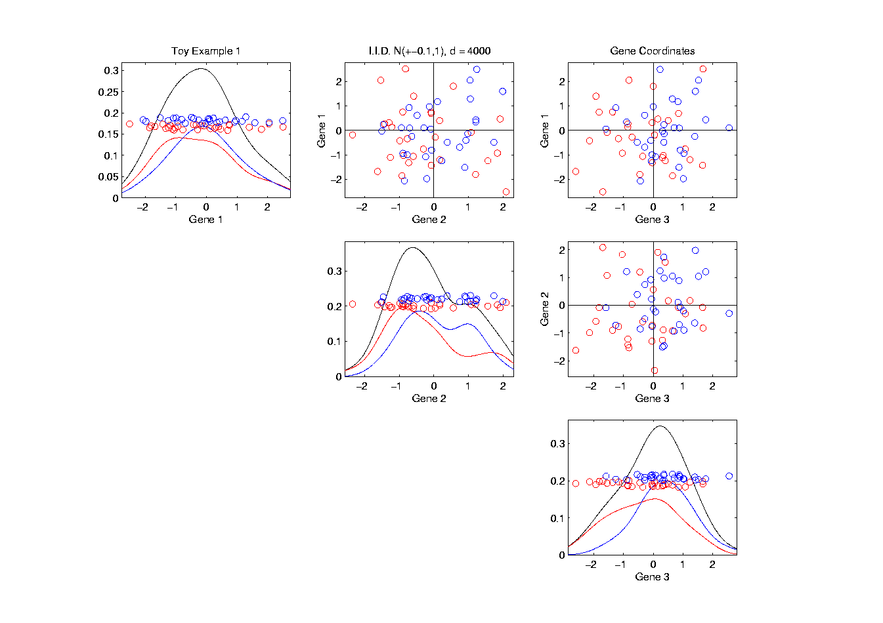
Another Comparison: Gene by Gene View
Notes:
EgView2p1dat1GeneView.ps

Slide 83
Another Comparison: Gene by Gene View
Very Small Differences
Between Means
Notes:
EgView2p1dat1GeneView.ps

Slide 84
Another Comparison of Views
Much higher dimension, # genes = 4000
Gene by Gene View
  Clusters very nearly the same
  Very slight difference in means

Slide 85
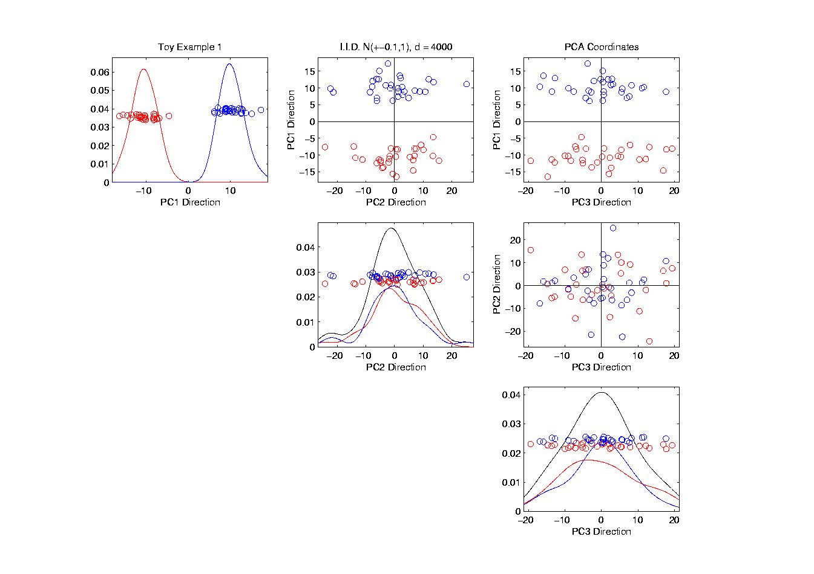
Another Comparison: PCA View
Notes:
EgView2p2dat1PCAView.ps

Slide 86
Another Comparison of Views
Much higher dimension, # genes = 4000
Gene by Gene View
  Clusters very nearly the same
  Very slight difference in means
PCA View
  Huge difference in 1st PC Direction
  Magnification of clustering
  Lesson: Alternate views can show much more
  (especially in high dimensions, i.e. for many genes)
  Shows PC view is very useful

Slide 87
Data Object Conceptualization
Object Space ←→ Descriptor Space
Curves
Images Manifolds
Shapes Tree Space
Trees
Movies

Slide 88
E.g. Curves As Data
Object Space: Set of curves
Descriptor Space(s):
Curves digitized to vectors (look at 1st)
Basis Representations:
  Fourier (sin & cos)
  B-splines
  Wavelets

Slide 89
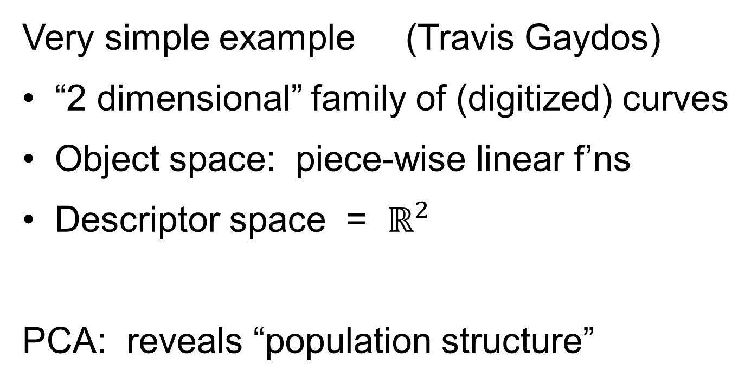
E.g. Curves As Data
Very simple example (Travis Gaydos)
“2 dimensional” family of (digitized) curves
Object space: piece-wise linear f’ns
Descriptor space = $ℝ^{2}$
PCA: reveals “population structure”

Slide 90
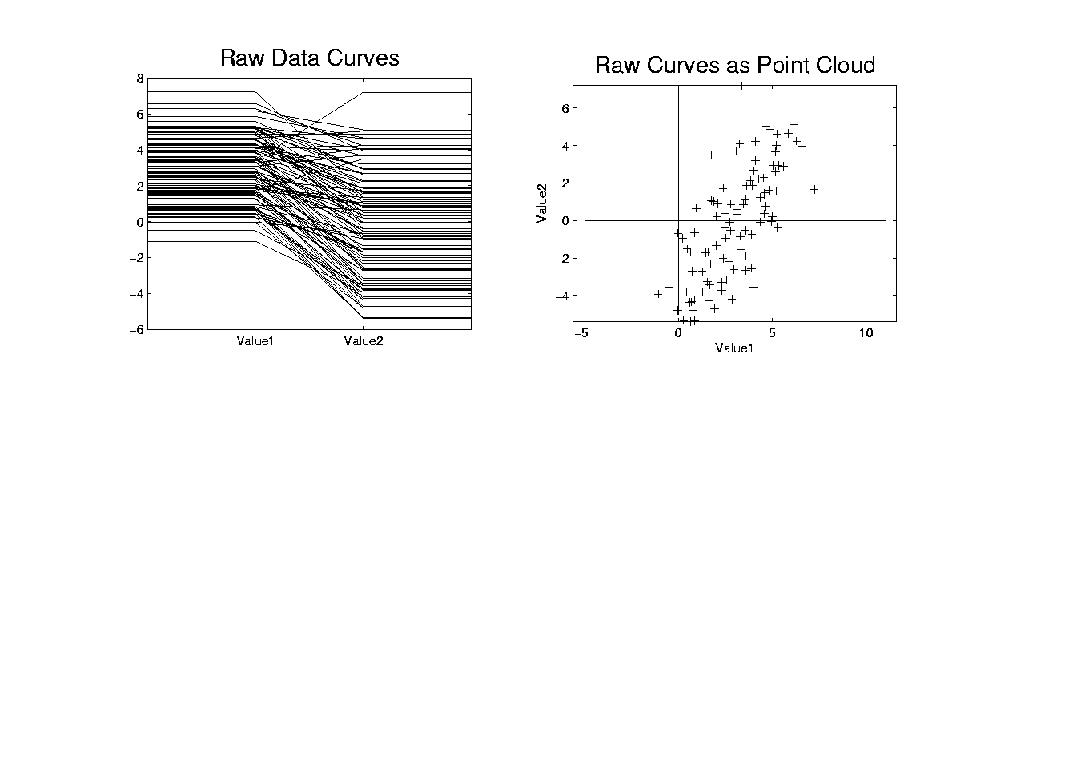
Functional Data Analysis, Toy EG I
Notes:
toyraw.ps

Slide 91
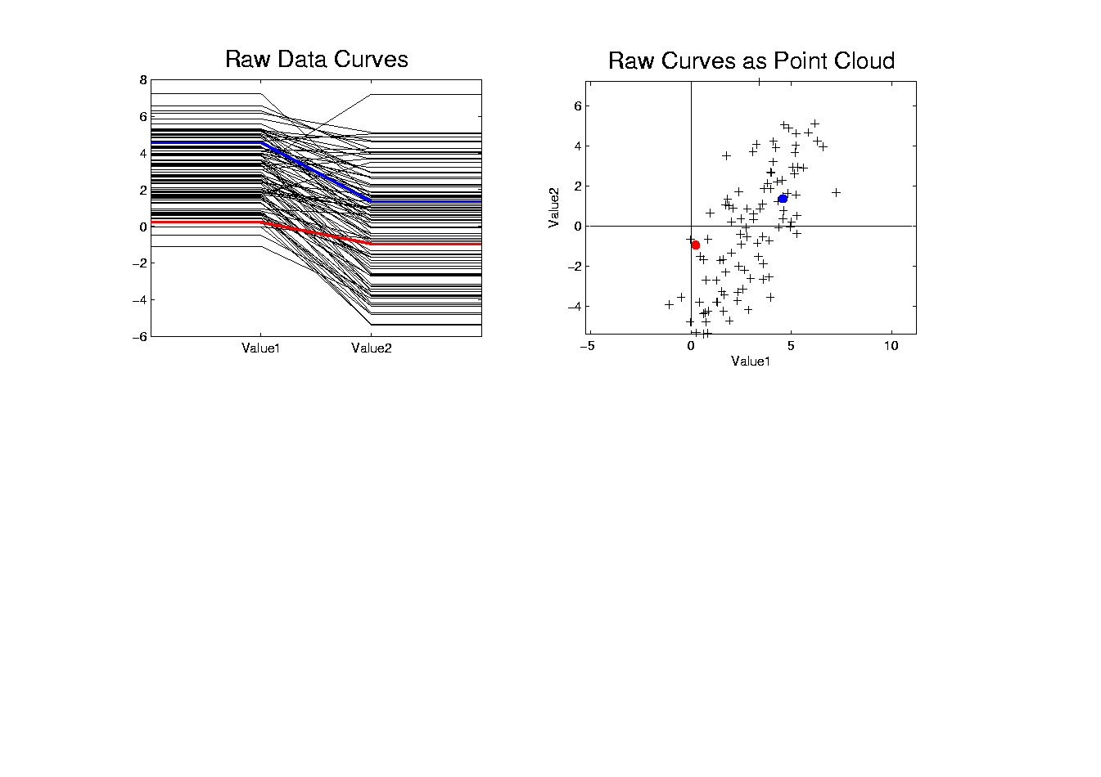
Functional Data Analysis, Toy EG II
Notes:
toyrawcol.ps

Slide 92

Functional Data Analysis, Toy EG III
Notes:
toyrawcolmean.ps

Slide 93

Functional Data Analysis, Toy EG IV
Notes:
centoyrawcolmean.ps

Slide 94

Functional Data Analysis, Toy EG V
Notes:
centoypc1.ps

Slide 95

Functional Data Analysis, Toy EG VI
Notes:
centoypc1proj.ps

Slide 96
Functional Data Analysis, Toy EG VI
Classical Terminology:
Coefficients of Projections are “Scores”
Entries of Direction Vector are “Loadings”
Notes:
centoypc1proj.ps

Slide 97

Functional Data Analysis, Toy EG VII
Notes:
centoypc2.ps

Slide 98

Functional Data Analysis, Toy EG VIII
Notes:
centoypc2proj.ps

Slide 99
Functional Data Analysis, Toy EG VIII
Terminology:
“Loadings Plot” “Scores Plot”
Notes:
centoypc2proj.ps

Slide 100

Functional Data Analysis, Toy EG IX
Notes:
addup.ps

Slide 101

Functional Data Analysis, Toy EG X
Notes:
addupcol.ps

Slide 102

E.g. Curves As Data
Very simple example (Travis Gaydos)
“2 dimensional” family of (digitized) curves
Object space: piece-wise linear f’ns
Descriptor space = $ℝ^{2}$
PCA: reveals “population structure”
Decomposition into modes of variation

Slide 103

E.g. Curves As Data
Deeper example
10-d family of (digitized) curves
Object space: bundles of curves
Descriptor space = $ℝ^{10}$
(harder to visualize as point cloud,
but keep point cloud in mind)
PCA: reveals “population structure”

Slide 104

E.g. Curves As Data
Aside on Visualization:
$\left(\begin{matrix}x_{1} \\ ⋮ \\ x_{d}\end{matrix}\right)$
Called Parallel Coordinate View
by Inselberg (1985, 2005)

Slide 105

Functional Data Analysis, 10-d Toy EG 1
Notes:
EGCD1Parabs.ps

Slide 106
Functional Data Analysis, 10-d Toy EG 1
Terminology:
“Loadings Plots” “Scores Plots”
Notes:
EGCD1Parabs.ps

Slide 107
Functional Data Analysis, 10-d Toy EG 1
Notes:
EGCD1Parabs.ps

Slide 108
E.g. Curves As Data
PCA: reveals “population structure”
Mean → Parabolic Structure
PC1 → Vertical Shift
PC2 → Tilt
higher PCs → Gaussian (spherical)
Decomposition into modes of variation

Slide 109
E.g. Curves As Data
Two Cluster Example
10-d curves again

Slide 110

Functional Data Analysis, 10-d Toy EG 2
Notes:
EGCD1Clust2.ps

