Slide 1
Statistics – O. R. 893 Object Oriented Data Analysis
Steve Marron
Dept. of Statistics and Operations Research
University of North Carolina

Slide 2
Administrative Info
Details on Course Web Page
https://stor893spring2016.web.unc.edu/
Or:
Google: “Marron Courses”
Choose This Course
Go Through These

Slide 3
Course Expectations
Grading Based on:
“Participant Presentations”
5 – 10 minute talks
By Enrolled Students
Hopefully Others

Slide 4
Class Meeting Style
When you don’t understand something
Many others probably join you
So please fire away with questions
Discussion usually enlightening for others
If needed, I’ll tell you to shut up
(essentially never happens)

Slide 5
Object Oriented Data Analysis
What is it?
A Sound-Bite Explanation:
What is the “atom of the statistical analysis”?
1st Course: Numbers
Multivariate Analysis Course : Vectors
Functional Data Analysis: Curves
More generally: Data Objects

Slide 6
Object Oriented Data Analysis
Current Motivation:
In Complicated Data Analyses
Fundamental (Non-Obvious) Question Is:
“What Should We Take as Data Objects?”
Key to Focussing Needed Analyses

Slide 7
Object Oriented Data Analysis
References:
Wang and Marron (2007)
Marron and Alonso (2014)

Slide 8
Object Oriented Data Analysis
What is Actually Done?
Major Statistical Tasks:
Understanding Population Structure
Classification (i. e. Discrimination)
Time Series of Data Objects
“Vertical Integration” of Datatypes

Slide 9
Visualization
How do we look at data?
Start in Euclidean Space,
$$ℝ^{d}=\left\{\left(\begin{matrix}x_{1} \\ ⋮ \\ x_{d}\end{matrix}\right):x_{1},⋯,x_{d}∈ℝ\right\}$$
Will later study other spaces

Slide 10
Visualization
How do we look at Euclidean data?
Higher Dimensions?
Workhorse Idea: Projections

Slide 11
Projection
General Definition (in a metric space):
Given a point $x$ and a set $S$, $S$
The Projection of $x$ onto $S$ is:
the closest point in $S$ to $x$
$x$

Slide 12
Illust’n of PCA View: PC1 Projections
Note Different Axis
Chosen to
Maximize Spread
Notes:
EgView1p51proj3dPC1.ps

Slide 13
Illust’n of PCA View: Projections on PC1,2 plane
Notes:
EgView1p54proj3dPC12.ps

Slide 14
Illust’n of PCA View: All 3 PC Projections
Notes:
EgView1p57proj3dPCall.ps

Slide 15
Illust’n of PCA: Add off-diagonals to matrix
Notes:
EgView1p68proj1n2dPCAcolor.ps

Slide 16
Illust’n of PCA View: PCA View
Clusters are “more distinct”
Since more “air space”
In between
Notes:
EgView1p72PCAViewClustColor.ps

Slide 17
Another Comparison: Gene by Gene View
Very Small Differences
Between Means
Notes:
EgView2p1dat1GeneView.ps

Slide 18
Another Comparison: PCA View
Notes:
EgView2p2dat1PCAView.ps

Slide 19
Data Object Conceptualization
Object Space ←→ Descriptor Space
Curves
Images Manifolds
Shapes Tree Space
Trees
Movies

Slide 20
Functional Data Analysis, Toy EG II
Notes:
toyrawcol.ps

Slide 21
Functional Data Analysis, Toy EG X
Notes:
addupcol.ps

Slide 22
E.g. Curves As Data
Aside on Visualization:
$\left(\begin{matrix}x_{1} \\ ⋮ \\ x_{d}\end{matrix}\right)$
Called Parallel Coordinate View
by Inselberg (1985, 2005)

Slide 23
Functional Data Analysis, 10-d Toy EG 1
Terminology:
“Loadings Plots” “Scores Plots”
Notes:
EGCD1Parabs.ps

Slide 24
E.g. Curves As Data
Two Cluster Example
10-d curves again

Slide 25
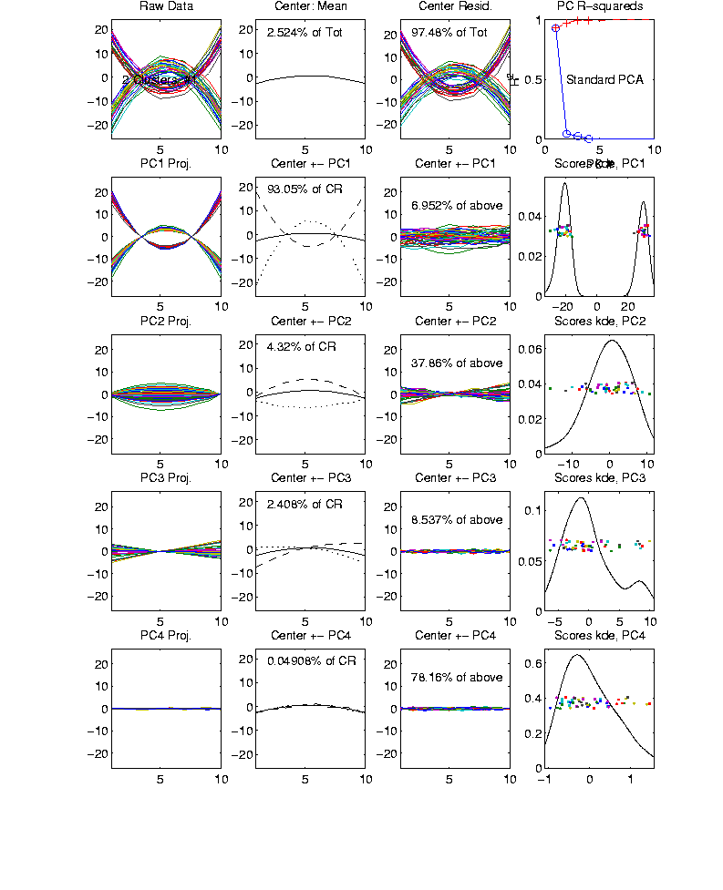
Functional Data Analysis, 10-d Toy EG 2
Notes:
EGCD1Clust2.ps

Slide 26
E.g. Curves As Data
Two Cluster Example
10-d curves again
Two big clusters
Revealed by 1-d projection plot (right side)
Note: Cluster Difference is not orthogonal
to Vertical Shift
PCA: reveals “population structure”

Slide 27
E.g. Curves As Data
More Complicated Example
50-d curves

Slide 28
Functional Data Analysis, 50-d Toy EG 3
Notes:
EGCD1Clust4a.ps

Slide 29
Functional Data Analysis, 50-d Toy EG 3
Notes:
EGCD1Clust4aDP2d.ps

Slide 30
E.g. Curves As Data
More Complicated Example
50-d curves
Pop’n structure hard to see in 1-d
2-d projections make structure clear
Joint Dist’ns More than Marginals
PCA: reveals “population structure”

Slide 31
Functional Data Analysis
Interesting Data Set:
Mortality Data
For Spanish Males (thus can relate to history)
Each curve is a single year
x coordinate is age
Mortality = # died / total # (for each age)
Study on log scale
Investigate change over years 1908 – 2002
From Andrés Alonso, U. Carlos III, Madrid
{See Marron & Alonso (2014)}

Slide 32
Functional Data Analysis
Interesting Data Set:
Mortality Data
For Spanish Males (thus can relate to history)
Each curve is a single year
x coordinate is age
Note: Choice made of Data Object
(could also study age as curves,
x coordinate = time)

Slide 33
Functional Data Analysis
Important Issue:
What are the Data Objects?
Mortality vs. Age Curves (over years)
Mortality vs. Year Curves (over ages)
Note: Rows vs. Columns of Data Matrix

Slide 34
Functional Data Analysis
Interesting Data Set:
Mortality Data
For Spanish Males (thus can relate to history)
Each curve is a single year
x coordinate is age
Mortality = # died / total # (for each age)
Study on log scale
Another Data Object Choice
(not about experimental units)

Slide 35
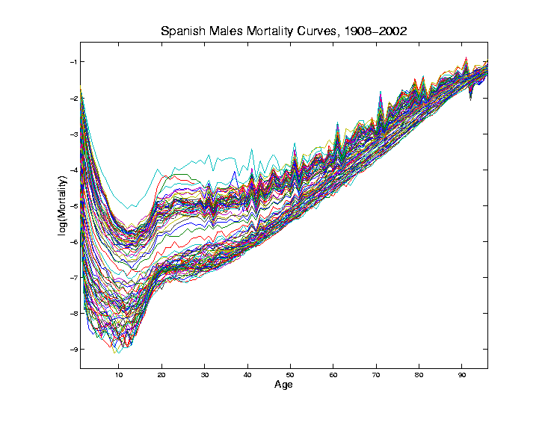
Mortality Time Series
Conventional
Coloring:
Rotate
Through
(7) Colors
Hard to
See Time
Structure

Slide 36
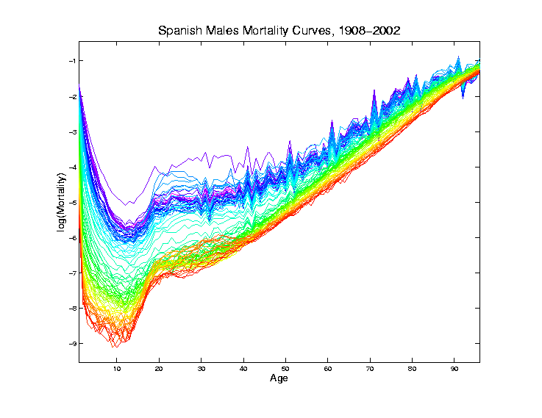
Mortality Time Series
Improved
Coloring:
Rainbow
Representing
Year:
Magenta
= 1908
Red = 2002

Slide 37
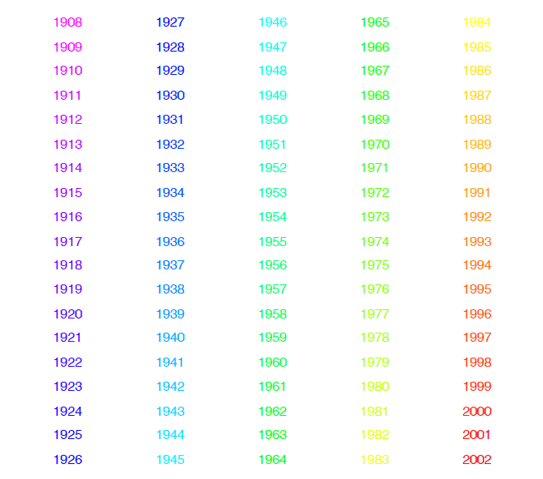
Mortality Time Series
Color Code
(Years)
Notes:
37

Slide 38
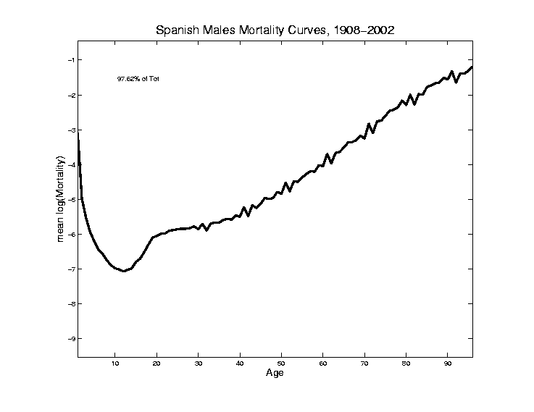
Mortality Time Series
Find
Population Center
(Mean Vector)
Compute in
Descriptor
Space
Show in
Object Space

Slide 39
Mortality Time Series
Blips Appear
At Decades
Since Ages
Not Precise
(in Spain)
Reported as
“about 50”,
Etc.

Slide 40
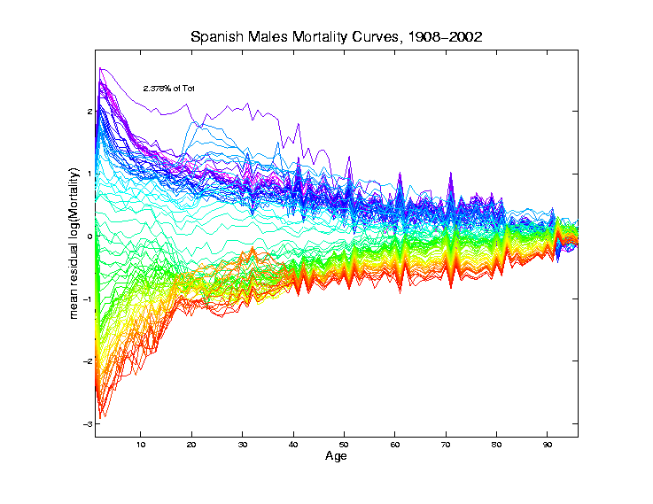
Mortality Time Series
Mean
Residual
Descriptor Space
View of
Shifting Data
To Origin
In Feature Space

Slide 41
Mortality Time Series
Shows:
Main Age
Effects in
Mean, Not
Variation
About Mean

Slide 42
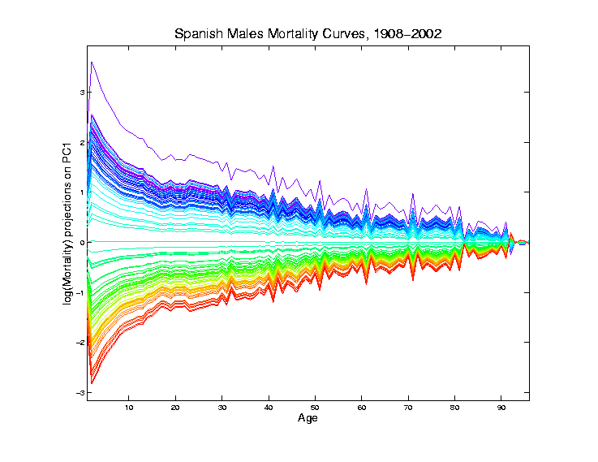
Mortality Time Series
Object Space View of Projections
Onto PC1
Direction
Main Mode
Of Variation:
Constant
Across Ages
Loadings Plot

Slide 43
Mortality Time Series
Shows Major
Improvement
Over Time
(medical technology,
etc.)
And Change
In Age
Rounding Blips

Slide 44
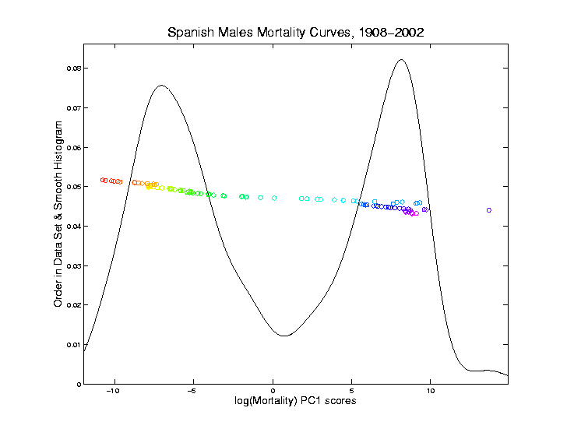
Mortality Time Series
Corresponding
PC 1 Scores
Again Shows
Overall
Improvement
High Mortality
Early

Slide 45
Mortality Time Series
Corresponding
PC 1 Scores
Again Shows
Overall
Improvement
High Mortality
Early
Lower Later
Transformation Fairly Rapid

Slide 46
Mortality Time Series
Outliers
1918 Global
Flu Pandemic
1936-1939
Spanish
Civil War

Slide 47
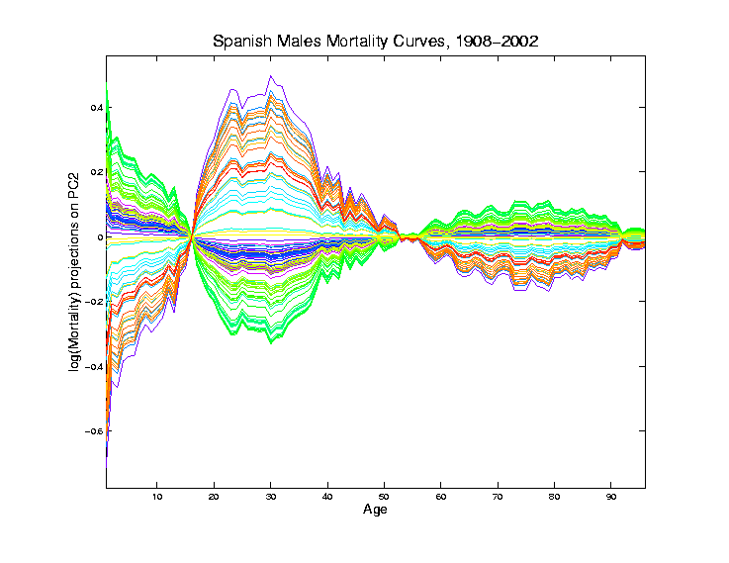
Mortality Time Series
Object Space View of Projections
Onto PC2
Direction
Loadings Plot

Slide 48
Mortality Time Series
Object Space View of Projections
Onto PC2
Direction
2nd Mode
Of Variation:
Difference
Between
20-45 & Rest

Slide 49
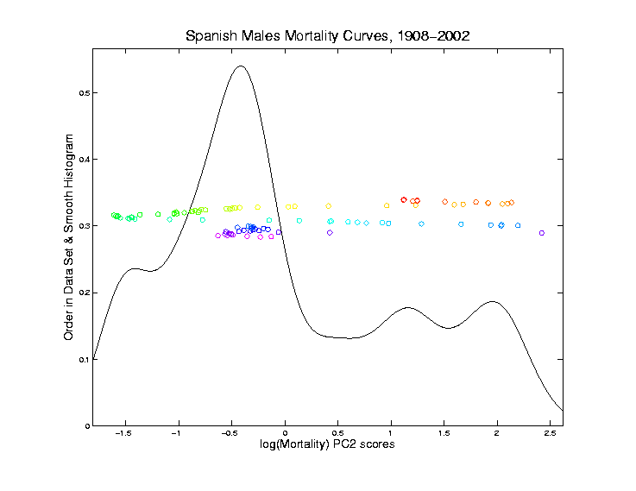
Mortality Time Series
Explain Using
PC 2 Scores
Early
Improvement

Slide 50
Mortality Time Series
Explain Using
PC 2 Scores
Early
Improvement
Pandemic
Hit Hardest

Slide 51
Mortality Time Series
Explain Using
PC 2 Scores
Then better

Slide 52
Mortality Time Series
Explain Using
PC 2 Scores
Then better
Spanish Civil War Hit
Hardest

Slide 53
Mortality Time Series
Explain Using
PC 2 Scores
Steady
Improvement
To mid-50s

Slide 54
Mortality Time Series
Explain Using
PC 2 Scores
Steady
Improvement
To mid-50s
Increasing
Automotive
Death Rate

Slide 55
Mortality Time Series
Explain Using
PC 2 Scores
Corner Finally
Turned by
Safer Cars
& Roads

Slide 56
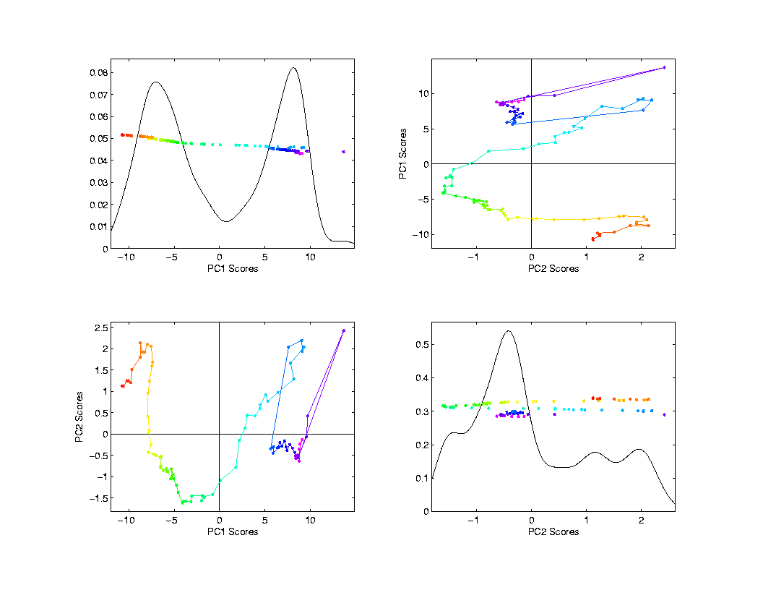
Mortality Time Series
Scores Plot
Descriptor
(Point Cloud)
Space View
Connecting
Lines
Highlight
Time Order
Good View of
Historical
Effects

Slide 57
Mortality Time Series
Try a Related Mortality Data Set:
Switzerland
(In Europe, but different history)

Slide 58
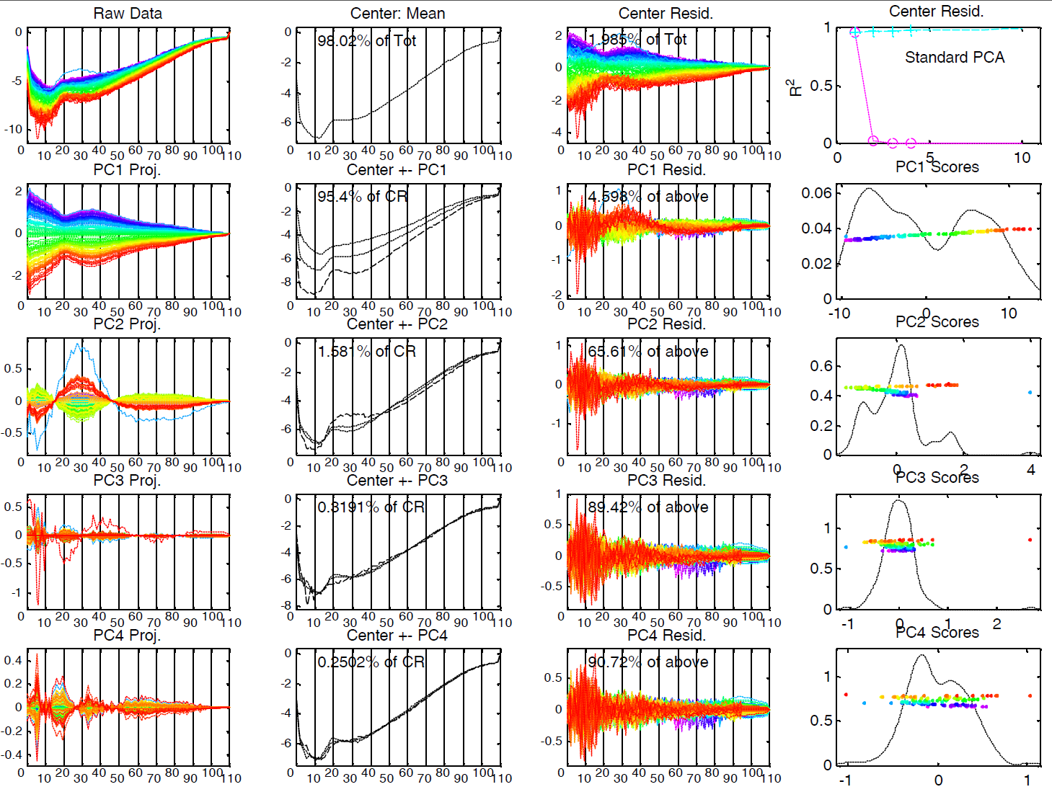
Mortality Time Series – Swiss Males

Slide 59
Mortality Time Series – Swiss Males
Some Points Similar to Spain:
PC1: Overall Improvement
Better for Young
PC2: About 20 – 45 vs. Others
Flu Pandemic
Automobile Effects
Some Quite Different:
No Age Rounding
No Civil War

Slide 60
Time Series of Data Objects
Mortality Data Illustrates an Important Point:
OODA is more than a “framework”
It Provides a Focal Point
Highlights Pivotal Choice:
What should be the Data Objects?

Slide 61
Time Series of Curves
Just a “Set of Curves”
But Time Order is Important!
Useful Approach (as above):
Use color to code for time
Start End

Slide 62
Time Series Toy E.g.
Explore Question:
“Is Horizontal Motion Linear Variation?”
Example: Set of time (mean) shifted
Gaussian densities
View: Code time with colors as above

Slide 63
T. S. Toy E.g., Raw Data

Slide 64
T. S. Toy E.g., PCA View
PCA gives “Modes of Variation”
But there are Many…
Intuitively Useful???
Like “harmonics”?
Isn’t there only 1 mode of variation?
Answer comes in scores scatterplots

Slide 65
T. S. Toy E.g., PCA Scatterplot

Slide 66
T. S. Toy E.g., PCA Scatterplot
Where is the Point Cloud?
Lies along a 1-d curve in
So actually have 1-d mode of variation
But a non-linear mode of variation
Poorly captured by PCA (linear method)
Will study more later

Slide 67
Interesting Question
Can we find a 1-d Representation?
Perhaps by:
Different Analysis?
Other Choice of Data Objects?

Slide 68
Chemo-metric Time Series
Mass Spectrometry Measurements
On an Aging Substance, called “Estane”
Made over Logarithmic Time Grid, n = 60
Each Data Object is a Spectrum
What about Time Evolution?
Approach: PCA & Time Coloring

Slide 69
Chemo-metric Time Series
Joint Work w/ E. Kober & J. Wendelberger
Los Alamos National Lab
Four Experimental Conditions:
Control
Aged 59 days in Dry Air
Aged 27 days in Humid Air
Aged 59 days in Humid Air

Slide 70
Chemo-metric Time Series, HA 27

Slide 71
Chemo-metric Time Series, HA 27
Raw Data:
All 60 spectra essentially the same
“Scale” of mean is much bigger than variation about mean
Hard to see structure of all 1600 freq’s
Centered Data:
Now can see different spectra
Since mean subtracted off
Note much smaller vertical axis
Generally: Scaling Impacts Visualization

Slide 72
Chemo-metric Time Series, HA 27
Next Zoom in on “Region of Interest”

Slide 73
Chemo-metric Time Series, HA 27

Slide 74
Chemo-metric Time Series, HA 27
Data zoomed to “important” freq’s:
Raw Data:
Now see slight differences
Smoother “natural looking” spectra
Centered Data:
Differences in spectra more clear
Maybe now have “real structure”
Scale is important to visualization

Slide 75
Chemo-metric Time Series, HA 27

Slide 76
Chemo-metric Time Series, HA 27
Use of Time Order Coloring:
Raw Data:
Can see a little ordering, not much
Centered Data:
Clear time ordering
Shifting peaks? (compare to Raw)
PC1:
Almost everything?
PC1 Residuals:
Data nearly linear (same scale import’nt)

Slide 77
Chemo-metric Time Series, Control

Slide 78
Chemo-metric Time Series, Control
PCA View
Clear systematic structure
Time ordering very important
Reminiscent of Toy Example
(Shifting Gaussian Peak)
Roughly 1-d curve in Feature Space
See this a lot
Physical Explanation?

Slide 79
Toy Data Explanations
Simple Chemical Reaction Model:
Subst. 1 transforms into Subst. 2
Note: linear path in Feature Space

Slide 80
Toy Data Explanations
Richer Chemical Reaction Model:
Subst. 1 → Subst. 2 → Subst. 3
Curved path in Feat. Sp.
2 Reactions → Curve lies in 2-dim’al subsp.

Slide 81
Toy Data Explanations
Another Chemical Reaction Model:
Subst. 1 → Subst. 2 & Subst. 5 → Subst. 6
Curved path in Feat. Sp.
2 Reactions → Curve lies in 2-dim’al subsp.

Slide 82
Toy Data Explanations
More Complex Chemical Reaction Model:
1 → 2 → 3 → 4
Curved path in Feat. Sp. (lives in 3-d)
3 Reactions → Curve lies in 3-dim’al subsp.

Slide 83
Toy Data Explanations
Even More Complex Chemical Reaction Model:
1 → 2 → 3 → 4 → 5
Curved path in Feat. Sp. (lives in 4-d)
4 Reactions → Curve lies in 4-dim’al subsp.

Slide 84
Chemo-metric Time Series, Control

Slide 85
Chemo-metric Time Series, Control
Suggestions from Toy Examples:
Clearly 3 reactions under way
Maybe a 4th???
Hard to distinguish from noise?
Interesting statistical open problem!

Slide 86
Chemo-metric Time Series
What about the other experiments? Recall:
Control
Aged 59 days in Dry Air
Aged 27 days in Humid Air
Aged 59 days in Humid Air
Above results were “cherry picked”,
to best makes points
What about other cases???

Slide 87
Scatterplot Matrix, Control
Above E.g., maybe ~4d curve → ~4 reactions

Slide 88
Scatterplot Matrix, Da59
PC2 is “bleeding of CO2”, discussed below

Slide 89
Scatterplot Matrix, Ha27
Only “3-d + noise”? → Only 3 reactions

Slide 90
Scatterplot Matrix, Ha27
Harder to judge???

Slide 91
Object Space View, Control
Terrible discretization effect, despite ~4d …

Slide 92
Object Space View, Da59
OK, except strange at beginning (CO2 …)

Slide 93
Object Space View, Ha27
Strong structure in PC1 Resid (d < 2)

Slide 94
Object Space View, Ha59
Lots at beginning, OK since “oldest”

Slide 95
Problem with Da59
What about strange behavior for DA59?
Recall:
PC2 showed “really different behavior at start”
Chemists comments:
Ignore this, should have started measuring later…

Slide 96
Problem with Da59
But still fun to look at broader spectra

Slide 97
Chemo-metric T. S. Joint View
Throw them all together as big population
Take Point Cloud View

Slide 98
Chemo-metric T. S. Joint View

Slide 99
Chemo-metric T. S. Joint View
Throw them all together as big population
Take Point Cloud View
Note 4d space of interest, driven by:
4 clusters (3d)
PC1 of chemical reaction (1-d)
But these don’t appear as the 4 PCs
Chem. PC1 “spread over PC2,3,4”
Essentially a “rotation of interesting dir’ns”
How to “unrotate”???

Slide 100
Chemo-metric T. S. Joint View
Interesting Variation:
Remove cluster means
Allows clear comparison of within curve variation

Slide 101
Chemo-metric T. S. Joint View (- mean)

Slide 102
Chemo-metric T. S. Joint View
Interesting Variation:
Remove cluster means
Allows clear comparison of within curve variation:
PC1 versus others are quite revealing
(note different “rotations”)
Others don’t show so much

