Slide 1
Statistics – O. R. 893 Object Oriented Data Analysis
Steve Marron
Dept. of Statistics and Operations Research
University of North Carolina

Slide 2
Administrative Info
Details on Course Web Page
https://stor893spring2016.web.unc.edu/
Or:
Google: “Marron Courses”
Choose This Course
Go Through These

Slide 3
Object Oriented Data Analysis
What is it?
A Sound-Bite Explanation:
What is the “atom of the statistical analysis”?
1st Course: Numbers
Multivariate Analysis Course : Vectors
Functional Data Analysis: Curves
More generally: Data Objects

Slide 4
Object Oriented Data Analysis
Three Major Parts of OODA Applications:
I. Object Definition
“What are the Data Objects?”
Exploratory Analysis
“What Is Data Structure / Drivers?”
III. Confirmatory Analysis / Validation
Is it Really There (vs. Noise Artifact)?

Slide 5
Object Oriented Data Analysis
I. Object Definition
“What are the Data Objects?”
Generally Not Widely Appreciated

Slide 6
Object Oriented Data Analysis
Exploratory Analysis
“What Is Data Structure / Drivers?”
Understood by Some in Statistics
Classical Reference: Tukey (1977)
Better Understood in Machine Learning

Slide 7
Object Oriented Data Analysis
III. Confirmatory Analysis / Validation
Is it Really There (vs. Noise Artifact)?
Primary Focus of Modern “Statistics”
E.g. STOR & Biostat PhD Curriculum
Less So In Machine Learning

Slide 8
Functional Data Analysis
I. Object Definition
Interesting Data Set:
Mortality Data
For Spanish Males (thus can relate to history)
Each curve is a single year
x coordinate is age
Note: Choice made of Data Object
(could also study age as curves,
x coordinate = time)

Slide 9
Functional Data Analysis
I. Object Definition
Interesting Data Set:
Mortality Data
For Spanish Males (thus can relate to history)
Each curve is a single year
x coordinate is age
Mortality = # died / total # (for each age)
Study on log scale
Another Data Object Choice
(not about experimental units)

Slide 10
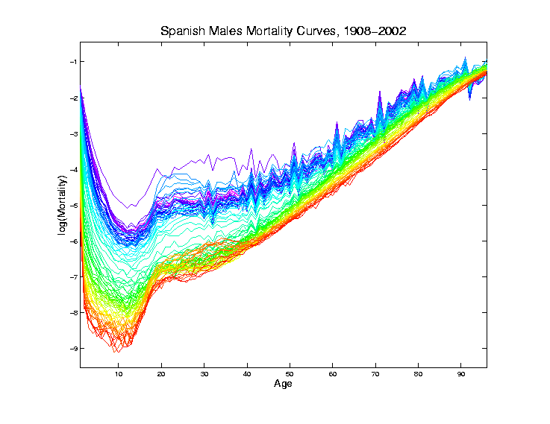
Mortality Time Series
Improved
Coloring:
Rainbow
Representing
Year:
Magenta
= 1908
Red = 2002
II. Exploratory
Analysis

Slide 11
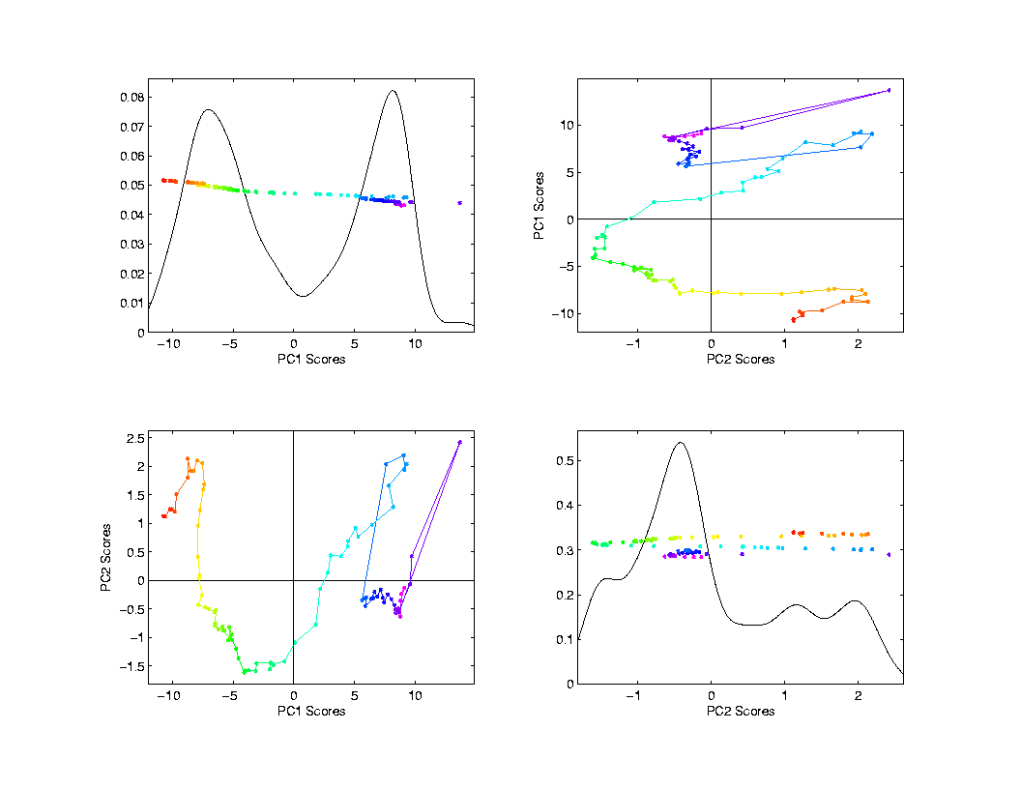
Mortality Time Series
Scores Plot
Descriptor
(Point Cloud)
Space View
Connecting
Lines
Highlight
Time Order
Good View of
Historical
Effects

Slide 12
T. S. Toy E.g., PCA View
PCA gives “Modes of Variation”
But there are Many…
Intuitively Useful???
Like “harmonics”?
Isn’t there only 1 mode of variation?
Answer comes in scores scatterplots

Slide 13
T. S. Toy E.g., PCA Scatterplot

Slide 14
Chemo-metric Time Series, Control
II. Exploratory
Analysis

Slide 15
Functional Data Analysis
Interesting Real Data Example
Genetics (Cancer Research)
RNAseq (Next Gener’n Sequen’g)
Deep look at “gene components”
Microarrays: Single number (per gene)
RNAseq: Thousands of measurements
I. Object Definition

Slide 16
Functional Data Analysis
Interesting Real Data Example
Genetics (Cancer Research)
RNAseq (Next Gener’n Sequen’g)
Deep look at “gene components”
Gene studied here: CDNK2A
Goal: Study Alternate Splicing
Sample Size, n = 180
Dimension, d = ~1700

Slide 17
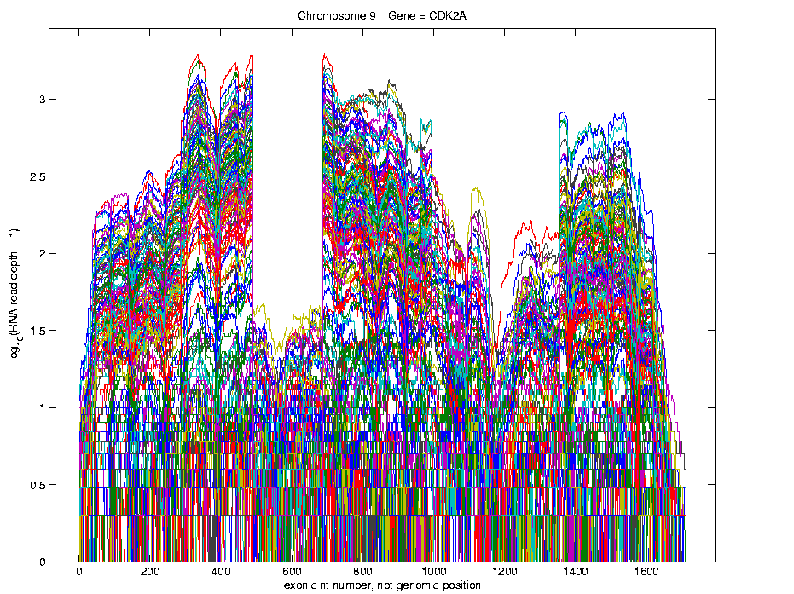
Functional Data Analysis
Simple
1st
View:
Curve
Overlay
(log
scale)
I. Object Definition

Slide 18
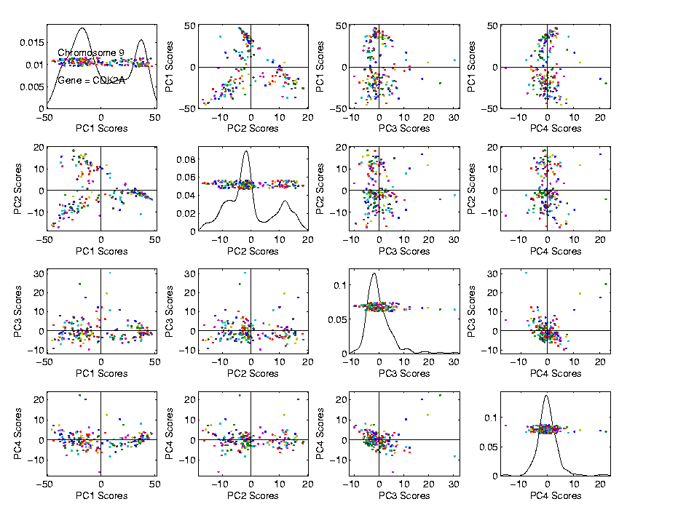
Functional Data Analysis
Often
Useful
Population
View:
PCA
Scores

Slide 19
Functional Data Analysis
Suggestion
Of
Clusters
???

Slide 20
Functional Data Analysis
Suggestion
Of
Clusters
Which
Are
These?

Slide 21
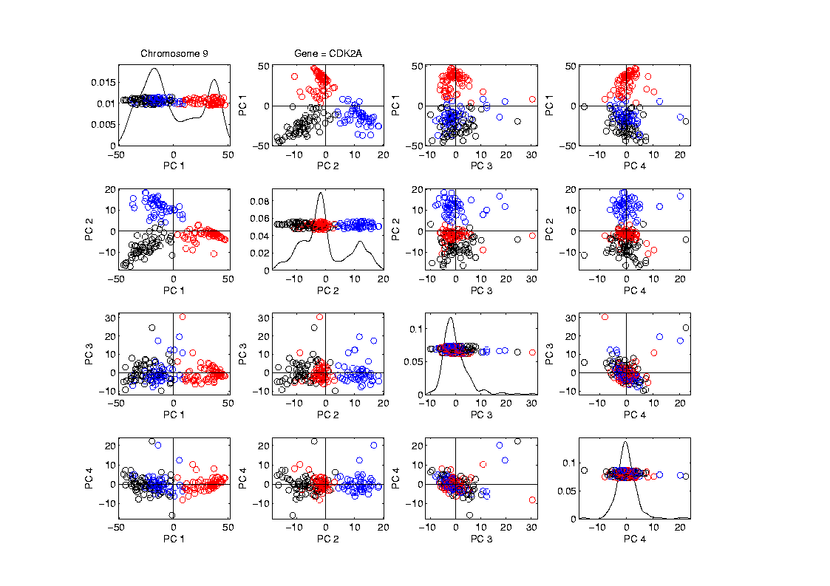
Functional Data Analysis
Manually
“Brush”
Clusters
II. Exploratory
Analysis

Slide 22
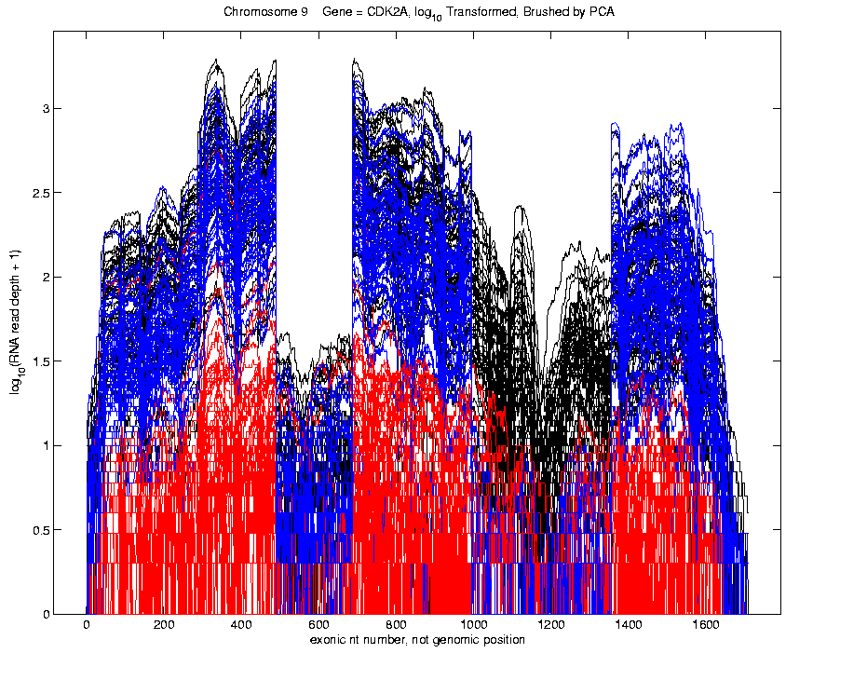
Functional Data Analysis
Manually
Brush
Clusters
Clear
Alternate
Splicing
II. Exploratory
Analysis

Slide 23
Functional Data Analysis
Important Points
PCA found Important Structure
In High Dimensional Data Analysis
d ~ 1700

Slide 24
Functional Data Analysis
Consequences:
Led to Development of SigFuge
Whole Genome Scan Found Interesting Genes
Published in Kimes, et al (2014)

Slide 25
Functional Data Analysis
Interesting Question:
When are clusters really there?
(will study later)
III. Confirmatory Analysis

Slide 26
Course Background I
Linear Algebra
Please Check Familiarity
No? Read Up in Linear Algebra Text
Or Wikipedia?

Slide 27
Course Background I
Linear Algebra Key Concepts
Vector
Scalar
Vector Space (Subspace)
Basis
Dimension
Unit Vector Basis in $ℝ^{d}$
Linear Combo as Matrix Multiplication

Slide 28
Course Background I
Linear Algebra Key Concepts
Matrix Trace
Vector Norm = Length
Distance in $ℝ^{d}$ = Euclidean Metric
Inner (Dot, Scalar) Product
Vector Angles
Orthogonality (Perpendicularity)
Orthonormal Basis

Slide 29
Course Background I
Linear Algebra Key Concepts
Spectral Representation
Pythagorean Theorem
ANOVA Decomposition (Sums of Squares)
Parseval Identity / Inequality
Projection (Vector onto a Subspace)
Projection Operator / Matrix
(Real) Unitary Matrices

Slide 30
Course Background I
Linear Algebra Key Concepts
Late will look at more carefully:
Singular Value Decomposition
Eigenanalysis
Generalized Inverse

Slide 31
Course Background II
MultiVariate Probability
Again Please Check Familiarity
No? Read Up in Probability Text
Or Wikipedia?

Slide 32
Course Background II
MultiVariate Probability
Probability Distributions
Theoretical (Underlying Population) Mean
Theoretical Covariance Matrix
Random Sampling
Sample Mean
Sample Covariance Matrix

Slide 33
Course Background II
MultiVariate Probability
Data Matrix (Course Convention)
$$X=\left(\begin{matrix}X_{11} & ⋯ & X_{1n} \\ ⋮ & ⋱ & ⋮ \\ X_{d1} & ⋯ & X_{dn}\end{matrix}\right)$$
Rows as Data Objects (e.g. Matlab)
Not Columns (e.g. SAS, R)

Slide 34
Review of Multivar. Prob. (Cont.)
Estimate the “Theoretical Cov.” $Σ$,
with the “Sample Cov.”:
Normalizations:
$\frac{1}{n−1}$ Gives Unbiasedness
$\frac{1}{n}$ Gives MLE in Gaussian Case

Slide 35
Review of Multivar. Prob. (Cont.)
Outer Product Representation:

Slide 36
Review of Multivar. Prob. (Cont.)
Outer Product Representation:
,
Where:

Slide 37
Review of Multivar. Prob. (Cont.)
Aside on Terminology,
Inner Product:
${\underline{x}}^{t}\underline{y}$

Slide 38
Review of Multivar. Prob. (Cont.)
Aside on Terminology,
Inner Product:
${\underline{x}}^{t}\underline{y}$
=
(scalar)

Slide 39
Review of Multivar. Prob. (Cont.)
Aside on Terminology,
Inner Product: Outer Product:
${\underline{x}}^{t}\underline{y}$ $\underline{x}{\underline{y}}^{t}$
=
(scalar)

Slide 40
Review of Multivar. Prob. (Cont.)
Aside on Terminology,
Inner Product: Outer Product:
${\underline{x}}^{t}\underline{y}$ $\underline{x}{\underline{y}}^{t}$
= =
(scalar) (matrix)

Slide 41
Limitation of PCA
PCA can provide useful projection directions

Slide 42
Limitation of PCA
PCA can provide useful projection directions
But can’t “see everything”…

Slide 43
Limitation of PCA
PCA can provide useful projection directions
But can’t “see everything”…
Reason:
PCA finds dir’ns of maximal variation
Which may obscure interesting structure

Slide 44
Limitation of PCA
Toy Example:
Apple – Banana – Pear

Slide 45
Limitation of PCA, Toy E.g.

Slide 46
Limitation of PCA
Toy Example:
Apple – Banana – Pear
Obscured by “noisy dimensions”
1st 3 PC directions only show noise

Slide 47
Limitation of PCA
Toy Example:
Apple – Banana – Pear
Obscured by “noisy dimensions”
1st 3 PC directions only show noise
Study some rotations, to find structure

Slide 48
Limitation of PCA, Toy E.g.

Slide 49
Limitation of PCA
Toy Example:
Rotation shows Apple – Banana – Pear
Example constructed as:
1st make these in 3-d
Add 3 dimensions of high s.d. noise
Carefully watch axis labels

Slide 50
Limitation of PCA
Main Point:
May be Important Data Structure
Not Visible in 1st Few PCs

Slide 51
Limitation of PCA, E.g.
Interesting Data Set: NCI-60
NCI = National Cancer Institute
60 Cell Lines (cancer treatment targets)
For Different Cancer Types
Measured “Gene Expression”
= “Gene Activity”
Several Thousand Genes (Simultaneously)
Data Objects = Vectors of Gene Exp’n
Lots of Preprocessing (study later)

Slide 52
NCI 60 Data
Important Aspect: 8 Cancer Types
Renal Cancer
Non Small Cell Lung Cancer
Central Nervous System Cancer
Ovarian Cancer
Leukemia Cancer
Colon Cancer
Breast Cancer
Melanoma (Skin)
Notes:
52

Slide 53
PCA Visualization of NCI 60 Data
Can we find classes:
(Renal, CNS, Ovar, Leuk, Colon, Melan)
Using PC directions??
First try “unsupervised view”
I.e. switch off class colors
Then turn on colors, to identify clusters
I.e. look at “supervised view”
II. Exploratory
Analysis
Notes:
53

Slide 54
NCI 60: Can we find classes Using PCA view?
Notes:
54

Slide 55
NCI 60: Can we find classes Using PCA view?
Notes:
55

Slide 56
PCA Visualization of NCI 60 Data
Maybe need to look at more PCs?
Study array of such PCA projections:
Notes:
56

Slide 57
NCI 60: Can we find classes Using PCA 5-8?
Notes:
57

Slide 58
NCI 60: Can we find classes Using PCA 5-8?
Notes:
58

Slide 59
NCI 60: Can we find classes Using PCA 9-12?
Notes:
59

Slide 60
NCI 60: Can we find classes Using PCA 9-12?
Notes:
60

Slide 61
NCI 60: Can we find classes Using PCA 1-4 vs. 5-8?
Notes:
61

Slide 62
NCI 60: Can we find classes Using PCA 1-4 vs. 5-8?
Notes:
62

Slide 63
NCI 60: Can we find classes Using PCA 1-4 vs. 9-12?
Notes:
63

Slide 64
NCI 60: Can we find classes Using PCA 5-8 vs. 9-12?
Notes:
64

Slide 65
PCA Visualization of NCI 60 Data
Can we find classes using PC directions??
Found some, but not others
Nothing after 1st five PCs
Rest seem to be noise driven
Are There Better Directions?
PCA only “feels” maximal variation
Ignores Class Labels
How Can We Use Class Labels?
Notes:
65

Slide 66
Matlab Software
Want to try similar analyses?
Matlab Available from UNC Site License
Download Software:
Google “Marron Software”

Slide 67
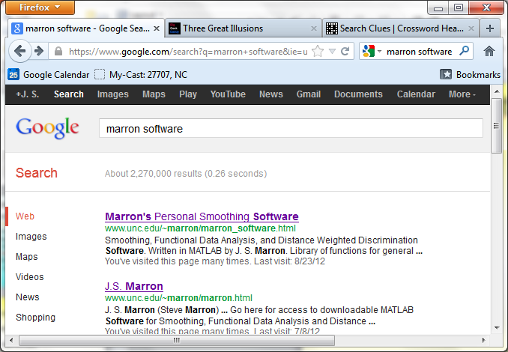
Matlab Software
Choose

Slide 68
Matlab Software
Download .zip File, & Expand to 3 Directories

Slide 69
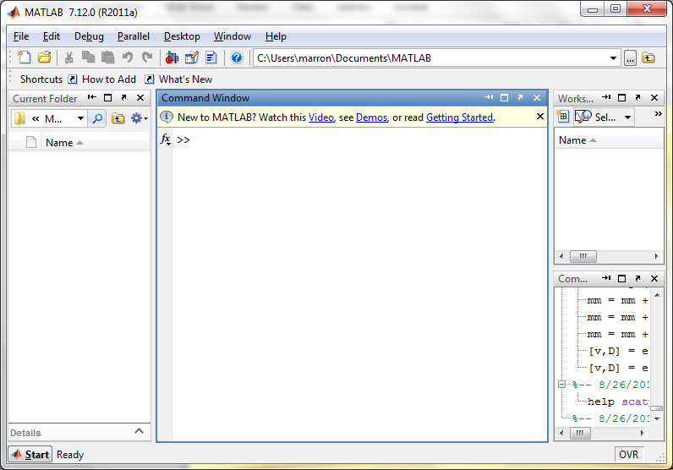
Matlab Software
Put these in Matlab Path

Slide 70
Matlab Software
Put these in Matlab Path

Slide 71
Matlab Basics
Matlab has Modalities:
Interpreted
(Type Commands & Run Individually)
Batch
(Run “Script Files” = Command Sets)

Slide 72
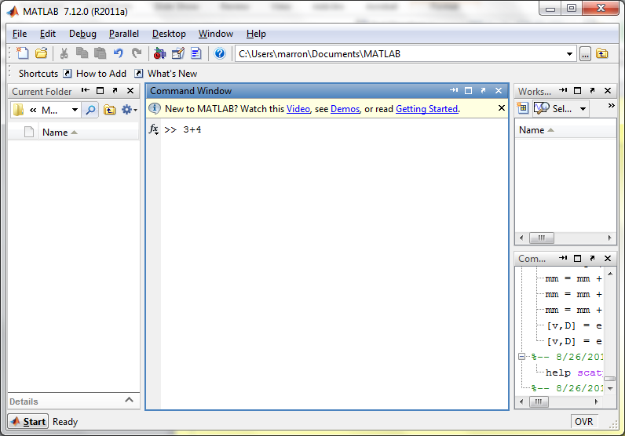
Matlab Basics
Matlab in Interpreted Mode:

Slide 73
Matlab Basics
Matlab in Interpreted Mode:

Slide 74
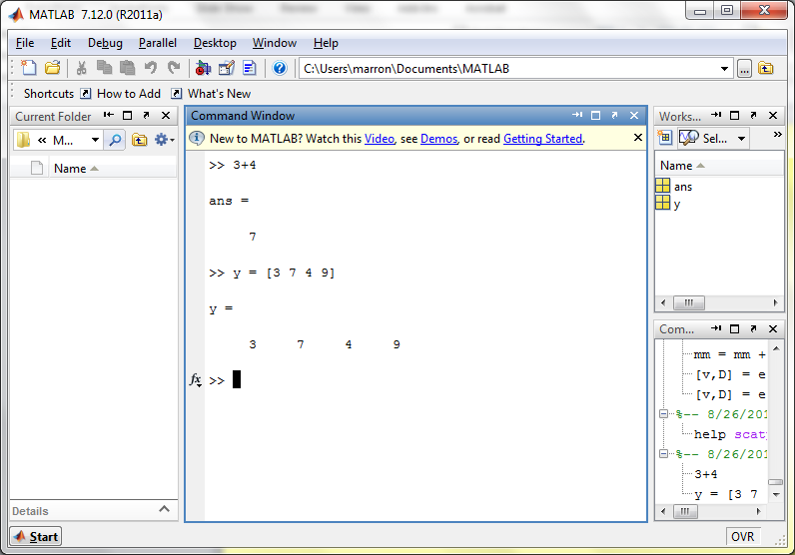
Matlab Basics
Matlab in Interpreted Mode:

Slide 75
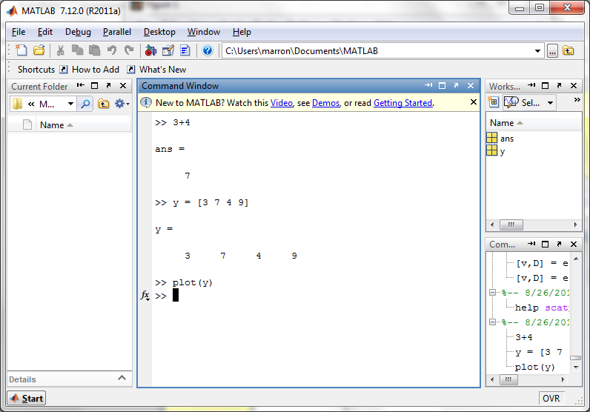
Matlab Basics
Matlab in Interpreted Mode:

Slide 76
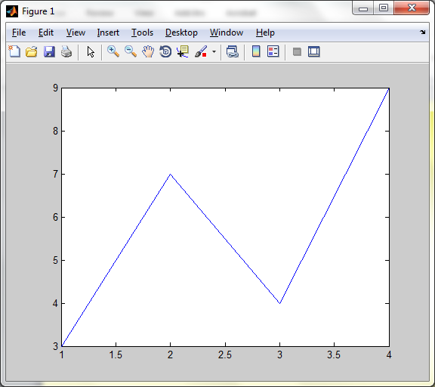
Matlab Basics
Matlab in Interpreted Mode:

Slide 77
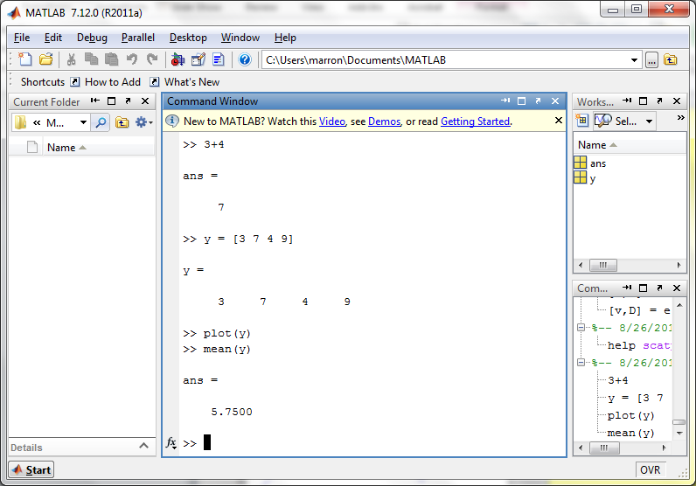
Matlab Basics
Matlab in Interpreted Mode:

Slide 78
Matlab Basics
Matlab in Interpreted Mode:
For description of a function:
>> help [function name]

Slide 79
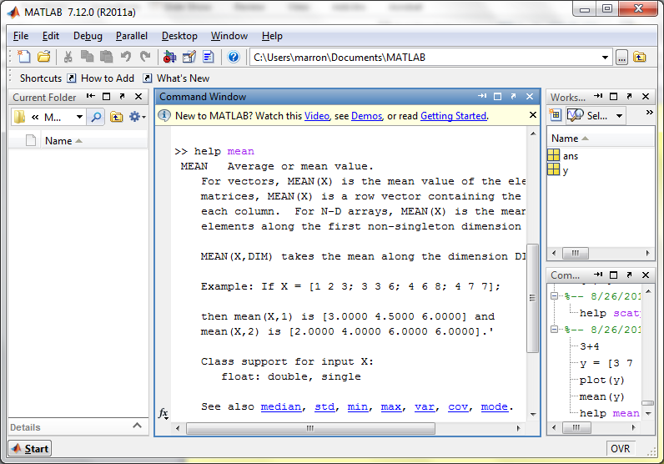
Matlab Basics
Matlab in Interpreted Mode:

Slide 80
Matlab Basics
Matlab in Interpreted Mode:
To Find Functions:
>> help [category name]
e.g.
>> help stats

Slide 81
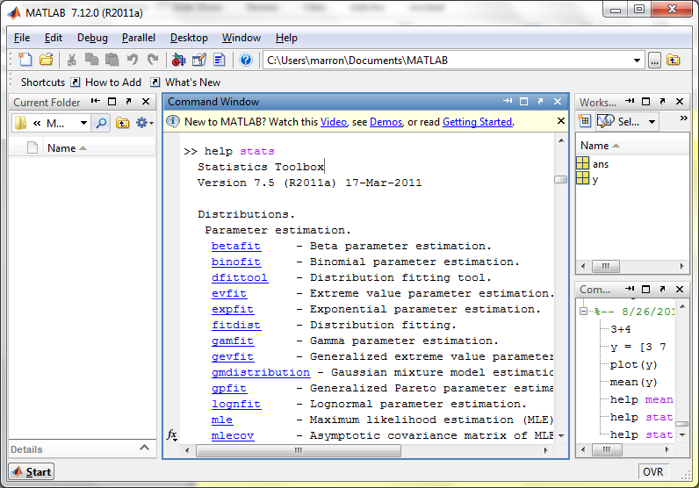
Matlab Basics
Matlab in Interpreted Mode:

Slide 82
Matlab Basics
Matlab has Modalities:
Interpreted (Type Commands)
Batch (Run “Script Files”)
For Serious Scientific Computing:
Always Run Scripts

Slide 83
Matlab Basics
Matlab Script File:
Just a List of Matlab Commands
Matlab Executes Them in Order
Why Bother (Why Not Just Type Commands)?
Reproducibility
(Can Find Mistakes & Use Again Much Later)

Slide 84
Matlab Script Files
An Example:
Recall “Brushing Analysis” of
Next Generation Sequencing Data

Slide 85
Functional Data Analysis
Simple
1st
View:
Curve
Overlay
(log
scale)

Slide 86
Functional Data Analysis
Often
Useful
Population
View:
PCA
Scores

Slide 87
Functional Data Analysis
Suggestion
Of
Clusters
???

Slide 88
Functional Data Analysis
Suggestion
Of
Clusters
Which
Are
These?

Slide 89
Functional Data Analysis
Manually
“Brush”
Clusters

Slide 90
Functional Data Analysis
Manually
Brush
Clusters
Clear
Alternate
Splicing

Slide 91
Matlab Script Files
An Example:
Recall “Brushing Analysis” of
Next Generation Sequencing Data
Analysis In Script File:
VisualizeNextGen2011.m
Matlab Script File Suffix

Slide 92
Matlab Script Files
An Example:
Recall “Brushing Analysis” of
Next Generation Sequencing Data
Analysis In Script File:
VisualizeNextGen2011.m
On Course Web Page
Matlab Script File Suffix

Slide 93
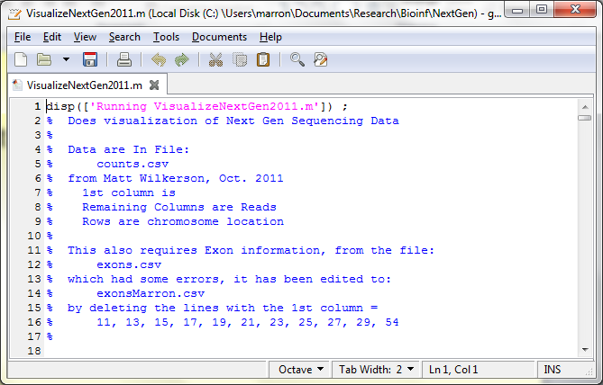
Matlab Script Files
String of Text

Slide 94
Matlab Script Files
Command to Display String to Screen

Slide 95
Matlab Script Files
Notes About Data (Maximizes Reproducibility)

Slide 96
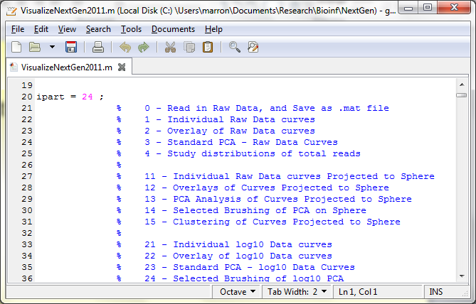
Matlab Script Files
Have Index for Each Part of Analysis

Slide 97
Matlab Script Files
So Keep Everything Done (Max’s Reprod’ity)

Slide 98
Matlab Script Files
Note Some Are Graphics Shown (Can Repeat)

Slide 99
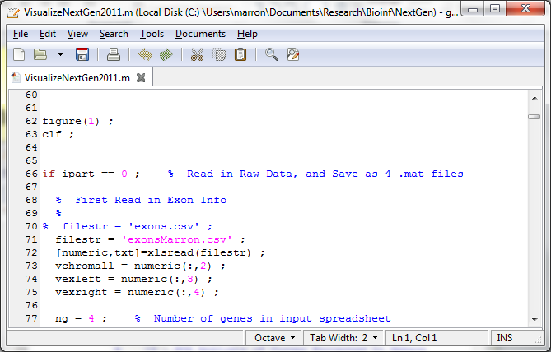
Matlab Script Files
Set Graphics to Default

Slide 100
Matlab Script Files
Put Different Program Parts in IF-Block

Slide 101
Matlab Script Files
Comment Out Currently Unused Commands

Slide 102
Matlab Script Files
Read Data from Excel File

Slide 103
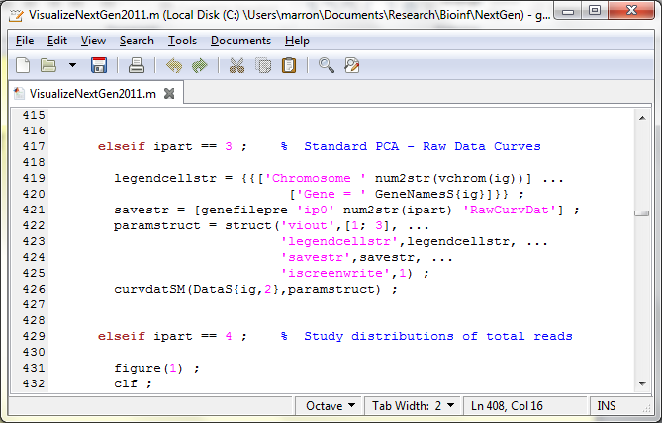
Matlab Script Files
For Generic Functional Data Analysis:

Slide 104
Matlab Script Files
Input Data Matrix

Slide 105
Matlab Script Files
Structure, with Other Settings

Slide 106
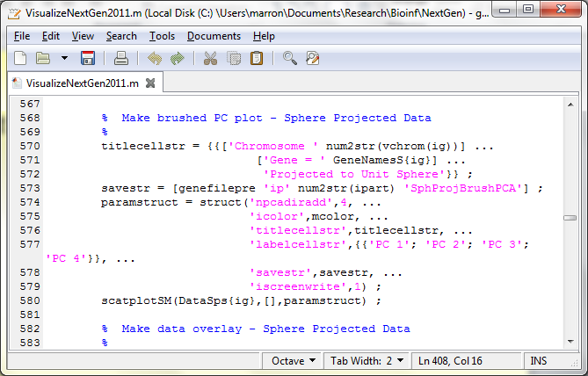
Matlab Script Files
Make Scores Scatterplot

Slide 107
Matlab Script Files
Uses Careful Choice of Color Matrix

Slide 108
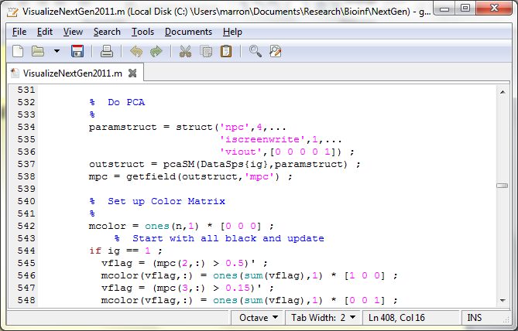
Matlab Script Files
Start with PCA

Slide 109
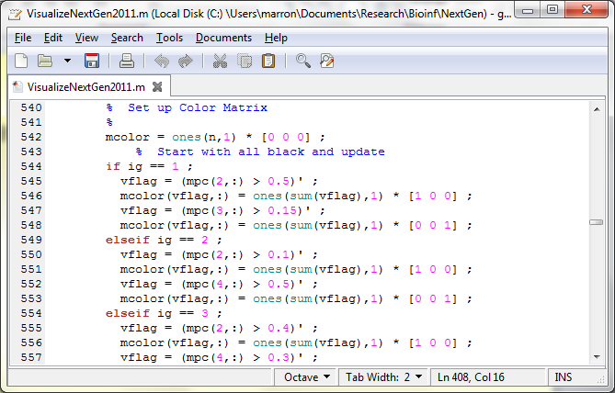
Matlab Script Files
Then Create Color Matrix

Slide 110
Matlab Script Files
Black Red Blue

Slide 111
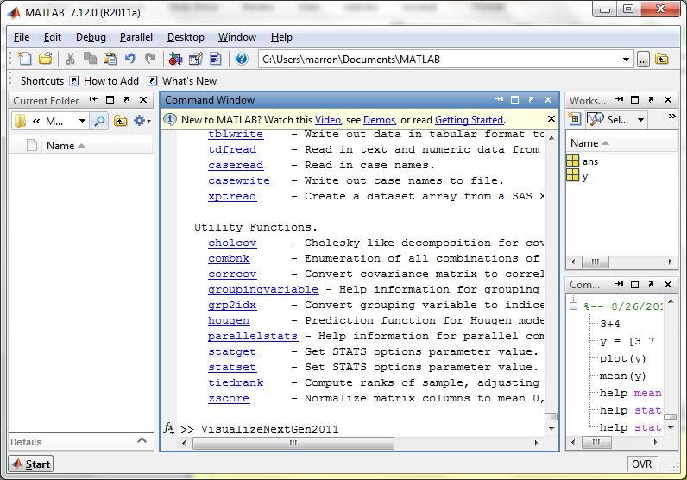
Matlab Script Files
Run Script Using Filename as a Command

Slide 112
Big Picture Data Visualization
For a Matrix of Data:
$${\left(\begin{matrix}x_{11} & ⋯ & x_{1n} \\ ⋮ & ⋱ & ⋮ \\ x_{d1} & ⋯ & x_{dn}\end{matrix}\right)}_{d×n}$$

Slide 113
Big Picture Data Visualization
For a Matrix of Data:
$${\left(\begin{matrix}x_{11} & ⋯ & x_{1n} \\ ⋮ & ⋱ & ⋮ \\ x_{d1} & ⋯ & x_{dn}\end{matrix}\right)}_{d×n}$$
With Columns as Data Objects
(recall not everybody does this,
e.g. rows are data objects in R & SAS)

Slide 114
Big Picture Data Visualization
For a Matrix of Data:
$${\left(\begin{matrix}x_{11} & ⋯ & x_{1n} \\ ⋮ & ⋱ & ⋮ \\ x_{d1} & ⋯ & x_{dn}\end{matrix}\right)}_{d×n}$$
Three Useful (& Important) Visualizations
(Not Widely Understood)
(Most Analysts Don’t Look Enough at Data)

Slide 115
Big Picture Data Visualization
For a Matrix of Data:
$${\left(\begin{matrix}x_{11} & ⋯ & x_{1n} \\ ⋮ & ⋱ & ⋮ \\ x_{d1} & ⋯ & x_{dn}\end{matrix}\right)}_{d×n}$$
Three Useful (& Important) Visualizations
Curve Objects (e.g. PCA decomp)

Slide 116
Big Picture Data Visualization
For a Matrix of Data:
$${\left(\begin{matrix}x_{11} & ⋯ & x_{1n} \\ ⋮ & ⋱ & ⋮ \\ x_{d1} & ⋯ & x_{dn}\end{matrix}\right)}_{d×n}$$
Three Useful (& Important) Visualizations
Curve Objects
Relationships Between Objects
(e.g. scatterplot matrices)

Slide 117
Big Picture Data Visualization
For a Matrix of Data:
$${\left(\begin{matrix}x_{11} & ⋯ & x_{1n} \\ ⋮ & ⋱ & ⋮ \\ x_{d1} & ⋯ & x_{dn}\end{matrix}\right)}_{d×n}$$
Three Useful (& Important) Visualizations
Curve Objects
Relationships Between Objects
Marginal Distributions (1-d each “variable”)

Slide 118
Marginal Distribution Plots
Ideas:
For Each Variable
Study 1-d Distributions
SimultaneousViews:
Jitter Plots
Smooth Histograms (Kernel Density Est’s)

Slide 119
Marginal Distribution Plots
View:
4 x 4 Grid
Since Comfortable Number
Lose Detail for More
For $d>16$:
Choose Representative Subset

Slide 120
Marginal Distribution Plots
Representative Subset:
Sort on a Data Summary
E.g Mean, S.D., Skewness, Median, …
Usually Take Nearly Equally Spaced Grid
Sometimes Specify
E.g. All Largest (or Smallest) Summaries

Slide 121
Marginal Distribution Plots
Note Often Useful for:
Object Definition
Which Variables to Include?
How to Scale Them?
Need to Transform (e.g. log)?

Slide 122
Marginal Distribution Plots
Toy Example: $n=200$, $d=50$,
i.i.d. Poisson, with parameters $λ=0.2,⋯,20$
Logarithmically Spaced

Slide 123
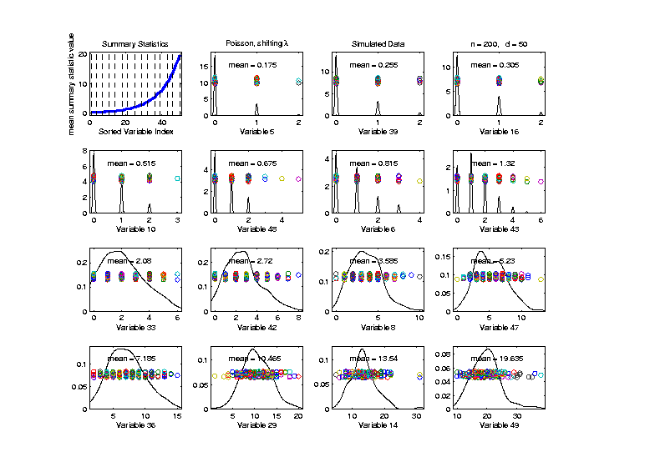
Marginal Distribution Plots
Toy Example: $n=200$, $d=50$,
i.i.d. Poisson, with parameters $λ=0.2,⋯,20$
Sort on
Mean
Summary
Plot with
Equal
Spacing

Slide 124
Marginal Distribution Plots
Toy Example: $n=200$, $d=50$,
i.i.d. Poisson, with parameters $λ=0.2,⋯,20$
Sort on
Mean
Dashed Lines
Correspond
To 1-d Distn’s

Slide 125
Marginal Distribution Plots
Toy Example: $n=200$, $d=50$,
i.i.d. Poisson, with parameters $λ=0.2,⋯,20$
Sort on
Mean
Wide Range
Of Poissons

Slide 126
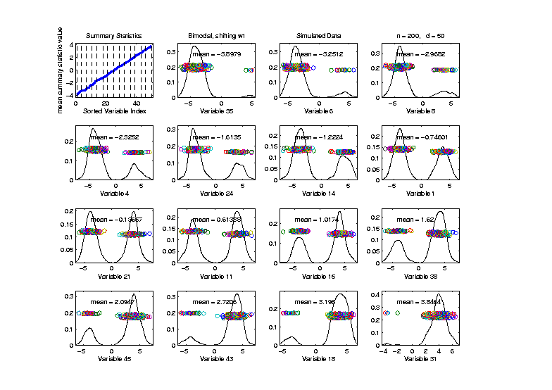
Marginal Distribution Plots
Toy Example: Normal Mean Mixture
$$ωN\left(4,1\right)+\left(1−ω\right)N\left(−4,1\right)$$
Sort on
Mean
Useful
Ordering

Slide 127
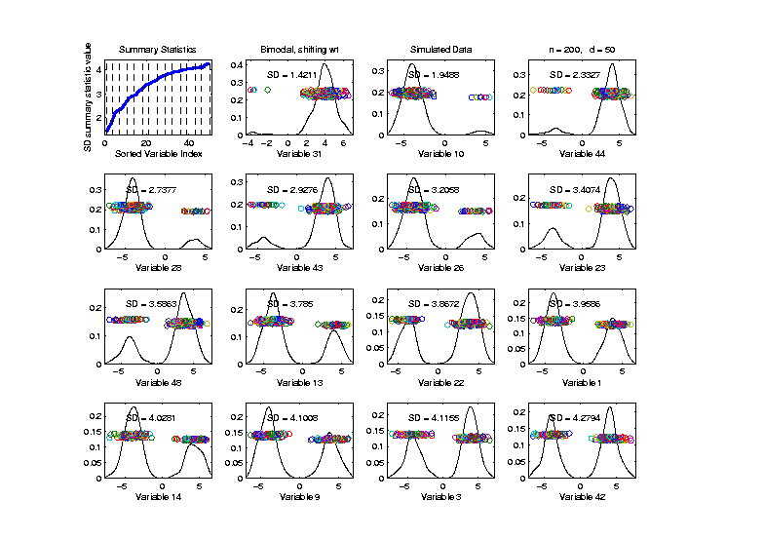
Marginal Distribution Plots
Toy Example: Normal Mean Mixture
$$ωN\left(4,1\right)+\left(1−ω\right)N\left(−4,1\right)$$
Sort on
Standard
Deviation
Less Useful
Ordering

Slide 128
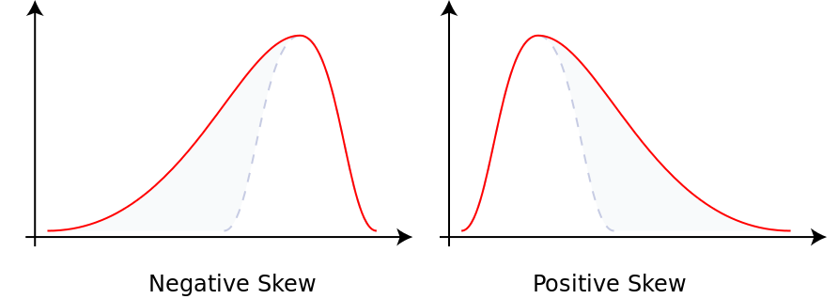
Marginal Distribution Plots
Additional Summaries: Skewness
Measure Asymmetry
Left Skewed Right Skewed
(Thanks to Wikipedia)

Slide 129
Marginal Distribution Plots
Additional Summaries: Skewness
Quantification: Based on “Moments”
$$E\left[{\left(\frac{X−μ}{σ}\right)}^{3}\right]=\frac{E\left[{\left(X−μ\right)}^{3}\right]}{{\left(E\left[{\left(X−μ\right)}^{2}\right]\right)}^{3/2}}$$
“Central 3rd Moment” (Also Rescaled)
Note: 0 at Gaussian

Slide 130
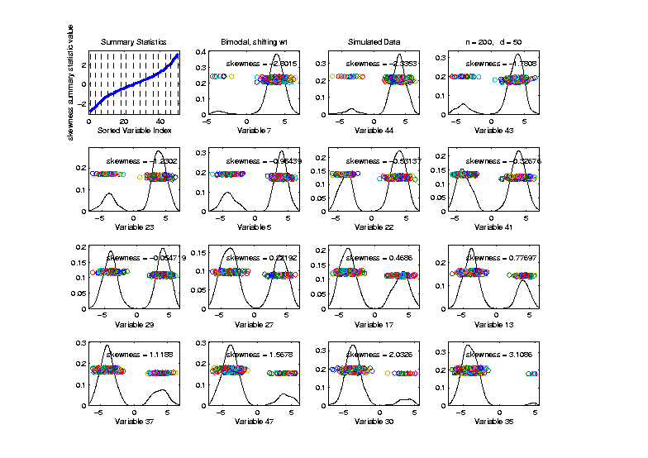
Marginal Distribution Plots
Toy Example: Normal Mean Mixture
$$ωN\left(4,1\right)+\left(1−ω\right)N\left(−4,1\right)$$
Sort on
Skewness
Useful
Ordering

Slide 131
Marginal Distribution Plots
Additional Summaries: Kurtosis
4-th Moment Summary
$$E\left[{\left(\frac{X−μ}{σ}\right)}^{4}\right]−3=\frac{E\left[{\left(X−μ\right)}^{4}\right]}{{\left(E\left[{\left(X−μ\right)}^{2}\right]\right)}^{2}}−3$$
Centered (and Scaled) 4th Moment

Slide 132
Marginal Distribution Plots
Additional Summaries: Kurtosis
4-th Moment Summary
$$E\left[{\left(\frac{X−μ}{σ}\right)}^{4}\right]−3=\frac{E\left[{\left(X−μ\right)}^{4}\right]}{{\left(E\left[{\left(X−μ\right)}^{2}\right]\right)}^{2}}−3$$
Makes 0 at Gaussian
Think of Departures From Gaussian
(not always done)

Slide 133
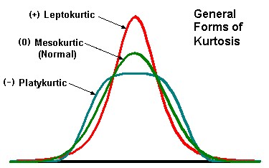
Marginal Distribution Plots
Additional Summaries: Kurtosis
4-th Moment Summary
Nice Graphic
(from mvpprograms.com)

Slide 134
Marginal Distribution Plots
Additional Summaries: Kurtosis
4-th Moment Summary
Positive Big at Peak
And Tails
(with controlled
variance)

Slide 135
Marginal Distribution Plots
Additional Summaries: Kurtosis
4-th Moment Summary
Negative Big in Flanks

Slide 136
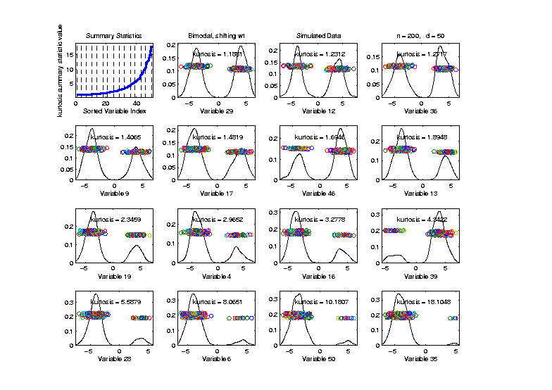
Marginal Distribution Plots
Toy Example: Normal Mean Mixture
$$ωN\left(4,1\right)+\left(1−ω\right)N\left(−4,1\right)$$
Sort on
Kurtosis
Less Useful
Ordering

