Slide 1
Participant Presentations
Please Prepare to Sign Up:
Name
Email (Onyen is fine, or …)
Are You ENRolled?
Tentative Title (???? Is OK)
When:
Next Week, Early, Oct., Nov., Late

Slide 2
Object Oriented Data Analysis
Three Major Parts of OODA Applications:
I. Object Definition
“What are the Data Objects?”
Exploratory Analysis
“What Is Data Structure / Drivers?”
III. Confirmatory Analysis / Validation
Is it Really There (vs. Noise Artifact)?

Slide 3
Functional Data Analysis
Interesting Real Data Example
Genetics (Cancer Research)
RNAseq (Next Gener’n Sequen’g)
Deep look at “gene components”
Gene studied here: CDNK2A
Goal: Study Alternate Splicing
Sample Size, n = 180
Dimension, d = ~1700

Slide 4
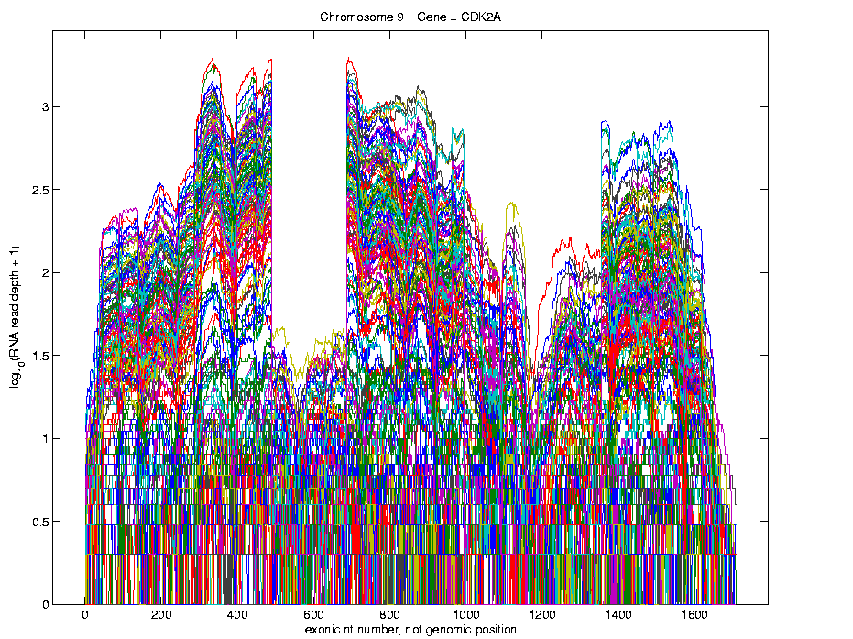
Functional Data Analysis
Simple
1st
View:
Curve
Overlay
(log
scale)
I. Object Definition

Slide 5
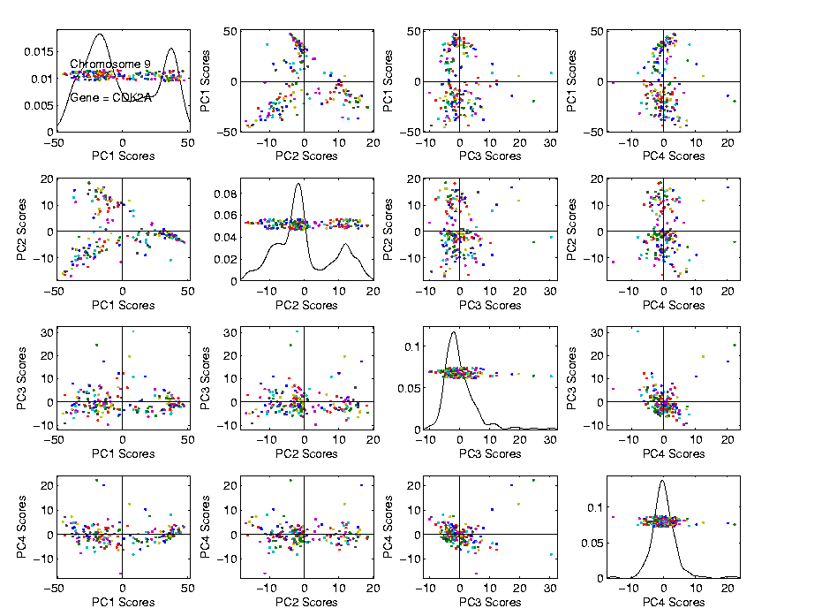
Functional Data Analysis
Often
Useful
Population
View:
PCA
Scores

Slide 6
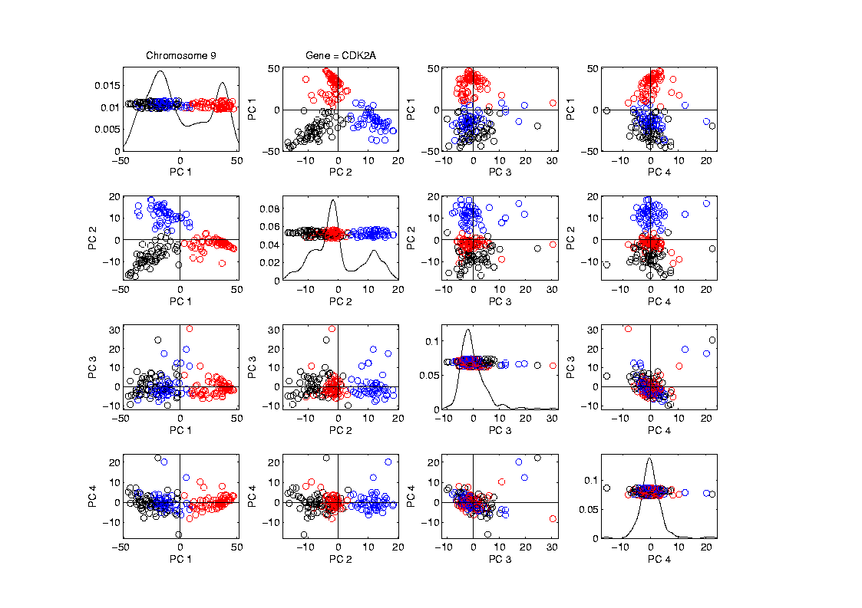
Functional Data Analysis
Manually
“Brush”
Clusters
II. Exploratory
Analysis

Slide 7
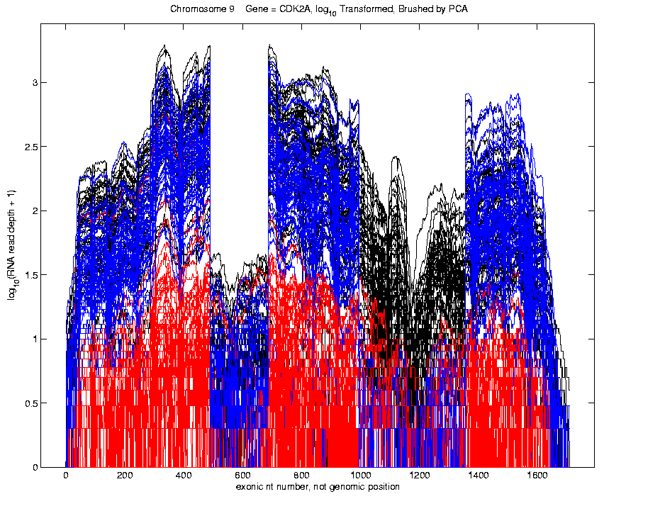
Functional Data Analysis
Manually
Brush
Clusters
Clear
Alternate
Splicing
II. Exploratory
Analysis

Slide 8
Course Background I
Linear Algebra
Please Check Familiarity
No? Read Up in Linear Algebra Text
Or Wikipedia?

Slide 9
Course Background II
MultiVariate Probability
Again Please Check Familiarity
No? Read Up in Probability Text
Or Wikipedia?

Slide 10
Limitation of PCA
Toy Example:
Apple – Banana – Pear
Obscured by “noisy dimensions”
1st 3 PC directions only show noise
Study some rotations, to find structure

Slide 11
Limitation of PCA, Toy E.g.

Slide 12
Limitation of PCA
Main Point:
May be Important Data Structure
Not Visible in 1st Few PCs

Slide 13
PCA Visualization of NCI 60 Data
Can we find classes:
(Renal, CNS, Ovar, Leuk, Colon, Melan)
Using PC directions??
First try “unsupervised view”
I.e. switch off class colors
Then turn on colors, to identify clusters
I.e. look at “supervised view”
II. Exploratory
Analysis
Notes:
13

Slide 14
NCI 60: Can we find classes Using PCA view?
Notes:
14

Slide 15
NCI 60: Can we find classes Using PCA 1-4 vs. 5-8?
Notes:
15

Slide 16
NCI 60: Can we find classes Using PCA 5-8 vs. 9-12?
Notes:
16

Slide 17
PCA Visualization of NCI 60 Data
Can we find classes using PC directions??
Found some, but not others
Nothing after 1st five PCs
Rest seem to be noise driven
Are There Better Directions?
PCA only “feels” maximal variation
Ignores Class Labels
How Can We Use Class Labels?
Notes:
17

Slide 18
Visualization of NCI 60 Data
How Can We Use Class Labels?
Approach:
Find Directions to “Best Separate” Classes
In Disjoint Pairs (thus 4 Directions)
Use DWD:
Distance Weighted Discrimination
Defined (& Motivated) Later
Project All Data on These 4 Directions
Notes:
18

Slide 19
NCI 60: Views using DWD Dir’ns (focus on biology)
Notes:
19

Slide 20
DWD Visualization of NCI 60 Data
Most cancer types clearly distinct
(Renal, CNS, Ovar, Leuk, Colon, Melan)
Using these carefully chosen directions
Others less clear cut
NSCLC (at least 3 subtypes)
Breast (4 published subtypes)

Slide 21
DWD Visualization
Recall PCA limitations
DWD uses class info
Hence can “better separate known classes”
Do this for pairs of classes
(DWD just on those, ignore others)
Carefully choose pairs in NCI 60 data
Note DWD Directions Not Orthogonal
(PCA orthogonality may be
too strong a constraint)

Slide 22
NCI 60: Views using DWD Dir’ns (focus on biology)

Slide 23
PCA Visualization of NCI 60 Data
Can we find classes using PC directions??
Found some, but not others
Not so distinct as in DWD view
Nothing after 1st five PCs
Rest seem to be noise driven
Orthogonality too strong a constraint???
Interesting dir’ns are nearly orthogonal
Notes:
23

Slide 24
Matlab Software
Want to try similar analyses?
Matlab Available from UNC Site License
Download Software:
Google “Marron Software”

Slide 25
Matlab Software
Download .zip File, & Expand to 4 Directories

Slide 26
Big Picture Data Visualization
For a Matrix of Data:
$${\left(\begin{matrix}x_{11} & ⋯ & x_{1n} \\ ⋮ & ⋱ & ⋮ \\ x_{d1} & ⋯ & x_{dn}\end{matrix}\right)}_{d×n}$$
With Columns as Data Objects
(recall not everybody does this,
e.g. rows are data objects in R & SAS)

Slide 27
Big Picture Data Visualization
For a Matrix of Data:
$${\left(\begin{matrix}x_{11} & ⋯ & x_{1n} \\ ⋮ & ⋱ & ⋮ \\ x_{d1} & ⋯ & x_{dn}\end{matrix}\right)}_{d×n}$$
Three Useful (& Important) Visualizations
Curve Objects (e.g. PCA decomp)

Slide 28
Big Picture Data Visualization
For a Matrix of Data:
$${\left(\begin{matrix}x_{11} & ⋯ & x_{1n} \\ ⋮ & ⋱ & ⋮ \\ x_{d1} & ⋯ & x_{dn}\end{matrix}\right)}_{d×n}$$
Three Useful (& Important) Visualizations
Curve Objects
Relationships Between Objects
(e.g. scatterplot matrices)

Slide 29
Big Picture Data Visualization
For a Matrix of Data:
$${\left(\begin{matrix}x_{11} & ⋯ & x_{1n} \\ ⋮ & ⋱ & ⋮ \\ x_{d1} & ⋯ & x_{dn}\end{matrix}\right)}_{d×n}$$
Three Useful (& Important) Visualizations
Curve Objects
Relationships Between Objects
Marginal Distributions (1-d each “variable”)

Slide 30
Marginal Distribution Plots
Ideas:
For Each Variable
Study 1-d Distributions
SimultaneousViews:
Jitter Plots
Smooth Histograms (Kernel Density Est’s)

Slide 31
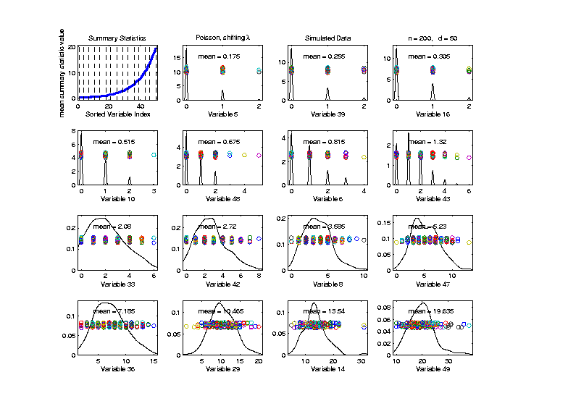
Marginal Distribution Plots
Toy Example: $n=200$, $d=50$,
i.i.d. Poisson, with parameters $λ=0.2,⋯,20$
Sort on
Mean
Dashed Lines
Correspond
To 1-d Distn’s

Slide 32
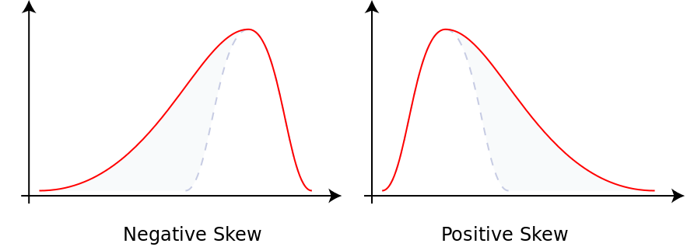
Marginal Distribution Plots
Additional Summaries: Skewness
Measure Asymmetry
Left Skewed Right Skewed
(Thanks to Wikipedia)

Slide 33
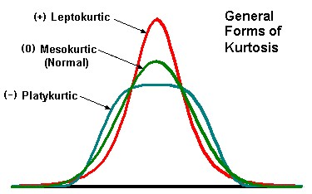
Marginal Distribution Plots
Additional Summaries: Kurtosis
4-th Moment Summary
Nice Graphic
(from mvpprograms.com)

Slide 34
Marginal Distribution Plots
Additional Summaries: Kurtosis
4-th Moment Summary
Positive Big at Peak
And Tails
(with controlled
variance)

Slide 35
Marginal Distribution Plots
Additional Summaries: Kurtosis
4-th Moment Summary
Negative Big in Flanks

Slide 36
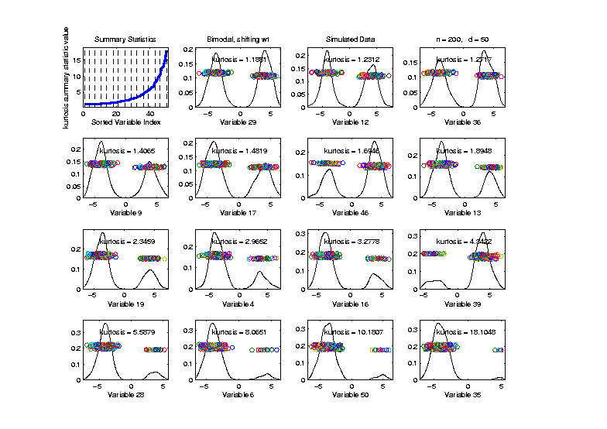
Marginal Distribution Plots
Toy Example: Normal Mean Mixture
$$ωN\left(4,1\right)+\left(1−ω\right)N\left(−4,1\right)$$
Sort on
Kurtosis
Less Useful
Ordering

Slide 37
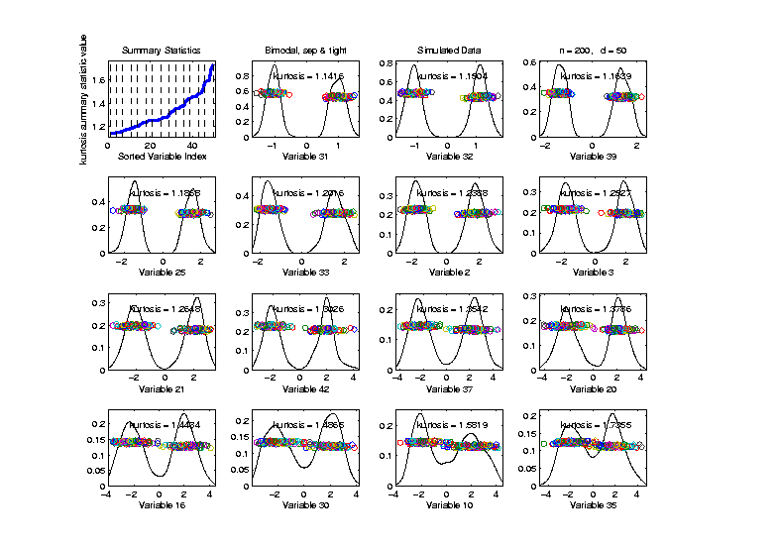
Marginal Distribution Plots
Toy Example: Normal Mixture
$$\frac{1}{2}N\left(−μ,σ^{2}\right)+\frac{1}{2}N\left(μ,σ^{2}\right)$$
Sort on
Kurtosis
Useful
Ordering

Slide 38
Marginal Distribution Plots
Some Useful Summaries:
Mean, SD, Skewness, Kurtosis
# Unique, # Most Frequent, # 0s
Robust Measures
L-statistics
Entropy
Continuity Measure
$⋮$

Slide 39
Marginal Distribution Plots
Matlab Software:
MargDistPlotSM.m
In General Directory

Slide 40
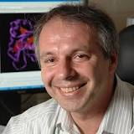
Marg. Dist. Plot Data Example
Drug Discovery Data
$n = 262$, Chemical Compounds
$d = 2489$, Chemical “Descriptors”
Discrete Response:
0 – blue 0, 1 – red +
(Thanks to Alex Tropsha Lab)

Slide 41
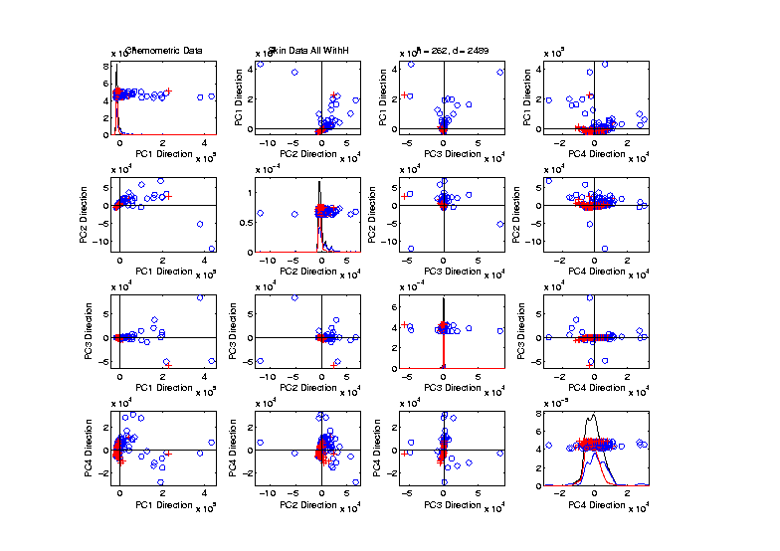
Marg. Dist. Plot Data Example
Drug Discovery – PCA Scatterplot
Dominated
By Few
Large
Compounds
Not Good
Blue - Red
Separation

Slide 42
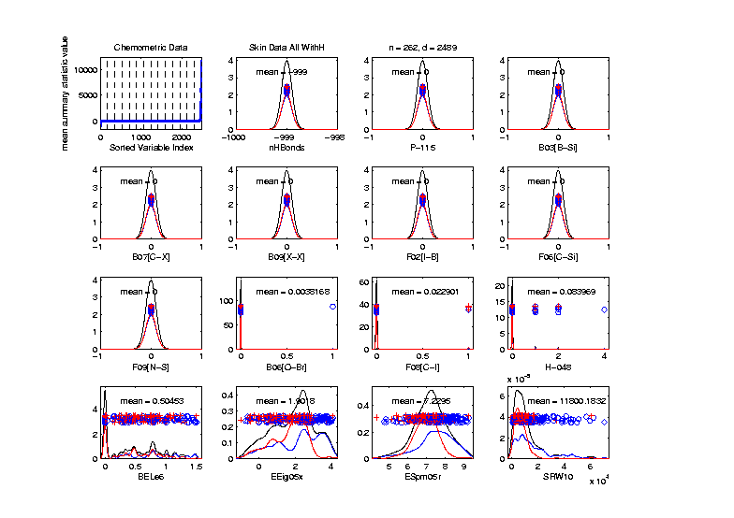
Marg. Dist. Plot Data Example
Drug Discovery – Sort on Means
Very Few
Are Crazy
Big
Will They
Dominate
PCA???

Slide 43
Marg. Dist. Plot Data Example
Drug Discovery – Sort on Means
Note: Many
With No
Variation???

Slide 44
Marg. Dist. Plot Data Example
Drug Discovery – Sort on Means
Suspicious
Value ???

Slide 45
Marg. Dist. Plot Data Example
Drug Discovery – Sort on Means
Note:
Sub-Densities
Highlight
Blue – Red
Differences

Slide 46
Marg. Dist. Plot Data Example
Drug Discovery – Sort on Means
Note:
Descriptor
Names

Slide 47
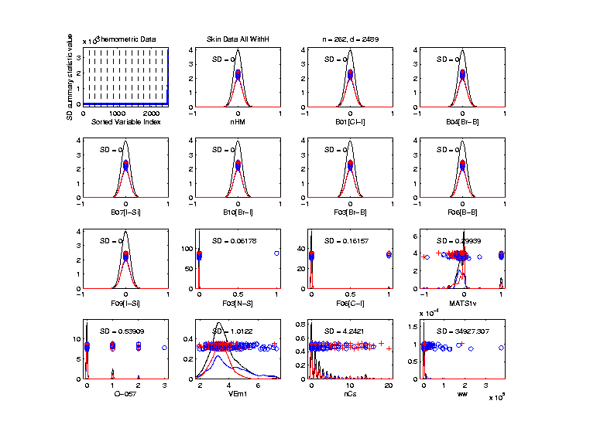
Marg. Dist. Plot Data Example
Drug Discovery – Sort on Standard Deviation
Very Large
Number of
0-Variation
Variables
(No Useful
Info…)

Slide 48
Marg. Dist. Plot Data Example
Drug Discovery – Sort on Means
Investigate Weird -999 Values
Note: Sometimes Such Values Are Used To Code Missing Values
(And Nobody Remembers to Say So)

Slide 49
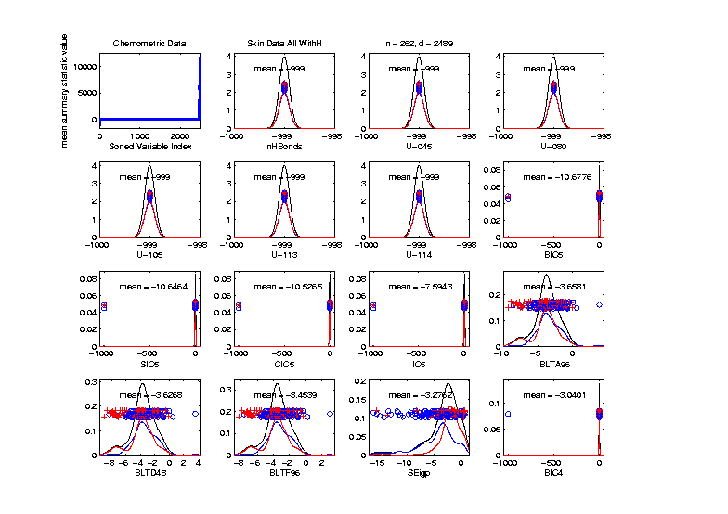
Marg. Dist. Plot Data Example
Drug Discovery – Sort on Means
Investigate Weird -999 Values, Via Mean
Look at
Smallest
Mean Values
(All Dashed
Bars On Left)

Slide 50
Marg. Dist. Plot Data Example
Drug Discovery – Sort on Means
Investigate Weird -999 Values, Via Mean,
Smallest
6 Variables
Are All -999

Slide 51
Marg. Dist. Plot Data Example
Drug Discovery – Sort on Means
Investigate Weird -999 Values, Via Mean,
Smallest
6 Variables
Are All -999
Other Have
Some -999

Slide 52
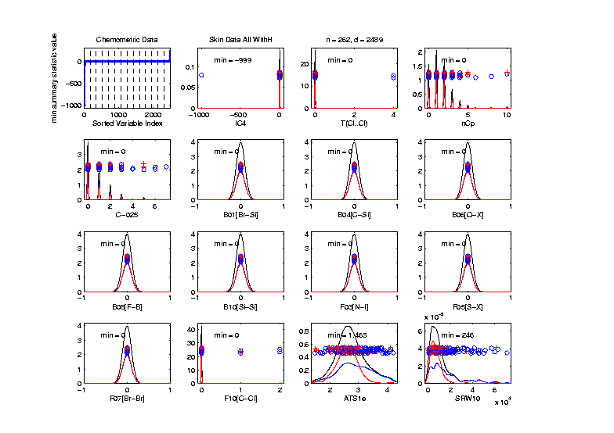
Marg. Dist. Plot Data Example
Drug Discovery
Focus on -999 Values, Using Minimum,
Equally
Spaced
Not Too
Many Such
Variables

Slide 53
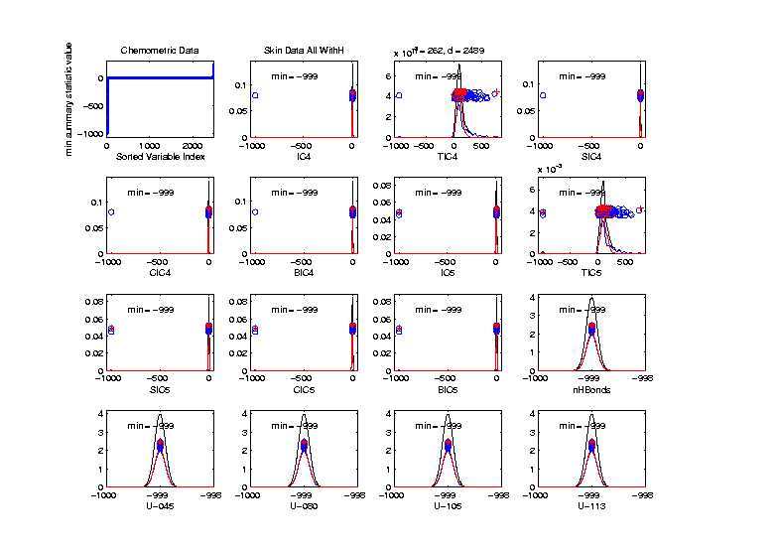
Marg. Dist. Plot Data Example
Drug Discovery
Focus More on -999 Values, Using Minimum,
Smallest 15
(Again All
Dashed
Bars On
Left)

Slide 54
Marg. Dist. Plot Data Example
Drug Discovery
Explicit Screening Found:
Out of $d = 2489$ Variables
$1315$ Had 0 Variance
$16$ Had some –999
So Deleted All Of The Above
Remaining Data Set Had $d = 1164$

Slide 55
Marg. Dist. Plot Data Example
Drug Discovery - Full Data PCA from Above
(Include
To Show
Contrast)

Slide 56
Marg. Dist. Plot Data Example
Drug Discovery - PCA After Variable Deletion
Looks Very
Similar!

Slide 57
Marg. Dist. Plot Data Example
Drug Discovery - PCA After Variable Deletion
Makes Sense
For 0-Var
Variables

Slide 58
Marg. Dist. Plot Data Example
Drug Discovery - PCA After Variable Deletion
-999s Have
No Impact
Since Others
Much Bigger!

Slide 59
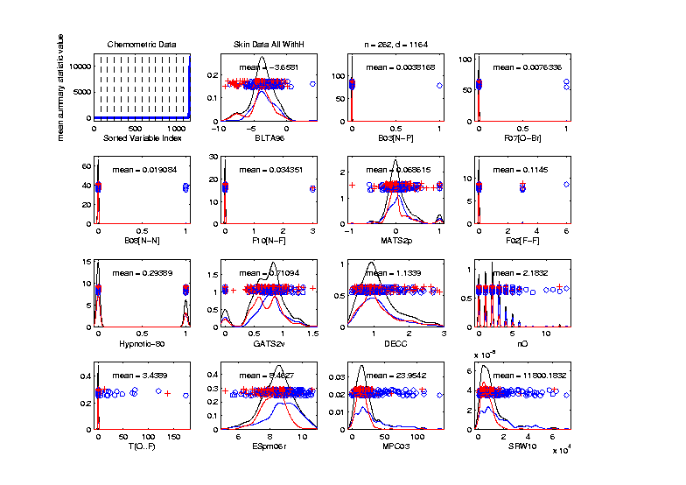
Marg. Dist. Plot Data Example
Drug Discovery - After Variable Deletion
Sort Marginals On Means, Equally Spaced
Still Have
Massive
Variation
In Types

Slide 60
Marg. Dist. Plot Data Example
Drug Discovery - After Variable Deletion
Sort Marginals On Means, Equally Spaced
Still Have
Very Few
That Are
Very Big

Slide 61
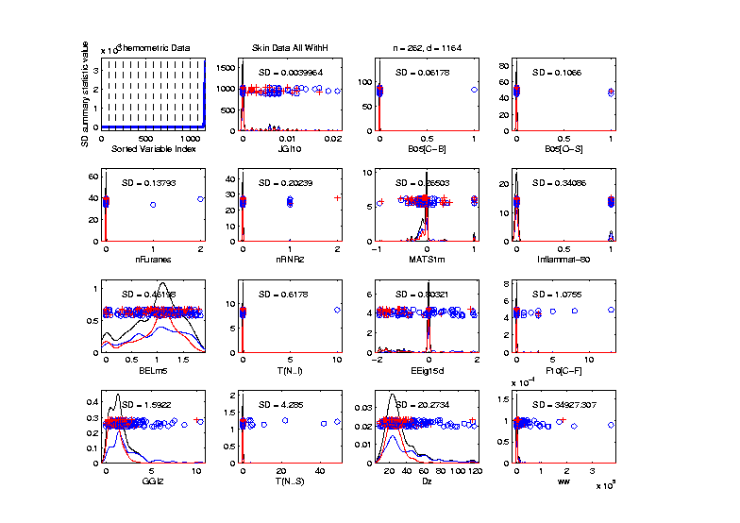
Marg. Dist. Plot Data Example
Drug Discovery - Sort Marginals On SDs,
Equally Spaced To Study Variation
Very Wide
Range
Standardization
May Be Useful

Slide 62
Marg. Dist. Plot Data Example
Drug Discovery - Sort Marginals On SDs,
Equally Spaced To Study Variation
Now See
Some
Very Small
How Many?

Slide 63
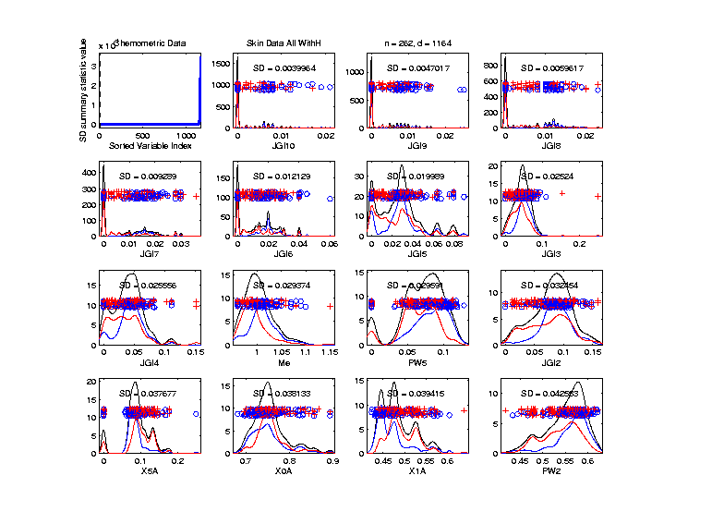
Marg. Dist. Plot Data Example
Drug Discovery - Sort Marginals On SDs,
Smallest
Several
Very Small
Variables
Some Very
Skewed???

Slide 64
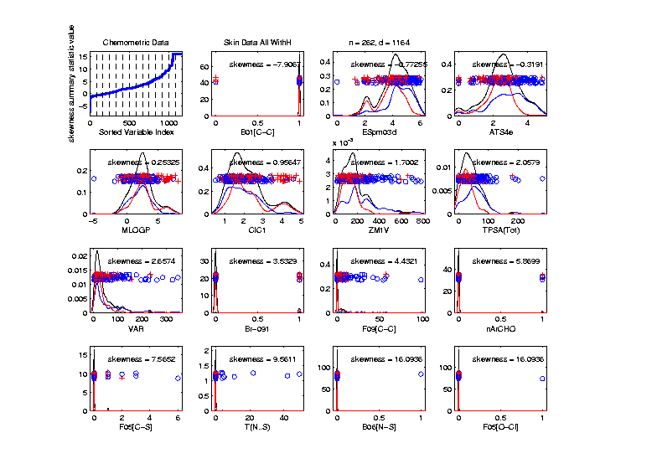
Marg. Dist. Plot Data Example
Drug Discovery - Sort On Skewness
Wide Range
(Consider
Transform-
ation)
0-1s Very
Prominent

Slide 65
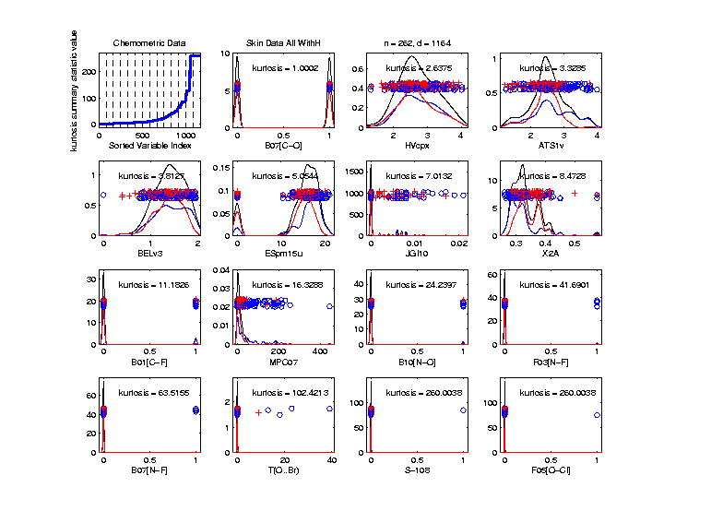
Marg. Dist. Plot Data Example
Drug Discovery - Sort On Kurtosis
Again Very
Wide Range
Again 0-1s
Are Major
Players
So Focus on 0-1 Variables

Slide 66
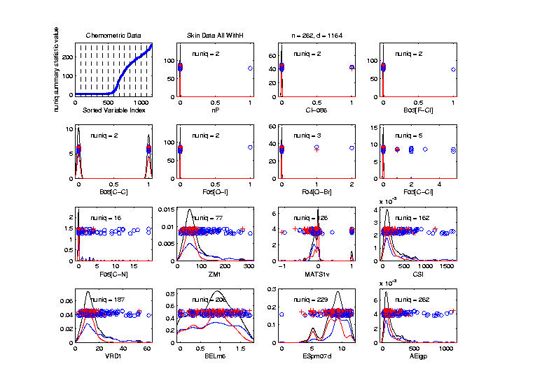
Marg. Dist. Plot Data Example
Drug Discovery - Sort On Number Unique
Shows
Many
Binary

Slide 67
Marg. Dist. Plot Data Example
Drug Discovery - Sort On Number Unique
Shows
Many
Binary
Few Truly
Continuous

Slide 68
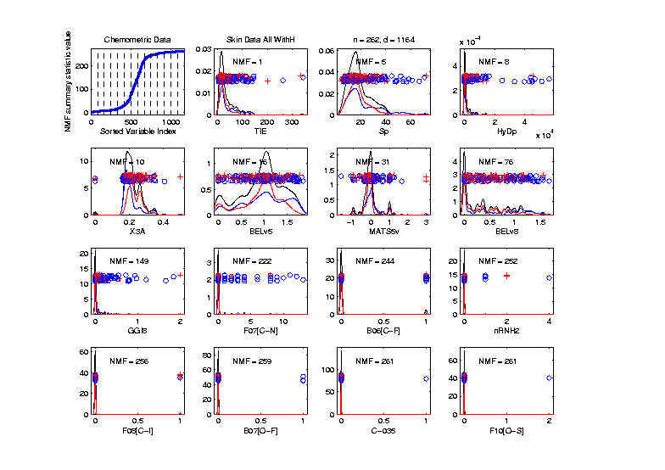
Marg. Dist. Plot Data Example
Drug Discovery - Sort On Number of Most Frequent
Shows Many
Have a Very
Common
Value
(Often 0)

Slide 69
Marg. Dist. Plot Data Example
Explicit Screening Found:
$d = 364$ Binary Variables
Consider Those Only
Do PCA
Try Variable Screening

Slide 70
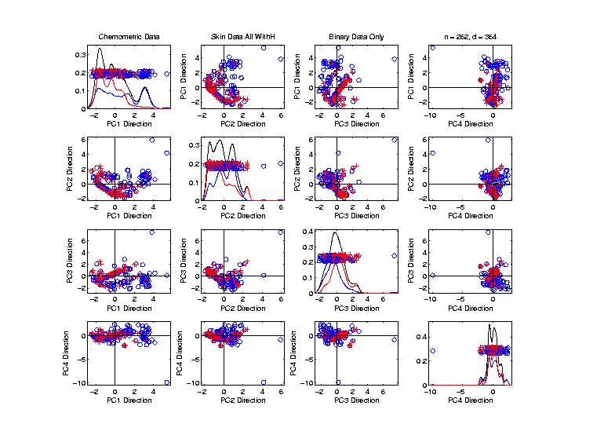
Marg. Dist. Plot Data Example
Drug Discovery - PCA on Binary Variables
Interesting
Structure?

Slide 71
Marg. Dist. Plot Data Example
Drug Discovery - PCA on Binary Variables
Interesting
Structure?
Clusters?

Slide 72
Marg. Dist. Plot Data Example
Drug Discovery - PCA on Binary Variables
Interesting
Structure?
Clusters?
Stronger
Red vs. Blue

Slide 73
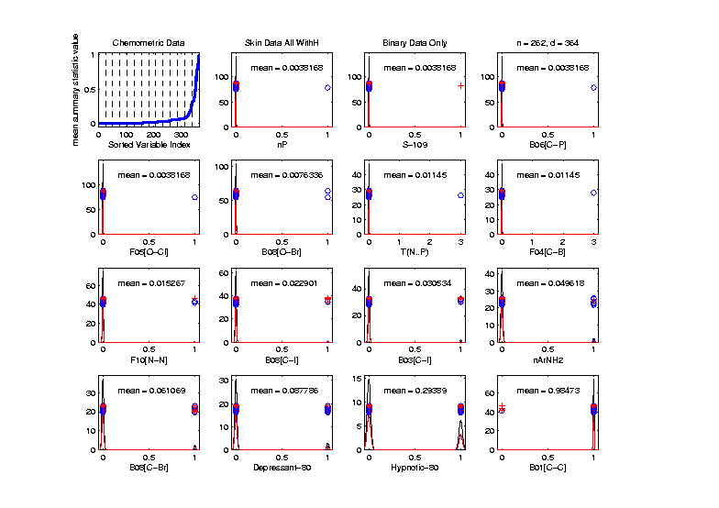
Marg. Dist. Plot Data Example
Drug Discovery - Binary Variables, Mean Sort
Shows
Many Are
Mostly 0s

Slide 74
Marg. Dist. Plot Data Example
Explicit Screening Found:
$d = 800$Non-Binary Variables
Now Focus on Those Only
Standardize Variables
(Subtract Mean, Divide By SD)

Slide 75
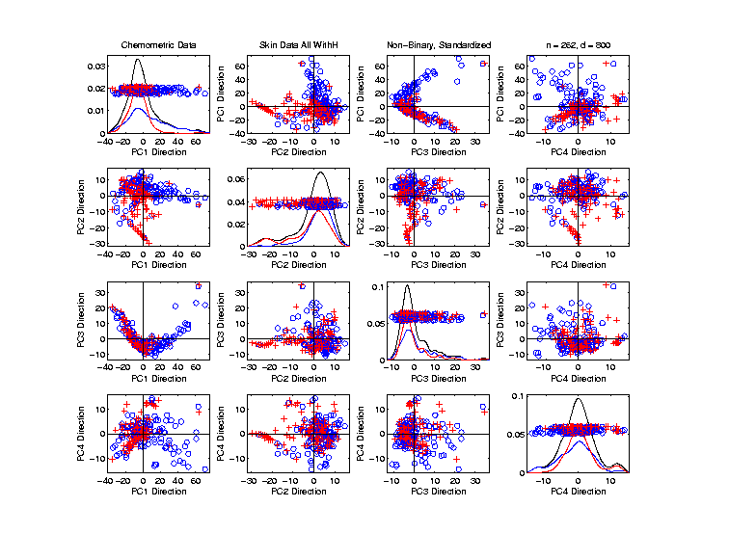
Marg. Dist. Plot Data Example
Drug Discovery - PCA on non-Binary Variables
Focus Only on Binary Variables
Interesting
Structure?

Slide 76
Marg. Dist. Plot Data Example
Drug Discovery - PCA on non-Binary Variables
Focus Only on Binary Variables
Interesting
Structure?
Suggests
Subtypes

Slide 77
Marg. Dist. Plot Data Example
Drug Discovery - PCA on non-Binary Variables
Focus Only on Binary Variables
Interesting
Structure?
Suggests
Subtypes
Reds Only?

Slide 78
Transformations
Useful Method for Data Analysts
Apply to Marginal Distributions
(i.e. to Individual Variables)
Idea: Put Data on Right Scale
Common Example:
Data Orders of Magnitude Different
Log₁₀ Puts Data on More Analyzable Scale

Slide 79
Transformations
Example: Melanoma Data Analysis
Miedema, et al (2012)

Slide 80
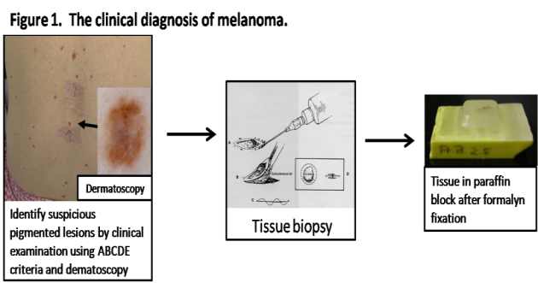
Introduction
Background
Clinical diagnosis

Slide 81
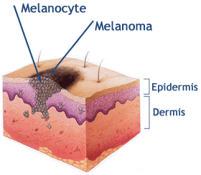
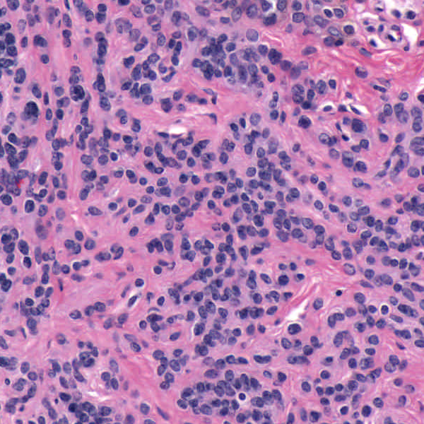
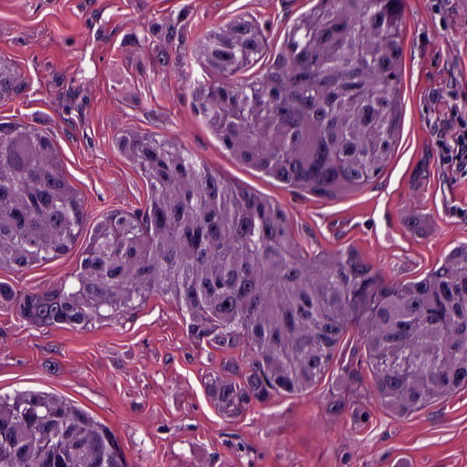
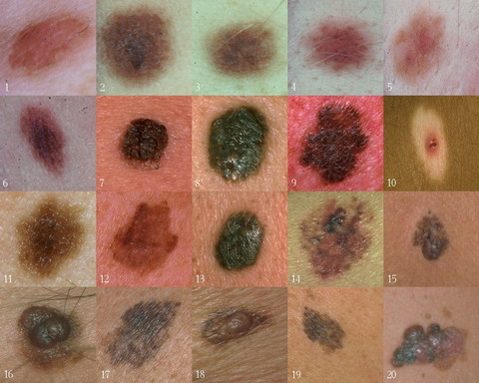
Background
Goal
Image Analysis of Histology Slides
Image: www.melanoma.ca
Benign
Melanoma
1 in 75 North Americans will develop a
malignant melanoma in their lifetime.
Initial goal: Automatically segment nuclei.
Challenge: Dense packing of nuclei.
Ultimately: Cancer grading and patient survival.
Image: melanoma.blogsome.com

Slide 82
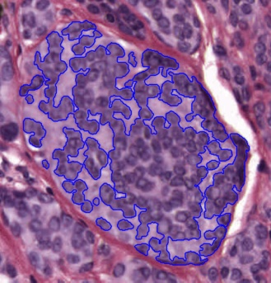
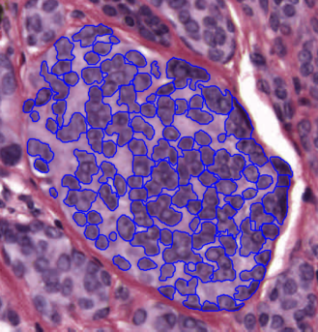
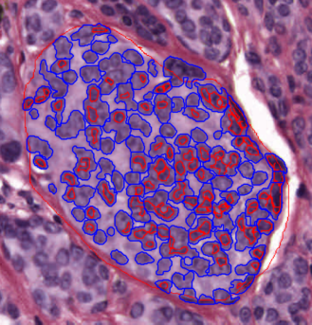
Segmentation
Cell Nuclei from Histology
Cutting Cell Clusters
Without subdivision
With subdivision
Our segmentation
Commercial seg.
Not perfect, but improved over standard algorithm (rq. validation).

Slide 83
Feature Extraction
Features from Cell Nuclei
Feature Extraction
Extract various features based on color and morphology
Example “high-level” concepts:
Stain intensity
Nuclear area
Density of nuclei
Regularity of nuclear shape

Slide 84
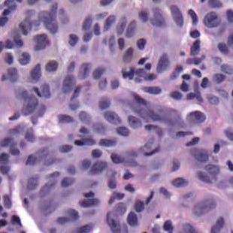
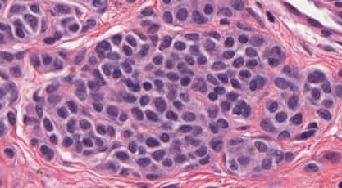
Feature Extraction
Features from Cell Nuclei
Original Image
Conventional Nevus
Superficial Spreading Melanoma

Slide 85
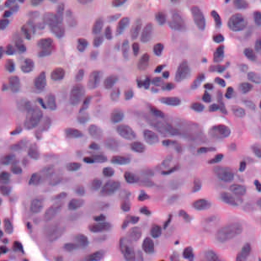
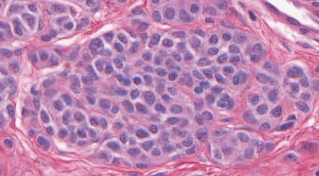
Feature Extraction
Features from Cell Nuclei
Restained Image
Conventional Nevus
Superficial Spreading Melanoma

Slide 86
Feature Extraction
Features from Cell Nuclei
Masked Region
Conventional Nevus
Conventional Nevus
Superficial Spreading Melanoma
Superficial Spreading Melanoma
Masks generated by pathologist

Slide 87
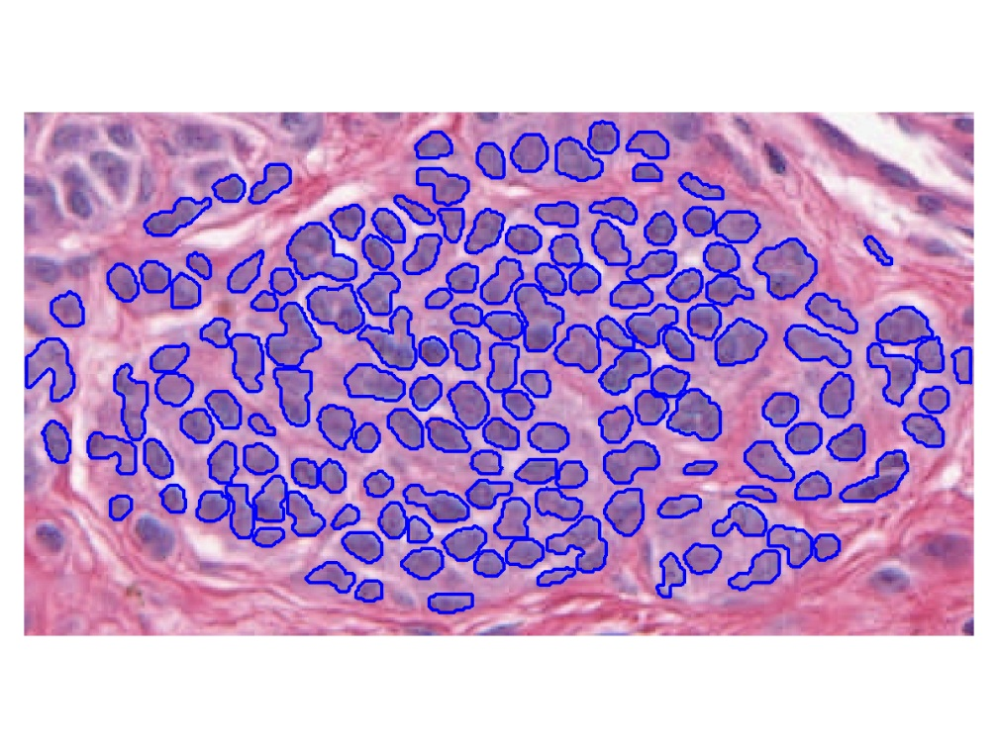
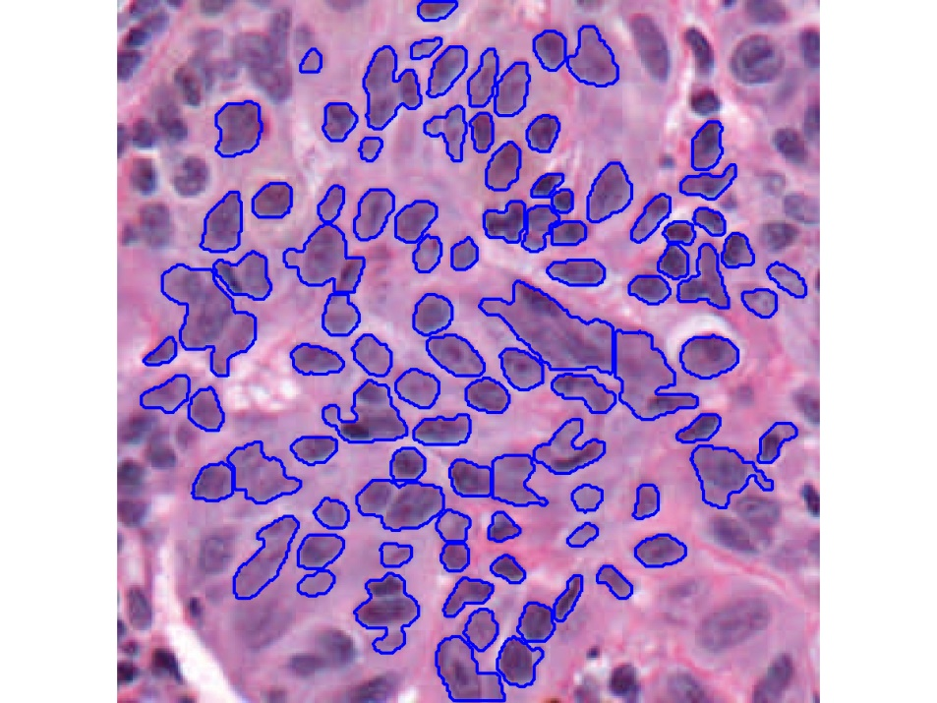
Feature Extraction
Features from Cell Nuclei
Segmented Nuclei
Conventional Nevus
Superficial Spreading Melanoma

Slide 88
Feature Extraction
Features from Cell Nuclei
Labeled Nuclei
Conventional Nevus
Superficial Spreading Melanoma

Slide 89
Feature Extraction
Features from Cell Nuclei
Nuclear Regions
Conventional Nevus
Superficial Spreading Melanoma
Generated by growing nuclei out from boundary
Used for various color and density features:
Region Stain 2, Region Area Ratio, etc.

Slide 90
Feature Extraction
Features from Cell Nuclei
Delaunay Triangulation
Conventional Nevus
Superficial Spreading Melanoma
Triangulation of nuclear centers
Used for various density features:
Mean Delaunay, Max. Delaunay, etc.

Slide 91
Transformations
Statistical Challenge:
Some Features Spread Over Several Orders of Magnitude
Few Big Values Can Dominate Analysis

Slide 92
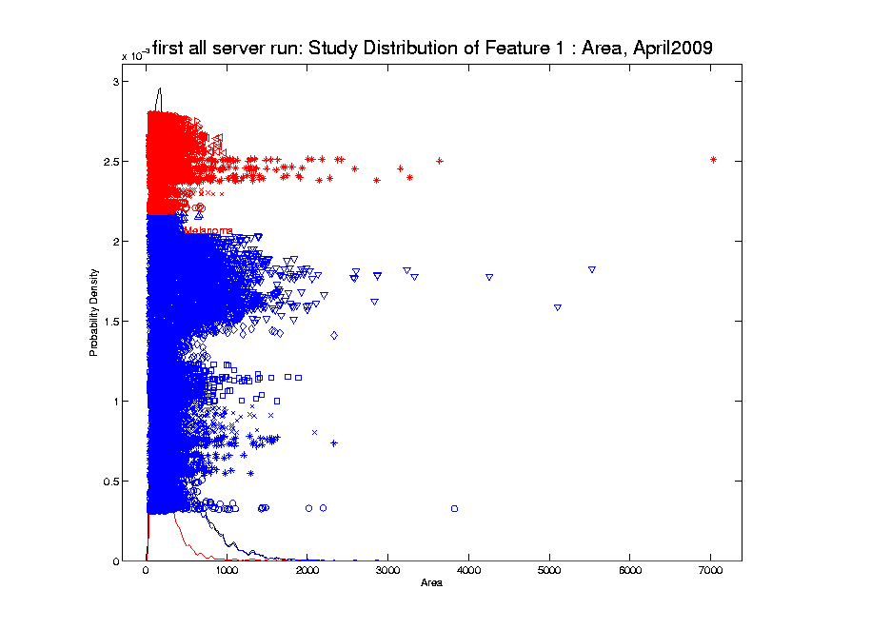
Transformations
Few Large Values Can Dominate Analysis

Slide 93
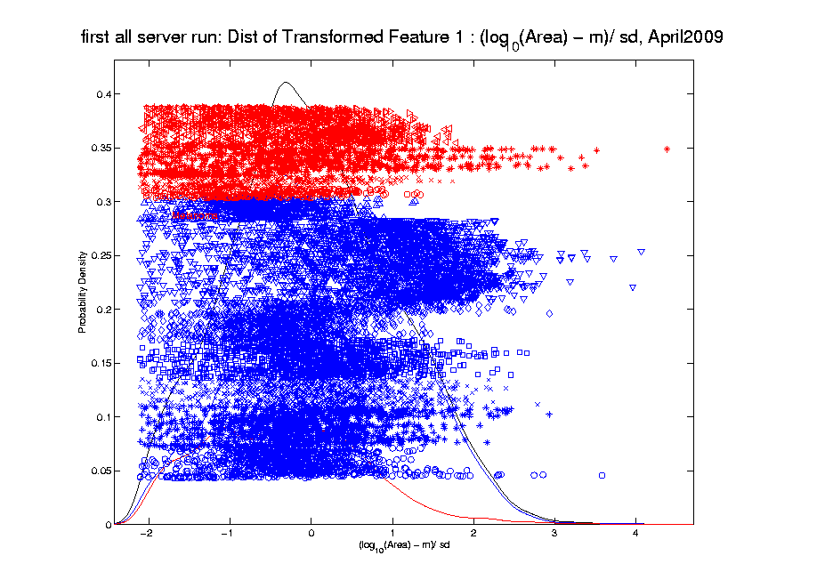
Transformations
Log Scale Gives All More Appropriate Weight
Note:
Orders
Of
Magnitude
Log₁₀ most
Interpretable

Slide 94
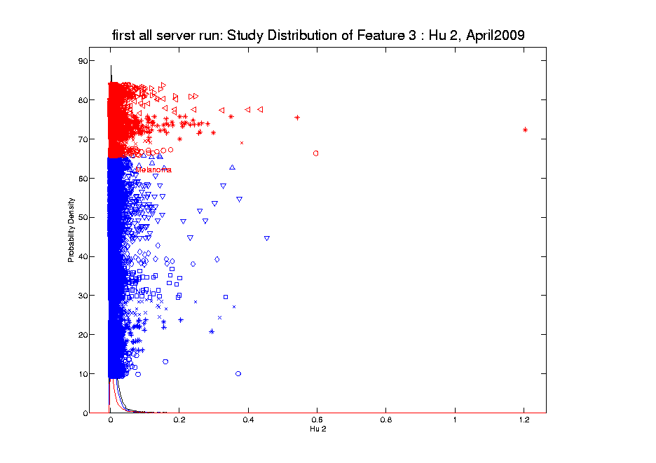
Transformations
Another Feature with Large Values
Problem
For This
Feature:
0 Values
(no log)

Slide 95
Transformations
Another Feature with Large Values
Approach:
Shifted
Log:
$$log\left(∙+δ\right)$$
Need to
Tune

Slide 96
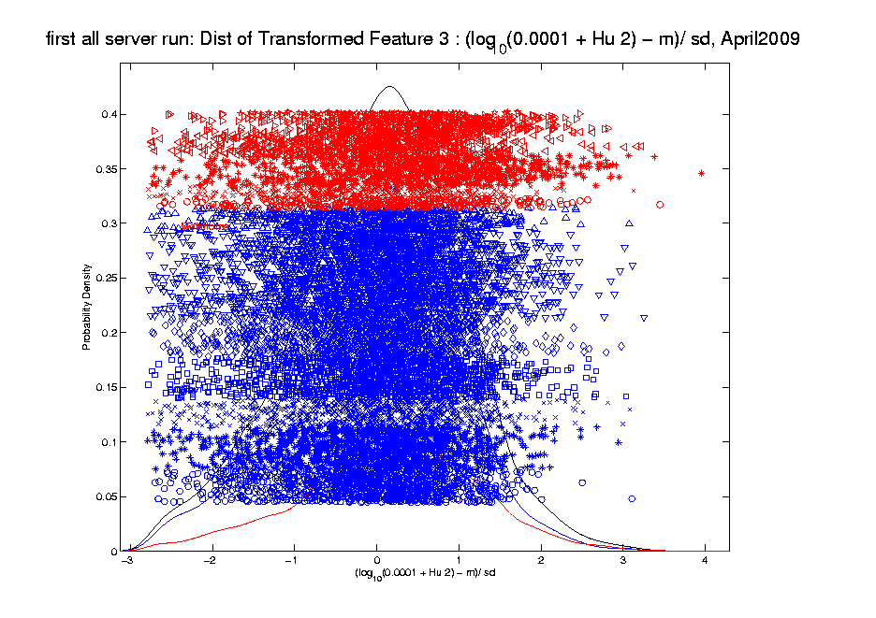
Transformations
Much Nicer Distribution

Slide 97
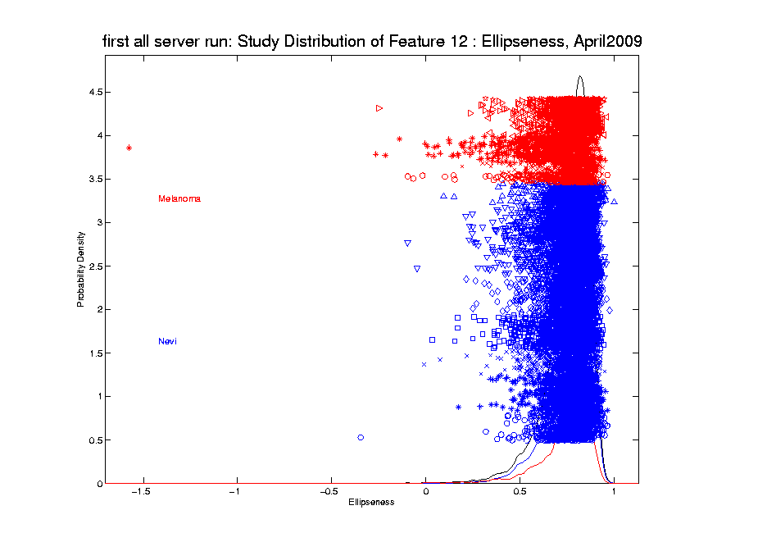
Transformations
Different Direction (Negative) of Skewness

Slide 98
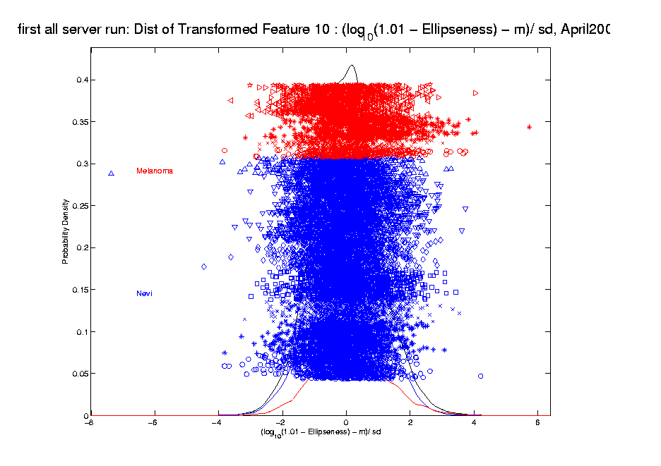
Transformations
Use Log Difference Transformation

Slide 99
Yeast Cell Cycle Data
Another Example Showing
Interesting Directions Beyond PCA
Exploratory Data Analysis

Slide 100
Yeast Cell Cycle Data
“Gene Expression” – Microarray data
Data (after major preprocessing): Expression “level” of:
thousands of genes (d ~ 1,000s)
but only dozens of “cases” (n ~ 10s)
Interesting statistical issue:
High Dimension Low Sample Size data
(HDLSS)

Slide 101
Yeast Cell Cycle Data
Data from:
Spellman, et al (1998)
Analysis here is from:
Zhao, Marron & Wells (2004)

Slide 102
Yeast Cell Cycle Data
Lab experiment:
Chemically “synchronize cell cycles”, of yeast cells
Do cDNA micro-arrays over time
Used 18 time points, over “about 2 cell cycles”
Studied 4,489 genes (whole genome)
Time series view of data:
have 4,489 time series of length 18
Functional Data View:
have 18 “curves”, of dimension 4,489
What are
the data
objects?

Slide 103
Yeast Cell Cycle Data, FDA View
Central question:
Which genes are “periodic” over 2 cell cycles?

Slide 104
Yeast Cell Cycle Data, FDA View
Periodic
genes?
Naïve
approach:
Simple PCA

Slide 105
Yeast Cell Cycle Data, FDA View
Central question: which genes are “periodic” over 2 cell cycles?
Naïve approach: Simple PCA
No apparent (2 cycle) periodic structure?
Eigenvalues suggest “variation” spread in many directions
PCA finds “directions of maximal variation”
Often, but not always, same as “interesting directions”
Here need better approach to study periodicities

Slide 106
Yeast Cell Cycle Data, FDA View
Approach
Project on Period 2 Components Only
Calculate via Fourier Representation
To understand, study Fourier Basis

