Slide 1
Participant Presentations
Please Sign Up:
Name
Email (Onyen is fine, or …)
Are You ENRolled?
Tentative Title (???? Is OK)
When:
  Next Week, Early, Oct., Nov., Late

Slide 2
Object Oriented Data Analysis
Three Major Parts of OODA Applications:
I. Object Definition
“What are the Data Objects?”
Exploratory Analysis
“What Is Data Structure / Drivers?”
III. Confirmatory Analysis / Validation
Is it Really There (vs. Noise Artifact)?

Slide 3
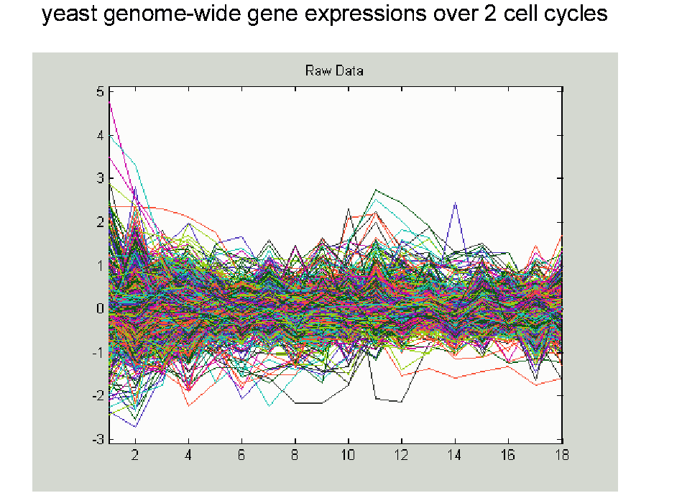
Yeast Cell Cycle Data, FDA View
Central question:
Which genes are “periodic” over 2 cell cycles?

Slide 4
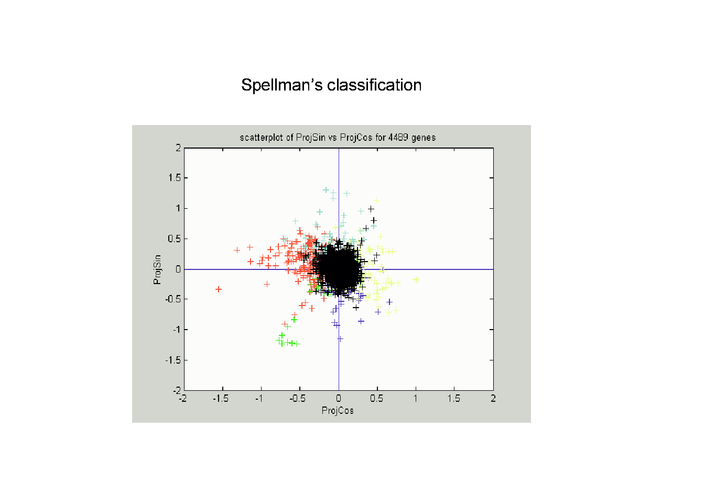
Frequency 2 Analysis
Colors are

Slide 5
Batch and Source Adjustment
For Stanford Breast Cancer Data (C. Perou)
Analysis in Benito, et al (2004) https://genome.unc.edu/pubsup/dwd/
Adjust for Source Effects
  Different sources of mRNA
Adjust for Batch Effects
  Arrays fabricated at different times

Slide 6
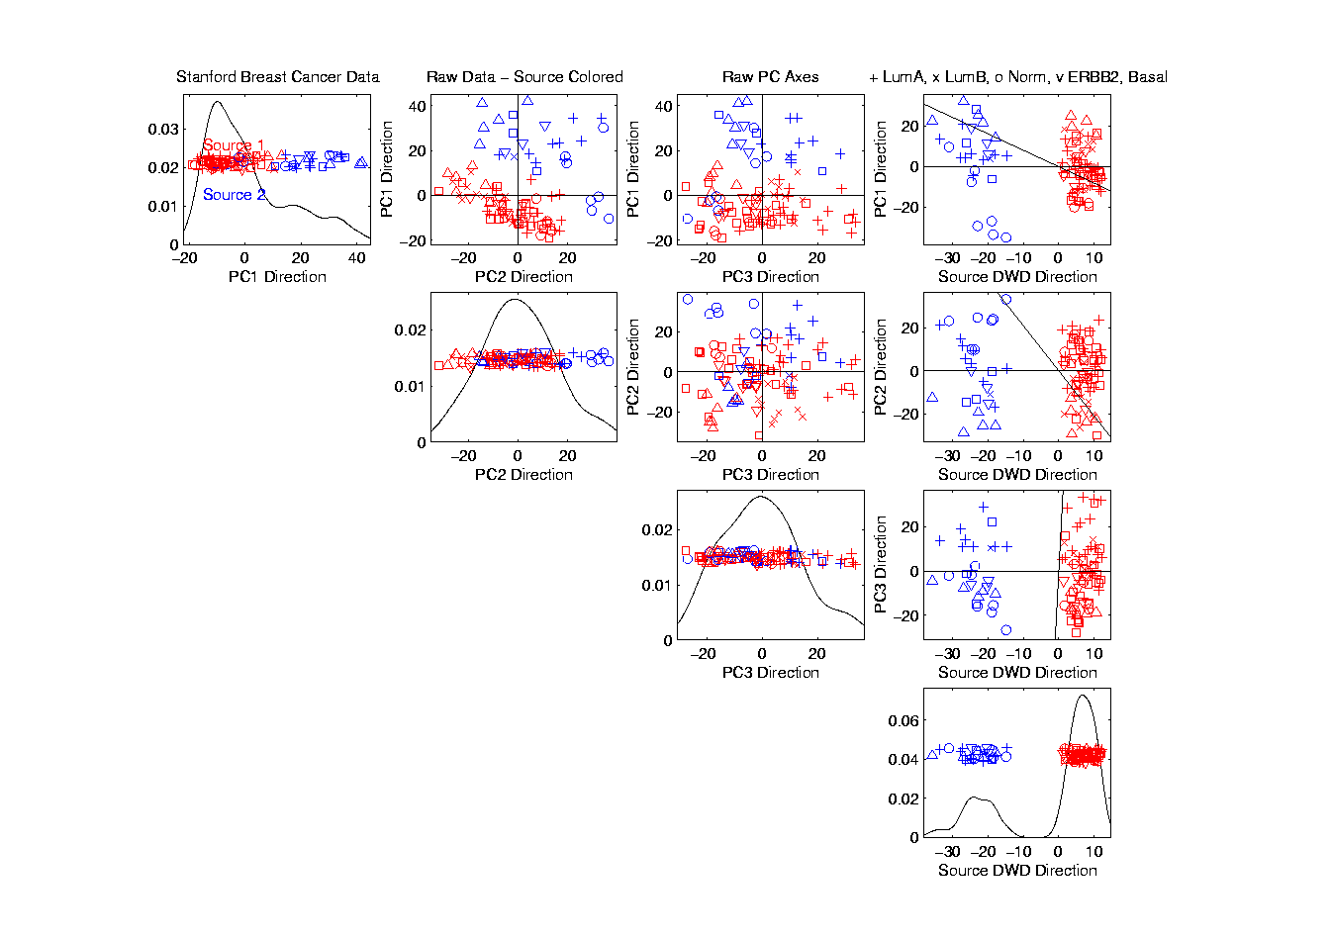
Source Batch Adj: PC 1-3 & DWD direction

Slide 7
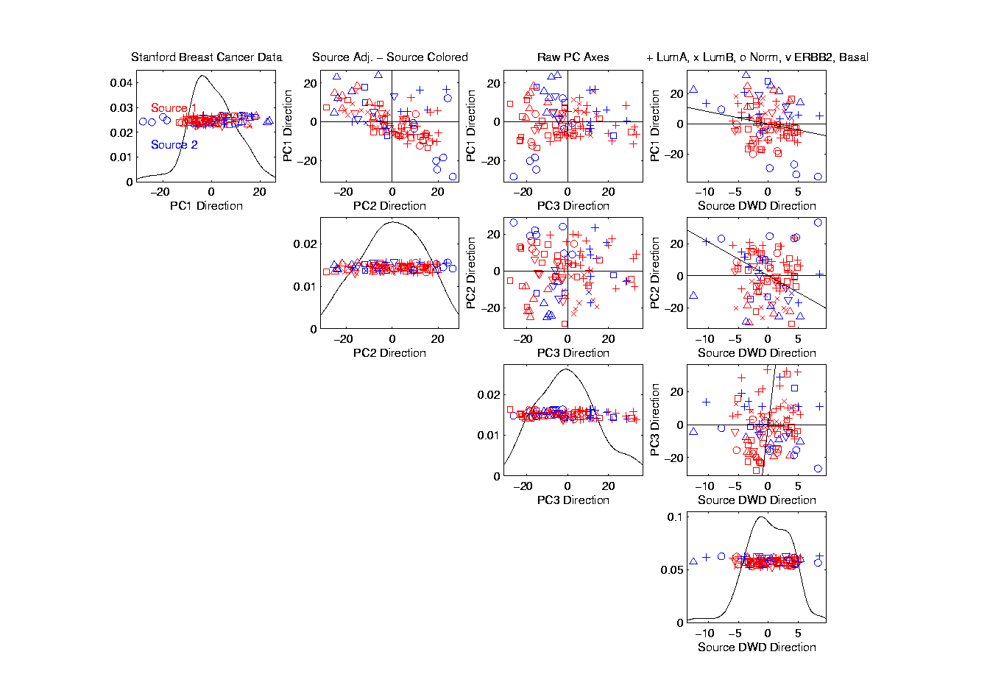
Source Batch Adj: DWD Source Adjustment

Slide 8
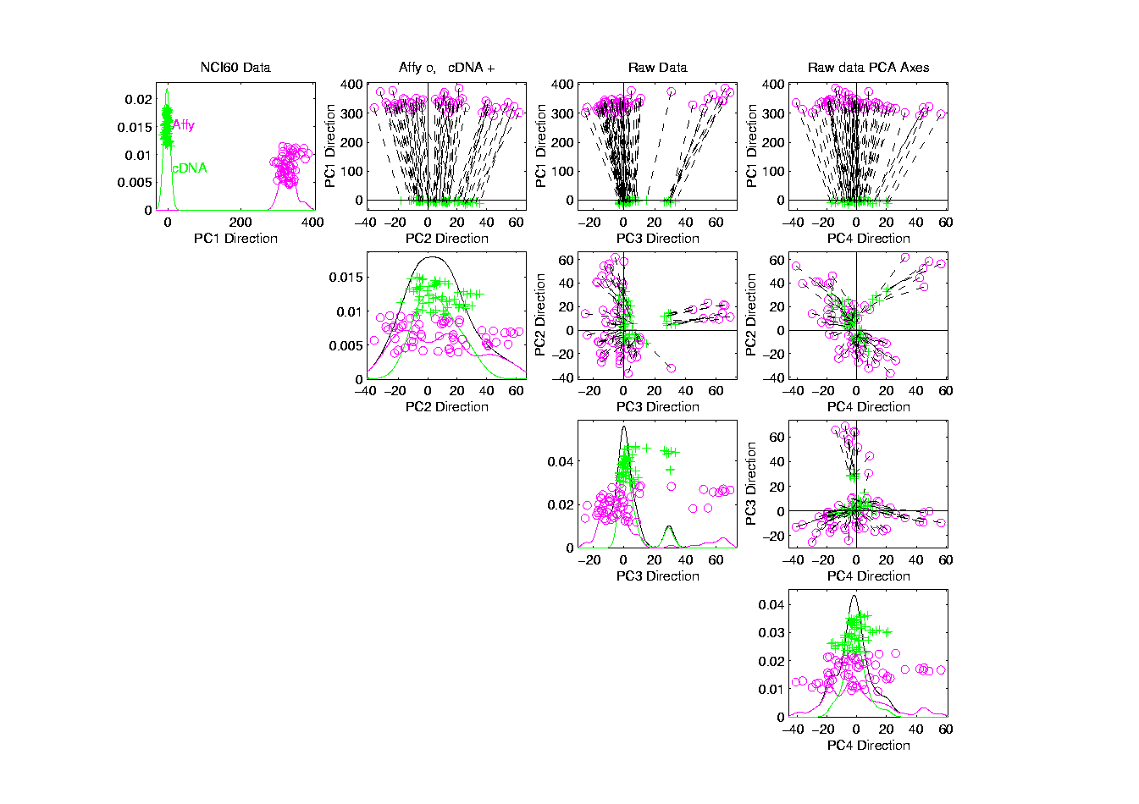
NCI 60: Raw Data, Platform Colored

Slide 9
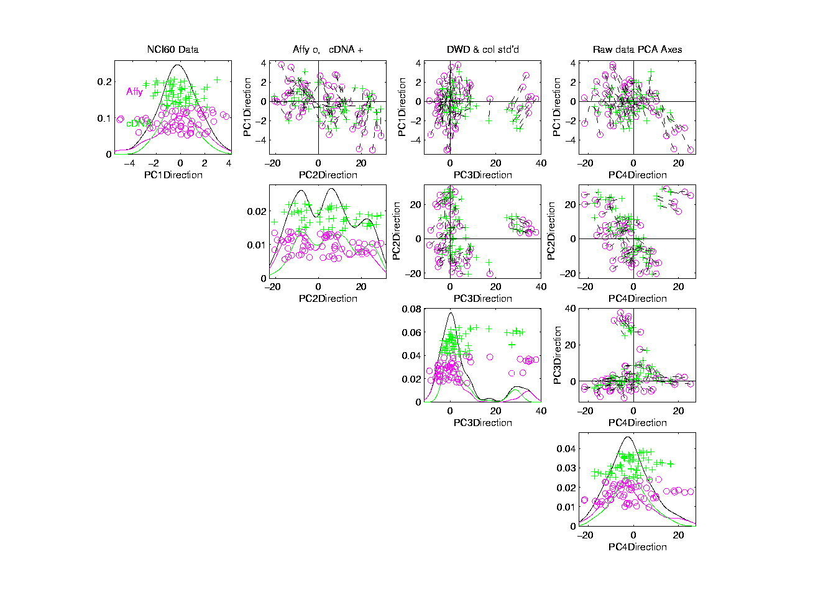
NCI 60: Fully Adjusted Data, Platform Colored

Slide 10
Object Oriented Data Analysis
Three Major Parts of OODA Applications:
I. Object Definition
“What are the Data Objects?”
Exploratory Analysis
“What Is Data Structure / Drivers?”
III. Confirmatory Analysis / Validation
Is it Really There (vs. Noise Artifact)?

Slide 11
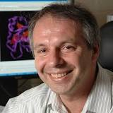
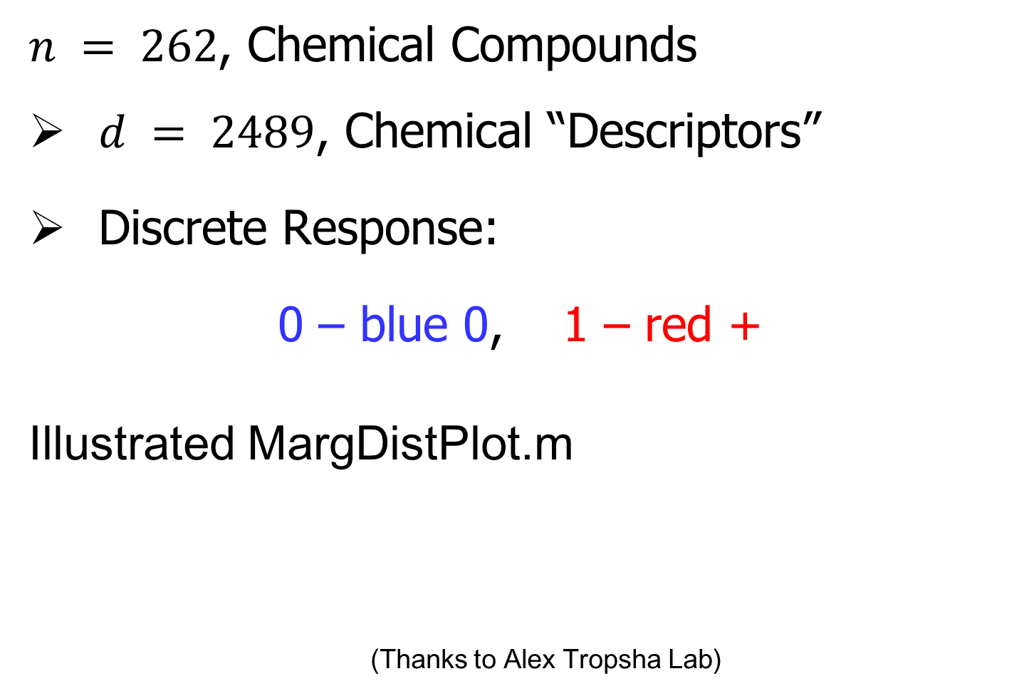
Recall Drug Discovery Data
$n = 262$, Chemical Compounds
$d = 2489$, Chemical “Descriptors”
Discrete Response:
0 – blue 0, 1 – red +
Illustrated MargDistPlot.m
(Thanks to Alex Tropsha Lab)

Slide 12
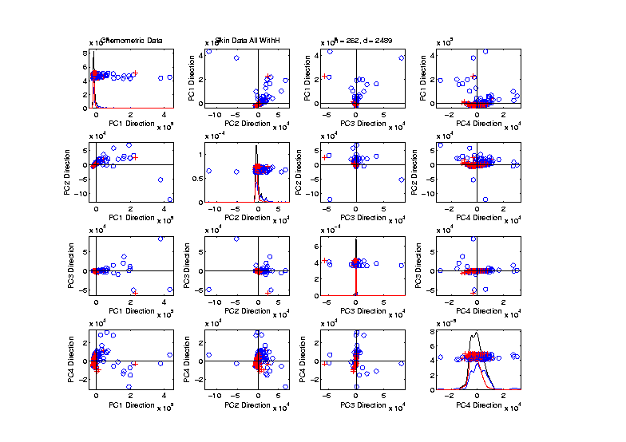
Recall Drug Discovery Data
Raw Data – PCA Scatterplot
Dominated
By Few
Large
Compounds
Not Good
Blue - Red
Separation

Slide 13
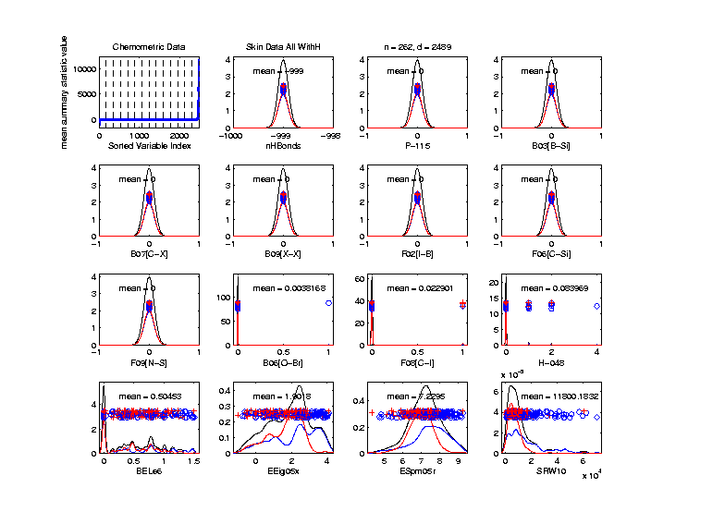
Recall Drug Discovery Data
MargDistPlot.m – Sorted on Means
Revealed
Many
Interesting
Features
Led To
Data
Modifcation

Slide 14
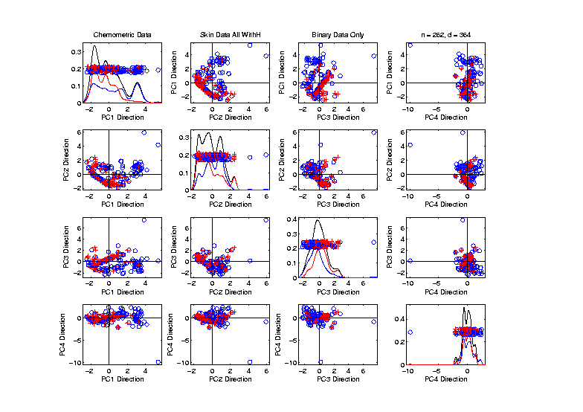
Recall Drug Discovery Data
PCA on Binary Variables
Interesting
Structure?
Clusters?
Stronger
Red vs. Blue

Slide 15
Recall Drug Discovery Data
PCA on Binary Variables
Deep
Question:
Is
Red vs. Blue
Separation
Better?

Slide 16
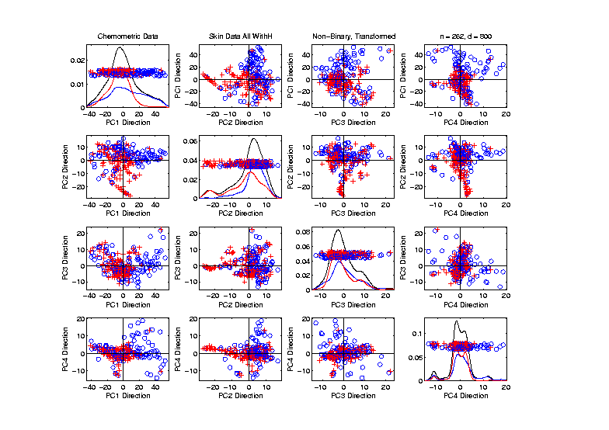
Recall Drug Discovery Data
PCA on Transformed Non-Binary Variables
Interesting
Structure?
Clusters?
Stronger
Red vs. Blue

Slide 17
Recall Drug Discovery Data
PCA on Transformed Non-Binary Variables
Same Deep
Question:
Is
Red vs. Blue
Separation
Better?

Slide 18
Recall Drug Discovery Data
Question:
When Is Red vs. Blue Separation Better?
Visual Approach:
Train DWD to Separate
Project, and View How Separated
Useful View, Add Orthogonal PC Directions

Slide 19
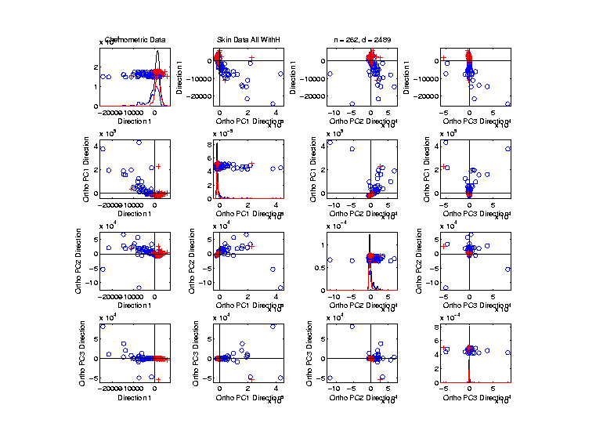
Recall Drug Discovery Data
Raw Data – DWD & Ortho PCs Scatterplot
Some
Blue - Red
Separation
But Dominated
By Few Large
Compounds

Slide 20
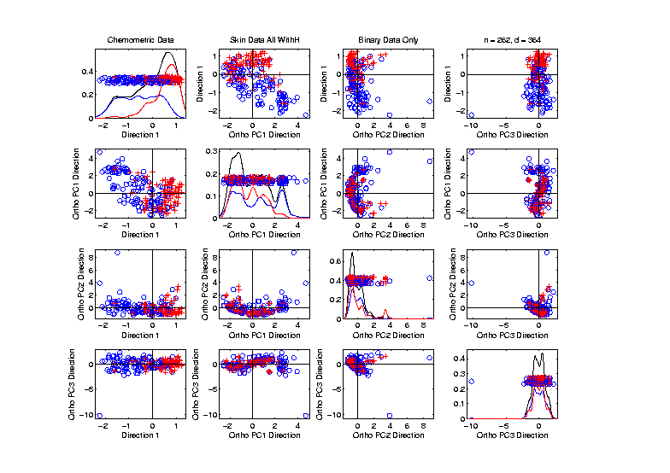
Recall Drug Discovery Data
Binary Data – DWD & Ortho PCs Scatterplot
Better
Blue - Red
Separation
And
Visualization

Slide 21
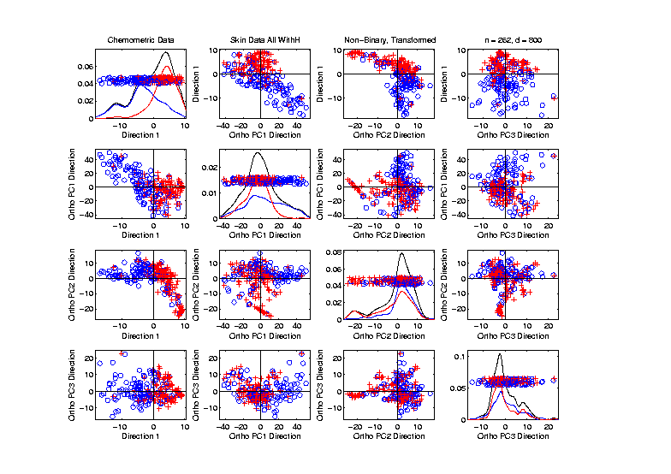
Recall Drug Discovery Data
Transform’d Non-Binary Data – DWD & OPCA
Better
Blue - Red
Separation
???
Very Useful
Visualization

Slide 22
Caution
DWD Separation Can Be Deceptive
Since DWD is Really Good at Separation
Important Concept:
Statistical Inference is Essential

Slide 23
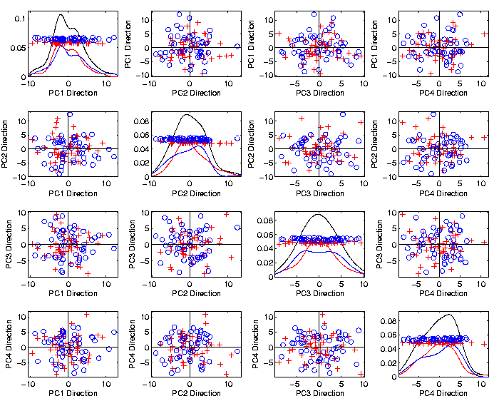
Caution
Toy 2-Class
Example
See
Structure?
Careful,
Only PC1-4

Slide 24
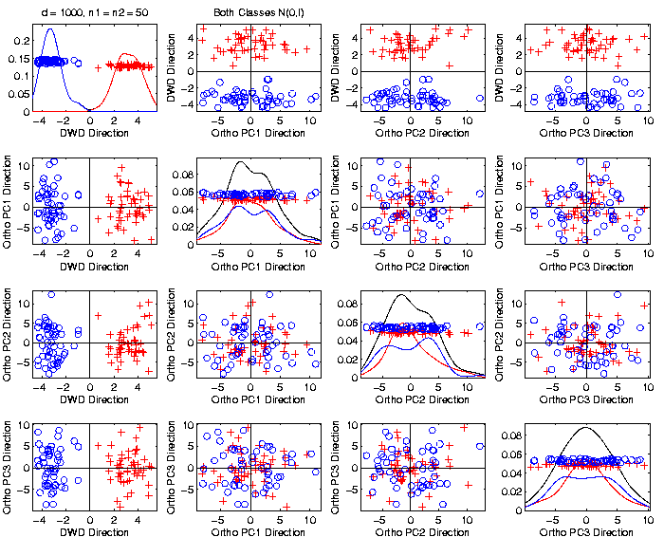
Caution
Toy 2-Class
Example
DWD &
Ortho PCA
Finds Big
Separation

Slide 25

Caution
Toy 2-Class
Example
Actually
Both
Classes
Are $N\left(0,I\right)$
$$d=1000$$

Slide 26
Caution
Toy 2-Class
Example
Separation
Is Natural
Sampling
Variation
(Will Study in Detail Later)

Slide 27
Caution
Main Lesson Again:
DWD Separation Can Be Deceptive
Since DWD is Really Good at Separation
Important Concept:
Statistical Inference is Essential
III. Confirmatory Analysis

Slide 28
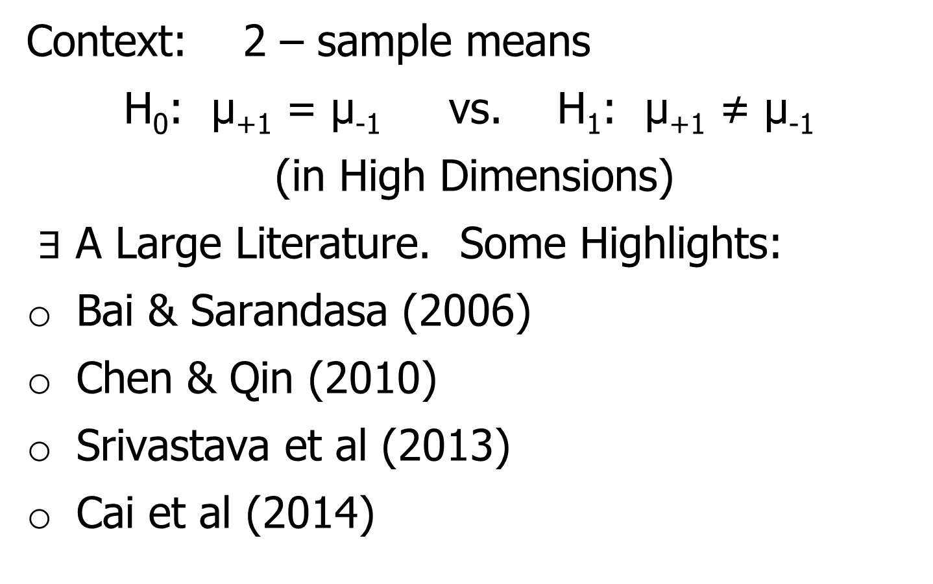
DiProPerm Hypothesis Test
Context: 2 – sample means
H₀: μ₊₁ = μ₋₁ vs. H₁: μ₊₁ ≠ μ₋₁
(in High Dimensions)
$∃$ A Large Literature. Some Highlights:
Bai & Sarandasa (2006)
Chen & Qin (2010)
Srivastava et al (2013)
Cai et al (2014)

Slide 29
DiProPerm Hypothesis Test
Context: 2 – sample means
H₀: μ₊₁ = μ₋₁ vs. H₁: μ₊₁ ≠ μ₋₁
(in High Dimensions)
Approach taken here:
Wei et al (2013)
Focus on Visualization via Projection
(Thus Test Related to Exploration)

Slide 30
DiProPerm Hypothesis Test
Context: 2 – sample means
H₀: μ₊₁ = μ₋₁ vs. H₁: μ₊₁ ≠ μ₋₁
Challenges:
Distributional Assumptions
Parameter Estimation
HDLSS space is slippery

Slide 31
DiProPerm Hypothesis Test
Context: 2 – sample means
H₀: μ₊₁ = μ₋₁ vs. H₁: μ₊₁ ≠ μ₋₁
Challenges:
Distributional Assumptions
Parameter Estimation
Suggested Approach:
Permutation test
(A flavor of classical “non-parametrics”)

Slide 32
DiProPerm Hypothesis Test
Suggested Approach:
Find a DIrection
(separating classes)
PROject the data
(reduces to 1 dim)
PERMute
(class labels, to assess significance,
with recomputed direction)

Slide 33
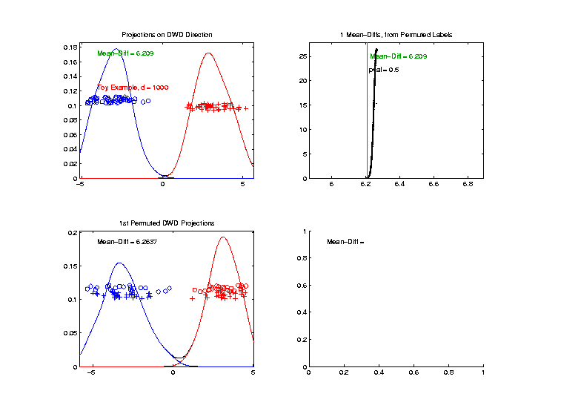

DiProPerm Hypothesis Test
Toy 2-Class Example
Separated DWD
Projections
(Again $N\left(0,I\right)$, $d=1000$)

Slide 34
DiProPerm Hypothesis Test
Toy 2-Class Example
Separated DWD
Projections
Measure Separation of Classes Using:
Mean Difference = 6.209

Slide 35
DiProPerm Hypothesis Test
Toy 2-Class Example
Separated DWD
Projections
Measure Separation of Classes Using:
Mean Difference = 6.209
Record as Vertical Line

Slide 36
DiProPerm Hypothesis Test
Toy 2-Class Example
Separated DWD
Projections
Measure Separation of Classes Using:
Mean Difference = 6.209
Statistically Significant???

Slide 37
DiProPerm Hypothesis Test
Toy 2-Class Example
Permuted
Class Labels

Slide 38
DiProPerm Hypothesis Test
Toy 2-Class Example
Permuted
Class Labels
Recompute DWD
& Projections

Slide 39
DiProPerm Hypothesis Test
Toy 2-Class Example
Measure Class
Separation
Using Mean
Difference
= 6.26

Slide 40
DiProPerm Hypothesis Test
Toy 2-Class Example
Measure Class
Separation
Using Mean
Difference
= 6.26
Record as Dot

Slide 41
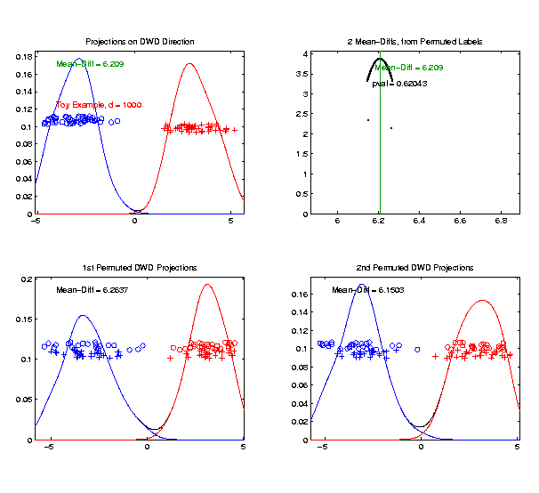
DiProPerm Hypothesis Test
Toy 2-Class Example
Generate 2nd
Permutation

Slide 42
DiProPerm Hypothesis Test
Toy 2-Class Example
Measure Class
Separation
Using Mean
Difference
= 6.15

Slide 43
DiProPerm Hypothesis Test
Toy 2-Class Example
Record as
Second Dot

Slide 44
DiProPerm Hypothesis Test
.
.
.
Repeat This 1,000 Times
To Generate Null Distribution

Slide 45
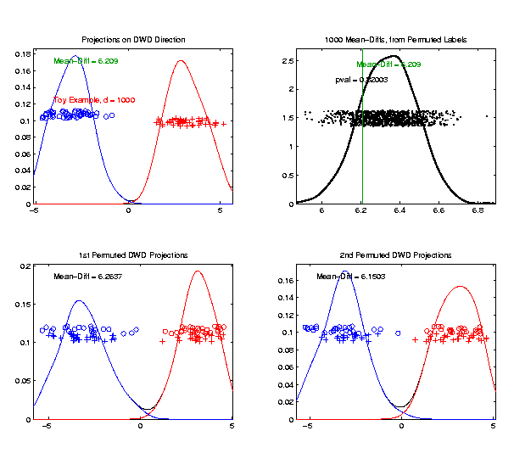
DiProPerm Hypothesis Test
Toy 2-Class Example
Generate Null
Distribution

Slide 46
DiProPerm Hypothesis Test
Toy 2-Class Example
Generate Null
Distribution
Compare With
Original Value

Slide 47
DiProPerm Hypothesis Test
Toy 2-Class Example
Generate Null
Distribution
Compare With
Original Value
Take Proportion
Larger as P-Value

Slide 48
DiProPerm Hypothesis Test
Toy 2-Class Example
Generate Null
Distribution
Compare With
Original Value
Not Significant

Slide 49
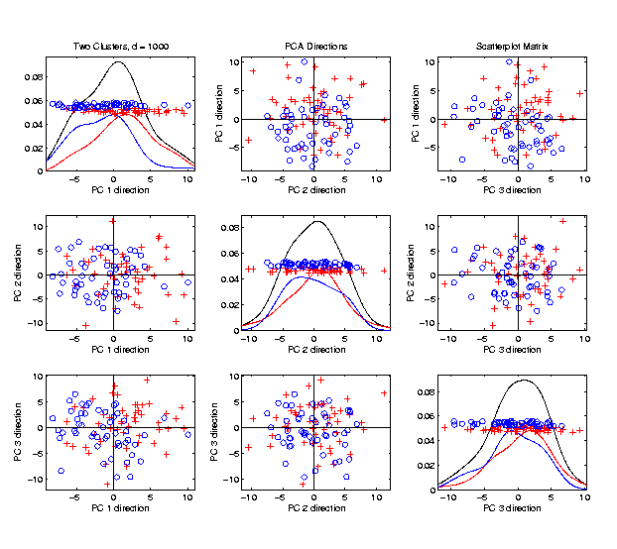
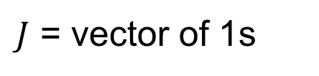

DiProPerm Hypothesis Test
$J$ = vector of 1s
Another Example
$N_{1000}\left(+0.05∗J,I\right)$
$N_{1000}\left(−0.05∗J,I\right)$
PCA View

Slide 50
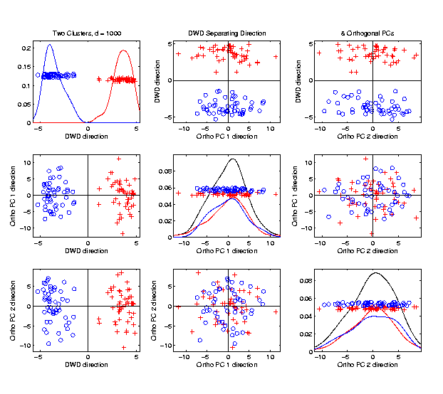

DiProPerm Hypothesis Test
Another Example
$N_{1000}\left(+0.05∗J,I\right)$
$N_{1000}\left(−0.05∗J,I\right)$
DWD View
(Similar
to $N\left(0,I\right)$?)

Slide 51
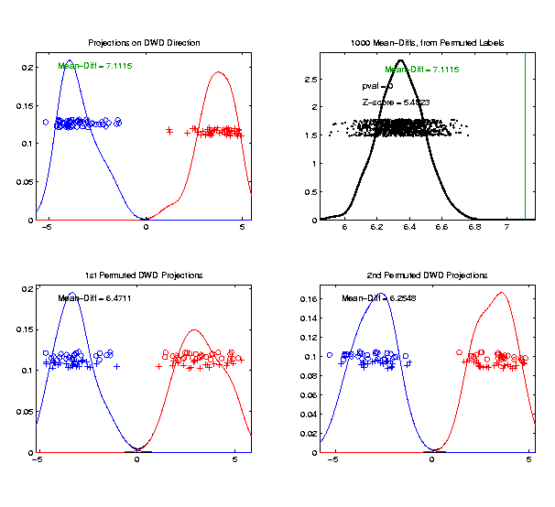

DiProPerm Hypothesis Test
Another Example
$N_{1000}\left(+0.05∗J,I\right)$
$N_{1000}\left(−0.05∗J,I\right)$
DiProPerm Now
Quite Significant

Slide 52
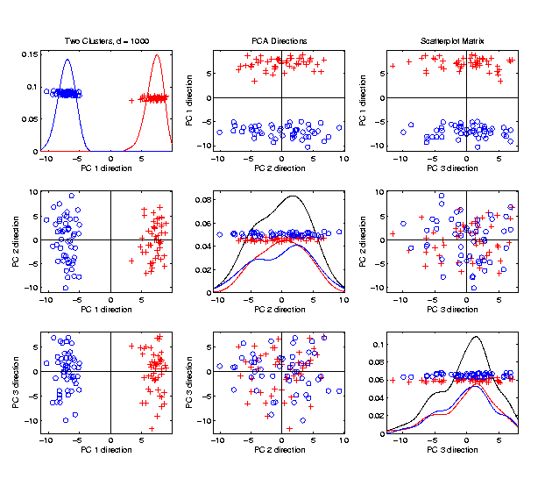

DiProPerm Hypothesis Test
Stronger Example
$N_{1000}\left(+0.2∗J,I\right)$
$N_{1000}\left(−0.2∗J,I\right)$
Even PCA
Shows Class
Difference

Slide 53
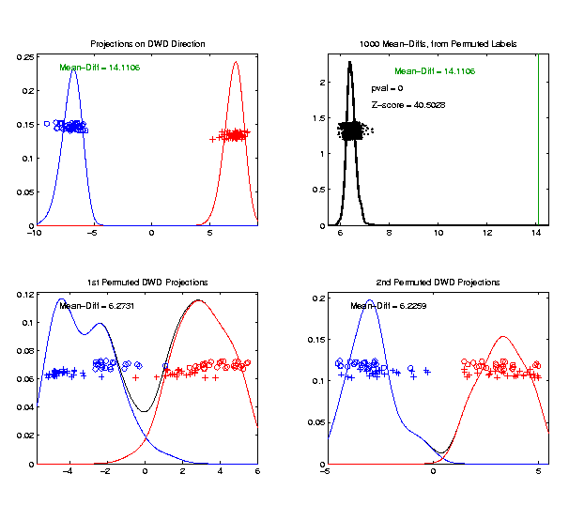

DiProPerm Hypothesis Test
Stronger Example
$N_{1000}\left(+0.2∗J,I\right)$
$N_{1000}\left(−0.2∗J,I\right)$
DiProPerm Very
Significant

Slide 54

DiProPerm Hypothesis Test
Stronger Example
$N_{1000}\left(+0.2∗J,I\right)$
$N_{1000}\left(−0.2∗J,I\right)$
DiProPerm Very
Significant
Z-Score Allows
Comparison
>> 5.4 above

Slide 55
DiProPerm Hypothesis Test
Real Data Example: Autism
Caudate Shape
(sub-cortical brain structure)
Shape summarized by 3-d locations of 1032 corresponding points
Autistic vs. Typically Developing
(Thanks to Josh Cates)

Slide 56
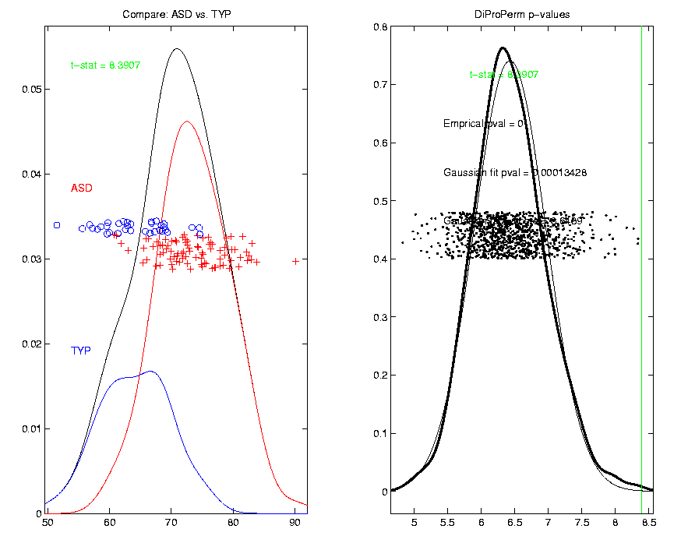
DiProPerm Hypothesis Test
Finds
Significant
Difference
Despite Weak
Visual
Impression

Slide 57
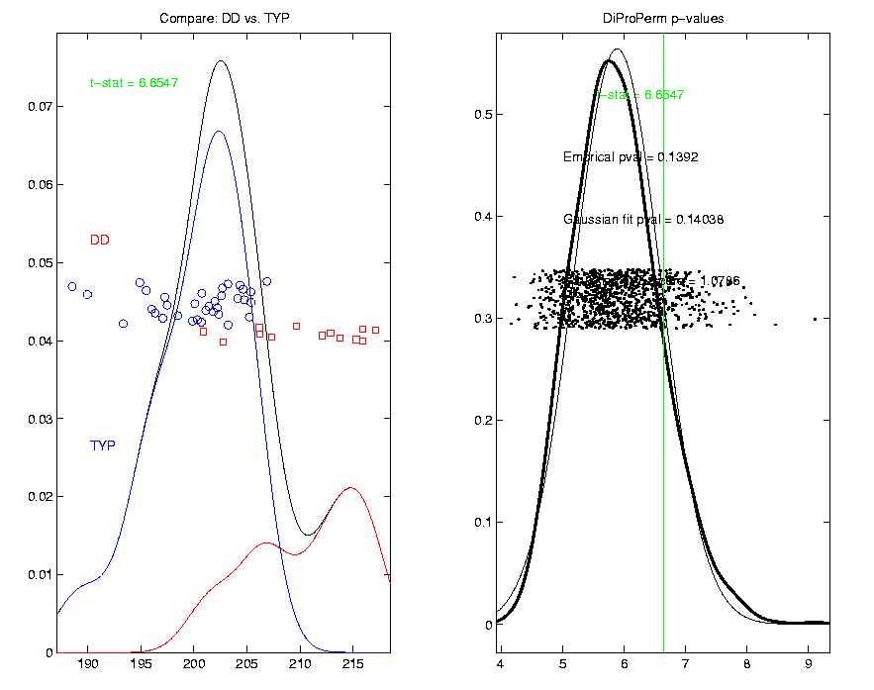
DiProPerm Hypothesis Test
Also Compare: Developmentally Delayed
No
Significant
Difference
But Stronger
Visual
Impression

Slide 58
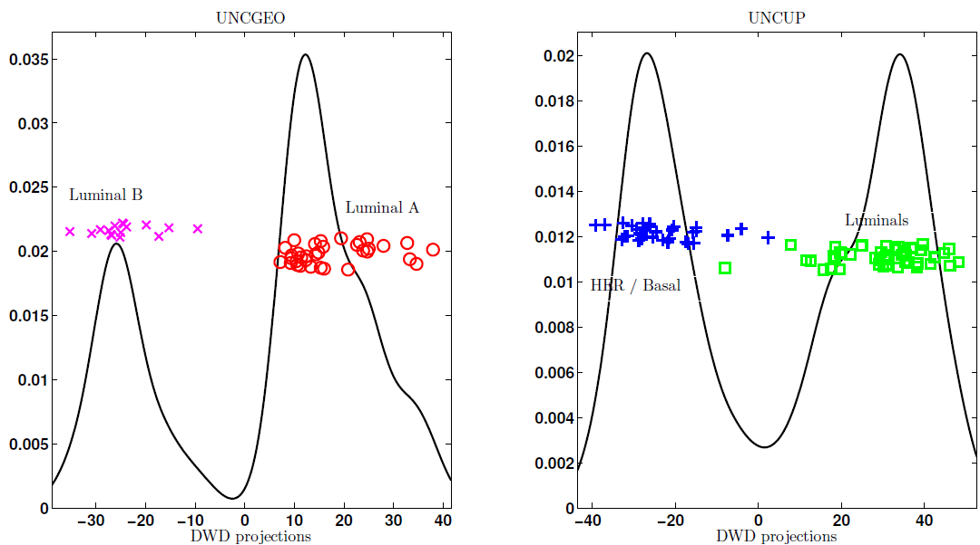
DiProPerm Hypothesis Test
Two
Examples
Which Is
“More
Distinct”?
Visually Better Separation?
Thanks to Katie Hoadley

Slide 59
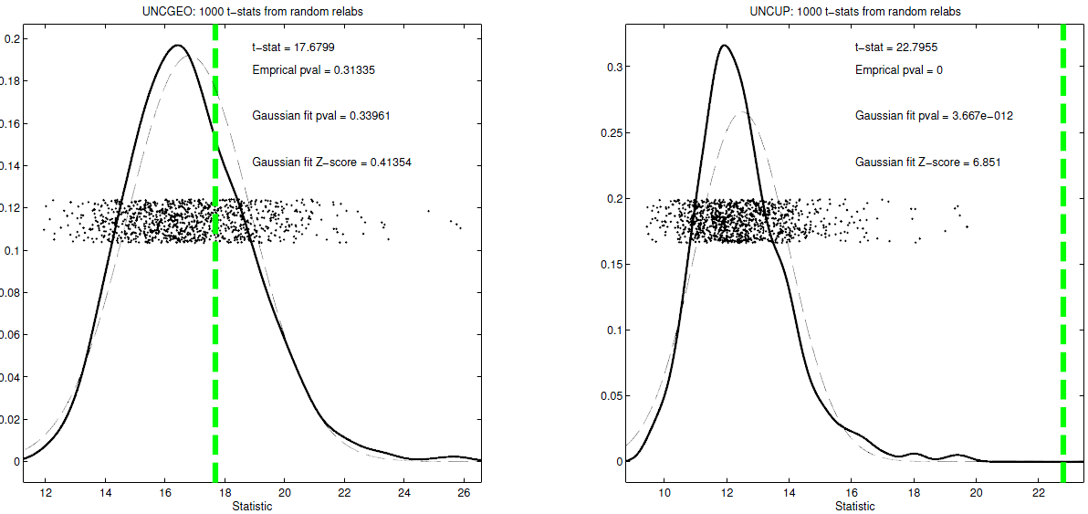
DiProPerm Hypothesis Test
Two
Examples
Which Is
“More
Distinct”?
Stronger Statistical Significance!
(Reason: Differing Sample Sizes)

Slide 60
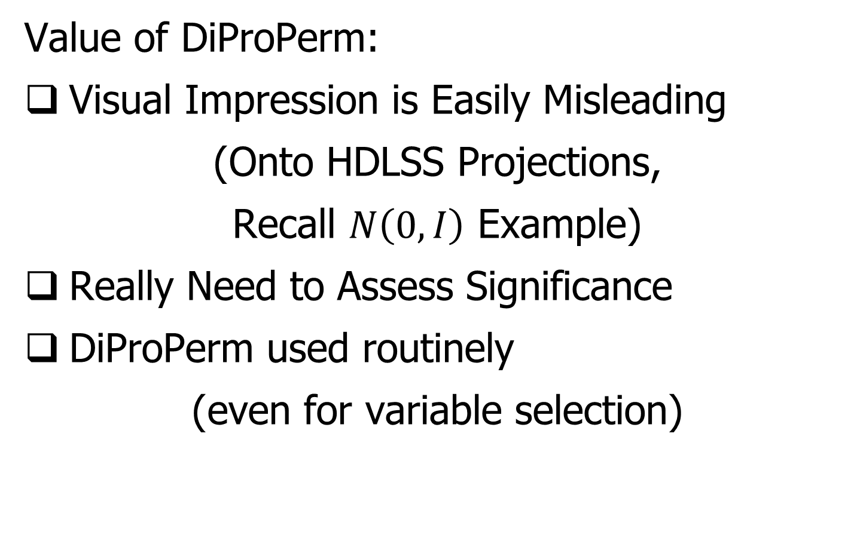
DiProPerm Hypothesis Test
Value of DiProPerm:
Visual Impression is Easily Misleading
(Onto HDLSS Projections,
Recall $N\left(0,I\right)$ Example)
Really Need to Assess Significance
DiProPerm used routinely
(even for variable selection)

Slide 61
DiProPerm Hypothesis Test
Choice of Direction:
Distance Weighted Discrimination (DWD)
Support Vector Machine (SVM)
Mean Difference
Maximal Data Piling
Introduced
Later

Slide 62
DiProPerm Hypothesis Test
Choice of 1-d Summary Statistic:
2-sample t-stat
Mean difference
Median difference
Area Under ROC Curve
Surprising
Comparison
Coming Later

Slide 63
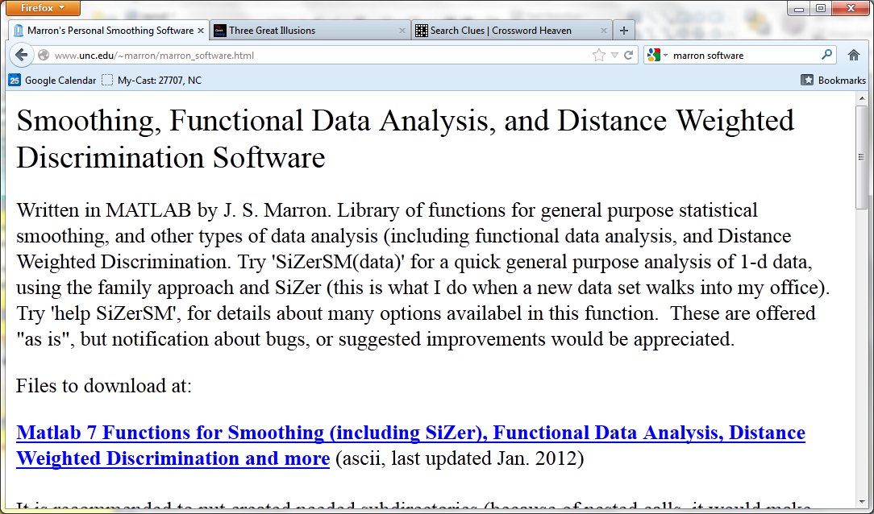
Recall Matlab Software
Posted Software for OODA

Slide 64
DiProPerm Hypothesis Test
Matlab Software:
DiProPermSM.m
In BatchAdjust Directory

Slide 65
Recall Drug Discovery Data
Raw Data – DWD & Ortho PCs Scatterplot
Some
Blue - Red
Separation
But Dominated
By Few Large
Compounds

Slide 66
Recall Drug Discovery Data
Binary Data – DWD & Ortho PCs Scatterplot
Better
Blue - Red
Separation
And
Visualization

Slide 67
Recall Drug Discovery Data
Transform’d Non-Binary Data – DWD & OPCA
Better
Blue - Red
Separation
???
Very Useful
Visualization

Slide 68
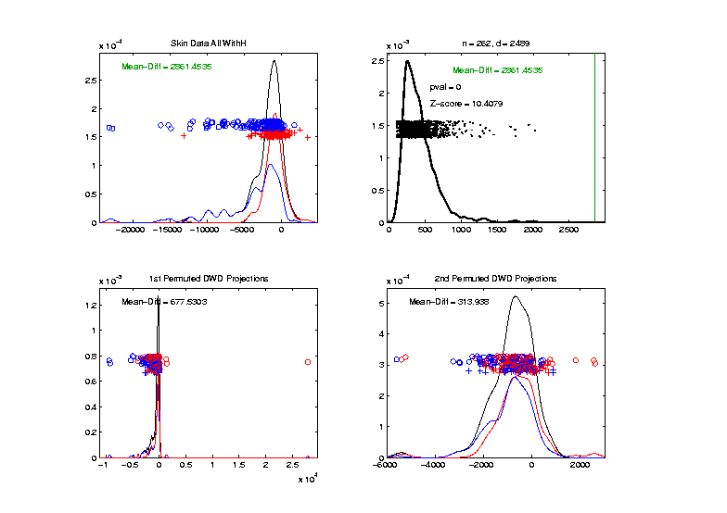
Recall Drug Discovery Data
DiProPerm test of Blue vs. Red
Full Raw Data
Z = 10.4
Reasonable
Difference

Slide 69
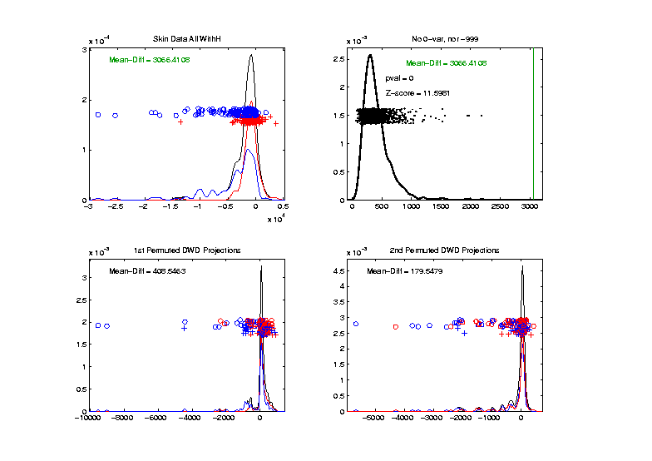
Recall Drug Discovery Data
DiProPerm test of Blue vs. Red
Delete var = 0 & -999 Variables
Z = 11.6
Slightly
Stronger

Slide 70
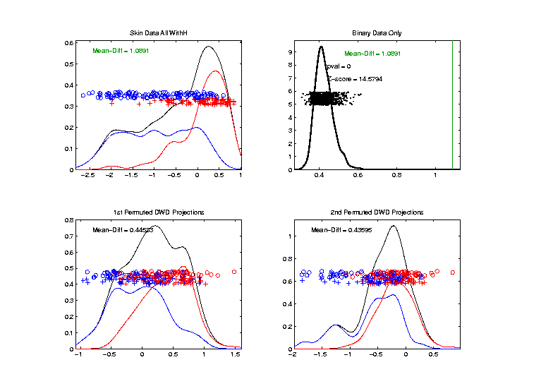
Recall Drug Discovery Data
DiProPerm test of Blue vs. Red
Binary Variables Only
Z = 14.6
More Than
Raw Data

Slide 71
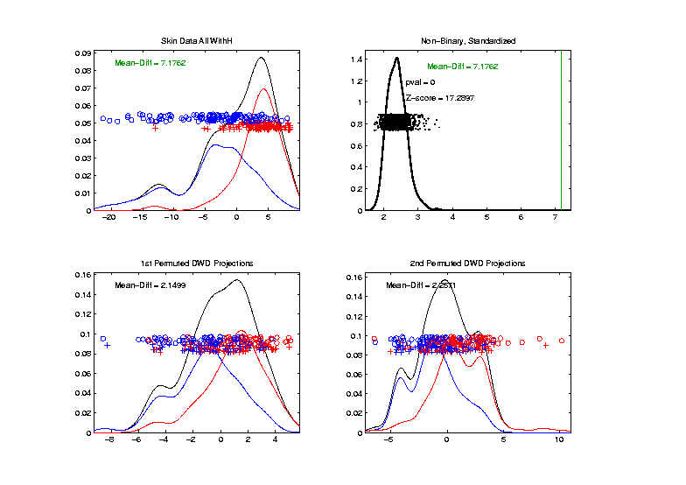
Recall Drug Discovery Data
DiProPerm test of Blue vs. Red
Non-Binary – Standardized
Z = 17.3
Stronger

Slide 72
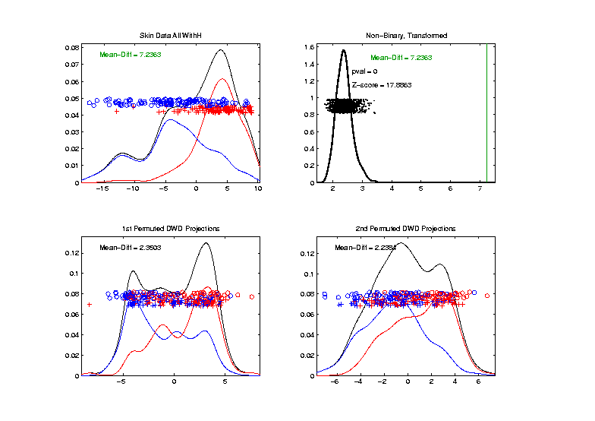
Recall Drug Discovery Data
DiProPerm test of Blue vs. Red
Non-Binary – Shifted Log Transform
Z = 17.9
Slightly
Stronger

Slide 73
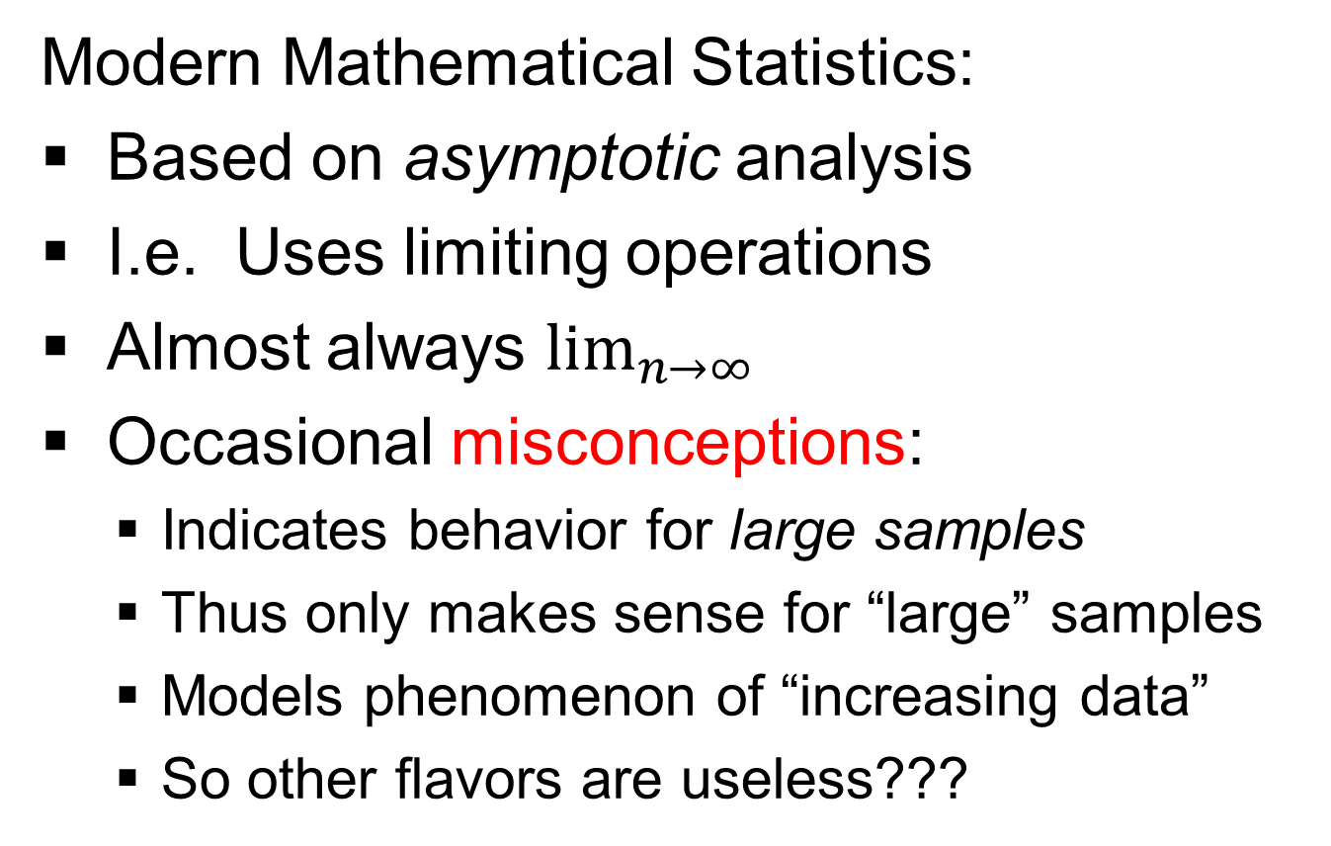
HDLSS Asymptotics
Modern Mathematical Statistics:
Based on asymptotic analysis
I.e. Uses limiting operations
Almost always $\lim_{n→∞}{}$
Occasional misconceptions:
  Indicates behavior for large samples
  Thus only makes sense for “large” samples
  Models phenomenon of “increasing data”
  So other flavors are useless???
Notes:
73

Slide 74
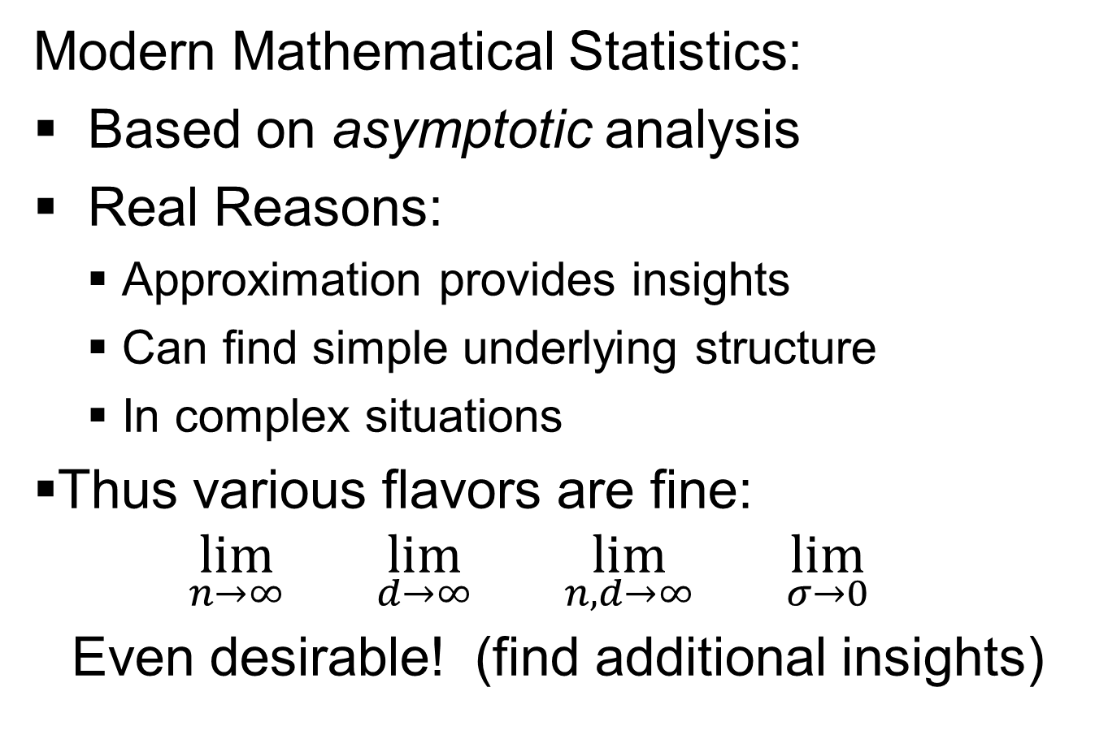
HDLSS Asymptotics
Modern Mathematical Statistics:
Based on asymptotic analysis
Real Reasons:
  Approximation provides insights
  Can find simple underlying structure
  In complex situations
Thus various flavors are fine:
$$\lim_{n→∞}{} \lim_{d→∞}{} \lim_{n,d→∞}{} \lim_{σ→0}{}$$
Even desirable! (find additional insights)
Notes:
74

Slide 75
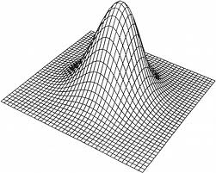
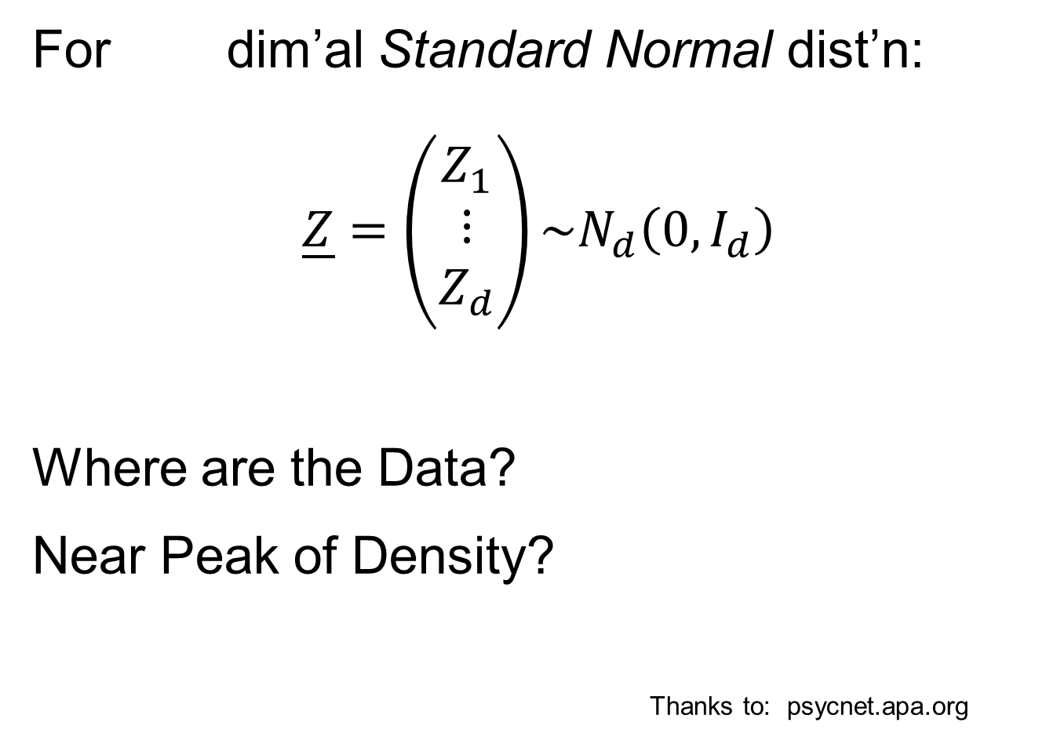
HDLSS Asymptotics: Simple Paradoxes
For dim’al Standard Normal dist’n:
$$\underline{Z}=\left(\begin{matrix}Z_{1} \\ ⋮ \\ Z_{d}\end{matrix}\right)\sim N_{d}\left(0,I_{d}\right)$$
Where are the Data?
Near Peak of Density?
Thanks to: psycnet.apa.org

Slide 76

HDLSS Asymptotics: Simple Paradoxes
As $d→∞$,
$$\left\|\underline{Z}\right\|=\sqrt{d}+O_{p}\left(1\right)$$
Data lie roughly on surface of sphere,
with radius $\sqrt{d}$
- Yet origin is point of highest density???
- Paradox resolved by:
density w. r. t. Lebesgue Measure
Notes:
76

Slide 77

HDLSS Asymptotics: Simple Paradoxes
- Paradox resolved by:
density w. r. t. Lebesgue Measure
Lebesgue Measure Pushes Mass Out
Density Pulls Data In
$d^{−\frac{1}{2}}$ Is The Balance Point
Notes:
77

Slide 78

HDLSS Asymptotics: Simple Paradoxes
As $d→∞$, $\left\|\underline{Z}\right\|=\sqrt{d}+O_{p}\left(1\right)$
Important Philosophical Consequence:
$∄$“Average People”
Parents Lament:
Why Can’t I Have Average Children?
Theorem: Impossible (over many factors)!
Notes:
78

Slide 79

HDLSS Asymptotics: Simple Paradoxes
Distance tends to non-random constant:
$$\left\|{\underline{Z}}_{1}−{\underline{Z}}_{2}\right\|=\sqrt{2d}+O_{p}\left(1\right)$$
Factor $\sqrt{2}$, since
$sd\left(X_{1}+X_{2}\right)=\sqrt{{sd\left(X_{1}\right)}^{2}+{sd\left(X_{2}\right)}^{2}}$
Can extend to ${\underline{Z}}_{1},⋯{\underline{Z}}_{n}$
All points are equidistant
Notes:
79

Slide 80

HDLSS Asymptotics: Simple Paradoxes
For $d$ dim’al Standard Normal dist’n:
${\underline{Z}}_{1}$ indep. of ${\underline{Z}}_{2}\sim N_{d}\left(\underline{0},I_{d}\right)$
High dim’al Angles (as $d→∞$):
$$Angle\left({\underline{Z}}_{1},{\underline{Z}}_{2}\right)={90}^{°}+O_{p}\left(d^{−1/2}\right)$$
- Everything is orthogonal???

Slide 81

HDLSS Asy’s: Geometrical Represent’n
Assume ${\underline{Z}}_{1},⋯{\underline{Z}}_{1}\sim N_{d}\left(\underline{0},I_{d}\right)$, let $d→∞$
Study Subspace Generated by Data
Hyperplane through $0$,
of dimension $n$
Points are “nearly equidistant to $0$”,
& dist $\sqrt{d}$
Within plane, can
“rotate towards $\sqrt{d} ×$ Unit Simplex”
All Gaussian data sets are:
“near Unit Simplex Vertices”!!!
“Randomness” appears
only in rotation of simplex
Hall, Marron & Neeman (2005)

Slide 82


HDLSS Asy’s: Geometrical Represent’n
Assume ${\underline{Z}}_{1},⋯{\underline{Z}}_{1}\sim N_{d}\left(\underline{0},I_{d}\right)$, let $d→∞$
Study Hyperplane Generated by Data
$n−1$ dimensional hyperplane
Points are pairwise equidistant, dist $\sim \sqrt{2d}$
Points lie at vertices of:
$\sqrt{2d}×$“regular $n−$ hedron”
Again “randomness in data” is only in rotation
Surprisingly rigid structure in random data?

Slide 83
HDLSS Asy’s: Geometrical Represen’tion
Simulation View: study “rigidity after rotation”
Simple 3 point data sets
In dimensions d = 2, 20, 200, 20000
Generate hyperplane of dimension 2
Rotate that to plane of screen
Rotate within plane, to make “comparable”
Repeat 10 times, use different colors

Slide 84
HDLSS Asy’s: Geometrical Represen’tion
Simulation View: Shows “Rigidity after Rotation”

Slide 85
HDLSS Asy’s: Geometrical Represen’tion
Straightforward Generalizations:
non-Gaussian data: only need moments?

Slide 86

HDLSS Asy’s: Geometrical Represen’tion
Straightforward Generalizations:
non-Gaussian data: only need moments
non-independent: use “mixing conditions”
Mild Eigenvalue condition on Theoretical Cov.
(Ahn, Marron, Muller & Chi, 2007)
$⋮$
All based on simple “Laws of Large Numbers”

Slide 87
2nd Paper on HDLSS Asymptotics
Ahn, Marron, Muller & Chi (2007)
  Assume 2nd Moments
  Assume no eigenvalues too large

Slide 88
2nd Paper on HDLSS Asymptotics
Ahn, Marron, Muller & Chi (2007)
  Assume 2nd Moments
  Assume no eigenvalues too large in sense:
For assume i.e.

Slide 89
2nd Paper on HDLSS Asymptotics
Ahn, Marron, Muller & Chi (2007)
  Assume 2nd Moments
  Assume no eigenvalues too large in sense:
For assume i.e.
(min possible)
(much weaker than previous mixing conditions…)

Slide 90
2nd Paper on HDLSS Asymptotics
Background:
In classical multivariate analysis, the statistic
Is called the “epsilon statistic”
And is used to test “sphericity” of dist’n,
i.e. “are all cov’nce eigenvalues the same?”

Slide 91
2nd Paper on HDLSS Asymptotics
Can show: epsilon statistic:
Satisfies:

Slide 92
2nd Paper on HDLSS Asymptotics
Can show: epsilon statistic:
Satisfies:
For spherical Normal,

Slide 93
2nd Paper on HDLSS Asymptotics
Can show: epsilon statistic:
Satisfies:
For spherical Normal,
Single extreme eigenvalue gives

Slide 94
2nd Paper on HDLSS Asymptotics
Can show: epsilon statistic:
Satisfies:
For spherical Normal,
Single extreme eigenvalue gives
So assumption is very mild
Much weaker than mixing conditions

Slide 95
2nd Paper on HDLSS Asymptotics
Ahn, Marron, Muller & Chi (2007)
  Assume 2nd Moments
  Assume no eigenvalues too large, :
Then

Slide 96
2nd Paper on HDLSS Asymptotics
Ahn, Marron, Muller & Chi (2007)
  Assume 2nd Moments
  Assume no eigenvalues too large, :
Then
Not so strong as before:

Slide 97
2nd Paper on HDLSS Asymptotics
Can we improve on:
?

Slide 98

2nd Paper on HDLSS Asymptotics
Can we improve on:
?
John Kent example: Normal scale mixture

Slide 99
2nd Paper on HDLSS Asymptotics
Can we improve on:
?
John Kent example: Normal scale mixture
Won’t get:

Slide 100


3rd Paper on HDLSS Asymptotics
Get Geometrical Representation using
4th Moment Assumption
Stronger Covariance Matrix (only) Assum’n
Yata & Aoshima (2012)

Slide 101
2nd Paper on HDLSS Asymptotics
Notes on Kent’s Normal Scale Mixture
Data Vectors are indep’dent of each other
But entries of each have strong depend’ce
However, can show entries have cov = 0!

Slide 102
2nd Paper on HDLSS Asymptotics
Notes on Kent’s Normal Scale Mixture
Data Vectors are indep’dent of each other
But entries of each have strong depend’ce
However, can show entries have cov = 0!
Recall statistical folklore:
Covariance = 0 Independence

Slide 103
0 Covariance is not independence
Simple Example

Slide 104
0 Covariance is not independence
Simple Example:
Random Variables and
Make both Gaussian
(Note: Not Using Multivariate Gaussian)

Slide 105
0 Covariance is not independence
Simple Example:
Random Variables and
Make both Gaussian
With strong dependence
Yet 0 covariance
Given , define

Slide 106

0 Covariance is not independence
Simple Example:

Slide 107

0 Covariance is not independence
Simple Example:

Slide 108

0 Covariance is not independence
Simple Example, c to make cov(X,Y) = 0

Slide 109
0 Covariance is not independence
Simple Example:
Distribution is degenerate
Supported on diagonal lines

Slide 110
0 Covariance is not independence
Simple Example:
Distribution is degenerate
Supported on diagonal lines
Not abs. cont. w.r.t. 2-d Lebesgue meas.

Slide 111
0 Covariance is not independence
Simple Example:
Distribution is degenerate
Supported on diagonal lines
Not abs. cont. w.r.t. 2-d Lebesgue meas.
For small , have
For large , have

Slide 112
0 Covariance is not independence
Simple Example:
Distribution is degenerate
Supported on diagonal lines
Not abs. cont. w.r.t. 2-d Lebesgue meas.
For small , have
For large , have
By continuity, with

Slide 113
0 Covariance is not independence
Result:
Joint distribution of and :
  Has Gaussian marginals
  Has

Slide 114
0 Covariance is not independence
Result:
Joint distribution of and :
  Has Gaussian marginals
  Has
  Yet strong dependence of and
  Thus not multivariate Gaussian

Slide 115
0 Covariance is not independence
Result:
Joint distribution of and :
  Has Gaussian marginals
  Has
  Yet strong dependence of and
  Thus not multivariate Gaussian
Shows Multivariate Gaussian means more
than Gaussian Marginals

Slide 116
HDLSS Math. Stat. of PCA
Consistency & Strong Inconsistency
(Study Properties of PCA,
In Estimating Eigen-Directions & -Values)
[Assume Data are Mean Centered]

Slide 117
HDLSS Math. Stat. of PCA
Consistency & Strong Inconsistency:
Spike Covariance Model, Paul (2007)
For Eigenvalues:

Slide 118
HDLSS Math. Stat. of PCA
Consistency & Strong Inconsistency:
Spike Covariance Model, Paul (2007)
For Eigenvalues:
Note: Critical Parameter

Slide 119
HDLSS Math. Stat. of PCA
Consistency & Strong Inconsistency:
Spike Covariance Model, Paul (2007)
For Eigenvalues:
1st Eigenvector:
Turns out: Direction Doesn’t Matter

Slide 120
HDLSS Math. Stat. of PCA
Consistency & Strong Inconsistency:
Spike Covariance Model, Paul (2007)
For Eigenvalues:
1st Eigenvector:
How Good are Empirical Versions,
as Estimates?

Slide 121
HDLSS Math. Stat. of PCA
Consistency (big enough spike):
For ,

Slide 122
HDLSS Math. Stat. of PCA
Consistency (big enough spike):
For ,
Strong Inconsistency (spike not big enough):
For ,

Slide 123
HDLSS Math. Stat. of PCA
Intuition: Random Noise ~ d^{1/2}
For (Recall on Scale of Variance),
Spike Pops Out of Pure Noise Sphere

Slide 124
HDLSS Math. Stat. of PCA
Intuition: Random Noise ~ d^{1/2}
For (Recall on Scale of Variance),
Spike Pops Out of Pure Noise Sphere
For ,
Spike Contained in Pure Noise Sphere

Slide 125
HDLSS Math. Stat. of PCA
Consistency of eigenvalues?

Slide 126
HDLSS Math. Stat. of PCA
Consistency of eigenvalues?
Eigenvalues Inconsistent

Slide 127
HDLSS Math. Stat. of PCA
Consistency of eigenvalues?
Eigenvalues Inconsistent
But Known Distribution

Slide 128
HDLSS Math. Stat. of PCA
Consistency of eigenvalues?
Eigenvalues Inconsistent
But Known Distribution
Consistent when as Well

Slide 129
HDLSS Math. Stat. of PCA
Conditions for Geo. Rep’n & PCA Consist.:
John Kent example:

Slide 130
HDLSS Math. Stat. of PCA
Conditions for Geo. Rep’n & PCA Consist.:
John Kent example:
Can only say:
not deterministic

Slide 131
HDLSS Math. Stat. of PCA
Conditions for Geo. Rep’n & PCA Consist.:
John Kent example:
Can only say:
not deterministic
PCA Conditions Same, since Noise Still

Slide 132
HDLSS Math. Stat. of PCA
Conditions for Geo. Rep’n & PCA Consist.:
John Kent example:
Can only say:
not deterministic
But for Geo. Rep’n: need some Mixing Cond.

Slide 133
HDLSS Math. Stat. of PCA
Conditions for Geo. Rep’n:
Conclude: Need some Mixing Condition

Slide 134
Mixing Conditions
Idea From Probability Theory:

Slide 135

Mixing Conditions
Idea From Probability Theory:
Recall Standard Asymptotic Results, as $n→∞:$

Slide 136
Mixing Conditions
Idea From Probability Theory:
Recall Standard Asymptotic Results, as $n→∞:$
Law of Large Numbers,
$$\overline{X}→μ$$
(“Weak” = in prob., “Strong” = a.s.)

Slide 137

Mixing Conditions
Idea From Probability Theory:
Recall Standard Asymptotic Results, as $n→∞:$
Law of Large Numbers,
$$\overline{X}→μ$$
Central Limit Theorem,
$$\overline{X}≈μ+σ\sqrt{n}N\left(0,1\right)$$

Slide 138
Mixing Conditions
Idea From Probability Theory:
Law of Large Numbers,
Central Limit Theorem,
Both have Technical Assumptions
(Usually Ignore ???)

Slide 139

Mixing Conditions
Idea From Probability Theory:
Law of Large Numbers,
Central Limit Theorem,
Both have Technical Assumptions
E.g. $X_{1},⋯,X_{n}$ Independent and Ident. Dist’d

Slide 140
Mixing Conditions
Idea From Probability Theory:
Mixing Conditions:
Explore Weaker Assumptions, to Still Get
Law of Large Numbers,
Central Limit Theorem

Slide 141

Mixing Conditions
Mixing Conditions:
A Whole Area in Probability Theory
$∃$ a Large Literature

Slide 142

Mixing Conditions
Mixing Conditions:
A Whole Area in Probability Theory
$∃$ a Large Literature
A Comprehensive Reference
Bradley (2005, update of 1986 version)

Slide 143

Mixing Conditions
Mixing Conditions:
A Whole Area in Probability Theory
$∃$ a Large Literature
A Comprehensive Reference
Bradley (2005, update of 1986 version)
Better, Newer References???

Slide 144
Mixing Conditions
Mixing Condition Used Here:
Rho – Mixing

Slide 145

Mixing Conditions
Mixing Condition Used Here:
Rho – Mixing
For Random Variables ${{\left\{Z_{j}\right\}}^{+∞}}_{−∞}^{}$, Define
$$ρ\left(m\right)=\sup_{j,f,g}\left|corr(f,g)\right|,$$
Where $f∈{ℑ^{j}}_{−∞}^{}$ , $g∈{ℑ^{+∞}}_{m+j}^{}$

Slide 146

Mixing Conditions
Mixing Condition Used Here:
Rho – Mixing
For Random Variables ${{\left\{Z_{j}\right\}}^{+∞}}_{−∞}^{}$, Define
$$ρ\left(m\right)=\sup_{j,f,g}\left|corr(f,g)\right|,$$
Where $f∈{ℑ^{j}}_{−∞}^{}$ , $g∈{ℑ^{+∞}}_{m+j}^{}$
For Sigma-Fields Generated by:
$Z_{−∞},⋯,Z_{j}$

Slide 147

Mixing Conditions
Mixing Condition Used Here:
Rho – Mixing
For Random Variables ${{\left\{Z_{j}\right\}}^{+∞}}_{−∞}^{}$, Define
$$ρ\left(m\right)=\sup_{j,f,g}\left|corr(f,g)\right|,$$
Where $f∈{ℑ^{j}}_{−∞}^{}$ , $g∈{ℑ^{+∞}}_{m+j}^{}$
For Sigma-Fields Generated by:
$Z_{−∞},⋯,Z_{j}$
$Z_{m+j},⋯,Z_{∞}$

Slide 148

Mixing Conditions
Mixing Condition Used Here:
Rho – Mixing
For Random Variables ${{\left\{Z_{j}\right\}}^{+∞}}_{−∞}^{}$, Define
$$ρ\left(m\right)=\sup_{j,f,g}\left|corr(f,g)\right|,$$
Where $f∈{ℑ^{j}}_{−∞}^{}$ , $g∈{ℑ^{+∞}}_{m+j}^{}$
For Sigma-Fields Generated by:
$Z_{−∞},⋯,Z_{j}$
$Z_{m+j},⋯,Z_{∞}$
Note Gap of Lag $m$

Slide 149

Mixing Conditions
Mixing Condition Used Here:
Rho – Mixing
For Random Variables ${{\left\{Z_{j}\right\}}^{+∞}}_{−∞}^{}$, Define
$$ρ\left(m\right)=\sup_{j,f,g}\left|corr(f,g)\right|,$$
Where $f∈{ℑ^{j}}_{−∞}^{}$ , $g∈{ℑ^{+∞}}_{m+j}^{}$
Assume: $\lim_{m→∞}{ρ\left(m\right)=0}$

Slide 150

Mixing Conditions
Mixing Condition Used Here:
Rho – Mixing
For Random Variables ${{\left\{Z_{j}\right\}}^{+∞}}_{−∞}^{}$, Define
$$ρ\left(m\right)=\sup_{j,f,g}\left|corr(f,g)\right|,$$
Where $f∈{ℑ^{j}}_{−∞}^{}$ , $g∈{ℑ^{+∞}}_{m+j}^{}$
Assume: $\lim_{m→∞}{ρ\left(m\right)=0}$
Idea: Uncorrelated at Far Lags

Slide 151

HDLSS Math. Stat. of PCA
Conditions for Geo. Rep’n:
Hall, Marron and Neeman (2005):
Assume Entries of Data Vectors
Are $ρ$-mixing

Slide 152
HDLSS Math. Stat. of PCA
Conditions for Geo. Rep’n:
Hall, Marron and Neeman (2005):
Drawback: Strong Assumption
(In JRSS-B, since
Biometrika Refused)

Slide 153
HDLSS Math. Stat. of PCA
Conditions for Geo. Rep’n:
Series of Technical Improvements:
Ahn, Marron, Muller & Chi (2007)
Aoshima (2010), Yata & Aoshima (2012)
(Fully Covariance Based,
No Mixing)

Slide 154
HDLSS Math. Stat. of PCA
Conditions for Geo. Rep’n:
Tricky Point: Classical Mixing Conditions
Require Notion of Time Ordering
Not Always Clear, e.g. Microarrays

Slide 155
HDLSS Math. Stat. of PCA
Conditions for Geo. Rep’n:
Condition from Jung & Marron (2009):
where
Note: Not Gaussian

Slide 156
HDLSS Math. Stat. of PCA
Conditions for Geo. Rep’n:
Condition from Jung & Marron (2009):
where
Define:
Standardized Version

Slide 157
HDLSS Math. Stat. of PCA
Conditions for Geo. Rep’n:
Condition from Jung & Marron (2009):
where
Define:
Assume: Ǝ a permutation,
So that is ρ-mixing

