Slide 1
Participant Presentations
Please Sign Up:
Name
Email (Onyen is fine, or …)
Are You ENRolled?
Tentative Title (???? Is OK)
When:
  Next Week, Early, Oct., Nov., Late

Slide 2
Participant Presentations
Draft Schedule Now on Course Web Page:
https://stor893spring2016.web.unc.edu/

Slide 3
Object Oriented Data Analysis
Three Major Parts of OODA Applications:
I. Object Definition
“What are the Data Objects?”
Exploratory Analysis
“What Is Data Structure / Drivers?”
III. Confirmatory Analysis / Validation
Is it Really There (vs. Noise Artifact)?

Slide 4
DiProPerm Hypothesis Test
Context: 2 – sample means
H₀: μ₊₁ = μ₋₁ vs. H₁: μ₊₁ ≠ μ₋₁
Challenges:
Distributional Assumptions
Parameter Estimation
HDLSS space is slippery

Slide 5
DiProPerm Hypothesis Test
Context: 2 – sample means
H₀: μ₊₁ = μ₋₁ vs. H₁: μ₊₁ ≠ μ₋₁
Challenges:
Distributional Assumptions
Parameter Estimation
Suggested Approach:
Permutation test
(A flavor of classical “non-parametrics”)

Slide 6
DiProPerm Hypothesis Test
Suggested Approach:
Find a DIrection
(separating classes)
PROject the data
(reduces to 1 dim)
PERMute
(class labels, to assess significance,
with recomputed direction)

Slide 7
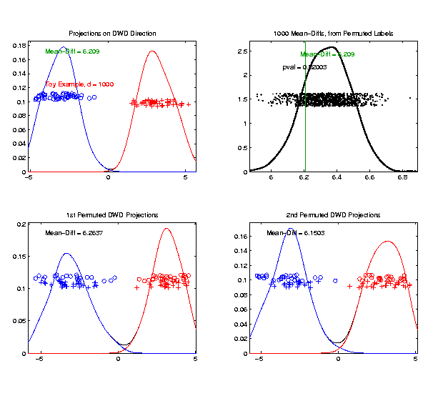
DiProPerm Hypothesis Test
Toy 2-Class Example
Generate Null
Distribution
Compare With
Original Value
Take Proportion
Larger as P-Value

Slide 8
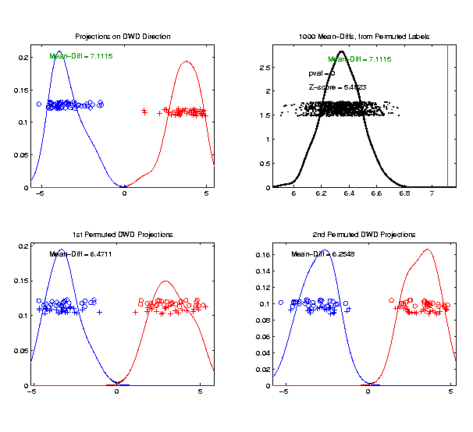

DiProPerm Hypothesis Test
Another Example
$N_{1000}\left(+0.05∗J,I\right)$
$N_{1000}\left(−0.05∗J,I\right)$
DiProPerm Now
Quite Significant

Slide 9
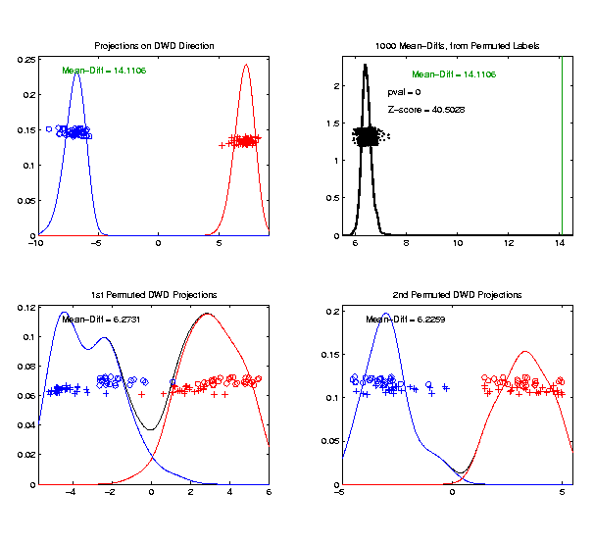

DiProPerm Hypothesis Test
Stronger Example
$N_{1000}\left(+0.2∗J,I\right)$
$N_{1000}\left(−0.2∗J,I\right)$
DiProPerm Very
Significant
Z-Score Allows
Comparison
>> 5.4 above

Slide 10
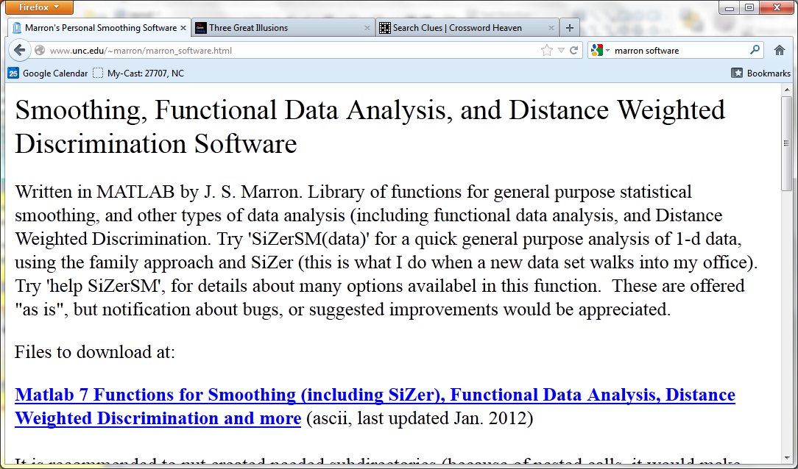
Recall Matlab Software
Posted Software for OODA

Slide 11
DiProPerm Hypothesis Test
Matlab Software:
DiProPermSM.m
In BatchAdjust Directory

Slide 12
HDLSS Asymptotics
Personal Observations:
HDLSS world is…
Surprising (many times!)
[Think I’ve got it, and then …]
Mathematically Beautiful (?)
Practically Relevant

Slide 13
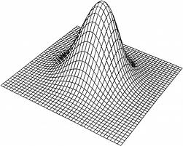
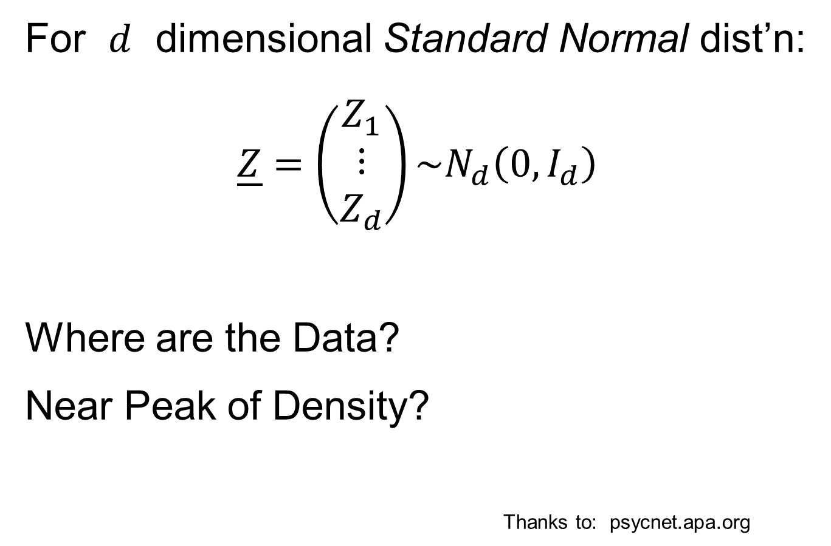
HDLSS Asymptotics: Simple Paradoxes
For $d$ dimensional Standard Normal dist’n:
$$\underline{Z}=\left(\begin{matrix}Z_{1} \\ ⋮ \\ Z_{d}\end{matrix}\right)\sim N_{d}\left(0,I_{d}\right)$$
Where are the Data?
Near Peak of Density?
Thanks to: psycnet.apa.org

Slide 14
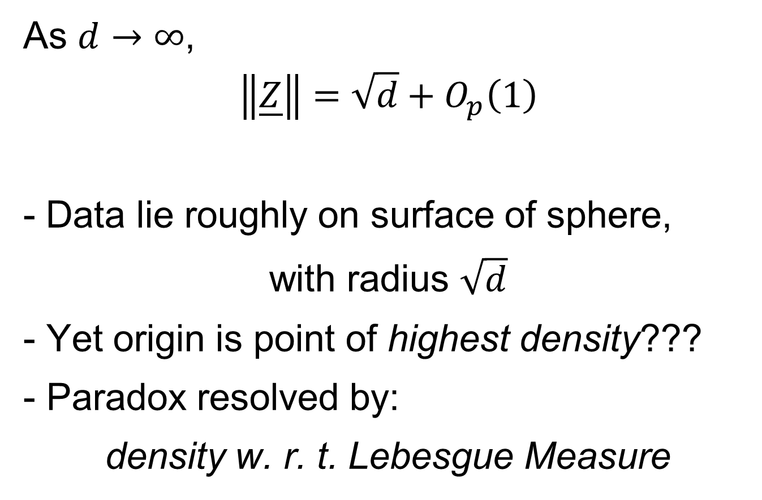
HDLSS Asymptotics: Simple Paradoxes
As $d→∞$,
$$\left\|\underline{Z}\right\|=\sqrt{d}+O_{p}\left(1\right)$$
Data lie roughly on surface of sphere,
with radius $\sqrt{d}$
- Yet origin is point of highest density???
- Paradox resolved by:
density w. r. t. Lebesgue Measure
Notes:
14

Slide 15
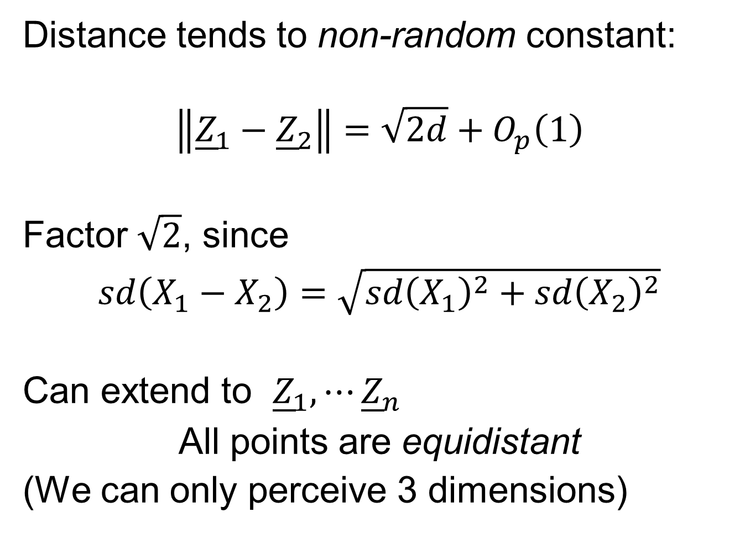
HDLSS Asymptotics: Simple Paradoxes
Distance tends to non-random constant:
$$\left\|{\underline{Z}}_{1}−{\underline{Z}}_{2}\right\|=\sqrt{2d}+O_{p}\left(1\right)$$
Factor $\sqrt{2}$, since
$sd\left(X_{1}−X_{2}\right)=\sqrt{{sd\left(X_{1}\right)}^{2}+{sd\left(X_{2}\right)}^{2}}$
Can extend to ${\underline{Z}}_{1},⋯{\underline{Z}}_{n}$
All points are equidistant
(We can only perceive 3 dimensions)
Notes:
15

Slide 16
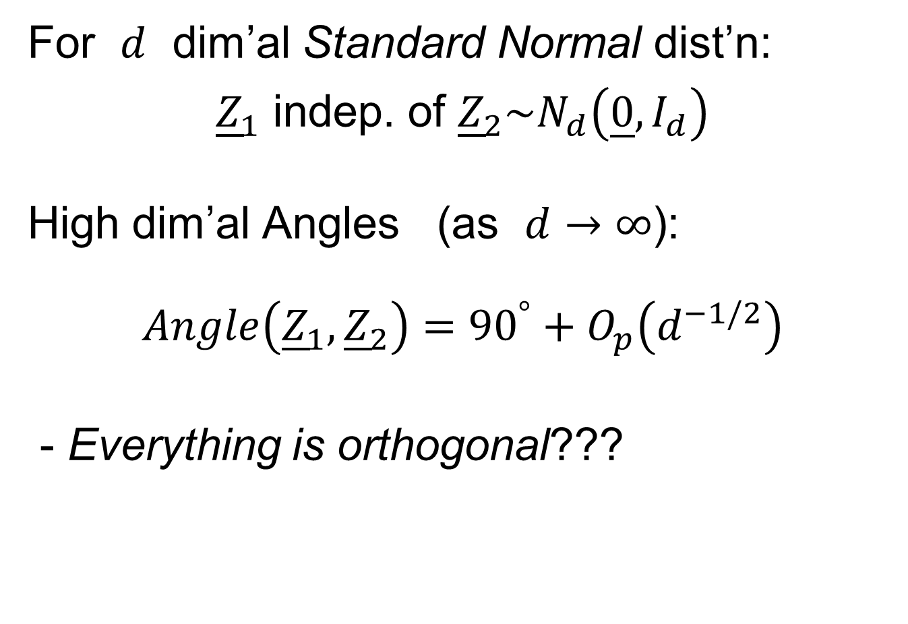
HDLSS Asymptotics: Simple Paradoxes
For $d$ dim’al Standard Normal dist’n:
${\underline{Z}}_{1}$ indep. of ${\underline{Z}}_{2}\sim N_{d}\left(\underline{0},I_{d}\right)$
High dim’al Angles (as $d→∞$):
$$Angle\left({\underline{Z}}_{1},{\underline{Z}}_{2}\right)={90}^{°}+O_{p}\left(d^{−1/2}\right)$$
- Everything is orthogonal???

Slide 17
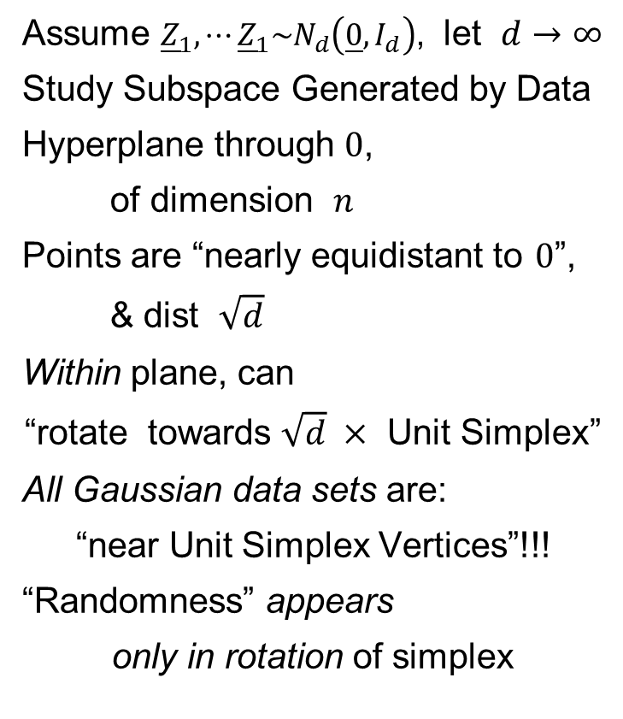
HDLSS Asy’s: Geometrical Represent’n
Assume ${\underline{Z}}_{1},⋯{\underline{Z}}_{1}\sim N_{d}\left(\underline{0},I_{d}\right)$, let $d→∞$
Study Subspace Generated by Data
Hyperplane through $0$,
of dimension $n$
Points are “nearly equidistant to $0$”,
& dist $\sqrt{d}$
Within plane, can
“rotate towards $\sqrt{d} ×$ Unit Simplex”
All Gaussian data sets are:
“near Unit Simplex Vertices”!!!
“Randomness” appears
only in rotation of simplex
Hall, Marron & Neeman (2005)

Slide 18
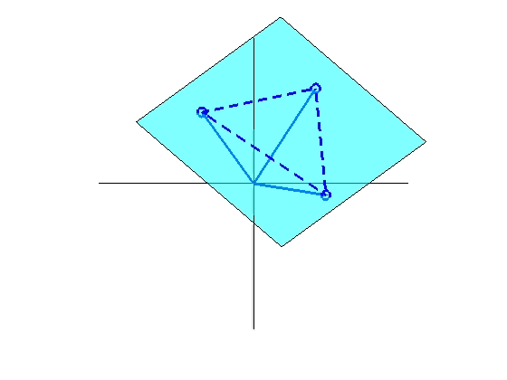
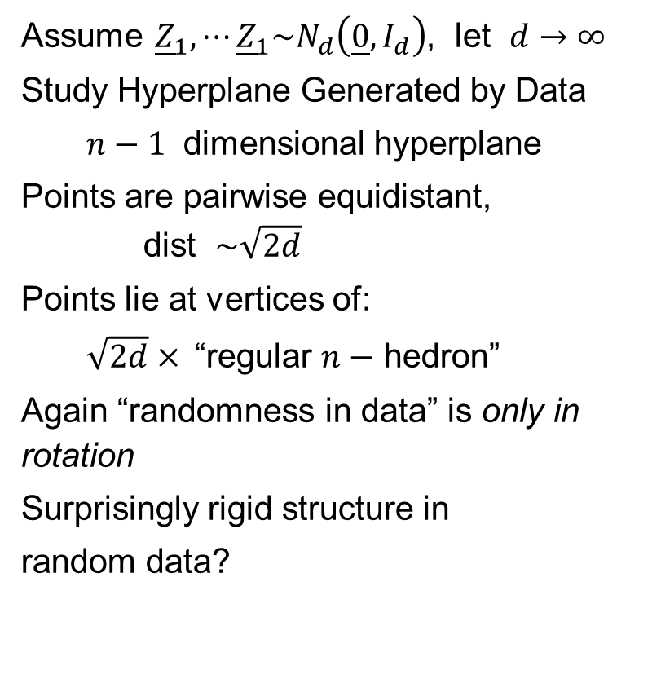
HDLSS Asy’s: Geometrical Represent’n
Assume ${\underline{Z}}_{1},⋯{\underline{Z}}_{1}\sim N_{d}\left(\underline{0},I_{d}\right)$, let $d→∞$
Study Hyperplane Generated by Data
$n−1$ dimensional hyperplane
Points are pairwise equidistant, dist $\sim \sqrt{2d}$
Points lie at vertices of:
$\sqrt{2d}×$“regular $n−$ hedron”
Again “randomness in data” is only in rotation
Surprisingly rigid structure in
random data?

Slide 19
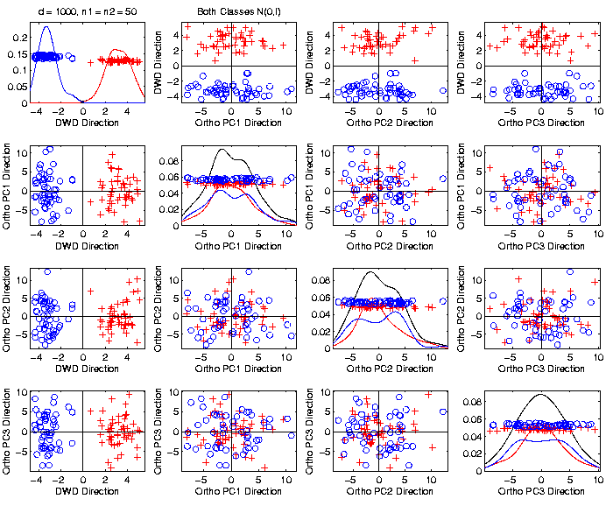
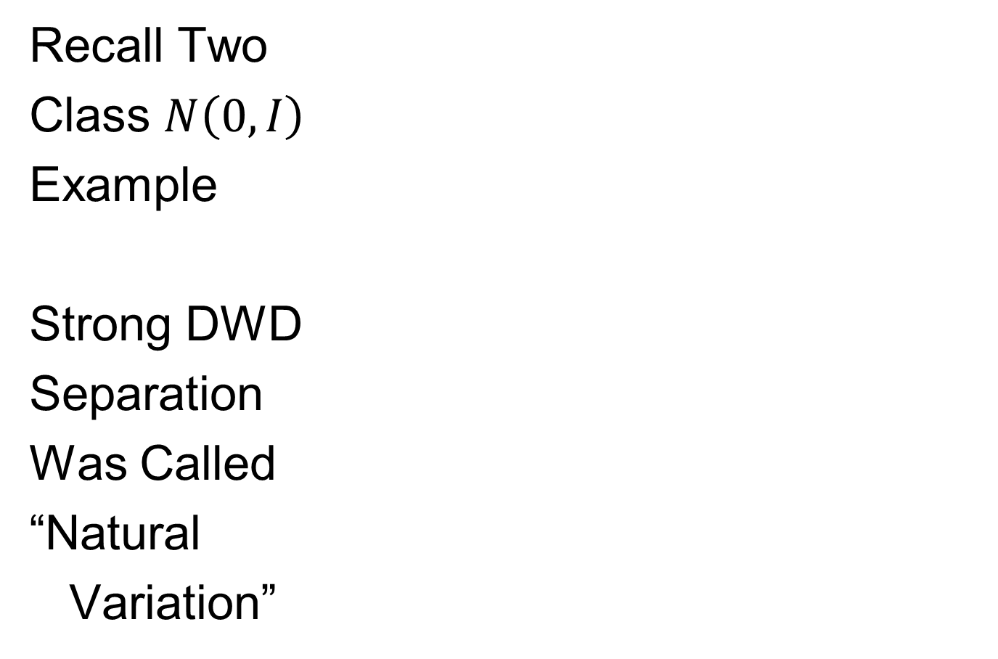
An Interesting HDLSS Explanation
Recall Two
Class $N\left(0,I\right)$
Example
Strong DWD
Separation
Was Called
“Natural
Variation”

Slide 20
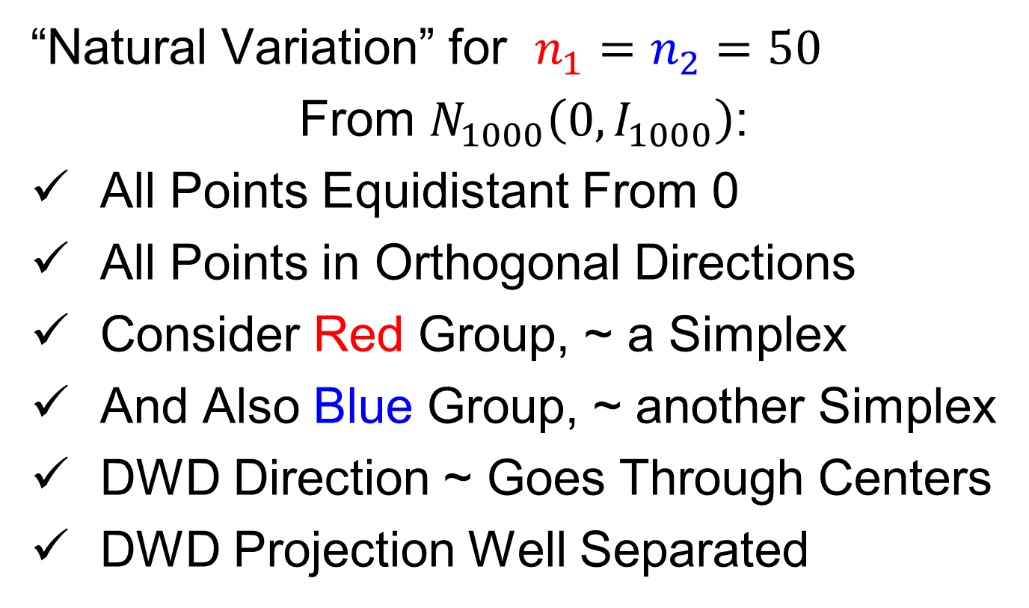
An Interesting HDLSS Explanation
“Natural Variation” for $n_{1}=n_{2}=50$
From $N_{1000}\left(0,I_{1000}\right)$:
All Points Equidistant From 0
All Points in Orthogonal Directions
Consider Red Group, ~ a Simplex
And Also Blue Group, ~ another Simplex
DWD Direction ~ Goes Through Centers
DWD Projection Well Separated

Slide 21
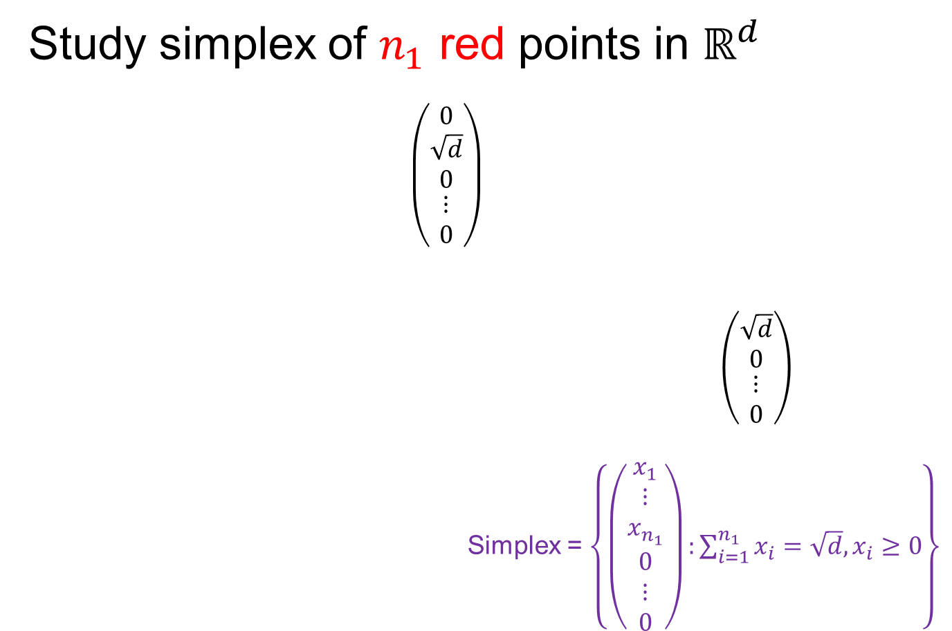
An Interesting HDLSS Explanation
Study simplex of $n_{1}$ red points in $ℝ^{d}$
$\left(\begin{matrix}\begin{matrix}0 \\ \sqrt{d} \\ 0\end{matrix} \\ ⋮ \\ 0\end{matrix}\right)$
$\left(\begin{matrix}\begin{matrix}\sqrt{d} \\ 0\end{matrix} \\ \begin{matrix}⋮ \\ 0\end{matrix}\end{matrix}\right)$
Simplex = $\left\{\left(\begin{matrix}\begin{matrix}x_{1} \\ ⋮ \\ x_{n_{1}}\end{matrix} \\ \begin{matrix}0 \\ ⋮ \\ 0\end{matrix}\end{matrix}\right):\sum_{i=1}^{n_{1}}{x_{i}=\sqrt{d},x_{i}≥0}\right\}$

Slide 22
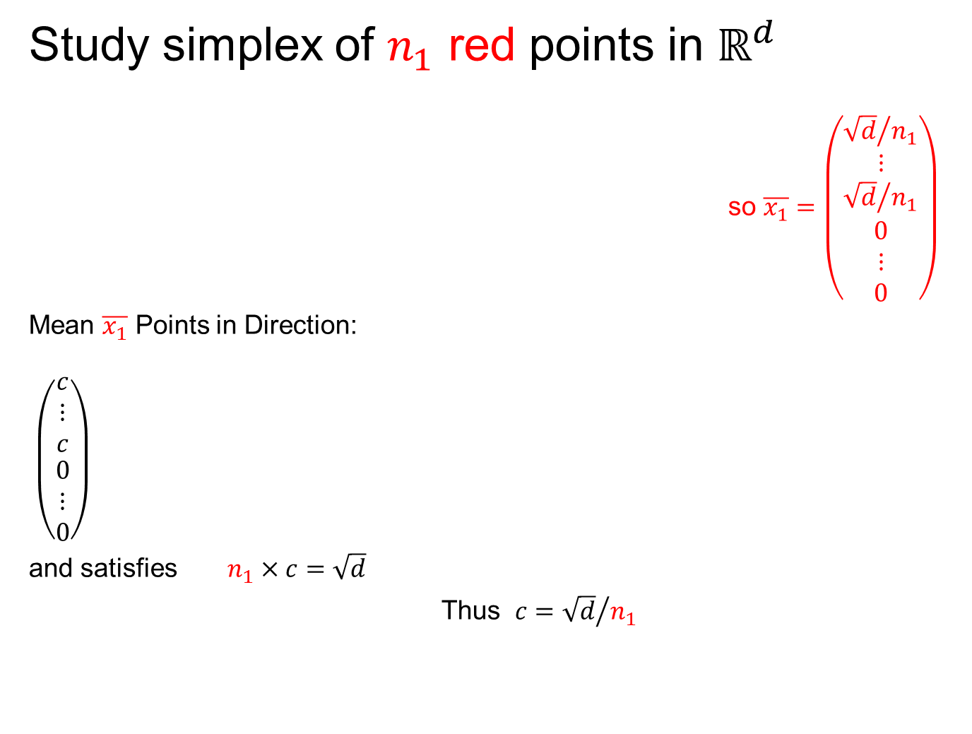
An Interesting HDLSS Explanation
Study simplex of $n_{1}$ red points in $ℝ^{d}$
so $\overline{x_{1}}=\left(\begin{matrix}\begin{matrix}{\sqrt{d}}/{n_{1}} \\ ⋮ \\ {\sqrt{d}}/{n_{1}}\end{matrix} \\ \begin{matrix}0 \\ ⋮ \\ 0\end{matrix}\end{matrix}\right)$
Mean $\overline{x_{1}}$ Points in Direction:
$\left(\begin{matrix}\begin{matrix}c \\ ⋮ \\ c\end{matrix} \\ \begin{matrix}0 \\ ⋮ \\ 0\end{matrix}\end{matrix}\right)$
and satisfies $n_{1}×c=\sqrt{d}$
Thus $c={\sqrt{d}}/{n_{1}}$

Slide 23
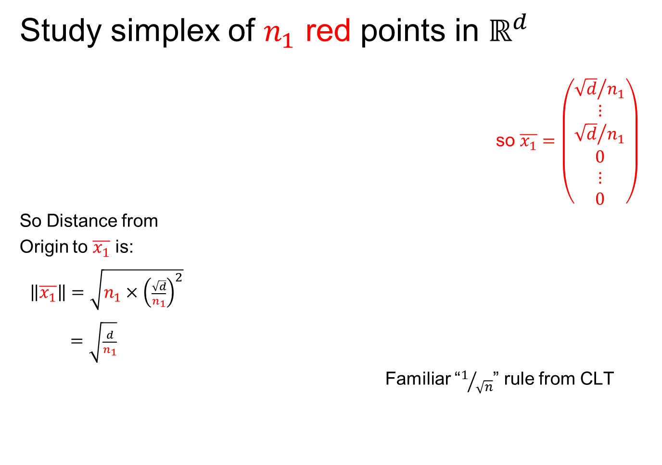
An Interesting HDLSS Explanation
Study simplex of $n_{1}$ red points in $ℝ^{d}$
so $\overline{x_{1}}=\left(\begin{matrix}\begin{matrix}{\sqrt{d}}/{n_{1}} \\ ⋮ \\ {\sqrt{d}}/{n_{1}}\end{matrix} \\ \begin{matrix}0 \\ ⋮ \\ 0\end{matrix}\end{matrix}\right)$
So Distance from
Origin to $\overline{x_{1}}$ is:
$\left\|\overline{x_{1}}\right\|=\sqrt{n_{1}×{\left(\frac{\sqrt{d}}{n_{1}}\right)}^{2}}$
$=\sqrt{\frac{d}{n_{1}}}$
Familiar “$1/{\sqrt{n}}$” rule from CLT

Slide 24
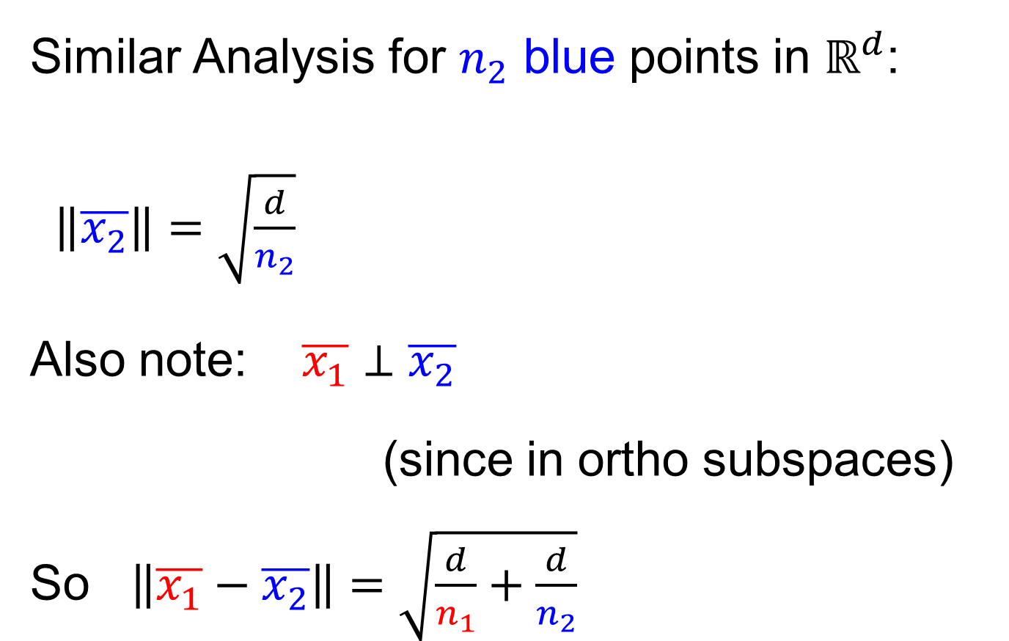
An Interesting HDLSS Explanation
Similar Analysis for $n_{2}$ blue points in $ℝ^{d}$:
$\left\|\overline{x_{2}}\right\|=\sqrt{\frac{d}{n_{2}}}$
Also note: $\overline{x_{1}}⊥\overline{x_{2}}$
(since in ortho subspaces)
So $\left\|\overline{x_{1}}−\overline{x_{2}}\right\|=\sqrt{\frac{d}{n_{1}}+\frac{d}{n_{2}}}$

Slide 25

An Interesting HDLSS Explanation
Recall Two
Class $N\left(0,I\right)$
Example
Plug In
These
Numbers

Slide 26

An Interesting HDLSS Explanation
Evaluate $\left\|\overline{x_{1}}−\overline{x_{2}}\right\|=\sqrt{\frac{d}{n_{1}}+\frac{d}{n_{2}}}$
$=\sqrt{\frac{1000}{50}+\frac{1000}{50}}$
$≈6.3$

Slide 27

An Interesting HDLSS Explanation
Recall Two
Class $N\left(0,I\right)$
Example
$\left\|\overline{x_{1}}−\overline{x_{2}}\right\|$
$≈6.3$

Slide 28
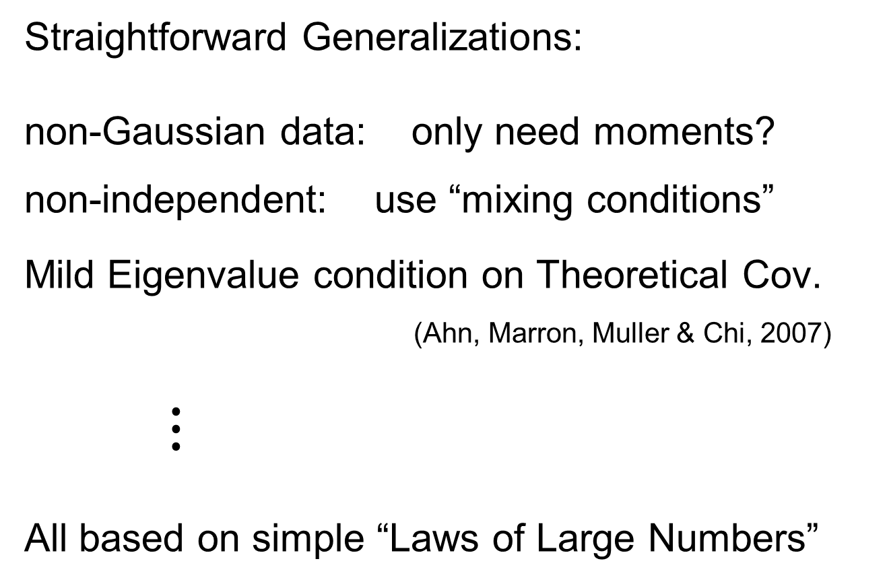
HDLSS Asy’s: Geometrical Represen’tion
Straightforward Generalizations:
non-Gaussian data: only need moments?
non-independent: use “mixing conditions”
Mild Eigenvalue condition on Theoretical Cov.
(Ahn, Marron, Muller & Chi, 2007)
$⋮$
All based on simple “Laws of Large Numbers”

Slide 29
2nd Paper on HDLSS Asymptotics
Ahn, Marron, Muller & Chi (2007)
  Assume 2nd Moments
  Assume no eigenvalues too large

Slide 30
2nd Paper on HDLSS Asymptotics
Ahn, Marron, Muller & Chi (2007)
  Assume 2nd Moments
  Assume no eigenvalues too large in sense:
For assume i.e.

Slide 31
2nd Paper on HDLSS Asymptotics
Ahn, Marron, Muller & Chi (2007)
  Assume 2nd Moments
  Assume no eigenvalues too large in sense:
For assume i.e.
(min possible)
(much weaker than previous mixing conditions…)

Slide 32
2nd Paper on HDLSS Asymptotics
Background:
In classical multivariate analysis, the statistic
Is called the “epsilon statistic”
And is used to test “sphericity” of dist’n,
i.e. “are all cov’nce eigenvalues the same?”

Slide 33
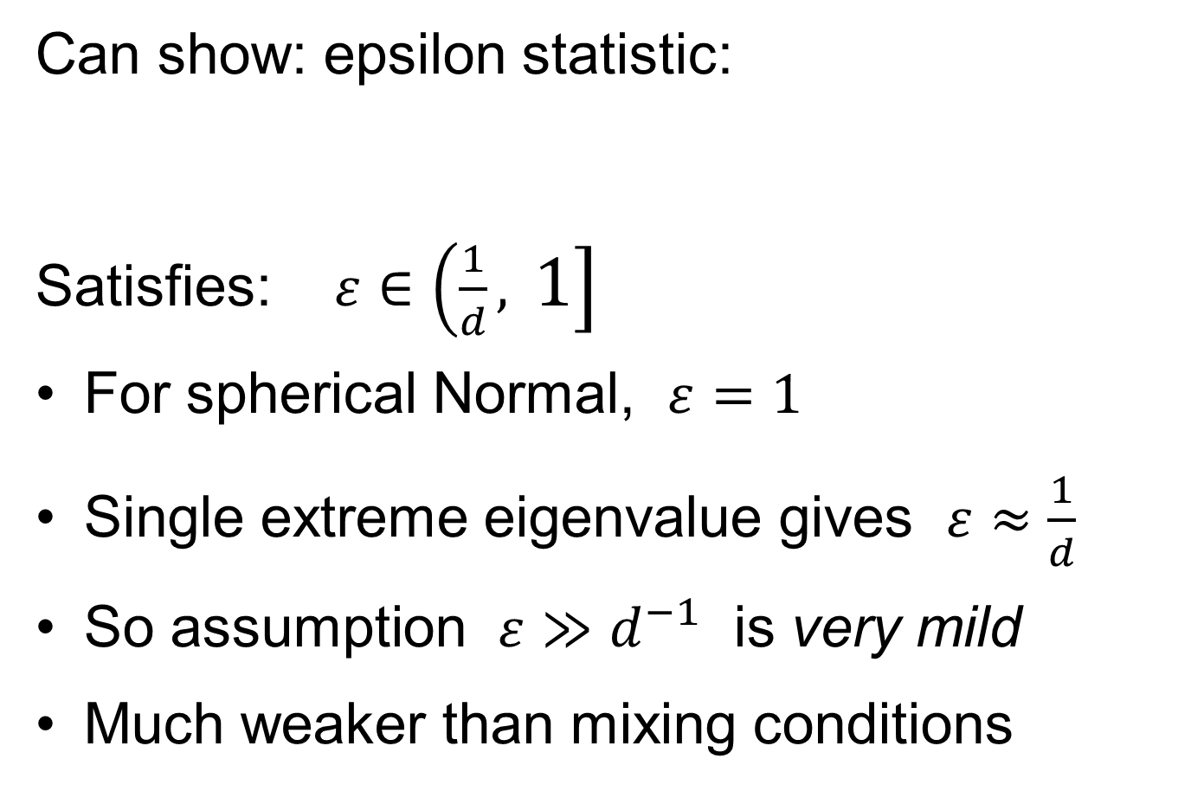
2nd Paper on HDLSS Asymptotics
Can show: epsilon statistic:
Satisfies: $ε∈\left(\frac{1}{d},\right.\left. 1\right]$
For spherical Normal, $ε=1$
Single extreme eigenvalue gives $ε≈\frac{1}{d}$
So assumption $ε≫d^{−1}$ is very mild
Much weaker than mixing conditions

Slide 34
2nd Paper on HDLSS Asymptotics
Ahn, Marron, Muller & Chi (2007)
  Assume 2nd Moments
  Assume no eigenvalues too large, :
Then

Slide 35
2nd Paper on HDLSS Asymptotics
Ahn, Marron, Muller & Chi (2007)
  Assume 2nd Moments
  Assume no eigenvalues too large, :
Then
Not so strong as before:

Slide 36
2nd Paper on HDLSS Asymptotics
Can we improve on:
?

Slide 37

2nd Paper on HDLSS Asymptotics
Can we improve on:
?
John Kent example: Normal scale mixture

Slide 38
2nd Paper on HDLSS Asymptotics
Can we improve on:
?
John Kent example: Normal scale mixture
Won’t get:

Slide 39
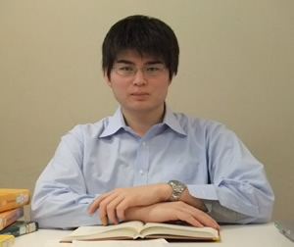
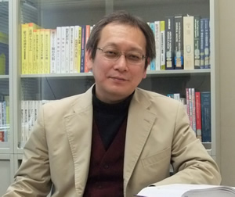
3rd Paper on HDLSS Asymptotics
Get Geometrical Representation using
4th Moment Assumption
Stronger Covariance Matrix (only) Assum’n
Yata & Aoshima (2012)

Slide 40
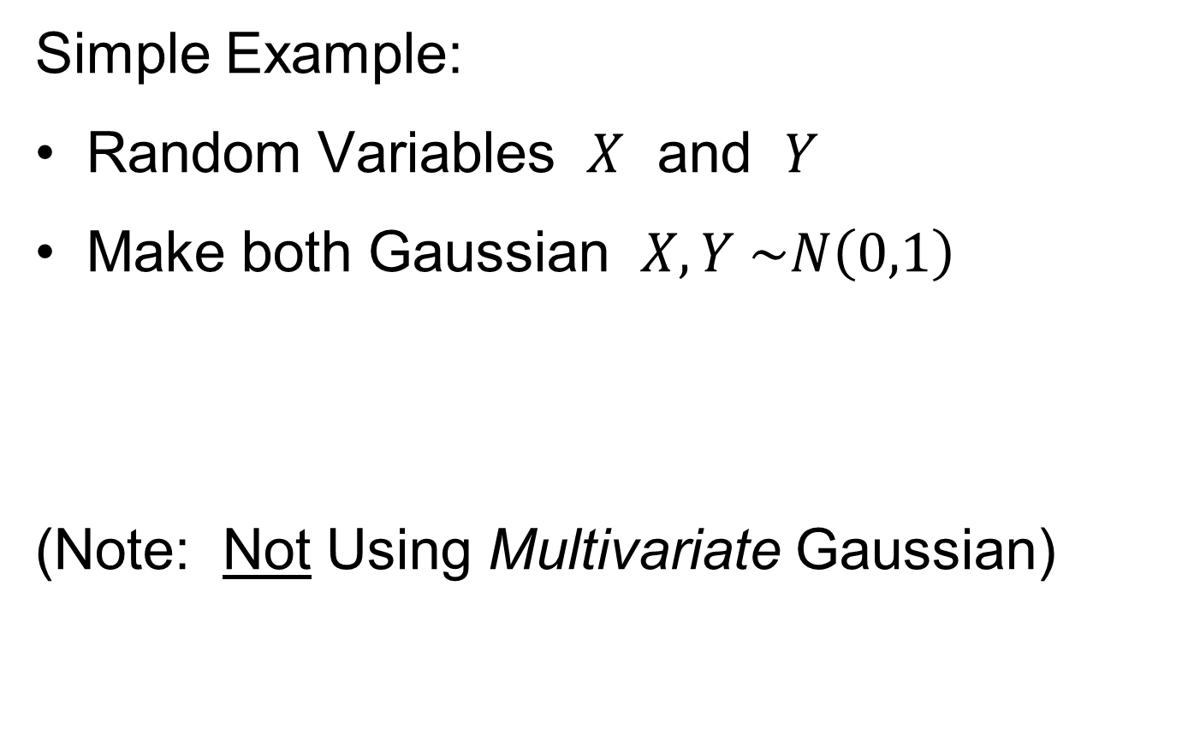
0 Covariance is not independence
Simple Example:
Random Variables $X$ and $Y$
Make both Gaussian $X, Y \sim N\left(0,1\right)$
(Note: Not Using Multivariate Gaussian)

Slide 41
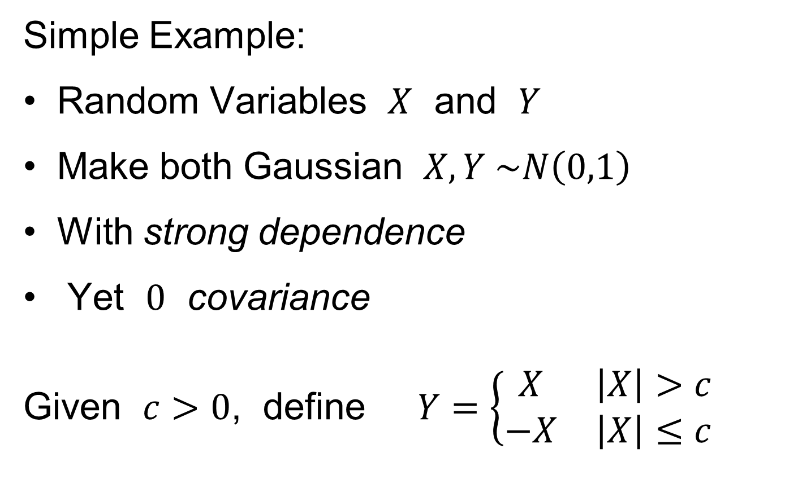
0 Covariance is not independence
Simple Example:
Random Variables $X$ and $Y$
Make both Gaussian $X, Y \sim N\left(0,1\right)$
With strong dependence
Yet $0$ covariance
Given $c>0$, define $Y=\left\{\begin{matrix}X & \left|X\right|>c \\ −X & \left|X\right|≤c\end{matrix}\right.$

Slide 42
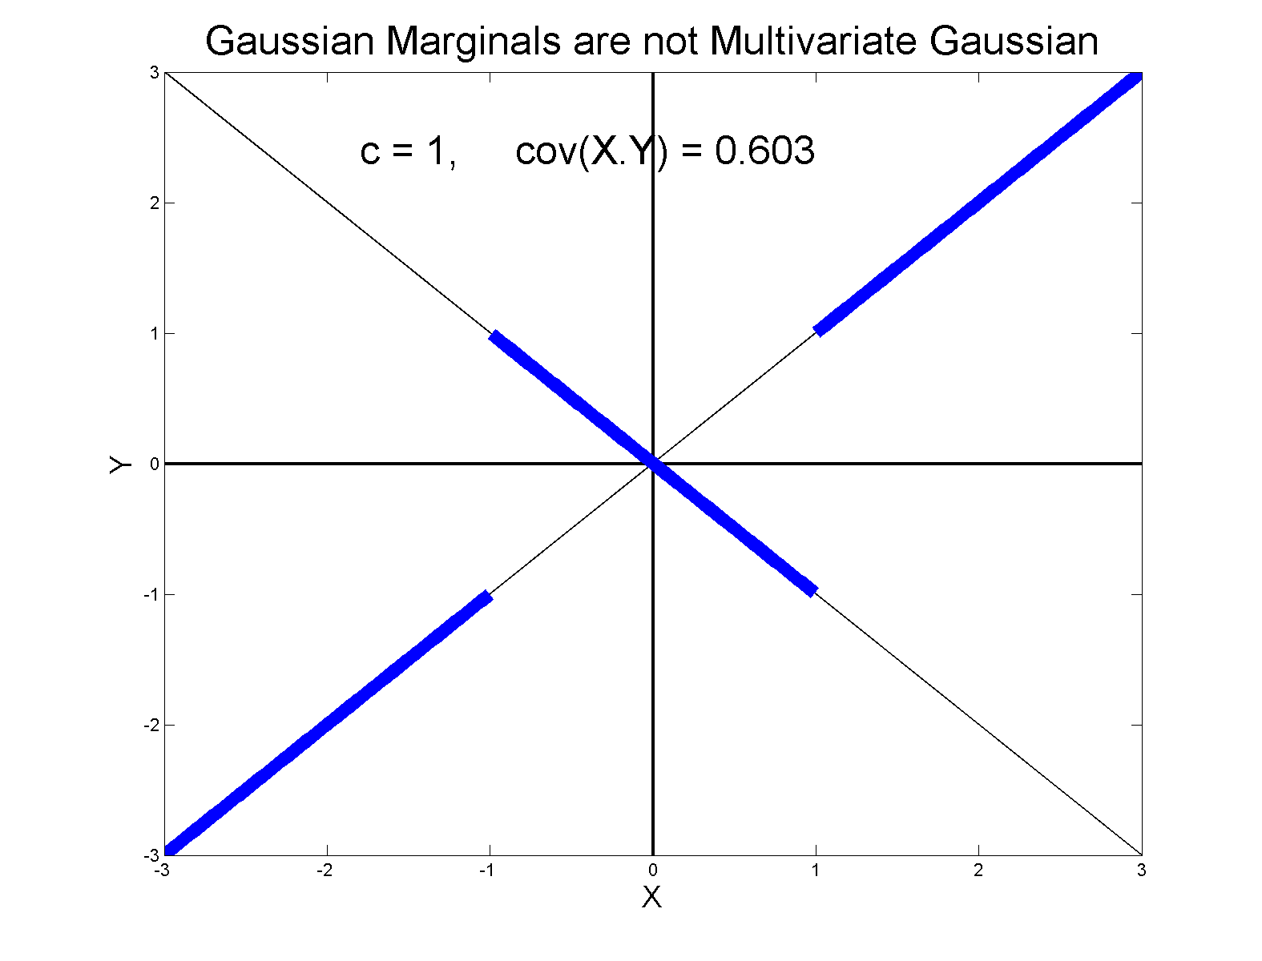
0 Covariance is not independence
Simple Example:

Slide 43
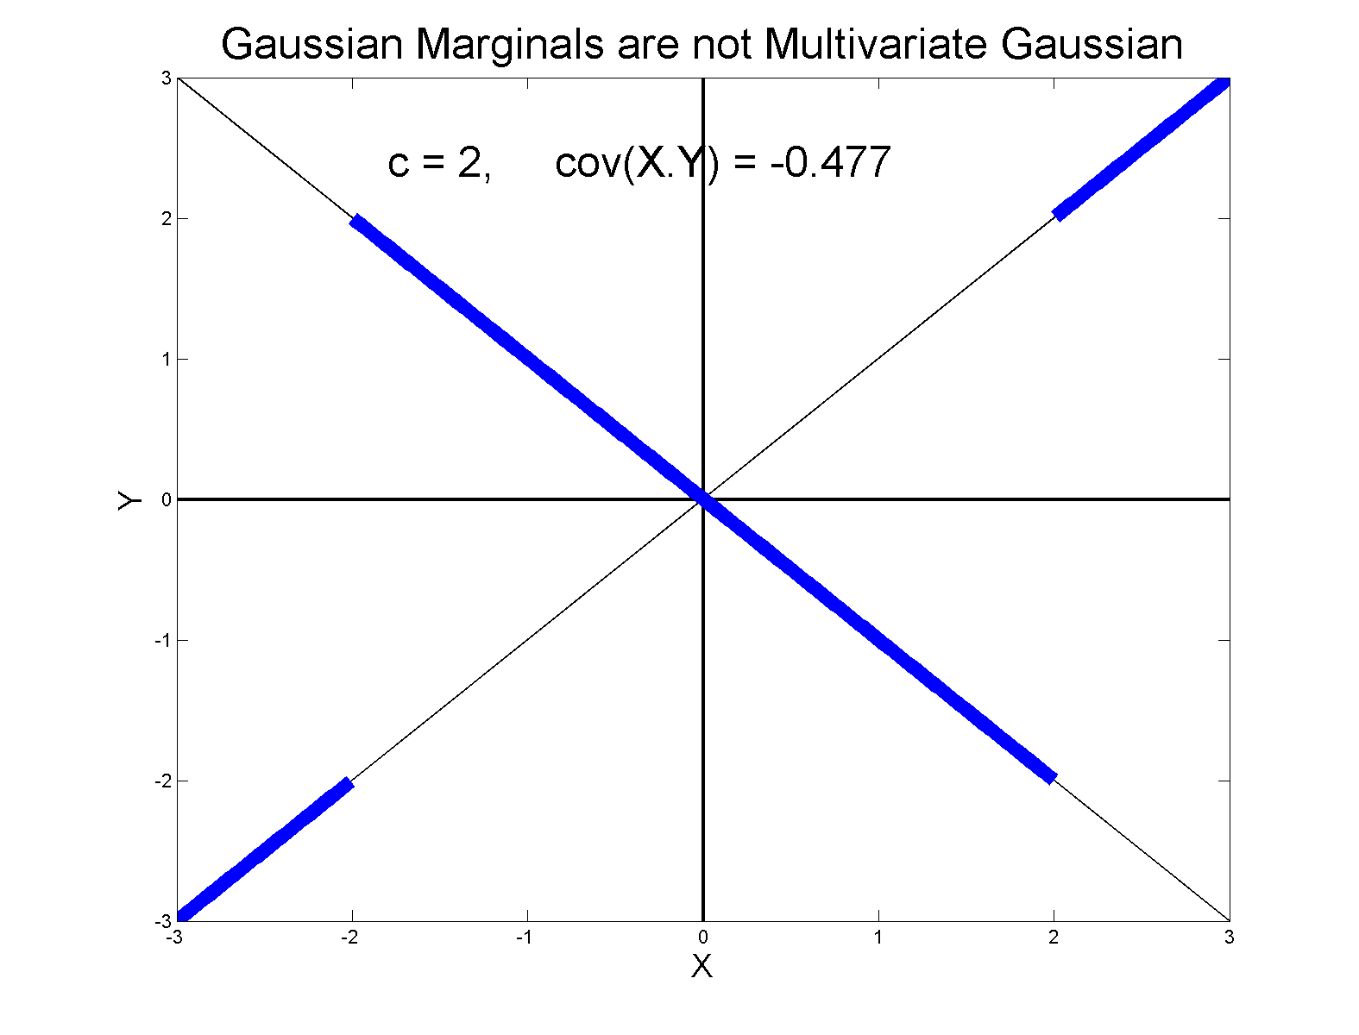
0 Covariance is not independence
Simple Example:

Slide 44
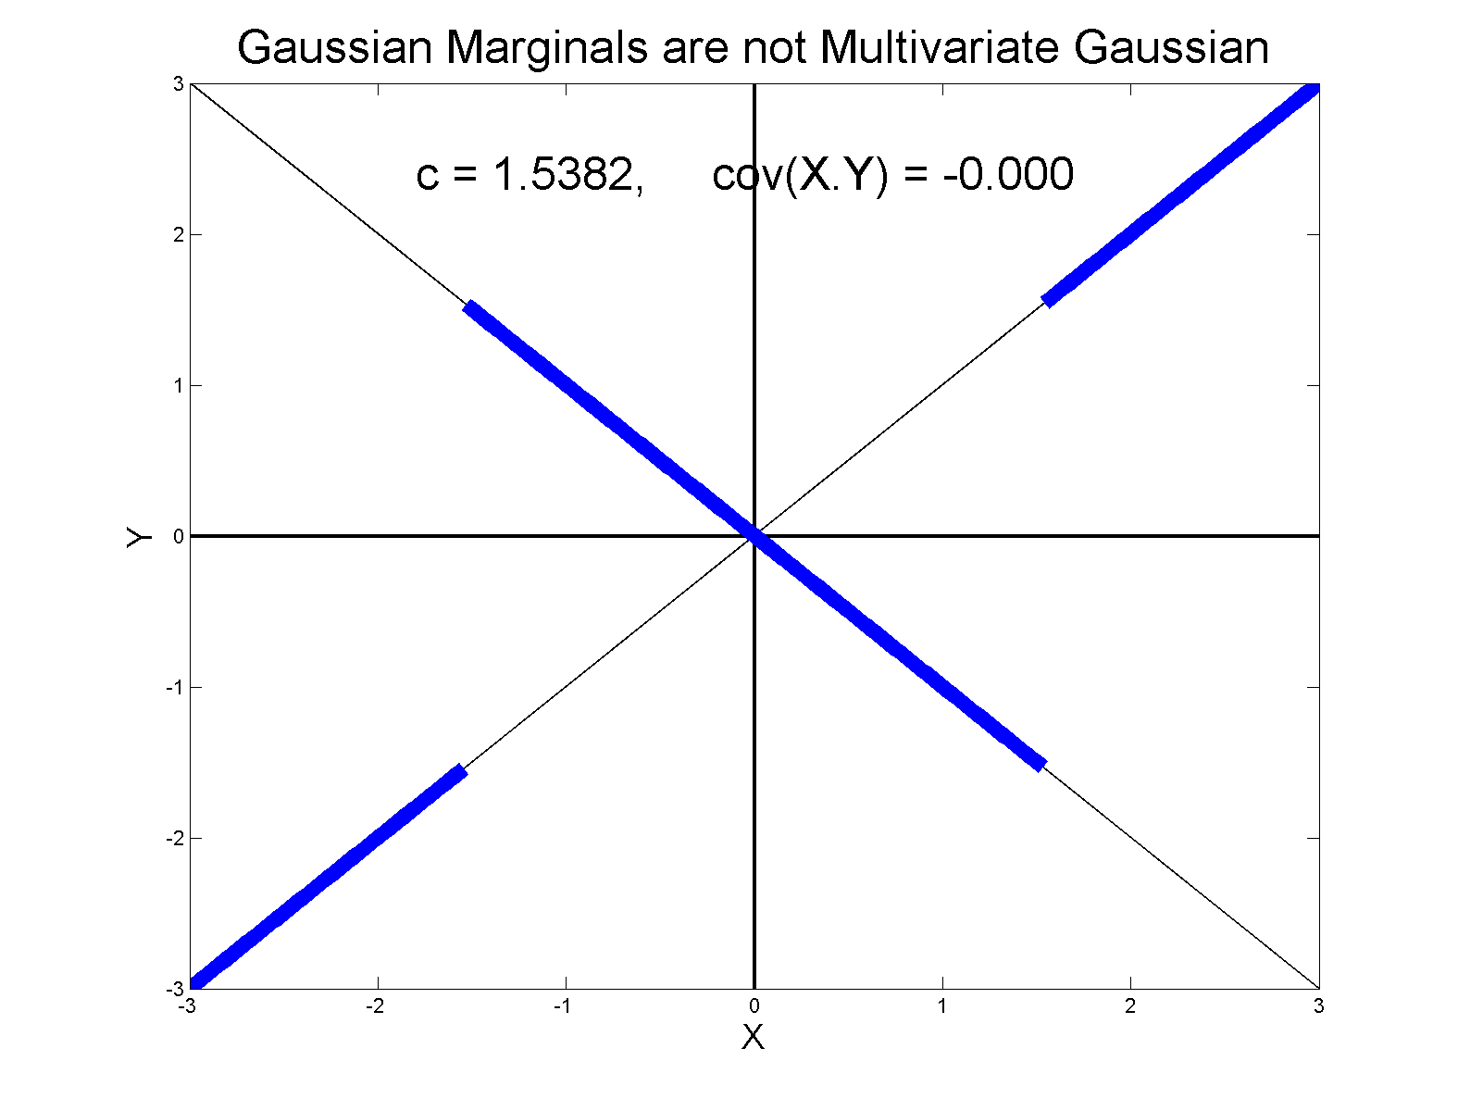
0 Covariance is not independence
Simple Example, c to make cov(X,Y) = 0

Slide 45
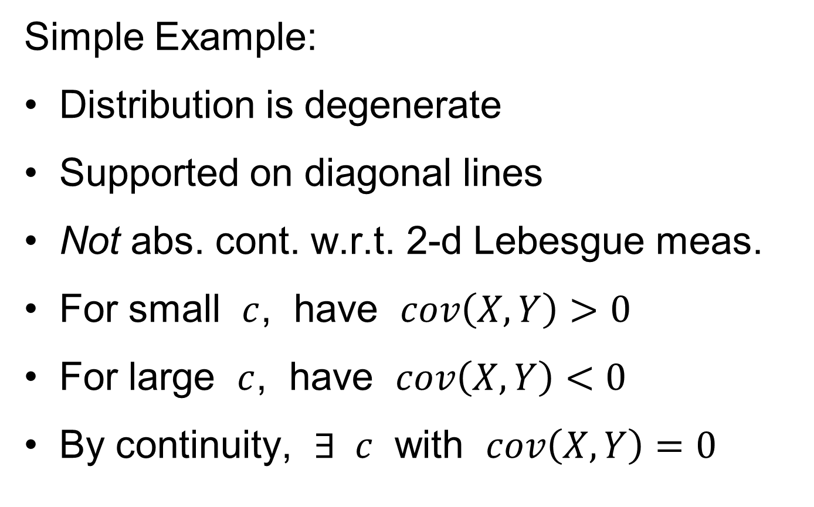
0 Covariance is not independence
Simple Example:
Distribution is degenerate
Supported on diagonal lines
Not abs. cont. w.r.t. 2-d Lebesgue meas.
For small $c$, have $cov\left(X,Y\right)>0$
For large $c$, have $cov\left(X,Y\right)<0$
By continuity, $∃ c$ with $cov\left(X,Y\right)=0$

Slide 46
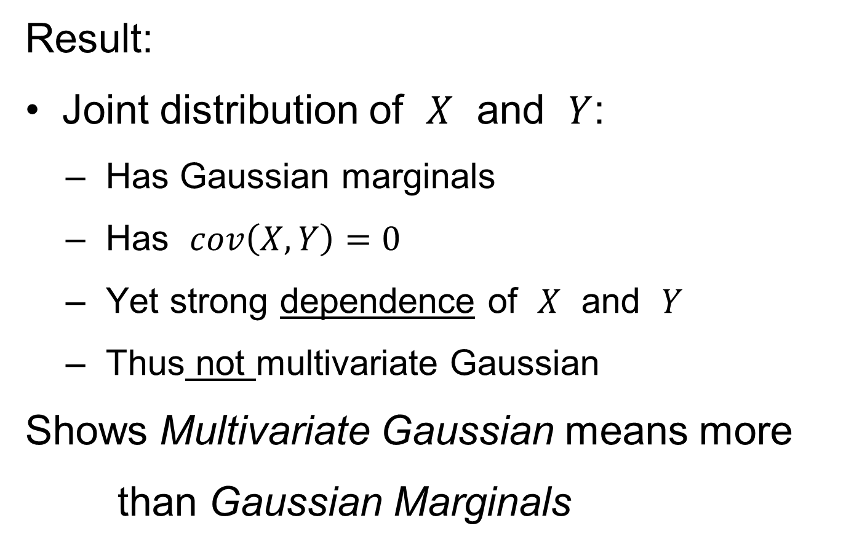
0 Covariance is not independence
Result:
Joint distribution of $X$ and $Y$:
  Has Gaussian marginals
  Has $cov\left(X,Y\right)=0$
  Yet strong dependence of $X$ and $Y$
  Thus not multivariate Gaussian
Shows Multivariate Gaussian means more
than Gaussian Marginals

Slide 47
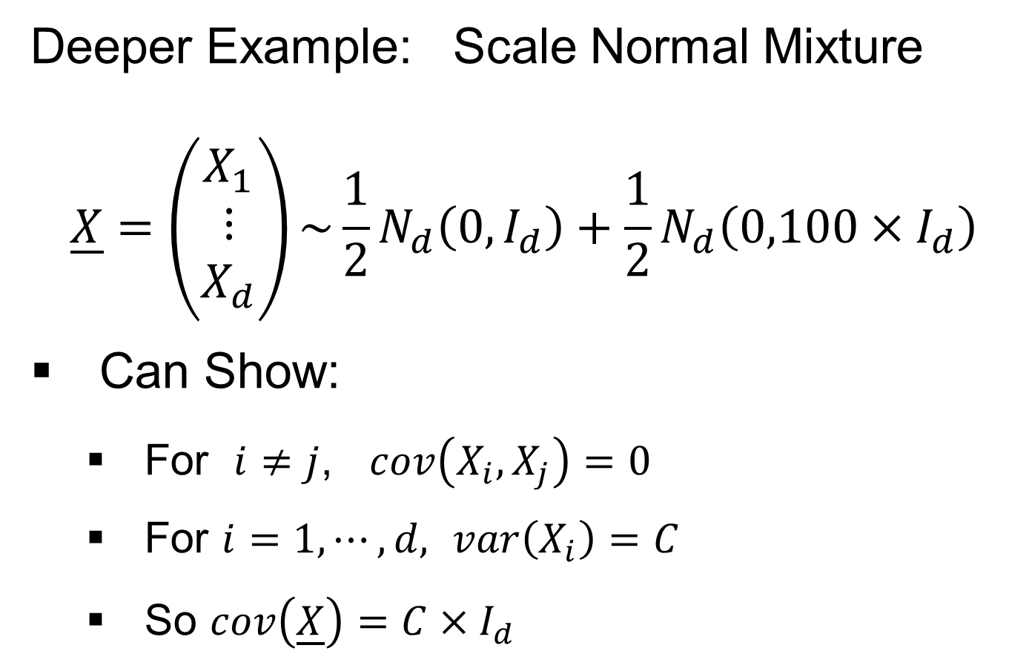
0 Covariance is not independence
Deeper Example: Scale Normal Mixture
$$\underline{X}=\left(\begin{matrix}X_{1} \\ ⋮ \\ X_{d}\end{matrix}\right)\sim {\frac{1}{2}N}_{d}\left(0,I_{d}\right)+\frac{1}{2}N_{d}\left(0,100×I_{d}\right)$$
Can Show:
  For $i≠j$, $cov\left(X_{i},X_{j}\right)=0$
  For $i=1,⋯,d,$ $var\left(X_{i}\right)=C$
  So $cov\left(\underline{X}\right)=C×I_{d}$

Slide 48
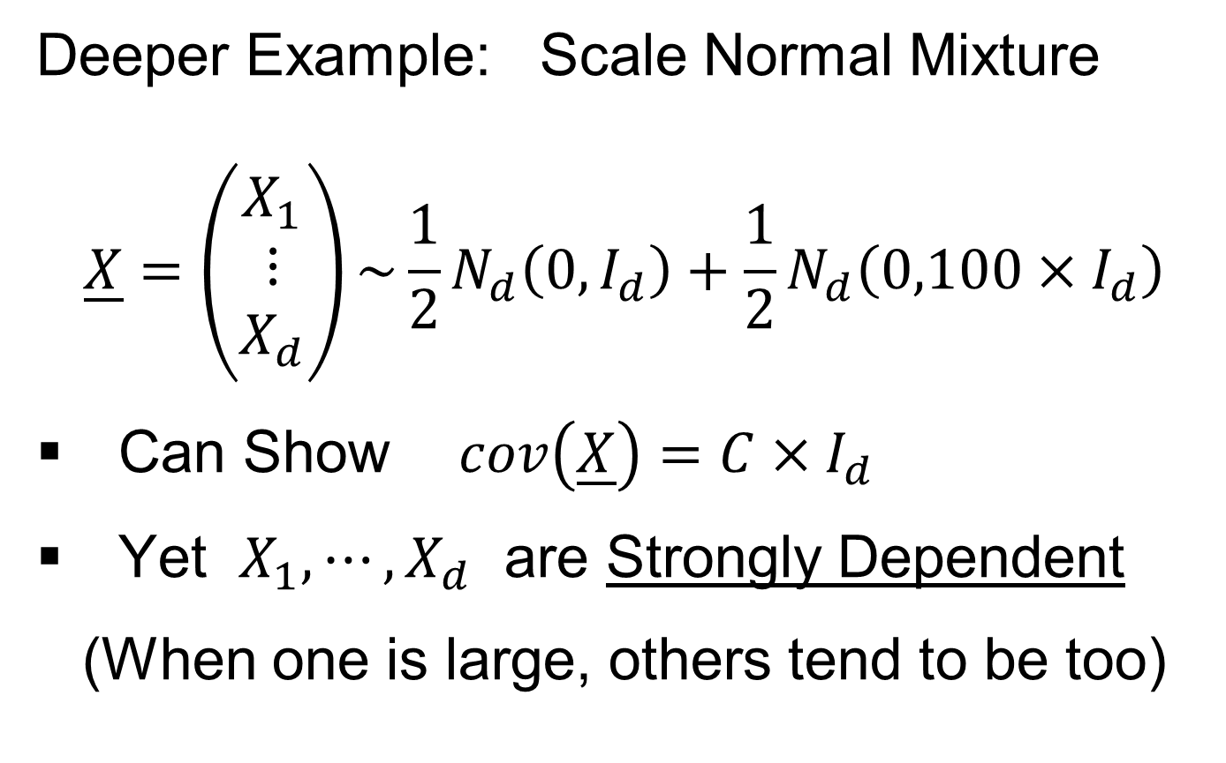
0 Covariance is not independence
Deeper Example: Scale Normal Mixture
$$\underline{X}=\left(\begin{matrix}X_{1} \\ ⋮ \\ X_{d}\end{matrix}\right)\sim {\frac{1}{2}N}_{d}\left(0,I_{d}\right)+\frac{1}{2}N_{d}\left(0,100×I_{d}\right)$$
Can Show $cov\left(\underline{X}\right)=C×I_{d}$
Yet $X_{1},⋯,X_{d}$ are Strongly Dependent
(When one is large, others tend to be too)

Slide 49
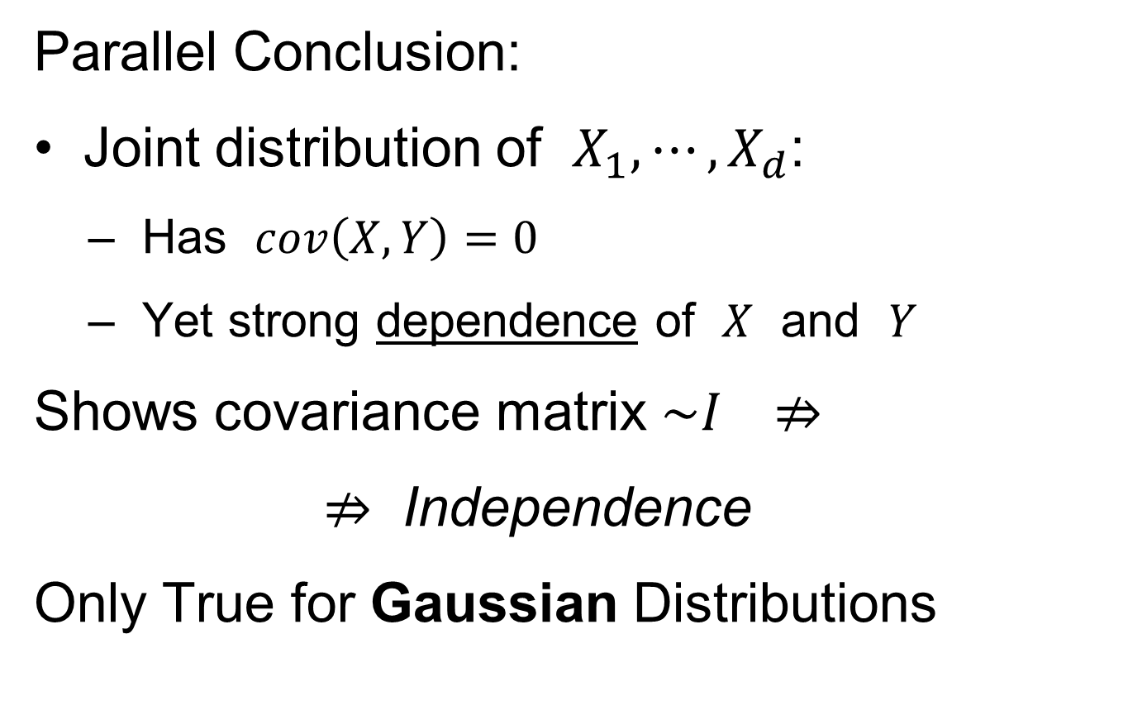
0 Covariance is not independence
Parallel Conclusion:
Joint distribution of $X_{1},⋯,X_{d}$:
  Has $cov\left(X,Y\right)=0$
  Yet strong dependence of $X$ and $Y$
Shows covariance matrix $\sim I ⇏$
$⇏$ Independence
Only True for Gaussian Distributions

Slide 50
Next Time:
Rethink Ordering of material
e.g. Probably want technical assumptions together,
Not in above block, plu later block after PCA asy’s

Slide 51
HDLSS Math. Stat. of PCA
Consistency & Strong Inconsistency
(Study Properties of PCA,
In Estimating Eigen-Directions & -Values)
[Assume Data are Mean Centered]

Slide 52
HDLSS Math. Stat. of PCA
Consistency & Strong Inconsistency:
Spike Covariance Model, Paul (2007)
For Eigenvalues:

Slide 53
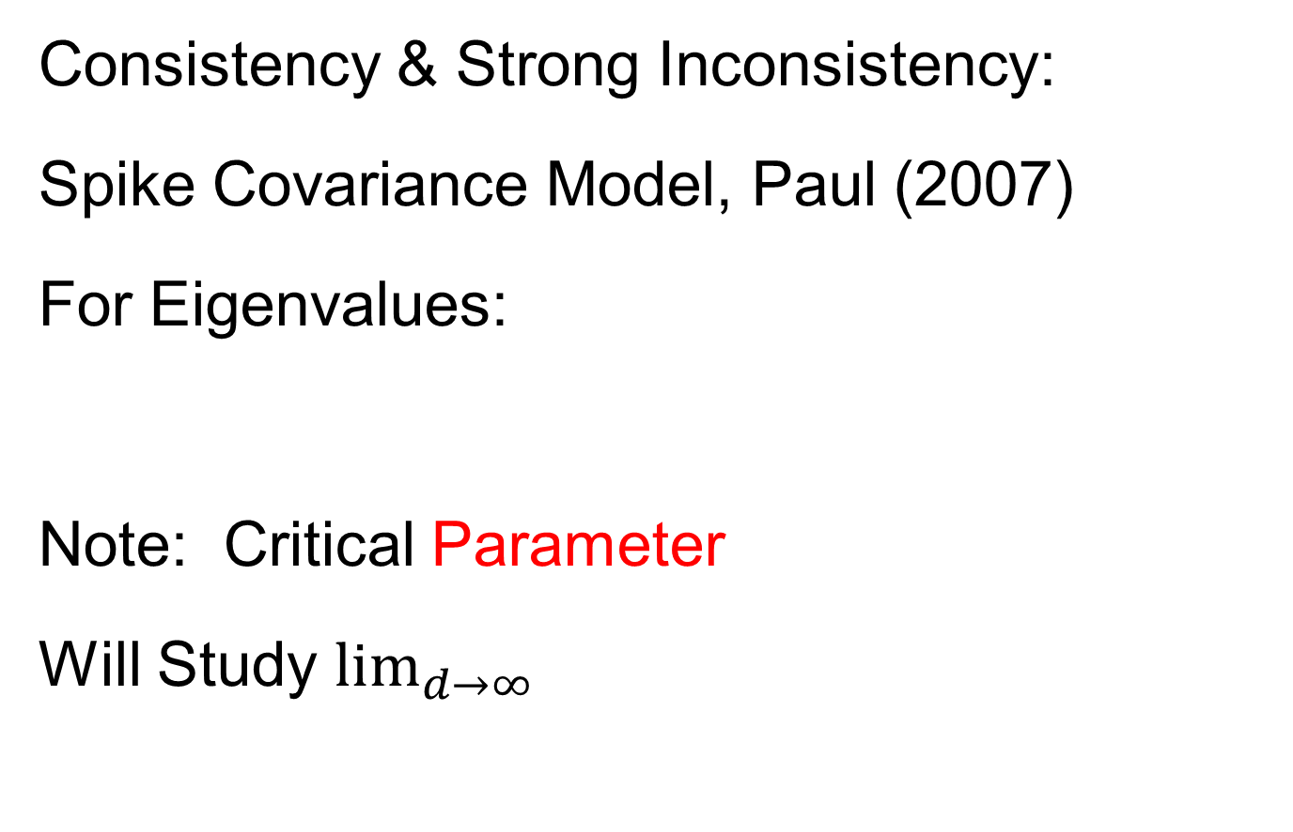
HDLSS Math. Stat. of PCA
Consistency & Strong Inconsistency:
Spike Covariance Model, Paul (2007)
For Eigenvalues:
Note: Critical Parameter
Will Study $\lim_{d→∞}{}$

Slide 54
HDLSS Math. Stat. of PCA
Consistency & Strong Inconsistency:
Spike Covariance Model, Paul (2007)
For Eigenvalues:
1st Eigenvector:
Turns out: Direction Doesn’t Matter

Slide 55
HDLSS Math. Stat. of PCA
Consistency & Strong Inconsistency:
Spike Covariance Model, Paul (2007)
For Eigenvalues:
1st Eigenvector:
How Good are Empirical Versions,
as Estimates?

Slide 56
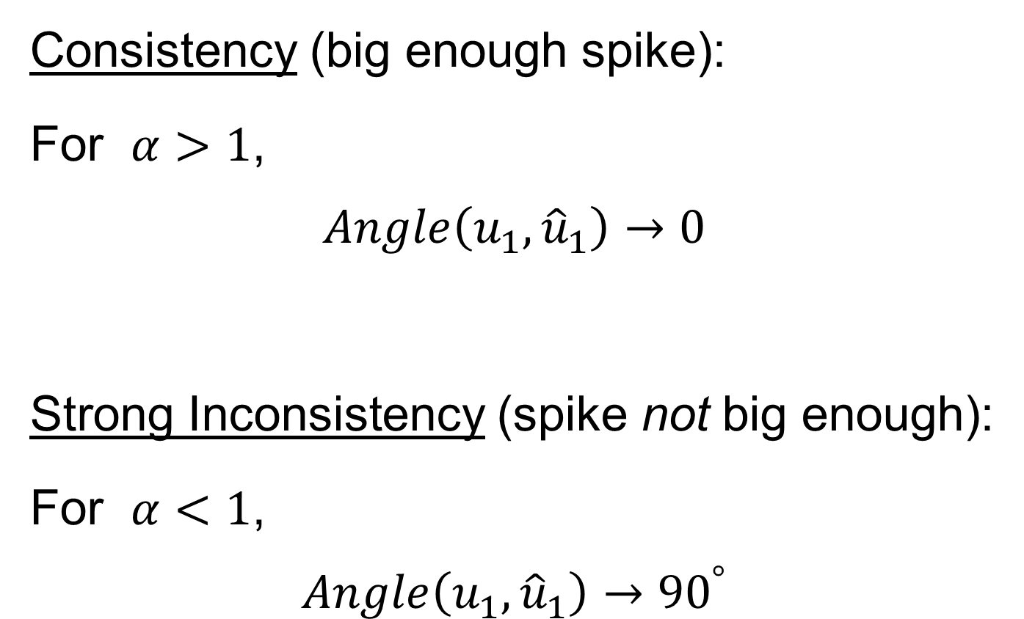
HDLSS Math. Stat. of PCA
Consistency (big enough spike):
For $α>1$,
$$Angle\left(u_{1},{\hat{u}}_{1}\right)→0$$
Strong Inconsistency (spike not big enough):
For $α<1$,
$$Angle\left(u_{1},{\hat{u}}_{1}\right)→{90}^{°}$$

Slide 57
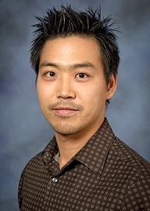
HDLSS Math. Stat. of PCA
Analysis from Jung & Marron (2009)

Slide 58
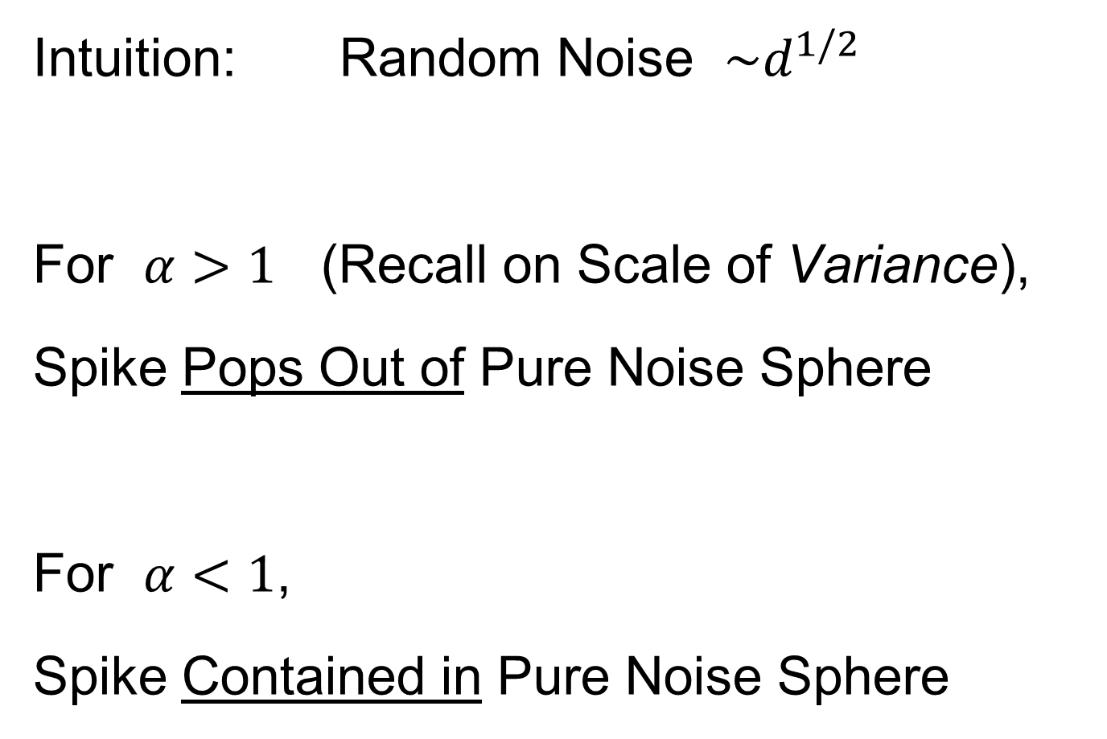
HDLSS Math. Stat. of PCA
Intuition: Random Noise $\sim d^{1/2}$
For $α>1$ (Recall on Scale of Variance),
Spike Pops Out of Pure Noise Sphere
For $α<1$,
Spike Contained in Pure Noise Sphere

Slide 59
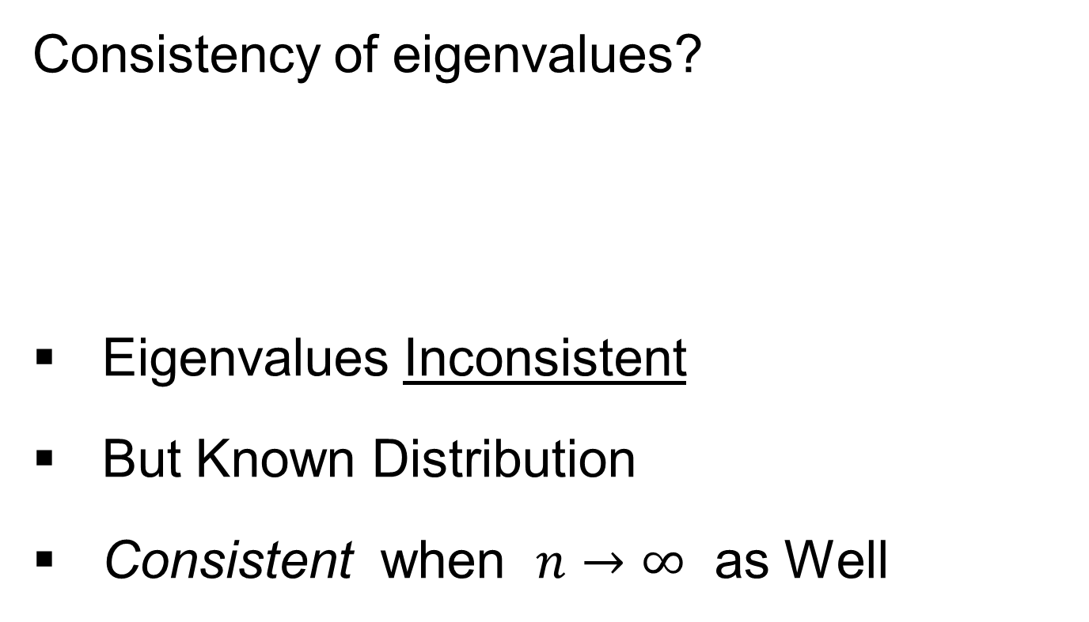
HDLSS Math. Stat. of PCA
Consistency of eigenvalues?
Eigenvalues Inconsistent
But Known Distribution
Consistent when $n→∞$ as Well

Slide 60
HDLSS Math. Stat. of PCA
Conditions for Geo. Rep’n & PCA Consist.:
John Kent example:

Slide 61
HDLSS Math. Stat. of PCA
Conditions for Geo. Rep’n & PCA Consist.:
John Kent example:
Can only say:
not deterministic

Slide 62
HDLSS Math. Stat. of PCA
Conditions for Geo. Rep’n & PCA Consist.:
John Kent example:
Can only say:
not deterministic
PCA Conditions Same, since Noise Still

Slide 63
HDLSS Math. Stat. of PCA
Conditions for Geo. Rep’n & PCA Consist.:
John Kent example:
Can only say:
not deterministic
But for Geo. Rep’n: need some Mixing Cond.

Slide 64
HDLSS Math. Stat. of PCA
Conditions for Geo. Rep’n:
Conclude: Need some Mixing Condition

Slide 65
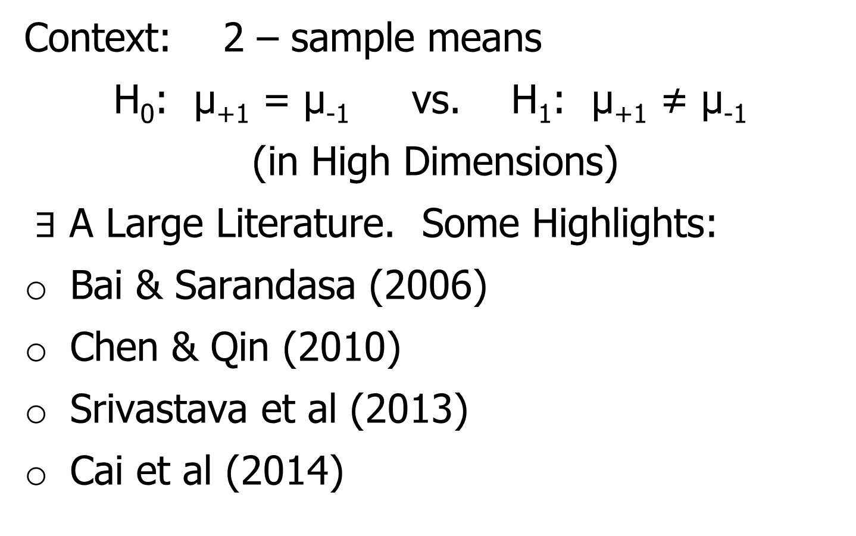
Mixing Conditions
Idea From Probability Theory:
Recall Standard Asymptotic Results, as $n→∞:$
Law of Large Numbers,
$$\overline{X}→μ$$
(“Weak” = in prob., “Strong” = a.s.)

Slide 66
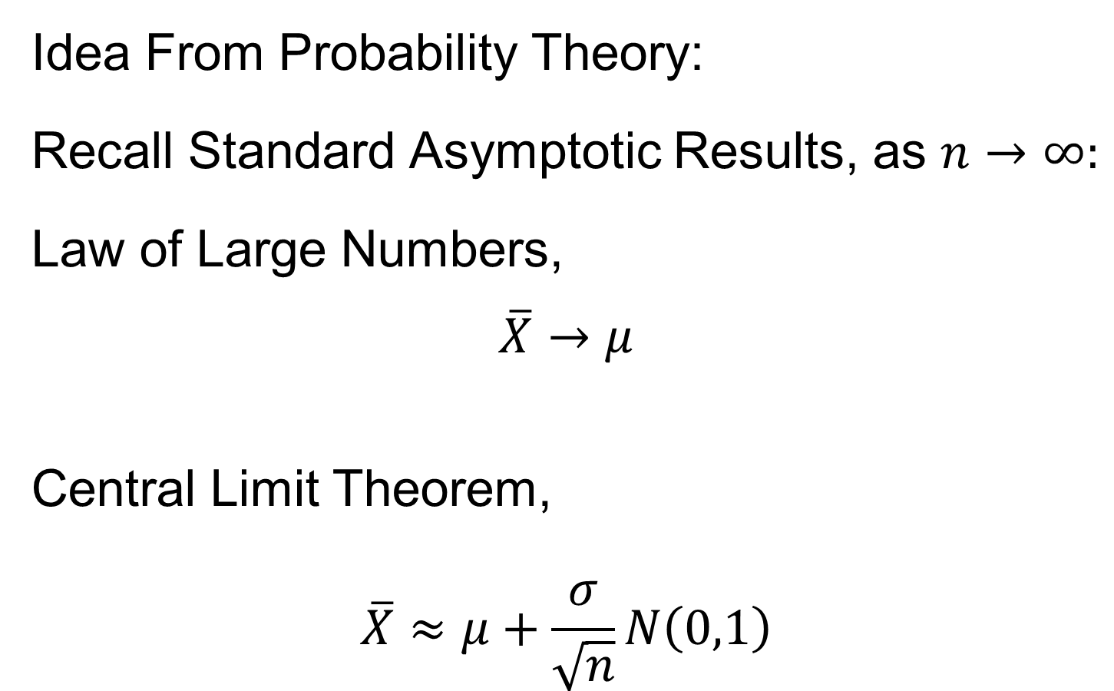
Mixing Conditions
Idea From Probability Theory:
Recall Standard Asymptotic Results, as $n→∞:$
Law of Large Numbers,
$$\overline{X}→μ$$
Central Limit Theorem,
$$\overline{X}≈μ+\frac{σ}{\sqrt{n}}N\left(0,1\right)$$

Slide 67
Mixing Conditions
Idea From Probability Theory:
Law of Large Numbers,
Central Limit Theorem,
Both have Technical Assumptions
(Usually Ignore ???)

Slide 68
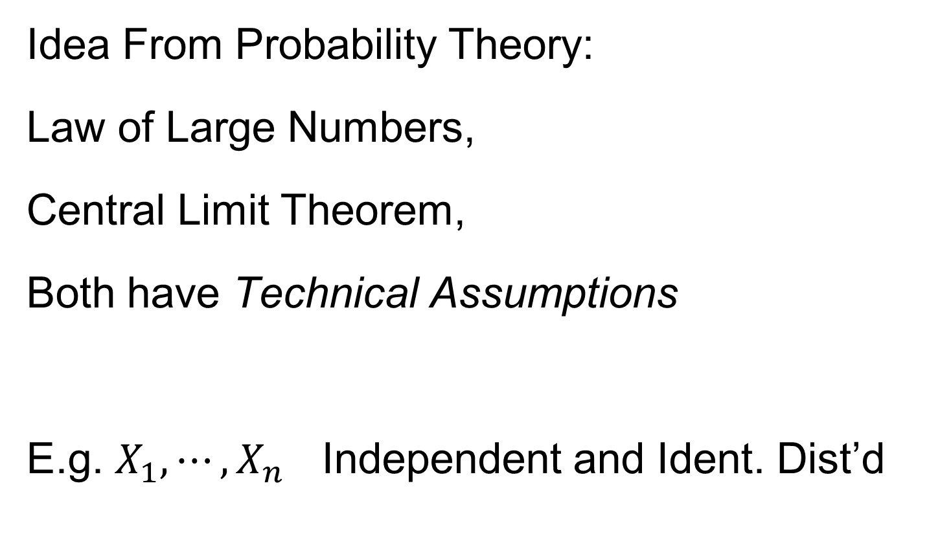
Mixing Conditions
Idea From Probability Theory:
Law of Large Numbers,
Central Limit Theorem,
Both have Technical Assumptions
E.g. $X_{1},⋯,X_{n}$ Independent and Ident. Dist’d

Slide 69
Mixing Conditions
Idea From Probability Theory:
Mixing Conditions:
Explore Weaker Assumptions, to Still Get
Law of Large Numbers,
Central Limit Theorem

Slide 70
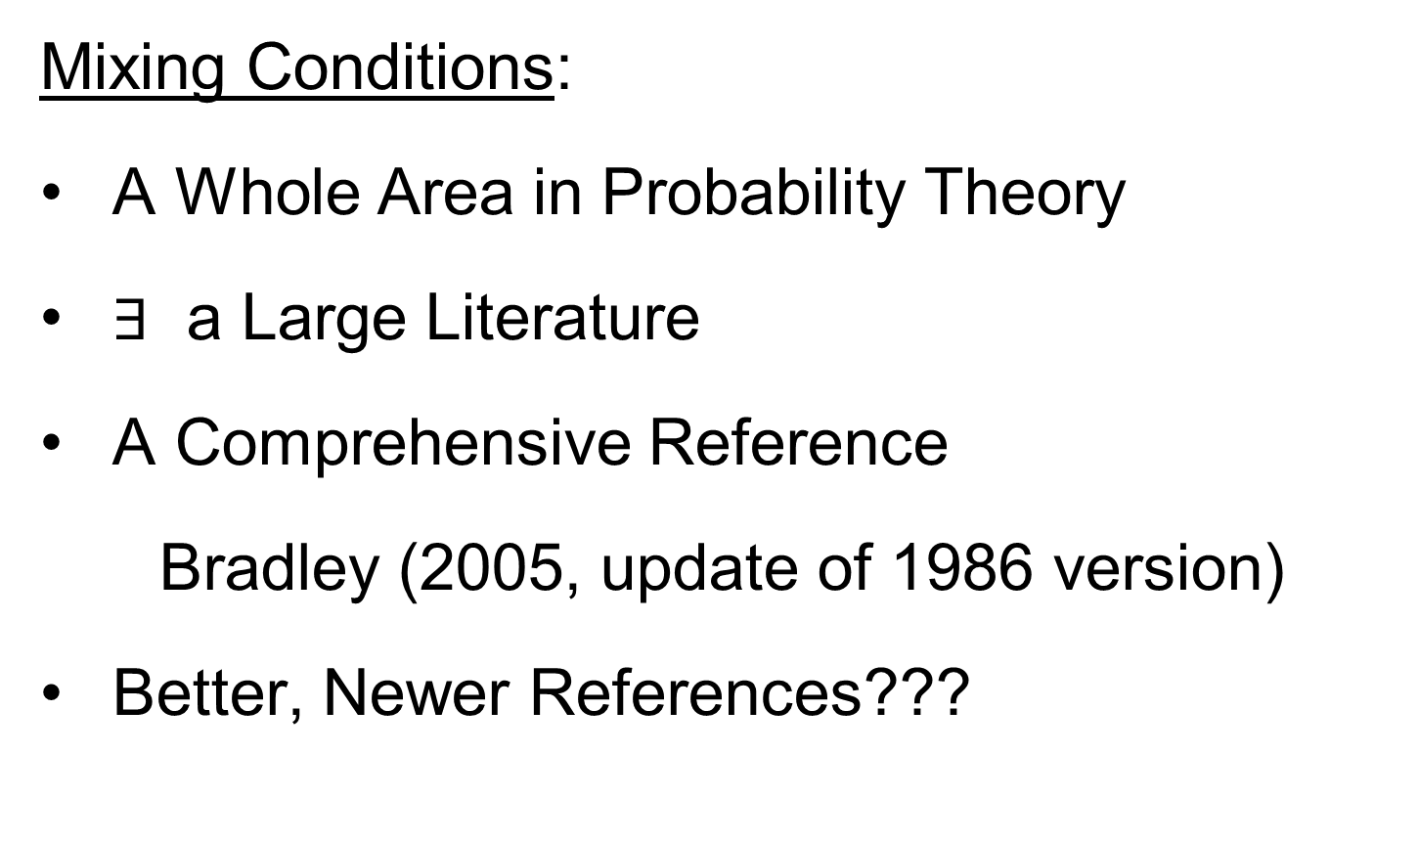
Mixing Conditions
Mixing Conditions:
A Whole Area in Probability Theory
$∃$ a Large Literature
A Comprehensive Reference
Bradley (2005, update of 1986 version)
Better, Newer References???

Slide 71
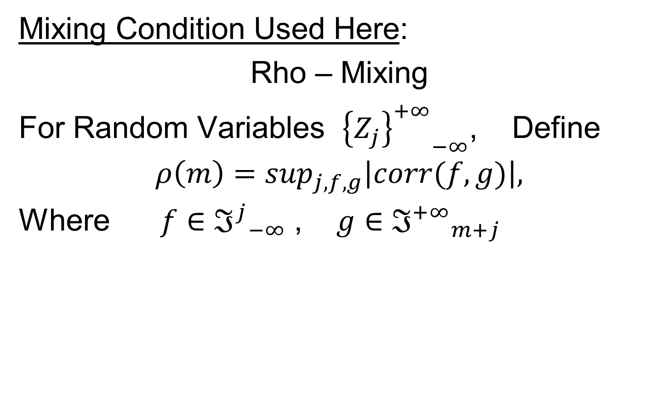
Mixing Conditions
Mixing Condition Used Here:
Rho – Mixing
For Random Variables ${{\left\{Z_{j}\right\}}^{+∞}}_{−∞}^{}$, Define
$$ρ\left(m\right)=\sup_{j,f,g}\left|corr(f,g)\right|,$$
Where $f∈{ℑ^{j}}_{−∞}^{}$ , $g∈{ℑ^{+∞}}_{m+j}^{}$

Slide 72
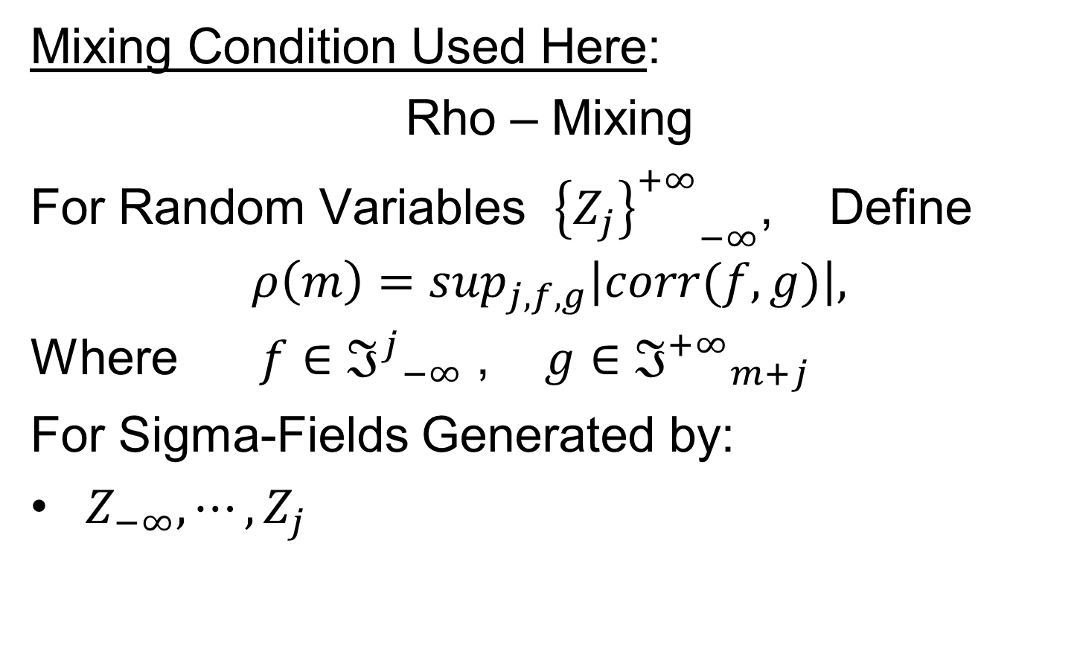
Mixing Conditions
Mixing Condition Used Here:
Rho – Mixing
For Random Variables ${{\left\{Z_{j}\right\}}^{+∞}}_{−∞}^{}$, Define
$$ρ\left(m\right)=\sup_{j,f,g}\left|corr(f,g)\right|,$$
Where $f∈{ℑ^{j}}_{−∞}^{}$ , $g∈{ℑ^{+∞}}_{m+j}^{}$
For Sigma-Fields Generated by:
$Z_{−∞},⋯,Z_{j}$

Slide 73
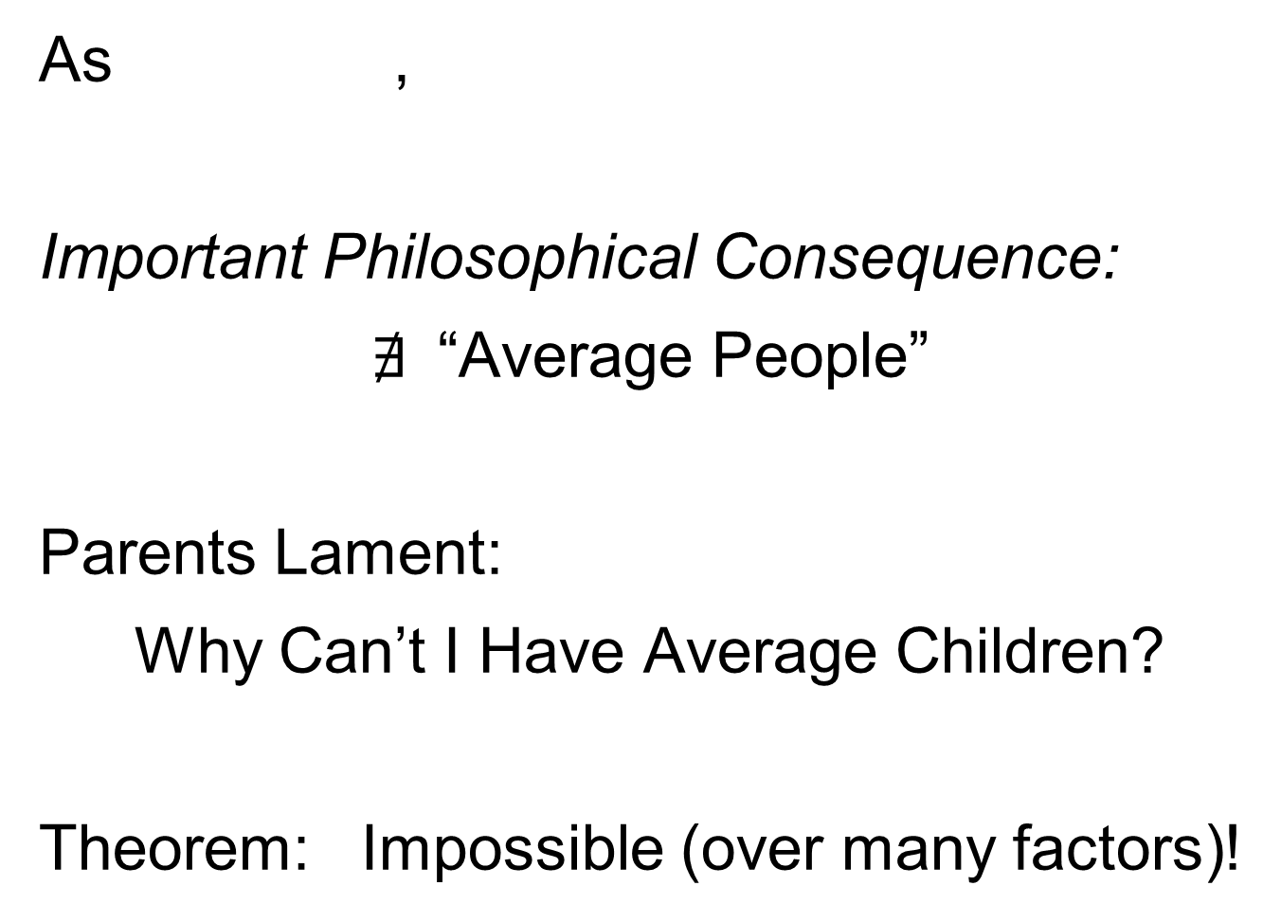
Mixing Conditions
Mixing Condition Used Here:
Rho – Mixing
For Random Variables ${{\left\{Z_{j}\right\}}^{+∞}}_{−∞}^{}$, Define
$$ρ\left(m\right)=\sup_{j,f,g}\left|corr(f,g)\right|,$$
Where $f∈{ℑ^{j}}_{−∞}^{}$ , $g∈{ℑ^{+∞}}_{m+j}^{}$
For Sigma-Fields Generated by:
$Z_{−∞},⋯,Z_{j}$
$Z_{m+j},⋯,Z_{∞}$

Slide 74

Mixing Conditions
Mixing Condition Used Here:
Rho – Mixing
For Random Variables ${{\left\{Z_{j}\right\}}^{+∞}}_{−∞}^{}$, Define
$$ρ\left(m\right)=\sup_{j,f,g}\left|corr(f,g)\right|,$$
Where $f∈{ℑ^{j}}_{−∞}^{}$ , $g∈{ℑ^{+∞}}_{m+j}^{}$
For Sigma-Fields Generated by:
$Z_{−∞},⋯,Z_{j}$
$Z_{m+j},⋯,Z_{∞}$
Note Gap of Lag $m$

Slide 75

Mixing Conditions
Mixing Condition Used Here:
Rho – Mixing
For Random Variables ${{\left\{Z_{j}\right\}}^{+∞}}_{−∞}^{}$, Define
$$ρ\left(m\right)=\sup_{j,f,g}\left|corr(f,g)\right|,$$
Where $f∈{ℑ^{j}}_{−∞}^{}$ , $g∈{ℑ^{+∞}}_{m+j}^{}$
Assume: $\lim_{m→∞}{ρ\left(m\right)=0}$
Idea: Uncorrelated at Far Lags

Slide 76

HDLSS Math. Stat. of PCA
Conditions for Geo. Rep’n:
Hall, Marron and Neeman (2005):
Assume Entries of Data Vectors
Are $ρ$-mixing

Slide 77
HDLSS Math. Stat. of PCA
Conditions for Geo. Rep’n:
Hall, Marron and Neeman (2005):
Drawback: Strong Assumption
(???)
In JRSS-B, since Biometrika Rejected

Slide 78
HDLSS Math. Stat. of PCA
Conditions for Geo. Rep’n:
Hall, Marron and Neeman (2005):
Later Realization:
This Mixing is Very Natural in
Genome Wide Association Studies
1st such: Klein et al (2005)

Slide 79
HDLSS Math. Stat. of PCA
Conditions for Geo. Rep’n:
Series of Technical Improvements:
Ahn, Marron, Muller & Chi (2007)
Yata & Aoshima (2010, 2012)
(Fully Covariance Based,
No Mixing)

Slide 80
HDLSS Math. Stat. of PCA
Conditions for Geo. Rep’n:
Tricky Point: Classical Mixing Conditions
Require Notion of Time Ordering
Not Always Clear, e.g. Microarrays

Slide 81
HDLSS Math. Stat. of PCA
Conditions for Geo. Rep’n:
Condition from Jung & Marron (2009):
where
Note: Not Gaussian

Slide 82
HDLSS Math. Stat. of PCA
Conditions for Geo. Rep’n:
Condition from Jung & Marron (2009):
where
Define:
Standardized Version

Slide 83
HDLSS Math. Stat. of PCA
Conditions for Geo. Rep’n:
Condition from Jung & Marron (2009):
where
Define:
Assume: Ǝ a permutation,
So that is ρ-mixing

Slide 84

HDLSS Math. Stat. of PCA
Careful look at:
PCA Consistency - $α>1$ spike
(Reality Check, Suggested by Reviewer)

Slide 85

HDLSS Math. Stat. of PCA
Careful look at:
PCA Consistency - $α>1$ spike
Independent of Sample Size,
So true for $n=1$(!?!)
Reviewers Conclusion: Absurd
(???)
Shows assumption too strong for practice

Slide 86

HDLSS Math. Stat. of PCA
HDLSS
PCA
Often
Finds
Signal,
Not Pure
Noise

Slide 87

HDLSS Math. Stat. of PCA
Recall
RNAseq
Example
$d\sim 1700$
$n=180$

Slide 88

Functional Data Analysis
Manually
Brushed
Clusters
Clear
Alternate
Splicing
Not
Noise!

Slide 89

HDLSS Math. Stat. of PCA
Recall Theoretical Separation:
Strong Inconsistency - $α<1$ spike
Consistency - $α>1$ spike

Slide 90

HDLSS Math. Stat. of PCA
Recall Theoretical Separation:
Strong Inconsistency - $α<1$ spike
Consistency - $α>1$ spike
Mathematically Driven Conclusion:
Real Data Signals Are This Strong

