Slide 1
GWAS Data Analysis
Genome Wide Association Study (GWAS)
Data Objects: Vectors of Genetic Variants, at known chromosome locations
(Called SNPs)
Discrete (takes on 2 or 3 values)
Dimension $d$ as large as ~5 million
(can be reduced, e.g. $d\sim 20000)$

Slide 2
L1 PCA
Challenge: L1 Projections Hard to Interpret
(i.e. Little Data Insight)
Solution:
Compute PC Directions Using L1
Compute Projections (Scores) Using L2
Called “Visual L1 PCA” (VL1PCA)
Recent work with Yihui Zhou

Slide 3
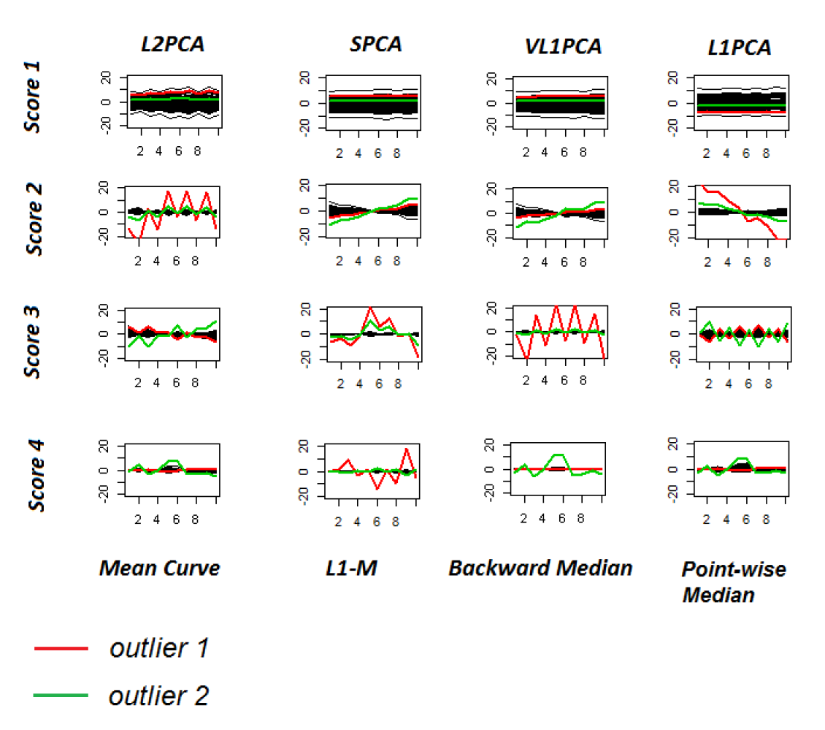
VL1 PCA
10-d Toy Example:
SCPA &
VL1PCA
Nicely
Robust
(Vl1PCA
Slightly
Better)

Slide 4
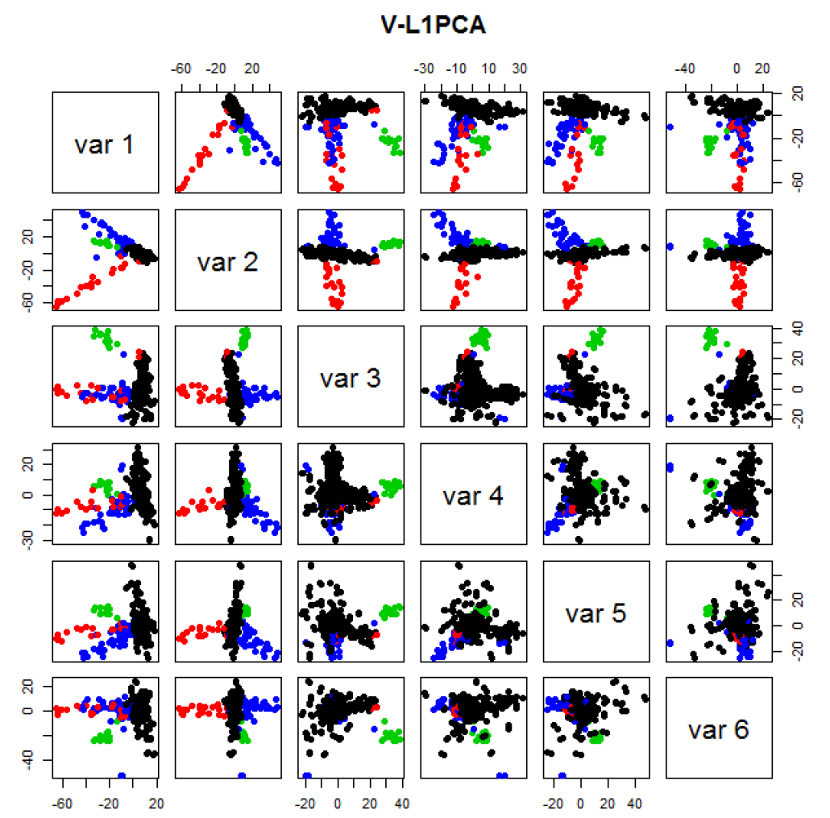
GWAS Data
VL1 PCA
Best Focus
On Ethnic
Groups
Seems To
Find Unlabelled
Clusters

Slide 5
Detailed Look at PCA
Now Study “Folklore” More Carefully
BackGround
History
Underpinnings
(Mathematical & Computational)
Good Overall Reference: Jolliffe (2002)

Slide 6
Review of Linear Algebra (Cont.)
Computation of Singular Value and Eigenvalue Decompositions:
Details too complex to spend time here
A “primitive” of good software packages
Eigenvalues $λ_{1},⋯,λ_{d}$ are Unique
Col’s of $B=\left(\underline{v_{1}},⋯,\underline{v_{d}}\right)$ are “Eigenvectors”
Eigenvectors are “$λ$-Stretched” by $X$ as a
Linear Transform: $X∙\underline{v_{i}}=λ_{i}∙\underline{v_{i}}$

Slide 7
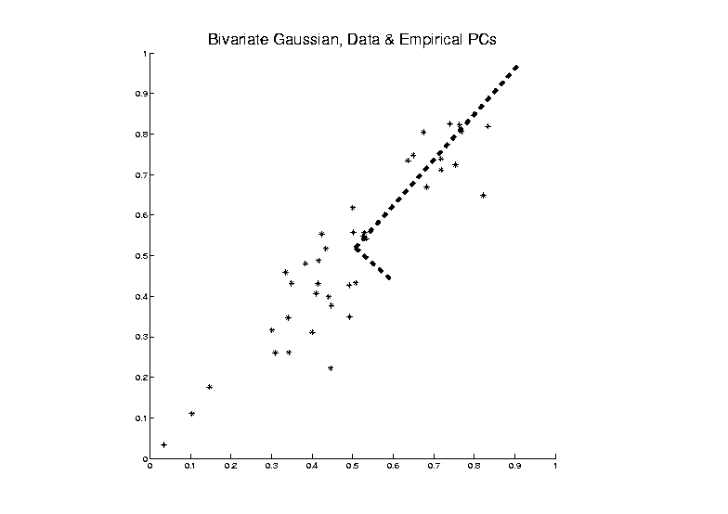
PCA as an Optimization Problem
Find Direction of Greatest Variability:

Slide 8
PCA as an Optimization Problem
Find Direction of Greatest Variability:
Raw Data

Slide 9
PCA as an Optimization Problem
Find Direction of Greatest Variability:
Mean
Residuals
(Shift to
Origin)

Slide 10
PCA as an Optimization Problem
Find Direction of Greatest Variability:
Centered
Data
Projections
Direction
Vector

Slide 11
PCA as Optimization (Cont.)
Find Direction of Greatest Variability:
Given a Direction Vector, (i.e. )
Projection of in the Direction :
Variability in the Direction :

Slide 12
PCA as Optimization (Cont.)
Now since is an Orthonormal Basis Matrix,
and
So the Rotation Gives a Distribution of the Energy of Over the Eigen-Directions
And is Max’d (Over ), by Putting all Energy in the “Largest Direction”, i.e. ,
Where “Eigenvalues are Ordered”,

Slide 13
PCA as Optimization (Cont.)
Notes:
Projecting onto Subspace $⊥$ to $\underline{v_{1}}$,
Gives $\underline{v_{2}}$ as Next Direction
Continue Through $\underline{v_{3}},⋯,\underline{v_{d}}$

Slide 14
Iterated PCA Visualization

Slide 15
PCA as Optimization (Cont.)
Notes:
Projecting onto Subspace $⊥$ to $\underline{v_{1}}$,
Gives $\underline{v_{2}}$ as Next Direction
Continue Through $\underline{v_{3}},⋯,\underline{v_{d}}$
Replace $\hat{Σ}$ by $Σ$ to get Theoretical PCA
Estimated by the Empirical Version
Solution is Unique when $λ_{1}<λ_{2}<⋯<λ_{d}$
Else have Sol’ns in Subsp. Gen’d by $\underline{v}$s

Slide 16
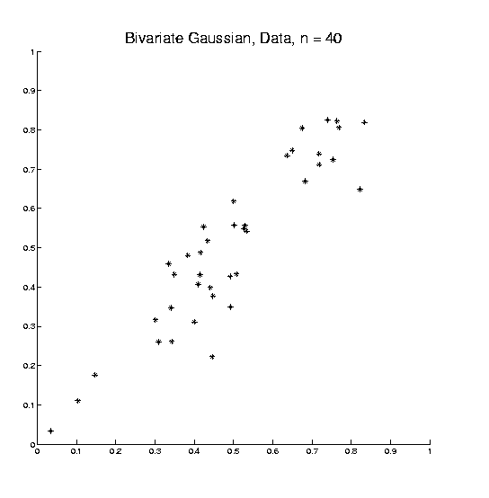
PCA as Optimization (Cont.)
Recall Toy
Example

Slide 17
PCA as Optimization (Cont.)
Recall Toy
Example
Empirical (Sample)
EigenVectors

Slide 18
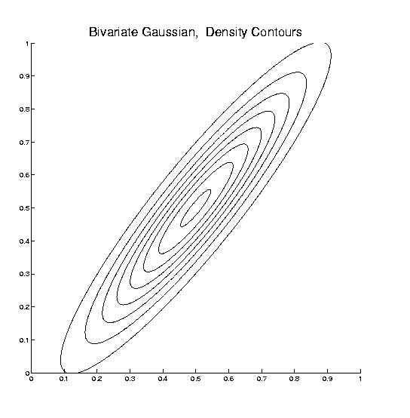
PCA as Optimization (Cont.)
Recall Toy
Example
Theoretical
Distribution

Slide 19
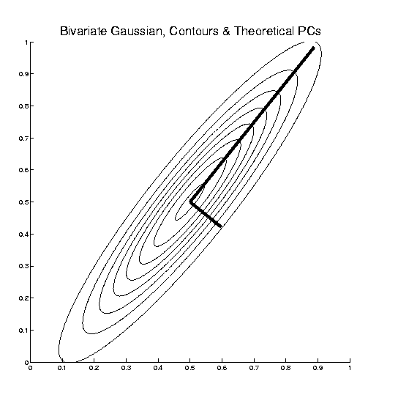
PCA as Optimization (Cont.)
Recall Toy
Example
Theoretical
Distribution
& Eigenvectors

Slide 20
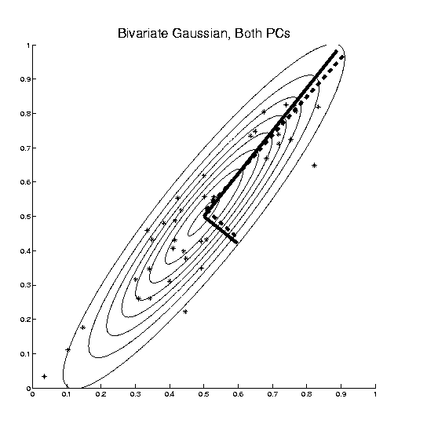
PCA as Optimization (Cont.)
Recall Toy
Example
Empirical (Sample)
EigenVectors
Theoretical
Distribution
& Eigenvectors
Different!

Slide 21
Connect Math to Graphics
2-d Toy Example
From First Class Meeting
2-d Curves as Data In Object Space
Simple, Visualizable Descriptor Space

Slide 22
Connect Math to Graphics
2-d Toy Example
Data Points
(Curves)
are columns of $2×25$ matrix, $X$

Slide 23
Connect Math to Graphics (Cont.)
2-d Toy Example
Sample Mean, $\overline{X}$

Slide 24
Connect Math to Graphics (Cont.)
2-d Toy Example
Residuals from Mean = Data - Mean

Slide 25
Connect Math to Graphics (Cont.)
2-d Toy Example
Recentered Data = Mean Residuals, shifted to 0
= (recentering of $X$) $\tilde{X}$

Slide 26
Connect Math to Graphics (Cont.)
2-d Toy Example
PC1 Direction follows $v_{1}$ = Eigvec (w/ biggest $λ=λ_{1}$)

Slide 27
Connect Math to Graphics (Cont.)
2-d Toy Example
PC1 Projections
Best 1-d Approximations of Data

Slide 28
Connect Math to Graphics (Cont.)
2-d Toy Example
PC1 Residuals

Slide 29
Connect Math to Graphics (Cont.)
2-d Toy Example
PC2 Direction follows $v_{2}$ = Eigvec (w/ 2nd $λ=λ_{2}$)

Slide 30
Connect Math to Graphics (Cont.)
2-d Toy Example
PC2 Projections (= PC1 Resid’s)
2nd Best 1-d Approximations of Data

Slide 31
Connect Math to Graphics (Cont.)
2-d Toy Example
PC2 Residuals = PC1 Projections

Slide 32
Connect Math to Graphics (Cont.)
Note for this 2-d Example:
PC1 Residuals = PC2 Projections
PC2 Residuals = PC1 Projections
(i.e. colors common across these pics)

Slide 33
PCA Redistribution of Energy
Convenient Summary of Amount of Structure:
Total Sum of Squares $\sum_{i=1}^{n}{{\left\|X_{i}\right\|}^{2}}$
Physical Interpetation:
Total Energy in Data
(Signal Processing Literature)

Slide 34
PCA Redistribution of Energy
Convenient Summary of Amount of Structure:
Total Sum of Squares $\sum_{i=1}^{n}{{\left\|X_{i}\right\|}^{2}}$
Physical Interpetation:
Total Energy in Data
Insight comes from decomposition
Statistical Terminology:
ANalysis Of VAriance (ANOVA)

Slide 35
PCA Redist’n of Energy (Cont.)
ANOVA Mean Decomposition:
Total Variation =
$\sum_{i=1}^{n}{{\left\|X_{i}\right\|}^{2}}$= $\sum_{i=1}^{n}{{\left\|\overline{X}\right\|}^{2}}$

Slide 36
PCA Redist’n of Energy (Cont.)
ANOVA Mean Decomposition:
Total Variation =
= Mean Variation + Mean Residual Variation
$\sum_{i=1}^{n}{{\left\|X_{i}\right\|}^{2}}$= $\sum_{i=1}^{n}{{\left\|\overline{X}\right\|}^{2}}+\sum_{i=1}^{n}{{\left\|X_{i}−\overline{X}\right\|}^{2}}$
Mathematics: Pythagorean Theorem
Intuition Quantified via Sums of Squares

Slide 37
Connect Math to Graphics (Cont.)
2-d Toy Example

Slide 38
Connect Math to Graphics (Cont.)
2-d Toy Example
Total Sum of Squares $=\sum_{i=1}^{n}{{\left\|X_{i}\right\|}^{2}}$

Slide 39
Connect Math to Graphics (Cont.)
2-d Toy Example
Total Sum of Squares $=\sum_{i=1}^{n}{{\left\|X_{i}\right\|}^{2}}=861$

Slide 40
Connect Math to Graphics (Cont.)
2-d Toy Example
Total Sum of Squares $=\sum_{i=1}^{n}{{\left\|X_{i}\right\|}^{2}}=861$
Quantifies Overall Variation (from 0)

Slide 41
Connect Math to Graphics (Cont.)
2-d Toy Example
Mean Sum of Squares $=\sum_{i=1}^{n}{{\left\|\overline{X}\right\|}^{2}}$

Slide 42
Connect Math to Graphics (Cont.)
2-d Toy Example
Mean Sum of Squares $=\sum_{i=1}^{n}{{\left\|\overline{X}\right\|}^{2}}=606$
$=92\%$ of Total Sum

Slide 43
Connect Math to Graphics (Cont.)
2-d Toy Example
Mean Sum of Squares $=\sum_{i=1}^{n}{{\left\|\overline{X}\right\|}^{2}}=606$
$=92\%$ of Total Sum
Quantifies Variation Due to Mean (from 0)

Slide 44
Connect Math to Graphics (Cont.)
2-d Toy Example
Mean Resid Sum of Sq’s $=\sum_{i=1}^{n}{{\left\|X_{i}−\overline{X}\right\|}^{2}}$

Slide 45
Connect Math to Graphics (Cont.)
2-d Toy Example
Mean Resid Sum of Sq’s $=\sum_{i=1}^{n}{{\left\|X_{i}−\overline{X}\right\|}^{2}}=55$
$=8\%$ of Total Sum
Quantifies Variation About Mean

Slide 46
PCA Redist’n of Energy (Cont.)
Have already studied this decomposition (recall curve e.g.)
Notes:
46

Slide 47
PCA Redist’n of Energy (Cont.)
Have already studied this decomposition (recall curve e.g.)
Variation (SS) due to Mean (% of total)
Notes:
47

Slide 48
PCA Redist’n of Energy (Cont.)
Have already studied this decomposition (recall curve e.g.)
Variation (SS) due to Mean (% of total)
Variation (SS) of Mean Residuals (% of total)
Notes:
48

Slide 49
PCA Redist’n of Energy (Cont.)
Now Decompose SS About the Mean
where:
Note Inner Products this time
Notes:
49

Slide 50
PCA Redist’n of Energy (Cont.)
Now Decompose SS About the Mean
where:
Recall: Can Commute Matrices Inside Trace
Notes:
50

Slide 51
PCA Redist’n of Energy (Cont.)
Now Decompose SS About the Mean
where:
Recall: Cov Matrix is Outer Product
Notes:
51

Slide 52
PCA Redist’n of Energy (Cont.)
Now Decompose SS About the Mean
where:
i.e. Energy is Expressed in Trace of Cov Matrix
Notes:
52

Slide 53
PCA Redist’n of Energy (Cont.)
(Using Eigenvalue Decomp. Of Cov Matrix)
Notes:
53

Slide 54
PCA Redist’n of Energy (Cont.)
(Commute Matrices Within Trace)
Notes:
54

Slide 55
PCA Redist’n of Energy (Cont.)
(Since Basis Matrix is Orthonormal)
Notes:
55

Slide 56
PCA Redist’n of Energy (Cont.)
Eigenvalues Provide Atoms of SS Decompos’n
Notes:
56

Slide 57
Connect Math to Graphics (Cont.)
2-d Toy Example
PC1 Sum of Squares $=51$
$=93\%$ of Mean Res. Sum

Slide 58
Connect Math to Graphics (Cont.)
2-d Toy Example
PC1 Sum of Squares $=51$
$=93\%$ of Mean Res. Sum
Quantifies PC1 Component of Variation

Slide 59
Connect Math to Graphics (Cont.)
2-d Toy Example
PC1 Residual SS $=$3.8
$=7\%$ of Mean Residual Sum

Slide 60
Connect Math to Graphics (Cont.)
2-d Toy Example
PC1 Sum of Squares $=3.8$
$=7\%$ of Mean Res. Sum

Slide 61
Connect Math to Graphics (Cont.)
2-d Toy Example
PC2 Sum of Squares $=3.8$
$=7\%$ of Mean Res. Sum
Quantifies PC2 Component of Variation

Slide 62
Connect Math to Graphics (Cont.)
2-d Toy Example
PC2 Residual SS $=51$
$=93\%$ of Mean Residual Sum

Slide 63
PCA Redist’n of Energy (Cont.)
Eigenvalues Provide Atoms of SS Decompos’n
Notes:
63

Slide 64
PCA Redist’n of Energy (Cont.)
Eigenvalues Provide Atoms of SS Decompos’n
Useful Plots are:
Power Spectrum: vs.
Notes:
64

Slide 65
PCA Redist’n of Energy (Cont.)
Eigenvalues Provide Atoms of SS Decompos’n
Useful Plots are:
Power Spectrum: vs.
log Power Spectrum: vs.
(Very Useful When Are Orders of Mag. Apart)
Notes:
65

Slide 66
PCA Redist’n of Energy (Cont.)
Eigenvalues Provide Atoms of SS Decompos’n
Useful Plots are:
Power Spectrum: vs.
log Power Spectrum: vs.
Cumulative Power Spectrum: vs.
Notes:
66

Slide 67
PCA Redist’n of Energy (Cont.)
Eigenvalues Provide Atoms of SS Decompos’n
Useful Plots are:
Power Spectrum: vs.
log Power Spectrum: vs.
Cumulative Power Spectrum: vs.
Note PCA Gives SS’s for Free (As Eigenval’s),
But Watch Factors of
Notes:
67

Slide 68
PCA Redist’n of Energy (Cont.)
Note, have already considered some of these Useful Plots:
Notes:
68

Slide 69
PCA Redist’n of Energy (Cont.)
Note, have already considered some of these Useful Plots:
Power Spectrum
Notes:
69

Slide 70
PCA Redist’n of Energy (Cont.)
Note, have already considered some of these Useful Plots:
Power Spectrum
Cumulative Power Spectrum
Notes:
70

Slide 71
PCA Redist’n of Energy (Cont.)
Note, have already considered some of these Useful Plots:
Power Spectrum
Cumulative Power Spectrum
Common Terminology:
Power Spectrum is Called
“Scree Plot”
Kruskal (1964) Cattell (1966)
(all but name “scree”) (1st Appearance of name???)
Notes:
71

Slide 72
Correlation PCA
A related (& better known?) variation of PCA:
Replace cov. matrix with correlation matrix
I.e. do eigen analysis of
Where

Slide 73
Correlation PCA
Why use correlation matrix?
Makes features “unit free”
e.g. Height, Weight, Age, $, …
Are “directions in point cloud” meaningful or useful?
Will unimportant directions dominate?

Slide 74
Correlation PCA
Personal Thoughts on Correlation PCA:
Can be very useful
(especially with noncommensurate units)
Not always, can hide important structure

Slide 75
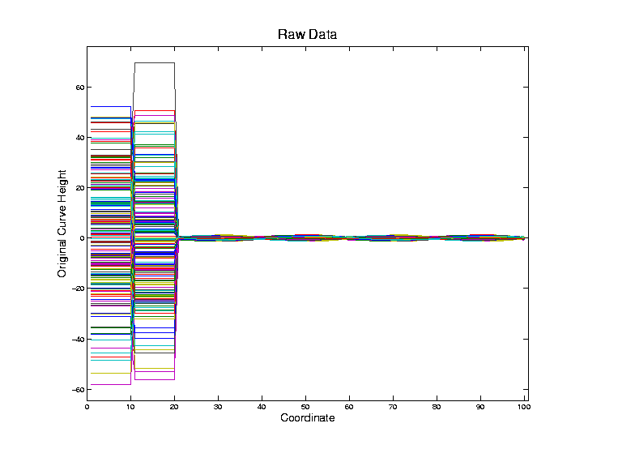
Correlation PCA
Toy Example Contrasting Cov vs. Corr.

Slide 76
Correlation PCA
Toy Example Contrasting Cov vs. Corr.
Big Var’n
Part

Slide 77
Correlation PCA
Toy Example Contrasting Cov vs. Corr.
Big Var’n
Part
Small
Var’n
Part

Slide 78
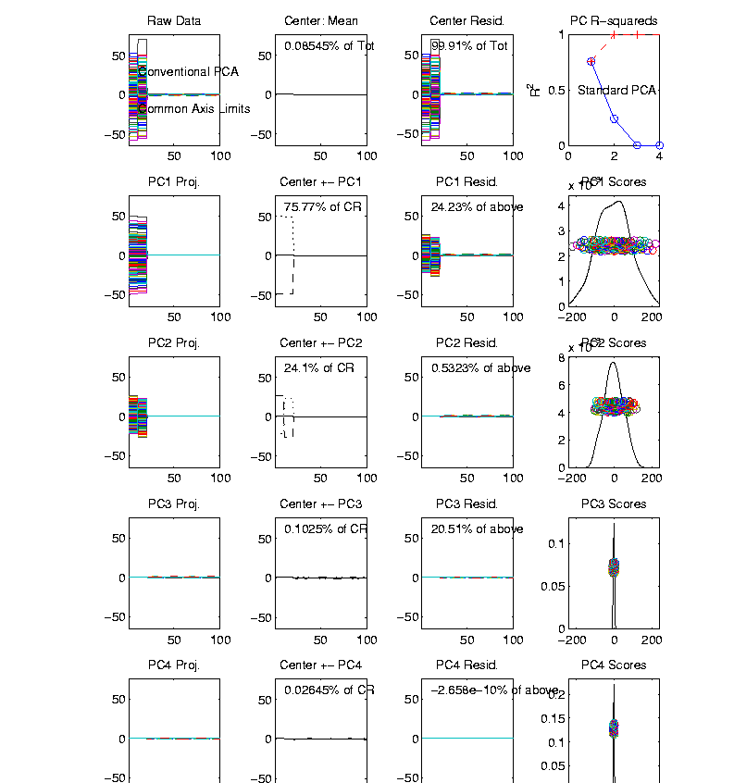
Correlation PCA
Toy Example Contrasting Cov vs. Corr.
1st Comp:
Nearly Flat

Slide 79
Correlation PCA
Toy Example Contrasting Cov vs. Corr.
1st Comp:
Nearly Flat
2nd Comp:
Contrast

Slide 80
Correlation PCA
Toy Example Contrasting Cov vs. Corr.
1st Comp:
Nearly Flat
2nd Comp:
Contrast
3rd & 4th:
Very Small

Slide 81
Correlation PCA
Toy Example Contrasting Cov vs. Corr.
1st Comp:
Nearly Flat
2nd Comp:
Contrast
3rd & 4th:
Look Very
Small Since
Common Axes

Slide 82
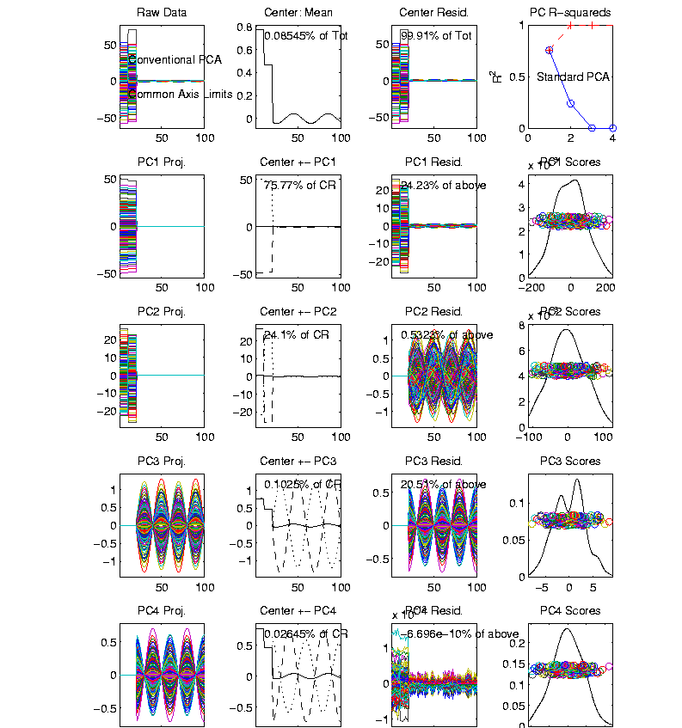
Correlation PCA
Toy Example Contrasting Cov vs. Corr.
Use Rescaled
Axes (Typical
Default)
Now Can
See Mean

Slide 83
Correlation PCA
Toy Example Contrasting Cov vs. Corr.
Use Rescaled
Axes (Typical
Default)
All Comp’s
Visible
(sin & cos)

Slide 84
Correlation PCA
Toy Example Contrasting Cov vs. Corr.
Use Rescaled
Axes (Typical
Default)
All Comp’s
Visible
Good or
Bad ???

Slide 85
Correlation PCA
Toy Example Contrasting Cov vs. Corr.

Slide 86
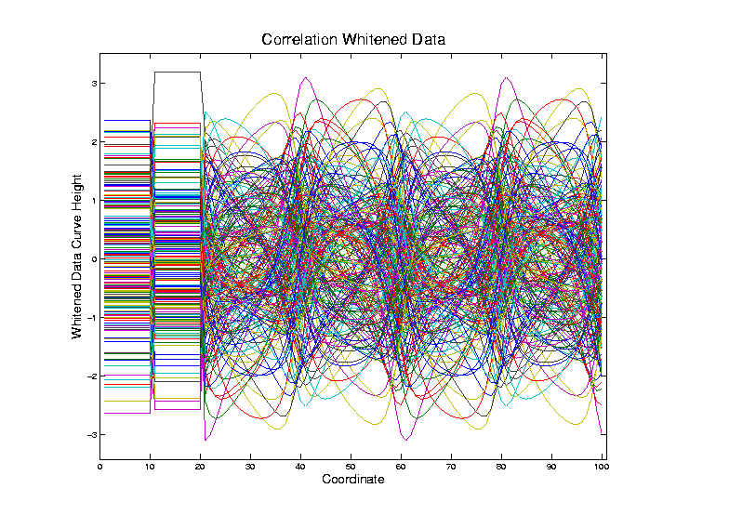
Correlation PCA
Toy Example Contrasting Cov vs. Corr.
Correlation
“Whitened”
Version
Each Coord.
Rescaled
By Its S.D.

Slide 87
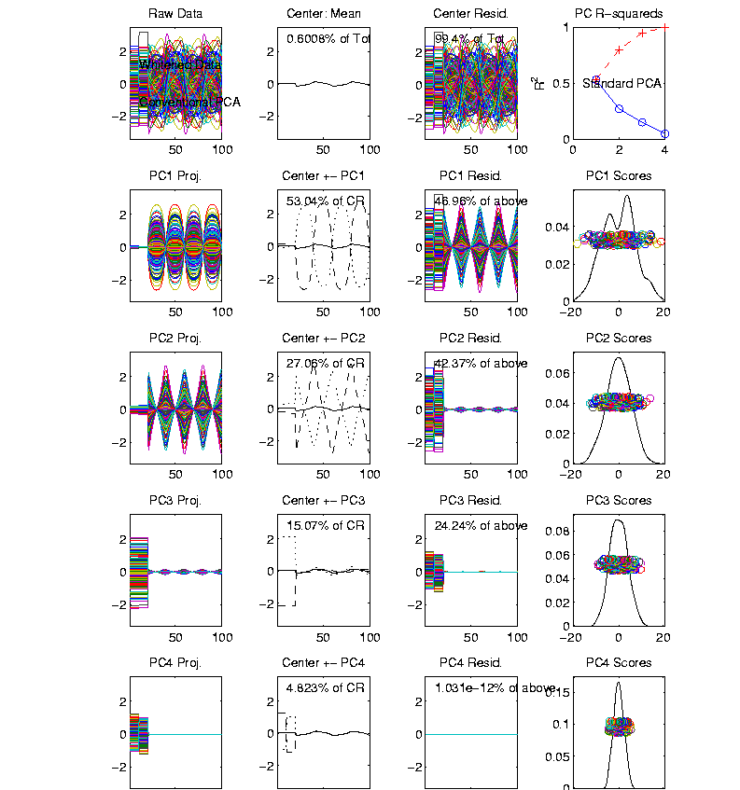
Correlation PCA
Toy Example Contrasting Cov vs. Corr.
Correlation
“Whitened”
Version
All Much
Different

Slide 88
Correlation PCA
Toy Example Contrasting Cov vs. Corr.
Correlation
“Whitened”
Version
All Much
Different
Which Is
Right ???

Slide 89
Correlation PCA
Personal Thoughts on Correlation PCA:
Can be very useful
(especially with noncommensurate units)
Not always, can hide important structure
To make choice:
Decide whether whitening is useful
My personal use of correlat’n PCA is rare
Other people use it most of the time

Slide 90
PCA vs. SVD
Sometimes “SVD Analysis of Data”
= Uncentered PCA
Investigate with Similar Toy Example

Slide 91
PCA vs. SVD
2-d Toy Example
Direction of “Maximal Variation”???

Slide 92
PCA vs. SVD
2-d Toy Example
Direction of “Maximal Variation”???
PC1 Solution (Mean Centered) Very Good!

Slide 93
PCA vs. SVD
2-d Toy Example
Direction of “Maximal Variation”???
SV1 Solution (Origin Centered) Poor Rep’n

Slide 94
PCA vs. SVD
2-d Toy Example
Look in Orthogonal Direction:
PC2 Solution (Mean Centered) Very Good!

Slide 95
PCA vs. SVD
2-d Toy Example
Look in Orthogonal Direction:
SV2 Solution (Origin Centered) Off Map!

Slide 96
PCA vs. SVD
2-d Toy Example
SV2 Solution Larger Scale View:
Not Representative of Data

Slide 97
PCA vs. SVD
Sometimes “SVD Analysis of Data”
= Uncentered PCA
Investigate with Similar Toy Example:
Conclusions:
PCA Generally Better
Unless “Origin Is Important”
Deeper Look: Zhang et al (2007)

Slide 98
Different Views of PCA
Solves several optimization problems:
Direction to maximize SS of 1-d proj’d data
Notes:
98

Slide 99
Different Views of PCA
2-d Toy Example
Max SS of Projected Data
Min SS of Residuals
Best Fit Line
Notes:
99

Slide 100
Different Views of PCA
Solves several optimization problems:
Direction to maximize SS of 1-d proj’d data
Direction to minimize SS of residuals
Notes:
100

Slide 101
Different Views of PCA
2-d Toy Example
Max SS of Projected Data
Min SS of Residuals
Best Fit Line
Notes:
101

Slide 102
Different Views of PCA
Solves several optimization problems:
Direction to maximize SS of 1-d proj’d data
Direction to minimize SS of residuals
(same, by Pythagorean Theorem)
“Best fit line” to data in “orthogonal sense”
(vs. regression of Y on X = vertical sense
& regression of X on Y = horizontal sense)
Notes:
102

Slide 103
Different Views of PCA
Toy Example Comparison of Fit Lines:
PC1
Regression of Y on X
Regression of X on Y
Notes:
103

Slide 104
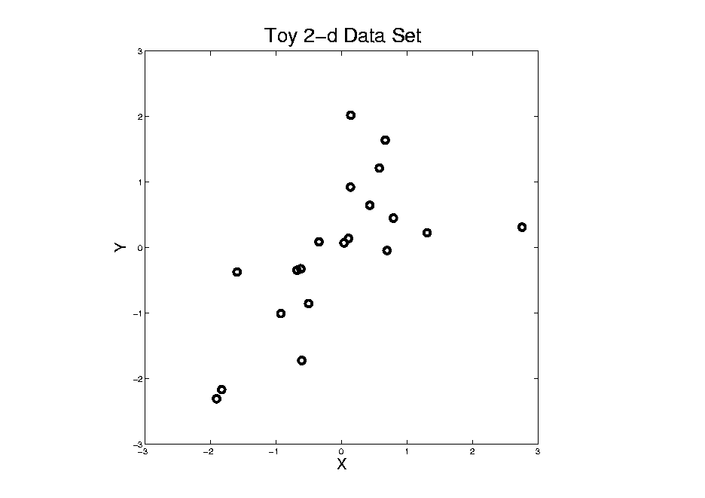
Different Views of PCA
Normal
Data
ρ = 0.3
Notes:
104

Slide 105
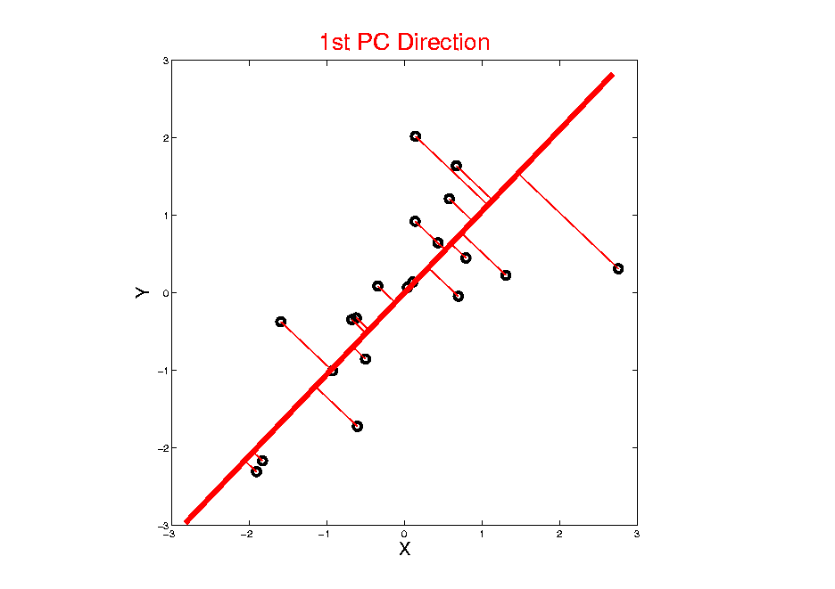
Different Views of PCA
Projected
Residuals
Notes:
105

Slide 106
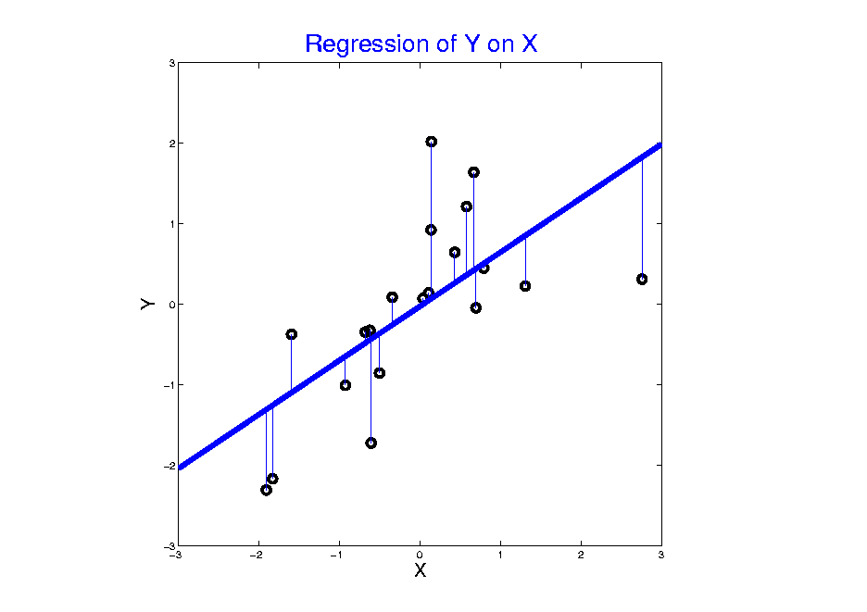
Different Views of PCA
Vertical
Residuals
(X predicts Y)
Notes:
106

Slide 107
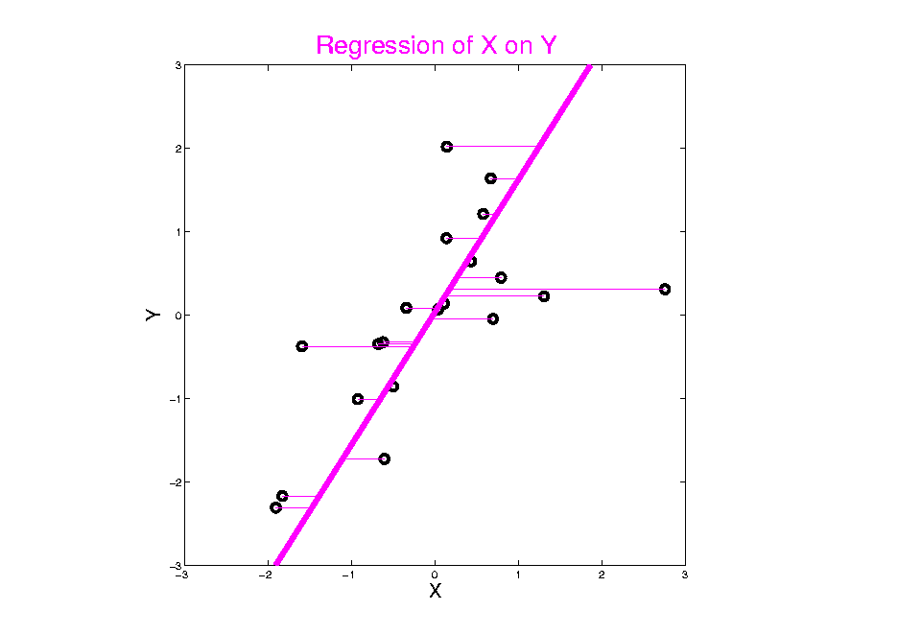
Different Views of PCA
Horizontal
Residuals
(Y predicts X)
Notes:
107

Slide 108
Different Views of PCA
Projected
Residuals
(Balanced
Treatment)
Notes:
108

Slide 109
Different Views of PCA
Toy Example Comparison of Fit Lines:
PC1
Regression of Y on X
Regression of X on Y
Note: Big Difference Prediction Matters
Notes:
109

Slide 110
Different Views of PCA
Solves several optimization problems:
Direction to maximize SS of 1-d proj’d data
Direction to minimize SS of residuals
(same, by Pythagorean Theorem)
“Best fit line” to data in “orthogonal sense”
(vs. regression of Y on X = vertical sense
& regression of X on Y = horizontal sense)
Use one that makes sense…
Notes:
110

Slide 111
PCA Data Representation
Idea: Expand Data Matrix
in Terms of Inner Prod’ts & Eigenvectors
Recall Notation:
$$\tilde{X}=\frac{1}{\sqrt{n−1}}{\left({\underline{X}}_{1}−\underline{\overline{X}},⋯,{\underline{X}}_{n}−\underline{\overline{X}}\right)}_{d×n}$$
(Mean Centered Data)

Slide 112
PCA Data Representation
Idea: Expand Data Matrix
in Terms of Inner Prod’ts & Eigenvectors
Recall Notation:
$$\tilde{X}=\frac{1}{\sqrt{n−1}}{\left({\underline{X}}_{1}−\underline{\overline{X}},⋯,{\underline{X}}_{n}−\underline{\overline{X}}\right)}_{d×n}$$
Spectral Representation (centered data):
$${\tilde{X}}_{d×n}=\sum_{j=1}^{d}{{\underline{v}}_{j}}\left({{\underline{v}}_{j}}^{t}\tilde{X}\right)$$

Slide 113
PCA Data Represent’n (Cont.)
Now Using:
$$X=\underline{\overline{X}}+\sqrt{n−1}\tilde{X}$$
Spectral Representation (Raw Data):
$$X_{d×n}=\underline{\overline{X}}+\sum_{j=1}^{d}{{\underline{v}}_{j}\sqrt{n−1}\left({{\underline{v}}_{j}}^{t}\tilde{X}\right)}=\underline{\overline{X}}+\sum_{j=1}^{d}{{\underline{v}}_{j}{\underline{c}}_{j}}$$
Where:
Entries of ${\underline{v}}_{j}$ $\left(d×1\right)$ are Loadings
Entries of ${\underline{c}}_{j}$ $\left(1×n\right)$ are Scores

Slide 114
PCA Data Represent’n (Cont.)
Can Focus on Individual Data Vectors:
$${\underline{X}}_{i}=\underline{\overline{X}}+\sum_{j=1}^{d}{{\underline{v}}_{j}}c_{ij}$$
(Part of Above Full Matrix Rep’n)
Terminology: $c_{ij}$ are Called “PCs”
and are also Called Scores

Slide 115
PCA Data Represent’n (Cont.)
More Terminology:
Scores, $c_{ij}$ are Coefficients in Spectral Representation:
$${\underline{X}}_{i}=\underline{\overline{X}}+\sum_{j=1}^{d}{{\underline{v}}_{j}}c_{ij}$$
Loadings are Entries $v_{ij}$ of Eigenvectors: ${\underline{v}}_{j}=\left(\begin{matrix}v_{1j} \\ ⋮ \\ v_{dj}\end{matrix}\right)$

Slide 116
PCA Data Represent’n (Cont.)
Reduced Rank Representation:
$${\underline{X}}_{i}=\underline{\overline{X}}+\sum_{j=1}^{k}{{\underline{v}}_{j}c_{ij}}$$
Reconstruct Using Only $k (≪d)$ Terms
(Assuming Decreasing Eigenvalues)

Slide 117
PCA Data Represent’n (Cont.)
Reduced Rank Representation:
$${\underline{X}}_{i}=\underline{\overline{X}}+\sum_{j=1}^{k}{{{\underline{v}}_{j}c}_{ij}}$$
Reconstruct Using Only $k (≪d)$ Terms
(Assuming Decreasing Eigenvalues)
Gives: Rank $k$ Approximation of Data
Key to PCA Dimension Reduction
And PCA for Data Compression (~ .jpeg)

Slide 118
Participant Presentation
Wes Crouse
Bayesian Clustering and Data Integration

