Slide 1
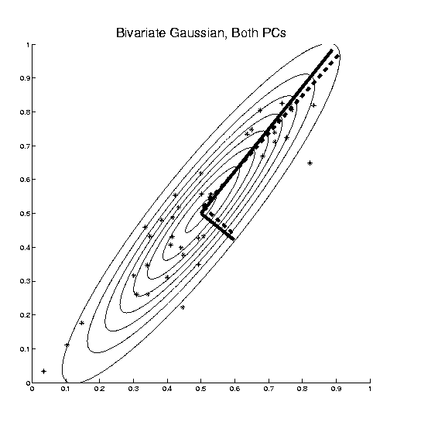
PCA as Optimization (Cont.)
Recall Toy
Example
Empirical (Sample)
EigenVectors
Theoretical
Distribution
& Eigenvectors
Different!

Slide 2
Connect Math to Graphics (Cont.)
2-d Toy Example
PC1 Projections
Best 1-d Approximations of Data

Slide 3
Connect Math to Graphics (Cont.)
2-d Toy Example
PC2 Projections (= PC1 Resid’s)
2nd Best 1-d Approximations of Data

Slide 4
PCA Redist’n of Energy (Cont.)
ANOVA Mean Decomposition:
Total Variation =
= Mean Variation + Mean Residual Variation
$\sum_{i=1}^{n}{{\left\|X_{i}\right\|}^{2}}$= $\sum_{i=1}^{n}{{\left\|\overline{X}\right\|}^{2}}+\sum_{i=1}^{n}{{\left\|X_{i}−\overline{X}\right\|}^{2}}$
Mathematics: Pythagorean Theorem
Intuition Quantified via Sums of Squares

Slide 5
PCA Redist’n of Energy (Cont.)
Eigenvalues Provide Atoms of SS Decompos’n
Useful Plots are:
Power Spectrum: vs.
log Power Spectrum: vs.
Cumulative Power Spectrum: vs.
Note PCA Gives SS’s for Free (As Eigenval’s),
But Watch Factors of
Notes:
5

Slide 6
PCA Redist’n of Energy (Cont.)
Note, have already considered some of these Useful Plots:
Power Spectrum
Cumulative Power Spectrum
Common Terminology:
Power Spectrum is Called
“Scree Plot”
Kruskal (1964) Cattell (1966)
(all but name “scree”) (1st Appearance of name???)
Notes:
6

Slide 7
Correlation PCA
A related (& better known?) variation of PCA:
Replace cov. matrix with correlation matrix
I.e. do eigen analysis of
Where

Slide 8
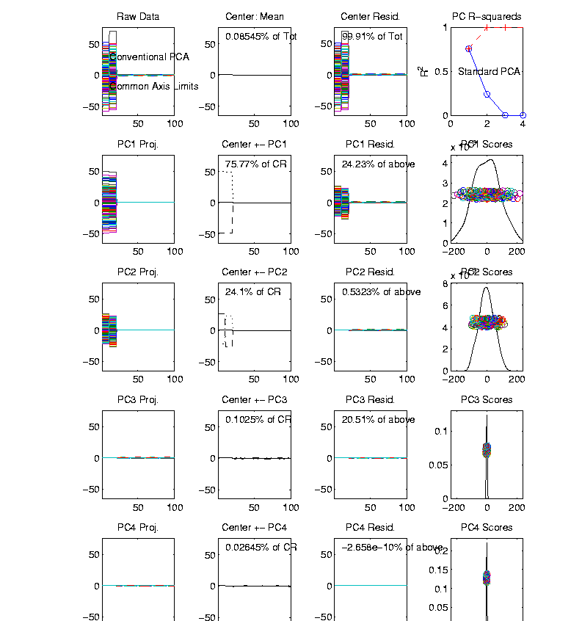
Correlation PCA
Toy Example Contrasting Cov vs. Corr.
1st Comp:
Nearly Flat
2nd Comp:
Contrast
3rd & 4th:
Very Small

Slide 9
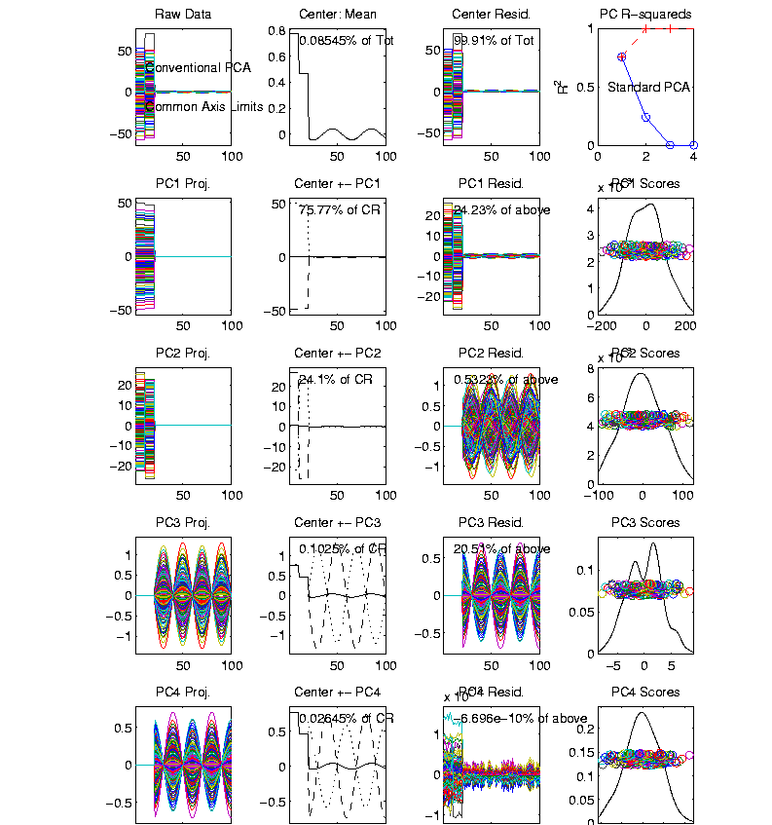
Correlation PCA
Toy Example Contrasting Cov vs. Corr.
Use Rescaled
Axes (Typical
Default)
All Comp’s
Visible
Good or
Bad ???

Slide 10
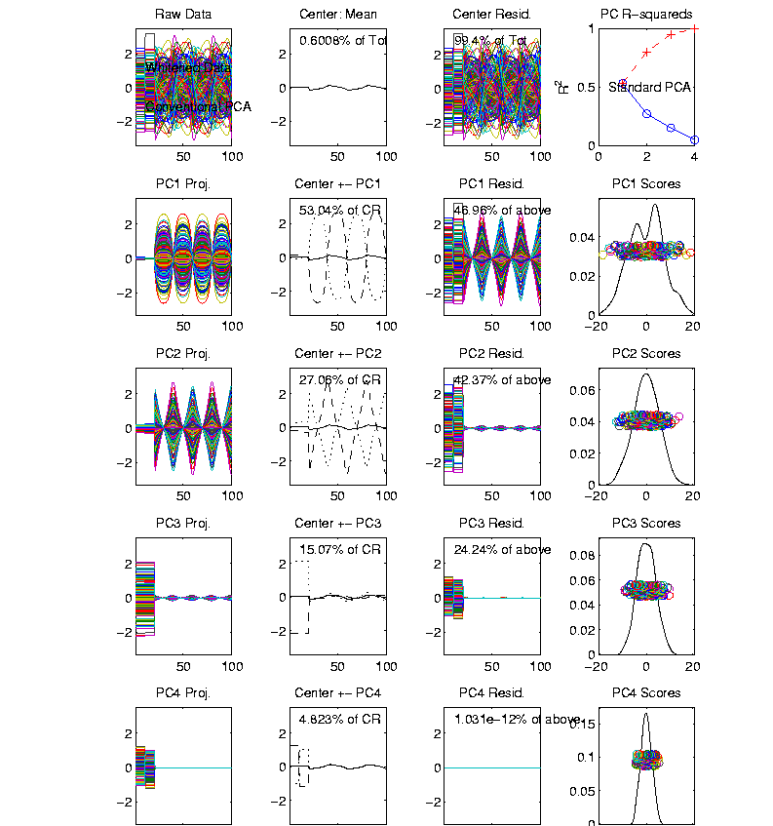
Correlation PCA
Toy Example Contrasting Cov vs. Corr.
Correlation
“Whitened”
Version
All Much
Different
Which Is
Right ???

Slide 11
PCA vs. SVD
2-d Toy Example
Direction of “Maximal Variation”???
PC1 Solution (Mean Centered) Very Good!

Slide 12
PCA vs. SVD
2-d Toy Example
Direction of “Maximal Variation”???
SV1 Solution (Origin Centered) Poor Rep’n

Slide 13
PCA vs. SVD
Sometimes “SVD Analysis of Data”
= Uncentered PCA
Investigate with Similar Toy Example:
Conclusions:
PCA Generally Better
Unless “Origin Is Important”
Deeper Look: Zhang et al (2007)

Slide 14
Different Views of PCA
Toy Example Comparison of Fit Lines:
PC1
Regression of Y on X
Regression of X on Y
Notes:
14

Slide 15
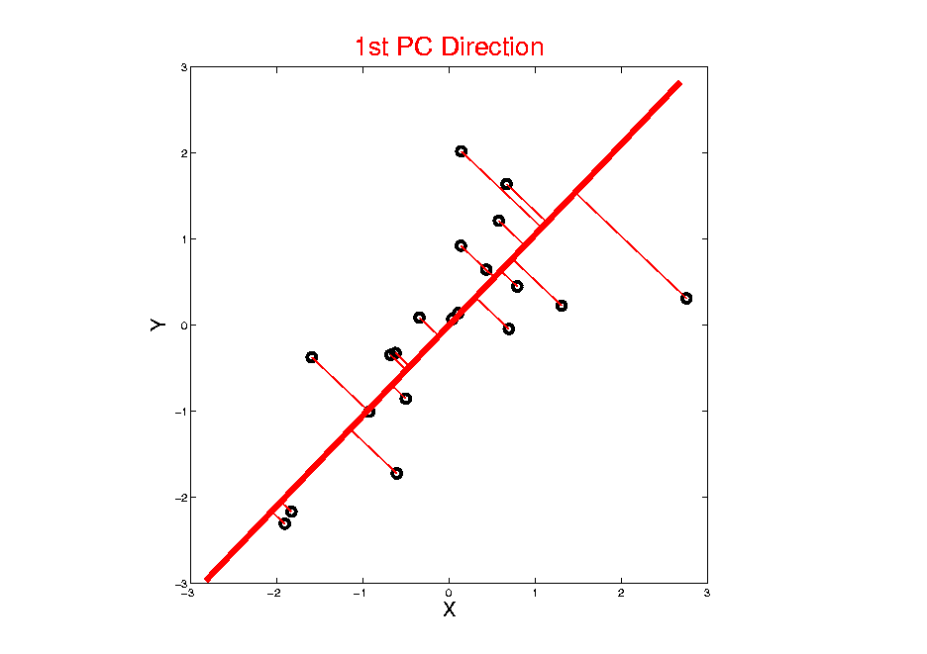
Different Views of PCA
Projected
Residuals
Notes:
15

Slide 16
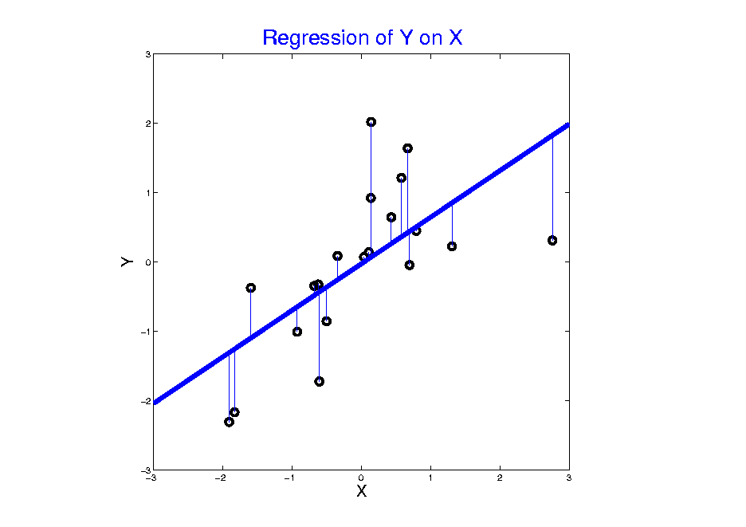
Different Views of PCA
Vertical
Residuals
(X predicts Y)
Notes:
16

Slide 17
Different Views of PCA
Solves several optimization problems:
Direction to maximize SS of 1-d proj’d data
Direction to minimize SS of residuals
(same, by Pythagorean Theorem)
“Best fit line” to data in “orthogonal sense”
(vs. regression of Y on X = vertical sense
& regression of X on Y = horizontal sense)
Use one that makes sense…
Notes:
17

Slide 18
PCA Data Represent’n (Cont.)
Now Using:
$$X=\underline{\overline{X}}+\sqrt{n−1}\tilde{X}$$
Spectral Representation (Raw Data):
$$X_{d×n}=\underline{\overline{X}}+\sum_{j=1}^{d}{{\underline{v}}_{j}\sqrt{n−1}\left({{\underline{v}}_{j}}^{t}\tilde{X}\right)}=\underline{\overline{X}}+\sum_{j=1}^{d}{{\underline{v}}_{j}{\underline{c}}_{j}}$$
Where:
Entries of ${\underline{v}}_{j}$ $\left(d×1\right)$ are Loadings
Entries of ${\underline{c}}_{j}$ $\left(1×n\right)$ are Scores

Slide 19
PCA Data Represent’n (Cont.)
Can Focus on Individual Data Vectors:
$${\underline{X}}_{i}=\underline{\overline{X}}+\sum_{j=1}^{d}{{\underline{v}}_{j}}c_{ij}$$
(Part of Above Full Matrix Rep’n)
Terminology: $c_{ij}$ are Called “PCs”
and are also Called Scores

Slide 20
PCA Data Represent’n (Cont.)
Reduced Rank Representation:
$${\underline{X}}_{i}=\underline{\overline{X}}+\sum_{j=1}^{k}{{\underline{v}}_{j}c_{ij}}$$
Reconstruct Using Only $k (≪d)$ Terms
(Assuming Decreasing Eigenvalues)

Slide 21
PCA Data Represent’n (Cont.)
Reduced Rank Representation:
$${\underline{X}}_{i}=\underline{\overline{X}}+\sum_{j=1}^{k}{{{\underline{v}}_{j}c}_{ij}}$$
Reconstruct Using Only $k (≪d)$ Terms
(Assuming Decreasing Eigenvalues)
Gives: Rank $k$ Approximation of Data
Key to PCA Dimension Reduction
And PCA for Data Compression (~ .jpeg)

Slide 22
PCA Data Represent’n (Cont.)
Choice of in Reduced Rank Represent’n:
Generally Very Slippery Problem
Not Recommended:
Arbitrary Choice
E.g. % Variation Explained 90%? 95%?

Slide 23
PCA Data Represent’n (Cont.)
Choice of in Reduced Rank Represent’n:
Generally Very Slippery Problem
SCREE Plot (Kruskal 1964):
Find Knee in Power Spectrum

Slide 24
PCA Data Represent’n (Cont.)
SCREE Plot Drawbacks:
What is a Knee?
What if There are Several?
Knees Depend on Scaling (Power? log?)
Personal Suggestions:
Find Auxiliary Cutoffs (Inter-Rater Variation)
Use the Full Range (ala Scale Space)

Slide 25
PCA Simulation
Idea: given
Mean Vector
Eigenvectors
Eigenvalues
Simulate data from Corresponding Normal Distribution

Slide 26
PCA Simulation
Idea: given
Mean Vector
Eigenvectors
Eigenvalues
Simulate data from Corresponding Normal Distribution
Approach: Invert PCA Data Represent’n
where

Slide 27
PCA & Graphical Displays
Small caution on PC directions & plotting:
PCA directions (may) have sign flip
Mathematically no difference
Numerically caused artifact of round off
Can have large graphical impact

Slide 28
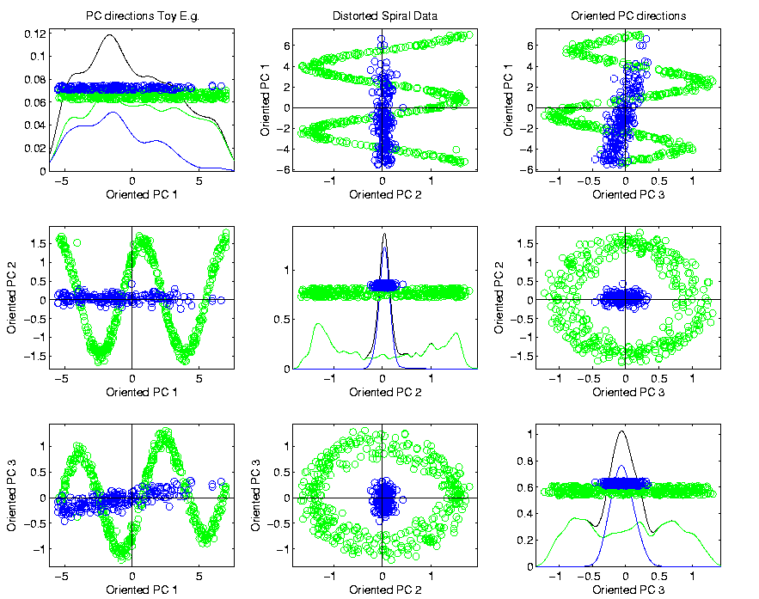
PCA & Graphical Displays
Toy Example (2 colored “clusters” in data)

Slide 29
PCA & Graphical Displays
Toy Example (1 point moved)

Slide 30
PCA & Graphical Displays
Toy Example (1 point moved)
Important
Point:
Constant
Axes

Slide 31
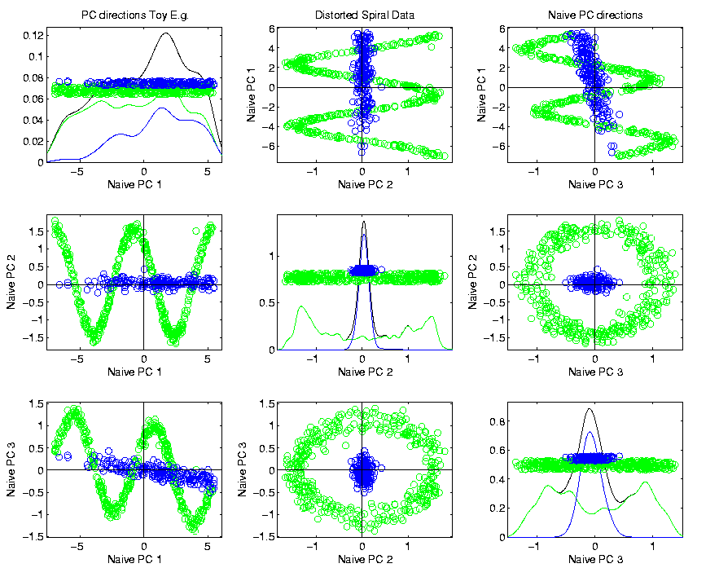
PCA & Graphical Displays
Original Data (arbitrary PC flip)

Slide 32
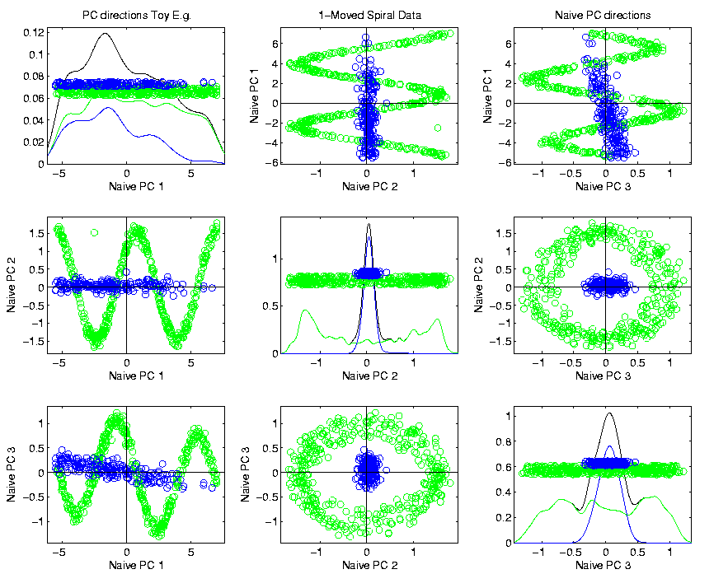
PCA & Graphical Displays
Point Moved Data (arbitrary PC flip)
Much
Harder
To See
Moving
Point

Slide 33
PCA & Graphical Displays
How to “fix directions”?
One Option:
Use ± 1 flip that gives:
$$\max_{i=1,⋯,n}{Proj\left(X_{i}\right)}>\left|\min_{i=1,⋯,n}{Proj\left(X_{i}\right)}\right|$$
(assumes 0 centered)

Slide 34
PCA & Graphical Displays
How to “fix directions”?
Personal Current Favorite:
Use ± 1 flip that makes the projection vector
$\underline{v}=\left(\begin{matrix}v_{1} \\ ⋮ \\ v_{d}\end{matrix}\right)$ “point most towards” $\left(\begin{matrix}1 \\ ⋮ \\ 1\end{matrix}\right)$
i.e. makes $\sum_{j=1}^{d}{v_{j}}>0$

Slide 35
Alternate PCA Computation
Issue: for HDLSS data (recall $d>n$)
$\hat{Σ}$ May be Quite Large, $d×d$
Thus Slow to Work with, and to Compute
What About a Shortcut?
Approach: Singular Value Decomposition
(of (centered, scaled) Data Matrix $\tilde{X}$)

Slide 36
Review of Linear Algebra (Cont.)
Recall SVD Full Representation:
=
Graphics Display Assumes

Slide 37
Review of Linear Algebra (Cont.)
Recall SVD Reduced Representation:
=

Slide 38
Review of Linear Algebra (Cont.)
Recall SVD Compact Representation:
=
where $r=$rank($X$)

Slide 39
Alternate PCA Computation
Singular Value Decomposition,
Computational Advantage (for Rank ):
Use Compact Form, only need to find
e-vec’s s-val’s scores
Other Components not Useful
So can be much faster for

Slide 40
Alternate PCA Computation
Another Variation: Dual PCA
Idea: Useful to View Data Matrix

Slide 41
Alternate PCA Computation
Another Variation: Dual PCA
Idea: Useful to View Data Matrix as
Col’ns as Data Objects

Slide 42
Alternate PCA Computation
Another Variation: Dual PCA
Idea: Useful to View Data Matrix as Both
Col’ns as Data Objects
&
Rows as Data Objects

Slide 43
Alternate PCA Computation
Aside on Row-Column Data Object Choice:
Col’ns as Data Objects
&
Rows as Data Objects

Slide 44
Alternate PCA Computation
Aside on Row-Column Data Object Choice:
Personal Choice: (~Matlab,Linear Algebra)
Col’ns as Data Objects
&
Rows as Data Objects

Slide 45
Alternate PCA Computation
Aside on Row-Column Data Object Choice:
Personal Choice: (~Matlab,Linear Algebra)
Another Choice: (~SAS,R, Linear Models)
Variables
Col’ns as Data Objects
&
Rows as Data Objects

Slide 46
Alternate PCA Computation
Aside on Row-Column Data Object Choice:
Personal Choice: (~Matlab,Linear Algebra)
Another Choice: (~SAS,R, Linear Models)
Careful When Discussing!
Col’ns as Data Objects
&
Rows as Data Objects

Slide 47
Alternate PCA Computation
Dual PCA Computation:
Same as above, but replace
with

Slide 48
Alternate PCA Computation
Dual PCA Computation:
Same as above, but replace
with
So can almost replace
with

Slide 49
Alternate PCA Computation
Dual PCA Computation:
Same as above, but replace
with
So can almost replace
with
Then use SVD, , to get:

Slide 50
Alternate PCA Computation
Dual PCA Computation:
Same as above, but replace
with
So can almost replace
with
Then use SVD, , to get:
Note: Same Eigenvalues

Slide 51
Alternate PCA Computation
Appears to be cool symmetry:
Primal ←→ Dual
Loadings ←→ Scores
←→
But, care is needed with the means
and $\sqrt{n−1}$ normalization …

Slide 52
Functional Data Analysis
Recall from 1st Class Meeting:
Spanish Mortality Data

Slide 53
Functional Data Analysis
Interesting Data Set:
Mortality Data
For Spanish Males (thus can relate to history)
Each curve is a single year
x coordinate is age
Note: Choice made of Data Object
(could also study age as curves,
x coordinate = time)

Slide 54
Functional Data Analysis
Important Issue:
What are the Data Objects?
Curves (years) : Mortality vs. Age
Curves (Ages) : Mortality vs. Year
Note: Rows vs. Columns of Data Matrix

Slide 55
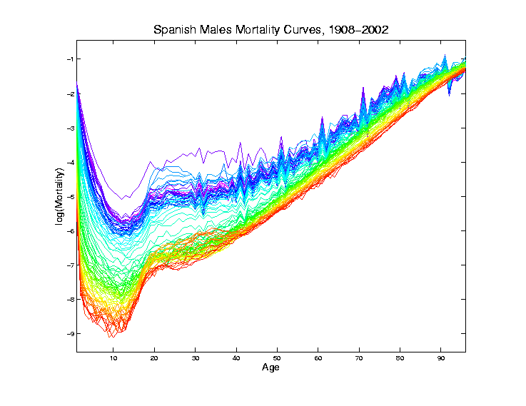
Mortality Time Series
Recall
Improved
Coloring:
Rainbow
Representing
Year:
Magenta
= 1908
Red = 2002

Slide 56
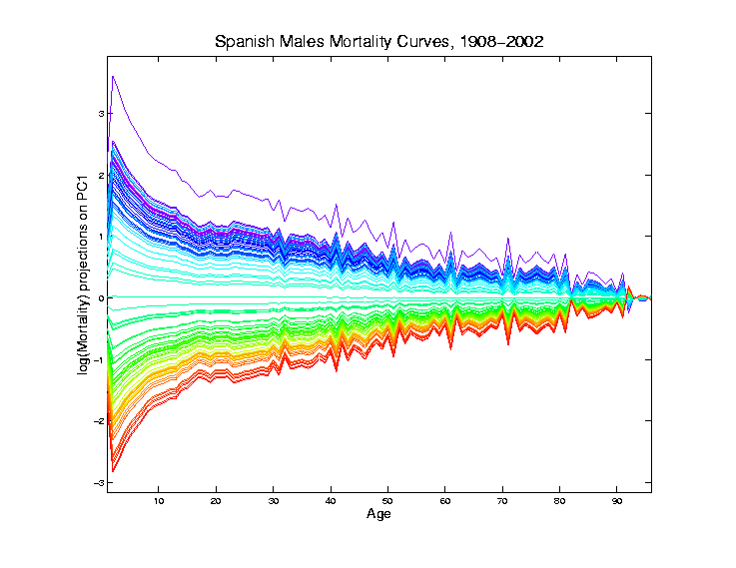
Mortality Time Series
Object Space View of Projections
Onto PC1
Direction
Main Mode
Of Variation:
Constant
Across Ages

Slide 57
Mortality Time Series
Shows Major
Improvement
Over Time
(medical technology,
etc.)
And Change
In Age
Rounding Blips

Slide 58
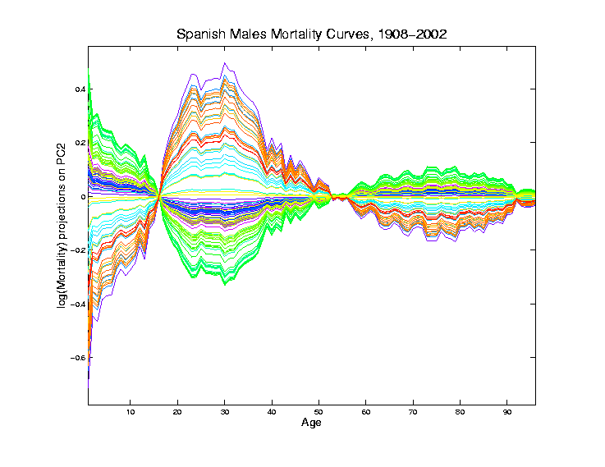
Mortality Time Series
Object Space View of Projections
Onto PC2
Direction
2nd Mode
Of Variation:
Difference
Between
20-45 & Rest

Slide 59
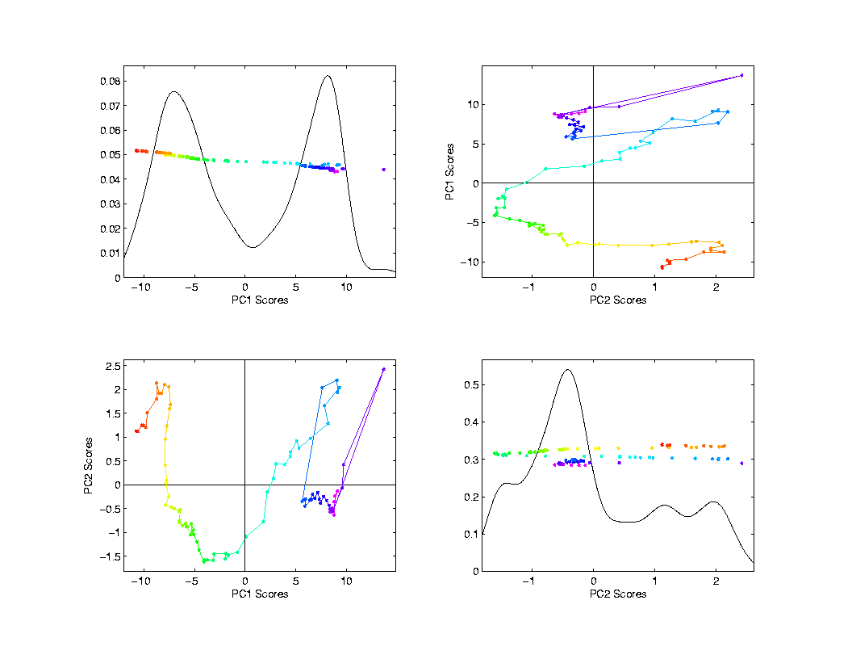
Mortality Time Series
Scores Plot
Feature
(Point Cloud)
Space View
Connecting
Lines
Highlight
Time Order
Good View of
Historical
Effects

Slide 60
Demography Data
Dual PCA
Idea: Rows and Columns trade places
Terminology: from optimization
Insights come from studying “primal” & “dual” problems

Slide 61
Primal / Dual PCA
Consider
“Data Matrix”
Notes:
61

Slide 62
Primal / Dual PCA
Consider
“Data Matrix”
Primal Analysis:
Columns are data vectors
Notes:
62

Slide 63
Primal / Dual PCA
Consider
“Data Matrix”
Dual Analysis:
Rows are data vectors
Notes:
63

Slide 64
Demography Data
Recall Primal - Raw Data
Rainbow
Color Scheme
Allowed Good
Interpretation
Notes:
64

Slide 65
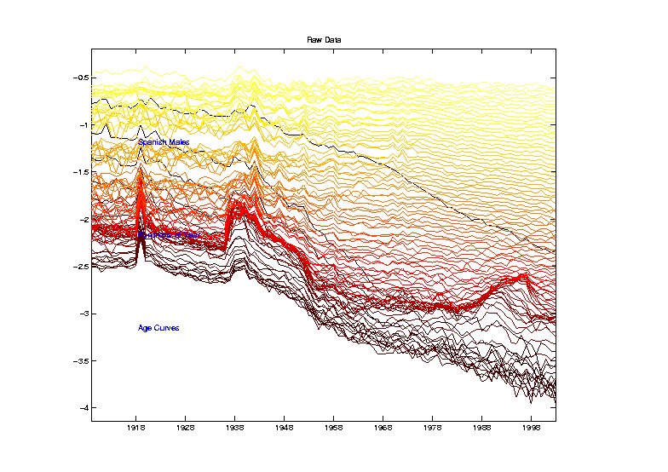
Demography Data
Dual PCA - Raw Data
Hot Metal
Color Scheme
To Help Keep
Primal & Dual
Separate
Notes:
65

Slide 66
Demography Data
Color Code
(Ages)
Notes:
66

Slide 67
Demography Data
Dual PCA - Raw Data
Note: Flu
Pandemic
Notes:
67

Slide 68
Demography Data
Dual PCA - Raw Data
Note: Flu
Pandemic
& Spanish
Civil War
Notes:
68

Slide 69
Demography Data
Dual PCA - Raw Data
Curves
Indexed
By Ages
1-95
Notes:
69

Slide 70
Demography Data
Dual PCA - Raw Data
1st Year of
Life Is
Dangerous
Notes:
70

Slide 71
Demography Data
Dual PCA - Raw Data
1st Year of
Life Is
Dangerous
Later
Childhood
Years Much
Improved
Notes:
71

Slide 72
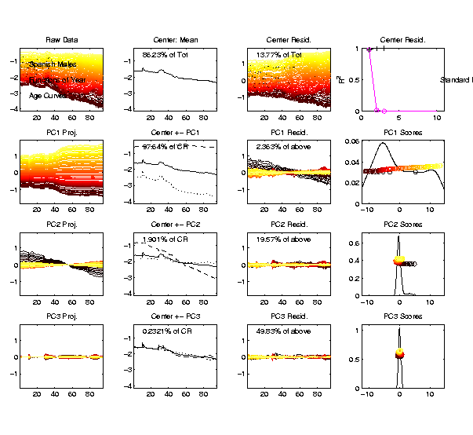
Demography Data
Dual PCA
Notes:
72

Slide 73
Demography Data
Dual PCA
Years
1908-2002
on
Horizontal
Axes
Notes:
73

Slide 74
Demography Data
Dual PCA
Note: Hard
To See /
Interpret
Smaller
Effects
(Lost in
Scaling)
Notes:
74

Slide 75
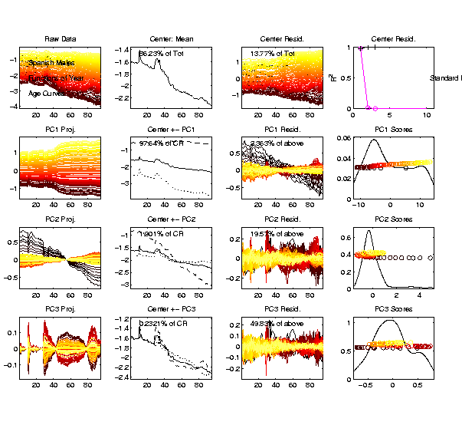
Demography Data
Dual PCA
Choose
Axis Limits
To Maximize
Visible
Variation
Notes:
75

Slide 76
Demography Data
Dual PCA
Mean Shows
Some History
Flu
Pandemic
Civil War
Notes:
76

Slide 77
Demography Data
Dual PCA
PC1 Shows
Mortality
Increases
With Age
Notes:
77

Slide 78
Demography Data
Dual PCA
PC2 Shows
Improvements
Strongest
For Young
Notes:
78

Slide 79
Demography Data
Dual PCA
PC3 Shows
Automobile
Effects
Notes:
79

Slide 80
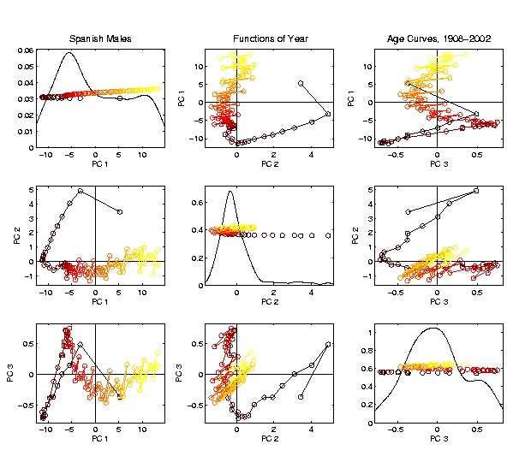
Demography Data
Dual PCA
Scores
Linear Connections
Highlight
Age Ordering
Notes:
80

Slide 81
Demography Data
Dual PCA
Scores
Note PC2
& PC1
Together
Show
Mortality
vs. Age
Notes:
81

Slide 82
Demography Data
Dual PCA
Scores
PC2
Captures
“Age
Rounding”
Notes:
82

Slide 83
Demography Data
Important Observation:
Effects in Primal Scores (Loadings)
$↕ ↕$
Appear in Dual Loadings (Scores)
(Would Be Exactly True, Except for Centering)
Notes:
83

Slide 84
Primal / Dual PCA
Which is “Better”?
Same Info,
Displayed
Differently
Here: Prefer Primal,
As Indicated by Graphics Quality
Notes:
84

Slide 85
Primal / Dual PCA
Which is “Better”?
In General:
Either Can Be Best
Try Both and Choose
Or Use “Natural Choice” of
Data Object
Notes:
85

Slide 86
Primal / Dual PCA
Important Early Version:
BiPlot Display
Overlay Primal & Dual PCAs
Not Easy to Interpret
Gabriel, K. R. (1971)
Notes:
86

Slide 87
Return to Big Picture
Main statistical goals of OODA:
Understanding population structure
Low dim’al Projections, PCA …
Classification (i. e. Discrimination)
Understanding 2+ populations
Time Series of Data Objects
Chemical Spectra, Mortality Data
“Vertical Integration” of Data Types

Slide 88
Classification - Discrimination
Background: Two Class (Binary) version:
Using “training data” from
Class +1 and Class -1
Develop a “rule” for
assigning new data to a Class
Canonical Example: Disease Diagnosis
New Patients are “Healthy” or “Ill”
Determine based on measurements

Slide 89
Classification - Discrimination
Important Distinction:
Classification vs. Clustering
Classification:
Class labels are known,
Goal: understand differences
Clustering:
Goal: Find class labels (to be similar)
Both are about clumps of similar data,
but much different goals

Slide 90
Classification - Discrimination
Important Distinction:
Classification vs. Clustering
Useful terminology:
Classification: supervised learning
Clustering: unsupervised learning

Slide 91
Classification - Discrimination
Terminology:
For statisticians, these are synonyms

Slide 92
Classification - Discrimination
Terminology:
For statisticians, these are synonyms
For biologists, classification means:
Constructing taxonomies
And sorting organisms into them
(maybe this is why discrimination
was used, until politically incorrect…)

Slide 93
Classification (i.e. discrimination)
There are a number of:
Approaches
Philosophies
Schools of Thought
Too often cast as:
Statistics vs. EE - CS

Slide 94
Classification (i.e. discrimination)
EE – CS variations:
Pattern Recognition
Artificial Intelligence
Neural Networks
Data Mining
Machine Learning

Slide 95
Classification (i.e. discrimination)
Differing Viewpoints:
Statistics
Model Classes with Probability Distribut’ns
Use to study class diff’s & find rules
EE – CS
Data are just Sets of Numbers
Rules distinguish between these
Current thought: combine these

Slide 96
Classification (i.e. discrimination)
Important Overview Reference:
Duda, Hart and Stork (2001)
Too much about neural nets???
Pizer disagrees…
Update of Duda & Hart (1973)

Slide 97
Classification (i.e. discrimination)
For a more classical statistical view:
McLachlan (2004).
Gaussian Likelihood theory, etc.
Not well tuned to HDLSS data
Notes:
97

Slide 98
Classification Basics
Personal Viewpoint: Point Clouds
Notes:
HDLSStmbRaw.ps

Slide 99
Classification Basics
Simple and Natural Approach:
Mean Difference
a.k.a.
Centroid Method
Find “skewer through two meatballs”

Slide 100
Classification Basics
For Simple Toy Example:
Project
On MD
& split
at center
Notes:
HDLSStmbMdif.ps

Slide 101
Classification Basics
Why not use PCA?
Reasonable
Result?
Doesn’t use
class labels…
Good?
Bad?
Notes:
HDLSStmbPCA.ps

Slide 102
Classification Basics
Harder Example (slanted clouds):
Notes:
HDLSSod1Raw.ps

Slide 103
Classification Basics
PCA for slanted clouds:
PC1 terrible
PC2 better?
Still misses
right dir’n
Doesn’t use
Class Labels
Notes:
HDLSSod1PCA.ps

Slide 104
Classification Basics
Mean Difference for slanted clouds:
A little
better?
Still misses
right dir’n
Want to
account for
covariance
Notes:
HDLSSod1Mdif.ps

Slide 105
Classification Basics
Mean Difference & Covariance,
Simplest Approach:
Rescale (standardize) coordinate axes
i. e. replace (full) data matrix:
Then do Mean Difference
Called “Naïve Bayes Approach”

Slide 106
Classification Basics
Naïve Bayes Reference:
Domingos & Pazzani (1997)
Most sensible contexts:
Non-comparable data
E.g. different units

Slide 107
Classification Basics
Problem with Naïve Bayes:
Only adjusts
Variances
Not Covariances
Doesn’t solve
this problem
Notes:
HDLSSod1Raw.ps

Slide 108
Classification Basics
Better Solution: Fisher Linear Discrimination
Gets the
right dir’n
How does
it work?
Notes:
HDLSSod1FLD.ps

Slide 109
Fisher Linear Discrimination
Other common terminology (for FLD):
Linear Discriminant Analysis (LDA)
Original Paper: Fisher (1936)

Slide 110
Fisher Linear Discrimination
Careful development:
Useful notation (data vectors of length ):
Class +1: Class -1:

Slide 111
Fisher Linear Discrimination
Careful development:
Useful notation (data vectors of length ):
Class +1: Class -1:
Centerpoints:
and

Slide 112
Fisher Linear Discrimination
Covariances, for
(outer products)
Based on centered, normalized data matrices:

Slide 113
Fisher Linear Discrimination
Covariances, for
(outer products)
Based on centered, normalized data matrices:
Note: use “MLE” version of estimated covariance matrices, for simpler notation

Slide 114
Fisher Linear Discrimination
Major Assumption:
Class covariances are the same (or “similar”)
Like this: Not this:
Notes:
HDLSSod1Raw.ps & HDLSSxd1Raw.ps

Slide 115
Fisher Linear Discrimination
Good estimate of (common) within class cov?
Pooled (weighted average) within class cov:
based on the combined full data matrix:

Slide 116
Fisher Linear Discrimination
Good estimate of (common) within class cov?
Pooled (weighted average) within class cov:
based on the combined full data matrix:
Note: Different Means

Slide 117
Fisher Linear Discrimination
Note: is similar to from before
I.e. covariance matrix ignoring class labels
Important Difference:
Class by Class Centering
Will be important later
Notes:
HDLSSod1Raw.ps

Slide 118
Fisher Linear Discrimination
Simple way to find “correct cov. adjustment”:
Individually transform subpopulations so
“spherical” about their means
For define
Notes:
HDLSSod1egFLD.ps

Slide 119
Fisher Linear Discrimination
For define
Note: This spheres the data, in the sense that
Notes:
HDLSSod1egFLD.ps

Slide 120
Fisher Linear Discrimination
Then:
In Transformed Space,
Best separating hyperplane
is
Perpendicular bisector of
line between means
Notes:
HDLSSod1egFLD.ps

Slide 121
Fisher Linear Discrimination
In Transformed Space,
Separating Hyperplane has:
Transformed Normal Vector:
Notes:
HDLSSod1egFLD.ps

Slide 122
Fisher Linear Discrimination
In Transformed Space,
Separating Hyperplane has:
Transformed Normal Vector:
Transformed Intercept:
Notes:
HDLSSod1egFLD.ps

Slide 123
Fisher Linear Discrimination
In Transformed Space,
Separating Hyperplane has:
Transformed Normal Vector:
Transformed Intercept:
Sep. Hyperp. has Equation:
Notes:
HDLSSod1egFLD.ps

Slide 124
Fisher Linear Discrimination
Thus discrimination rule is:
Given a new data vector ,
Choose Class +1 when:

Slide 125
Fisher Linear Discrimination
Thus discrimination rule is:
Given a new data vector ,
Choose Class +1 when:
i.e. (transforming back to original space)
Using, for symmetric and invertible:

Slide 126
Fisher Linear Discrimination
Thus discrimination rule is:
Given a new data vector ,
Choose Class +1 when:
i.e. (transforming back to original space)
where:

Slide 127
Fisher Linear Discrimination
So (in orig’l space) have separ’ting hyperplane with:
Normal vector: Intercept:
Notes:
HDLSSod1egFLD.ps

Slide 128
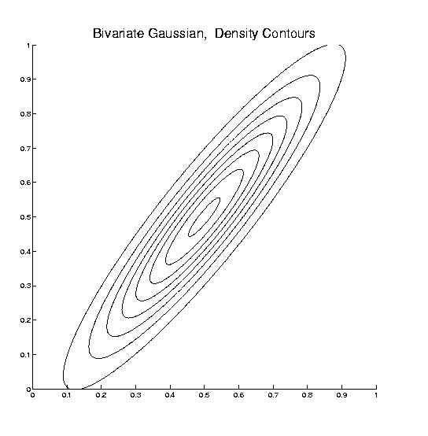
Fisher Linear Discrimination
Relationship to Mahalanobis distance
Idea: For , a natural distance measure is:
$$d_{1}=d_{2}$$

Slide 129
Fisher Linear Discrimination
Relationship to Mahalanobis distance
Idea: For , a natural distance measure is:
“unit free”, i.e. “standardized”
essentially mod out covariance structure

Slide 130
Fisher Linear Discrimination
Relationship to Mahalanobis distance
Idea: For , a natural distance measure is:
“unit free”, i.e. “standardized”
essentially mod out covariance structure
Euclidean dist. applied to &
Same as key transformation for FLD
I.e. FLD is
mean difference in Mahalanobis space

Slide 131
Participant Presentation
Sherif Faraq
Rational Design of ED Free Chemicals

