Slide 1
PCA Data Represent’n (Cont.)
Reduced Rank Representation:
$${\underline{X}}_{i}=\underline{\overline{X}}+\sum_{j=1}^{k}{{{\underline{v}}_{j}c}_{ij}}$$
Reconstruct Using Only $k (≪d)$ Terms
(Assuming Decreasing Eigenvalues)
Gives: Rank $k$ Approximation of Data
Key to PCA Dimension Reduction
And PCA for Data Compression (~ .jpeg)

Slide 2
PCA Data Represent’n (Cont.)
Choice of $k$ in Reduced Rank Represent’n:
Generally Very Slippery Problem
Not Recommended:
Arbitrary Choice
E.g. % Variation Explained 90%? 95%?

Slide 3
PCA Simulation
Idea: given
Mean Vector
Eigenvectors
Eigenvalues
Simulate data from Corresponding Normal Distribution
Approach: Invert PCA Data Represent’n
where

Slide 4
Alternate PCA Computation
Singular Value Decomposition,
Computational Advantage (for Rank ):
Use Compact Form, only need to find
e-vec’s s-val’s scores
Other Components not Useful
So can be much faster for

Slide 5
Alternate PCA Computation
Aside on Row-Column Data Object Choice:
Personal Choice: (~Matlab,Linear Algebra)
Another Choice: (~SAS,R, Linear Models)
Careful When Discussing!
Col’ns as Data Objects
&
Rows as Data Objects

Slide 6
Primal / Dual PCA
Consider
“Data Matrix”
Primal Analysis:
Columns are data vectors
Notes:
6

Slide 7
Primal / Dual PCA
Consider
“Data Matrix”
Dual Analysis:
Rows are data vectors
Notes:
7

Slide 8
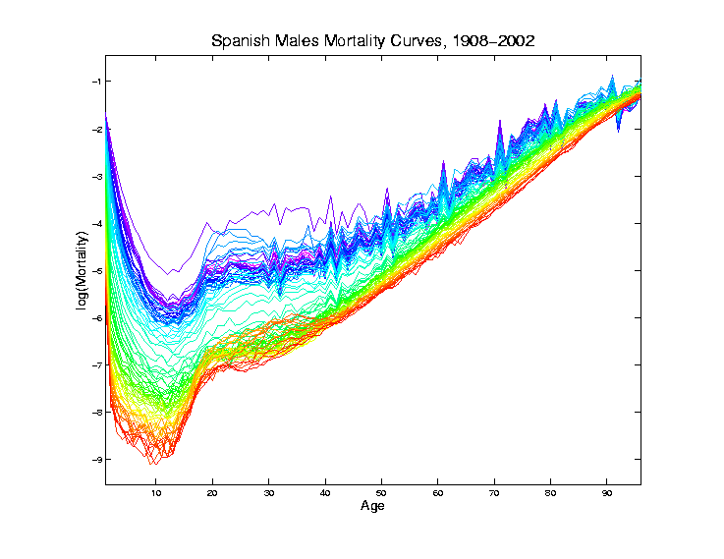
Demography Data
Recall Primal - Raw Data
Rainbow
Color Scheme
Allowed Good
Interpretation
Notes:
8

Slide 9
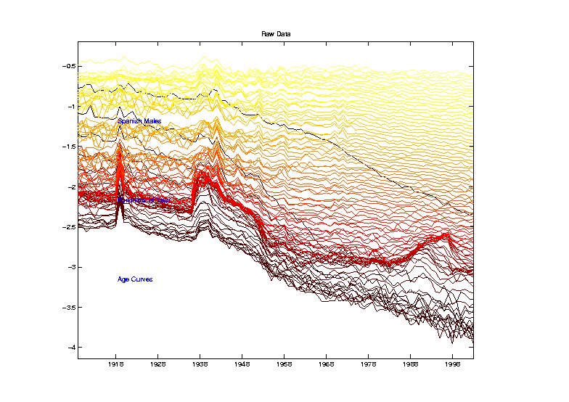
Demography Data
Dual PCA - Raw Data
Hot Metal
Color Scheme
To Help Keep
Primal & Dual
Separate
Notes:
9

Slide 10
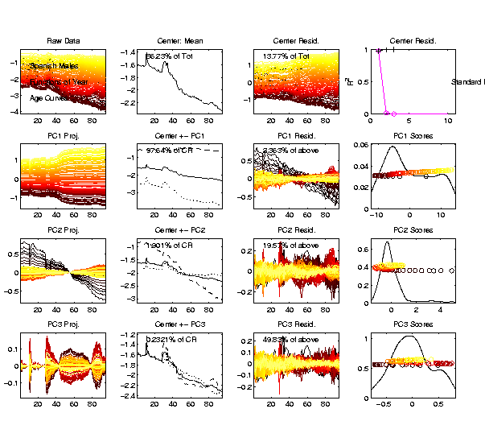
Demography Data
Dual PCA
PC2 Shows
Improvements
Strongest
For Young
Notes:
10

Slide 11
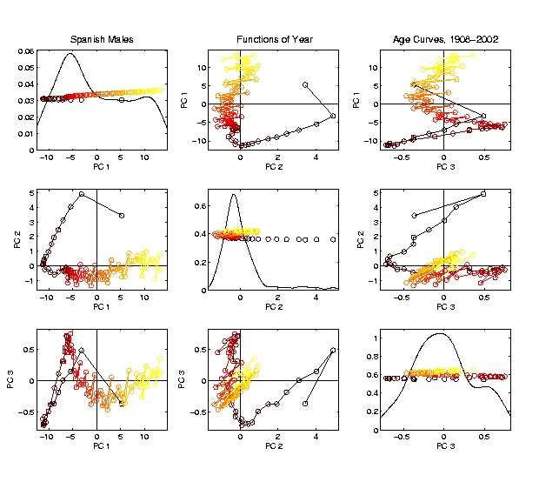
Demography Data
Dual PCA
Scores
Note PC2
& PC1
Together
Show
Mortality
vs. Age
Notes:
11

Slide 12
Return to Big Picture
Main statistical goals of OODA:
Understanding population structure
Low dim’al Projections, PCA …
Classification (i. e. Discrimination)
Understanding 2+ populations
Time Series of Data Objects
Chemical Spectra, Mortality Data
“Vertical Integration” of Data Types

Slide 13
Classification - Discrimination
Background: Two Class (Binary) version:
Using “training data” from
Class +1 and Class -1
Develop a “rule” for
assigning new data to a Class
Canonical Example: Disease Diagnosis
New Patients are “Healthy” or “Ill”
Determine based on measurements

Slide 14
Classification Basics
For Simple Toy Example:
Project
On MD
& split
at center
Notes:
HDLSStmbMdif.ps

Slide 15
Classification Basics
Mean Difference for slanted clouds:
A little
better?
Still misses
right dir’n
Want to
account for
covariance
Notes:
HDLSSod1Mdif.ps

Slide 16
Classification Basics
Better Solution: Fisher Linear Discrimination
Gets the
right dir’n
How does
it work?
Notes:
HDLSSod1FLD.ps

Slide 17
Fisher Linear Discrimination
Careful development:
Useful notation (data vectors of length ):
Class +1: Class -1:
Centerpoints:
and

Slide 18
Fisher Linear Discrimination
Covariances, for
(outer products)
Based on centered, normalized data matrices:
Note: use “MLE” version of estimated covariance matrices, for simpler notation

Slide 19
Fisher Linear Discrimination
Good estimate of (common) within class cov?
Pooled (weighted average) within class cov:
based on the combined full data matrix:

Slide 20
Fisher Linear Discrimination
Good estimate of (common) within class cov?
Pooled (weighted average) within class cov:
based on the combined full data matrix:
Note: Different Means

Slide 21
Fisher Linear Discrimination
Note: is similar to from before
I.e. covariance matrix ignoring class labels
Important Difference:
Class by Class Centering
Will be important later
Notes:
HDLSSod1Raw.ps

Slide 22
Fisher Linear Discrimination
Simple way to find “correct cov. adjustment”:
Individually transform subpopulations so
“spherical” about their means
For define
Notes:
HDLSSod1egFLD.ps

Slide 23
Fisher Linear Discrimination
For define
Note: This spheres the data, in the sense that
Notes:
HDLSSod1egFLD.ps

Slide 24
Fisher Linear Discrimination
Then:
In Transformed Space,
Best separating hyperplane
is
Perpendicular bisector of
line between means
Notes:
HDLSSod1egFLD.ps

Slide 25
Fisher Linear Discrimination
In Transformed Space,
Separating Hyperplane has:
Transformed Normal Vector:
Notes:
HDLSSod1egFLD.ps

Slide 26
Fisher Linear Discrimination
In Transformed Space,
Separating Hyperplane has:
Transformed Normal Vector:
Transformed Intercept:
Notes:
HDLSSod1egFLD.ps

Slide 27
Fisher Linear Discrimination
In Transformed Space,
Separating Hyperplane has:
Transformed Normal Vector:
Transformed Intercept:
Sep. Hyperp. has Equation:
Notes:
HDLSSod1egFLD.ps

Slide 28
Fisher Linear Discrimination
Thus discrimination rule is:
Given a new data vector ,
Choose Class +1 when:

Slide 29
Fisher Linear Discrimination
Thus discrimination rule is:
Given a new data vector ,
Choose Class +1 when:
i.e. (transforming back to original space)
Using, for symmetric and invertible:

Slide 30
Fisher Linear Discrimination
Thus discrimination rule is:
Given a new data vector ,
Choose Class +1 when:
i.e. (transforming back to original space)
where:

Slide 31
Fisher Linear Discrimination
So (in orig’l space) have separ’ting hyperplane with:
Normal vector: ${\underline{n}}_{FLD}$
Intercept: ${\underline{μ}}_{FLD}$
Notes:
HDLSSod1egFLD.ps

Slide 32
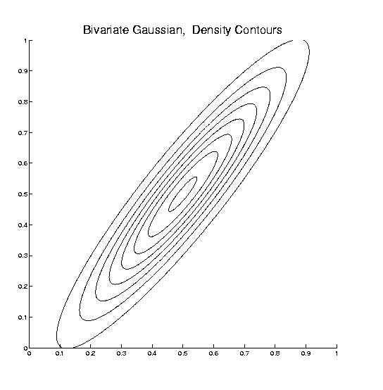
Fisher Linear Discrimination
Relationship to Mahalanobis distance
Idea: For $X_{1},X_{2}\sim N\left(μ,Σ\right)$, a natural distance
measure is: $d_{M}={\left[{\left(X_{1}−X_{2}\right)}^{t}Σ^{−1}\left(X_{1}−X_{2}\right)\right]}^{1/2}$
$$d_{1}=d_{2}$$

Slide 33
Fisher Linear Discrimination
Relationship to Mahalanobis distance
Idea: For $X_{1},X_{2}\sim N\left(μ,Σ\right)$, a natural distance
measure is: $d_{M}={\left[{\left(X_{1}−X_{2}\right)}^{t}Σ^{−1}\left(X_{1}−X_{2}\right)\right]}^{1/2}$
“unit free”, i.e. “standardized”
essentially mod out covariance structure
Euclidean dist. applied to $Σ^{−1/2}X_{1}$ & $Σ^{−1/2}X_{2}$
Same as key transformation for FLD
I.e. FLD is
mean difference in Mahalanobis space

Slide 34
Classical Discrimination
Above derivation of FLD was:
Nonstandard
Not in any textbooks(?)
Nonparametric (don’t need Gaussian data)
I.e. Used no probability distributions
More Machine Learning than Statistics

Slide 35
Classical Discrimination
FLD Likelihood View

Slide 36
Classical Discrimination
FLD Likelihood View
Assume:
Class distributions are multivariate
for
strong distributional assumption
+ common covariance

Slide 37
Classical Discrimination
FLD Likelihood View (cont.)
At a location , the likelihood ratio, for
choosing between Class +1 and Class -1, is:
where is the Gaussian density
with covariance

Slide 38
Classical Discrimination
FLD Likelihood View (cont.)
Simplifying, using the Gaussian density:
Gives

Slide 39
Classical Discrimination
FLD Likelihood View (cont.)
Simplifying, using the Gaussian density:
Gives (critically using common covariances):

Slide 40
Classical Discrimination
FLD Likelihood View (cont.)
Simplifying, using the Gaussian density:
Gives (critically using common covariances):

Slide 41
Classical Discrimination
FLD Likelihood View (cont.)
But:
for $k=±1$

Slide 42
Classical Discrimination
FLD Likelihood View (cont.)
But:
so:
Note: same terms subtract off

Slide 43
Classical Discrimination
FLD Likelihood View (cont.)
But:
so:
Note: cross terms have ± cancellation

Slide 44
Classical Discrimination
FLD Likelihood View (cont.)
But:
so:
Thus when

Slide 45
Classical Discrimination
FLD Likelihood View (cont.)
But:
so:
Thus when
i.e.

Slide 46
Classical Discrimination
FLD Likelihood View (cont.)
Replacing , and
by maximum likelihood estimates:
, and
Gives the likelihood ratio discrimination rule

Slide 47
Classical Discrimination
FLD Likelihood View (cont.)
Replacing , and
by maximum likelihood estimates:
, and
Gives the likelihood ratio discrimination rule:
Choose Class +1, when
Same as above, so: FLD can be viewed as
Likelihood Ratio Rule

Slide 48
Classical Discrimination
FLD Generalization I
Gaussian Likelihood Ratio Discrimination
(a. k. a. “nonlinear discriminant analysis”)

Slide 49
Classical Discrimination
FLD Generalization I
Gaussian Likelihood Ratio Discrimination
(a. k. a. “nonlinear discriminant analysis”)
Idea: Assume
class distributions are
Different covariances!
Likelihood Ratio rule is straightf’d num’l calc.
(thus can easily implement, and do discrim’n)

Slide 50
Classical Discrimination
Gaussian Likelihood Ratio Discrim’n (cont.)
No longer have separ’g hyperplane repr’n
(instead regions determined by quadratics)
(fairly complicated case-wise calculations)
Graphical display: for each point, color as:
Yellow if assigned to Class +1
Cyan if assigned to Class -1
(intensity is strength of assignment)

Slide 51
Classical Discrimination
FLD for Tilted Point Clouds – Works well
Notes:
PEod1FLDe1.ps

Slide 52
Classical Discrimination
GLR for Tilted Point Clouds – Works well
Notes:
PEod1GLRe1.ps

Slide 53
Classical Discrimination
FLD for Donut – Poor, no plane can work
Notes:
PEdonFLDe1.ps

Slide 54
Classical Discrimination
GLR for Donut – Works well (good quadratic)
(Even
though
data not
Gaussian)
Notes:
PEdonGLRe1.ps

Slide 55
Classical Discrimination
FLD for X – Poor, no plane can work
Notes:
PExd3FLDe1.ps

Slide 56
Classical Discrimination
GLR for X – Better, but not great
Notes:
PExd3GLRe1.ps

Slide 57
Classical Discrimination
Summary of FLD vs. GLR:
Tilted Point Clouds Data
FLD good
GLR good
Donut Data
FLD bad
GLR good
X Data
FLD bad
GLR OK, not great
Classical Conclusion: GLR generally better
(will see a different answer for HDLSS data)

Slide 58
Classical Discrimination
FLD Generalization II (Gen. I was GLR)
Different prior probabilities
Main idea:
Give different weights to 2 classes
I.e. assume not a priori equally likely
Development is “straightforward”
Modified likelihood
Change intercept in FLD
Won’t explore further here

Slide 59
Classical Discrimination
FLD Generalization III
Principal Discriminant Analysis
Idea: FLD-like approach to > 2 classes
Assumption: Class covariance matrices are the same (similar)
(but not Gaussian, same situation as for FLD)
Main idea:
Quantify “location of classes” by their means
$${\underline{μ}}^{(1)},{\underline{μ}}^{(2)},⋯,{\underline{μ}}^{(k)}$$

Slide 60
Classical Discrimination
Principal Discriminant Analysis (cont.)
Simple way to find “interesting directions” among the means:
PCA on set of means
(Think Analog of Mean Difference)

Slide 61
Classical Discrimination
Principal Discriminant Analysis (cont.)
Simple way to find “interesting directions” among the means:
PCA on set of means
i.e. Eigen-analysis of “between class covariance matrix”
Where
Aside: can show: overall

Slide 62
Classical Discrimination
Principal Discriminant Analysis (cont.)
But PCA only works like Mean Difference,
Expect can improve by
taking covariance into account.
(Recall Improvement of FLD over MD)

Slide 63
Classical Discrimination
Principal Discriminant Analysis (cont.)
But PCA only works like Mean Difference,
Expect can improve by
taking covariance into account.
Blind application of above ideas suggests eigen-analysis of: ${Σ^{w}}^{−1}Σ^{B}$

Slide 64
Classical Discrimination
Principal Discriminant Analysis (cont.)
There are:
smarter ways to compute
(“generalized eigenvalue”)
other representations
(this solves optimization prob’s)
Special case: 2 classes,
reduces to standard FLD
Good reference for more: Section 3.8 of:
Duda, Hart & Stork (2001)

Slide 65
Classical Discrimination
Summary of Classical Ideas:
Among “Simple Methods”
MD and FLD sometimes similar
Sometimes FLD better
So FLD is preferred
Among Complicated Methods
GLR is best
So always use that?
Caution:
Story changes for HDLSS settings

Slide 66
HDLSS Discrimination
Main HDLSS issues:
Sample Size, $n$ < Dimension, $d$
Singular covariance matrix
So can’t use matrix inverse
I.e. can’t standardize (sphere) the data
(requires root inverse covariance)
Can’t do classical multivariate analysis

Slide 67
HDLSS Discrimination
Main HDLSS issues:
Can’t do classical multivariate analysis
Key Idea: Standardize
Subtract Sample Mean
Sphere the Data
And use $N(0,I)$ dist’n for statistical inference

Slide 68
HDLSS Discrimination
An approach to non-invertible covariances:
Replace by generalized inverses
Sometimes called pseudo inverses
Note: there are several
Here use Moore Penrose inverse
As used by Matlab (pinv.m)
Often provides useful results
(but not always)

Slide 69
HDLSS Discrimination
Application of Generalized Inverse to FLD:
Direction (Normal) Vector:
$${\underline{n}}_{FLD}={\left({\hat{Σ}}^{w}\right)}^{−}\left({\underline{\overline{X}}}^{(+1)}−{\underline{\overline{X}}}^{(−1)}\right)$$
Intercept:
$$μ_{FLD}=\left(\frac{1}{2}{\underline{\overline{X}}}^{(+1)}+\frac{1}{2}{\underline{\overline{X}}}^{(−1)}\right)$$

Slide 70
HDLSS Discrimination
Application of Generalized Inverse to FLD:
Direction (Normal) Vector:
$${\underline{n}}_{FLD}={\left({\hat{Σ}}^{w}\right)}^{−}\left({\underline{\overline{X}}}^{(+1)}−{\underline{\overline{X}}}^{(−1)}\right)$$
Intercept:
$$μ_{FLD}=\left(\frac{1}{2}{\underline{\overline{X}}}^{(+1)}+\frac{1}{2}{\underline{\overline{X}}}^{(−1)}\right)$$
Have replaced ${\left({\hat{Σ}}^{w}\right)}^{−1}$ by ${\left({\hat{Σ}}^{w}\right)}^{−}$

Slide 71
HDLSS Discrimination
Toy Example: Increasing Dimension
$n_{+}=n_{−}=20$ data vectors:
Entry 1:
Class +1: $N\left(+2.2,1\right)$ Class –1: $N\left(−2.2,1\right)$
Other Entries: $N\left(0,1\right)$
All Entries Independent
Look through dimensions, $d=1, 2, ⋯, 1000$

Slide 72
HDLSS Discrimination
Increasing Dimension Example
Project on
Optimal
Direction
Project on
FLD Direction
Project on
Both

Slide 73
HDLSS Discrimination
Add a 2nd Dimension ($N\left(0,1\right)$ noise)
Same Projections on
Optimal Direction
Axes Here
Are Same As
Directions Here
Now See 2
Dimensions

Slide 74
HDLSS Discrimination
Add a 3rd Dimension ($N\left(0,1\right)$ noise)
Project on
2-d subspace
generated
by optimal
dir’n & by
FLD dir’n

Slide 75
HDLSS Discrimination
Movie Through Increasing Dimensions

Slide 76
Participant Presentation
Jessime Kirk
lncRNA Functional Prediction

