Slide 1
Return to Big Picture
Main statistical goals of OODA:
Understanding population structure
  Low dim’al Projections, PCA …
Classification (i. e. Discrimination)
  Understanding 2+ populations
Time Series of Data Objects
  Chemical Spectra, Mortality Data
“Vertical Integration” of Data Types

Slide 2
Classification - Discrimination
Background: Two Class (Binary) version:
Using “training data” from
Class +1 and Class -1
Develop a “rule” for
assigning new data to a Class
Canonical Example: Disease Diagnosis
New Patients are “Healthy” or “Ill”
Determine based on measurements

Slide 3
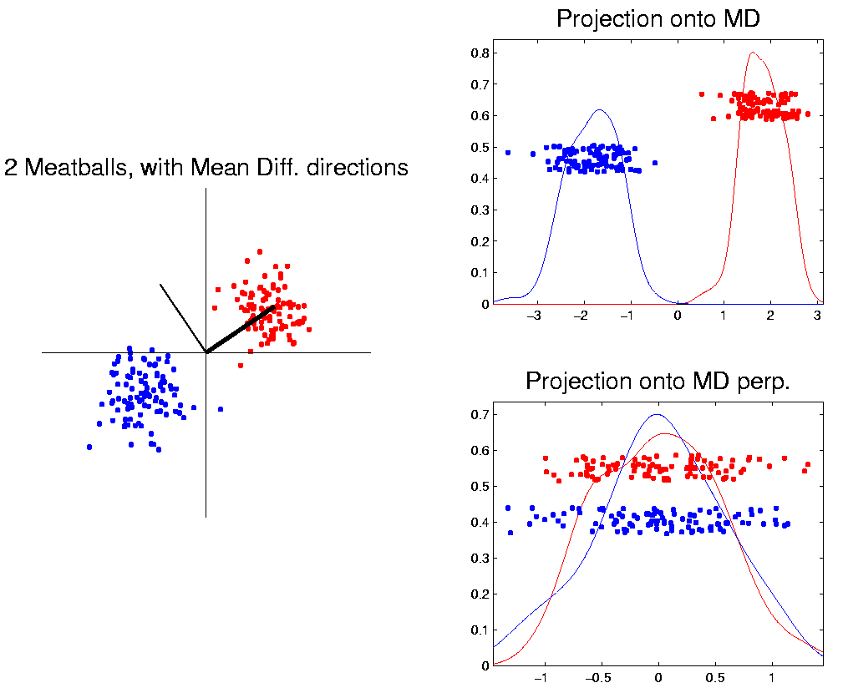
Classification Basics
For Simple Toy Example:
Project
On MD
& split
at center
Notes:
HDLSStmbMdif.ps

Slide 4
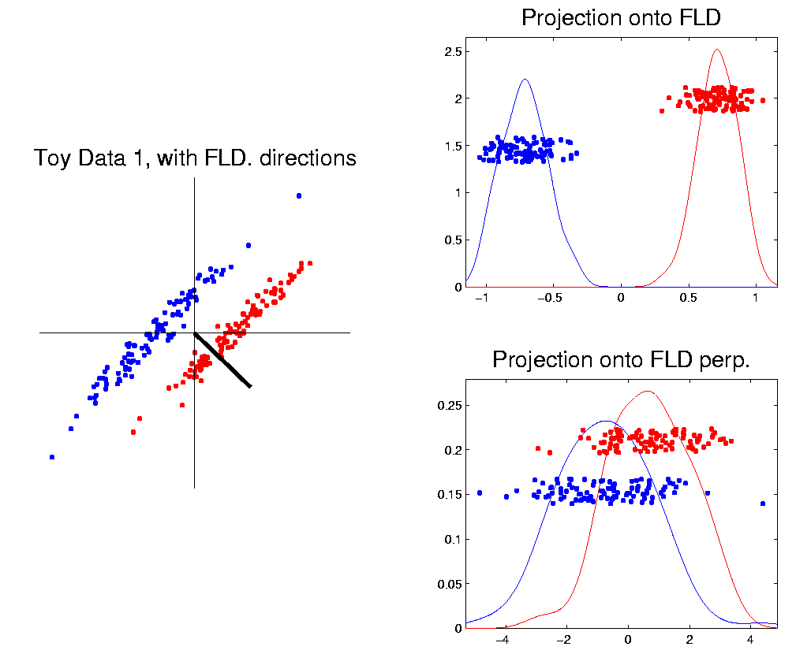
Classification Basics
Better Solution: Fisher Linear Discrimination
Gets the
right dir’n
How does
it work?
Notes:
HDLSSod1FLD.ps

Slide 5
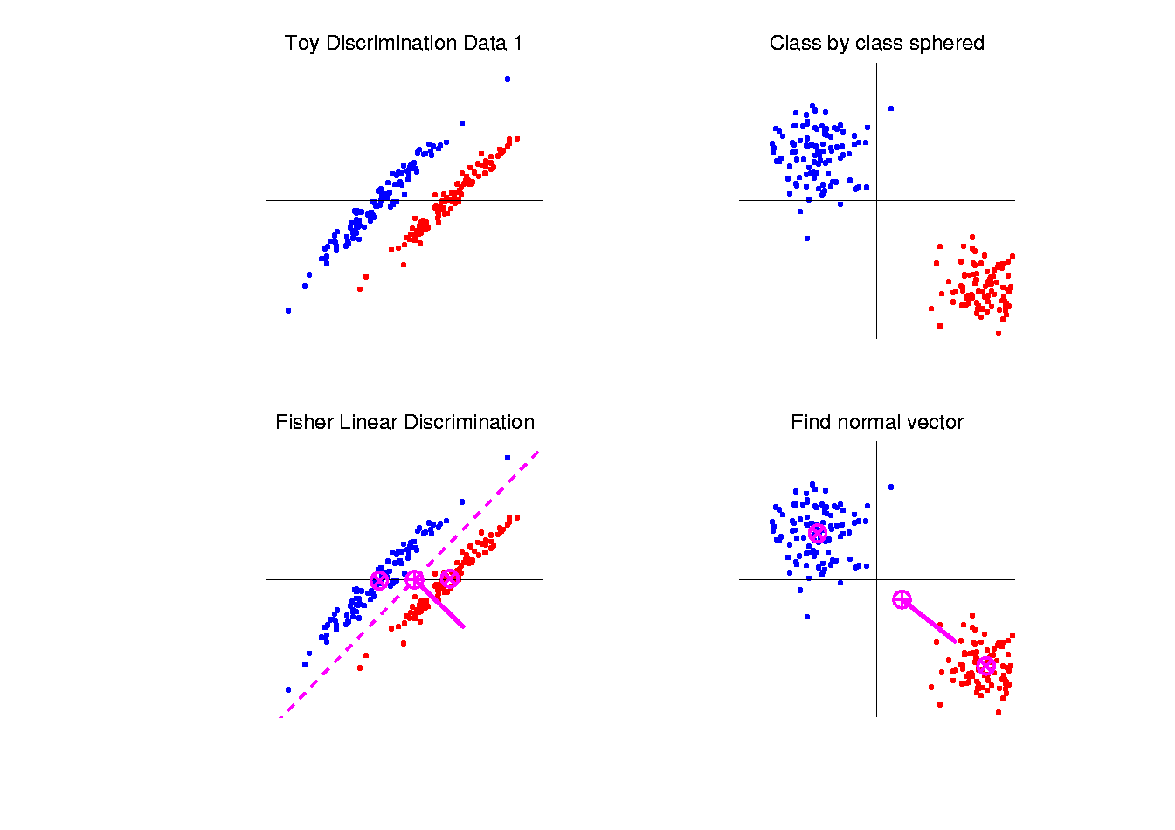
Fisher Linear Discrimination
Simple way to find “correct cov. adjustment”:
Individually transform subpopulations so
“spherical” about their means
For define
Notes:
HDLSSod1egFLD.ps

Slide 6

Fisher Linear Discrimination
So (in orig’l space) have separ’ting hyperplane with:
Normal vector: ${\underline{n}}_{FLD}$
Intercept: ${\underline{μ}}_{FLD}$
Notes:
HDLSSod1egFLD.ps

Slide 7
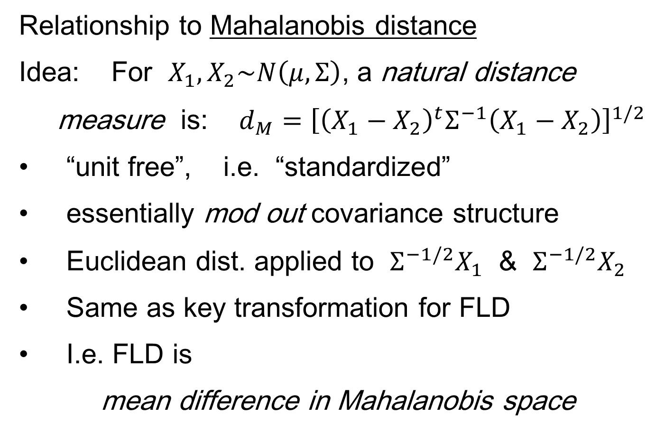
Fisher Linear Discrimination
Relationship to Mahalanobis distance
Idea: For $X_{1},X_{2}\sim N\left(μ,Σ\right)$, a natural distance
measure is: $d_{M}={\left[{\left(X_{1}−X_{2}\right)}^{t}Σ^{−1}\left(X_{1}−X_{2}\right)\right]}^{1/2}$
“unit free”, i.e. “standardized”
essentially mod out covariance structure
Euclidean dist. applied to $Σ^{−1/2}X_{1}$ & $Σ^{−1/2}X_{2}$
Same as key transformation for FLD
I.e. FLD is
mean difference in Mahalanobis space

Slide 8
Classical Discrimination
FLD Likelihood View
Assume:
Class distributions are multivariate
for
strong distributional assumption
+ common covariance

Slide 9
Classical Discrimination
FLD Likelihood View (cont.)
Replacing , and
by maximum likelihood estimates:
, and
Gives the likelihood ratio discrimination rule:
Choose Class +1, when
Same as above, so: FLD can be viewed as
Likelihood Ratio Rule

Slide 10
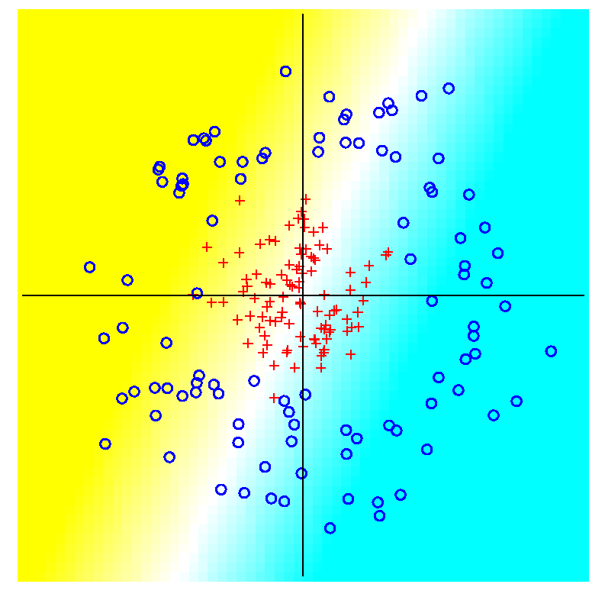
Classical Discrimination
FLD for Donut – Poor, no plane can work
Notes:
PEdonFLDe1.ps

Slide 11
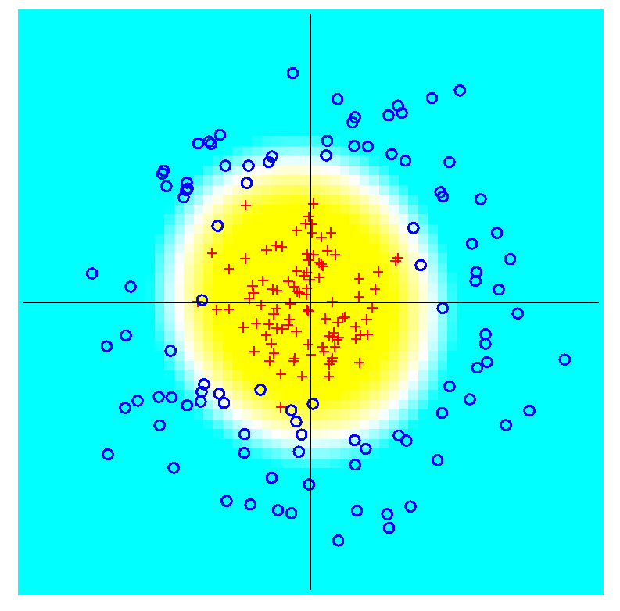
Classical Discrimination
GLR for Donut – Works well (good quadratic)
(Even
though
data not
Gaussian)
Notes:
PEdonGLRe1.ps

Slide 12
Classical Discrimination
Summary of Classical Ideas:
Among “Simple Methods”
  MD and FLD sometimes similar
  Sometimes FLD better
  So FLD is preferred
Among Complicated Methods
  GLR is best
  So always use that?
Caution:
  Story changes for HDLSS settings

Slide 13
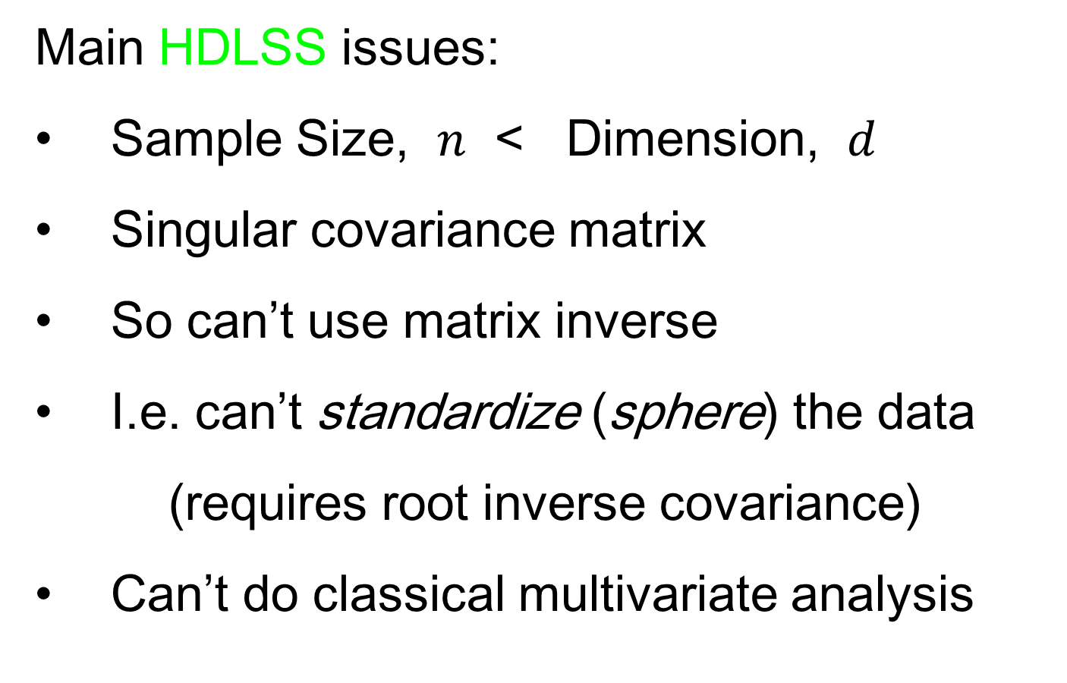
HDLSS Discrimination
Main HDLSS issues:
Sample Size, $n$ < Dimension, $d$
Singular covariance matrix
So can’t use matrix inverse
I.e. can’t standardize (sphere) the data
(requires root inverse covariance)
Can’t do classical multivariate analysis

Slide 14
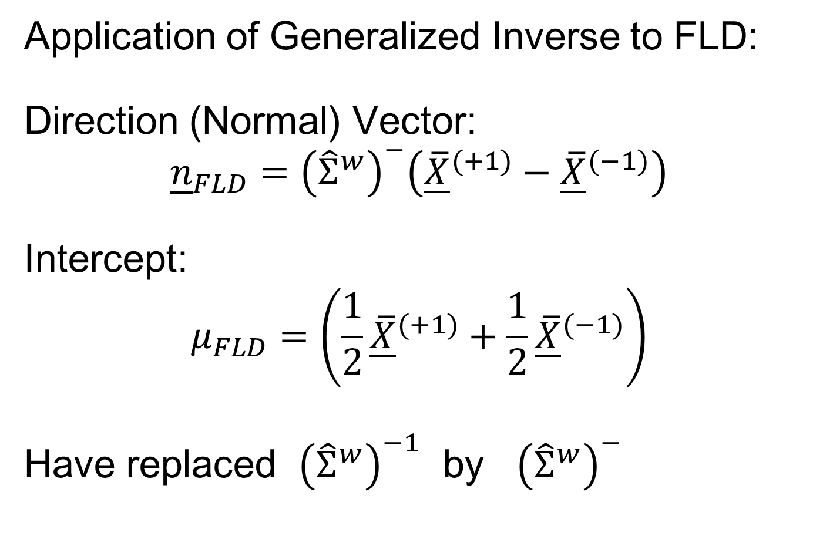
HDLSS Discrimination
Application of Generalized Inverse to FLD:
Direction (Normal) Vector:
$${\underline{n}}_{FLD}={\left({\hat{Σ}}^{w}\right)}^{−}\left({\underline{\overline{X}}}^{(+1)}−{\underline{\overline{X}}}^{(−1)}\right)$$
Intercept:
$$μ_{FLD}=\left(\frac{1}{2}{\underline{\overline{X}}}^{(+1)}+\frac{1}{2}{\underline{\overline{X}}}^{(−1)}\right)$$
Have replaced ${\left({\hat{Σ}}^{w}\right)}^{−1}$ by ${\left({\hat{Σ}}^{w}\right)}^{−}$

Slide 15
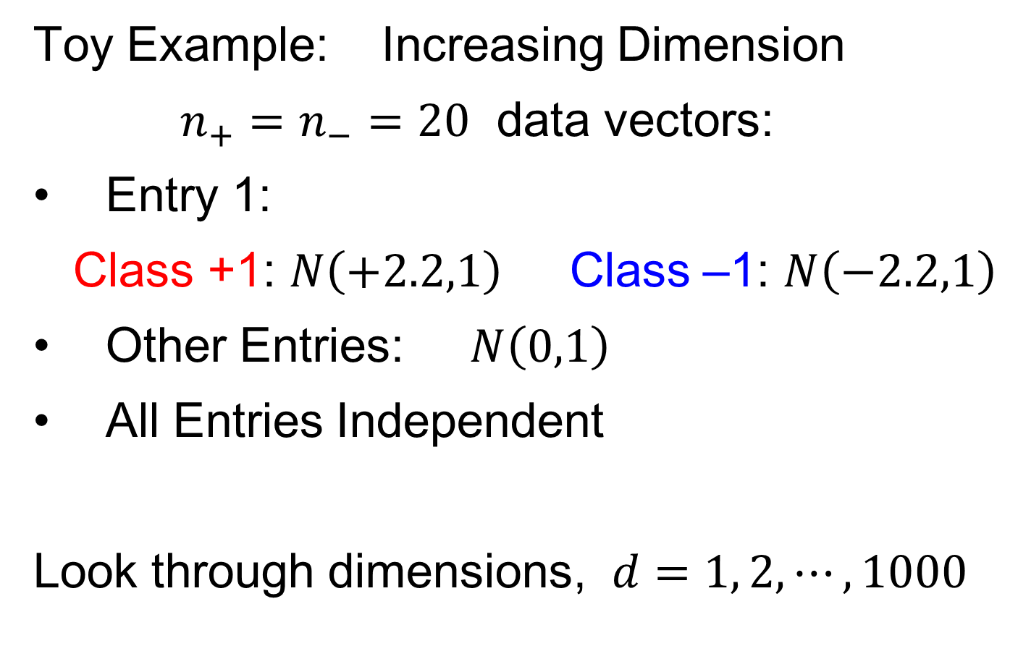
HDLSS Discrimination
Toy Example: Increasing Dimension
$n_{+}=n_{−}=20$ data vectors:
Entry 1:
Class +1: $N\left(+2.2,1\right)$ Class –1: $N\left(−2.2,1\right)$
Other Entries: $N\left(0,1\right)$
All Entries Independent
Look through dimensions, $d=1, 2, ⋯, 1000$

Slide 16
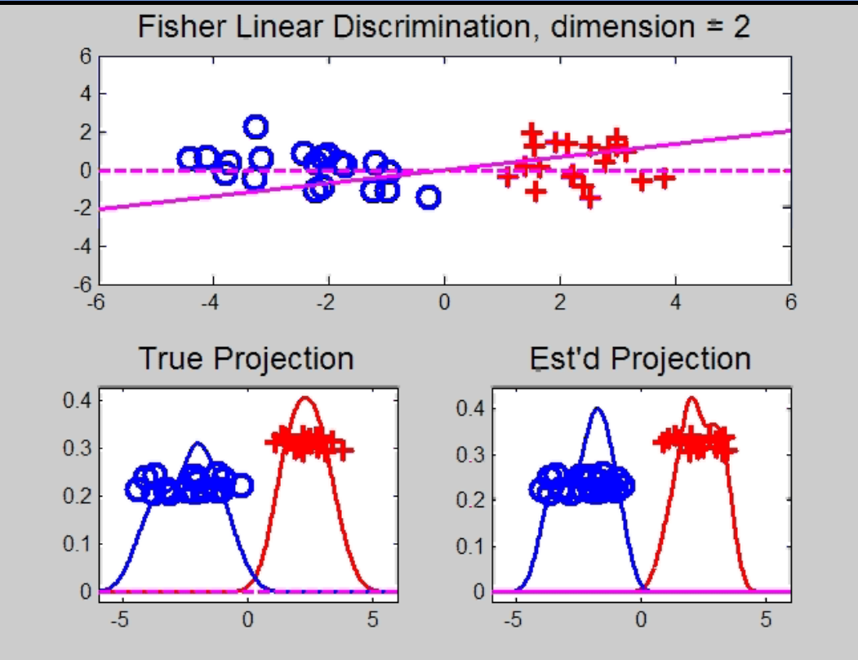

HDLSS Discrimination
Add a 2nd Dimension ($N\left(0,1\right)$ noise)
Same Projections on
Optimal Direction
Axes Here
Are Same As
Directions Here
Now See 2
Dimensions

Slide 17
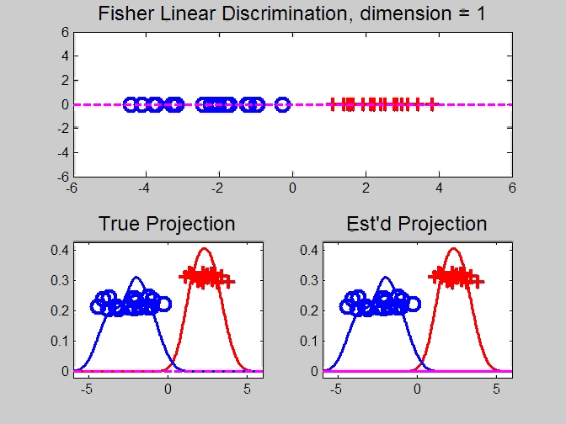
HDLSS Discrimination
Movie Through Increasing Dimensions

Slide 18
HDLSS Discrimination
FLD in Increasing Dimensions:
Low dimensions (d = 2-9):
  Visually good separation
  Small angle between FLD and Optimal
  Good generalizability
Medium Dimensions (d = 10-26):
  Visual separation too good?!?
  Larger angle between FLD and Optimal
  Worse generalizability
  Feel effect of sampling noise

Slide 19
HDLSS Discrimination
FLD in Increasing Dimensions:
High Dimensions (d=27-37):
  Much worse angle
  Very poor generalizability
  But very small within class variation
  Poor separation between classes
  Large separation / variation ratio

Slide 20
HDLSS Discrimination
FLD in Increasing Dimensions:
At HDLSS Boundary (d=38):
  38 = degrees of freedom
  (need to estimate 2 class means)
  Within class variation = 0 ?!?
  Data pile up, on just two points
  Perfect separation / variation ratio?
  But only feels microscopic noise aspects
  So likely not generalizable
  Angle to optimal very large

Slide 21
HDLSS Discrimination
FLD in Increasing Dimensions:
Just beyond HDLSS boundary (d=39-70):
  Improves with higher dimension?!?
  Angle gets better
  Improving generalizability?
  More noise helps classification?!?

Slide 22
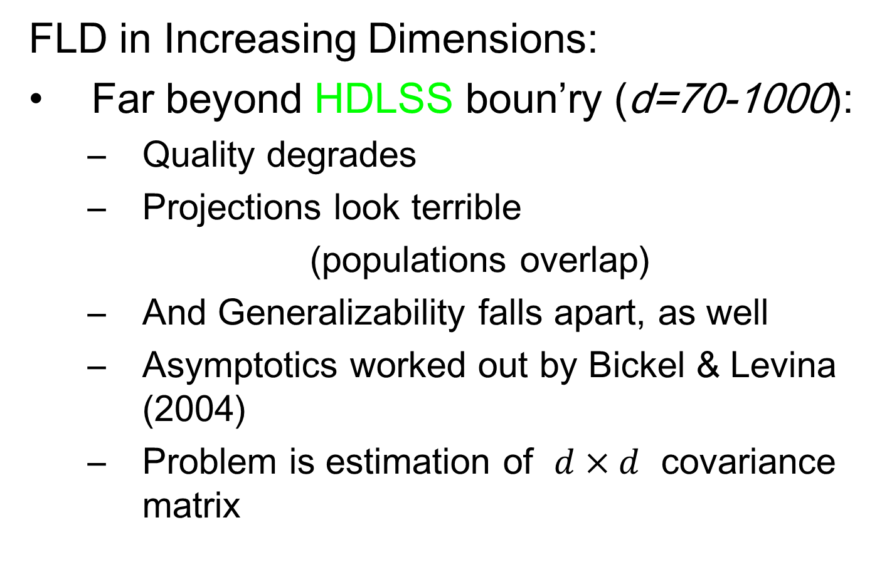
HDLSS Discrimination
FLD in Increasing Dimensions:
Far beyond HDLSS boun’ry (d=70-1000):
  Quality degrades
  Projections look terrible
  (populations overlap)
  And Generalizability falls apart, as well
  Asymptotics worked out by Bickel & Levina (2004)
  Problem is estimation of $d×d$ covariance matrix

