Slide 1
Maximal Data Piling
MDP in Increasing Dimensions:
Sub HDLSS dimensions (d = 1-37):
Looks similar to FLD?!?
Reason for this?
At HDLSS Boundary (d = 38):
Again similar to FLD…

Slide 2
Maximal Data Piling
FLD in Increasing Dimensions:
For HDLSS dimensions (d = 39-1000):
Always have data piling
Gap between grows for larger n
Even though noise increases?
Angle (gen’bility) first improves, d = 39–180
Then worsens, d = 200-1000
Eventually noise dominates
Trade-off is where gap near optimal diff’nce

Slide 3
Maximal Data Piling
How to compute ${\underline{v}}_{MDP}$?
Can show (Ahn & Marron 2009):
$${\underline{v}}_{MDP}={\hat{Σ}}^{−1}\left({\underline{\overline{X}}}^{+}−{\underline{\overline{X}}}^{−}\right)$$
Recall FLD formula:
$${\underline{v}}_{FLD}={\left({\hat{Σ}}^{w}\right)}^{−1}\left({\underline{\overline{X}}}^{+}−{\underline{\overline{X}}}^{−}\right)$$
Only difference is global vs. within class
Covariance Estimates!

Slide 4
Maximal Data Piling
Historical Note:
Discovery of MDP
Came from a programming error
Forgetting to use within class covariance
In FLD…

Slide 5
Maximal Data Piling
Visual similarity of ${\underline{v}}_{MDP}$ & ${\underline{v}}_{FLD}$?
Can show (Ahn & Marron 2009), for $d<n$:
$${{\underline{v}}_{MDP}}/{\left\|{\underline{v}}_{MDP}\right\|}={{\underline{v}}_{FLD}}/{\left\|{\underline{v}}_{FLD}\right\|}$$
I.e. directions are the same!
How can this be?
Note lengths are different…
Study from transformation viewpoint

Slide 6
Maximal Data Piling
Recall
Transfo’
view of
FLD:

Slide 7
Maximal Data Piling
Include
Corres-
ponding
MDP
Transfo’:
Both give
Same
Result!

Slide 8
Maximal Data Piling
Details:
FLD & MDP:
Separating Plane
Normal Vector
Within Class:
PC1
PC2
Global:
PC1
PC2

Slide 9
Maximal Data Piling
Acknowledgement:
This viewpoint
I.e. insight into why FLD = MDP
(for low dim’al data)
Suggested by Daniel Peña

Slide 10
Maximal Data Piling
Fun e.g:
rotate
from PCA
to MDP
dir’ns

Slide 11
Maximal Data Piling
MDP for other class labellings:
Always exists
Separation bigger for natural clusters
Could be used for clustering
Consider all directions
Find one that makes largest gap
Very hard optimization problem
Over 2^{n-2} possible directions

Slide 12
Maximal Data Piling
A point of terminology (Ahn & Marron 2009):
MDP is “maximal” in 2 senses:
# of data piled
Size of gap
(within subspace
gen’d by data)

Slide 13
Maximal Data Piling
Recurring, over-arching, issue:
HDLSS space is a weird place

Slide 14
Maximal Data Piling
Usefulness for Classification?
First Glance: Terrible, not generalizable
HDLSS View: Maybe OK?
Simulation Result:
Good Performance for
Autocorrelated Errors
Reason: Induces “Stretch” in Data
Miao (2015)

Slide 15
Kernel Embedding
Aizerman, Braverman and Rozoner (1964)
Motivating idea:
Extend scope of linear discrimination,
By adding nonlinear components to data
(embedding in a higher dim’al space)
Better use of name:
nonlinear discrimination?

Slide 16
Kernel Embedding
Toy Examples:
In 1d, linear separation splits the domain
$\left\{x:x∈ℝ\right\}$ into only 2 parts

Slide 17
Kernel Embedding
But in the “quadratic
embedded domain”,
$\left\{\left(x,x^{2}\right):x∈ℝ\right\}⊂ℝ^{2}$
linear separation
can give 3 parts

Slide 18
Kernel Embedding
But in the quadratic embedded domain
$\left\{\left(x,x^{2}\right):x∈ℝ\right\}⊂ℝ^{2}$
Linear separation can give 3 parts
original data space lies in 1d manifold
very sparse region of $ℝ^{2}$
curvature of manifold gives:
better linear separation
can have any 2 break points
(2 points $⟹$ line)

Slide 19
Kernel Embedding
Stronger effects for
higher order
polynomial embedding:
E.g. for cubic,
$\left\{\left(x,x^{2},x^{3}\right):x∈ℝ\right\}⊂ℝ^{3}$
linear separation
can give 4 parts
(or fewer)

Slide 20
Kernel Embedding
Stronger effects - high. ord. poly. embedding:
original space lies in 1-d manifold,
even sparser in $ℝ^{3}$
higher d curvature gives:
improved linear separation
can have any 3 break points
(3 points $⟹$ plane)?
Note: relatively few
“interesting separating planes”

Slide 21
Kernel Embedding
General View: for original data matrix:
add rows:
i.e. embed in
Higher
Dimensional
space

Slide 22
Kernel Embedding
Embedded Fisher Linear Discrimination:
Choose Class +1, for any ${\underline{x}}^{0}∈ℝ^{d}$ when:
$${{\underline{x}}^{0}}^{t}{{\hat{Σ}}^{w}}^{−1}\left({\underline{\overline{X}}}^{(+1)}−{\underline{\overline{X}}}^{(−1)}\right)≥\frac{1}{2}{\left({\underline{\overline{X}}}^{(+1)}−{\underline{\overline{X}}}^{(−1)}\right){\hat{Σ}}^{w}}^{−1}\left({\underline{\overline{X}}}^{(+1)}−{\underline{\overline{X}}}^{(−1)}\right)$$
in embedded space.
Image of class boundaries in original space is nonlinear
Allows more complicated class regions
Can also do Gaussian Lik. Rat. (or others)
Compute image by classifying points from original space

Slide 23
Kernel Embedding
Visualization for Toy Examples:
Have Linear Disc. In Embedded Space
Study Effect in Original Data Space
Via Implied Nonlinear Regions
Challenge: Hard to Explicitly Compute

Slide 24
Kernel Embedding
Visualization for Toy Examples:
Have Linear Disc. In Embedded Space
Study Effect in Original Data Space
Via Implied Nonlinear Regions
Approach:
Use Test Set in Original Space
(dense equally spaced grid)
Apply embedded discrimination Rule
Color Using the Result

Slide 25
Kernel Embedding
Polynomial Embedding, Toy Example 1:
Parallel Clouds
Use Yellow for Grid
Points Assigned
to Plus Class
Use Cyan for Grid
Points Assigned
to Minus Class
Notes:
PEod1Raw.ps

Slide 26
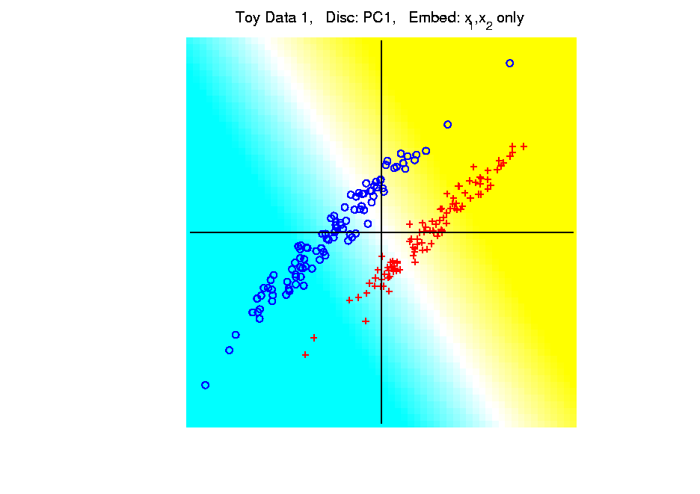
Kernel Embedding
Polynomial Embedding, Toy Example 1:
Parallel Clouds
PC1
Original
Data
Notes:
PEod1Raw.ps

Slide 27
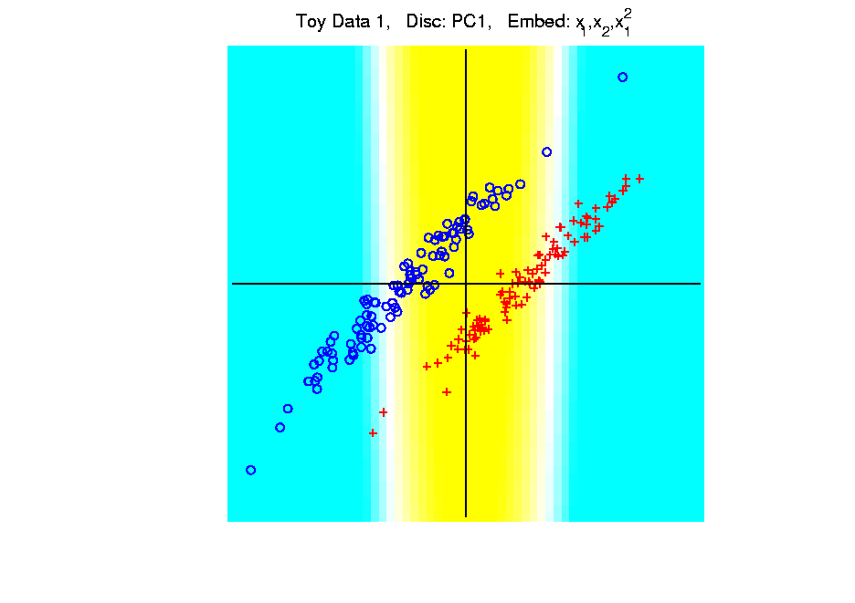
Kernel Embedding
Polynomial Embedding, Toy Example 1:
Parallel Clouds
PC1
Notes:
PEod1Raw.ps

Slide 28
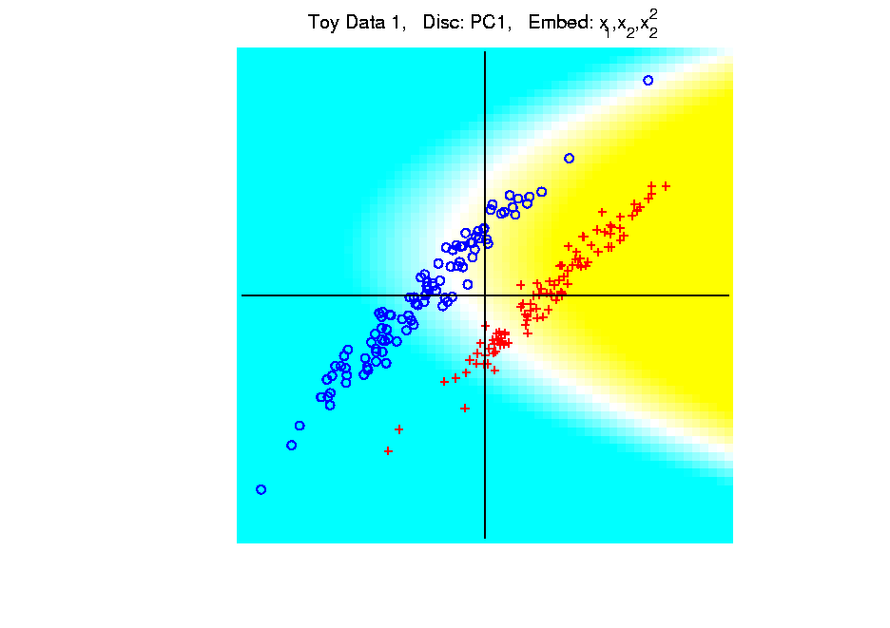
Kernel Embedding
Polynomial Embedding, Toy Example 1:
Parallel Clouds
PC1
Notes:
PEod1Raw.ps

Slide 29
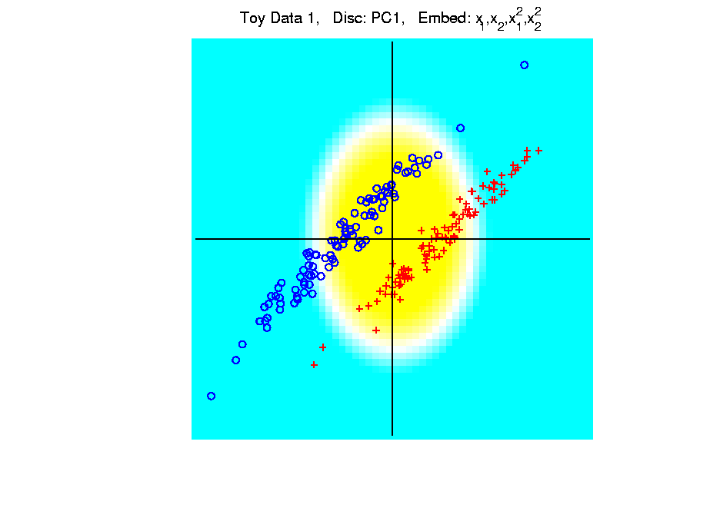
Kernel Embedding
Polynomial Embedding, Toy Example 1:
Parallel Clouds
PC1
Notes:
PEod1Raw.ps

Slide 30
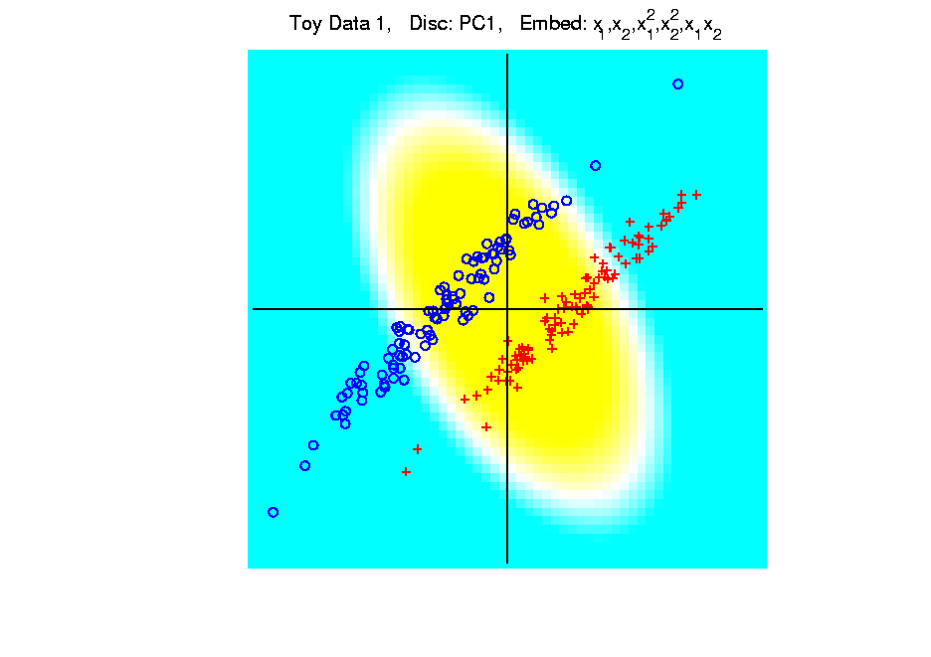
Kernel Embedding
Polynomial Embedding, Toy Example 1:
Parallel Clouds
PC1
Notes:
PEod1Raw.ps

Slide 31
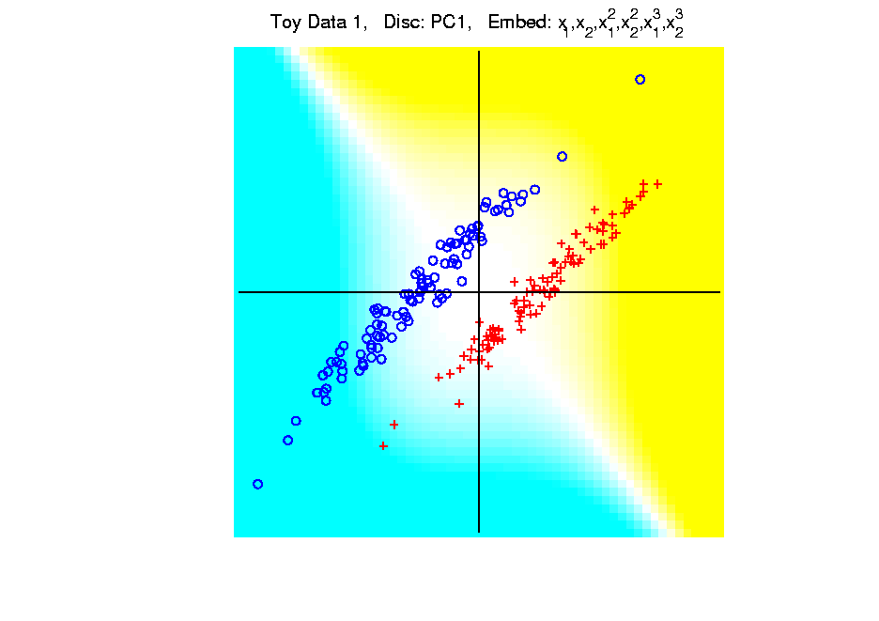
Kernel Embedding
Polynomial Embedding, Toy Example 1:
Parallel Clouds
PC1
Note:
Embedding
Always Bad
Don’t Want
Greatest
Variation
Notes:
PEod1Raw.ps

Slide 32
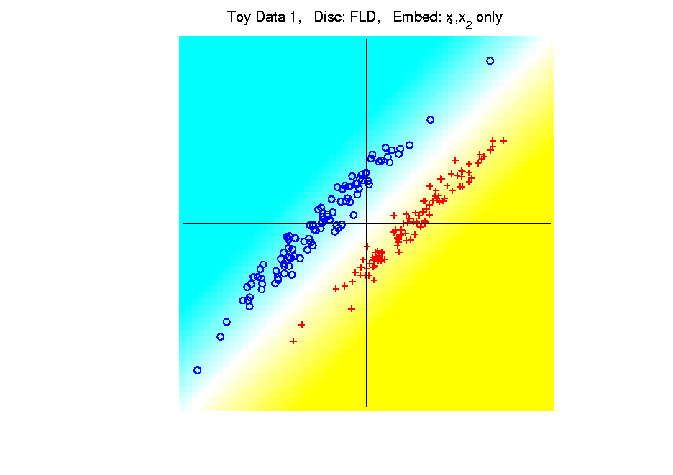
Kernel Embedding
Polynomial Embedding, Toy Example 1:
Parallel Clouds
FLD
Original
Data
Notes:
PEod1Raw.ps

Slide 33
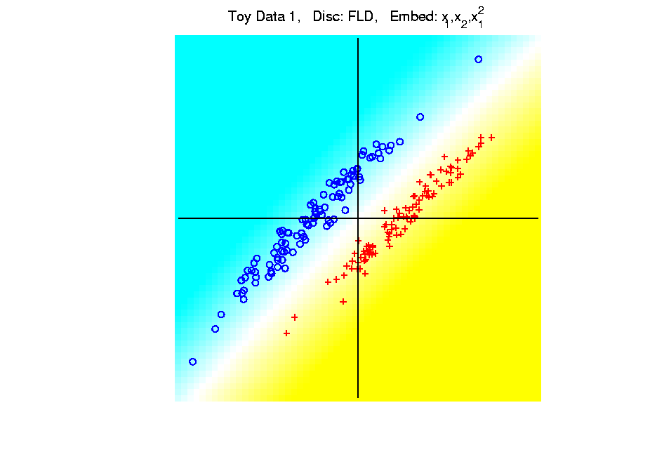
Kernel Embedding
Polynomial Embedding, Toy Example 1:
Parallel Clouds
FLD
Notes:
PEod1Raw.ps

Slide 34
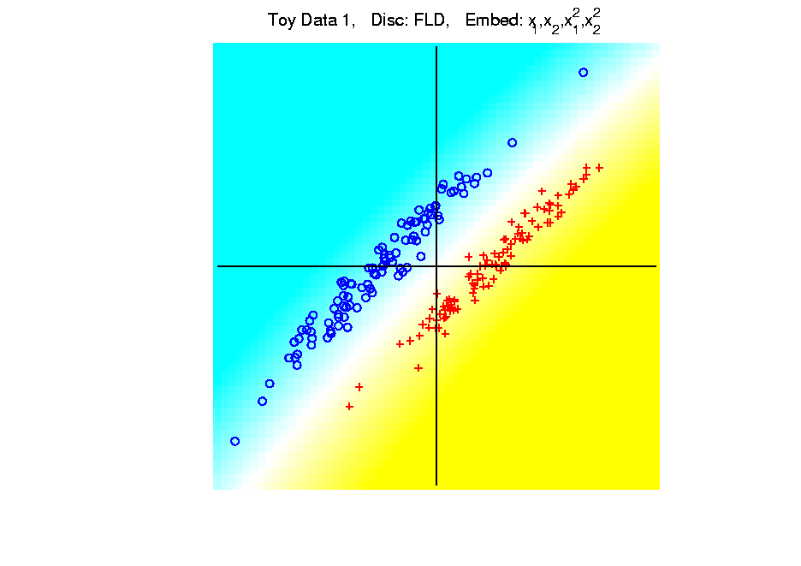
Kernel Embedding
Polynomial Embedding, Toy Example 1:
Parallel Clouds
FLD
Notes:
PEod1Raw.ps

Slide 35
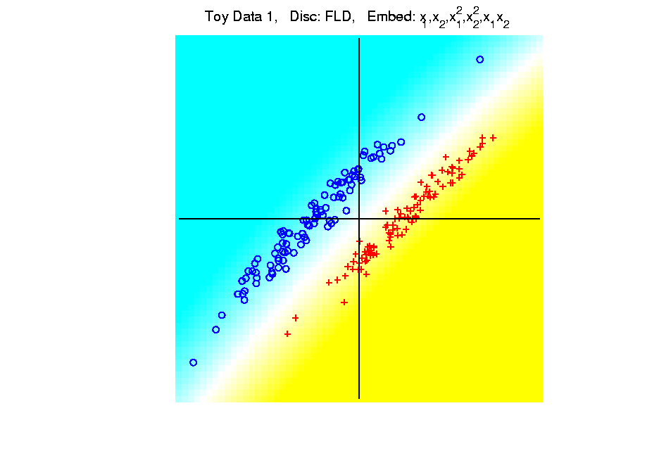
Kernel Embedding
Polynomial Embedding, Toy Example 1:
Parallel Clouds
FLD
Notes:
PEod1Raw.ps

Slide 36
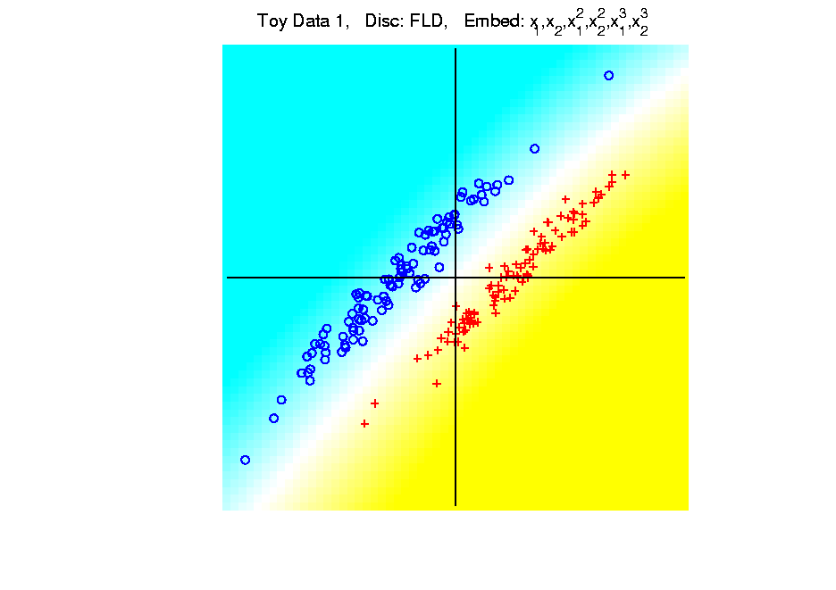
Kernel Embedding
Polynomial Embedding, Toy Example 1:
Parallel Clouds
FLD
All Stable
& Very Good
Since No Better
Separation in
Embedded Space
Notes:
PEod1Raw.ps

Slide 37
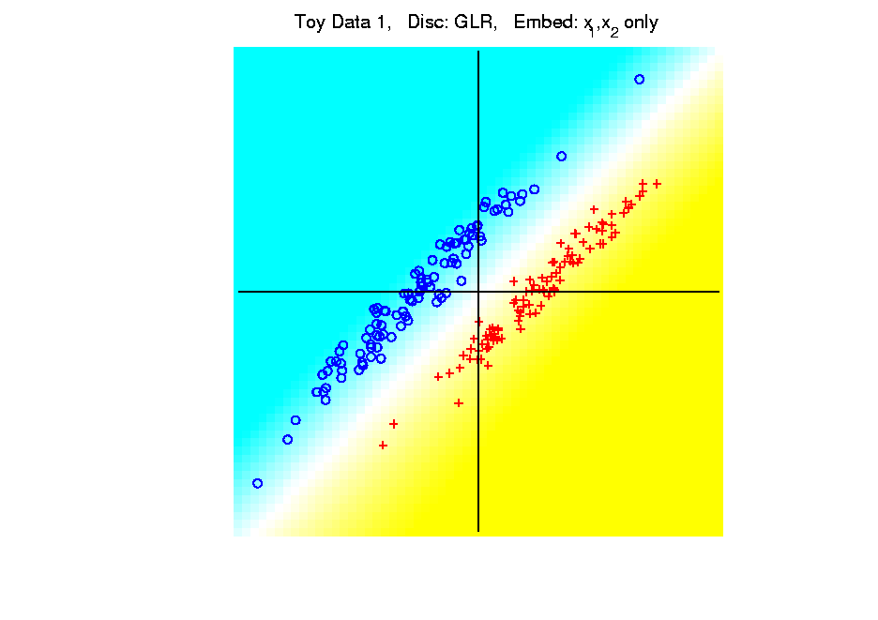
Kernel Embedding
Polynomial Embedding, Toy Example 1:
Parallel Clouds
GLR
Original
Data
Notes:
PEod1Raw.ps

Slide 38
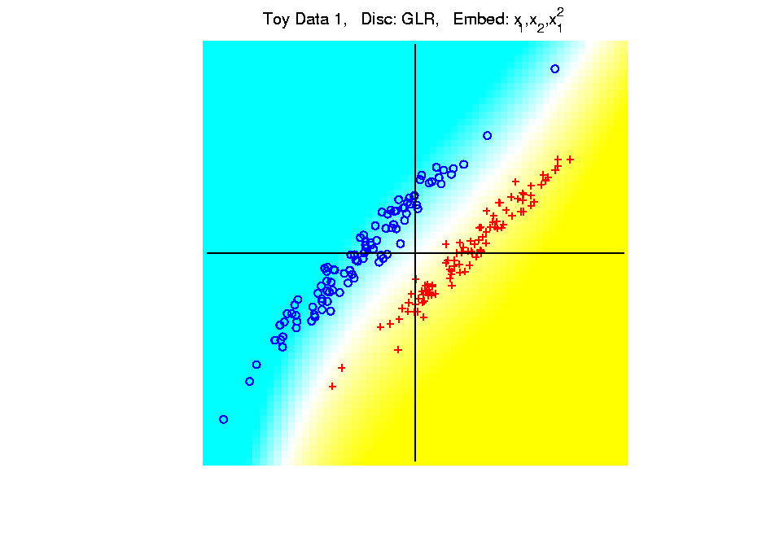
Kernel Embedding
Polynomial Embedding, Toy Example 1:
Parallel Clouds
GLR
Notes:
PEod1Raw.ps

Slide 39
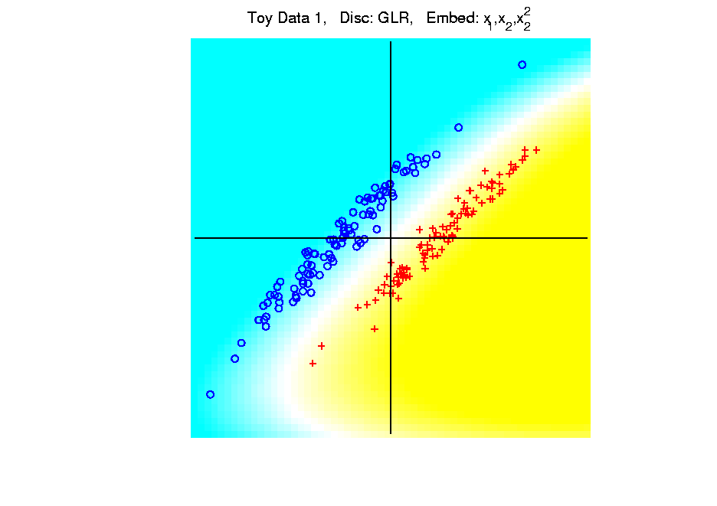
Kernel Embedding
Polynomial Embedding, Toy Example 1:
Parallel Clouds
GLR
Notes:
PEod1Raw.ps

Slide 40
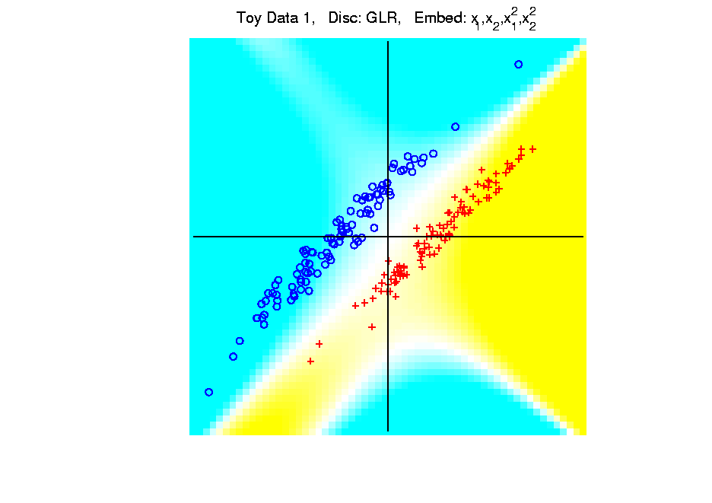
Kernel Embedding
Polynomial Embedding, Toy Example 1:
Parallel Clouds
GLR
Notes:
PEod1Raw.ps

Slide 41
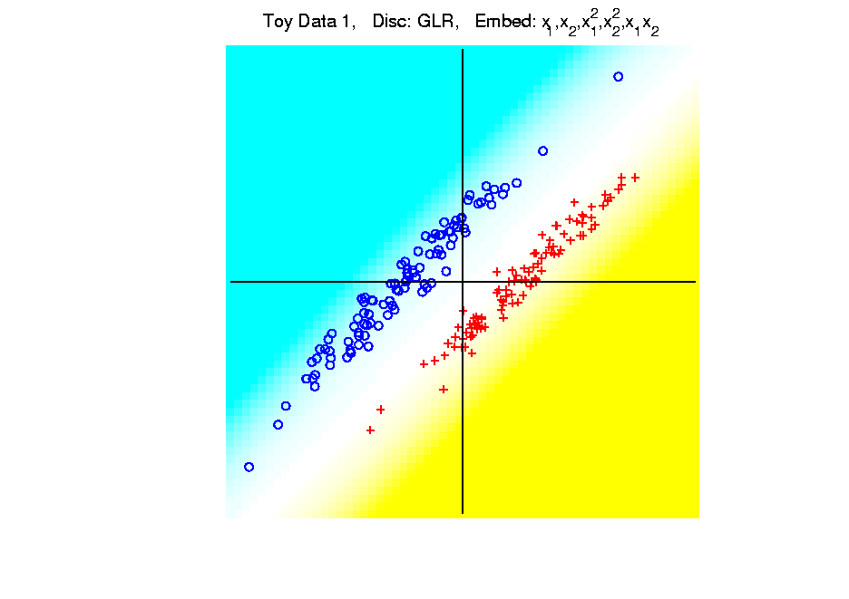
Kernel Embedding
Polynomial Embedding, Toy Example 1:
Parallel Clouds
GLR
Notes:
PEod1Raw.ps

Slide 42
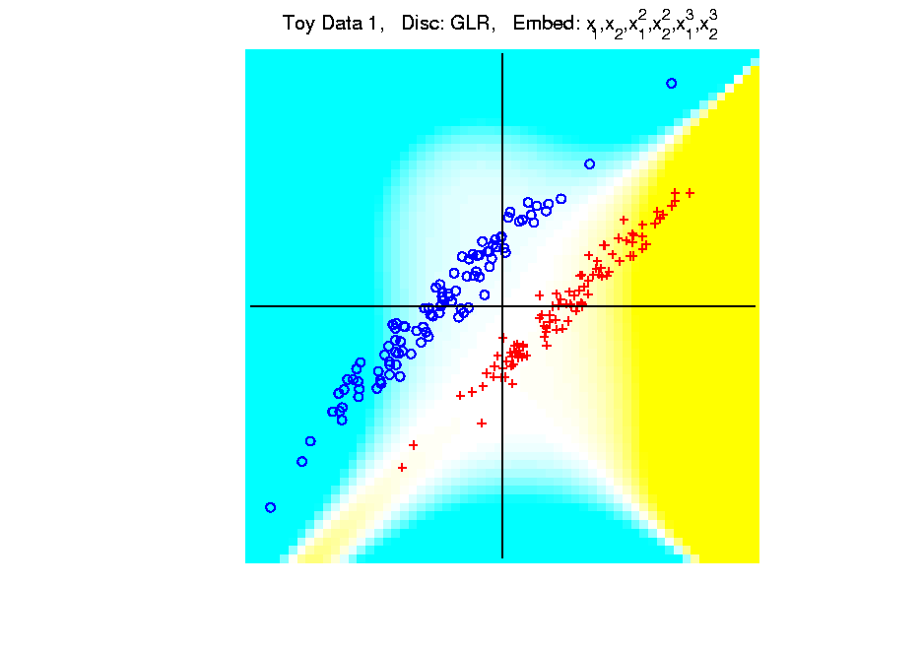
Kernel Embedding
Polynomial Embedding, Toy Example 1:
Parallel Clouds
GLR
Unstable
Subject to
Overfitting
Too Much Flexibility
In Embedded Space
Notes:
PEod1Raw.ps

Slide 43
Kernel Embedding
Polynomial Embedding, Toy Example 2:
Split X
Very Challenging
For Linear
Approaches
Notes:
PEod1Raw.ps

Slide 44
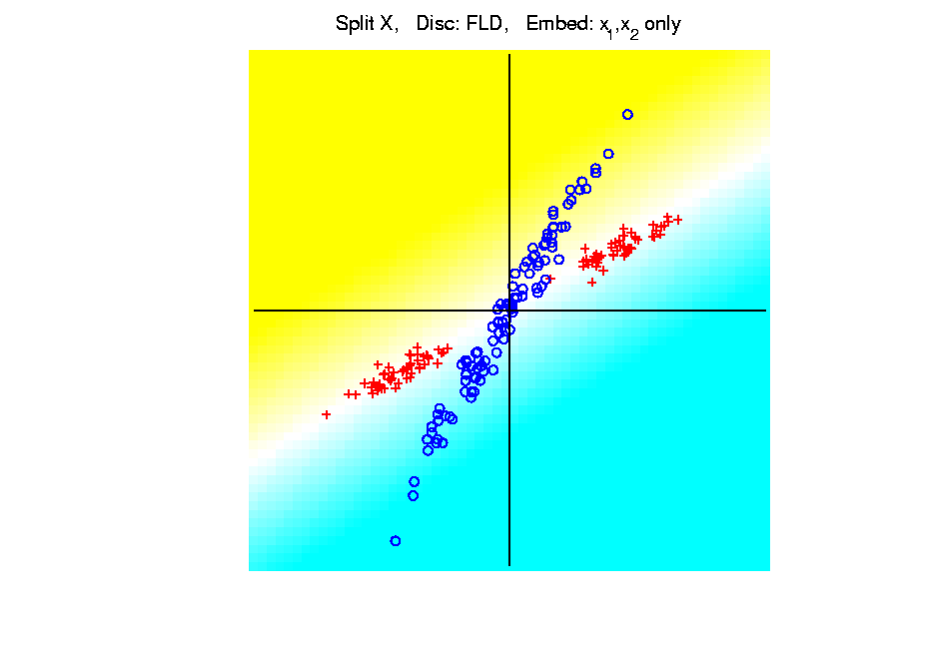
Kernel Embedding
Polynomial Embedding, Toy Example 2:
Split X
FLD
Original
Data
Notes:
PEod1Raw.ps

Slide 45
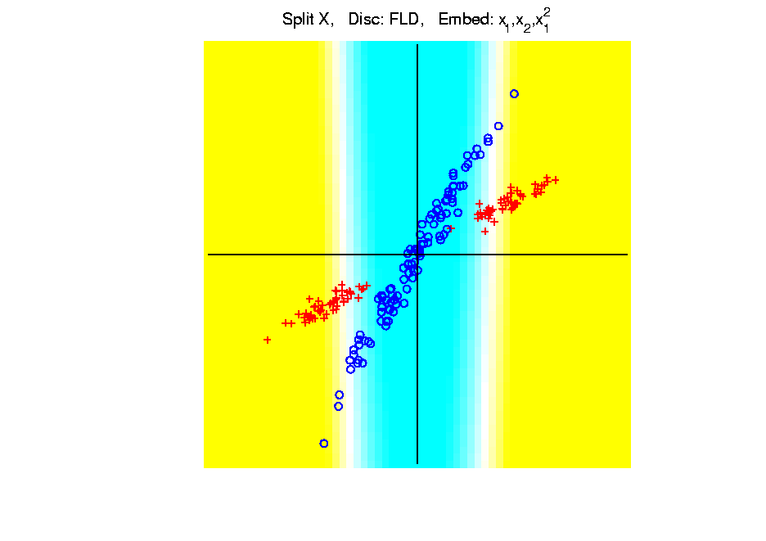
Kernel Embedding
Polynomial Embedding, Toy Example 2:
Split X
FLD
Slightly
Better
Notes:
PEod1Raw.ps

Slide 46
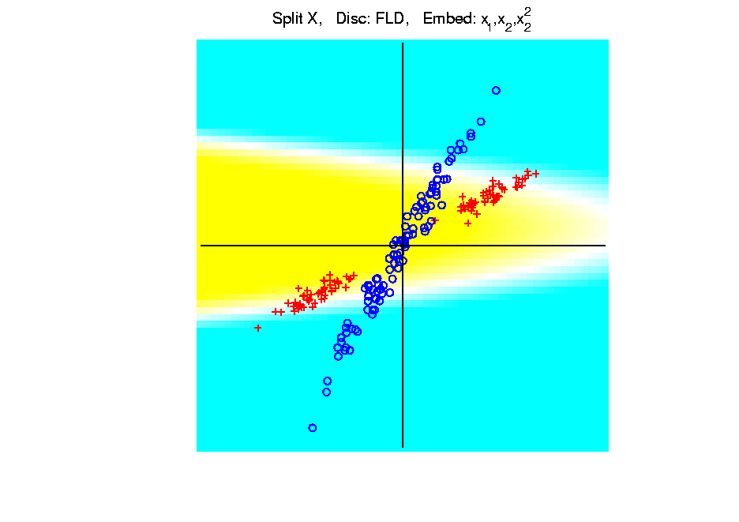
Kernel Embedding
Polynomial Embedding, Toy Example 2:
Split X
FLD
Notes:
PEod1Raw.ps

Slide 47
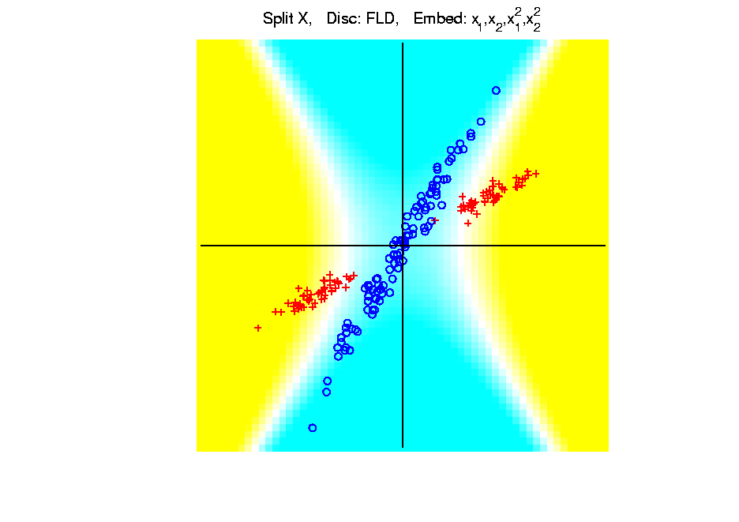
Kernel Embedding
Polynomial Embedding, Toy Example 2:
Split X
FLD
Very Good
Effective
Hyperbola
Notes:
PEod1Raw.ps

Slide 48
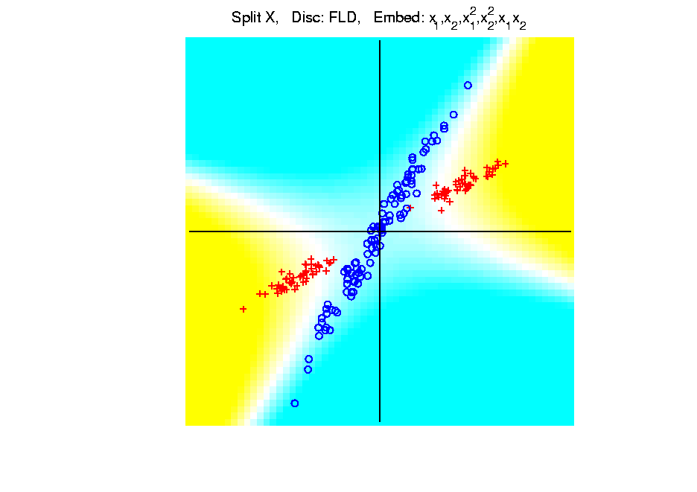
Kernel Embedding
Polynomial Embedding, Toy Example 2:
Split X
FLD
Notes:
PEod1Raw.ps

Slide 49
Kernel Embedding
Polynomial Embedding, Toy Example 2:
Split X
FLD
Robust
Against
Overfitting
Notes:
PEod1Raw.ps

Slide 50
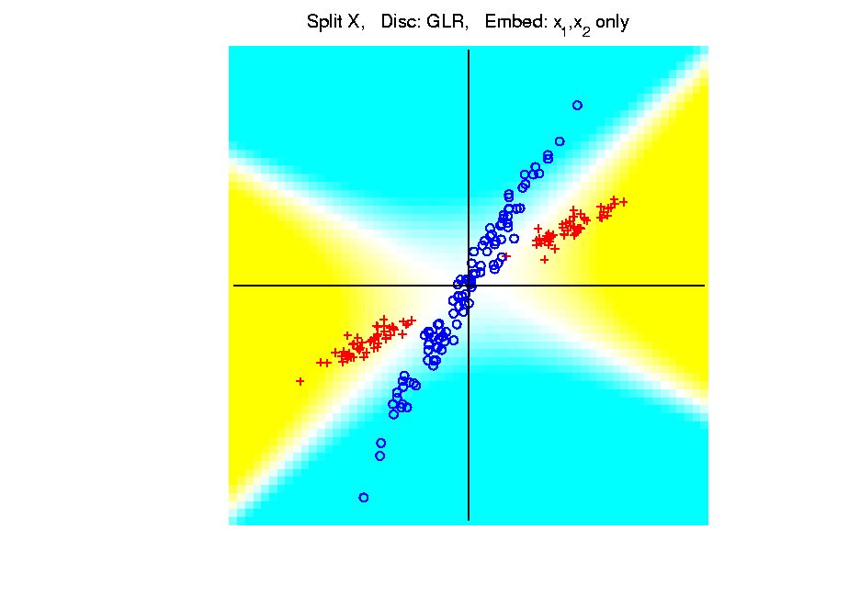
Kernel Embedding
Polynomial Embedding, Toy Example 2:
Split X
GLR
Original
Data
Looks
Very
Good
Notes:
PEod1Raw.ps

Slide 51
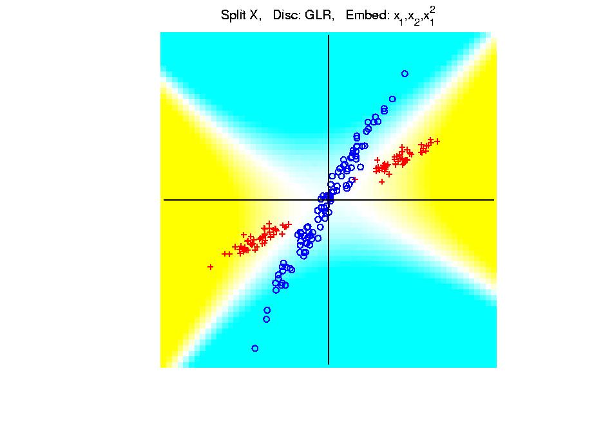
Kernel Embedding
Polynomial Embedding, Toy Example 2:
Split X
GLR
Notes:
PEod1Raw.ps

Slide 52
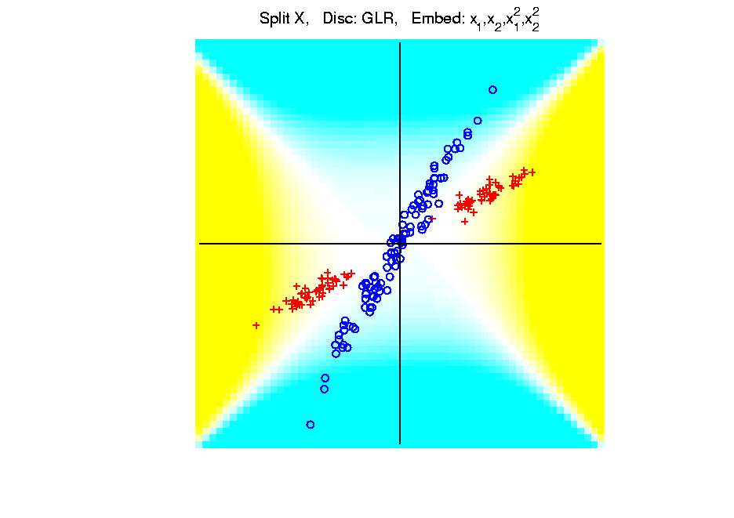
Kernel Embedding
Polynomial Embedding, Toy Example 2:
Split X
GLR
Reasonably
Stable
Never Ellipse
Around Blues
Notes:
PEod1Raw.ps

Slide 53
Kernel Embedding
Polynomial Embedding, Toy Example 3:
Donut
Very Challenging
For Any Linear
Approach
Notes:
PEod1Raw.ps

Slide 54
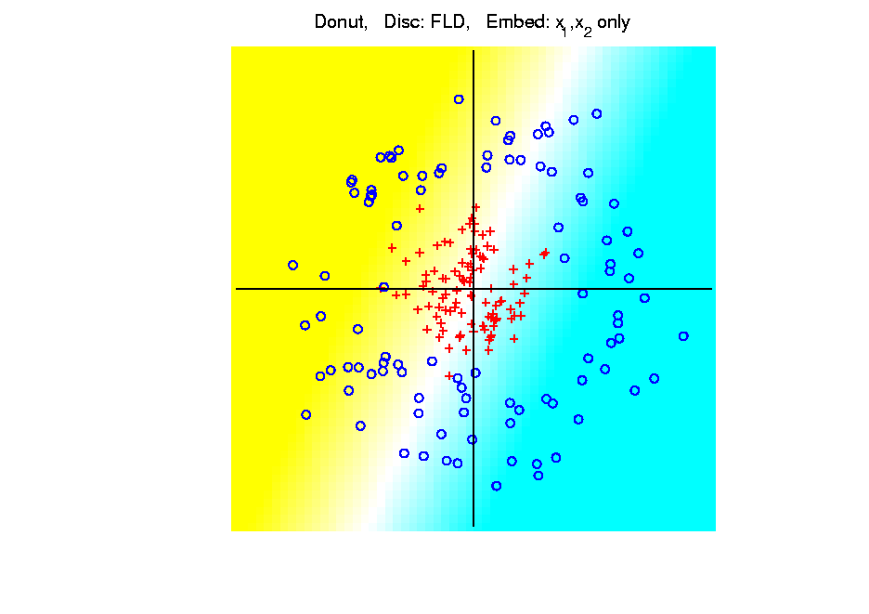
Kernel Embedding
Polynomial Embedding, Toy Example 3:
Donut
FLD
Original
Data
Very
Bad
Notes:
PEod1Raw.ps

Slide 55
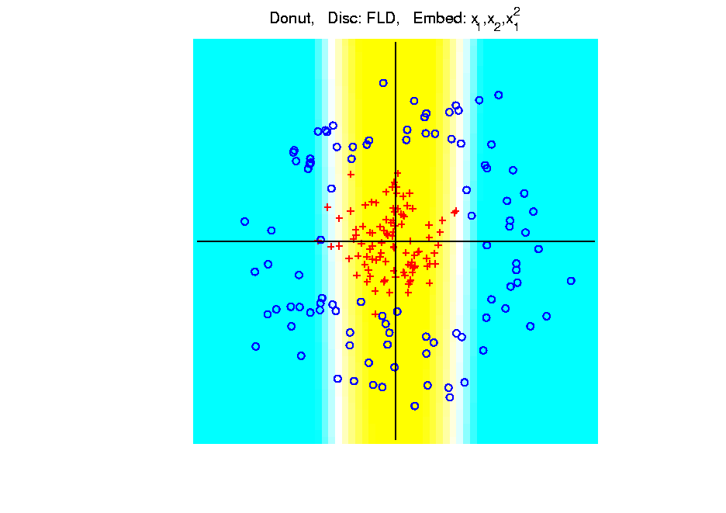
Kernel Embedding
Polynomial Embedding, Toy Example 3:
Donut
FLD
Somewhat
Better
(Parabolic Fold)
Notes:
PEod1Raw.ps

Slide 56
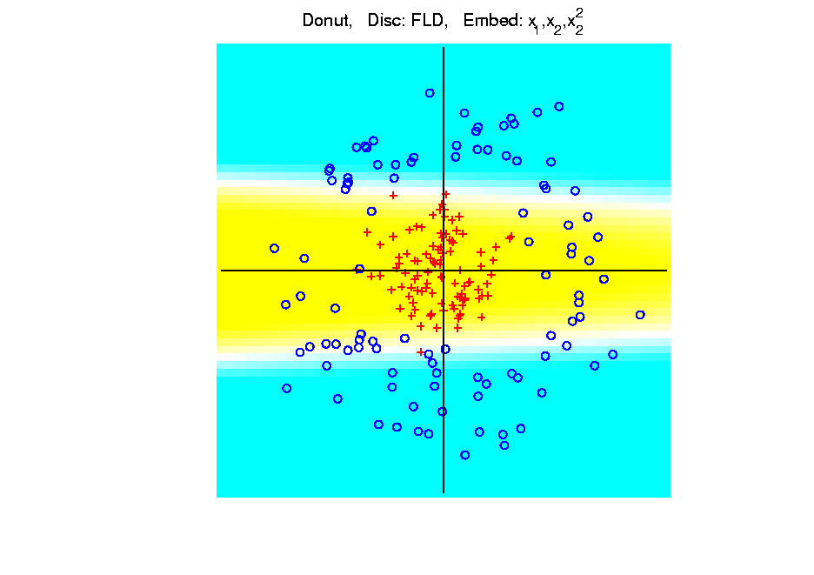
Kernel Embedding
Polynomial Embedding, Toy Example 3:
Donut
FLD
Somewhat
Better
(Other Fold)
Notes:
PEod1Raw.ps

Slide 57
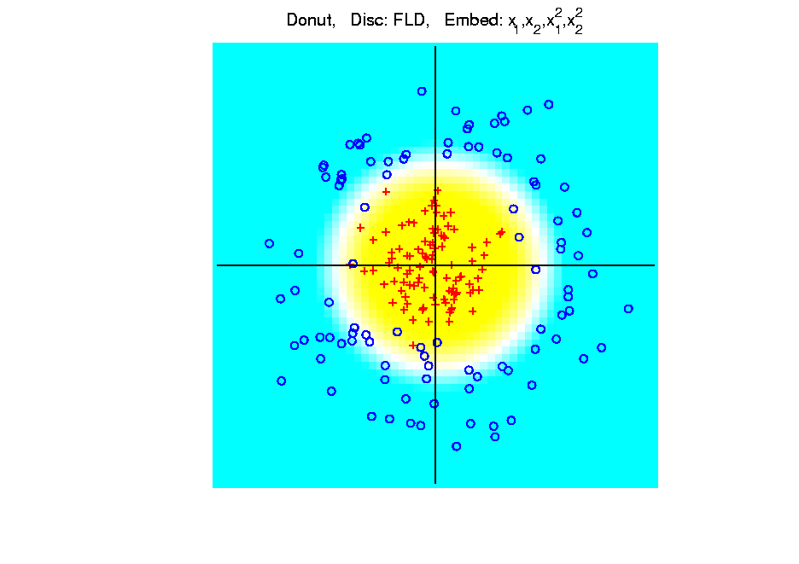
Kernel Embedding
Polynomial Embedding, Toy Example 3:
Donut
FLD
Good
Performance
(Slice of
Paraboloid)
Notes:
PEod1Raw.ps

Slide 58
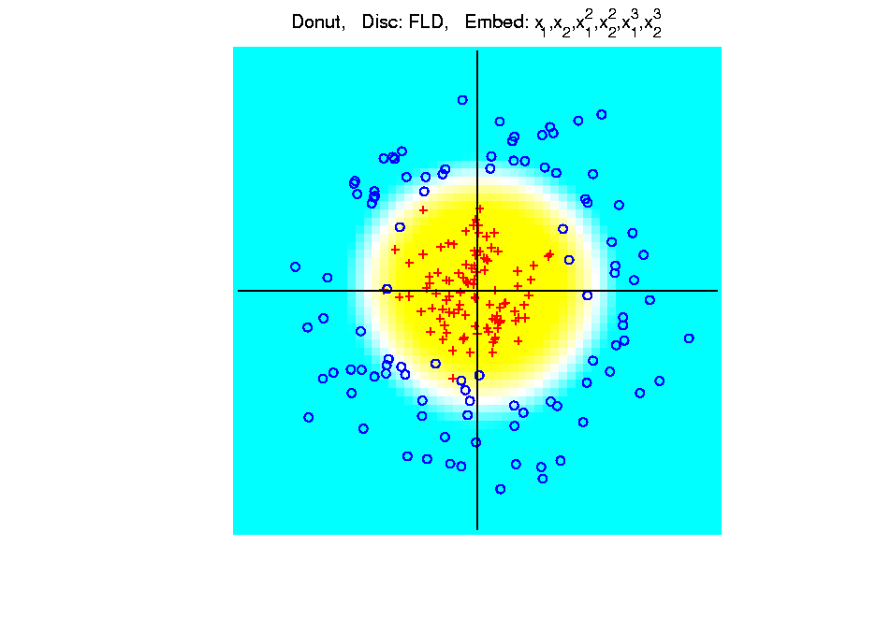
Kernel Embedding
Polynomial Embedding, Toy Example 3:
Donut
FLD
Robust
Against
Overfitting
Notes:
PEod1Raw.ps

Slide 59
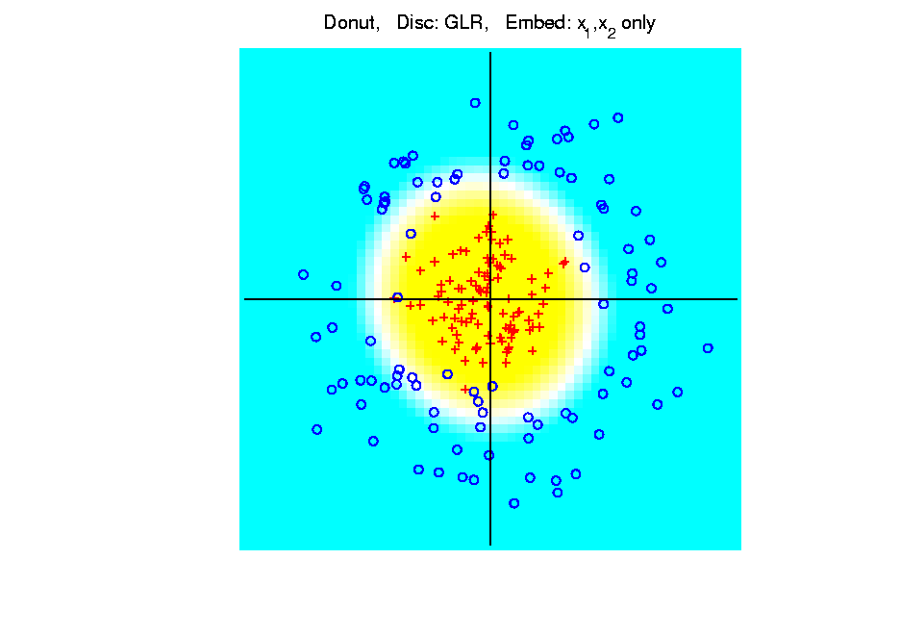
Kernel Embedding
Polynomial Embedding, Toy Example 3:
Donut
GLR
Original
Data
Best With
No Embedding?
Notes:
PEod1Raw.ps

Slide 60
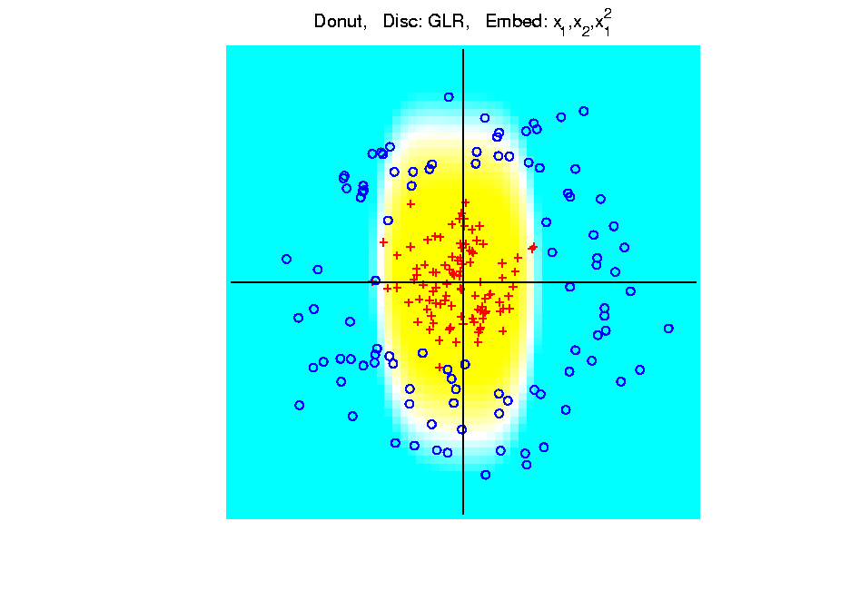
Kernel Embedding
Polynomial Embedding, Toy Example 3:
Donut
GLR
Notes:
PEod1Raw.ps

Slide 61
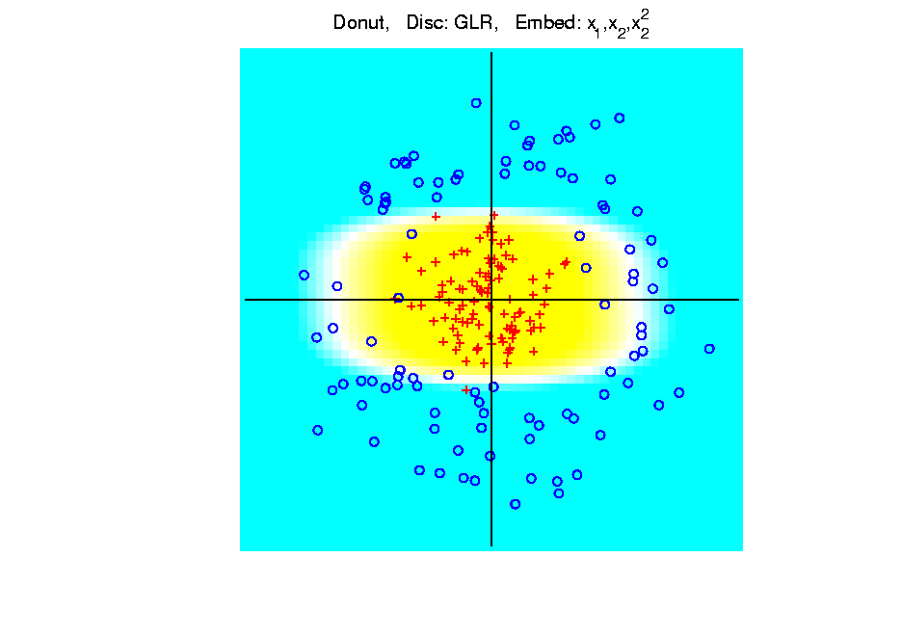
Kernel Embedding
Polynomial Embedding, Toy Example 3:
Donut
GLR
Notes:
PEod1Raw.ps

Slide 62
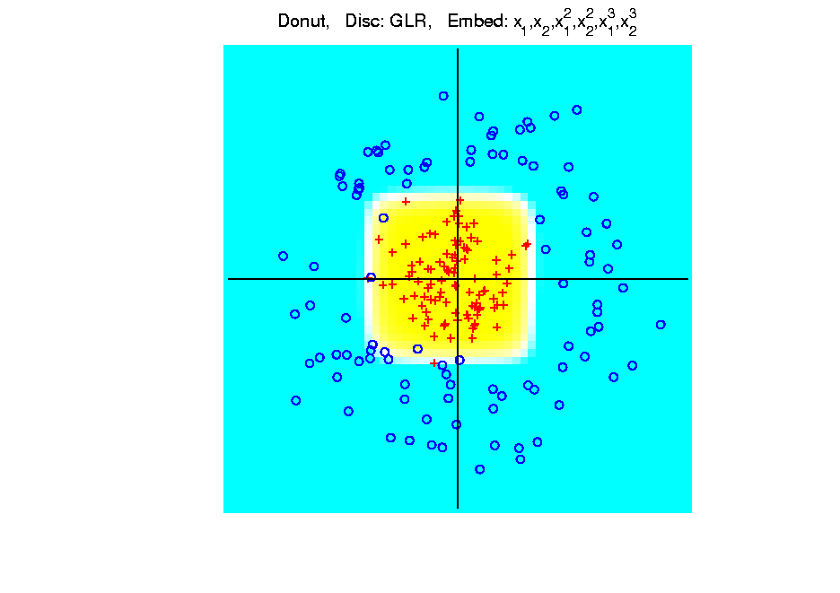
Kernel Embedding
Polynomial Embedding, Toy Example 3:
Donut
GLR
Overfitting
Gives Square
Shape?
Notes:
PEod1Raw.ps

Slide 63
Kernel Embedding
Drawbacks to polynomial embedding:
Too many extra terms create spurious structure
i.e. have “overfitting”
Too much flexibility
HDLSS problems typically get worse

Slide 64
Kernel Embedding
Important Variation: “Kernel Machines”
Idea: replace polynomials by
other nonlinear functions
e.g. 1: sigmoid functions from neural nets
e.g. 2: radial basis functions
Gaussian kernels
Related to “kernel density estimation”
(study more later)

Slide 65
Kernel Embedding
Radial Basis Functions:
Note: there are several ways to embed:
Naïve Embedding (equally spaced grid)
Explicit Embedding (evaluate at data)
Implicit Emdedding (inner prod. based)
(everybody currently does the latter)

Slide 66
Kernel Embedding
Naïve Embedding, Radial basis functions:

Slide 67
Kernel Embedding
Naïve Embedding, Radial basis functions:
At some “grid points” ,
For a “bandwidth” (i.e. standard dev’n) ,

Slide 68
Kernel Embedding
Naïve Embedding, Radial basis functions:
At some “grid points” ,
For a “bandwidth” (i.e. standard dev’n) ,
Consider ( dim’al) functions:

Slide 69
Kernel Embedding
Naïve Embedding, Radial basis functions:
At some “grid points” ,
For a “bandwidth” (i.e. standard dev’n) ,
Consider ( dim’al) functions:
Replace data matrix with:

Slide 70
Kernel Embedding
Naïve Embedding, Radial basis functions:
For discrimination:
Work in radial basis space,
With new data vector ,
represented by:

Slide 71
Kernel Embedding
Naïve Embedd’g, Toy E.g. 1: Parallel Clouds
Good
at data
Poor
outside

Slide 72
Kernel Embedding
Naïve Embedd’g, Toy E.g. 2: Split X
OK at
data
Strange
outside

Slide 73
Kernel Embedding
Naïve Embedd’g, Toy E.g. 3: Donut
Mostly
good

Slide 74
Kernel Embedding
Naïve Embedd’g, Toy E.g. 3: Donut
Mostly
good
Slight
mistake
for one
kernel

Slide 75
Kernel Embedding
Naïve Embedding, Radial basis functions:
Toy Example, Main lessons:
Generally good in regions with data,
Unpredictable where data are sparse

Slide 76
Kernel Embedding
Toy Example 4: Checkerboard
Very
Challenging!
Linear
Method?
Polynomial
Embedding?
Notes:
PEod1Raw.ps

Slide 77
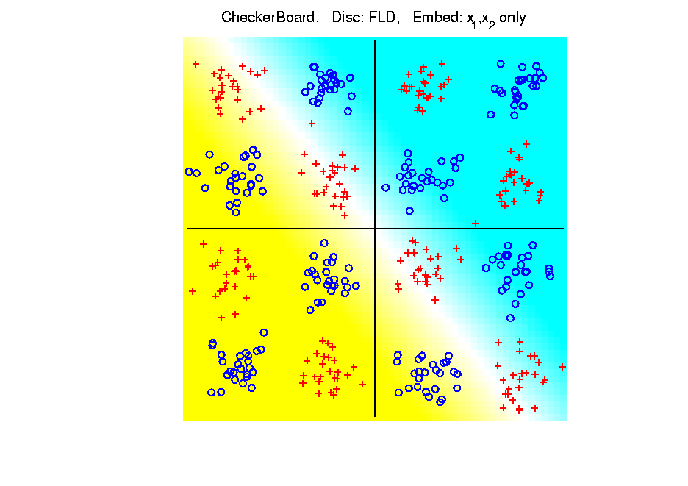
Kernel Embedding
Toy Example 4: Checkerboard
Very
Challenging!
FLD
Linear Is
Hopeless
Notes:
PEod1Raw.ps

Slide 78
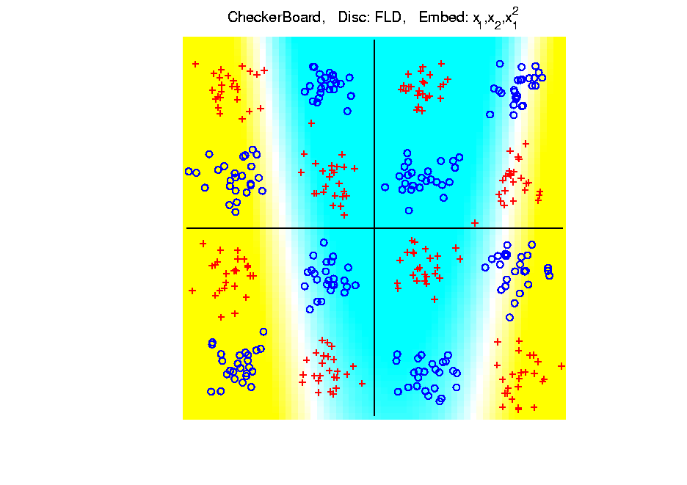
Kernel Embedding
Toy Example 4: Checkerboard
Very
Challenging!
FLD
Notes:
PEod1Raw.ps

Slide 79
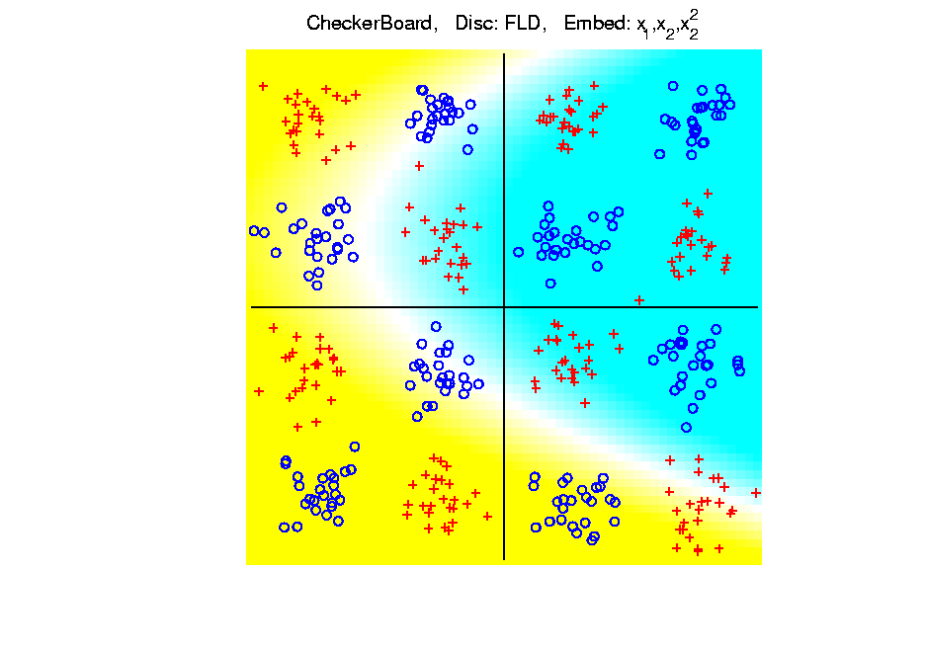
Kernel Embedding
Toy Example 4: Checkerboard
Very
Challenging!
FLD
Notes:
PEod1Raw.ps

Slide 80
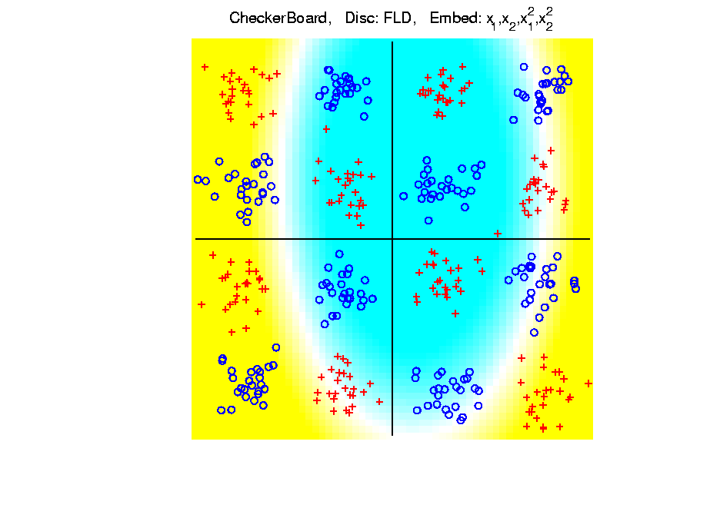
Kernel Embedding
Toy Example 4: Checkerboard
Very
Challenging!
FLD
Notes:
PEod1Raw.ps

Slide 81
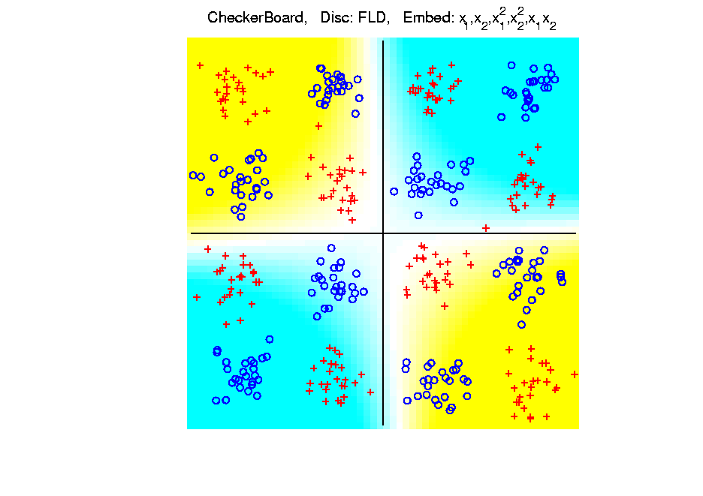
Kernel Embedding
Toy Example 4: Checkerboard
Very
Challenging!
FLD
Notes:
PEod1Raw.ps

Slide 82
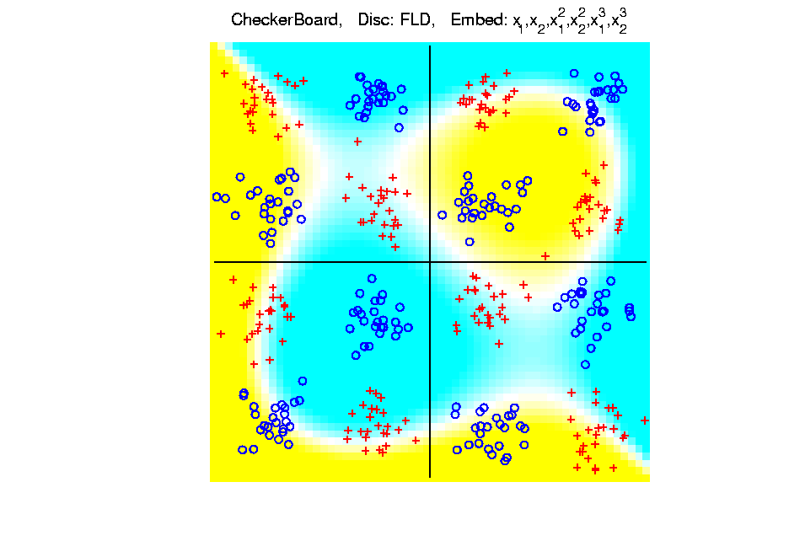
Kernel Embedding
Toy Example 4: Checkerboard
Very
Challenging!
FLD
Embedding
Gets Better
But Still
Not Great
Notes:
PEod1Raw.ps

Slide 83
Kernel Embedding
Toy Example 4: Checkerboard
Very
Challenging!
Polynomials
Don’t Have
Needed
Flexiblity
Notes:
PEod1Raw.ps

Slide 84
Kernel Embedding
Toy Example 4: Checkerboard
Radial
Basis
Embedding
+ FLD
Is
Excellent!
Notes:
PEod1Raw.ps

Slide 85
Kernel Embedding
Drawbacks to naïve embedding:
Equally spaced grid too big in high $d$
Not computationally tractable $\left(g^{d}\right)$
Approach:
Evaluate only at data points
Not on full grid
But where data live

Slide 86
Kernel Embedding
Other types of embedding:
Explicit
Implicit
Will be studied soon, after
introduction to Support Vector Machines…

Slide 87
Kernel Embedding
$∃$ generalizations of this idea to other types of analysis
& some clever computational ideas.
E.g. “Kernel based, nonlinear Principal Components Analysis”
Ref: Schölkopf, Smola and Müller (1998)

Slide 88
Participant Presentation
Erika Helgeson
Nonparametric Cluster Significance Testing

