Slide 1
Return to Big Picture
Main statistical goals of OODA:
Understanding population structure
Low dim’al Projections, PCA …
Classification (i. e. Discrimination)
Understanding 2+ populations
Time Series of Data Objects
Chemical Spectra, Mortality Data
“Vertical Integration” of Data Types

Slide 2
HDLSS Discrimination
Add a 2nd Dimension ($N\left(0,1\right)$ noise)
Same Projections on
Optimal Direction
Axes Here
Are Same As
Directions Here
Now See 2
Dimensions

Slide 3
HDLSS Discrimination
Mean Difference (Centroid) Method
Far more stable over dimensions
Because is likelihood ratio solution
(for known variance - Gaussians)
Doesn’t feel HDLSS boundary
Eventually becomes too good?!?
Widening gap between clusters?!?
Careful: angle to optimal grows
So lose generalizability (since noise inc’s)
HDLSS data present some odd effects…

Slide 4
Maximal Data Piling
Details:
FLD & MDP:
Separating Plane
Normal Vector
Within Class:
PC1
PC2
Global:
PC1
PC2

Slide 5
Maximal Data Piling
A point of terminology (Ahn & Marron 2009):
MDP is “maximal” in 2 senses:
# of data piled
Size of gap
(within subspace
gen’d by data)

Slide 6
Maximal Data Piling
Recurring, over-arching, issue:
HDLSS space is a weird place

Slide 7
Maximal Data Piling
Usefulness for Classification?
First Glance: Terrible, not generalizable
HDLSS View: Maybe OK?
Simulation Result:
Good Performance for
Autocorrelated Errors
Reason: Induces “Stretch” in Data
Miao (2015)

Slide 8
Kernel Embedding
Aizerman, Braverman and Rozoner (1964)
Motivating idea:
Extend scope of linear discrimination,
By adding nonlinear components to data
(embedding in a higher dim’al space)
Better use of name:
nonlinear discrimination?

Slide 9
Kernel Embedding
Stronger effects for
higher order
polynomial embedding:
E.g. for cubic,
$\left\{\left(x,x^{2},x^{3}\right):x∈ℝ\right\}⊂ℝ^{3}$
linear separation
can give 4 parts
(or fewer)

Slide 10
Kernel Embedding
Stronger effects - high. ord. poly. embedding:
original space lies in 1-d manifold,
even sparser in $ℝ^{3}$
higher d curvature gives:
improved linear separation
can have any 3 break points
(3 points $⟹$ plane)?
Note: relatively few
“interesting separating planes”

Slide 11
Kernel Embedding
General View: for original data matrix:
add rows:
i.e. embed in
Higher
Dimensional
space

Slide 12
Kernel Embedding
Embedded Fisher Linear Discrimination:
Choose Class +1, for any ${\underline{x}}^{0}∈ℝ^{d}$ when:
$${{\underline{x}}^{0}}^{t}{{\hat{Σ}}^{w}}^{−1}\left({\underline{\overline{X}}}^{(+1)}−{\underline{\overline{X}}}^{(−1)}\right)≥\frac{1}{2}{\left({\underline{\overline{X}}}^{(+1)}−{\underline{\overline{X}}}^{(−1)}\right){\hat{Σ}}^{w}}^{−1}\left({\underline{\overline{X}}}^{(+1)}−{\underline{\overline{X}}}^{(−1)}\right)$$
in embedded space.
Image of class boundaries in original space is nonlinear
Allows more complicated class regions
Can also do Gaussian Lik. Rat. (or others)
Compute image by classifying points from original space

Slide 13
Kernel Embedding
Visualization for Toy Examples:
Have Linear Disc. In Embedded Space
Study Effect in Original Data Space
Via Implied Nonlinear Regions
Challenge: Hard to Explicitly Compute

Slide 14
Kernel Embedding
Visualization for Toy Examples:
Have Linear Disc. In Embedded Space
Study Effect in Original Data Space
Via Implied Nonlinear Regions
Approach:
Use Test Set in Original Space
(dense equally spaced grid)
Apply embedded discrimination Rule
Color Using the Result

Slide 15
Kernel Embedding
Polynomial Embedding, Toy Example 1:
Parallel Clouds
Use Yellow for Grid
Points Assigned
to Plus Class
Use Cyan for Grid
Points Assigned
to Minus Class
Notes:
PEod1Raw.ps

Slide 16
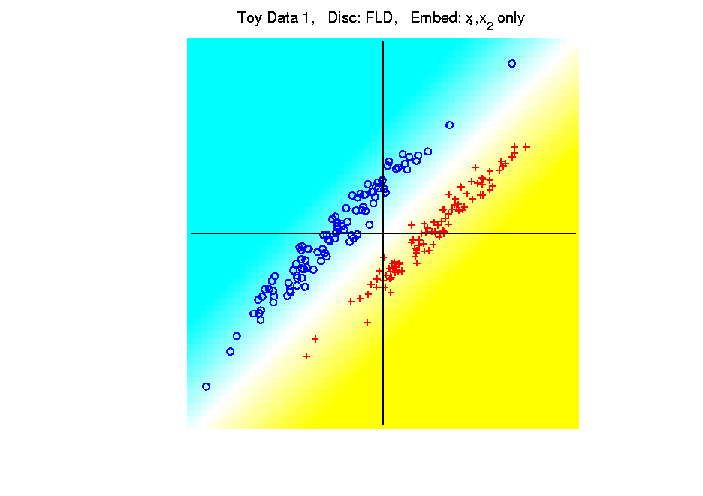
Kernel Embedding
Polynomial Embedding, Toy Example 1:
Parallel Clouds
FLD
Original
Data
Notes:
PEod1Raw.ps

Slide 17
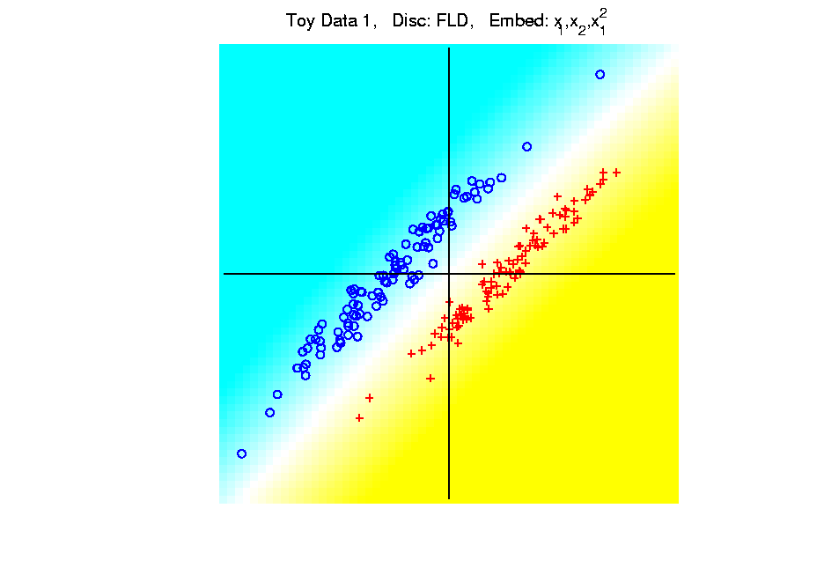
Kernel Embedding
Polynomial Embedding, Toy Example 1:
Parallel Clouds
FLD
Notes:
PEod1Raw.ps

Slide 18
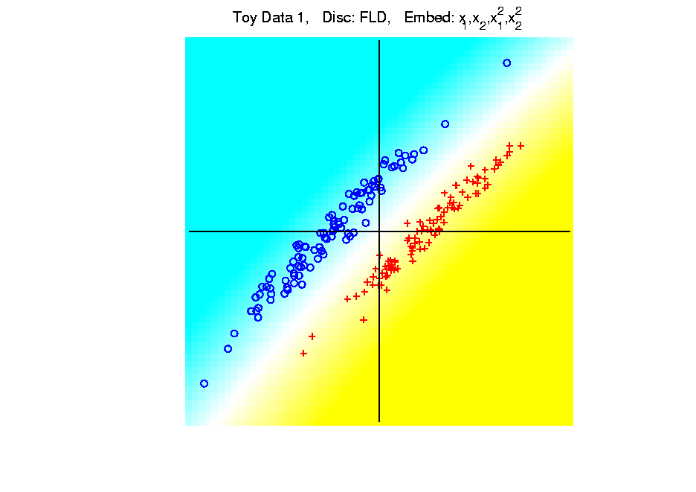
Kernel Embedding
Polynomial Embedding, Toy Example 1:
Parallel Clouds
FLD
Notes:
PEod1Raw.ps

Slide 19
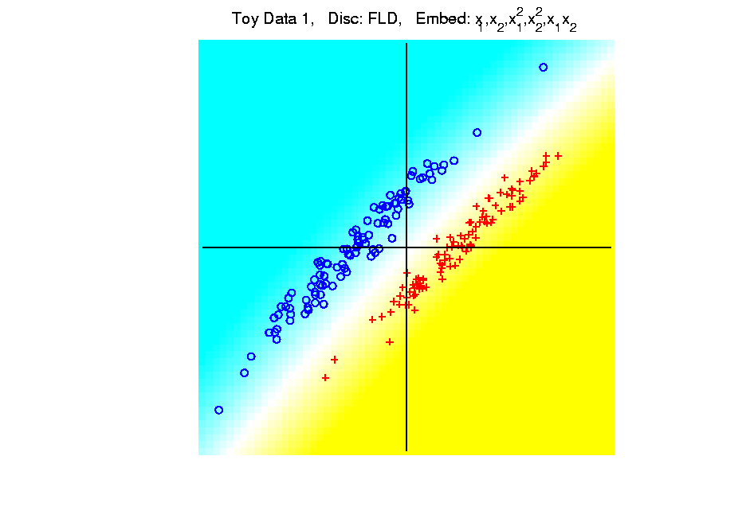
Kernel Embedding
Polynomial Embedding, Toy Example 1:
Parallel Clouds
FLD
Notes:
PEod1Raw.ps

Slide 20
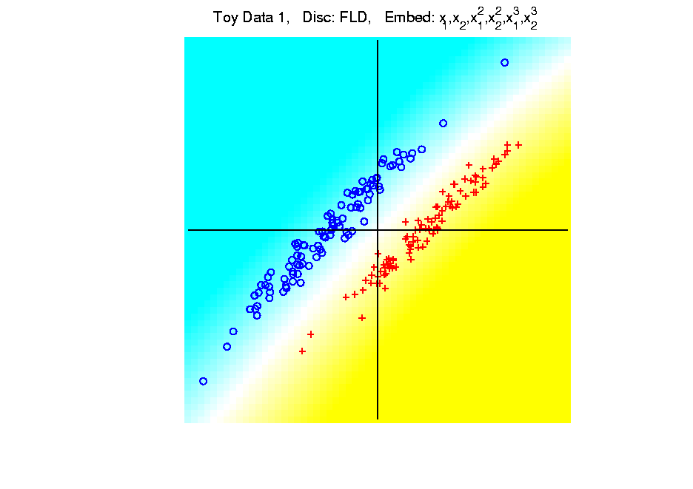
Kernel Embedding
Polynomial Embedding, Toy Example 1:
Parallel Clouds
FLD
All Stable
& Very Good
Since No Better
Separation in
Embedded Space
Notes:
PEod1Raw.ps

Slide 21
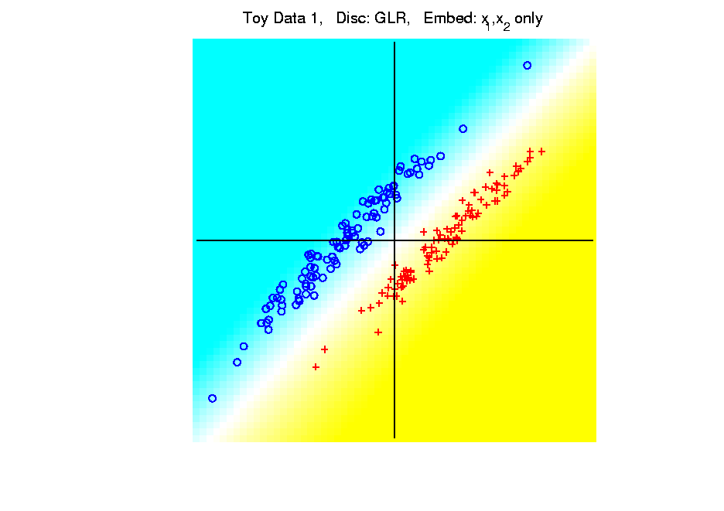
Kernel Embedding
Polynomial Embedding, Toy Example 1:
Parallel Clouds
GLR
Original
Data
Notes:
PEod1Raw.ps

Slide 22
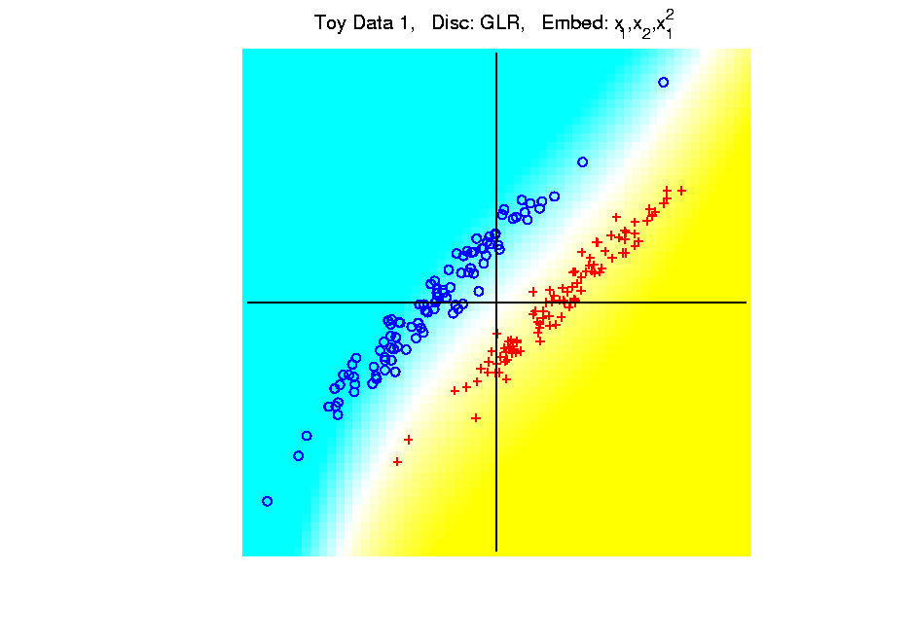
Kernel Embedding
Polynomial Embedding, Toy Example 1:
Parallel Clouds
GLR
Notes:
PEod1Raw.ps

Slide 23
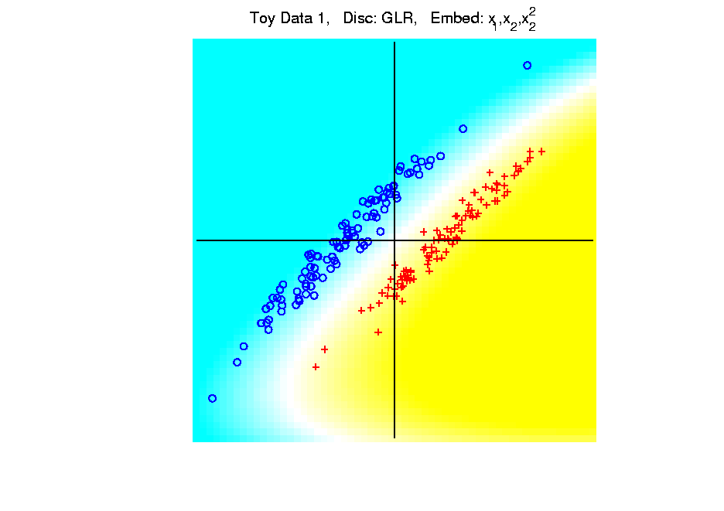
Kernel Embedding
Polynomial Embedding, Toy Example 1:
Parallel Clouds
GLR
Notes:
PEod1Raw.ps

Slide 24
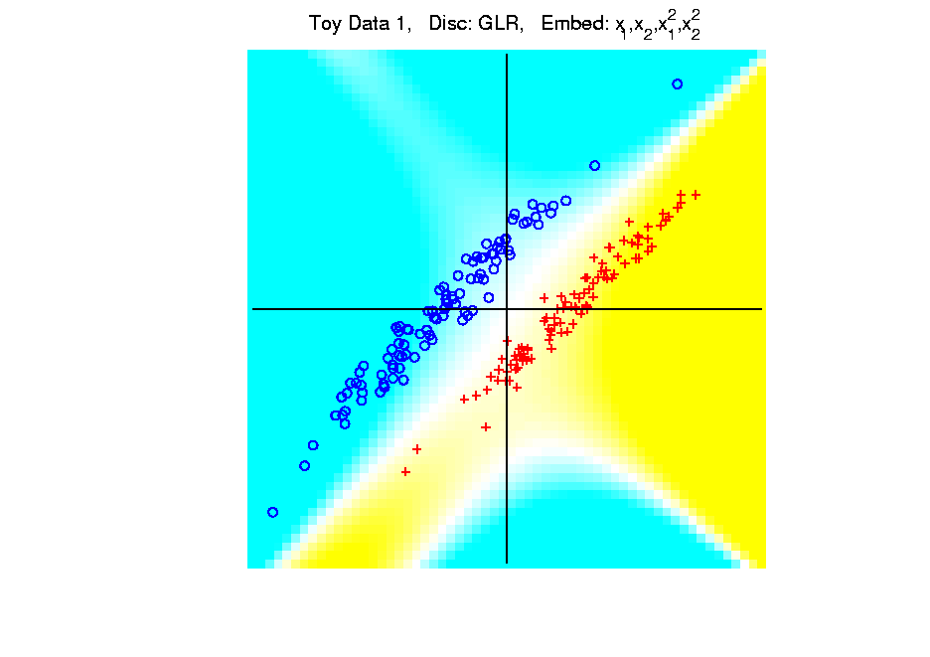
Kernel Embedding
Polynomial Embedding, Toy Example 1:
Parallel Clouds
GLR
Notes:
PEod1Raw.ps

Slide 25
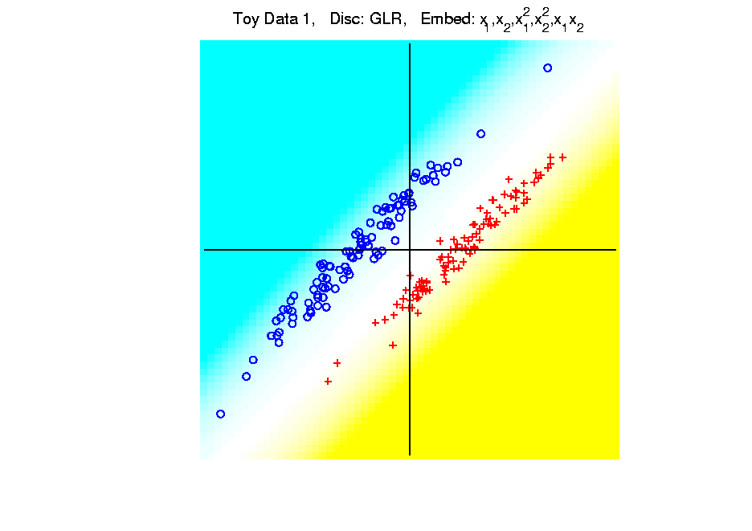
Kernel Embedding
Polynomial Embedding, Toy Example 1:
Parallel Clouds
GLR
Notes:
PEod1Raw.ps

Slide 26
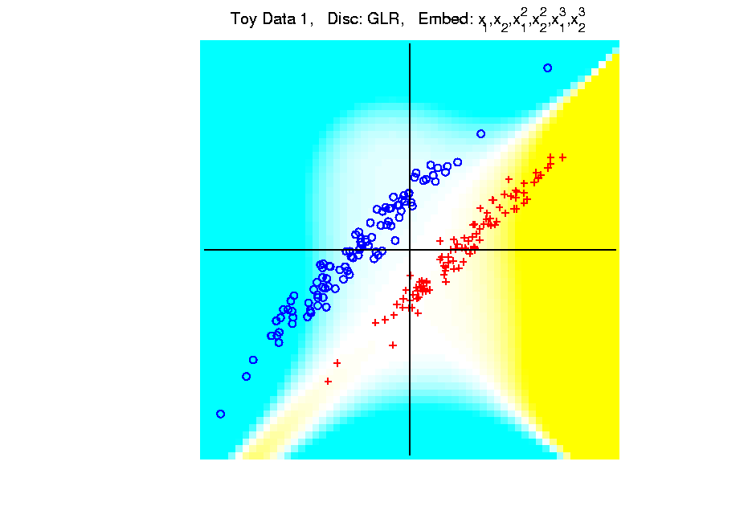
Kernel Embedding
Polynomial Embedding, Toy Example 1:
Parallel Clouds
GLR
Unstable
Subject to
Overfitting
Too Much Flexibility
In Embedded Space
Notes:
PEod1Raw.ps

Slide 27
Kernel Embedding
Polynomial Embedding, Toy Example 2:
Split X
Very Challenging
For Linear
Approaches
Notes:
PEod1Raw.ps

Slide 28
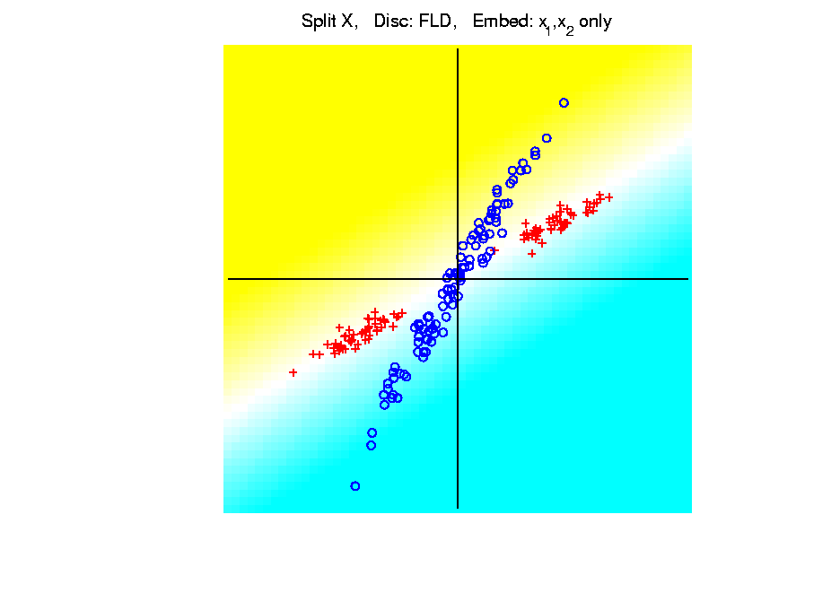
Kernel Embedding
Polynomial Embedding, Toy Example 2:
Split X
FLD
Original
Data
Notes:
PEod1Raw.ps

Slide 29
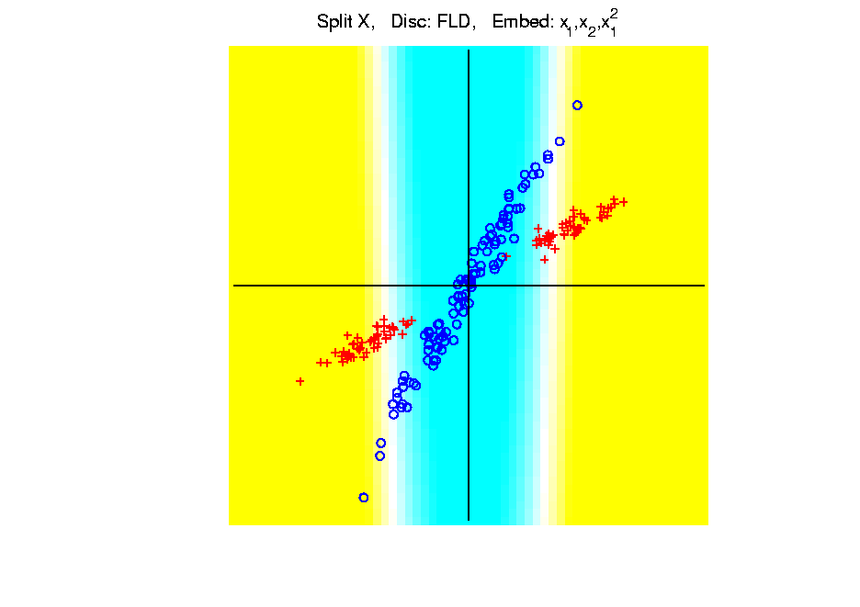
Kernel Embedding
Polynomial Embedding, Toy Example 2:
Split X
FLD
Slightly
Better
Notes:
PEod1Raw.ps

Slide 30
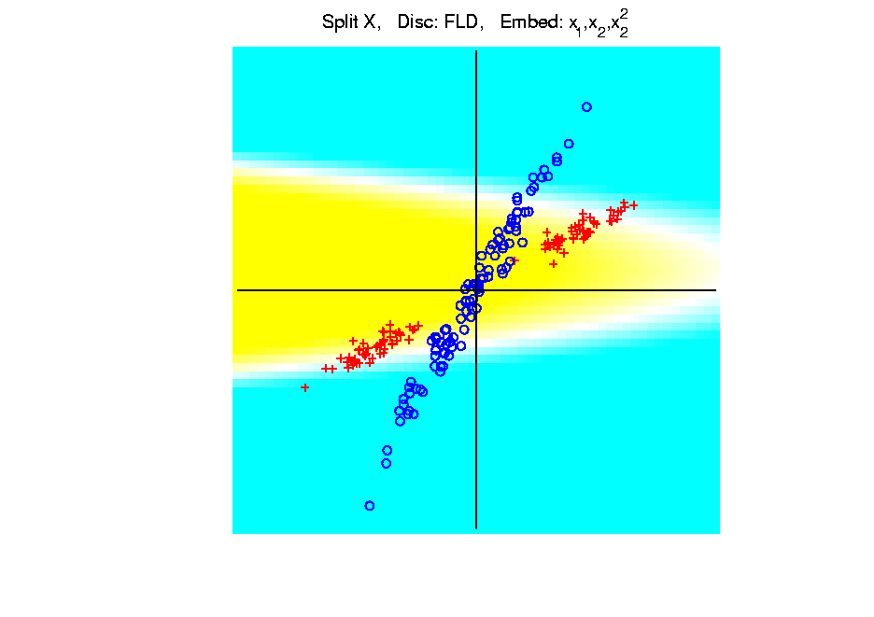
Kernel Embedding
Polynomial Embedding, Toy Example 2:
Split X
FLD
Notes:
PEod1Raw.ps

Slide 31
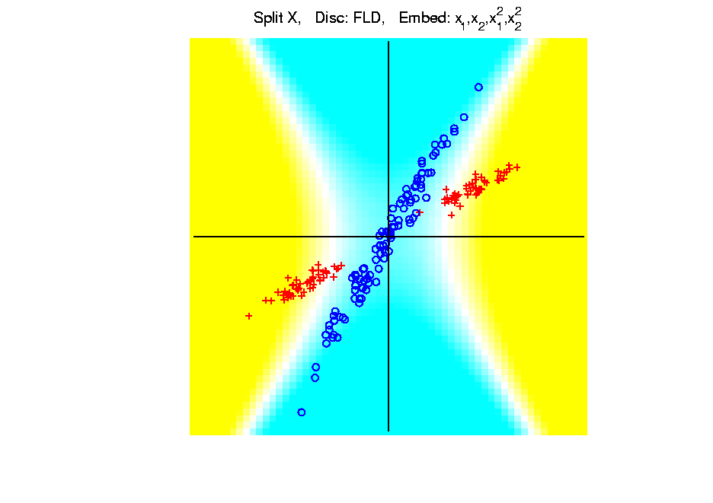
Kernel Embedding
Polynomial Embedding, Toy Example 2:
Split X
FLD
Very Good
Effective
Hyperbola
Notes:
PEod1Raw.ps

Slide 32
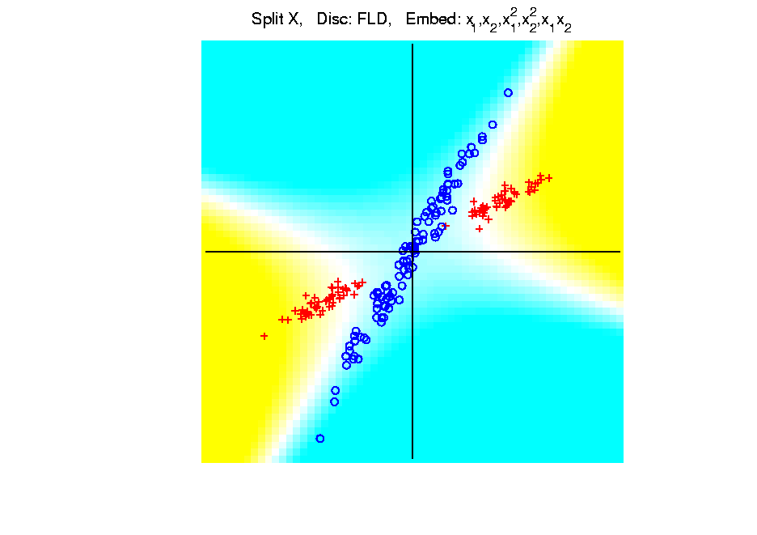
Kernel Embedding
Polynomial Embedding, Toy Example 2:
Split X
FLD
Notes:
PEod1Raw.ps

Slide 33
Kernel Embedding
Polynomial Embedding, Toy Example 2:
Split X
FLD
Robust
Against
Overfitting
Notes:
PEod1Raw.ps

Slide 34
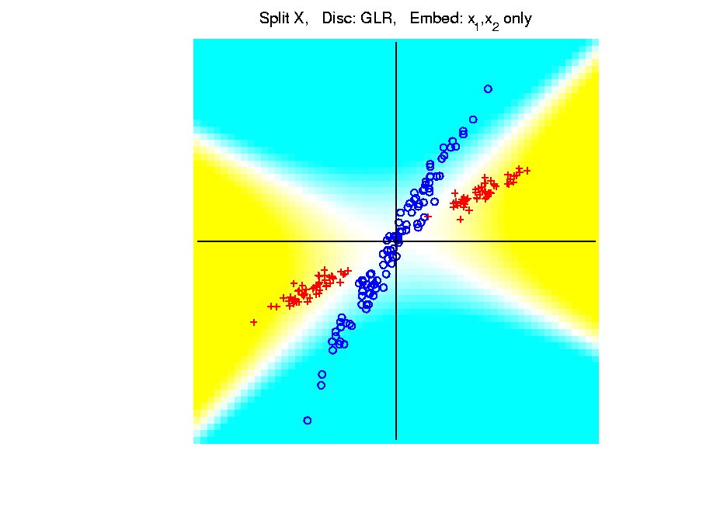
Kernel Embedding
Polynomial Embedding, Toy Example 2:
Split X
GLR
Original
Data
Looks
Very
Good
Notes:
PEod1Raw.ps

Slide 35
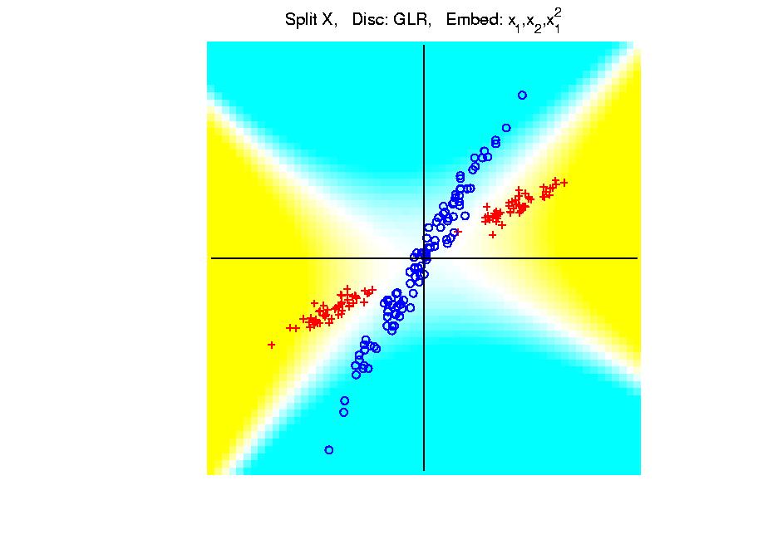
Kernel Embedding
Polynomial Embedding, Toy Example 2:
Split X
GLR
Notes:
PEod1Raw.ps

Slide 36
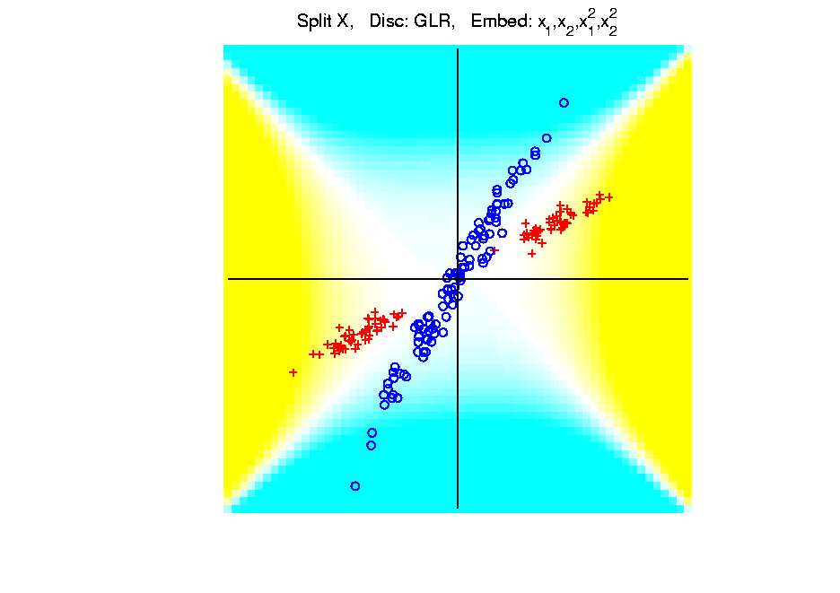
Kernel Embedding
Polynomial Embedding, Toy Example 2:
Split X
GLR
Reasonably
Stable
Never Ellipse
Around Blues
Notes:
PEod1Raw.ps

Slide 37
Kernel Embedding
Polynomial Embedding, Toy Example 3:
Donut
Very Challenging
For Any Linear
Approach
Notes:
PEod1Raw.ps

Slide 38
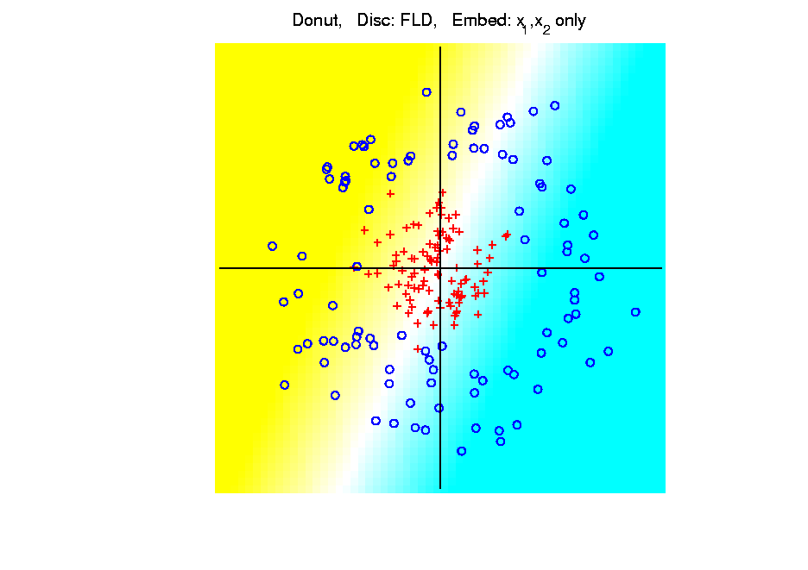
Kernel Embedding
Polynomial Embedding, Toy Example 3:
Donut
FLD
Original
Data
Very
Bad
Notes:
PEod1Raw.ps

Slide 39
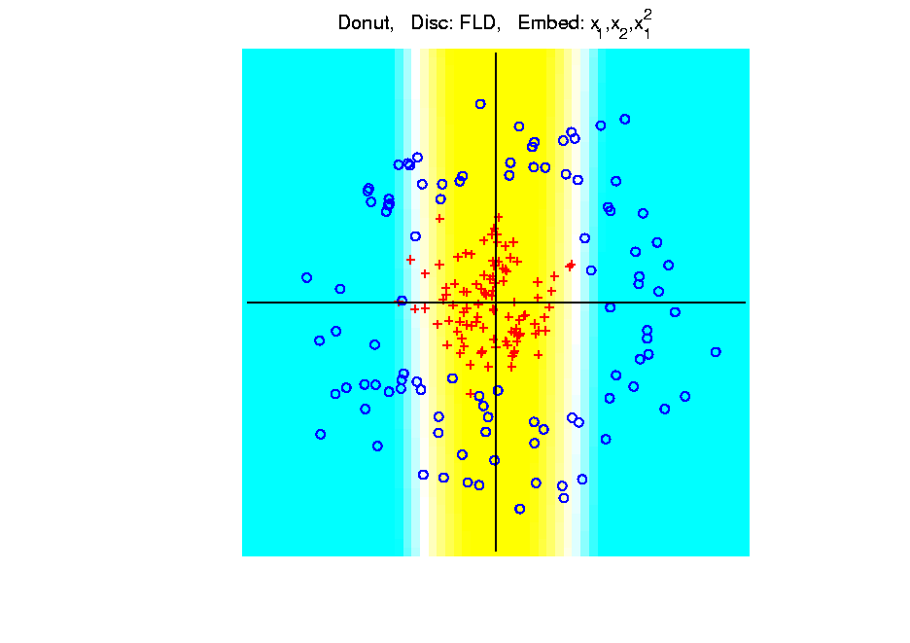
Kernel Embedding
Polynomial Embedding, Toy Example 3:
Donut
FLD
Somewhat
Better
(Parabolic Fold)
Notes:
PEod1Raw.ps

Slide 40
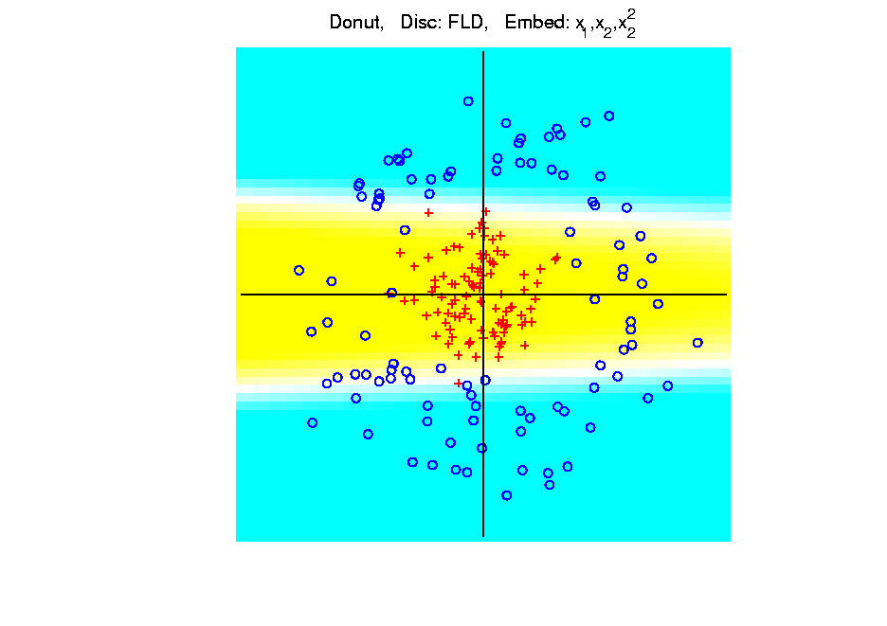
Kernel Embedding
Polynomial Embedding, Toy Example 3:
Donut
FLD
Somewhat
Better
(Other Fold)
Notes:
PEod1Raw.ps

Slide 41
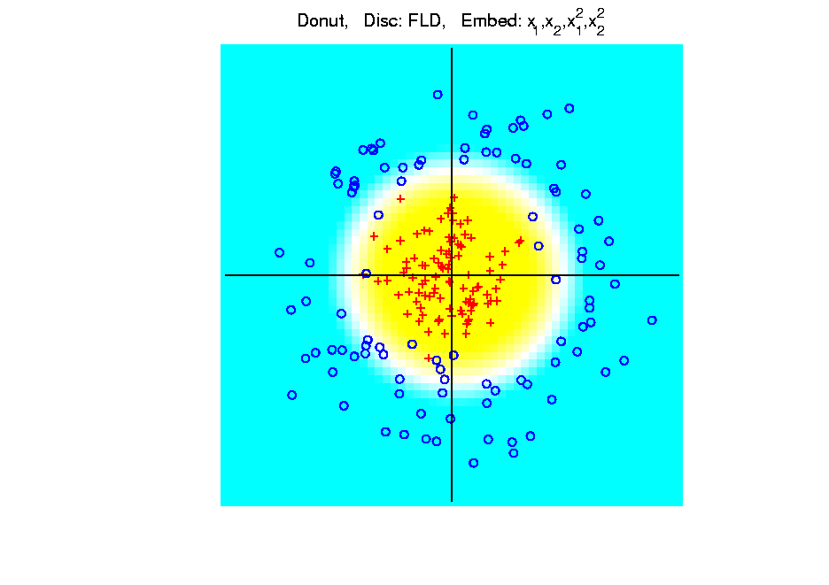
Kernel Embedding
Polynomial Embedding, Toy Example 3:
Donut
FLD
Good
Performance
(Slice of
Paraboloid)
Notes:
PEod1Raw.ps

Slide 42
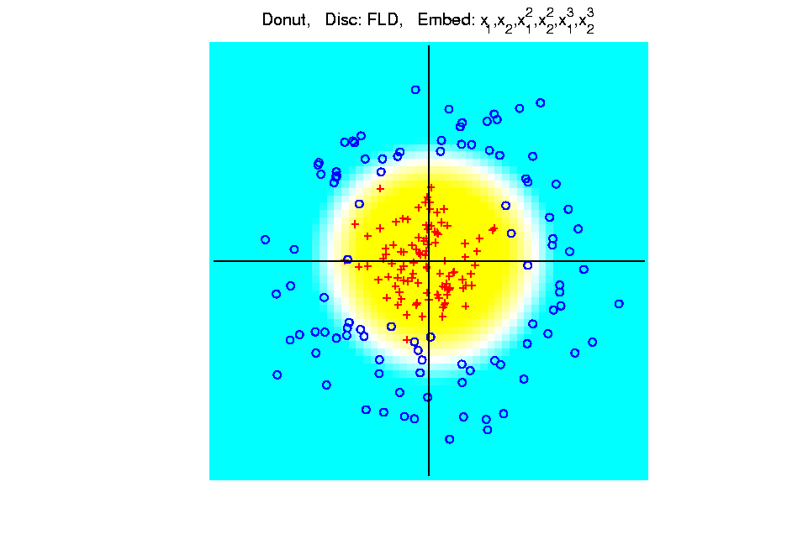
Kernel Embedding
Polynomial Embedding, Toy Example 3:
Donut
FLD
Robust
Against
Overfitting
Notes:
PEod1Raw.ps

Slide 43
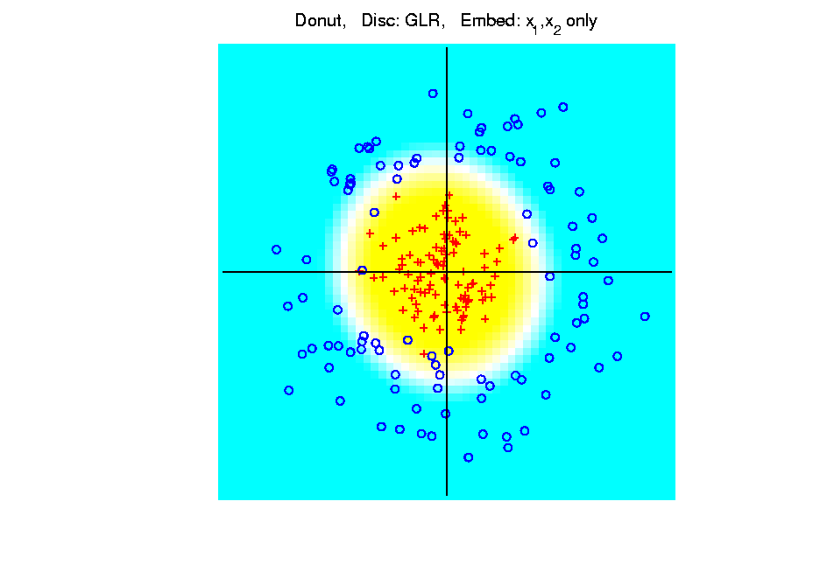
Kernel Embedding
Polynomial Embedding, Toy Example 3:
Donut
GLR
Original
Data
Best With
No Embedding?
Notes:
PEod1Raw.ps

Slide 44
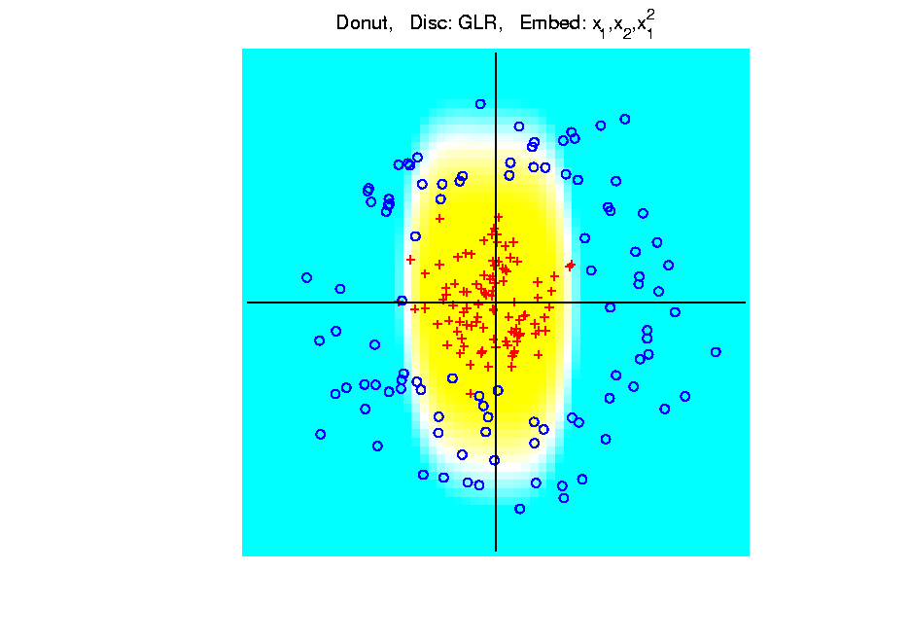
Kernel Embedding
Polynomial Embedding, Toy Example 3:
Donut
GLR
Notes:
PEod1Raw.ps

Slide 45
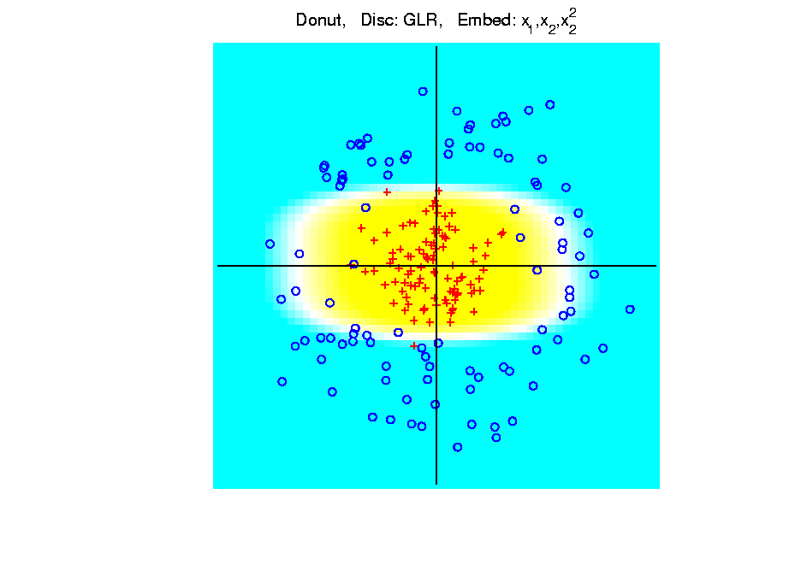
Kernel Embedding
Polynomial Embedding, Toy Example 3:
Donut
GLR
Notes:
PEod1Raw.ps

Slide 46
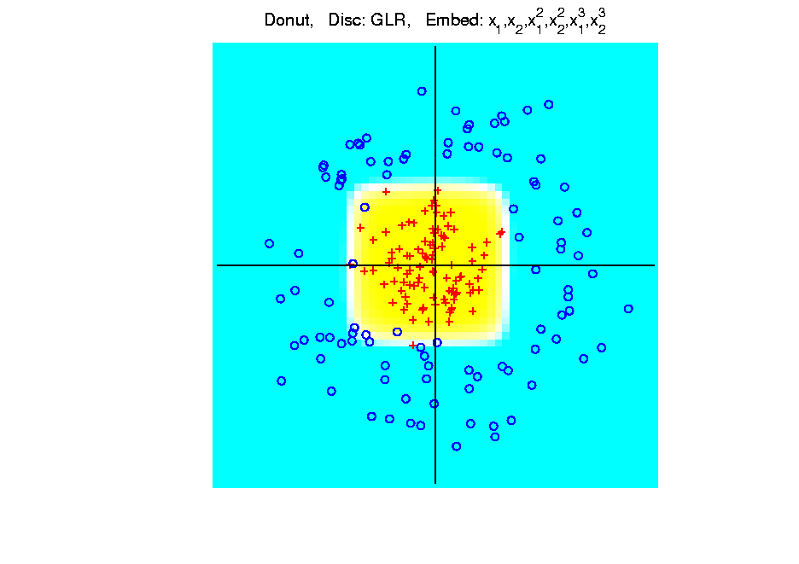
Kernel Embedding
Polynomial Embedding, Toy Example 3:
Donut
GLR
Overfitting
Gives Square
Shape?
Notes:
PEod1Raw.ps

Slide 47
Kernel Embedding
Drawbacks to polynomial embedding:
Too many extra terms create spurious structure
i.e. have “overfitting”
Too much flexibility
HDLSS problems typically get worse

Slide 48
Kernel Embedding
Important Variation: “Kernel Machines”
Idea: replace polynomials by
other nonlinear functions
e.g. 1: sigmoid functions from neural nets
e.g. 2: radial basis functions
Gaussian kernels
Related to “kernel density estimation”
(study more later)

Slide 49
Kernel Embedding
Radial Basis Functions:
Note: there are several ways to embed:
Naïve Embedding (equally spaced grid)
Explicit Embedding (evaluate at data)
Implicit Embedding (inner prod. based)
(everybody currently does the latter)

Slide 50
Kernel Embedding
Naïve Embedding, Radial basis functions:
At some “grid points” ${\underline{g}}_{1}⋯,{\underline{g}}_{k}$,
For a “bandwidth” (i.e. standard dev’n) $σ$,
Consider ($d$ dim’al) functions:
$$φ_{σ}\left(\underline{x}−{\underline{g}}_{1}\right),⋯,φ_{σ}\left(\underline{x}−{\underline{g}}_{k}\right)$$
Standard Normal Probability Density

Slide 51
Kernel Embedding
Naïve Embedding, Radial basis functions:
At some “grid points” ${\underline{g}}_{1}⋯,{\underline{g}}_{k}$,
For a “bandwidth” (i.e. standard dev’n) $σ$,
Consider ($d$ dim’al) functions:
$$φ_{σ}\left(\underline{x}−{\underline{g}}_{1}\right),⋯,φ_{σ}\left(\underline{x}−{\underline{g}}_{k}\right)$$
Replace data matrix with:

Slide 52
Kernel Embedding
Naïve Embedding, Radial basis functions:
For discrimination: work in radial basis space, With new data vector ${\underline{X}}_{0}$,
represented by: $\left(\begin{matrix}φ_{σ}\left({\underline{X}}_{0}−{\underline{g}}_{1}\right) \\ ⋮ \\ φ_{σ}\left({\underline{X}}_{0}−{\underline{g}}_{k}\right)\end{matrix}\right)$

Slide 53
Kernel Embedding
Naïve Embedd’g, Toy E.g. 1: Parallel Clouds
Good
at data
Poor
outside

Slide 54
Kernel Embedding
Naïve Embedd’g, Toy E.g. 2: Split X
OK at
data
Strange
outside

Slide 55
Kernel Embedding
Naïve Embedd’g, Toy E.g. 3: Donut
Mostly
good
Slight
mistake
for one
kernel

Slide 56
Kernel Embedding
Naïve Embedding, Radial basis functions:
Toy Example, Main lessons:
Generally good in regions with data,
Unpredictable where data are sparse

Slide 57
Kernel Embedding
Toy Example 4: Checkerboard
Very
Challenging!
Linear
Method?
Polynomial
Embedding?
Notes:
PEod1Raw.ps

Slide 58
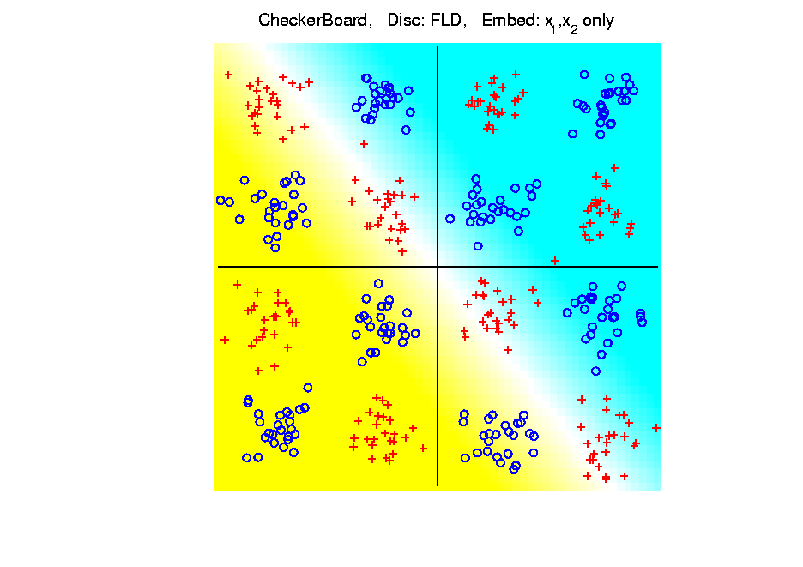
Kernel Embedding
Toy Example 4: Checkerboard
Very
Challenging!
FLD
Linear Is
Hopeless
Notes:
PEod1Raw.ps

Slide 59
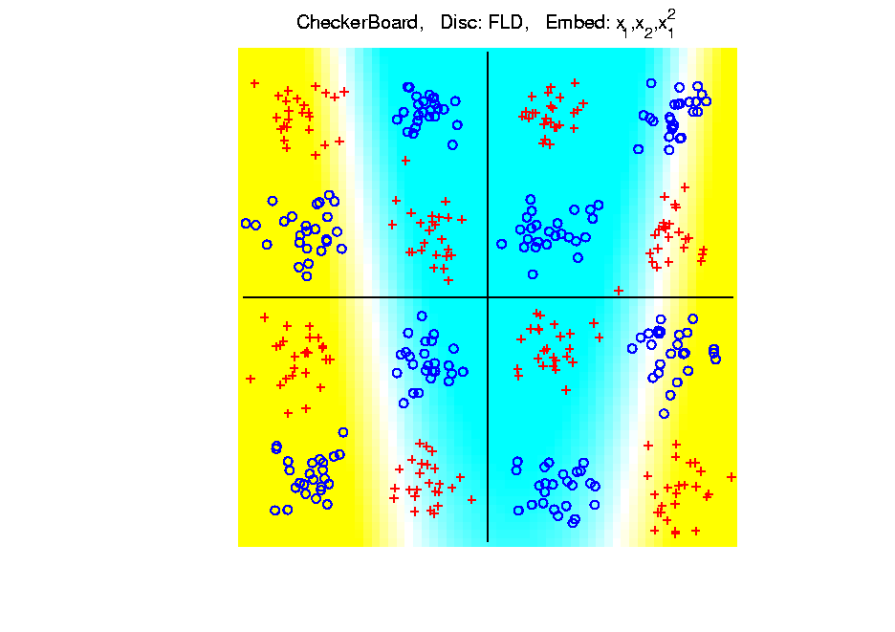
Kernel Embedding
Toy Example 4: Checkerboard
Very
Challenging!
FLD
Notes:
PEod1Raw.ps

Slide 60
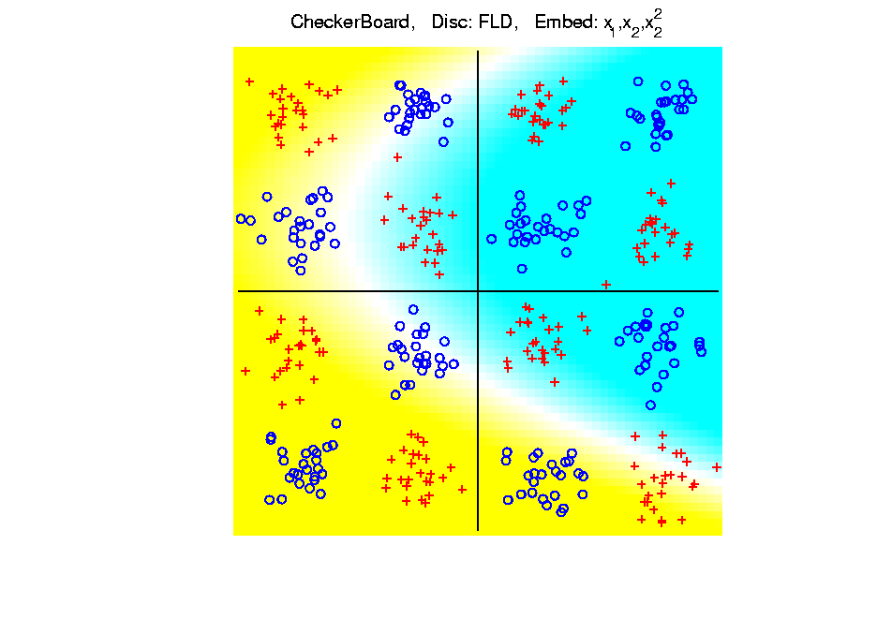
Kernel Embedding
Toy Example 4: Checkerboard
Very
Challenging!
FLD
Notes:
PEod1Raw.ps

Slide 61
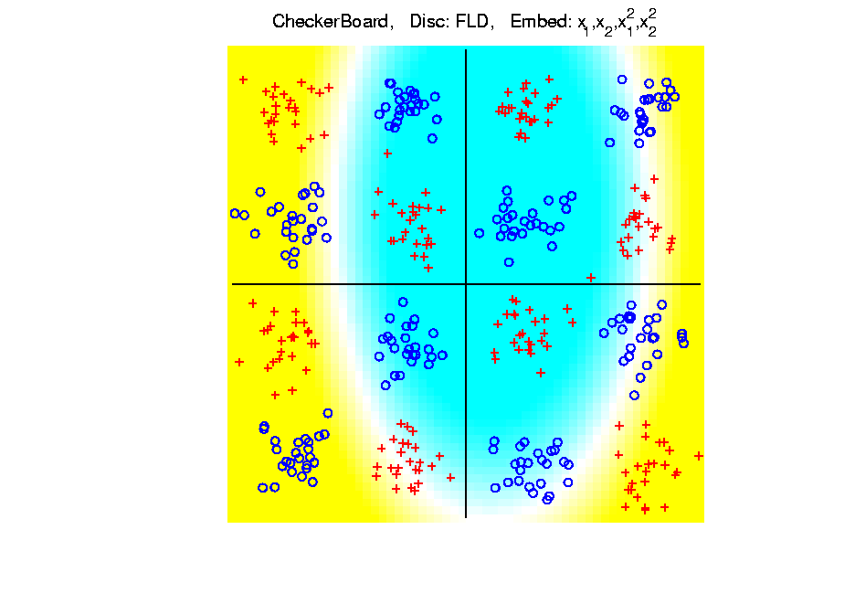
Kernel Embedding
Toy Example 4: Checkerboard
Very
Challenging!
FLD
Notes:
PEod1Raw.ps

Slide 62
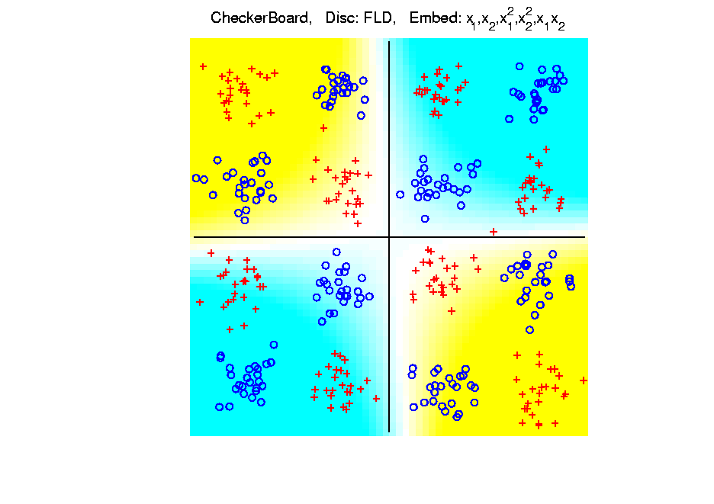
Kernel Embedding
Toy Example 4: Checkerboard
Very
Challenging!
FLD
Notes:
PEod1Raw.ps

Slide 63
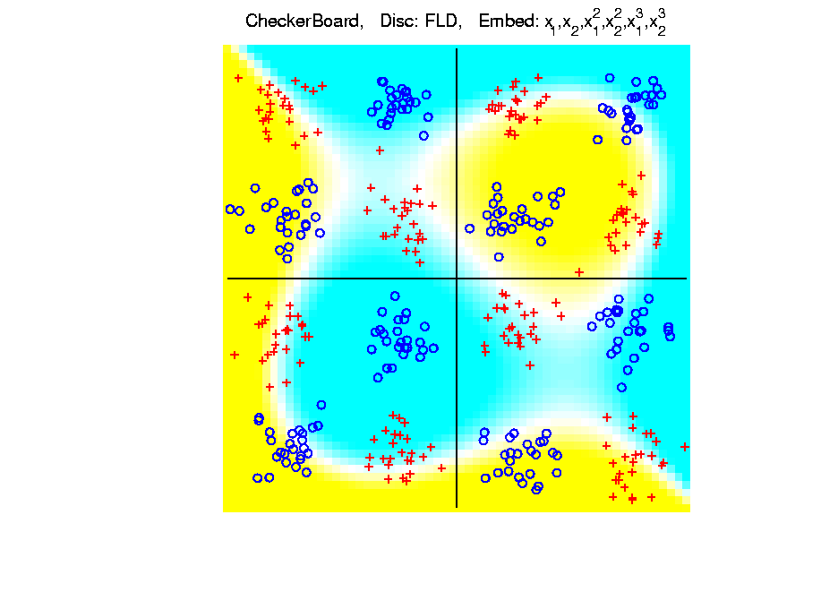
Kernel Embedding
Toy Example 4: Checkerboard
Very
Challenging!
FLD
Embedding
Gets Better
But Still
Not Great
Notes:
PEod1Raw.ps

Slide 64
Kernel Embedding
Toy Example 4: Checkerboard
Very
Challenging!
Polynomials
Don’t Have
Needed
Flexiblity
Notes:
PEod1Raw.ps

Slide 65
Kernel Embedding
Toy Example 4: Checkerboard
Radial
Basis
Embedding
+ FLD
Is
Excellent!
Notes:
PEod1Raw.ps

Slide 66
Kernel Embedding
Drawbacks to naïve embedding:
Equally spaced grid too big in high $d$
Not computationally tractable $\left(g^{d}\right)$
Approach:
Evaluate only at data points
Not on full grid
But where data live

Slide 67
Kernel Embedding
Other types of embedding:
Explicit
Implicit
Will be studied soon, after
introduction to Support Vector Machines…

Slide 68
Kernel Embedding
$∃$ generalizations of this idea to other types of analysis
& some clever computational ideas.
E.g. “Kernel based, nonlinear Principal Components Analysis”
Ref: Schölkopf, Smola and Müller (1998)

Slide 69
Support Vector Machines
Motivation:
Find a linear method that “works well”
for embedded data
Note: Embedded data are
very non-Gaussian
Classical Statistics: “Use Prob. Dist’n”
Looks Hopeless

Slide 70
Support Vector Machines
Motivation:
Find a linear method that “works well”
for embedded data
Note: Embedded data are
very non-Gaussian
Suggests value of
really new approach

Slide 71
Support Vector Machines
Classical References:
Vapnik (1982)
Boser, Guyon & Vapnik (1992)
Vapnik (1995)

Slide 72
Support Vector Machines
Recommended tutorial:
Burges (1998)
Early Monographs:
Cristianini & Shawe-Taylor (2000)
Schölkopf & Smola (2002)
More Recent Monographs:
Hastie et al (2005)
Bishop (2006)

Slide 73
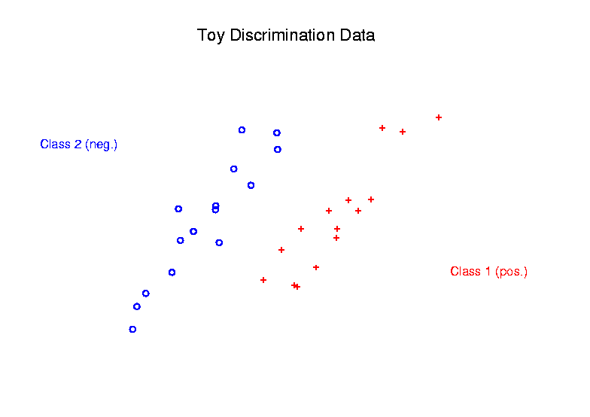
Support Vector Machines
Graphical View, using Toy Example:

Slide 74
Support Vector Machines
Graphical View, using Toy Example:
Find separating plane
To maximize distances from data to plane

Slide 75
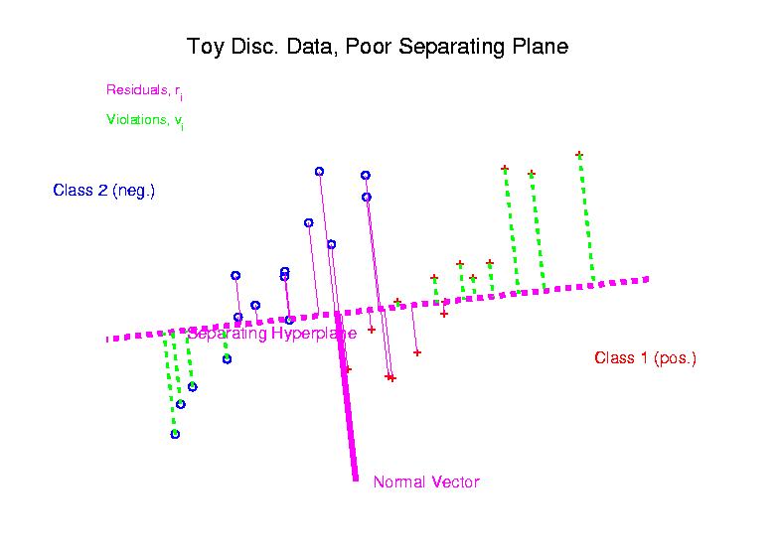
Support Vector Machines
Graphical View, using Toy Example:

Slide 76
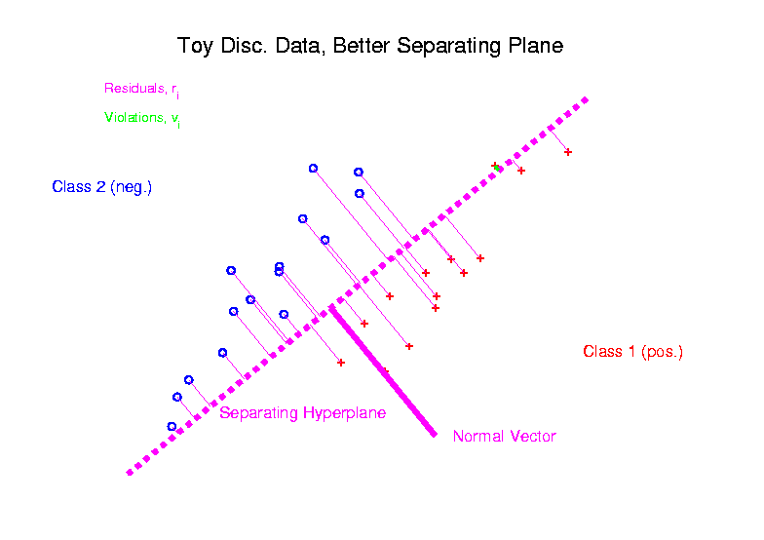
Support Vector Machines
Graphical View, using Toy Example:

Slide 77
Support Vector Machines
Graphical View, using Toy Example:
Find separating plane
To maximize distances from data to plane
In particular smallest distance

Slide 78
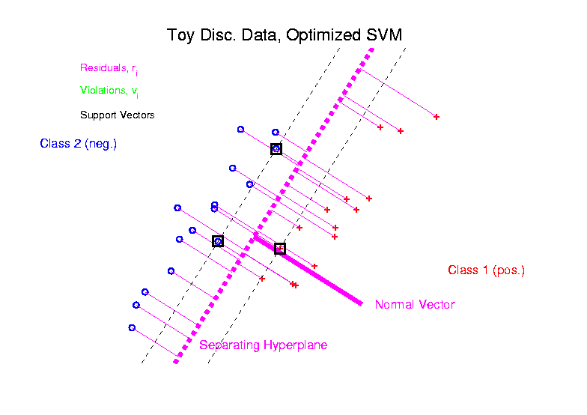
Support Vector Machines
Graphical View, using Toy Example:

Slide 79
Support Vector Machines
Graphical View, using Toy Example:
Find separating plane
To maximize distances from data to plane
In particular smallest distance
Data points closest are called
support vectors
Gap between is called margin
Caution: For some “margin” is different

Slide 80
SVMs, Optimization Viewpoint
Formulate Optimization problem, based on:
Data (feature) vectors $x_{1},⋯,x_{n}$
Class Labels $y_{i}=±1$
Normal Vector $w$
Location (determines intercept) $b$
Residuals (right side) $r_{i}=y_{i}\left({x_{i}}^{t}w+b\right)$
Residuals (wrong side) $ξ_{i}=−r_{i}$
Solve (convex problem) by quadratic programming

Slide 81
SVMs, Optimization Viewpoint
Lagrange Multipliers primal formulation (separable case):
Minimize:
Where are Lagrange multipliers

Slide 82
SVMs, Optimization Viewpoint
Lagrange Multipliers primal formulation (separable case):
Minimize:
Where are Lagrange multipliers
Notation: “dot product” = inner product
Elsewhere: $u∙v= \left\langle u,v\right\rangle =u^{t}v$

Slide 83
SVMs, Optimization Viewpoint
Lagrange Multipliers primal formulation (separable case):
Minimize:
Where are Lagrange multipliers
Dual Lagrangian version:
Maximize:

Slide 84
SVMs, Optimization Viewpoint
Lagrange Multipliers primal formulation (separable case):
Minimize:
Where are Lagrange multipliers
Dual Lagrangian version:
Maximize:
Get classification function:

Slide 85
SVMs, Optimization Viewpoint
Get classification function:

Slide 86
SVMs, Optimization Viewpoint
Get classification function:
Choose Class:
+1, when $f\left(x\right)>0$
-1, when $f\left(x\right)<0$

Slide 87
SVMs, Optimization Viewpoint
Get classification function:
Choose Class:
+1, when $f\left(x\right)>0$
-1, when $f\left(x\right)<0$
Note: linear function of $x$
i.e. have found separating hyperplane

Slide 88
SVMs, Computation
Major Computational Point:
Classifier only depends on data through inner products!

Slide 89
SVMs, Computation
Major Computational Point:
Classifier only depends on data through inner products!
Thus enough to only store inner products
Creates big savings in optimization
Especially for HDLSS data
But also creates variations in kernel embedding (interpretation?!?)
This is almost always done in practice

Slide 90
SVMs, Comput’n & Embedding
For an “Embedding Map”,
e.g.
Explicit Embedding

Slide 91
SVMs, Comput’n & Embedding
For an “Embedding Map”,
e.g.
Explicit Embedding:
Maximize:

Slide 92
SVMs, Comput’n & Embedding
For an “Embedding Map”,
e.g.
Explicit Embedding:
Maximize:
Get classification function:
Straightforward application of embedding
But loses inner product advantage

Slide 93
SVMs, Comput’n & Embedding
Implicit Embedding:
Maximize:

Slide 94
SVMs, Comput’n & Embedding
Implicit Embedding:
Maximize:
Note Difference from Explicit Embedding:

Slide 95
SVMs, Comput’n & Embedding
Implicit Embedding:
Maximize:
Get classification function:
Still defined only via inner products
Retains optimization advantage
Thus used very commonly
Comparison to explicit embedding?
Which is “better”???

Slide 96
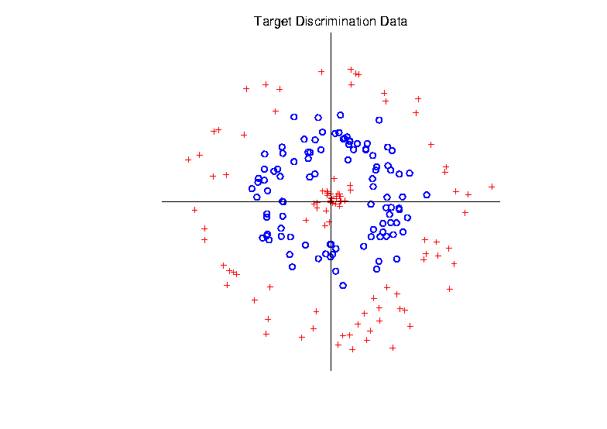
Support Vector Machines
Target Toy Data set:

Slide 97
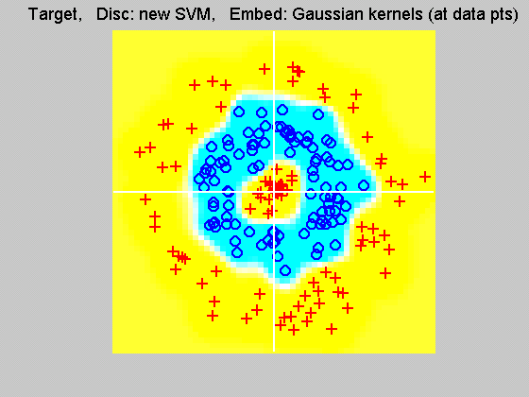
Support Vector Machines
Explicit Embedding, window σ = 0.1:
Gaussian
Kernel,
i.e.
Radial
Basis
Function

Slide 98
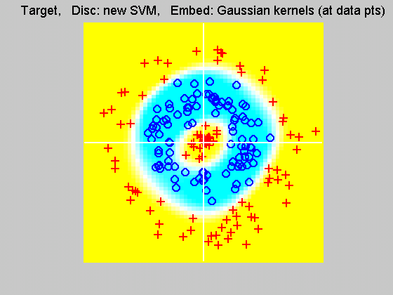
Support Vector Machines
Explicit Embedding, window σ = 1:
Pretty Big
Change
(Factor
of 10)

Slide 99
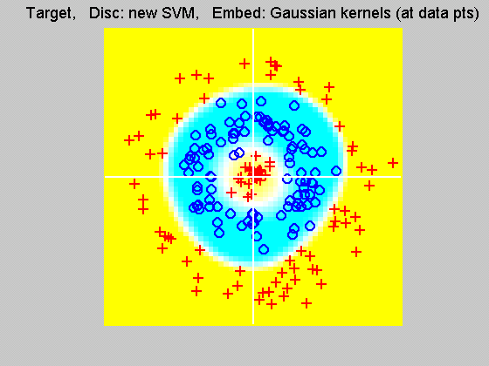
Support Vector Machines
Explicit Embedding, window σ = 10:
Not Quite
As Good
???

Slide 100
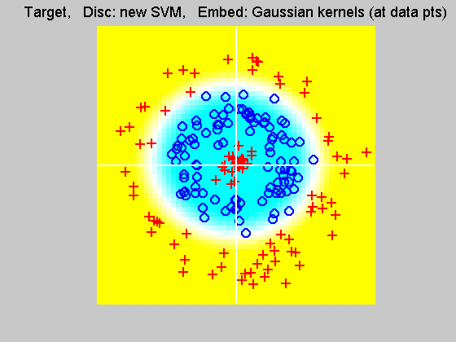
Support Vector Machines
Explicit Embedding, window σ = 100:
Note: Lost Center
(Over- Smoothed)

Slide 101
Support Vector Machines
Notes on Explicit Embedding:
Too small → Poor generalizability
Too big → miss important regions
Classical lessons from kernel smoothing
Surprisingly large “reasonable region”
I.e. parameter less critical (sometimes?)

Slide 102
Support Vector Machines
Interesting Alternative Viewpoint:
Study Projections
In Kernel Space
(Never done in Machine Learning World)

Slide 103
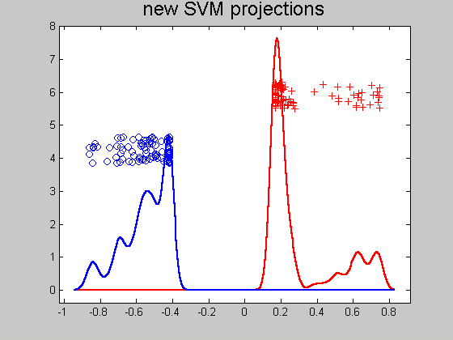
Support Vector Machines
Kernel space projection, window σ = 0.1:
Note:
Data
Piling
At
Margin

Slide 104
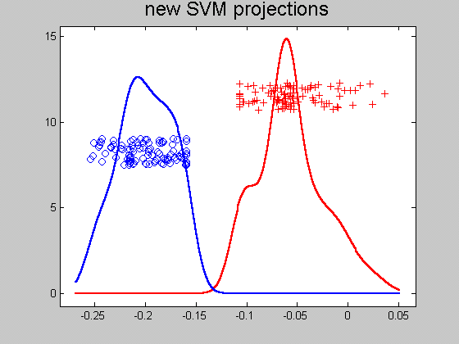
Support Vector Machines
Kernel space projection, window σ = 1:
Excellent
Separation
(but less
than σ = 0.1)

Slide 105
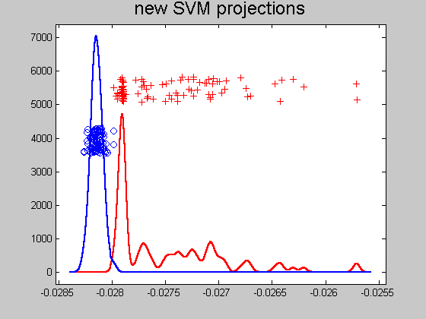
Support Vector Machines
Kernel space projection, window σ = 10:
Still Good
(But Some
Overlap)

Slide 106
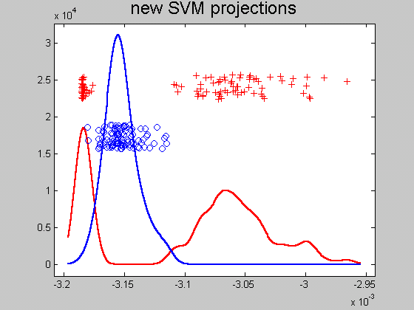
Support Vector Machines
Kernel space projection, window σ = 100:
Some Reds
On Wrong
Side
(Missed
Center)

Slide 107
Support Vector Machines
Notes on Kernel space projection:
Too small $σ$ →
Great separation
But recall, poor generalizability
Too big $σ$ → no longer separable
As above:
Classical lessons from kernel smoothing
Surprisingly large “reasonable region”
I.e. parameter less critical (sometimes?)
Also explore projections (in kernel space)

Slide 108
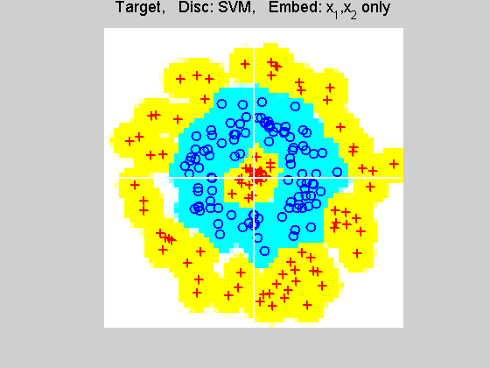
Support Vector Machines
Implicit Embedding, window σ = 0.1:

Slide 109
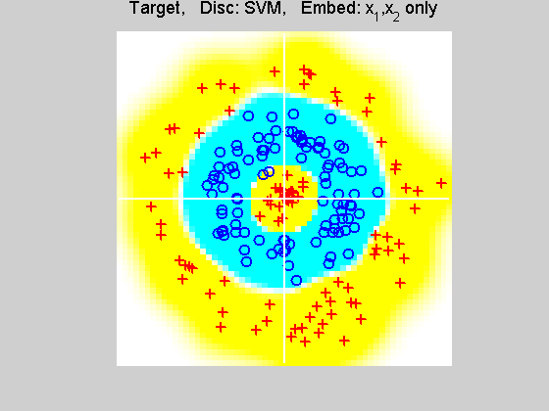
Support Vector Machines
Implicit Embedding, window σ = 0.5:

Slide 110
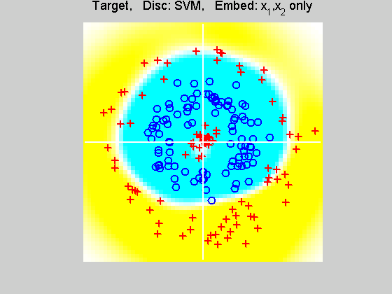
Support Vector Machines
Implicit Embedding, window σ = 1:

Slide 111
Support Vector Machines
Implicit Embedding, window σ = 10:

Slide 112
Support Vector Machines
Notes on Implicit Embedding:
Similar Large vs. Small lessons
Range of “reasonable results”
Seems to be smaller
(note different range of windows)
Much different “edge” behavior
Interesting topic for future work…

Slide 113
SVMs & Robustness
Usually not severely affected by outliers,
But a possible weakness:
Can have very influential points
Toy E.g., only 2 points drive SVM

Slide 114
SVMs & Robustness
Can have very influential points

Slide 115
SVMs & Robustness
Usually not severely affected by outliers,
But a possible weakness:
Can have very influential points
Toy E.g., only 2 points drive SVM
Notes:
Huge range of chosen hyperplanes
But all are “pretty good discriminators”
Only happens when whole range is OK???
Good or bad?

Slide 116
SVMs & Robustness
Effect of violators:

