Slide 1
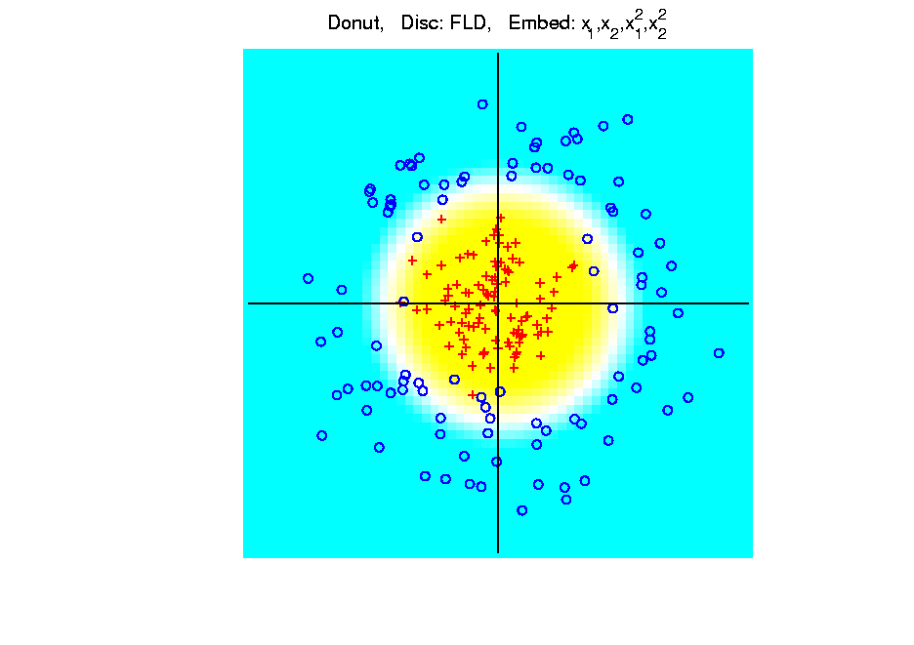
Kernel Embedding
Polynomial Embedding, Toy Example 3:
Donut
FLD
Good
Performance
(Slice of
Paraboloid)
Notes:
PEod1Raw.ps

Slide 2
Kernel Embedding
Drawbacks to polynomial embedding:
Too many extra terms create spurious structure
i.e. have “overfitting”
Too much flexibility
HDLSS problems typically get worse

Slide 3
Kernel Embedding
Important Variation: “Kernel Machines”
Idea: replace polynomials by
other nonlinear functions
e.g. 1: sigmoid functions from neural nets
e.g. 2: radial basis functions
Gaussian kernels
Related to “kernel density estimation”
(study more later)

Slide 4
Kernel Embedding
Radial Basis Functions:
Note: there are several ways to embed:
Naïve Embedding (equally spaced grid)
Explicit Embedding (evaluate at data)
Implicit Embedding (inner prod. based)
(everybody currently does the latter)

Slide 5
Kernel Embedding
Naïve Embedding, Radial basis functions:
Toy Example, Main lessons:
Generally good in regions with data,
Unpredictable where data are sparse

Slide 6
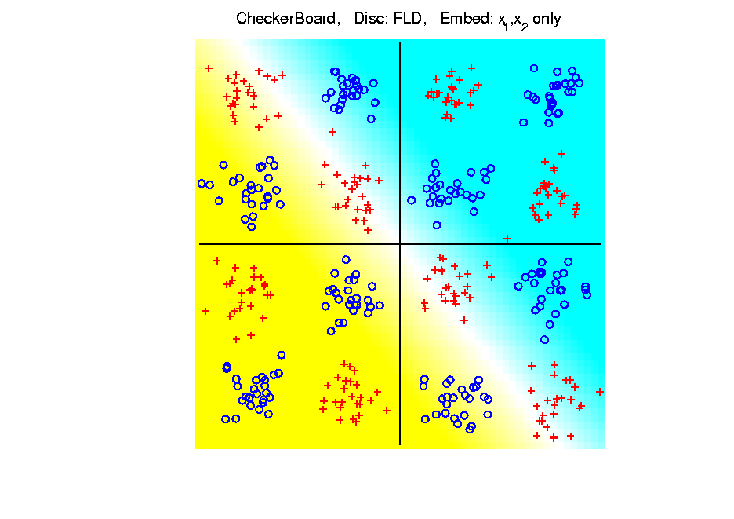
Kernel Embedding
Toy Example 4: Checkerboard
Very
Challenging!
FLD
Linear Is
Hopeless
Notes:
PEod1Raw.ps

Slide 7
Kernel Embedding
Toy Example 4: Checkerboard
Radial
Basis
Embedding
+ FLD
Is
Excellent!
Notes:
PEod1Raw.ps

Slide 8
Kernel Embedding
Drawbacks to naïve embedding:
Equally spaced grid too big in high $d$
Not computationally tractable $\left(g^{d}\right)$
Approach:
Evaluate only at data points
Not on full grid
But where data live

Slide 9
Support Vector Machines
Motivation:
Find a linear method that “works well”
for embedded data
Note: Embedded data are
very non-Gaussian
Classical Statistics: “Use Prob. Dist’n”
Looks Hopeless

Slide 10
Support Vector Machines
Motivation:
Find a linear method that “works well”
for embedded data
Note: Embedded data are
very non-Gaussian
Suggests value of
really new approach

Slide 11
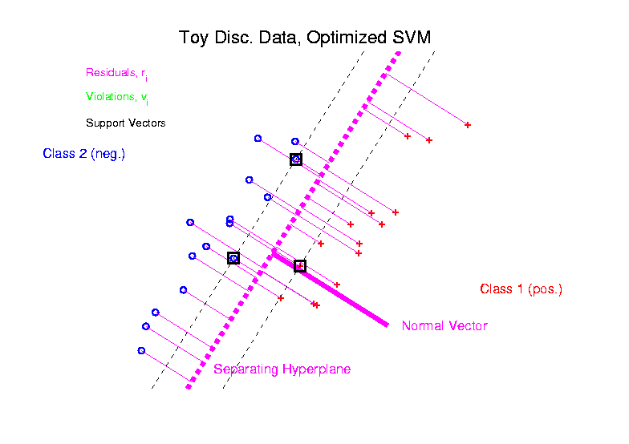
Support Vector Machines
Graphical View, using Toy Example:

Slide 12
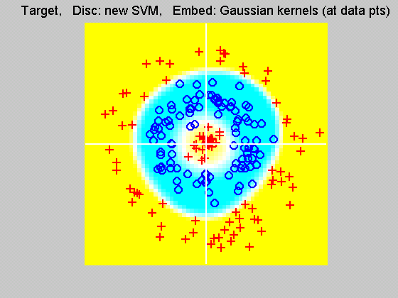
Support Vector Machines
Explicit Embedding, window σ = 10:
Not Quite
As Good
???

Slide 13
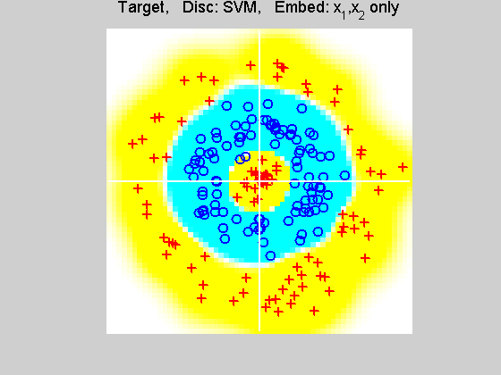
Support Vector Machines
Implicit Embedding, window σ = 0.5:

Slide 14
SVMs, Tuning Parameter
Recall Regularization Parameter C:
Controls penalty for violation
I.e. lying on wrong side of plane
Appears in slack variables
Affects performance of SVM
Toy Example:
d = 50, Spherical Gaussian data

Slide 15
SVMs, Tuning Parameter
Toy Example: d = 50, Sph’l Gaussian data

Slide 16
SVMs, Tuning Parameter
Toy Example:
d = 50, Spherical Gaussian data
X=Axis: Opt. Dir’n Other: SVM Dir’n
Small C:
Where is the margin?
Small angle to optimal (generalizable)
Large C:
More data piling
Larger angle (less generalizable)
Bigger gap (but maybe not better???)
Between: Very small range

Slide 17
SVMs, Tuning Parameter
Toy Example: d = 50, Sph’l Gaussian data
Put MD on horizontal axis

Slide 18
SVMs, Tuning Parameter
Toy Example:
d = 50, Spherical Gaussian data
Careful look at small C:
Put MD on horizontal axis
Shows SVM and MD same for C small
Mathematics behind this?
Separates for large C
No data piling for MD

Slide 19
Support Vector Machines
Important Extension:
Multi-Class SVMs
Hsu & Lin (2002)
Lee, Lin, & Wahba (2002)
Defined for “implicit” version
“Direction Based” variation???

Slide 20
Distance Weighted Discrim’n
Improvement of SVM for HDLSS Data
Toy e.g.
$d=50$
indep. $N\left(0,1\right)$
$μ_{1}=±2$
$n_{+}=n_{−}=20$
(similar to
earlier movie)

Slide 21
Distance Weighted Discrim’n
Toy e.g.: Maximal Data Piling Direction
- Perfect
Separation
- Gross
Overfitting
- Large Angle
- Poor
Gen’ability
MDP

Slide 22
Distance Weighted Discrim’n
Toy e.g.: Support Vector Machine Direction
- Bigger Gap
- Smaller Angle
- Better
Gen’ability
- Feels support
vectors too
strongly???
- Ugly subpops?
- Improvement?

Slide 23
Distance Weighted Discrim’n
Toy e.g.: Distance Weighted Discrimination
- Addresses
these issues
- Smaller Angle
- Better
Gen’ability
- Nice subpops
- Replaces
min dist. by
avg. dist.

Slide 24
Distance Weighted Discrim’n
Based on Optimization Problem:
For “Residuals”:

Slide 25
Distance Weighted Discrim’n
Based on Optimization Problem:
Uses “poles” to push plane away from data

Slide 26
Distance Weighted Discrim’n
Based on Optimization Problem:
More precisely:
Work in appropriate penalty for violations
Optimization Method:
Second Order Cone Programming
“Still convex” gen’n of quad’c program’g
Allows fast greedy solution
Can use available fast software
(SDP3, Michael Todd, et al)

Slide 27
Distance Weighted Discrim’n
References for more on DWD:
Current paper:
Marron, Todd and Ahn (2007)
Links to more papers:
Ahn (2007)
R Implementation of DWD:
CRAN 2011
SDPT3 Software:
Toh (2007)
Sparse DWD: Wang & Zou (2015)
Notes:
27

Slide 28
Distance Weighted Discrim’n
2-d Visualization:
Pushes Plane
Away From
Data
All Points
Have Some
Influence
(not just support vectors)

Slide 29
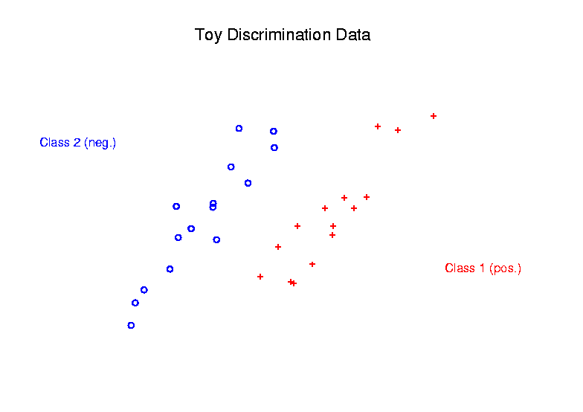
Support Vector Machines
Graphical View, using Toy Example:

Slide 30
Support Vector Machines
Graphical View, using Toy Example:

Slide 31
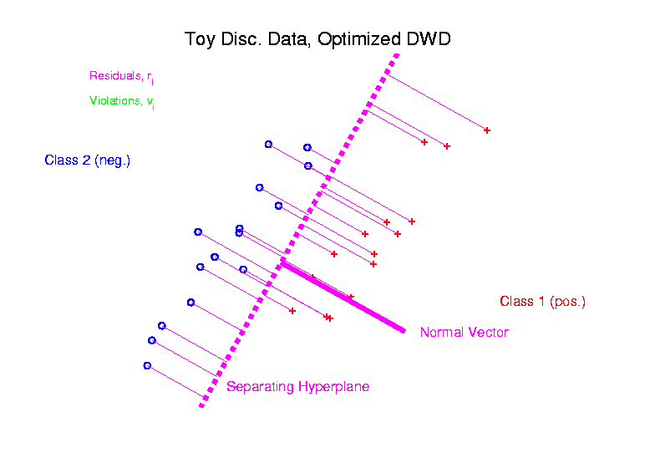
Distance Weighted Discrim’n
Graphical View, using Toy Example:

Slide 32
DWD in Face Recognition
Face Images as Data
(with M. Benito & D. Peña)
Male – Female Difference?
Discrimination Rule?
Represented as long vector of pixel gray levels
Registration is critical

Slide 33
DWD in Face Recognition, (cont.)
Registered Data
Shifts and scale
Manually chosen
To align eyes and mouth
Still large variation
See males vs. females???

Slide 34
DWD in Face Recognition , (cont.)
DWD Direction
Good separation
Images “make sense”
Garbage at ends?
(extrapolation effects?)

Slide 35
DWD in Face Recognition , (cont.)
Unregistered Version
Much blurrier
Since features don’t properly line up
Nonlinear Variation
But DWD still works
Can see M-F differ’ce?

Slide 36
HDLSS Discrim’n Simulations
Main idea:
Comparison of
SVM (Support Vector Machine)
DWD (Distance Weighted Discrimination)
MD (Mean Difference, a.k.a. Centroid)
Linear versions, across dimensions
Notes:
36

Slide 37
HDLSS Discrim’n Simulations
Overall Approach:
Study different known phenomena
Spherical Gaussians
Outliers
Polynomial Embedding
Common Sample Sizes
$$n_{+}=n_{−}=25$$
But wide range of dimensions
$$d=10, 40, 100, 400, 1600$$

Slide 38
HDLSS Discrim’n Simulations
Spherical Gaussians:
Notes:
DWD1figEBig.ps

Slide 39
HDLSS Discrim’n Simulations
Spherical Gaussians:
Same setup as before
Means shifted in dim 1 only, $μ_{1}=±2.2$
All methods pretty good
Harder problem for higher dimension
SVM noticeably worse
MD best (Likelihood method)
DWD very close to MD
Methods converge for higher dimension??

Slide 40
HDLSS Discrim’n Simulations
Outlier Mixture:
Notes:
DWD1figFBig.ps

Slide 41
HDLSS Discrim’n Simulations
Outlier Mixture:
80% dim. 1 $μ_{1}=±2.2$, other dims 0
20% dim. 1 ±100, dim. 2 ±500, others 0
MD is a disaster, driven by outliers
SVM & DWD are both very robust
SVM is best
DWD very close to SVM (insig’t difference)
Methods converge for higher dimension??
Ignore RLR (a mistake)

Slide 42
HDLSS Discrim’n Simulations
Wobble Mixture:
Notes:
DWD1figGBig.ps

Slide 43
HDLSS Discrim’n Simulations
Wobble Mixture:
80% dim. 1 $μ_{1}=±2.2$, other dims 0
20% dim. 1 ±0.1, rand dim ±100, others 0
MD still very bad, driven by outliers
SVM & DWD are both very robust
SVM loses (affected by margin push)
DWD slightly better (by w’ted influence)
Methods converge for higher dimension??
Ignore RLR (a mistake)

Slide 44
HDLSS Discrim’n Simulations
Nested Spheres:
Notes:
DWD1figHBig.ps

Slide 45
HDLSS Discrim’n Simulations
Nested Spheres:
1st d/2 dim’s, Gaussian with var 1 or C
2nd d/2 dim’s, the squares of the 1st dim’s
(as for 2nd degree polynomial embedding)
Each method best somewhere
MD best in highest d (data non-Gaussian)
Methods not comparable (realistic)
Methods converge for higher dimension??
HDLSS space is a strange place
Ignore RLR (a mistake)

Slide 46
HDLSS Discrim’n Simulations
Conclusions:
Everything (sensible) is best sometimes
DWD often very near best
MD weak beyond Gaussian
Caution about simulations (and examples):
Very easy to cherry pick best ones
Good practice in Machine Learning
“Ignore method proposed, but read
paper for useful comparison of others”

Slide 47
HDLSS Discrim’n Simulations
Caution: There are additional players
E.g. Regularized Logistic Regression
looks also very competitive
Interesting Phenomenon:
All methods come together
in very high dimensions???

Slide 48
HDLSS Discrim’n Simulations
Can we say more about:
All methods come together
in very high dimensions???
Mathematical Statistical Question:
Mathematics behind this???
Notes:
48

Slide 49
HDLSS Asy’s: Geometrical Represen’tion
Explanation of Observed (Simulation) Behavior:
“everything similar for very high d ”
2 popn’s are 2 simplices (i.e. regular n-hedrons)
All are same distance from the other class
i.e. everything is a support vector
i.e. all sensible directions show “data piling”
so “sensible methods are all nearly the same”

Slide 50
HDLSS Asy’s: Geometrical Represen’tion
Further Consequences of Geometric Represen’tion
1. DWD more stable than SVM
(based on deeper limiting distributions)
(reflects intuitive idea feeling sampling variation)
(something like mean vs. median)
Hall, Marron, Neeman (2005)
2. 1-NN rule inefficiency is quantified.
Hall, Marron, Neeman (2005)
3. Inefficiency of DWD for uneven sample size
(motivates weighted version)
Qiao, et al (2010)

