Slide 1
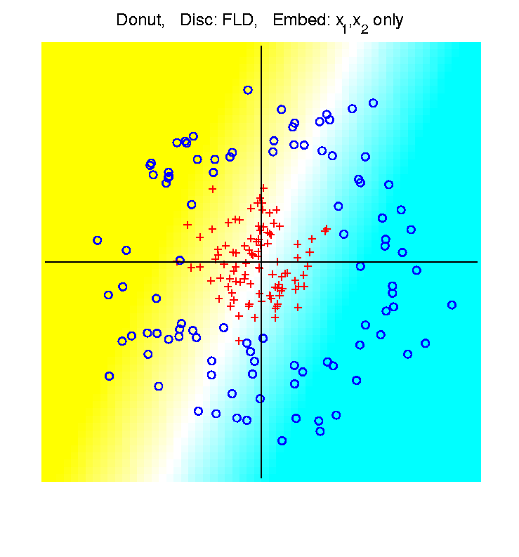
HDLSS Asymptotics & Kernel Methods
Recall
Flexibility
From
Kernel
Embedding
Idea

Slide 2
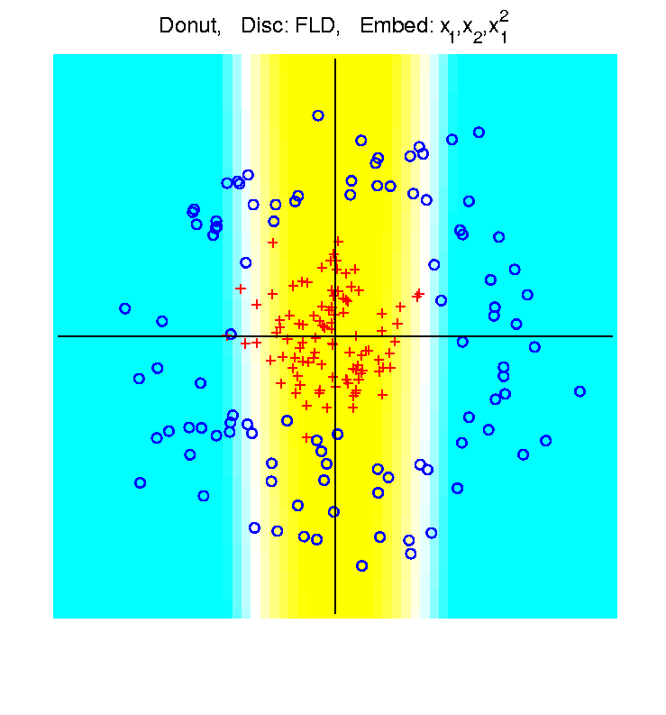
HDLSS Asymptotics & Kernel Methods
Recall
Flexibility
From
Kernel
Embedding
Idea

Slide 3
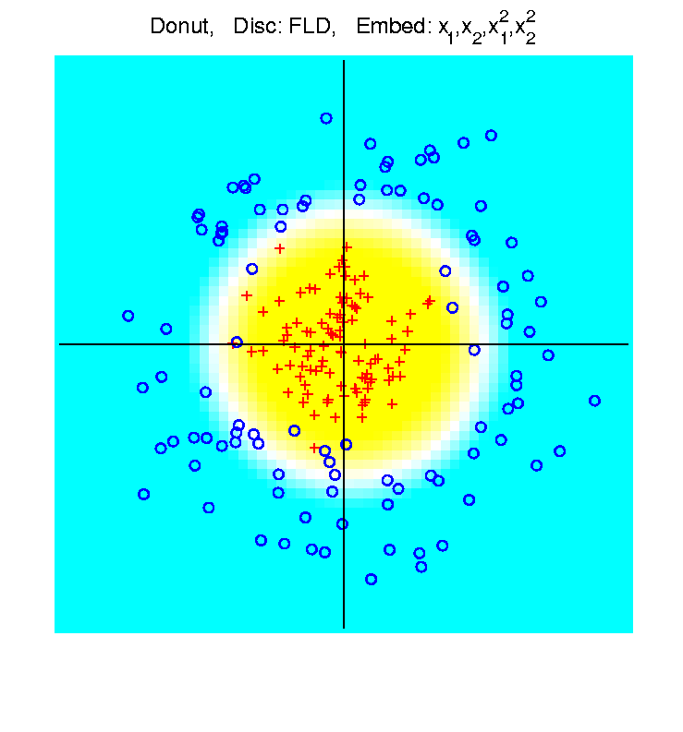
HDLSS Asymptotics & Kernel Methods
Recall
Flexibility
From
Kernel
Embedding
Idea

Slide 4
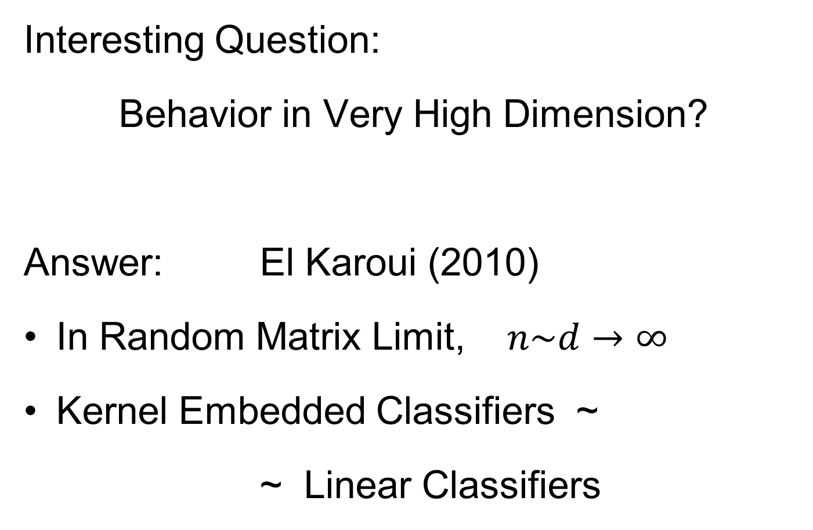

HDLSS Asymptotics & Kernel Methods
Interesting Question:
Behavior in Very High Dimension?
Answer: El Karoui (2010)
In Random Matrix Limit, $n\sim d→∞$
Kernel Embedded Classifiers ~
~ Linear Classifiers

Slide 5
HDLSS Asymptotics & Kernel Methods
Interesting Question:
Behavior in Very High Dimension?
Implications for DWD:
Recall Main Advantage is for High d
So Not Clear Embedding Helps
Thus Not Yet Implemented in DWD

Slide 6
Batch and Source Adjustment
Recall from Class Notes 1/26/16
For Stanford Breast Cancer Data (C. Perou)
Analysis in Benito, et al (2004)
https://genome.unc.edu/pubsup/dwd/
Adjust for Source Effects
  Different sources of mRNA
Adjust for Batch Effects
  Arrays fabricated at different times

Slide 7
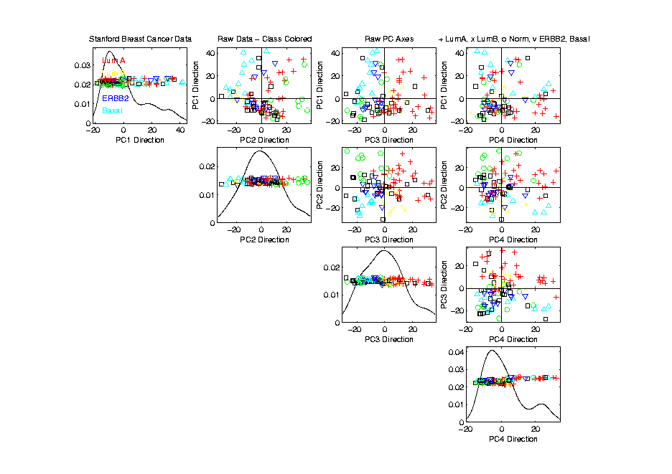
Source Batch Adj: Biological Class Col. & Symbols

Slide 8
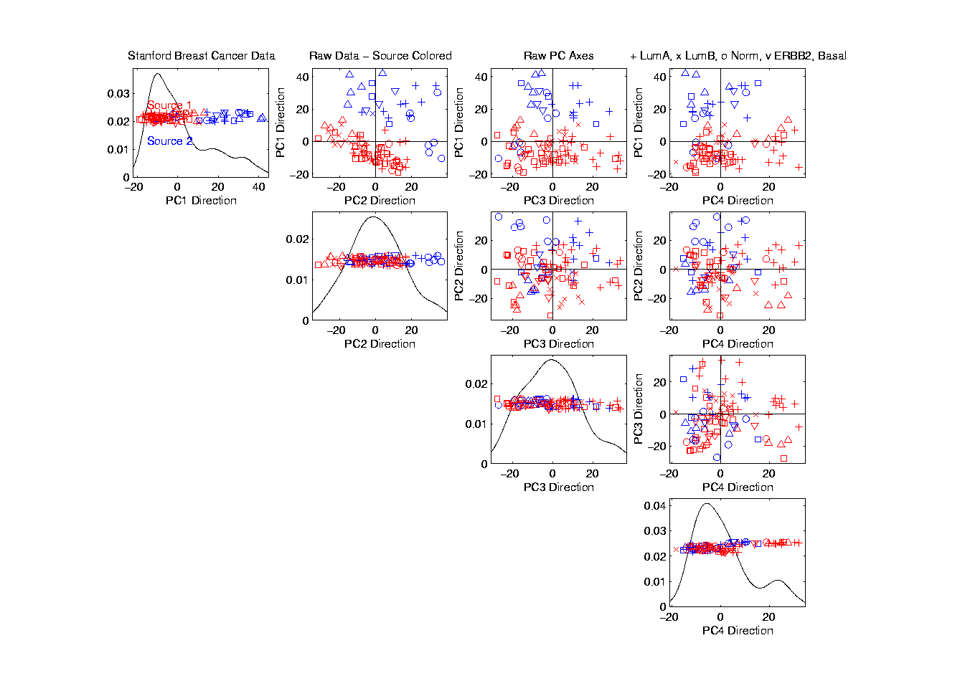
Source Batch Adj: Source Colors

Slide 9
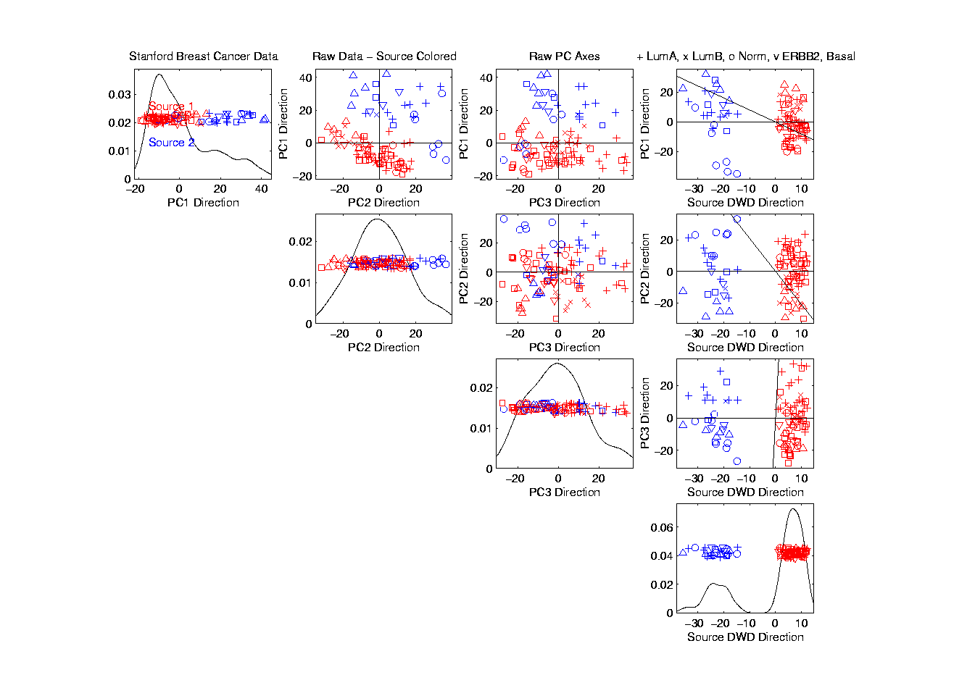
Source Batch Adj: PC 1-3 & DWD direction

Slide 10
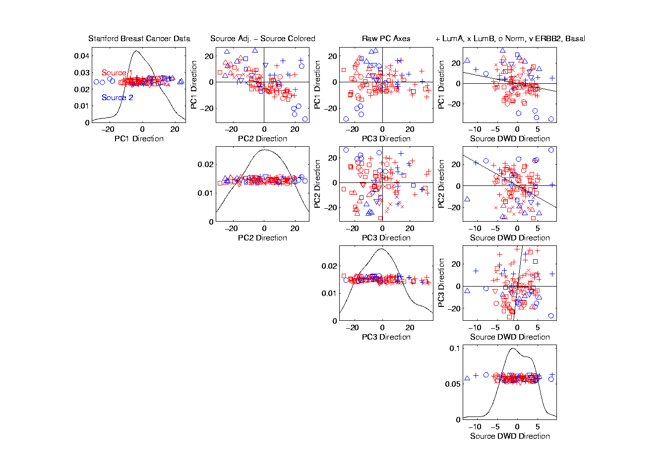
Source Batch Adj: DWD Source Adjustment

Slide 11
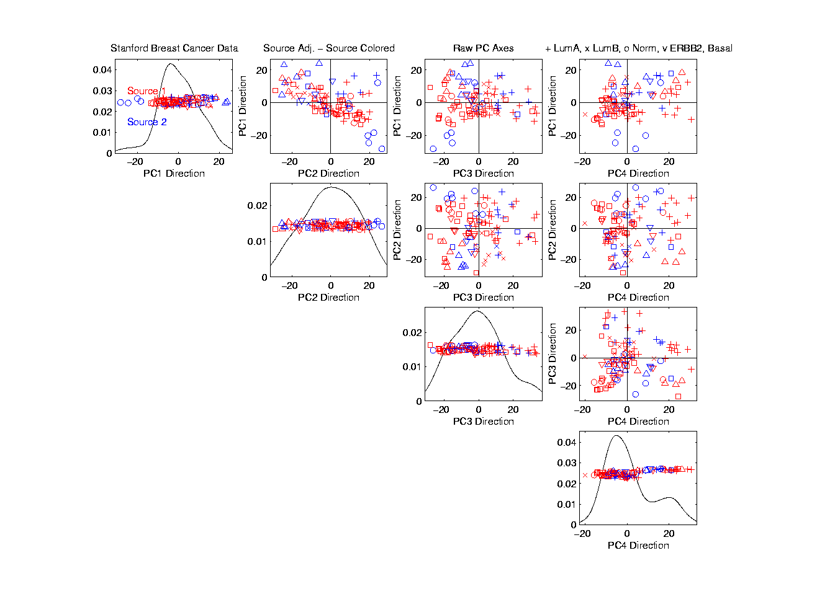
Source Batch Adj: Source Adj’d, PCA view

Slide 12
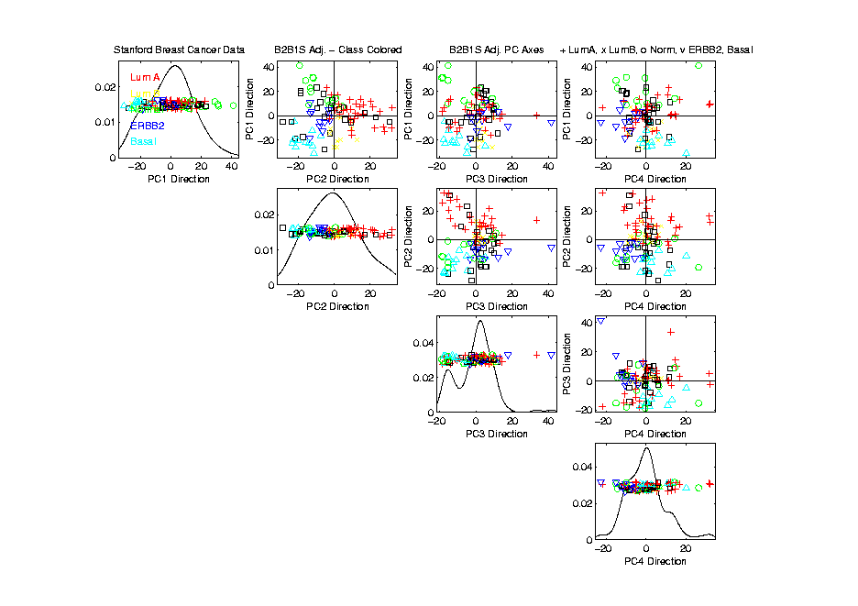
Source Batch Adj: S. & B Adj’d, Adj’d PCA

Slide 13
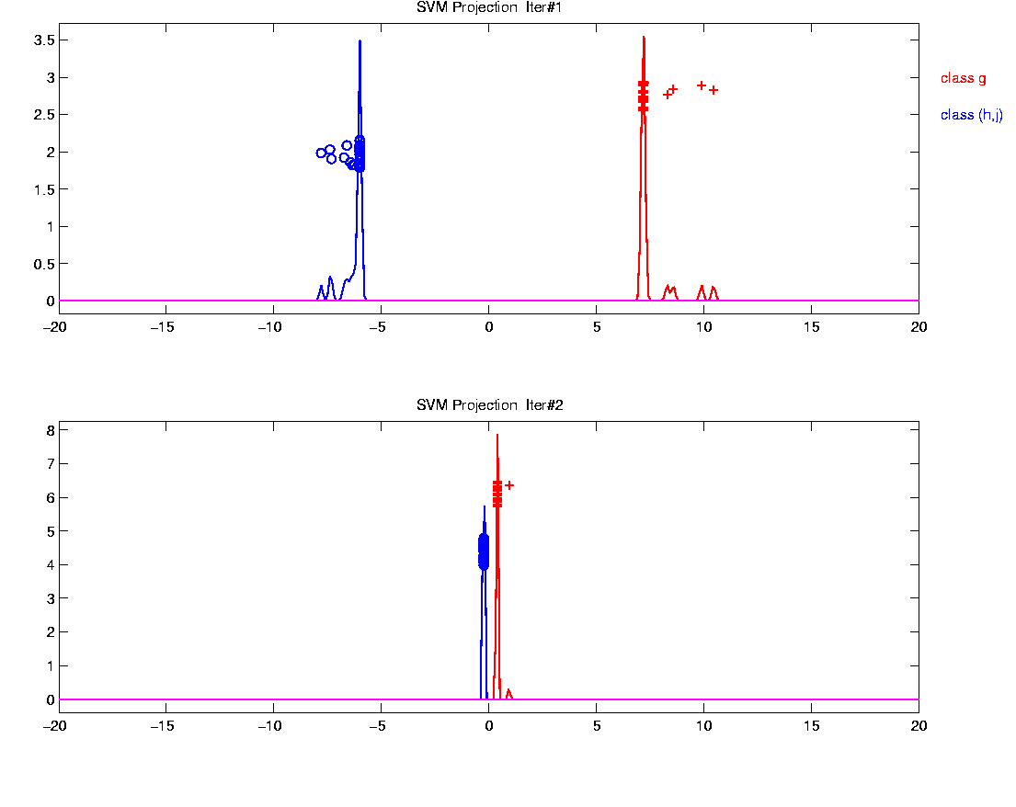
Why not adjust using SVM?
Major Problem: Proj’d Distrib’al Shape
Triangular Dist’ns (opposite skewed)
Does not allow sensible rigid shift

Slide 14
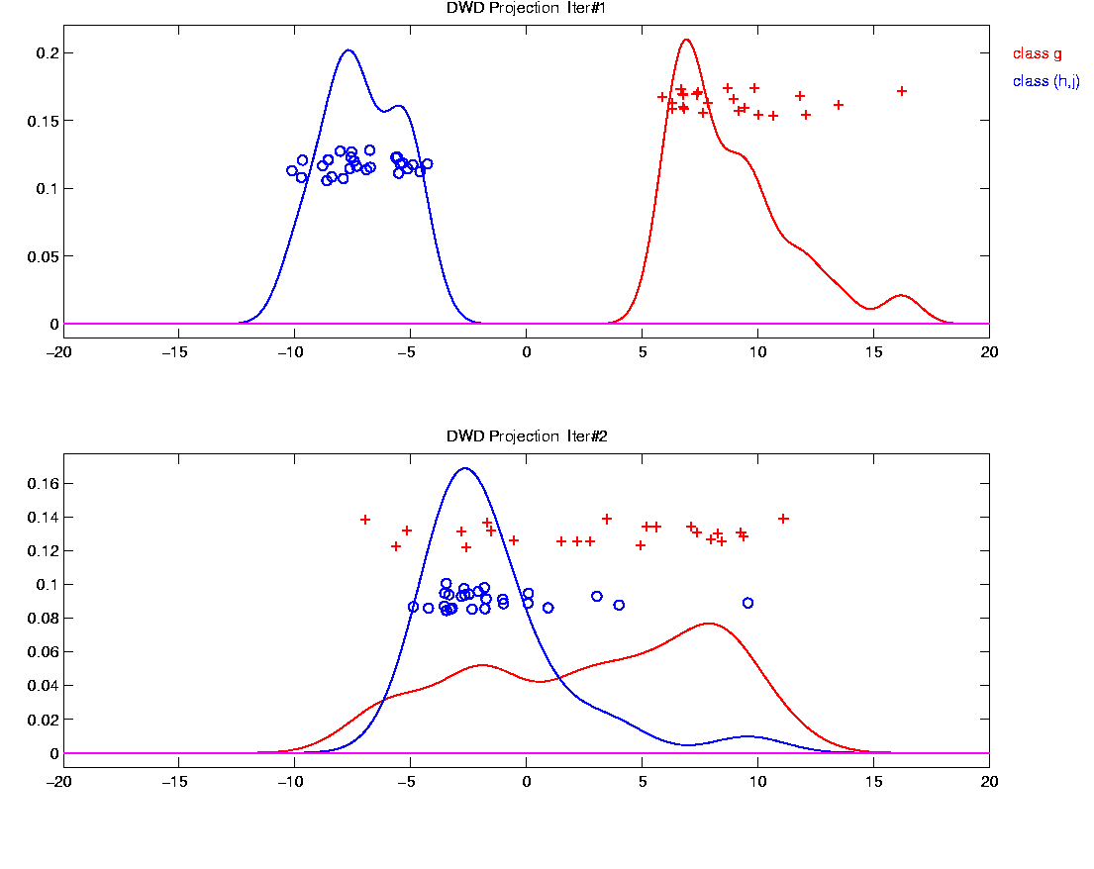
Why not adjust using SVM?
Nicely Fixed by DWD
Projected Dist’ns near Gaussian
Sensible to shift

Slide 15
Why not adjust by means?
DWD is complicated: value added?
Because it is “cool”
  Recall Improves SVM for HDLSS
Good Empirical Success
  Routinely Used in Perou Lab
  Many Comparisons Done
  Similar Lessons from Wistar
Proven Statistical Power

Slide 16
Why not adjust by means?
But Why Not PAM (~Mean Difference)?
Simpler is Better
Why not means, i.e. point cloud centerpoints?
Elegant Answer: Xuxin Liu, et al (2009)

Slide 17
Why not adjust by means?
But Why Not PAM (~Mean Difference)?
Simpler is Better
Why not means, i.e. point cloud centerpoints?
Drawback to PAM:
Poor Handling of Unbalanced Biological Subtypes
DWD more Resistant to Unbalance

Slide 18
Why not adjust by means?
Toy Example:
  Gaussian Clusters
  Two batches (denoted: + o)
  Two subtypes (red and blue)
  Goal: bring together
  + ←→ o and also + ←→ o
  Challenge: unequal biological ratios within batches

Slide 19
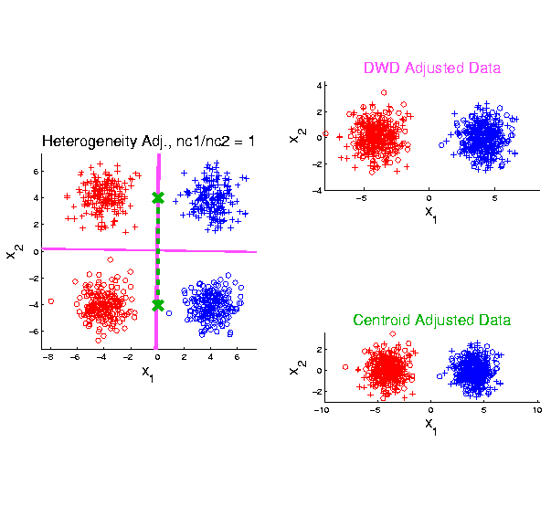
Twiddle ratios of subtypes
2-d Toy
Example
Balanced
Mixture

Slide 20
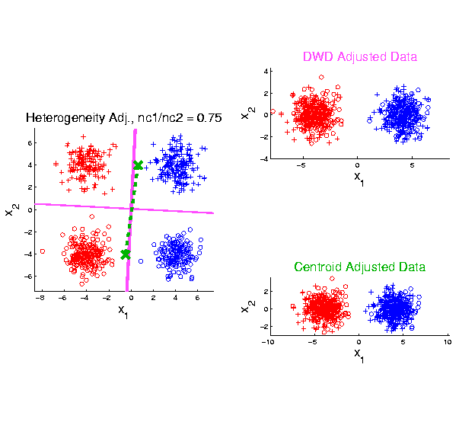
Twiddle ratios of subtypes
2-d Toy
Example
Unbalanced
Mixture
(Through
“decimation”)

Slide 21
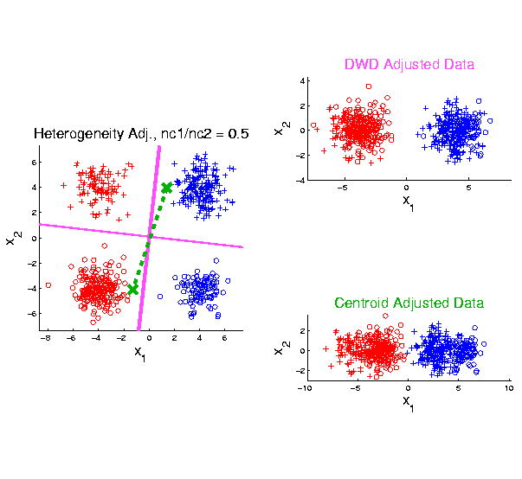
Twiddle ratios of subtypes
2-d Toy
Example
Unbalanced
Mixture
(Diminishing
Discriminatory
Power)

Slide 22
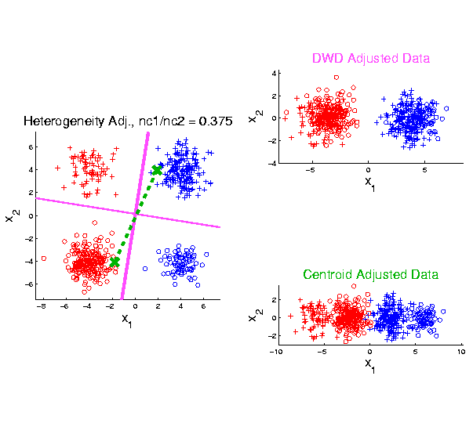
Twiddle ratios of subtypes
2-d Toy
Example
Unbalanced
Mixture

Slide 23
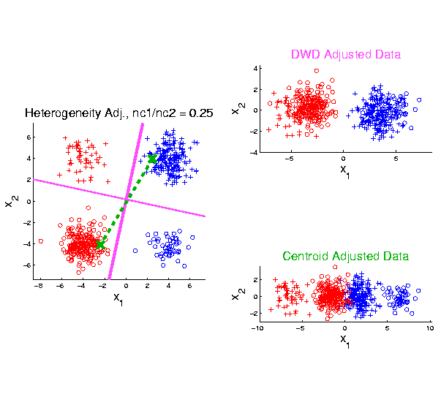
Twiddle ratios of subtypes
2-d Toy
Example
Unbalanced
Mixture

Slide 24
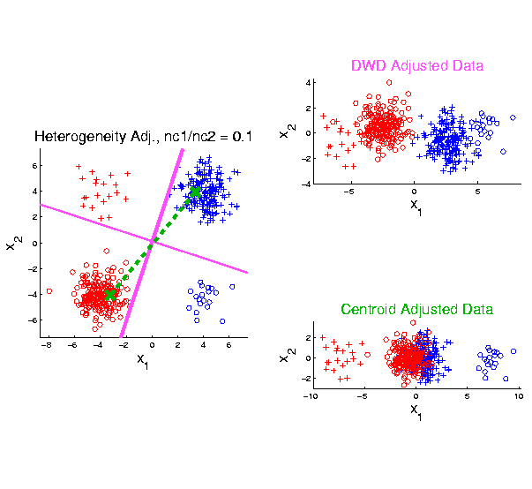
Twiddle ratios of subtypes
2-d Toy
Example
Unbalanced
Mixture
Note: Losing
Distinction
To Be Studied

Slide 25
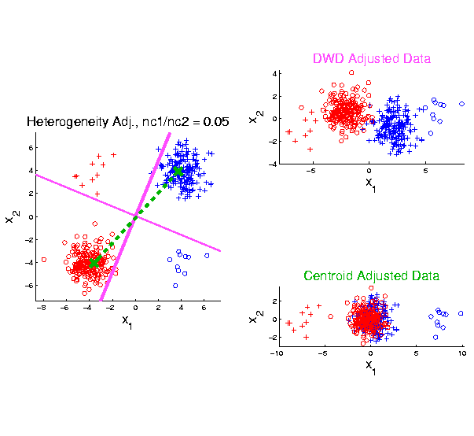
Twiddle ratios of subtypes
2-d Toy
Example
Unbalanced
Mixture

Slide 26
Why not adjust by means?
DWD robust against non-proportional subtypes…
Mathematical Statistical Question:
Are there mathematics behind this?
Notes:
26

Slide 27
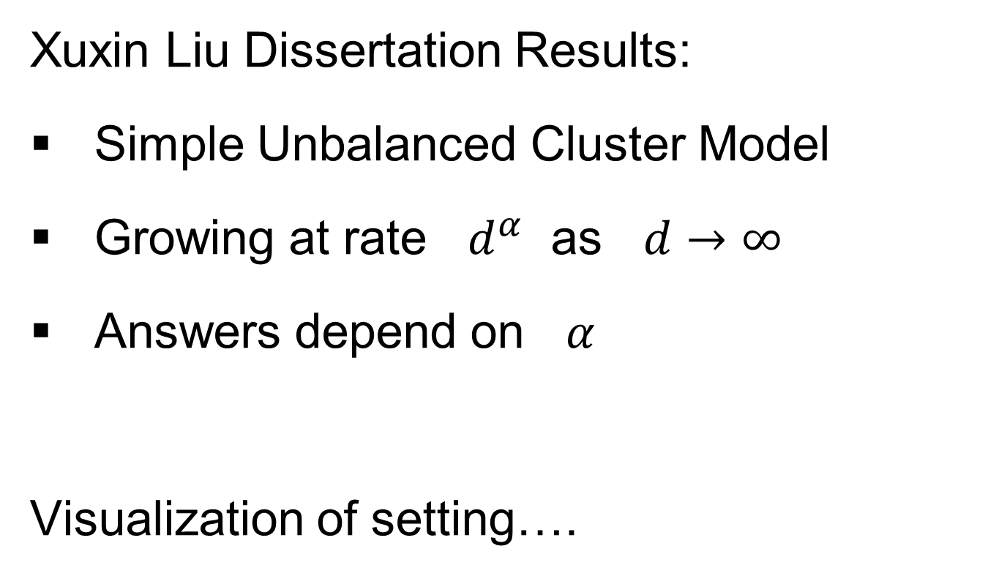
HDLSS Data Combo Mathematics
Xuxin Liu Dissertation Results:
Simple Unbalanced Cluster Model
Growing at rate $d^{α}$ as $d→∞$
Answers depend on $α$
Visualization of setting….

Slide 28
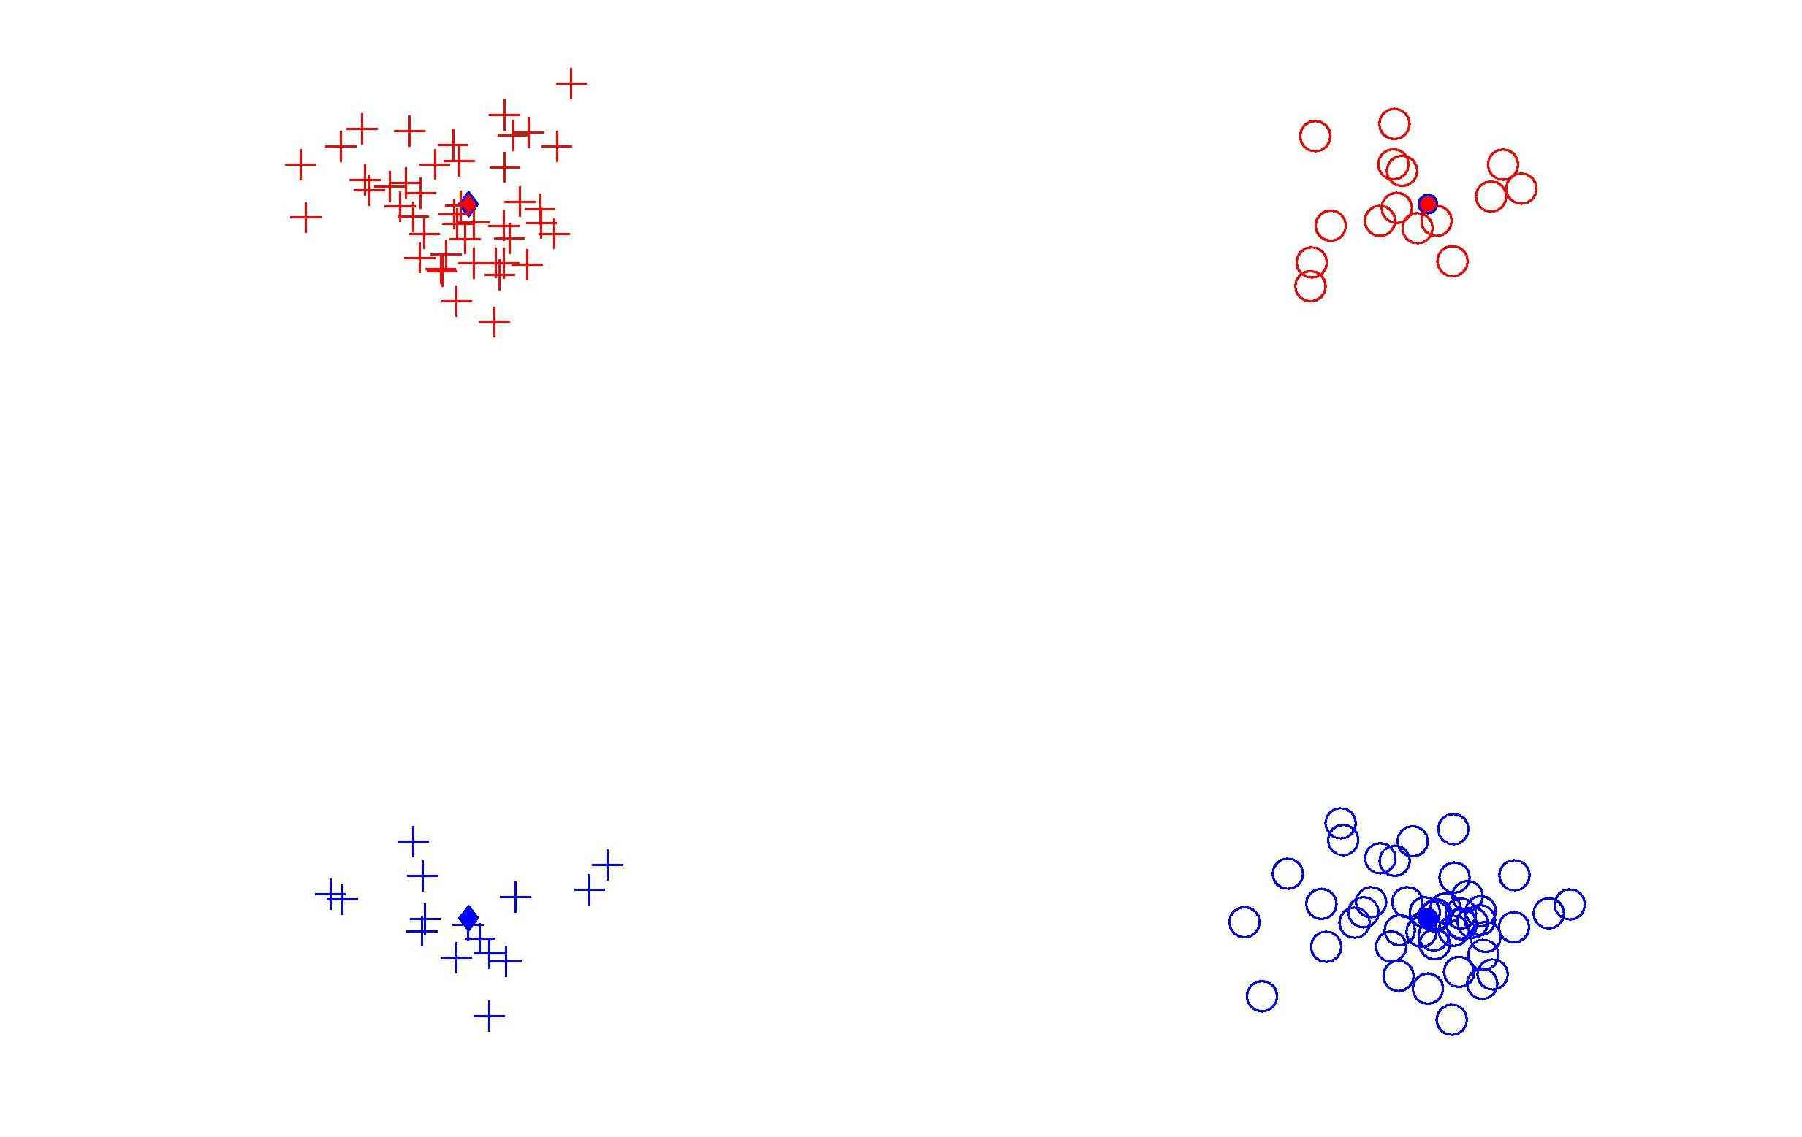
HDLSS Data Combo Mathematics

Slide 29
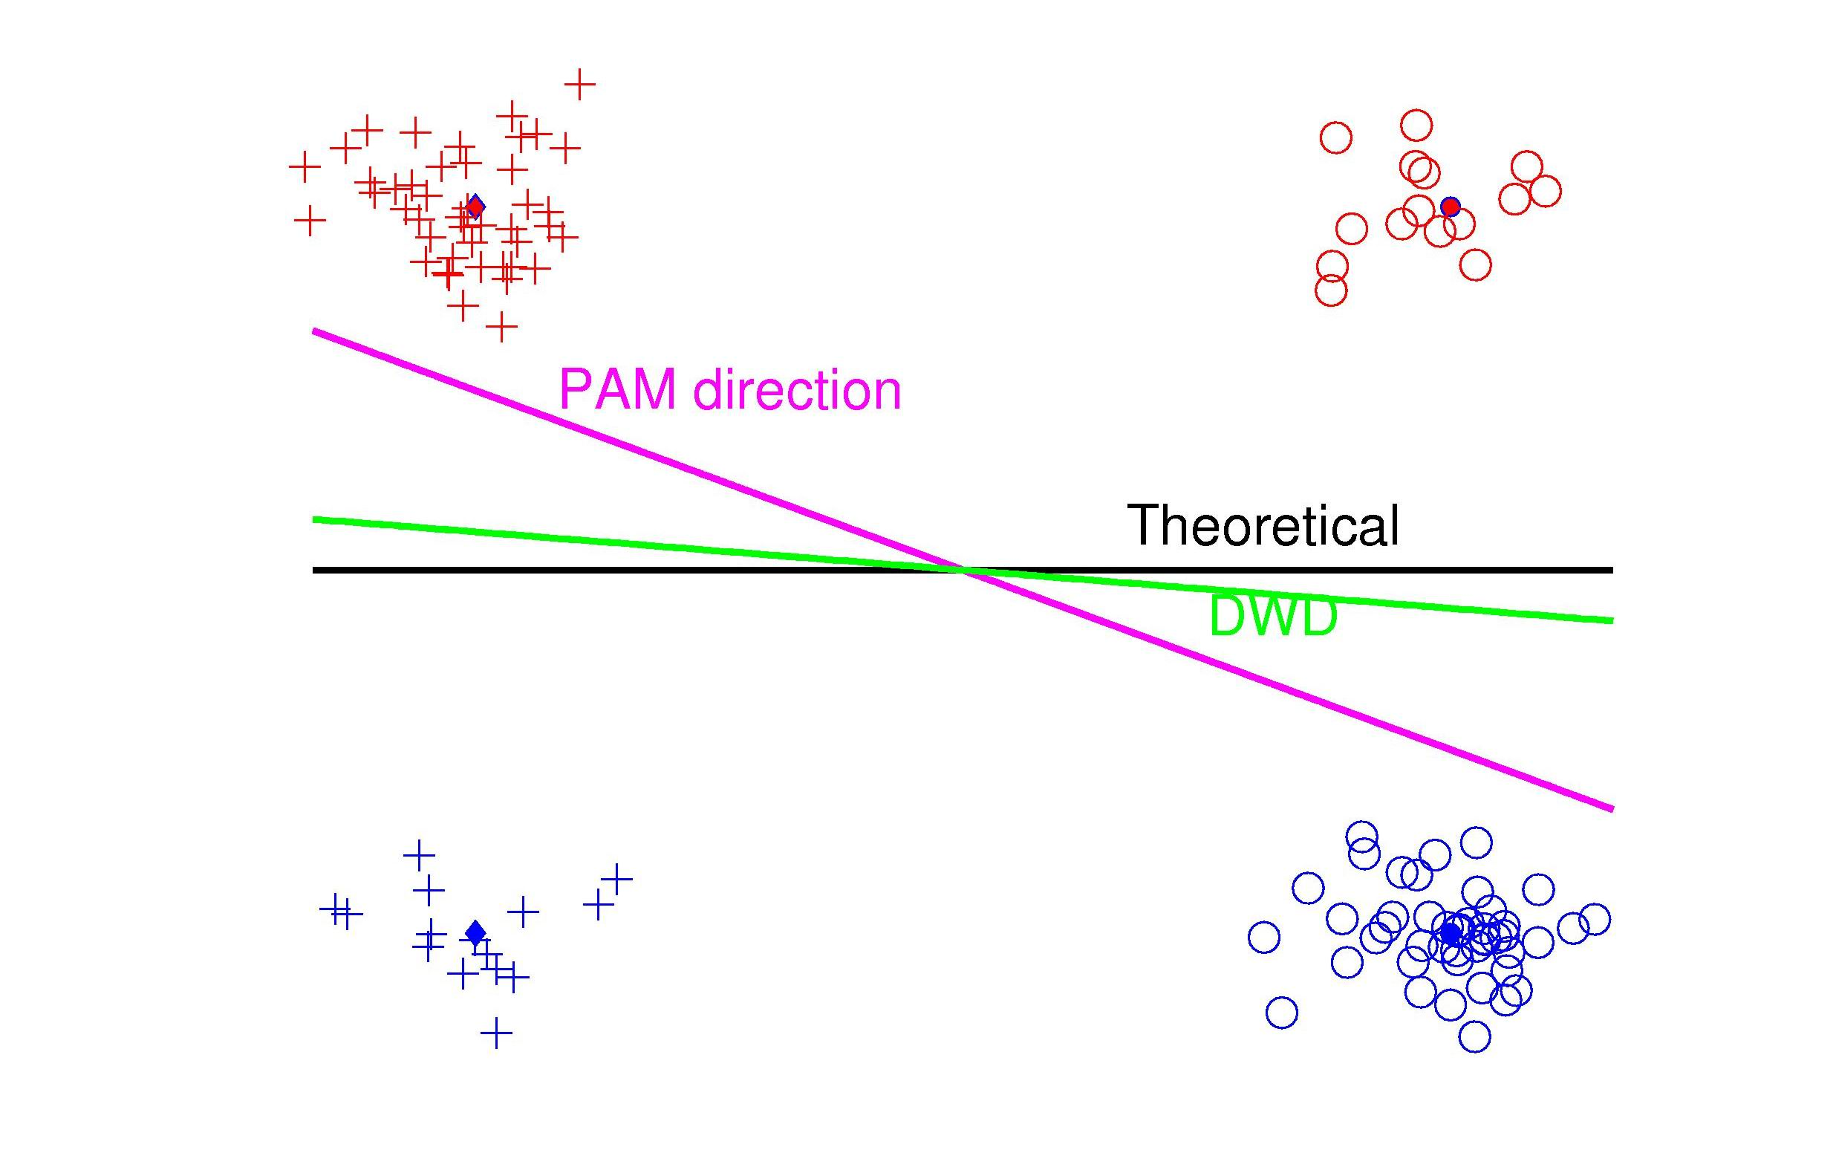
HDLSS Data Combo Mathematics

Slide 30
HDLSS Data Combo Mathematics
Asymptotic Results (as )
Let denote ratio between subgroup sizes

Slide 31
HDLSS Data Combo Mathematics
Asymptotic Results (as ):
For , PAM Inconsistent
Angle(PAM,Truth)
For , PAM Strongly Inconsistent
Angle(PAM,Truth)

Slide 32
HDLSS Data Combo Mathematics
Asymptotic Results (as ):
For , DWD Inconsistent
Angle(DWD,Truth)
For , DWD Strongly Inconsistent
Angle(DWD,Truth)

Slide 33
HDLSS Data Combo Mathematics
Value of and , for sample size ratio :
, only when
Otherwise for , both are Inconsistent

Slide 34
HDLSS Data Combo Mathematics
Comparison between PAM and DWD?
I.e. between and ?

Slide 35
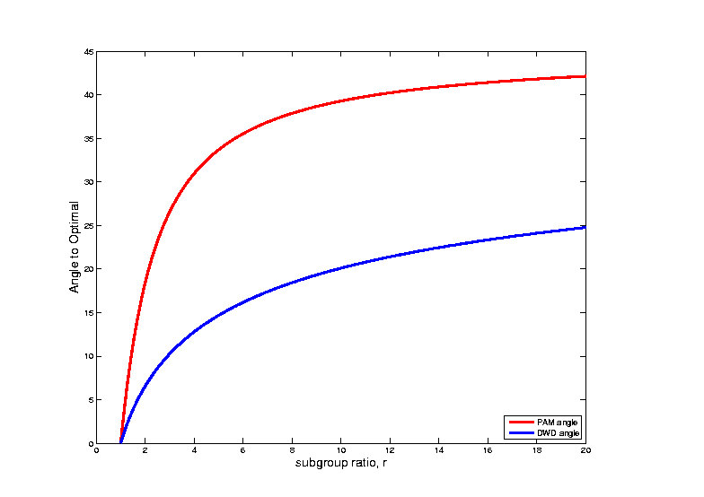
HDLSS Data Combo Mathematics
Comparison between PAM and DWD?

Slide 36
HDLSS Data Combo Mathematics
Comparison between PAM and DWD?
I.e. between and ?
Shows Strong Difference
Explains Above Empirical Observation

Slide 37
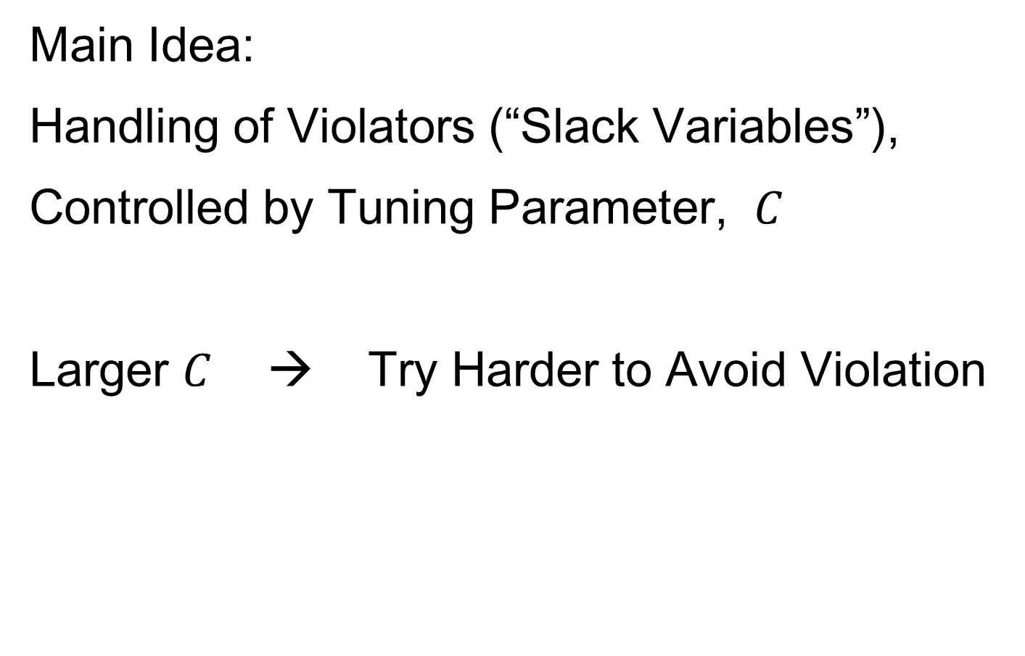
SVM & DWD Tuning Parameter
Main Idea:
Handling of Violators (“Slack Variables”),
Controlled by Tuning Parameter, $C$
Larger $C$ → Try Harder to Avoid Violation
Notes:
37

Slide 38
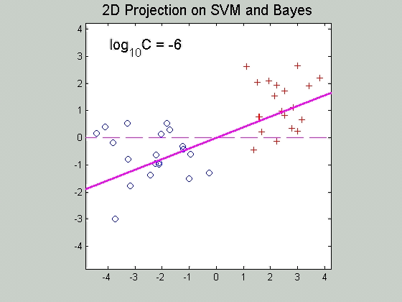

SVM Tuning Parameter
Recall Movie over $C$ for SVM:
Notes:
38

Slide 39
SVM & DWD Tuning Parameter
Possible Approaches:
Visually Tuned
(Can be Effective,
But Takes Time,
Requires Expertise)
Notes:
39

Slide 40
SVM & DWD Tuning Parameter
Possible Approaches:
Visually Tuned
Simple Defaults
DWD: 100 / median pairwise distance
(Surprisingly Useful, Simple Answer)
SVM: 1000
(Works Well Sometimes, Not Others)
Notes:
40

Slide 41
SVM & DWD Tuning Parameter
Possible Approaches:
Visually Tuned
Simple Defaults
(Works Well for DWD,
Less Effective for SVM)
Notes:
41

Slide 42
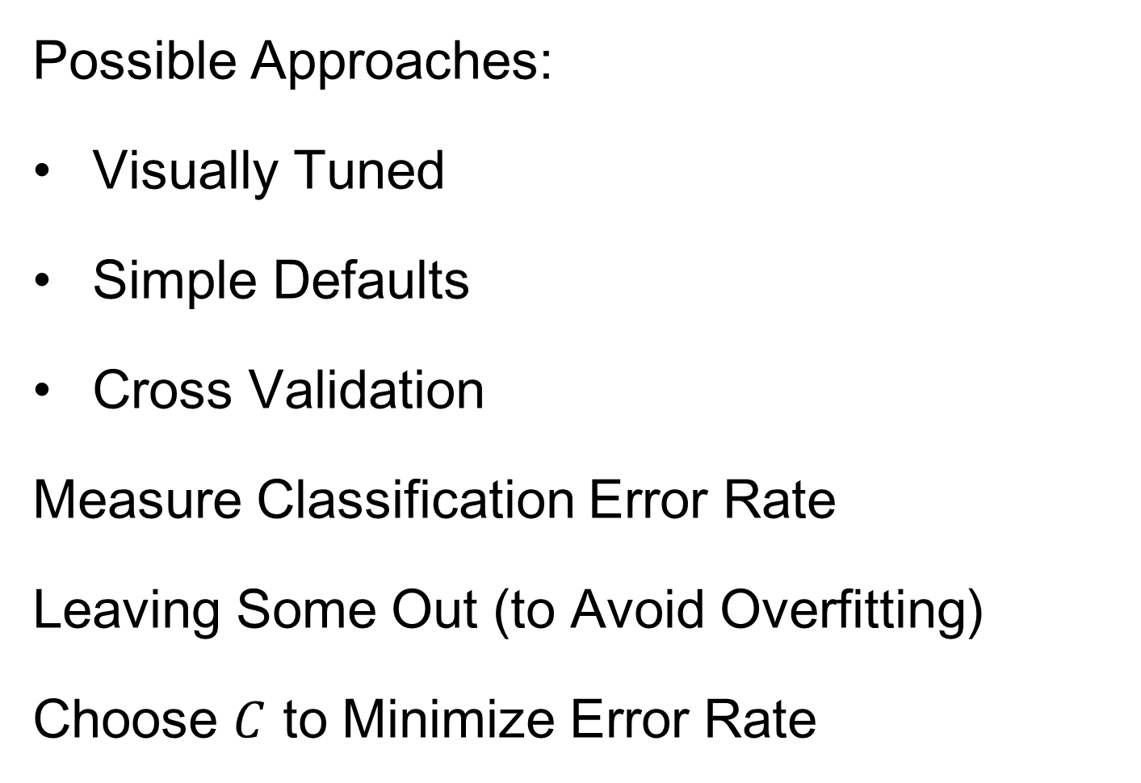
SVM & DWD Tuning Parameter
Possible Approaches:
Visually Tuned
Simple Defaults
Cross Validation
Measure Classification Error Rate
Leaving Some Out (to Avoid Overfitting)
Choose $C$ to Minimize Error Rate
Notes:
42

Slide 43
SVM & DWD Tuning Parameter
Possible Approaches:
Visually Tuned
Simple Defaults
Cross Validation
(Very Popular – Useful for SVM,
But Comes at Computational Cost)
Notes:
43

Slide 44
SVM & DWD Tuning Parameter
Possible Approaches:
Visually Tuned
Simple Defaults
Cross Validation
Scale Space
(Work with Full Range of Choices,
Will Explore More Soon)
Notes:
44

Slide 45
Participant Presentation
Frank Teets
Characterizing Protein Assembly Graphs

