Slide 1
Distance Weighted Discrim’n
Based on Optimization Problem:
For “Residuals”:

Slide 2
HDLSS Discrim’n Simulations
Wobble Mixture:
Notes:
DWD1figGBig.ps

Slide 3
HDLSS Discrim’n Simulations
Can we say more about:
All methods come together
in very high dimensions???
Mathematical Statistical Question:
Mathematics behind this???
Notes:
3

Slide 4
HDLSS Asy’s: Geometrical Represen’tion
Explanation of Observed (Simulation) Behavior:
“everything similar for very high d ”
2 popn’s are 2 simplices (i.e. regular n-hedrons)
All are same distance from the other class
i.e. everything is a support vector
i.e. all sensible directions show “data piling”
so “sensible methods are all nearly the same”

Slide 5
HDLSS Asymptotics & Kernel Methods
Interesting Question:
Behavior in Very High Dimension?
Answer: El Karoui (2010)
In Random Matrix Limit, $n\sim d→∞$
Kernel Embedded Classifiers ~
~ Linear Classifiers

Slide 6
Source Batch Adj: PC 1-3 & DWD direction

Slide 7
Source Batch Adj: DWD Source Adjustment

Slide 8
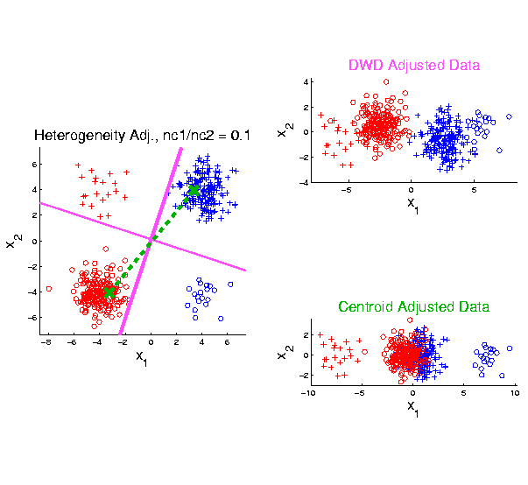
Twiddle ratios of subtypes
2-d Toy
Example
Unbalanced
Mixture
Note: Losing
Distinction
To Be Studied

Slide 9
HDLSS Data Combo Mathematics
Asymptotic Results (as ):
For , PAM Inconsistent
Angle(PAM,Truth)
For , PAM Strongly Inconsistent
Angle(PAM,Truth)

Slide 10
HDLSS Data Combo Mathematics
Asymptotic Results (as ):
For , DWD Inconsistent
Angle(DWD,Truth)
For , DWD Strongly Inconsistent
Angle(DWD,Truth)

Slide 11
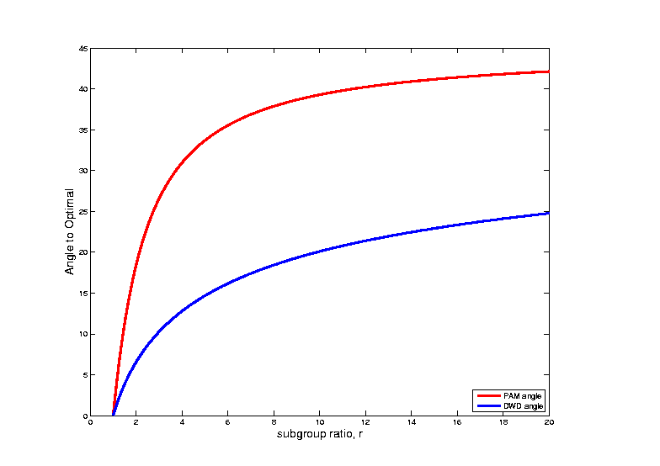
HDLSS Data Combo Mathematics
Comparison between PAM and DWD?

Slide 12
SVM & DWD Tuning Parameter
Possible Approaches:
Visually Tuned
Simple Defaults
Cross Validation
Scale Space
(Work with Full Range of Choices,
Will Explore More Soon)
Notes:
12

Slide 13
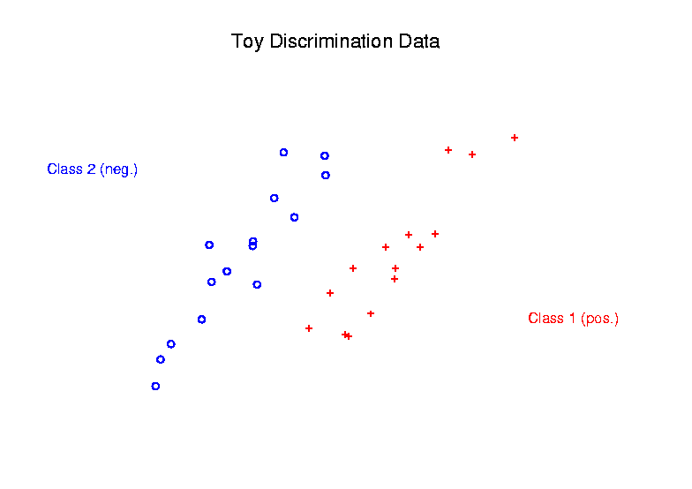
Radial DWD
Main Idea:
Linear Classifiers Good When Each Class Lives in a Distinct Region
Notes:
13

Slide 14
Radial DWD
Main Idea:
Linear Classifiers Good When Each Class Lives in a Distinct Region
Hard When All Members Of One Class Are Outliers in a Random Direction
Notes:
14

Slide 15
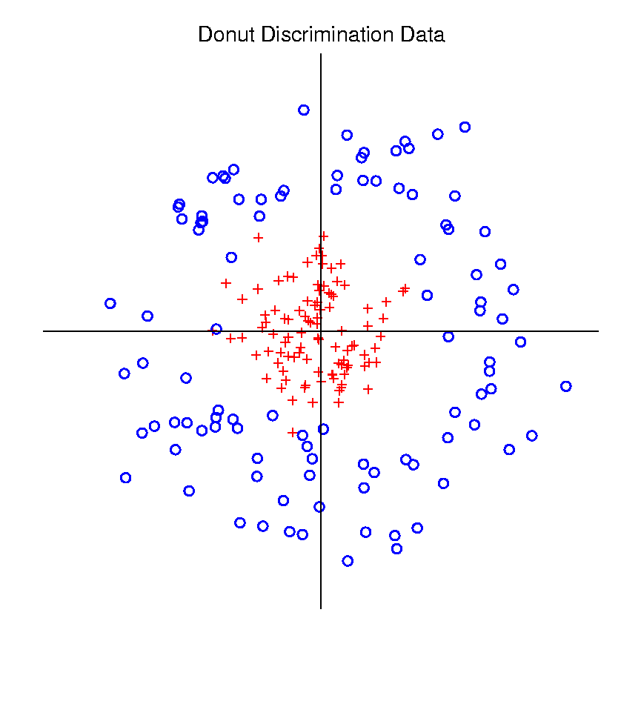
Radial DWD
Hard When All Members Of One Class Are Outliers in a Random Direction
Think HDLSS
Version of
Notes:
15

Slide 16
Radial DWD
Hard When All Members Of One Class Are Outliers in a Random Direction
E.g. Normal Cases
& Randomly Degraded
Notes:
16

Slide 17
Radial DWD
Reference:
Xiong, Dittmer & Marron (2016)
Notes:
17

Slide 18
Radial DWD
Motivating Example: Virus Hunting
Based on DNA
DNA in Sample is Amplified & Cut Up
Matched to Known Virus Genome
Data Objects: Counts $\underline{x}=\left(\begin{matrix}x_{1} \\ ⋮ \\ x_{d}\end{matrix}\right)$
Notes:
18

Slide 19
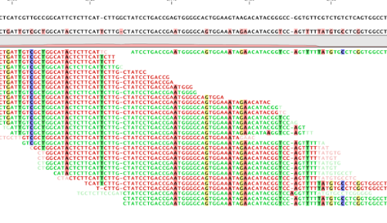
Virus Hunting
“Reads” Matched to Virus Genome & Counted to give $x_{1},⋯,x_{d}$
Notes:
19

Slide 20
Virus Hunting
Challenge 1:
Highly Variable DNA Amplification
Solution:
Standardize by Dividing by Total
Notes:
20

Slide 21
Virus Hunting
Standardize by Dividing by Total
Consequence:
Data Objects lie on “Unit Simplex” $\left\{\underline{x}=\left(\begin{matrix}x_{1} \\ ⋮ \\ x_{d}\end{matrix}\right):x_{1},⋯x_{d}≥0,\sum_{j=1}^{d}{x_{j}}=1\right\}$
Notes:
21

Slide 22
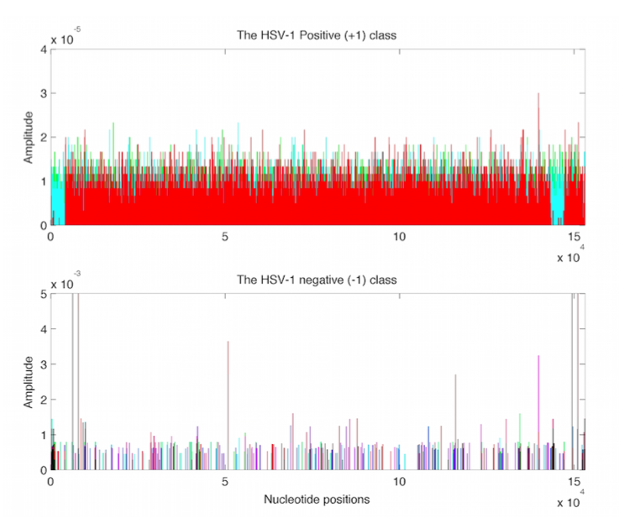
Virus Hunting
Look at
Data:
Mostly
Non-0
Near Simplex Center
Almost
All 0
Near Simplex Corners
Notes:
22

Slide 23
Virus Hunting
Look at
Data:
Note:
Heights
Orders of
Magnitude
-5 << -3
Different
Notes:
23

Slide 24
Virus Hunting
Note: HDLSS situation: $d\sim 10,000s n\sim 100s$
Have usual asymptotics?
Recall:
$\left\|{\underline{x}}_{i}\right\| \sim \sqrt{d}$
$\left\|{\underline{x}}_{i}−{\underline{x}}_{j}\right\| \sim \sqrt{2d}$
Notes:
24

Slide 25
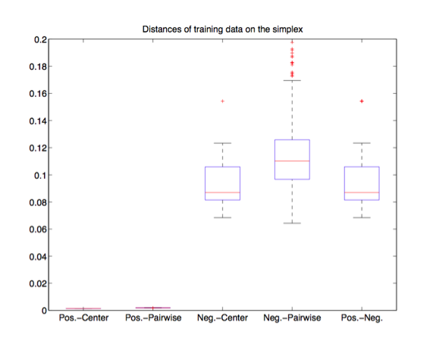
Virus Hunting
Check
HDLSS
Dist’s
Notes:
25

Slide 26
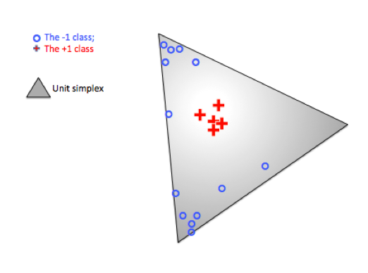
Radial DWD
Thought
Model:
+ Class
Near Center
- Class At
Random
Corners
Note: $∃$ Many ($d$) Corners
Notes:
26

Slide 27
Radial DWD
Consider Training Data
+ Class in Center
- Class Really in
Multiple Corners
Notes:
27

Slide 28
Radial DWD
Consider Training Data
Classify Using
Separating Plane
Notes:
28

Slide 29
Radial DWD
Consider Training Data
But What About
Test Point In A
Different Corner
???
Notes:
29

Slide 30
Radial DWD
Approach:
Replace Separating Plane
With Separating Sphere
Find Parameters
Via DWD-like
Optimization
Enables Finding Corners
With No Training Data
Notes:
30

Slide 31
Virus Hunting
Real Data Result:
Train +
Train –
Test +
Related
Test -
Notes:
31

Slide 32
Virus Hunting
Compare With Other Classifiers
Includes Above Radial DWD
Notes:
32

Slide 33
Virus Hunting
Compare With Other Classifiers
Linear Methods All Poor
Notes:
33

Slide 34
Virus Hunting
Compare With Other Classifiers
Even Kernel SVM Fails!!!
Reason:
Test Data
Lies In
Corners
With No
Training
Data
Notes:
34

Slide 35
Radial DWD
Verify With Simulation Study
Note: Very Similar Behavior!
Notes:
35

Slide 36
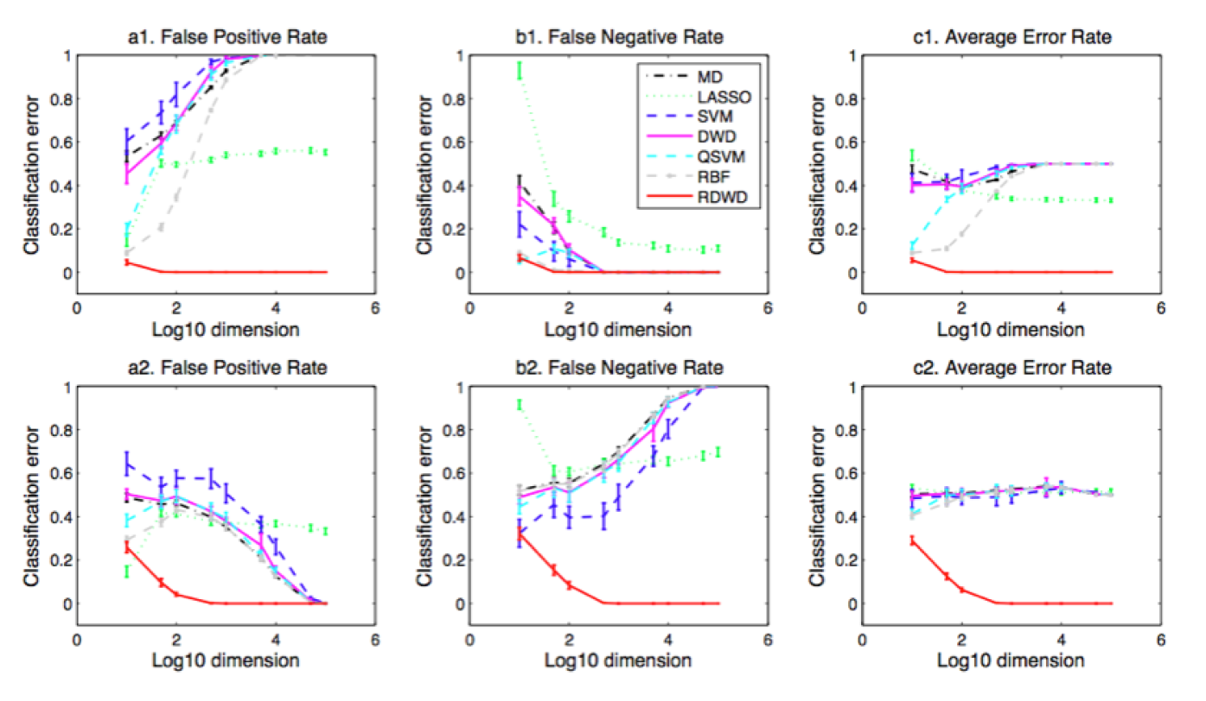
Radial DWD
Verify With Simulation Study
Stunning Test Classificat’n Rates as $d$ grows!
Notes:
36

Slide 37
Melanoma Data
Study Differences Between
(Malignant) Melanoma & (Benign) Nevi
Use Image Features From 1/21/16
(Recall from Transformation Discussion)
Paper: Miedema et al (2012)

Slide 38
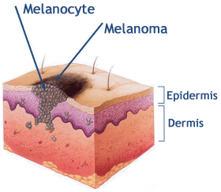
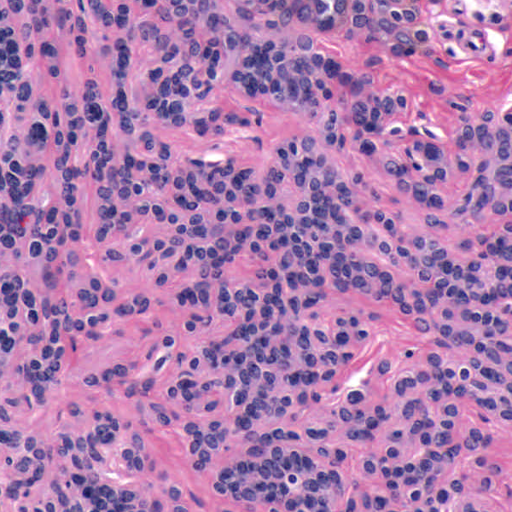
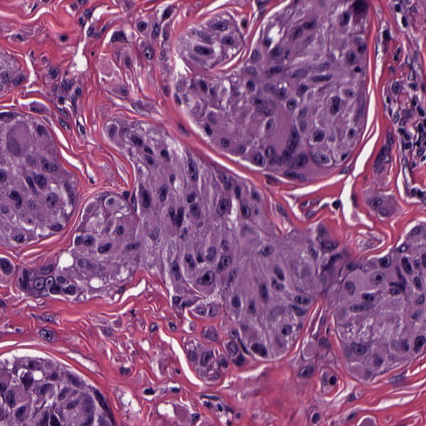
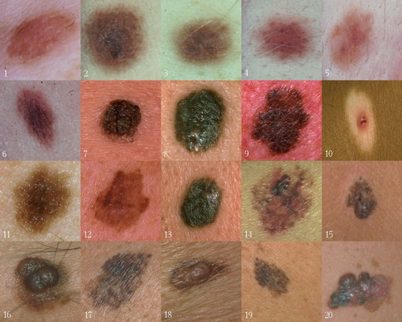
Background
Goal
Image Analysis of Histology Slides
Image: www.melanoma.ca
Benign
Melanoma
1 in 75 North Americans will develop a
malignant melanoma in their lifetime.
Initial goal: Automatically segment nuclei.
Challenge: Dense packing of nuclei.
Ultimately: Cancer grading and patient survival.
Image: melanoma.blogsome.com

Slide 39
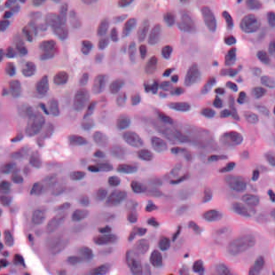
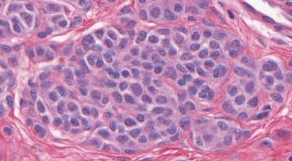
Feature Extraction
Features from Cell Nuclei
Delaunay Triangulation
Conventional Nevus
Superficial Spreading Melanoma
Triangulation of nuclear centers
Used for various density features:
Mean Delaunay, Max. Delaunay, etc.

Slide 40
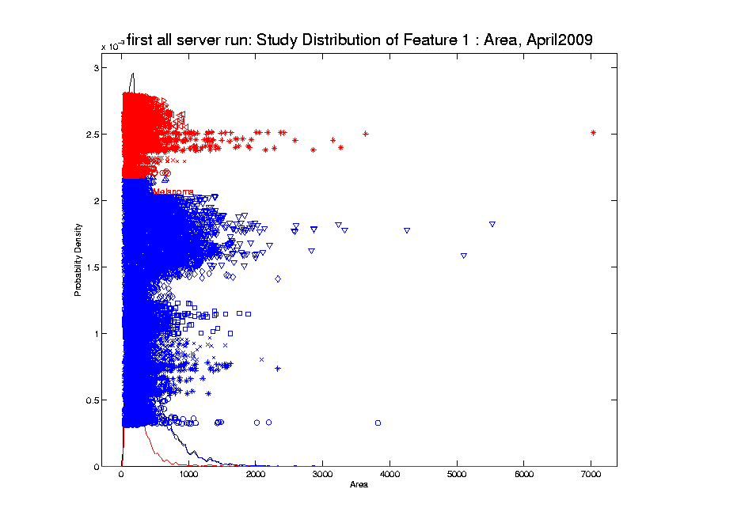
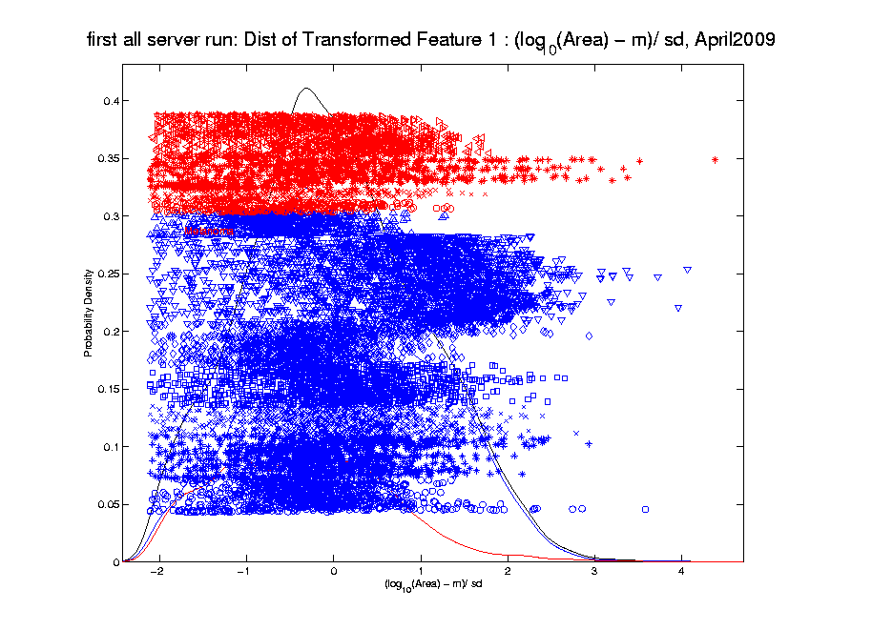
Melanoma Data
Recall From 1/21/16:
Studied
Transformation
Of This
Data

Slide 41
Melanoma Data
Study Differences Between
(Malignant) Melanoma & (Benign) Nevi
Explore with PCA View

Slide 42
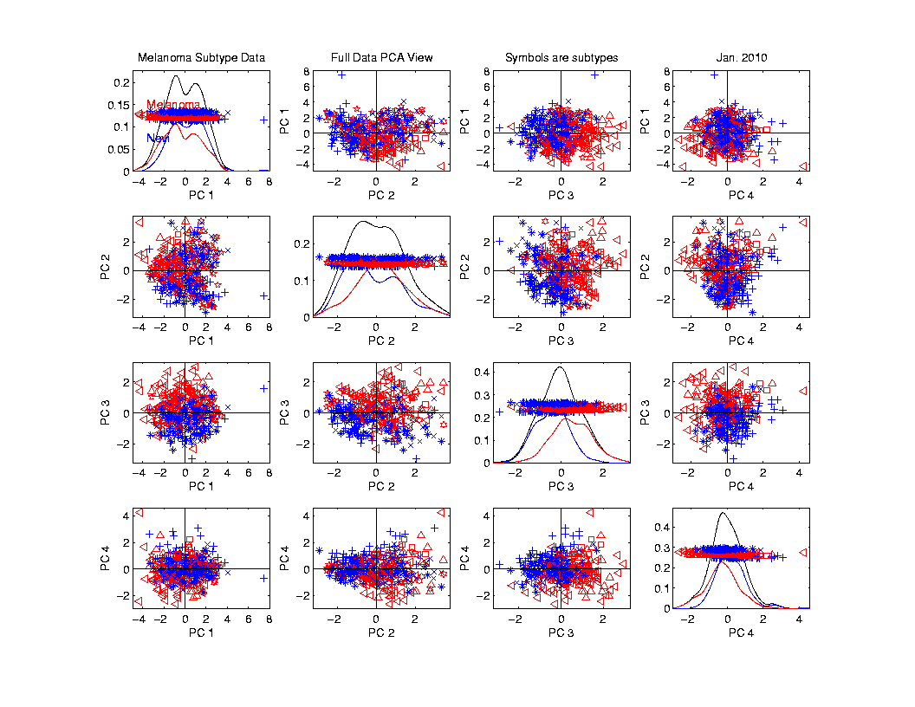
Melanoma Data
PCA
View

Slide 43
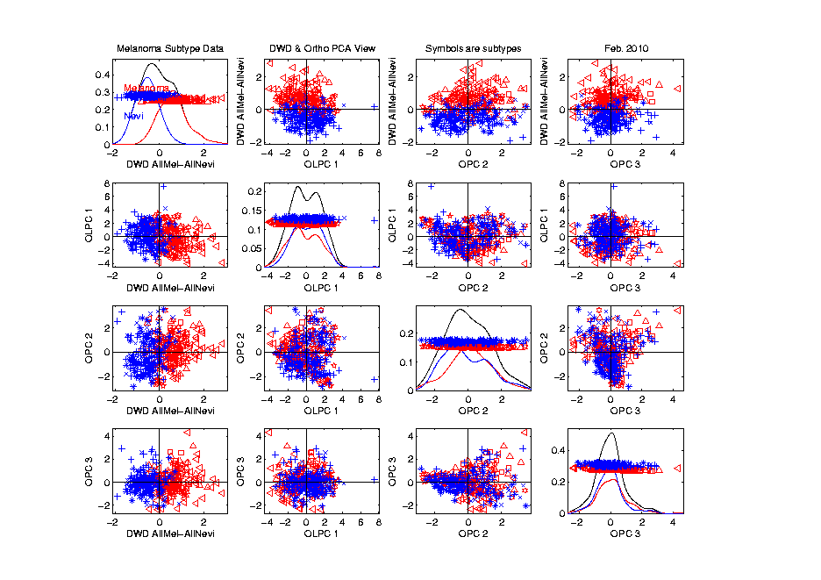
Melanoma Data
Rotate
To DWD
Direction
“Good”
Separation
???

Slide 44
Melanoma Data
Rotate
To DWD
Direction
Orthogonal
PCs
Avoid
Strange
Projections

Slide 45
Melanoma Data
Return
To
PCA
View
And
Focus
On
Subtypes

Slide 46
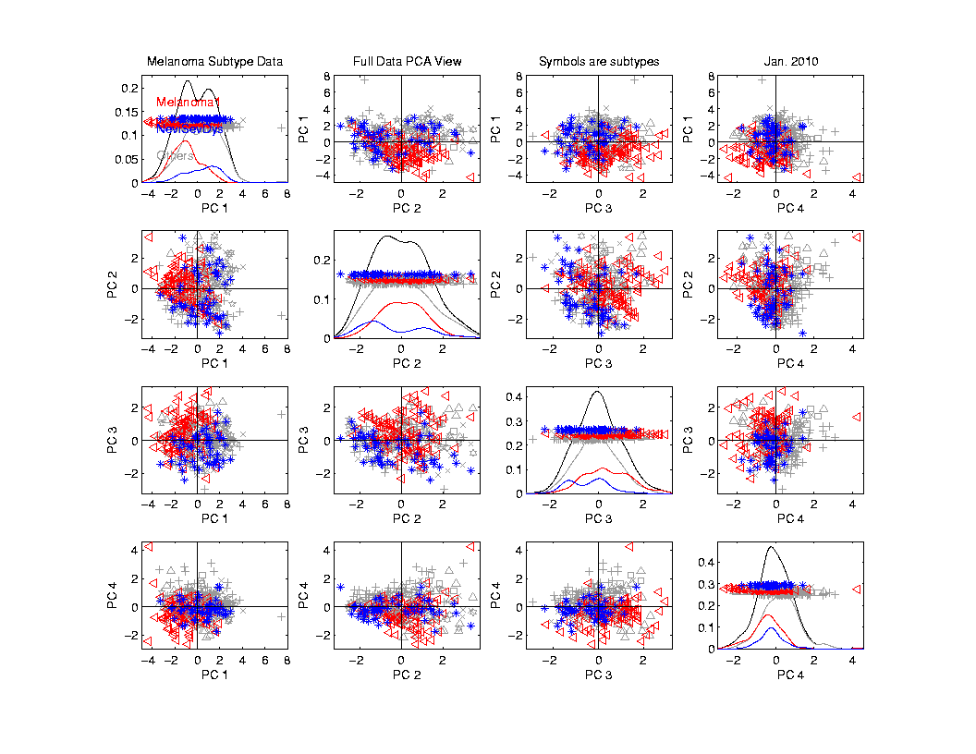
Melanoma Data
Focus
On
Subtypes:
Melanoma 1
Sev. Dys.
Nevi
Gray Out
Others

Slide 47
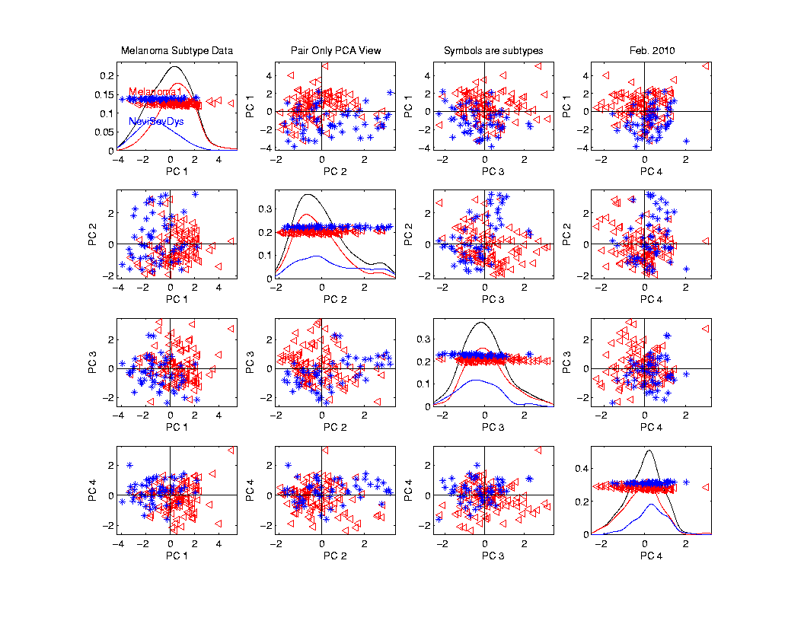
Melanoma Data
Rotate
To
Pairwise
Only
PCA
Separation
From PC1
And PC4

Slide 48
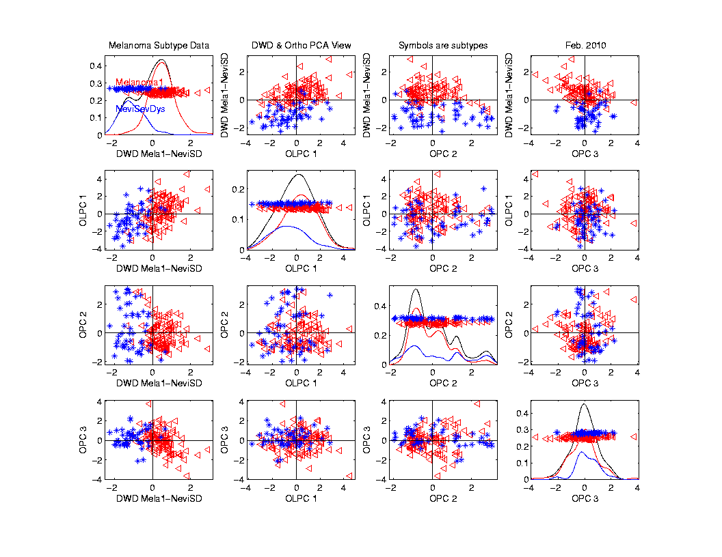
Melanoma Data
Rotate
To DWD
& Ortho PCs
Better
Separation
Than Full
Data???

Slide 49
Melanoma Data
Full Data
DWD
Direction
“Good”
Separation
???

Slide 50
Melanoma Data
Challenge:
Measure “Goodness of Separation”
Could use DiProPerm Hypothesis Test
Alternate Approach from Signal Detection:
Receiver Operator Characteristic
(ROC) Curve

Slide 51
ROC Curve
Challenge:
Measure “Goodness of Separation”
Approach from Signal Detection:
Receiver Operator Characteristic
(ROC) Curve
Developed in WWII, History in
Green and Swets (1966)

Slide 52
ROC Curve
Challenge:
Measure “Goodness of Separation”
Approach from Signal Detection:
Receiver Operator Characteristic
(ROC) Curve
Good Modern Treatment:
DeLong, DeLong & Clarke-Pearson (1988)

Slide 53
ROC Curve
Challenge:
Measure “Goodness of Separation”
Idea: For Range of Cutoffs
Plot:
Prop’n +1’s Smaller than Cutoff
Vs.
Prop’n -1s Smaller than Cutoff

Slide 54
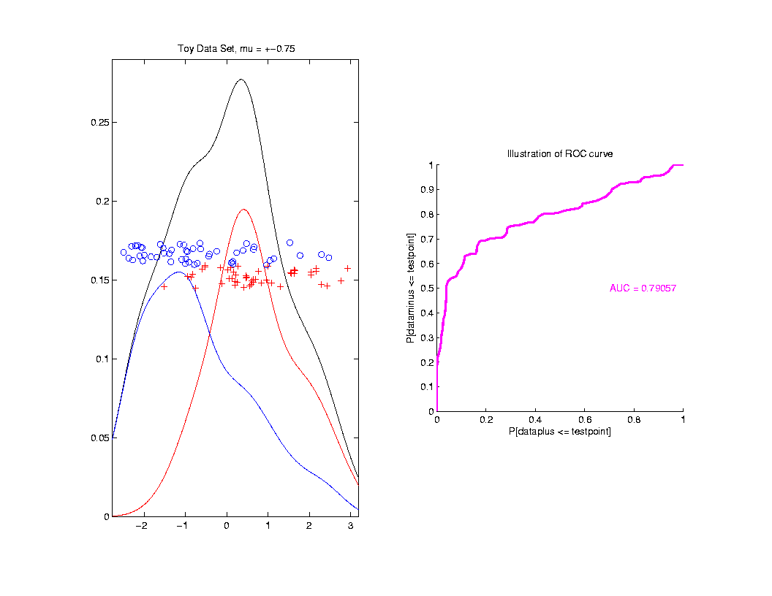
ROC Curve
Aim:
Quantify
“Overlap”
Approach
Consider
Series
Of Cutoffs

Slide 55
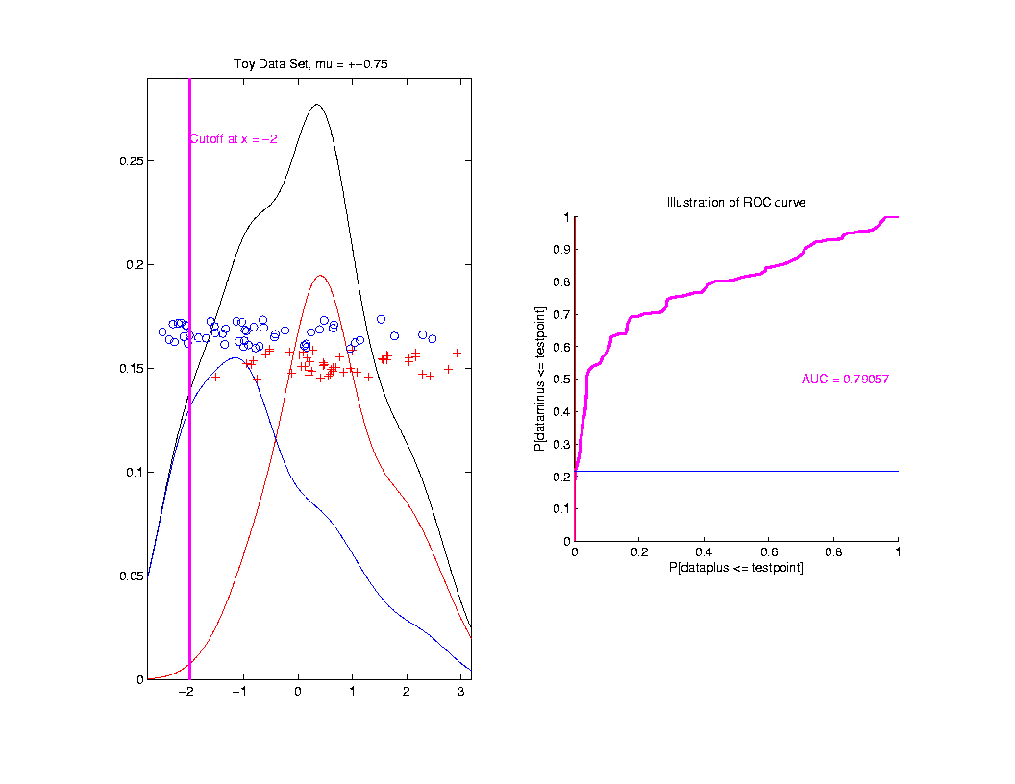
ROC Curve
Approach
Consider
Series
Of Cutoffs

Slide 56
ROC Curve
X-coord
Is Prop’n
Of Reds
Smaller

Slide 57
ROC Curve
X-coord
Is Prop’n
Of Reds
Smaller
Y-coord
Is Prop’n
Of Blues
Smaller

Slide 58
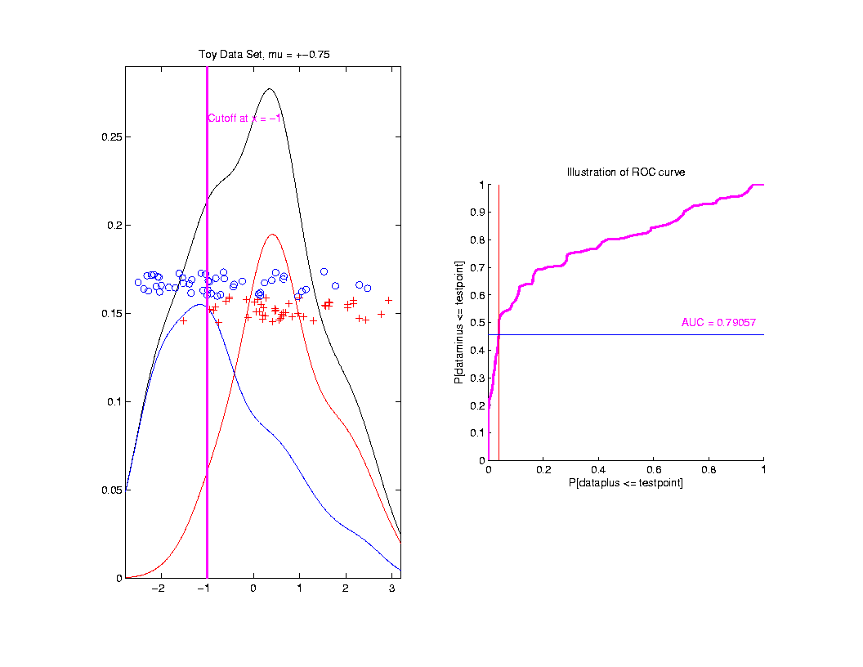
ROC Curve
Slide
Cutoff
To
Trace
Out
Curve

Slide 59
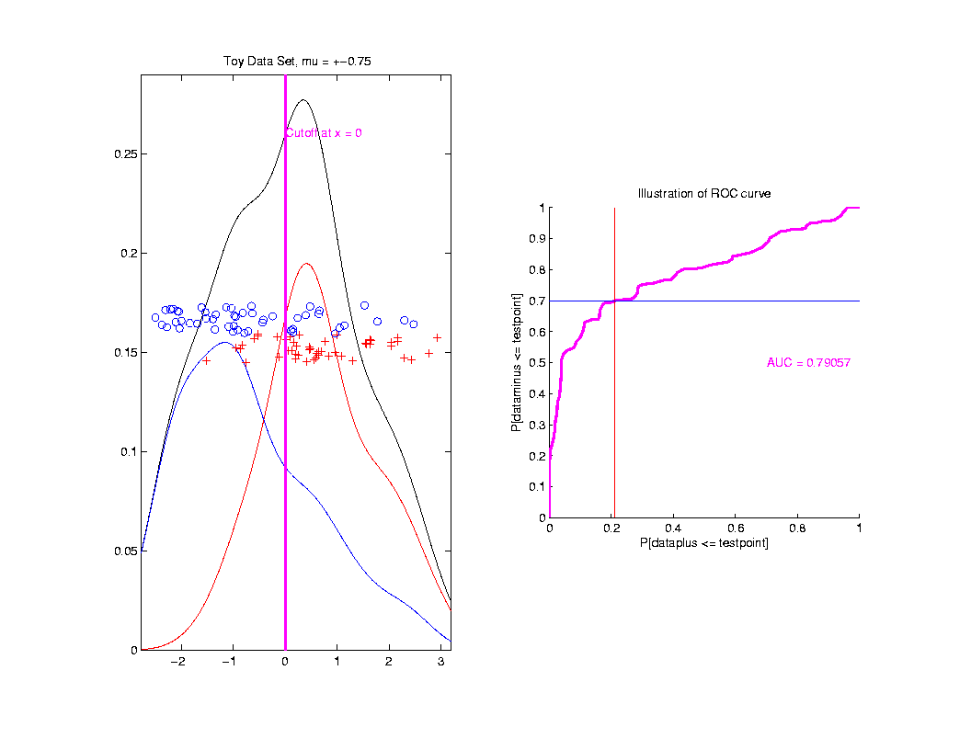
ROC Curve
Slide
Cutoff
To
Trace
Out
Curve

Slide 60
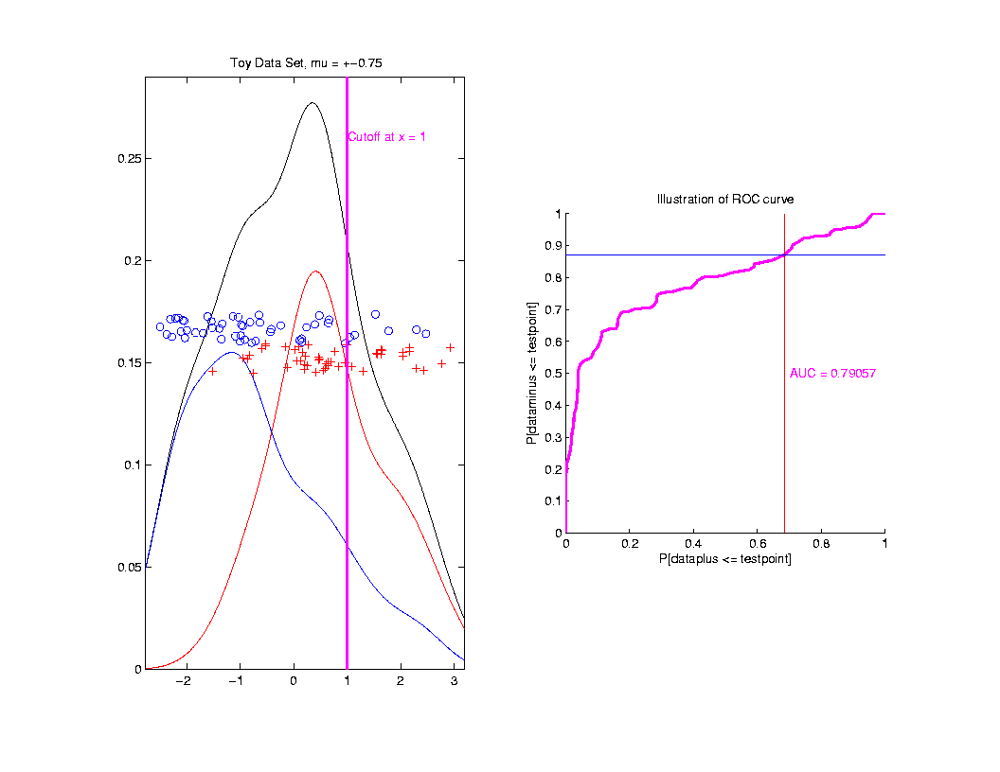
ROC Curve
Slide
Cutoff
To
Trace
Out
Curve

Slide 61
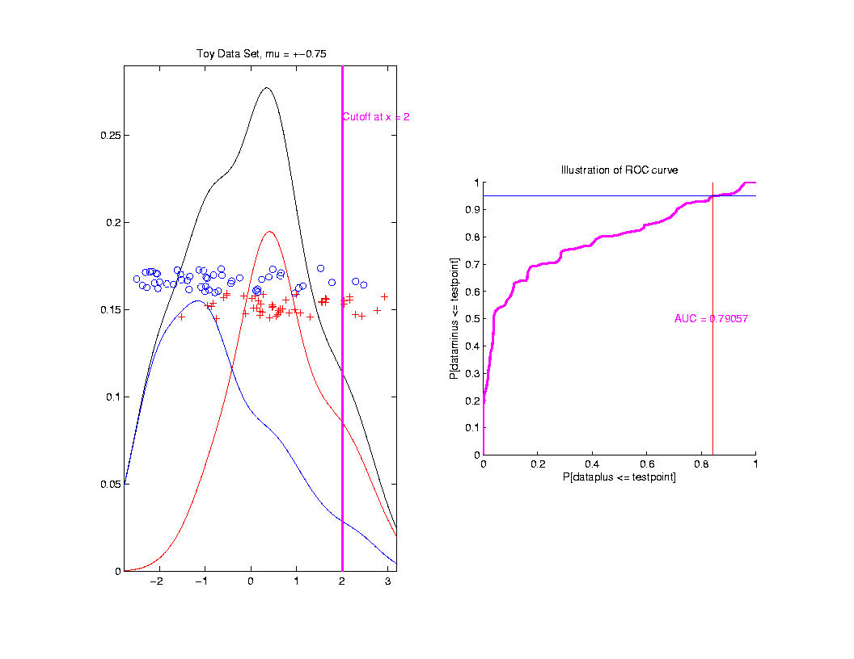
ROC Curve
Slide
Cutoff
To
Trace
Out
Curve

Slide 62
ROC Curve
Better
Separation
Is “More
To Upper
Left”

Slide 63
ROC Curve
Summarize
& Compare
Using
Area
Under
Curve
(AUC)

Slide 64
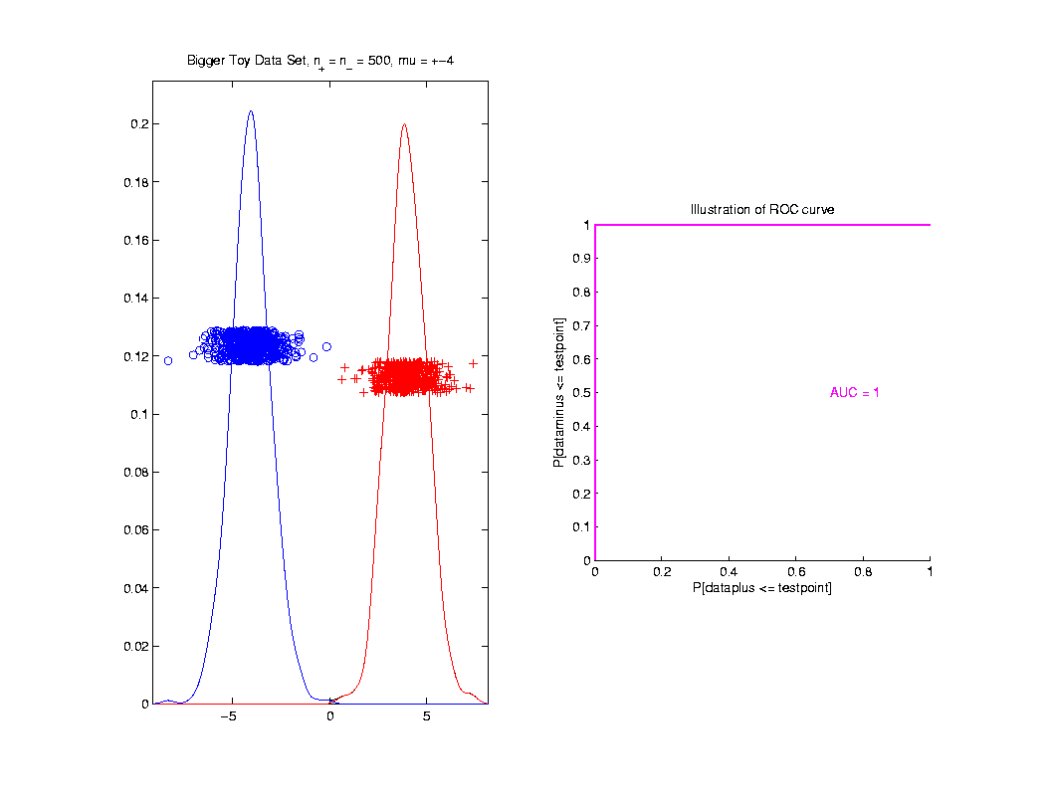
ROC Curve
Toy
Example
Perfect
Separation

Slide 65
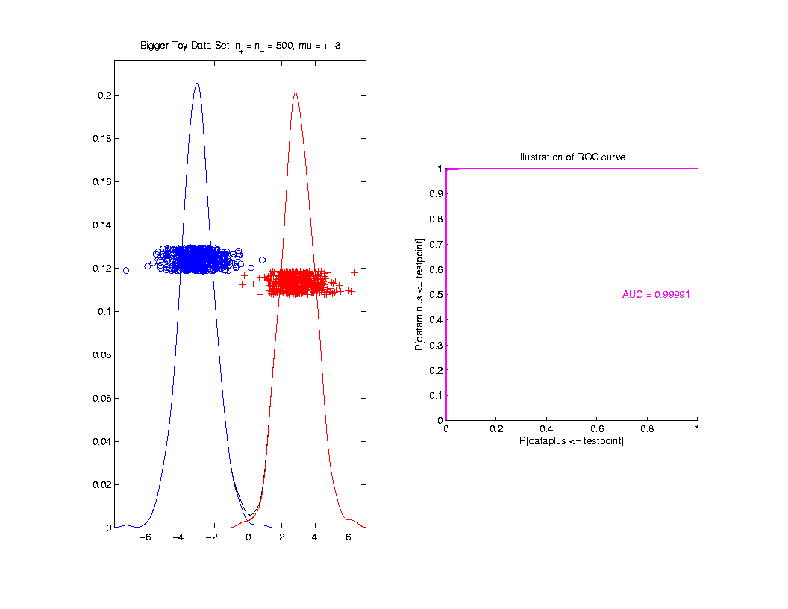
ROC Curve
Toy
Example
Very
Slight
Overlap

Slide 66
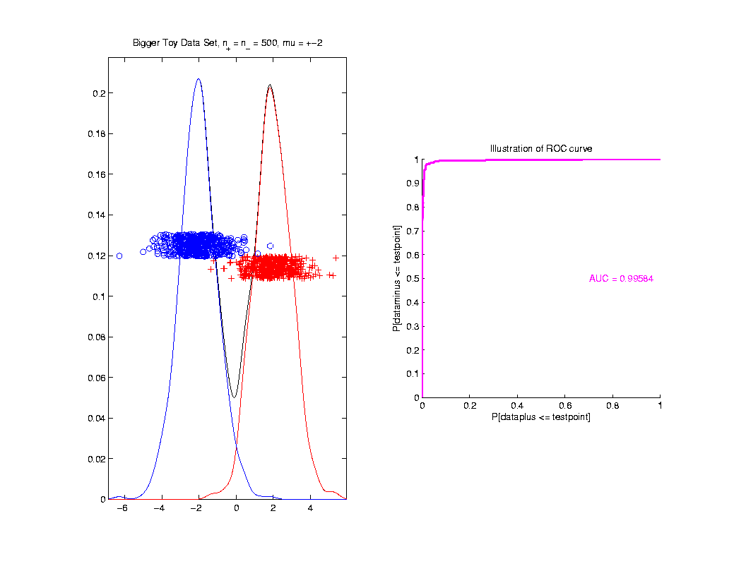
ROC Curve
Toy
Example
Little
More
Overlap

Slide 67
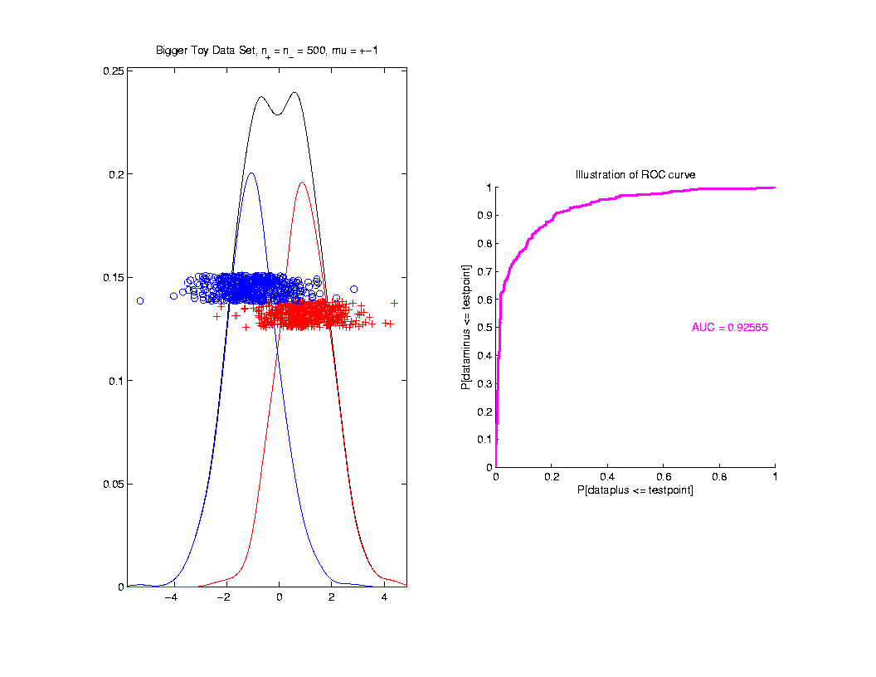
ROC Curve
Toy
Example
More
Overlap

Slide 68
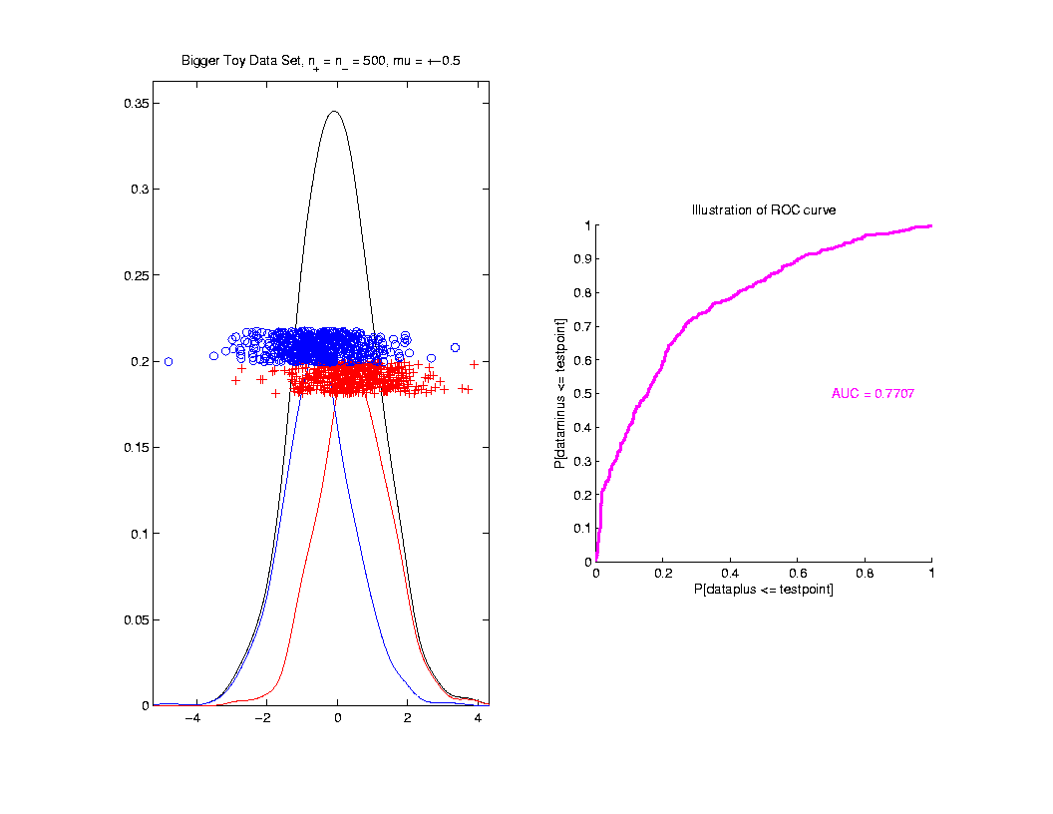
ROC Curve
Toy
Example
Much
More
Overlap

Slide 69
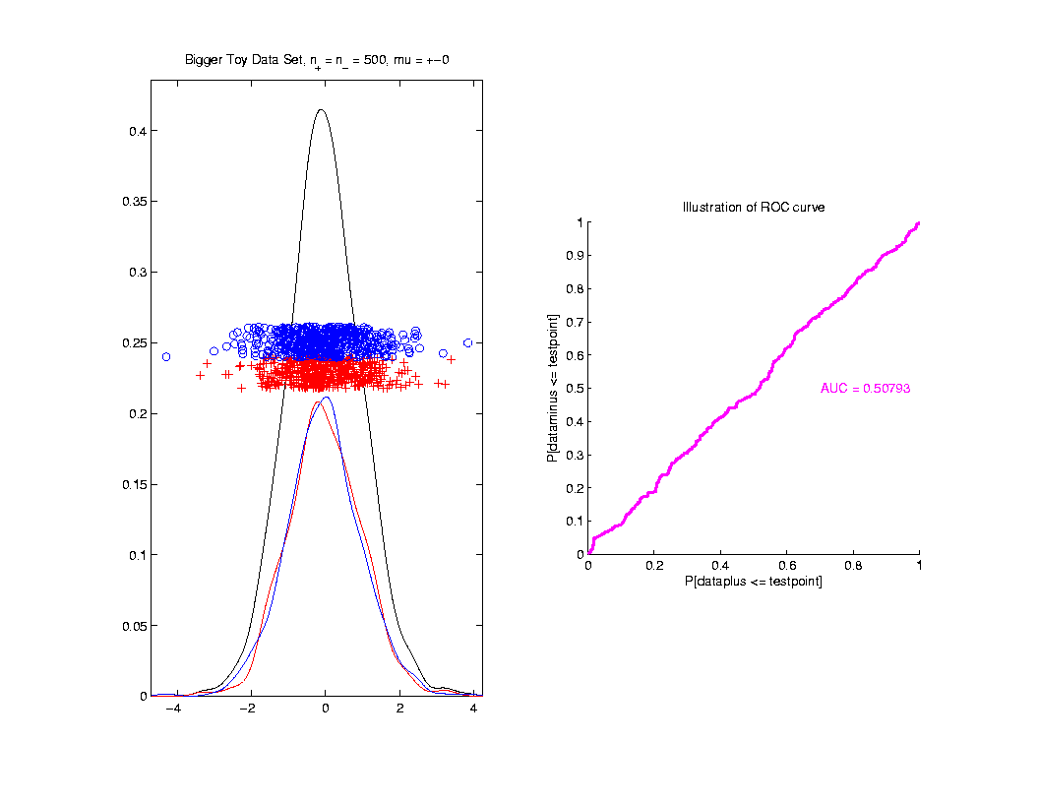
ROC Curve
Toy
Example
Complete
Overlap

Slide 70
ROC Curve
Toy
Example
Complete
Overlap
AUC ≈ 0.5 Reflects “Coin Tossing”

Slide 71
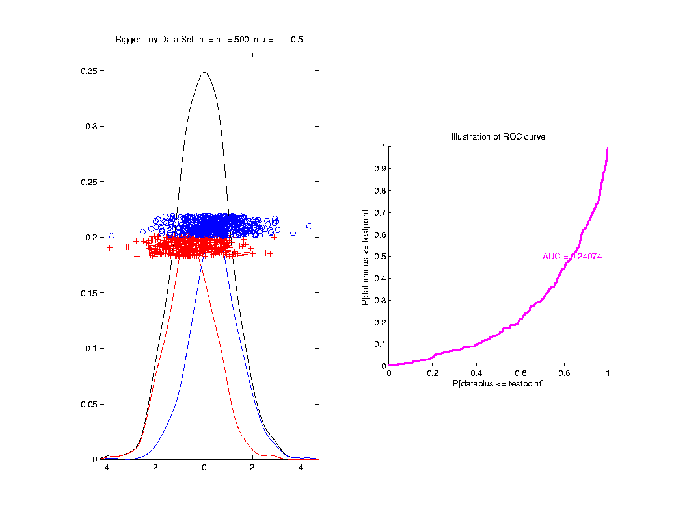
ROC Curve
Toy
Example
Can
Reflect
“Worse
Than Coin
Tossing”

Slide 72
ROC Curve
Interpretation of AUC:
Very Context Dependent
Radiology:
“> 70% has Predictive Usefulness”
Varies Field by Field
Bigger is Better

Slide 73
Melanoma Data
Recall Question:
Which Gives Better Separation of
Melanoma vs. Nevi?
DWD on All Melanoma vs. All Nevi
DWD on Melanoma 1 vs. Sev. Dys. Nevi

Slide 74
Melanoma Data
Subclass
DWD
Direction

Slide 75
Melanoma Data
Full Data
DWD
Direction

Slide 76
Melanoma Data
Recall Question:
Which Gives Better Separation of
Melanoma vs. Nevi
DWD on All Melanoma vs. All Nevi
DWD on Melanoma 1 vs. Sev. Dys. Nevi

Slide 77
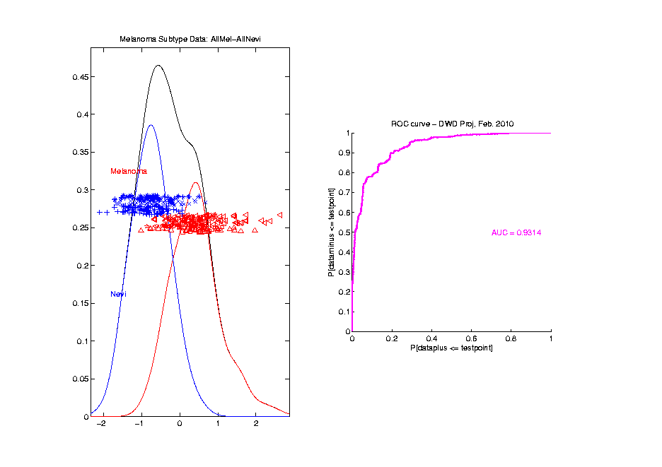
Melanoma Data
Full Data
ROC
Analysis
AUC = 0.93

Slide 78
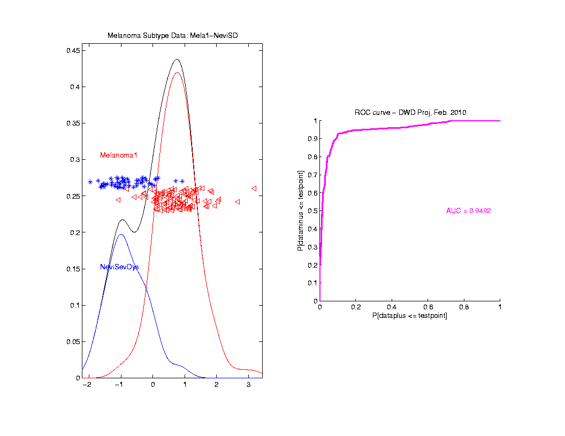
Melanoma Data
SubClass
ROC
Analysis
AUC = 0.95
Better,
Makes
Intuitive
Sense

Slide 79
Clusters in data
Common Statistical Task:
Find Clusters in Data
Interesting sub-populations?
Important structure in data?
How to do this?
PCA & visualization is very simple approach
There is a large literature of other methods
(will study more later)

Slide 80
PCA to find clusters
Toy Example (2 clusters)

Slide 81
PCA to find clusters
Toy Example (2 clusters)
Dominant direction finds very distinct clusters
Skewer through meatballs (in point cloud space)
Shows up clearly in scores plot
An important use of scores plot is finding such structure

Slide 82
PCA to find clusters
Recall Toy Example with more clusters:

Slide 83
PCA to find clusters
Best revealed by 2d scatterplots (4 clusters):

Slide 84
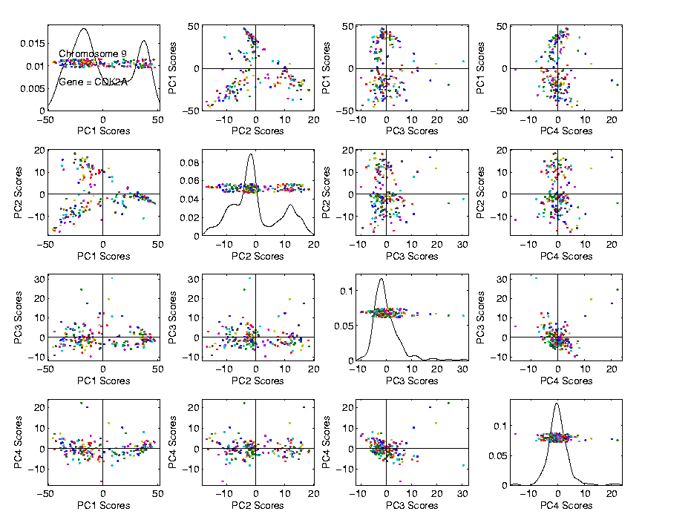
PCA to find clusters
Recall Data Discovery in RNAseq Data (1/19/16)

Slide 85
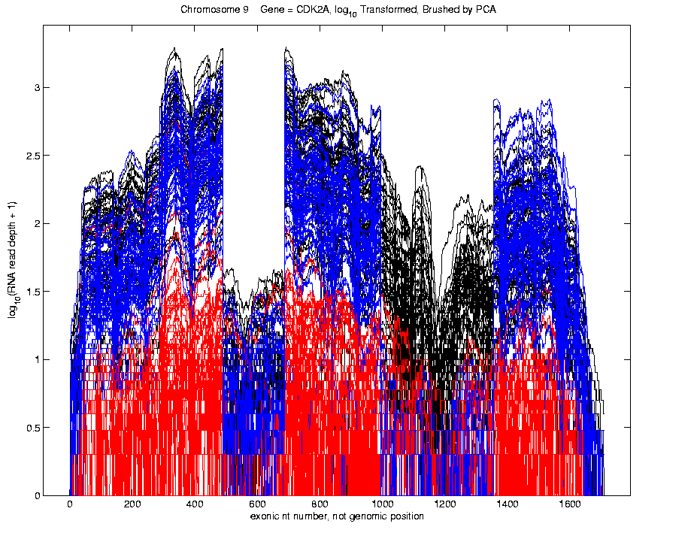
PCA to find clusters
Recall Data Discovery in RNAseq Data (1/19/16)
Used
Brushing
To Visualize
Clusters

Slide 86
PCA to find clusters
Caution: there are limitations…
Revealed by NCI60 data
Recall Microarray data
With 8 known different cancer types
Could separate out clusters
Using specialized DWD directions
But mostly not found using PCA
Recall only finds dirn’s of max variation
Does not use class label information

Slide 87
PCA to find clusters
Specific DWD directions, for NCI60 Data:
Good
Separation
Of Cancer
Types

Slide 88
PCA to find clusters
PCA directions, for NCI60 Data:
PC2:
Melanoma
PC1-3
Leukemia

Slide 89
PCA to find clusters
Off Diagonal PC1-4 & 5-8, NCI60 Data:
PC1 & 5
Renal
Leukemia
(separated)
PC2:
Melanoma

Slide 90
PCA to find clusters
Main Lesson:
PCA is limited at finding clusters
Revealed by NCI60 data
Recall Microarray data
With 8 known different cancer types
PCA does not find all 8 clusters
Recall only finds dirn’s of max variation
Does not use class label information

Slide 91
PCA to find clusters
A deeper example:
Mass Flux Data
Data from Enrica Bellone,
National Center for Atmospheric Research
Mass Flux for quantifying cloud types
How does mass change when moving into a cloud

Slide 92
PCA to find clusters
PCA of Mass Flux Data:

Slide 93
PCA to find clusters
Summary of PCA of Mass Flux Data:
Mean:
Captures General Mountain Shape
PC1:
Generally overall height of peak
shows up nicely in mean +- plot (2nd col)
3 apparent clusters in scores plot
Are those “really there”?
If so, could lead to interesting discovery
If not, could waste effort in investigation

Slide 94
PCA to find clusters
Summary of PCA of Mass Flux Data:
PC2:
Location of peak
again mean +- plot very useful here
PC3:
Width adjustment
again see most clearly in mean +- plot
Maybe non-linear modes of variation???

Slide 95
PCA to find clusters
Return to Investigation of PC1 Clusters:
Can see 3 bumps in smooth histogram
Main Question:
Important structure
or
sampling variability?
Approach: SiZer
(SIgnificance of ZERo crossings of deriv.)

