Slide 1
Statistical Smoothing
In 1 Dimension
(Numbers as Data Objects)

Slide 2
Statistical Smoothing
In 1 Dimension, 2 Major Settings:
Density Estimation
“Histograms”
Nonparametric Regression
“Scatterplot Smoothing”

Slide 3
Density Estimation
E.g. Hidalgo Stamp Data
Thicknesses of Postage Stamps
Produced in Mexico
Over ~ 70 years
During 1800s
Paper produced in several factories?
How many factories? (Records lost)
Brought to statistical literature by:
Izenman and Sommer (1988)

Slide 4
Density Estimation
E.g. Hidalgo Stamp Data
Thicknesses of Postage Stamps
Produced in Mexico
Over ~ 70 years
During 1800s
Paper produced in several factories?
(Thicknesses vary by up to factor of 2)

Slide 5
Density Estimation
E.g. Hidalgo Stamp Data
A histogram
“Oversmoothed”
Bin Width too
large?
Miss important
structure?

Slide 6
Density Estimation
E.g. Hidalgo Stamp Data
Another histogram
Smaller binwidth
Suggests 2 modes?
2 factories making
the paper?

Slide 7
Density Estimation
E.g. Hidalgo Stamp Data
Another histogram
Smaller binwidth
Suggests 6 modes?
6 factories making
the paper?

Slide 8
Density Estimation
E.g. Hidalgo Stamp Data
Another histogram
Even smaller binwidth
Suggests many modes?
Really believe
modes are “there”?
Or just sampling
variation?

Slide 9
Density Estimation
E.g. Hidalgo Stamp Data
Critical Issue for histograms:
Choice of binwidth (well understood?)

Slide 10
Histograms
Less Well Understood Issue:
Choice of bin location
Major impact on number of modes (2-7)
All for same binwidth

Slide 11
Histograms
Choice of bin location:
What is going on?
Compare with Average Histogram

Slide 12
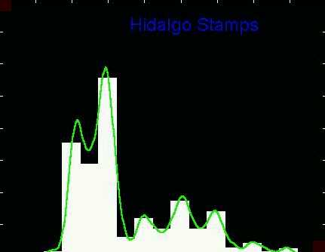
Density Estimation
Compare shifts with Average Histogram
For 7 mode shift
Peaks line up with bin centers
So shifted histo’s
find peaks

Slide 13
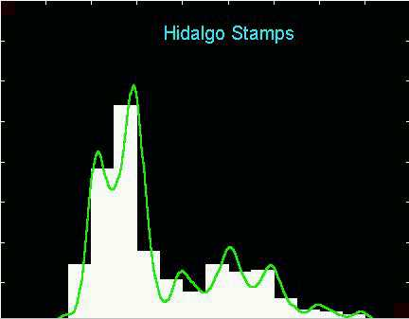
Density Estimation
Compare shifts with Average Histogram
For 2 (3?) mode shift
Peaks split between bins
So shifted histo’s
miss peaks

Slide 14
Density Estimation
Histogram Drawbacks:
Need to choose bin width
Need to choose bin location
But Average Histogram reveals structure
So should use that, instead of histo
Name: Kernel Density Estimate

Slide 15
Kernel Density Estimation
Chondrite Data:
Stony (metal) Meteorites (hit the earth)
So have a chunk of rock
Study “% of silica”
From how many sources?
Only 22 rocks…
Histogram hopeless?
Brought to statistical literature by:
Good and Gaskins (1980)

Slide 16
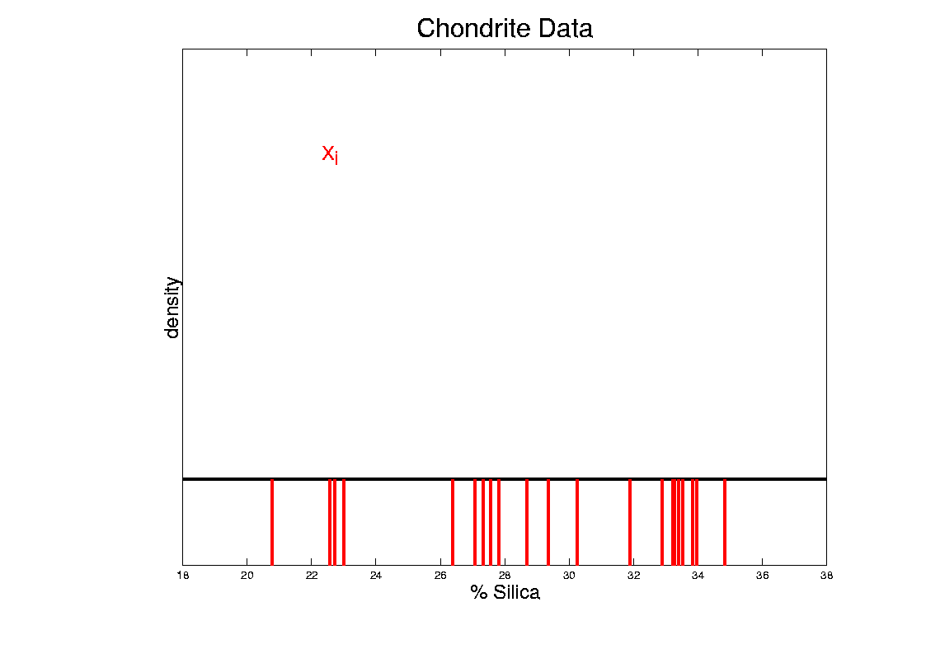
Kernel Density Estimation
Chondrite Data:
Represent points by red bars
Where are data “more dense”?

Slide 17
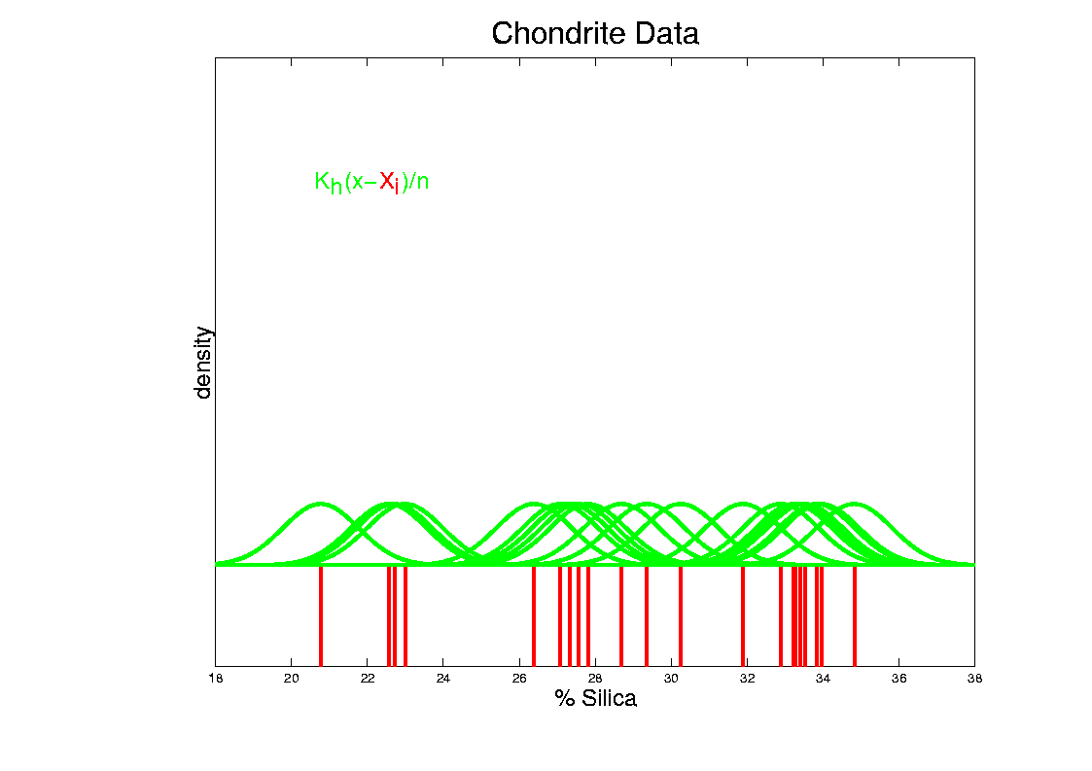
Kernel Density Estimation
Chondrite Data:
Put probability mass 1/n at each point
Smooth piece of “density”

Slide 18
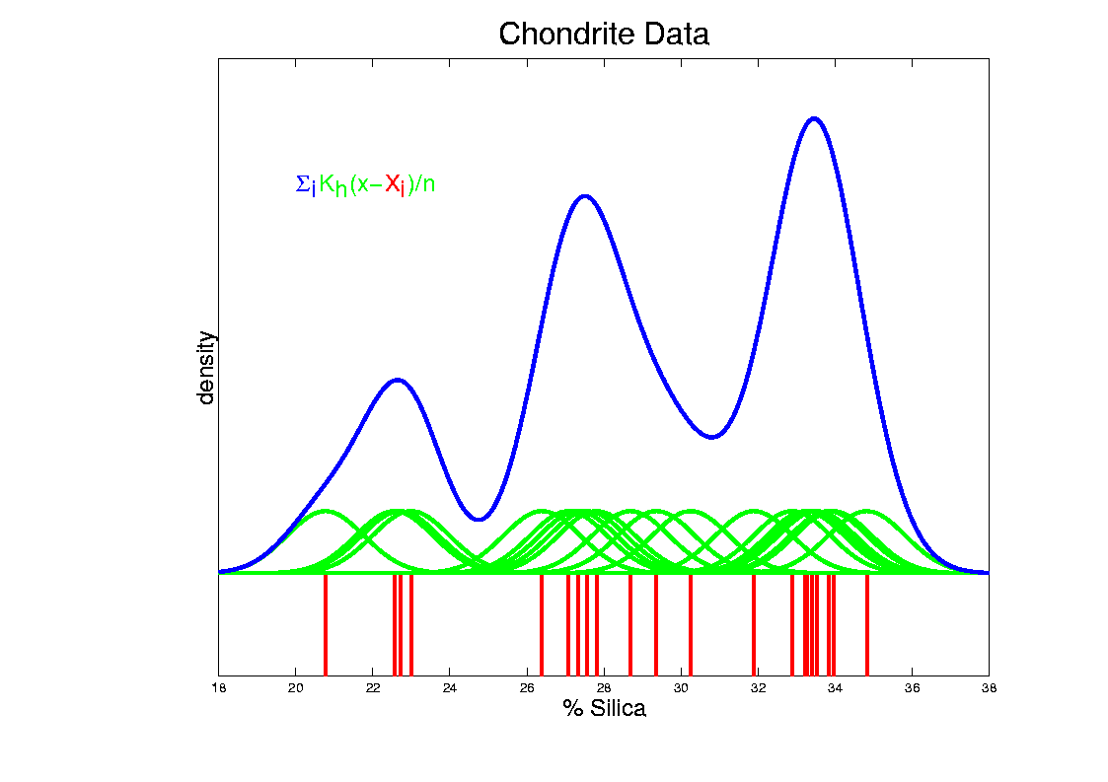
Kernel Density Estimation
Chondrite Data:
Sum pieces to estimate density
Suggests 3 modes (rock sources)

Slide 19
Kernel Density Estimation
Mathematical Notation:
$${\hat{f}}_{h}\left(x\right)=\frac{1}{n}\sum_{i=1}^{n}{K_{h}\left(x−X_{i}\right)}$$
Where
Window shape given by “kernel”,
$$K_{h}\left(∙\right)=\frac{1}{h}K\left(\frac{∙}{h}\right)$$
Window width given by “bandwidth”, $h$

Slide 20
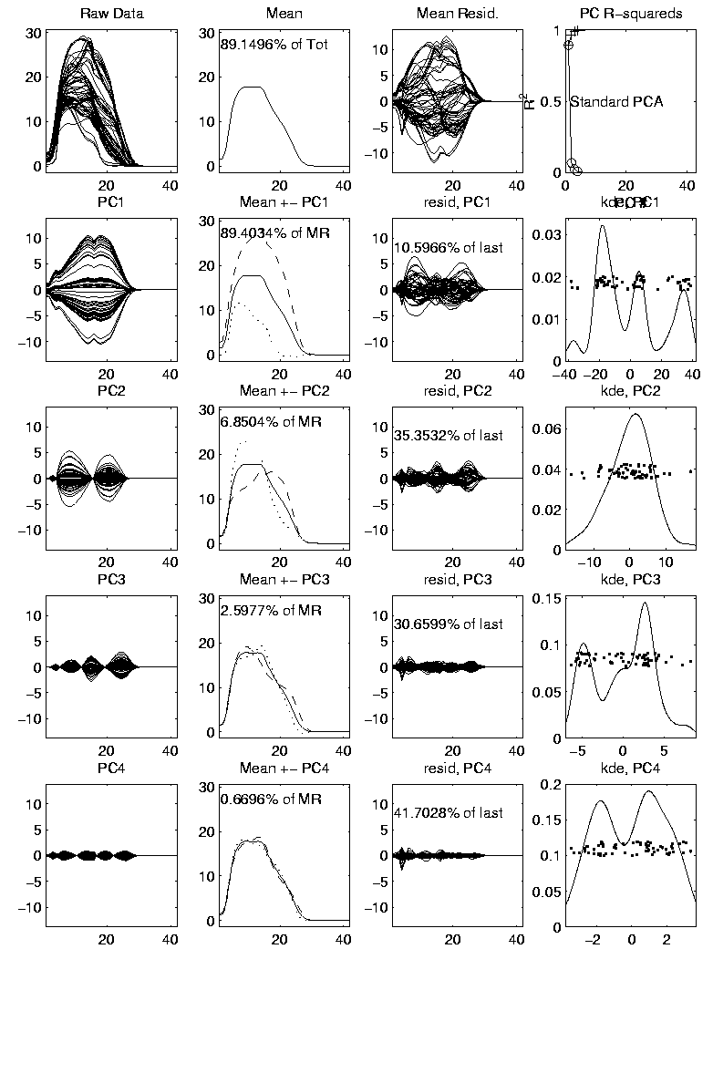
Kernel Density Estimation
Mathematical Notation:
$${\hat{f}}_{h}\left(x\right)=\frac{1}{n}\sum_{i=1}^{n}{K_{h}\left(x−X_{i}\right)}$$
This
Was
Used
In PCA
Graphics

Slide 21
Kernel Density Estimation
Choice of kernel (window shape)?
Controversial issue
Want Computational Speed?
Want Statistical Efficiency?
Want Smooth Estimates?
There is more, but personal choice:
Gaussian
Good Overall Reference:
Wand and Jones (1994)

Slide 22
Kernel Density Estimation
Choice of bandwidth (window width)?
Very important to performance
Fundamental Issue:
Which modes are “really there”?

Slide 23
Density Estimation
How to use histograms if you must:
Undersmooth (minimizes bin edge effect)
Human eye is OK at “post-smoothing”

Slide 24
Statistical Smoothing
2 Major Settings:
Density Estimation
“Histograms”
Nonparametric Regression
“Scatterplot Smoothing”

Slide 25
Scatterplot Smoothing
E.g. Bralower Fossil Data
Prof. of Geosciences
Penn. State Univ.

Slide 26
Scatterplot Smoothing
E.g. Bralower Fossil Data
Study Global Climate
Time scale of millions of years
Data points are fossil shells
Dated by surrounding material
Ratio of Isotopes of Strontium
(differences in 4th decimal point!)
Surrogate for Sea Level (Ice Ages)
Data seem to have structure…

Slide 27
Scatterplot Smoothing
E.g. Bralower Fossil Data

Slide 28
Scatterplot Smoothing
E.g. Bralower Fossil Data
Way to bring out structure:
Smooth the data
Methods of smoothing?
Local Averages
Splines (several types)
Fourier – trim high frequencies
Other bases
…
Also controversial

Slide 29
Scatterplot Smoothing
E.g. Bralower Fossil Data – some smooths

Slide 30
Scatterplot Smoothing
A simple approach: local averages
Given data: $\left(X_{1},Y_{1}\right),⋯,\left(X_{n},Y_{n}\right)$
Model in regression form:
$$E\left(Y_{i}\right)=m\left(X_{i}\right), i=1,⋯,n$$
How to estimate $m\left(x\right)$?

Slide 31
Scatterplot Smoothing
A simple approach: local averages
Given a kernel window function:
$$K_{h}\left(x\right)=\frac{1}{h}K\left(\frac{x}{h}\right)$$
Estimate the curve $m\left(x\right)$
by a $K_{h}$ weighted local average:
$${\hat{m}}_{h}\left(x\right)=\frac{\sum_{i=1}^{n}{K_{h}\left(x−X_{i}\right)Y_{i}}}{\sum_{i=1}^{n}{K_{h}\left(x−X_{i}\right)}}$$

Slide 32
Scatterplot Smoothing
Interesting representation of local average:
Given kernel window weights,
$$K_{h}\left(x\right)=\frac{1}{h}K\left(\frac{x}{h}\right)$$
Local Constant Least Squares Fit to Data:
$${\hat{m}}_{h}\left(x\right)={argmin}_{a}\sum_{i=1}^{n}{K_{h}\left(x−X_{i}\right){\left(Y_{i}−a\right)}^{2}}$$

Slide 33
Scatterplot Smoothing
Local Constant Fits (visually):
“Moving Average”
Window width $h$ is critical (~ k.d.e.)

Slide 34
Scatterplot Smoothing
Interesting variation:
Local linear fit to data:
Given kernel window weights, $K_{h}\left(x\right)=\frac{1}{h}K\left(\frac{x}{h}\right)$
${\hat{m}}_{h}\left(x\right)={argmin}_{a}\sum_{i=1}^{n}{K_{h}\left(x−X_{i}\right){\left(Y_{i}−\left(bX_{i}+a\right)\right)}^{2}}$

Slide 35
Scatterplot Smoothing
Local Linear Fits (visually):
“Intercept of Moving Fit Line”
Window width $h$ is critical (~ k.d.e.)

Slide 36
Scatterplot Smoothing
Another variation:
“Intercept of Moving Polynomial Fit”
Window width $h$ is critical (~ k.d.e.)

Slide 37
Scatterplot Smoothing
Local Polynomial Smoothing
What is best polynomial degree?
Once again controversial…
Advocates for all of 0, 1, 2, 3.
Depends on personal weighting of factors involved
Good reference:
Fan & Gijbels (1995)
Personal choice: degree 1, local linear

Slide 38
Scatterplot Smoothing
E.g. Bralower Fossils – local linear smooths

Slide 39
Scatterplot Smoothing
Smooths of Bralower Fossil Data:
Oversmoothed misses structure
Undersmoothed feels sampling noise?
About right shows 2 valleys:
One seems clear
Is other one really there?
Same question as above…

Slide 40
Kernel Density Estimation
Choice of bandwidth (window width)?
Very important to performance
Fundamental Issue:
Which modes are “really there”?

Slide 41
Kernel Density Estimation
Choice of bandwidth (window width)?
Very important to performance
Data Based Choice?
Controversial Issue
Many recommendations
Suggested Reference:
Jones, Marron & Sheather (1996)
Never a consensus…

Slide 42
Kernel Density Estimation
Choice of bandwidth (window width)?
Alternate Choice:
Consider all of them!
I.e. look at whole spectrum of smooths
Can see different structure
At different smoothing levels
Connection to Scale Space
E.g. Stamps data
How many modes?
All answers are there….

Slide 43
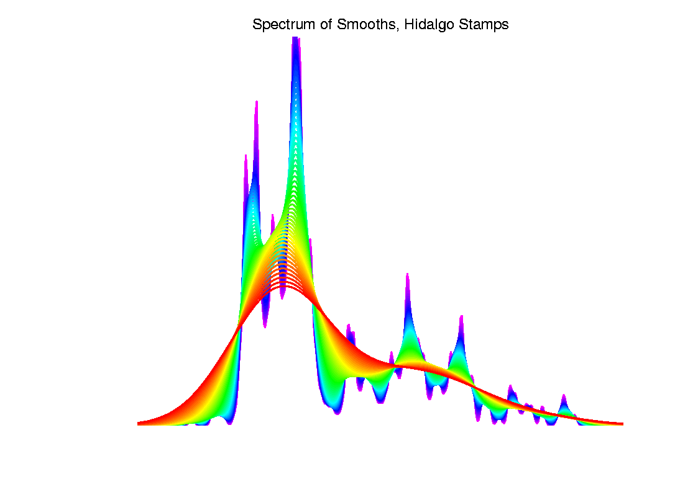
Kernel Density Estimation

Slide 44
Statistical Smoothing
Fundamental Question
For both of
Density Estimation: “Histograms”
Regression: “Scatterplot Smoothing”
Which bumps are “really there”?
vs. “artifacts of sampling noise”?

