Slide 1
Radial DWD
Consider Training Data
But What About
Test Point In A
Different Corner
???
Notes:
1

Slide 2
Radial DWD
Approach:
Replace Separating Plane
With Separating Sphere
Find Parameters
Via DWD-like
Optimization
Enables Finding Corners
With No Training Data
Notes:
2

Slide 3
Virus Hunting
Compare With Other Classifiers
Even Kernel SVM Fails!!!
Reason:
Test Data
Lies In
Corners
With No
Training
Data
Notes:
3

Slide 4
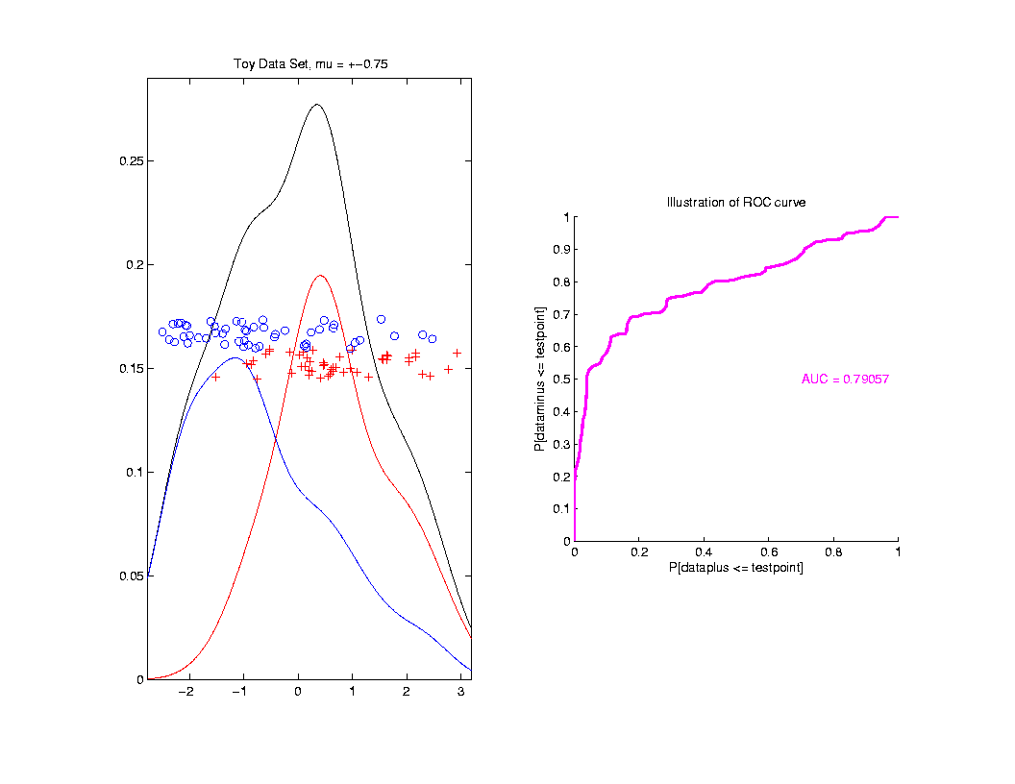
ROC Curve
Summarize
& Compare
Using
Area
Under
Curve
(AUC)

Slide 5
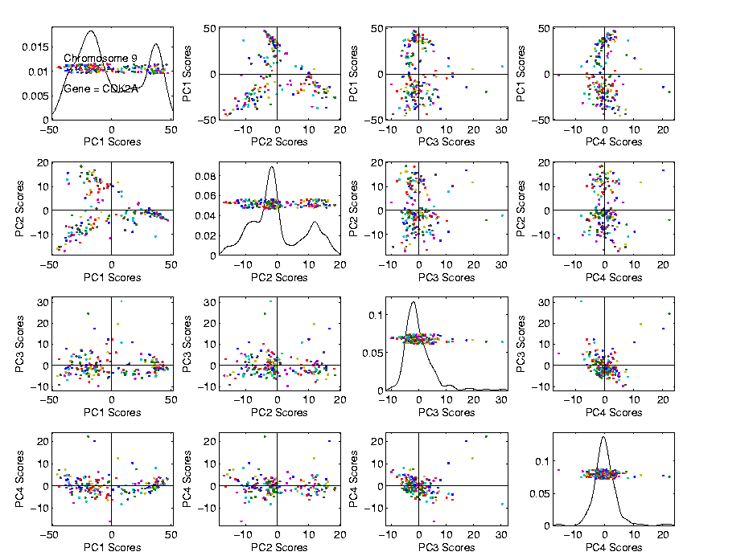
PCA to find clusters
Recall Data Discovery in RNAseq Data (1/19/16)

Slide 6
PCA to find clusters
PCA of Mass Flux Data:

Slide 7
PCA to find clusters
Return to Investigation of PC1 Clusters:
Can see 3 bumps in smooth histogram
Main Question:
Important structure
or
sampling variability?
Approach: SiZer
(SIgnificance of ZERo crossings of deriv.)

Slide 8
Statistical Smoothing
In 1 Dimension, 2 Major Settings:
Density Estimation
“Histograms”
Nonparametric Regression
“Scatterplot Smoothing”

Slide 9
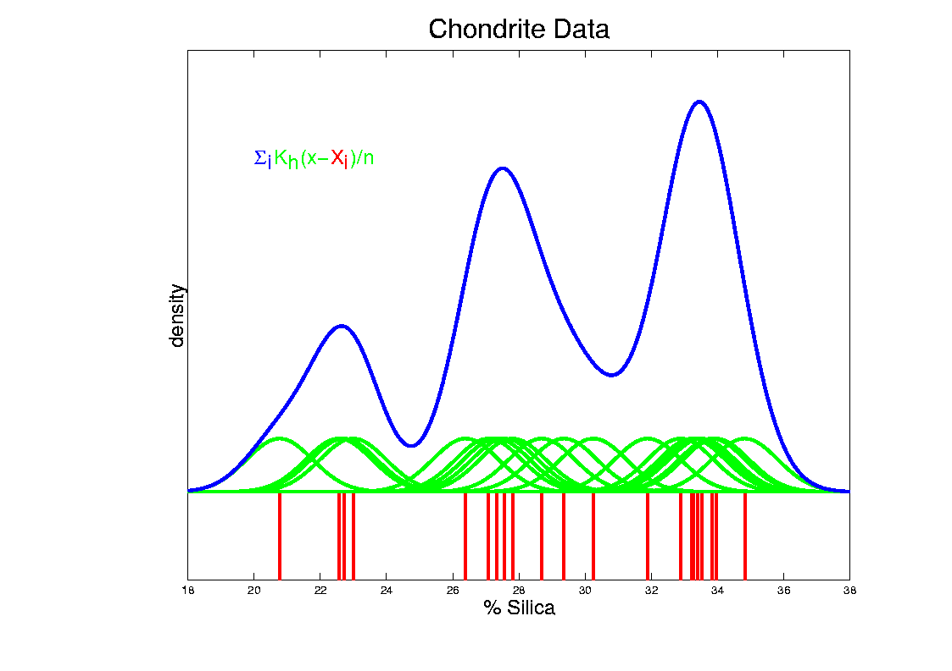
Kernel Density Estimation
Chondrite Data:
Sum pieces to estimate density
Suggests 3 modes (rock sources)

Slide 10
Scatterplot Smoothing
E.g. Bralower Fossil Data – some smooths

Slide 11
Scatterplot Smoothing
Interesting representation of local average:
Given kernel window weights,
$$K_{h}\left(x\right)=\frac{1}{h}K\left(\frac{x}{h}\right)$$
Local Constant Least Squares Fit to Data:
$${\hat{m}}_{h}\left(x\right)={argmin}_{a}\sum_{i=1}^{n}{K_{h}\left(x−X_{i}\right){\left(Y_{i}−a\right)}^{2}}$$

Slide 12
Scatterplot Smoothing
Interesting variation:
Local linear fit to data:
Given kernel window weights, $K_{h}\left(x\right)=\frac{1}{h}K\left(\frac{x}{h}\right)$
${\hat{m}}_{h}\left(x\right)={argmin}_{a}\sum_{i=1}^{n}{K_{h}\left(x−X_{i}\right){\left(Y_{i}−\left(bX_{i}+a\right)\right)}^{2}}$

Slide 13
Scatterplot Smoothing
Another variation:
“Intercept of Moving Polynomial Fit”
Window width $h$ is critical (~ k.d.e.)

Slide 14
Scatterplot Smoothing
Local Polynomial Smoothing
What is best polynomial degree?
Once again controversial…
Advocates for all of 0, 1, 2, 3.
Depends on personal weighting of factors involved
Good reference:
Fan & Gijbels (1995)
Personal choice: degree 1, local linear

Slide 15
Scatterplot Smoothing
E.g. Bralower Fossils – local linear smooths

Slide 16
Scatterplot Smoothing
Smooths of Bralower Fossil Data:
Oversmoothed misses structure
Undersmoothed feels sampling noise?
About right shows 2 valleys:
One seems clear
Is other one really there?
Same question as above…

Slide 17
Kernel Density Estimation
Choice of bandwidth (window width)?
Very important to performance
Fundamental Issue:
Which modes are “really there”?

Slide 18
Kernel Density Estimation
Choice of bandwidth (window width)?
Very important to performance
Data Based Choice?
Controversial Issue
Many recommendations
Suggested Reference:
Jones, Marron & Sheather (1996)
Never a consensus…

Slide 19
Kernel Density Estimation
Choice of bandwidth (window width)?
Alternate Choice:
Consider all of them!
I.e. look at whole spectrum of smooths
Can see different structure
At different smoothing levels
Connection to Scale Space
E.g. Stamps data
How many modes?
All answers are there….

Slide 20
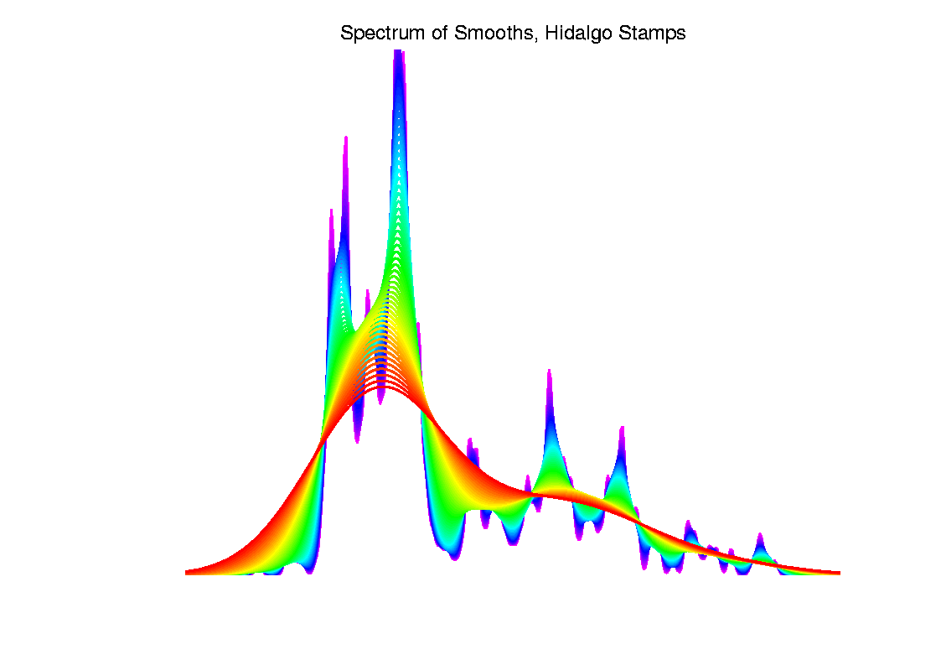
Kernel Density Estimation

Slide 21
Statistical Smoothing
Fundamental Question
For both of
Density Estimation: “Histograms”
Regression: “Scatterplot Smoothing”
Which bumps are “really there”?
vs. “artifacts of sampling noise”?

Slide 22
SiZer Background
Scale Space – Idea from Computer Vision
Goal: Teach Computers to “See”
Modern Research:
Extract “Information” from Images
Early Theoretical work

Slide 23
SiZer Background
Scale Space – Idea from Computer Vision
Conceptual basis:
Oversmoothing = “view from afar”
(macroscopic)
Undersmoothing = “zoomed in view”
(microscopic)
Main idea: all smooths contain useful information, so study “full spectrum”
(i. e. all smoothing levels)
Recommended reference: Lindeberg (1994)

Slide 24
SiZer Background
Fun Scale Space Views
(of Family Incomes Data)

Slide 25
SiZer Background
Fun Scale Space Views (Incomes Data)
Spectrum Overlay

Slide 26
SiZer Background
Fun Scale Space Views (Incomes Data)
Surface View

Slide 27
SiZer Background
Fun Scale Space Views
(of Family Incomes Data)
Note:
The scale space viewpoint makes
Data Dased Bandwidth Selection
Much less important
(than I once thought….)

Slide 28
SiZer Background
SiZer:
Significance of Zero crossings, of the derivative, in scale space
Combines:
needed statistical inference
novel visualization
To get: a powerful exploratory data analysis method
Main references:
Chaudhuri & Marron (1999)
Hannig & Marron (2006)

Slide 29
SiZer Background
Basic idea: a bump is characterized by:
an increase
followed by a decrease
Generalization:
Many features of interest captured
by sign of the slope of the smooth
Foundation of SiZer:
Statistical inference on slopes,
over scale space

Slide 30
SiZer Background
SiZer Visual presentation:
Color map over scale space:
Blue: slope significantly upwards
(derivative CI above 0)
Red: slope significantly downwards
(derivative CI below 0)
Purple: slope insignificant
(derivative CI contains 0)

Slide 31
SiZer Background
SiZer analysis of Fossils data:

Slide 32
SiZer Background
SiZer analysis of Fossils data:
Upper Left: Scatterplot, family of smooths, 1 highlighted
Upper Right: Scale space rep’n of family, with SiZer colors
Lower Left: SiZer map, more easy to view
Lower Right: SiCon map – replace slope by curvature
Slider (in movie viewer) highlights different smoothing levels

Slide 33
SiZer Background
SiZer analysis of Fossils data (cont.):
Oversmoothed (top of SiZer map):
Decreases at left, not on right
Medium smoothed (middle of SiZer map):
Main valley significant, and left most increase
Smaller valley not statistically significant
Undersmoothed (bottom of SiZer map):
“noise wiggles” not significant
Additional SiZer color: gray - not enough data for inference

Slide 34
SiZer Background
SiZer analysis of Fossils data (cont.):
Common Question: Which is right?
Decreases on left, then flat
(top of SiZer map)
Up, then down, then up again
(middle of SiZer map)
No significant features
(bottom of SiZer map)
Answer: All are right
Just different scales of view,
i.e. levels of resolution of data

Slide 35
SiZer Background
SiZer analysis of British Incomes data:

Slide 36
SiZer Background
SiZer analysis of British Incomes data:
Oversmoothed: Only one mode
Medium smoothed: Two modes, statistically significant
Confirmed by Schmitz & Marron, (1992)
Undersmoothed: many noise wiggles, not significant
Again: all are correct,
just different scales

Slide 37
SiZer Background
E.g. - Marron & Wand (1992) Trimodal #9
Increasing n
Only 1 Signif’t Mode
Now 2 Signif’t Modes
Finally all 3 Modes

Slide 38
SiZer Background
E.g. - Marron & Wand Discrete Comb #15
Increasing n
Coarse Bumps Only
Now Fine bumps too
Someday: “draw” local
Bandwidth on SiZer map

