Slide 1
Automatic Data Transformation
Qing Feng
Joint work with Dr. Jan Hannig, Dr. J. S. Marron
Mar. 22th, 2016

Slide 2
Transformations
Useful Method for Data Analysts
Apply to Marginal Distributions
(i.e. to Individual Variables)
Idea
Data close to normality
Notes:
Goal: apply transformation marginally to each feature
Dr. Marron have already talked about the usefulness of transformation.
Today we will dive deeper into the data transformation and see how can automate it to handle data with many variables in another words high dimensional data sets.
First let’s do a recap about the transformation
Transformation is in fact a useful step in the preliminary analysis. Because most classical methods works for data that are approximately normal distributed. We will check each variable and try to improve the closeness of the data distribution to normality.

Slide 3
Transformations
Example: Melanoma Data Analysis
Miedema, et al (2012)
Notes:
One motivated example comes from the melanoma data set in which you have different image features which are very non-Gaussian data

Slide 4
Transformations
Statistical Challenge:
Strong skewness
Some Features Spread Over Several Orders of Magnitude
Few Big Values Can Dominate Analysis
Notes:
Very non-Gaussian data
1. They presents strong skewness 2. 3.

Slide 5
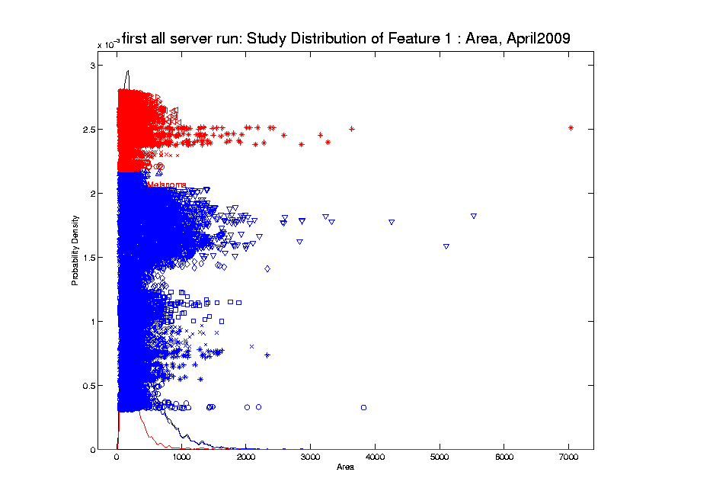
Transformations
Few Large Values Can Dominate Analysis
Notes:
Magnitude difference, right skewness (positive skewness), non-Gaussian, a few large values

Slide 6
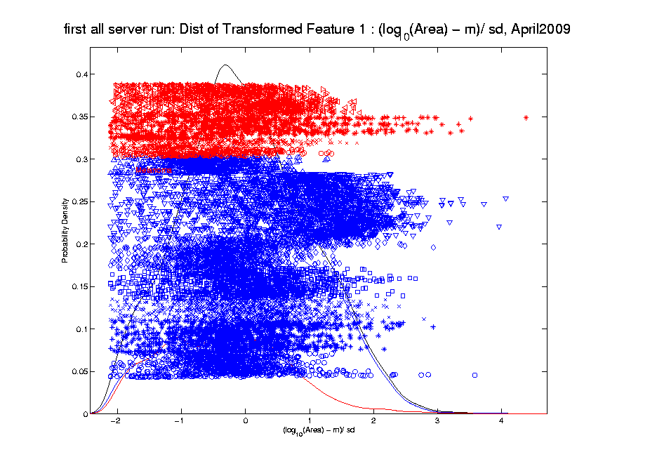
Transformations
Log Scale Gives All More Appropriate Weight
Note:
Orders
Of
Magnitude
Log₁₀ most
Interpretable
Notes:
Log-transformation + standardize

Slide 7
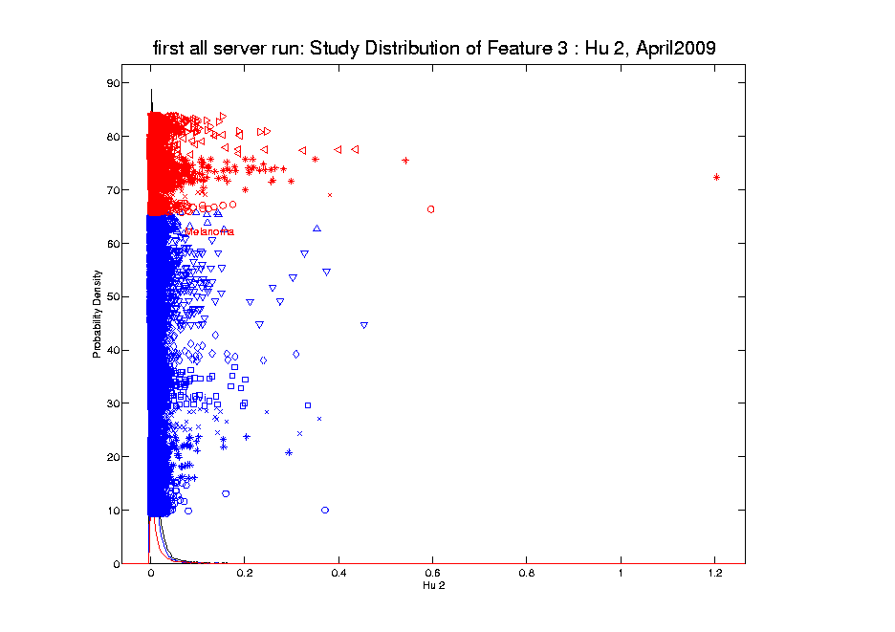
Transformations
Another Feature with Large Values
Problem
For This
Feature:
0 Values
(no log)
Notes:
Similar problem besides, contain zero values

Slide 8
Transformations
Another Feature with Large Values
Approach:
Shifted
Log:
$$log\left(∙+δ\right)$$
Need to
Tune
Notes:
shift parameter: determined by the range of data values, and can be optimized to make data close to be either symmetric/normal

Slide 9
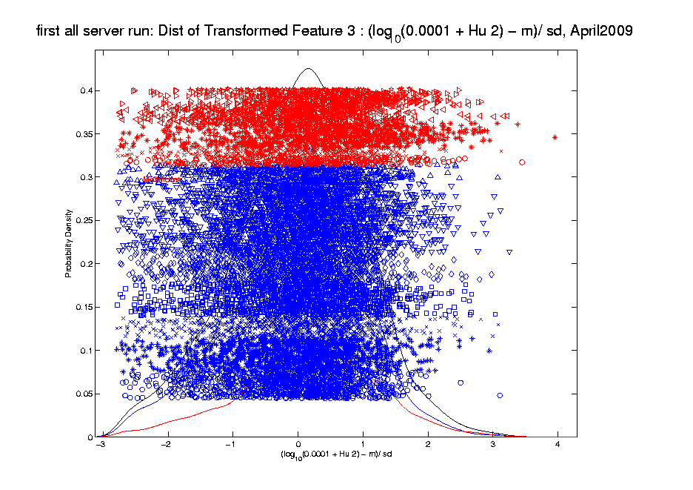
Transformations
Much Nicer Distribution
Notes:
Shift log transformation + standardization

Slide 10
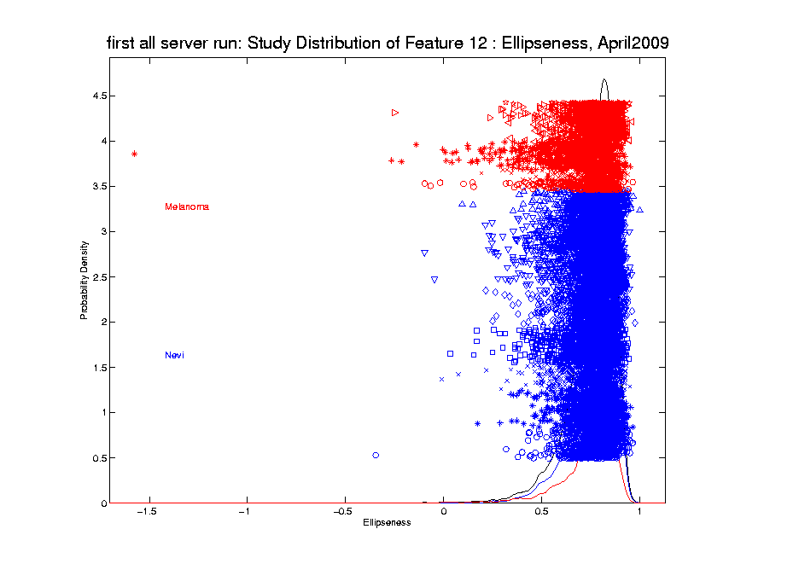
Transformations
Different Direction (Negative) of Skewness
Notes:
Different sign of skewness

Slide 11
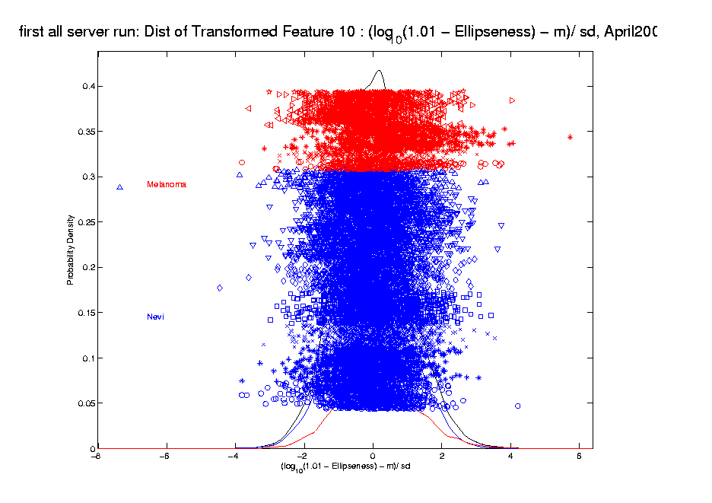
Transformations
Use Log Difference Transformation
$\text{Shifted} \text{Log}$:
$$log\left(δ− ∙\right)$$
Notes:
Different shift log
In summary from the three feature examples we have seen, shift log transformation is useful
But you need to tune the shift parameter based on the data values and also use different functions for the negative skewness!

Slide 12
Transformations
Call for automation!
Automation Challenges:
Tune the shift parameter for each variable
𝑙𝑜𝑔( + 𝛿): Independent of data magnitude
Handle both positive and negative skewness
Address influential data points
Notes:
For a high dimensional data set, automation is important!
The parameterizations of the shift parameter strongly depend on knowledge of the data e.g. data range, data distribution, so user intervention is usually required. However, modern high-output data sets usually have a very large number of variables, i.e. features, so there is a strong need to automate the selection of shift parameter
What is the challenge here?
First challenge comes from tuning the shift parameter value
variables may range from different magnitude
It depends on the data magnitude (to make valid log function)
You have different optimal shift parameter value for different variables given a target
How to handle positive and negative skewness at same time
2. Address outliers which are also quite different from variable to variable

Slide 13
Automatic Transformations
Goal
Automatically select shift log transformation
Automatically detect and address influential values
Apply to individual variables
Notes:
Specify our target
Given a data set, it will select optimal shift log transformation for each variable

Slide 14
Automatic Transformations
Outline
A new parameterized transformation function
𝑙𝑜𝑔( + 𝛿): re-parametrize 𝛿
Standardization and winsorization
Parameter value selection
Notes:
Based on these challenges we propose an automatic transformation scheme
The new scheme consists of three parts
1. A new parametrized family of transformation functions
This re-parametrization facilitate the automation by making the selection of shift tuning parameter independent of data magnitude.
Beside, it put transformation function for handling both positive and negative skewness in the same family
2. A robust way for standardization and also an option for winsorizing the influential points (winsorization means that given a vector of data values and a threshold, when the absolute data values are larger than the threshold, you will pull these values back to the threshold)
3. The parameter value selection
How to use an algorithm for optimal value

Slide 15
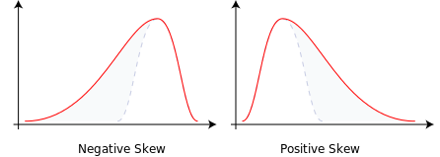
Automatic Transformations
Transformation function
A feature vector $x=(x_{1}, ⋯,x_{n})$ with sample skewness $g(x)$
Positive skewness : $\log\left(x_{i}\right)$
Negative skewness: $−\log\left(−x_{i}\right)$
Need valid inputs!
Notes:
We start with the new re-parametrized function and we will start from the very basic
Deal both positive and negative skewness + maintain the order of data values
Given a feature vector in the data set, we need to first calculate its skewness
Based on the sign of the skewness we will have different log transformation (applying convex transformation function will increase the skewness and concave will decrease)
For negative one, we add negative sign to keep the same order of the data values

Slide 16
Automatic Transformations
Transformation function
Modify functions for being valid for any inputs
Positive skewness
$log⁡(x_{i}−min\left(x_{1}, ⋯,x_{n}\right)+η$)
Negative skewness
$−log⁡(\max\left(x_{1}, ⋯,x_{n}\right)− x_{i}+η$)
$η>0$ It still depends on the data magnitude
Notes:
One big concern is that logarithm functions require positive inputs
Therefore it is important to modify the functions for both positive and negative cases to be valid for any element value.
Substract the minimal value and add a positive shift parameter
use max value to minus each data value and add with a positive shift parameter

Slide 17
Automatic Transformations
Transformation function
Parameterize $η=\left|\frac{1}{β}\right|R$, $R=\max\left(x_{1}, ⋯,x_{n}\right)−min\left(x_{1}, ⋯,x_{n}\right)$
Positive skewness
$log⁡(x_{i}−min\left(x_{1}, ⋯,x_{n}\right)+\left|\frac{1}{β}\right|R$)
Negative skewness
$−log⁡(\max\left(x_{1}, ⋯,x_{n}\right)− x_{i}+\left|\frac{1}{β}\right|R$)
$β∈\left(−∞,+∞\right)$,
symmetric about 0
Notes:
Thus, we further parametrize the parameter eta in terms of the multiples of the range
of the feature vectors
This makes the selection of parameter values beta independent of the data magnitude
The beta ranges from negative inf to positive inf
Now we note that the functions for pos and negative are both symmetric around zero
Thus we can take advantage of it and combine them into one family of functions.

Slide 18
Automatic Transformations
$$φ_{β}\left(x_{i}\right)=\left\{\begin{aligned}log⁡(x_{i}−min\left(x_{1}, ⋯,x_{n}\right)+\frac{1}{β}R\text{)}, β>0 \\ −log⁡(\max\left(x_{1}, ⋯,x_{n}\right)− x_{i}−\frac{1}{β}R\text{)}\text{, }β<0\end{aligned}\right.$$
Family of transformation functions
Comments
One family for address both positive and negative skewness
Parameter value selection is independent of data magnitude
Notes:
Finally incorporating all the elements we have discussed the new parameterized family of transformation functions
For beta is positive, transformation for positive skewness
For beta is negative, transformation for negative skewness
And the parameter value selection is independent of data magnitude

Slide 19
Automatic Transformations
$$φ_{β}\left(x_{i}\right)=\left\{\begin{aligned}log⁡(x_{i}−min\left(x_{1}, ⋯,x_{n}\right)+\frac{1}{β}R\text{)}, β>0 \\ −log⁡(\max\left(x_{1}, ⋯,x_{n}\right)− x_{i}−\frac{1}{β}R\text{)}\text{, }β<0\end{aligned}\right.$$
Family of transformation functions
Comments
$β$ approaches 0: transformation + standardization = standardization only
Notes:
The other good property of this function is continuous over beta
You may ask, what if beta approaches zero
If beta is zero, binding this transformation with a standardization =this is equal to standardization only which you understand as no transformation has been done.
In summary,
For beta is zero = no transformation
For beta is positive, transformation for positive skewness
For beta is negative, transformation for negative skewness

Slide 20
Automatic Transformations
Standardization
Subtract median
Divide by $\sqrt{π/2}$ of the mean absolute deviation from the median
Winsorization
Thresholds based on extreme value theory
Notes:
After the shift log transformation, we need to deal with potential influential values by winsorization,
Before that we need a robust standardization ( and I will talk about it later)
To make standardization robust, we will use some robust statistics that is subtracting the median and divide based on the mean absolute deviation from median (not MAD which might be 0)

Slide 21
Automatic Transformations
Three types theorem (Fisher and Tippett (1928); Gnedenko (1943))
Suppose $X=\left(X_{1}, ⋯, X_{n}\right)$ are i.i.d. normal random variables, and $M_{n}=\max\left(x_{1}, ⋯,x_{n}\right),$ there exist real constants $a_{n}>0$ and ${ b}_{n}$such that
$$P\left(\frac{M_{n}−b_{n}}{a_{n}}≤x\right)→G\left(x\right)$$
Where $G\left(x\right)$is the CDF of the standard Gumbel distribution $G\left(x\right)=e^{−e^{−x}}$ and $a_{n}={\left(2\log{n}\right)}^{−1/2}$
$$b_{n}=\sqrt{2\log{n−\log{\log{n}−\log{4π}}}}$$
Notes:
Based on the extreme value theory we can study the distribution of the extreme values
In particular we use a special case in the three types theorem for iid gaussian
That’s why we do this after shift log and standardization

Slide 22
Automatic Transformations
Winsorization
Threshold $L=p_{95}a_{n}+ b_{n}$
Pull back element value based on $L$
Re-standardization
Subtract sample mean
Divide by standard deviation
Notes:
Based on the thm, we can get a threshold based on the 95th percentile of the standard Gumbel distribution (p95).
For element values with absolute value larger the threshold, we will put them back

Slide 23
Automatic Transformations
Select parameter value $β$
Evaluation: Anderson – Darling test statistics
Give appropriate weight to the tails
Powerful for detecting departures from normality
Algorithm: grid search
Search a value minimizing AD test statistics
Can be computed in parallel
Notes:
Here we a process for transformation which is controlled by the parameter beta
The last step is to deicide the optimal value of beta
To do that, we first need a criteria
A-D test stat is used which measures the distance between the empirical distribution function (EDF) of the transformed data and the cumulative distribution function (CDF) of the standard normal.
It give appropriate weight to the tails using a weighted L2 metric. It is more powerful for detecting
Given the evaluation, we adopt the grid search algorithm for minimizing the A-D test stat.
One major reason for using it is due to the simplicity of computing the stat and complexity of optimizing it. Besides, grid search is useful if the number of parameter to optimize is not large. Another advantage is that the computation of A-D test stat is independent with each other and thus is easy to be computed in parallel.

Slide 24
Automatic Transformations
Transformation scheme
Initialization: construct a grid of parameter values
Step 1: apply the transformation function to the feature vector for each parameter value
Step 2: standardization and winsorization
Step 3: calculate the Anderson–Darling test statistic.
Notes:
Here we give a summarized of our transformation scheme

Slide 25
Melanoma Data
Much Nicer Distribution
Notes:
We applied our automatic transformation on the same melanoma data

Slide 26
Melanoma Data
Much Nicer Distribution
Notes:
Use QQ Plot to compare normality

Slide 27
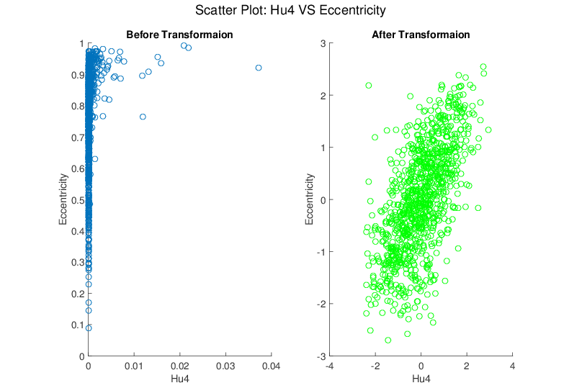
Melanoma Data
Much Nicer Distribution
Notes:
Besides, although the transformation targets at marginal dist
We see improvement of bivariate normality in many real data sets for example here.

Slide 28
Takeaway for Analysis
Chemometric Data from Alex Tropsha Lab
n = 262, d = 800, Non-binary Response

Slide 29
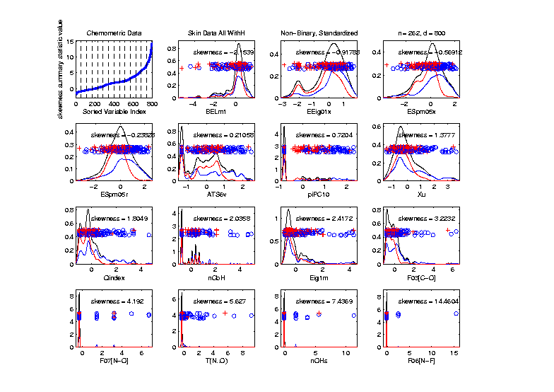
Takeaway for Analysis
Start with MargDistPlot for variable screen
Sort on Skewness, Equally Spaced
Have
Substantial
Skewness
(Consider
Transform’n)

Slide 30
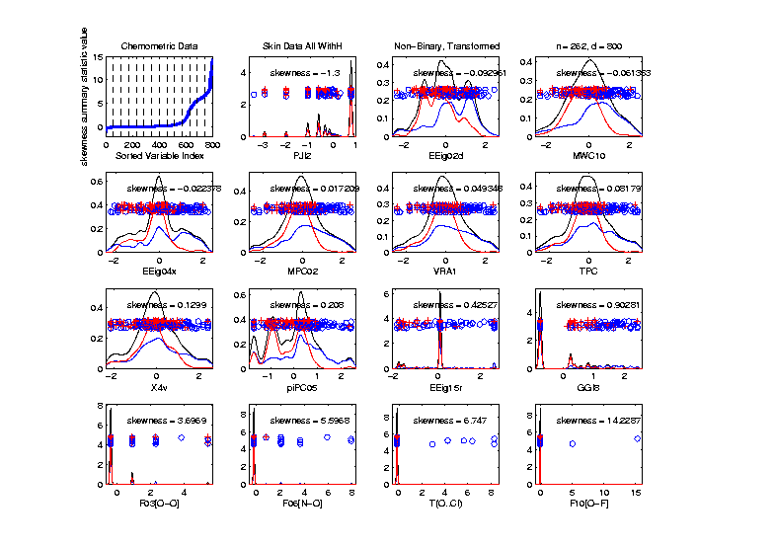
Takeaway for Analysis
Perform automatic transformation
Sort on Skewness
Better
Symmetry
!

Slide 31
Discussion
Limitation
Binary variable
Symmetric but highly kurtotic distribution
Software available
http://www.unc.edu/depts/stat-or/miscellaneous/marron/Matlab7Software/General/
https://github.com/qingfeng10/autotransformation
Notes:
No benefit for binary variables.
not useful in modifying a symmetric, but highly kurtotic distribution.

