Slide 1
SigClust
Statistical Significance of Clusters
in HDLSS Data
When is a cluster “really there”?
Liu et al (2007), Huang et al (2014)

Slide 2
Simple Gaussian Example
Clearly only 1 Cluster in this Example
But Extreme Relabelling looks different
Extreme T-stat strongly significant
Indicates 2 clusters in data

Slide 3
Simple Gaussian Example
Results:
Random relabelling T-stat is not significant
But extreme T-stat is strongly significant
This comes from clustering operation
Conclude sub-populations are different
Now see that:
Not the same as clusters really there
Need a new approach to study clusters

Slide 4
Statistical Significance of Clusters
Basis of SigClust Approach:
What defines: A Single Cluster?
A Gaussian distribution (Sarle & Kou 1993)
So define SigClust test based on:
2-means cluster index (measure) as statistic
Gaussian null distribution
Currently compute by simulation
Possible to do this analytically???

Slide 5
SigClust Statistic – 2-Means Cluster Index
Measure of non-Gaussianity:
2-means Cluster Index:
Class Index Sets Class Means
“Within Class Var’n” / “Total Var’n”

Slide 6
SigClust Gaussian null distribut’n
Which Gaussian (for null)?
Standard (sphered) normal?
No, not realistic
Rejection not strong evidence for clustering
Could also get that from a-spherical Gaussian
Need Gaussian more like data:
Need Full $N_{d}\left(μ,Σ\right)$ model
Challenge: Parameter Estimation
Recall HDLSS Context

Slide 7
SigClust Gaussian null distribut’n
Estimated Mean, $μ$ (of Gaussian dist’n)?
1st Key Idea: Can ignore this
By appealing to shift invariance of CI
When Data are (rigidly) shifted
CI remains the same
So enough to simulate with mean 0
Other uses of invariance ideas?

Slide 8
SigClust Gaussian null distribut’n
2nd Key Idea: Mod Out Rotations
Replace full Cov. by diagonal matrix
As done in PCA eigen-analysis
$$Σ=MDM^{t}$$
But then “not like data”???
OK, since k-means clustering (i.e. CI) is
rotation invariant
(assuming e.g. Euclidean Distance)

Slide 9
SigClust Gaussian null distribut’n
3rd Key Idea: Factor Analysis Model
Model Covariance as: Biology + Noise
$$Σ=Σ_{B}+{σ_{N}}^{2}×I$$
Where
$Σ_{B}$ is “fairly low dimensional”
${σ_{N}}^{2}$ is estimated from background noise

Slide 10
SigClust Gaussian null distribut’n
Estimation of Background Noise ${σ_{N}}^{2}$:
For all expression values (as numbers)
Use robust estimate of scale
Median Absolute Deviation (MAD)
(from the median)
Rescale to put on same scale as s. d.:
$$\hat{σ}=\frac{{MAD}_{data}}{{MAD}_{N\left(0,1\right)}}$$

Slide 11
SigClust Estimation of Background Noise
Hope: Most
Entries are
“Pure Noise,
(Gaussian)”
A Few (<< ¼)
Are Biological
Signal –
Outliers
How to Check?

Slide 12
Q-Q plots
Illustrative graphic (toy data set):

Slide 13
Q-Q plots
Need to understand sampling variation
Approach: Q-Q envelope plot
Simulate from Theoretical Dist’n
Samples of same size
About 100 samples gives
“good visual impression”
Overlay resulting 100 QQ-curves
To visually convey natural sampling variation

Slide 14
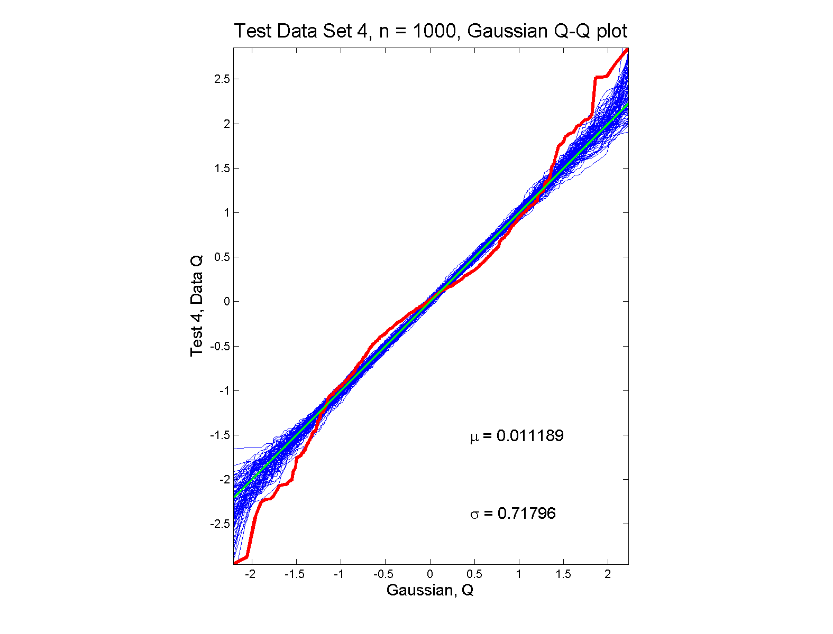
Q-Q plots
non-Gaussian (?) departures from line?

Slide 15
SigClust Estimation of Background Noise
n = 533, d = 9456

Slide 16
SigClust Estimation of Background Noise
Overall distribution has strong kurtosis
Shown by height of kde relative to
MAD based Gaussian fit
Mean and Median both ~ 0
SD ~ 1, driven by few large values
MAD ~ 0.7, driven by bulk of data

Slide 17
SigClust Estimation of Background Noise
Central part of distribution
“seems to look Gaussian”
But recall density does not provide
great diagnosis of Gaussianity
Better to look at Q-Q plot

Slide 18
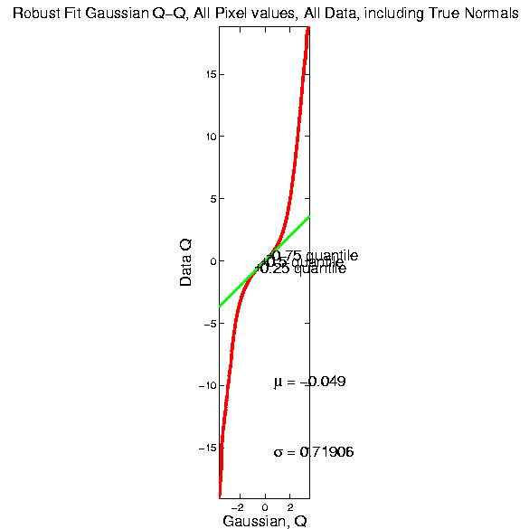
SigClust Estimation of Background Noise

Slide 19
SigClust Estimation of Background Noise
Distribution clearly not Gaussian
Except near the middle
Q-Q curve is very linear there
(closely follows 45º line)
Suggests Gaussian approx. is good there
And that MAD scale estimate is good
(Always a good idea to do such diagnostics)

Slide 20
SigClust Estimation of Background Noise
Now Check Effect of
Using SD, not MAD

Slide 21
SigClust Estimation of Background Noise
Checks that estimation of $σ$ matters
Show sample s.d. is indeed too large
As expected
Variation assessed by Q-Q envelope plot
Shows variation not negligible
Not surprising with n ~ 5 million

Slide 22
SigClust Gaussian null distribut’n
Estimation of Biological Covariance $Σ_{B}$:
Keep only “large” eigenvalues $λ_{1},λ_{2},⋯,λ_{d}$
Defined as $>{σ_{N}}^{2}$
So for null distribution, use eigenvalues:
$$\max_{}\left(λ_{1},{σ_{N}}^{2}\right),⋯,\max_{}\left(λ_{d},{σ_{N}}^{2}\right)$$

Slide 23
SigClust Estimation of Eigenval’s

Slide 24
SigClust Estimation of Eigenval’s
All eigenvalues $>{σ_{N}}^{2}$!
Suggests biology is very strong here!
I.e. very strong signal to noise ratio
Have more structure than can analyze
(with only 533 data points)
Data are very far from pure noise
So don’t actually use Factor Anal. Model
Instead end up with estim’d eigenvalues

Slide 25
SigClust Estimation of Eigenval’s
Do we need the factor model?
Explore this with another data set
(with fewer genes)
This time:
n = 315 cases
d = 306 genes

Slide 26
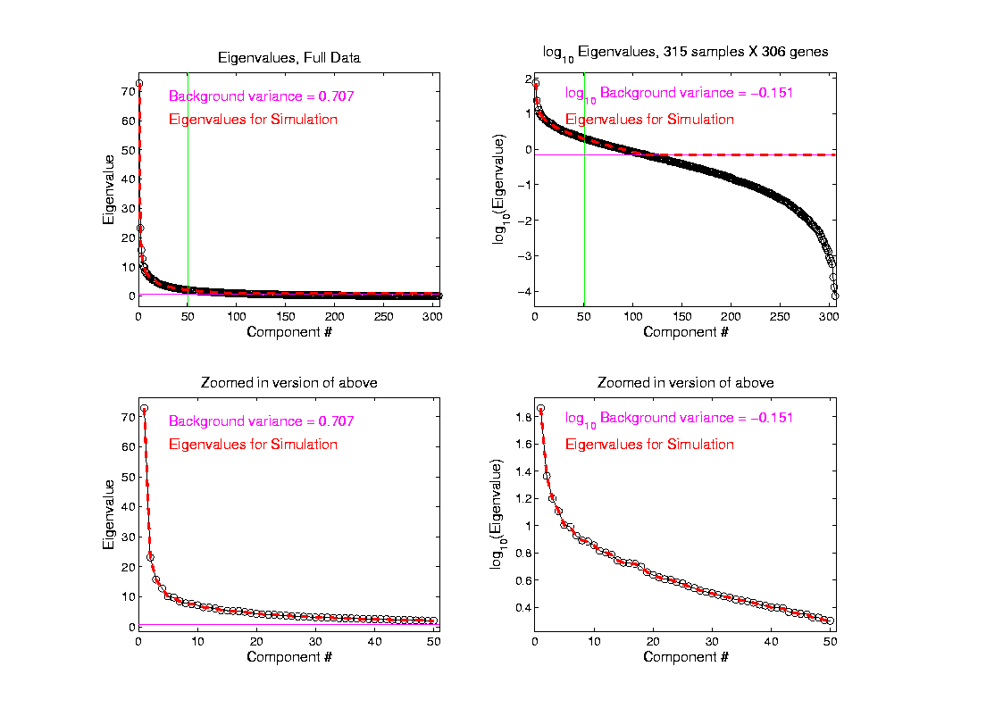
SigClust Estimation of Eigenval’s

Slide 27
SigClust Estimation of Eigenval’s
Try another data set, with fewer genes
This time:
First ~110 eigenvalues $>{σ_{N}}^{2}$
Rest are negligible
So threshold smaller ones at ${σ_{N}}^{2}$

Slide 28
SigClust Gaussian null distribution - Simulation
Now simulate from null distribution using:
$\left(\begin{matrix}X_{1,i} \\ ⋮ \\ X_{d,i}\end{matrix}\right)$ where $X_{j,i} \sim N\left(0,λ_{j}\right)$ (indep.)
Again rotation invariance makes this work
(and location invariance)

Slide 29
SigClust Gaussian null distribution - Simulation
Then compare data CI,
With simulated null population CIs
Spirit similar to DiProPerm
But now significance happens for
smaller values of CI

Slide 30
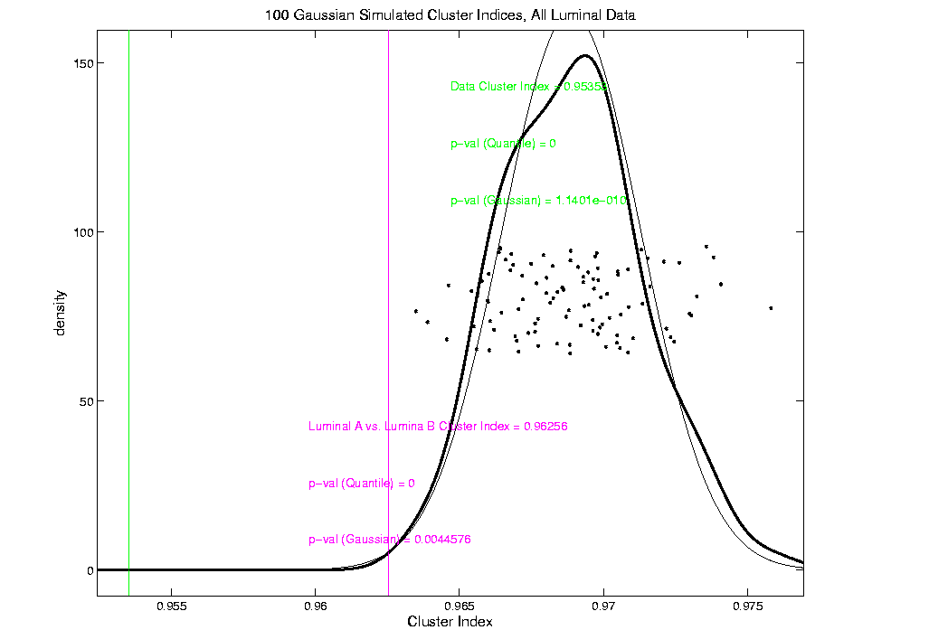
An example (details to follow)
P-val = 0.0045

Slide 31
SigClust Modalities
Two major applications:
Test significance of given clusterings
(e.g. for those found in heat map)
(Use given class labels)
Test if known cluster can be further split
(Use 2-means class labels)

Slide 32
SigClust Real Data Results
Analyze Perou 500 breast cancer data
(large cross study combined data set)
Current folklore: 5 classes
Luminal A
Luminal B
Normal
Her 2
Basal

Slide 33
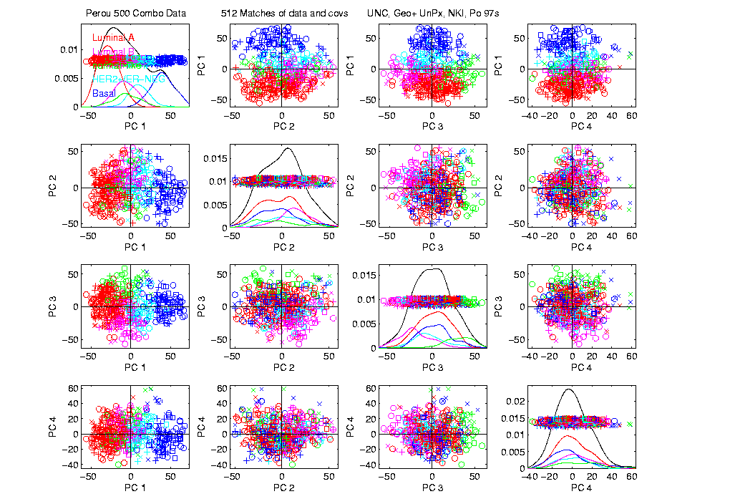
Perou 500 PCA View – real clusters???

Slide 34
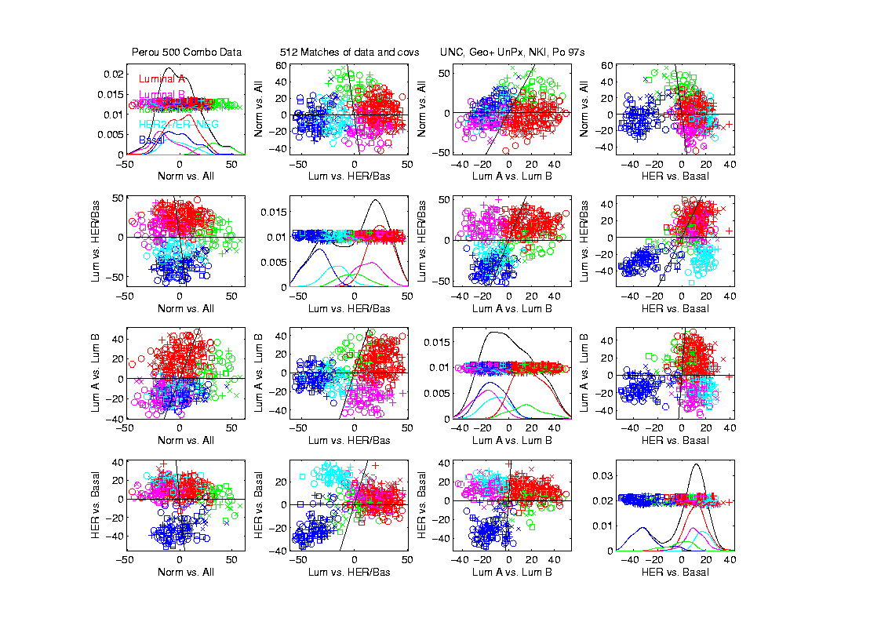
Perou 500 DWD Dir’ns View – real clusters???

Slide 35
Perou 500 – Fundamental Question
Are Luminal A &
Luminal B really
distinct clusters?
Famous for
Far Different
Survivability

Slide 36
SigClust Results for Luminal A vs. Luminal B
P-val = 0.0045

Slide 37
SigClust Results for Luminal A vs. Luminal B
Get p-values from:
Empirical Quantile
From simulated sample CIs
Fit Gaussian Quantile
Don’t “believe these”
But useful for comparison
Especially when Empirical Quantile = 0
Note: Currently Replaced by “Z-Scores”

Slide 38
SigClust Results for Luminal A vs. Luminal B
Test significance of given clusterings
Empirical p-val = 0
Definitely 2 clusters
Gaussian fit p-val = 0.0045
same strong evidence
Conclude these really are two clusters

Slide 39
SigClust Results for Luminal A vs. Luminal B
Test if known cluster can be further split
Empirical p-val = 0
definitely 2 clusters
Gaussian fit p-val = 10⁻¹⁰
Stronger evidence than above
Such comparison is value of Gaussian fit
Makes sense (since CI is min possible)
Conclude these really are two clusters

Slide 40
SigClust Real Data Results
Summary of Perou 500 SigClust Results:
Lum & Norm vs. Her2 & Basal, p-val = 10⁻¹⁹
Luminal A vs. B, p-val = 0.0045
Her 2 vs. Basal, p-val = 10⁻¹⁰
Split Luminal A, p-val = 10⁻⁷
Split Luminal B, p-val = 0.058
Split Her 2, p-val = 0.10
Split Basal, p-val = 0.005

Slide 41
SigClust Real Data Results
Summary of Perou 500 SigClust Results:
All previous splits were real
Most not able to split further
Exception is Basal, already known
Chuck Perou has good intuition!
(insight about signal vs. noise)
How good are others???

Slide 42
SigClust Real Data Results
Experience with Other Data Sets: Similar
Smaller data sets: less power
Gene filtering: more power
Lung Cancer: more distinct clusters

Slide 43
SigClust Real Data Results
Some Personal Observations
Experienced Analysts Impressively Good
SigClust can save them time
SigClust can help them with skeptics
SigClust essential for non-experts

Slide 44
SigClust Overview
Works Well When Factor Part Not Used

Slide 45
SigClust Overview
Works Well When Factor Part Not Used
Sample Eigenvalues Always Valid
But Can be Too Conservative

Slide 46
SigClust Overview
Works Well When Factor Part Not Used
Sample Eigenvalues Always Valid
But Can be Too Conservative
Above Factor Threshold Anti-Conservative

Slide 47
SigClust Overview
Works Well When Factor Part Not Used
Sample Eigenvalues Always Valid
But Can be Too Conservative
Above Factor Threshold Anti-Conservative
Problem Fixed by Soft Thresholding
(Huang et al, 2014)

Slide 48
SigClust Open Problems
Improved Eigenvalue Estimation
(Random Matrix Theory)
More attention to Local Minima in 2-means Clustering
Theoretical Null Distributions
Inference for k > 2 means Clustering
Multiple Comparison Issues

Slide 49
Big Picture
Object Oriented Data Analysis
Have done detailed study of Data Objects
In Euclidean Space, $ℝ^{d}$
Next: OODA in Non-Euclidean Spaces

Slide 50
Shapes As Data Objects
Several Different Notions of Shape
Oldest and Best Known (in Statistics):
Landmark Based

Slide 51
Shapes As Data Objects
Landmark Based Shape Analysis:
Kendall (et al 1999)
Bookstein (1991)
Dryden & Mardia (1998, revision coming)
(Note: these are summarizing
Monographs, $∃$ many papers)

Slide 52
Shapes As Data Objects
Landmark Based Shape Analysis:
Kendall (et al 1999)
Bookstein (1991)
Dryden & Mardia (1998, revision coming)
Recommended as Most Accessible

Slide 53
Landmark Based Shape Analysis
Start by Representing Shapes

Slide 54
Landmark Based Shape Analysis
Start by Representing Shapes by
Landmarks (points in R² or R³)
$$\left(x_{1},y_{1}\right)$$
$$\left(x_{2},y_{2}\right)$$
$$\left(x_{3},y_{3}\right)$$

Slide 55
Landmark Based Shape Analysis
Start by Representing Shapes by
Landmarks (points in R² or R³)
$$\left(x_{1},y_{1}\right)$$
$$\left(x_{2},y_{2}\right)$$
$$\left(x_{3},y_{3}\right)$$

Slide 56
Landmark Based Shape Analysis
Clearly different shapes:

Slide 57
Landmark Based Shape Analysis
Clearly different shapes:
But what about: ?

Slide 58
Landmark Based Shape Analysis
Clearly different shapes:
But what about: ?
(just translation and rotation of,
but different points in R⁶)

Slide 59
Landmark Based Shape Analysis
Note: Shape should be same over different:
Translations

Slide 60
Landmark Based Shape Analysis
Note: Shape should be same over different:
Translations
Rotations

Slide 61
Landmark Based Shape Analysis
Note: Shape should be same over different:
Translations
Rotations
Scalings

Slide 62
Landmark Based Shape Analysis
Approach: Identify objects that are:
Translations
Rotations
Scalings
of each other

Slide 63
Landmark Based Shape Analysis
Approach: Identify objects that are:
Translations
Rotations
Scalings
of each other
Mathematics: Equivalence Relation

Slide 64
Equivalence Relations
Useful Mathematical Device
Weaker generalization of “=“ for a set
Main consequence:
Partitions Set Into Equivalence Classes
For “=“, Equivalence Classes Are Singletons

Slide 65
Equivalence Relations
Common Example: Modulo Arithmetic
(E.g. Clock Arithmetic, mod 12)
3 hours after 11:00 is 2:00 …
Hours are equivalence classes:
{1} = {1:00, 13:00, …}
{2} = {2:00, 14:00, …}
$$⋮$$

Slide 66
Equivalence Relations
Common Example: Modulo Arithmetic
(E.g. Clock Arithmetic, mod 12)
For $a, b, c ∈ ℤ$, Say $a≡b (mod c)$
When $\left(b −a\right)$ is divisible by $c$
Clock e.g. $14−12=2$, so $14≡2 (mod 12)$
i.e. 14:00 is “identified with” 2:00

Slide 67
Equivalence Relations
For $a, b, c ∈ ℤ$, Say $a≡b (mod c)$
When $\left(b −a\right)$ is divisible by $c$
E.g. Binary Arithmetic, mod $2$
Equivalence classes:
$\left\{0\right\}=\left\{⋯,−2,0,2,4,⋯\right\}$
$$\left\{1\right\}=\left\{⋯,−1,1,3,5,⋯\right\}$$
(just evens and odds)

Slide 68
Equivalence Relations
Another Example: Vector Subspaces
E.g. Say $\left(\begin{matrix}x_{1} \\ y_{1}\end{matrix}\right)≈\left(\begin{matrix}x_{2} \\ y_{2}\end{matrix}\right)$ when $y_{1}=y_{2}$
Equiv. Classes are indexed by $y∈ℝ^{1},$
And are: $\left\{y\right\}=\left\{\left(\begin{matrix}x \\ y\end{matrix}\right)∈ℝ^{2}:x∈ℝ^{1}\right\}$
i.e. Horizontal lines (same $y$ coordinate)

Slide 69
Equivalence Relations
Deeper Example: Transformation Groups
For $g∈G$, operating on a set $S$
Say $s_{1}≈s_{2}$ when $∃$ $g$ where $g\left(s_{1}\right)=s_{2}$
Equivalence Classes:
$$\left\{s_{i}\right\}=\left\{s_{j}∈S:s_{j}=g\left(s_{i}\right), for some g∈G\right\}$$
Terminology: Also called orbits

Slide 70
Equivalence Relations
Deeper Example: Group Transformations
Above Examples Are Special Cases
Modulo Arithmetic
$$G= \left\{g:ℤ→ℤ :g\left(z\right)=z+kc, for k∈ℤ\right\}$$

Slide 71
Equivalence Relations
Deeper Example: Group Transformations
Above Examples Are Special Cases
Modulo Arithmetic
Vector Subspace of $ℝ^{2}$
$$G=\left\{g:ℝ^{2}{→ℝ}^{2} :g\left(\begin{matrix}x \\ y\end{matrix}\right)=\left(\begin{matrix}x′ \\ y\end{matrix}\right), x′∈ℝ\right\}$$
(orbits are horizontal lines, shifts of $ℝ$)

Slide 72
Equivalence Relations
Deeper Example: Group Transformations
Above Examples Are Special Cases
Modulo Arithmetic
Vector Subspace of $ℝ^{2}$
General Vector Subspace $V$
$G$ maps $V$ into $V$
Orbits are Shifts of $V$, indexed by $V^{⊥}$

Slide 73
Equivalence Relations
Deeper Example: Group Transformations
Above Examples Are Special Cases
Modulo Arithmetic
Vector Subspace of $ℝ^{2}$
General Vector Subspace $V$
Shape: $G=$ Group of “Similarities”
(translations, rotations, scalings)

Slide 74
Equivalence Relations
Deeper Example: Group Transformations
Mathematical Terminology:
Quotient Operation
Set of Equiv. Classes = Quotient Space
Denoted $S/G$

