Slide 1
JIVE Integration of HCP Data
Qunqun Yu
Dr. Steve Marron, Dr. Kai Zhang & Dr. Ben Risk
University of North Carolina at Chapel Hill

Slide 2
Human Connectome Project (HCP)
HCP Goals:
  structural and functional connections in the human brain
  relationship of brain connectivity with behavior
Our goal: Different parts of brain work together → behavior
Notes:
In this project, they want to approximately include 1200 healthy individuals across a wide range of things like education levels, econ levels, people from different racial ethical background.
The goals of this project include mapping brain’s structural and functional connections and learning the relationship between brain function and behavior.
A most simple way to think about the connectome is about how different parts of brain work together to produce behavior.
Is there something about how well those different parts of brain talk to each other that help you do certain kinds of behavior?
With this target in mind, they have the participants do specific tasks when they are on the scanner for the brain images. What parts of the brain are active when people are processing certain kinds of information or doing certain memory tasks or remembering things?
The image obtained when they were doing the tasks is called task functional magnetic ‘resonance imaging.
They collected tfMRI of 8 different tasks, but we are not using all of them.

Slide 3
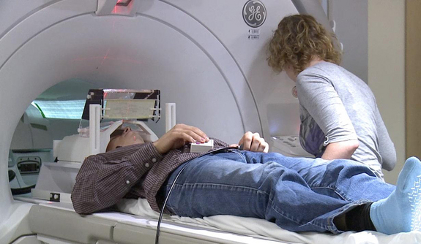
Human Connectome Project
Task functional magnetic resonance imaging (tfMRI)
Brain image
Task related measurements
Image source:http://www.livescience.com

Slide 4
Human Connectome Project
Task related measurements ✔
Brain Image
lots of confounding effects
Behavior + Image → common driver → the responsible regions
Joint and Individual Variation Explained (JIVE)

Slide 5
Joint and Individual Variation Explained (JIVE)
1st generation: Eric F. Lock, Katherine A. Hoadley, J. S. Marron and Andrew B. Nobel.
2nd generation: Qing Feng, Jan Hannig and J. S. Marron.

Slide 6
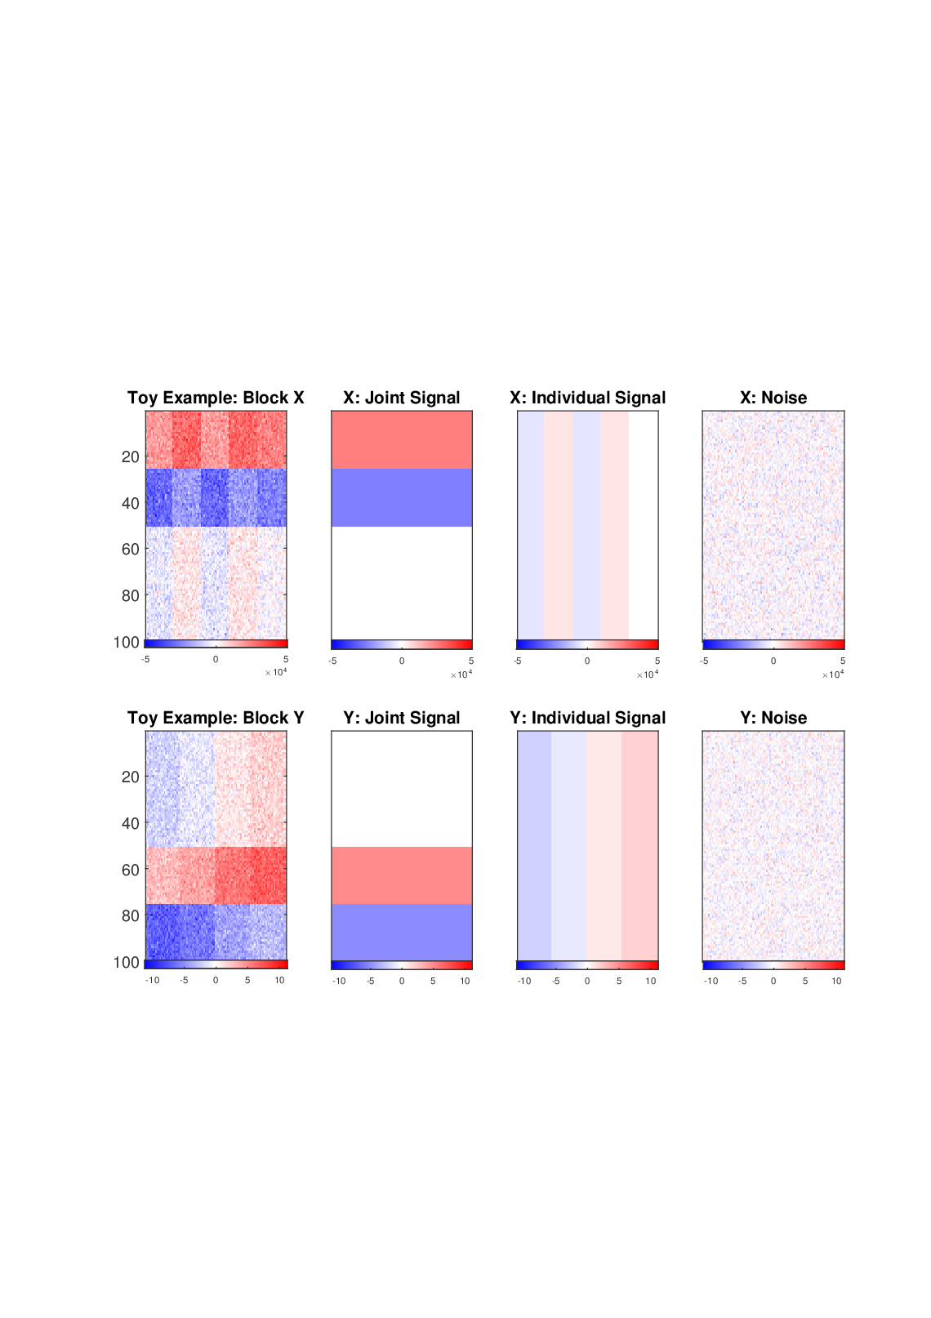
JIVE Methodology (Qing Feng)
Analyze pairwise data types
Figure: Toy example heat-map
Example:
X = Image
Y = Behavior
Matrices containing joint variation
  Model common latent variation

Slide 7
JIVE Methodology
Analyze pairwise data types
Figure: Toy example heat-map
Matrices containing individual variation
  Model unique latent variation to each data type

Slide 8

JIVE Methodology (Qing Feng)
Analyze pairwise data types
Figure: Toy example heat-map
$${10}^{4}$$

Slide 9
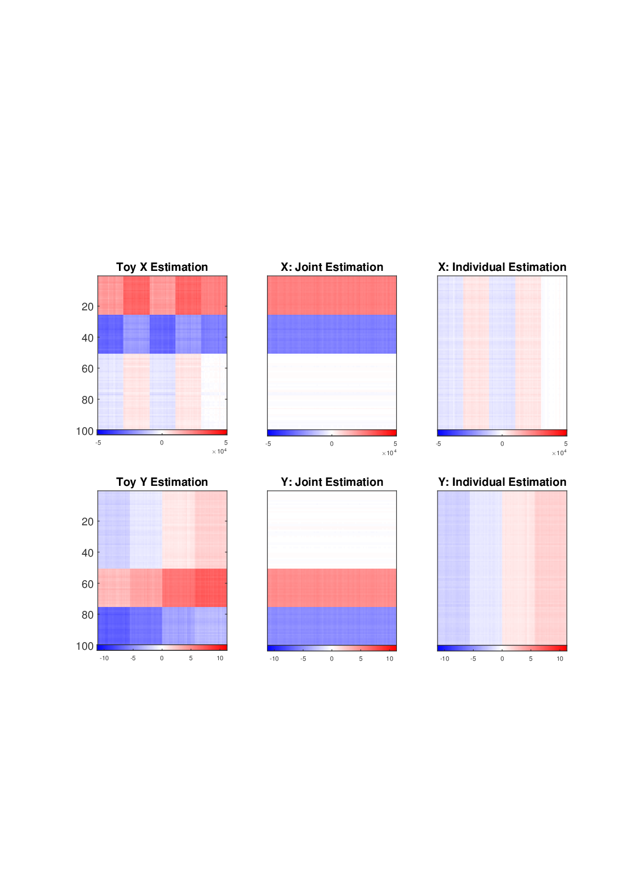
JIVE Methodology
Analyze pairwise data types
JIVE obtain approximations of joint and individual matrices for each data
Figure: Toy example heat-map
Figure: JIVE approximation

Slide 10
Roadmap
Data introduction
Data preprocessing
JIVE analysis
Notes:
After giving the essential ideas of this research, next we are going to dig into the detailed parts.

Slide 11
Roadmap
Data introduction
Data preprocessing
JIVE analysis

Slide 12
Data
Image data (tfMRI):
- Working memory/category specific representation task
- Motor task
Behavioral data

Slide 13
Working memory/category specific representation task
2 working memory task types: 0 – back & 2 – back
4 category task types: body parts, faces, places and tools
8 task blocks:
0 bk body, 0 bk face, 0 bk place, 0 bk tool,
2 bk body, 2 bk face, 2 bk place, 2 bk tool
Use “working memory task” in short
Barch et al. (2013) Task-fMRI paper

Slide 14
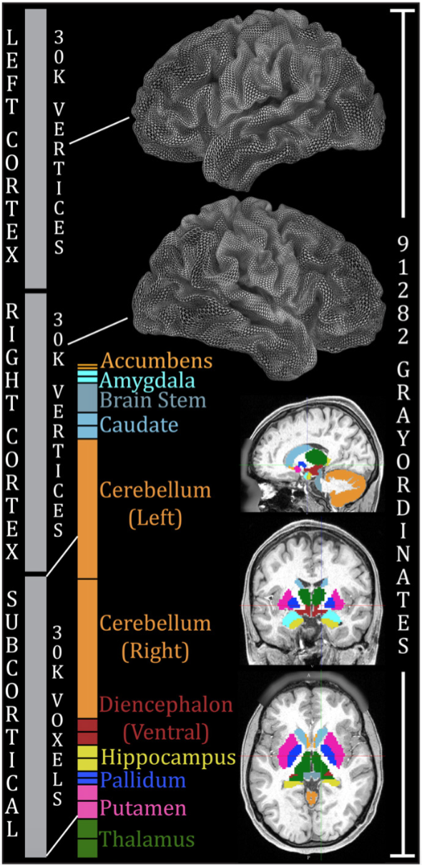
Image data format
Total: 91282 locations in the brain
Glasser et al. (2013) Preprocessing pipelines

Slide 15
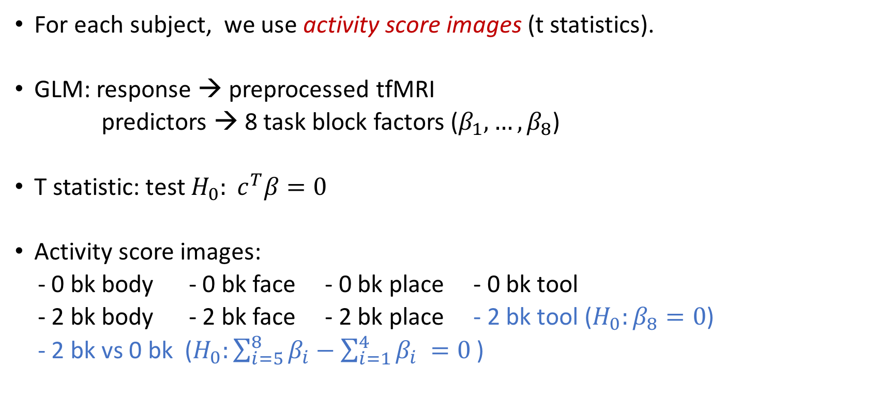
Image data
For each subject, we use activity score images (t statistics).
GLM: response → preprocessed tfMRI
predictors → 8 task block factors ($β_{1}, …, β_{8}$)
T statistic: test ${H_{0}: c}^{T}β=0$
Activity score images:
- 0 bk body - 0 bk face - 0 bk place - 0 bk tool
- 2 bk body - 2 bk face - 2 bk place - 2 bk tool ($H_{0}:β_{8}=0$)
- 2 bk vs 0 bk ($H_{0}:\sum_{i=5}^{8}{β_{i}}−\sum_{i=1}^{4}{β_{i} }=0$ )
Remove the common activations

Slide 16
Behavioral data
NIH Toolbox measures
- cognition, emotion, motor, sensory
Other measures
- visual processing, personality, emotion, psychiatric, substance abuse, life function, physical function, other
Working memory task related measures (e.g. working memory accuracy and reaction time)
We use 139 measurements.

Slide 17
Roadmap
Data introduction
Data preprocessing
JIVE analysis

Slide 18

Data preprocessing – missing data
Behavior, $n_{2}= 541$
41 – more than 10 missing

Slide 19

Data preprocessing – missing data
Behavior, $n_{2}= 541$
39 of 41 – no image data
Exclude all the 41 participants.

Slide 20

Data preprocessing – missing data
Behavior, $d_{2} =139$
0- with missing >20 (4%)
Impute with the
median of the corresponding
variable

Slide 21

Data preprocessing – missing data
Image & behavior: $n=487$
Image data matrix: $91282×487$
Behavioral data matrix: $139×487$

Slide 22
Data preprocessing – Visualization
Behavior variables:
marginal distributions
Sort variables on sd.
Summary plot with
equal spacing.

Slide 23
Data preprocessing – Visualization
Behavior variables:
marginal distributions
Dashed lines
correspond to
1-d distributions.

Slide 24
Data preprocessing – Visualization
Behavior variables:
marginal distributions
1. Different Scales

Slide 25
Data preprocessing – Visualization
Behavior variables:
marginal distributions
sort on skewness
2. Strong skewness
diff scale + strong skew
Shifted log and
standardize

Slide 26
Data preprocessing – Visualization
Behavior variables:
marginal distributions
after transformation
Much less skewed.
Scale similar.

Slide 27
Data preprocessing – Visualization
Image variables:
marginal distributions
sort on skewness.
Roughly Gaussian
same scale
→No Transformation

Slide 28
Roadmap
Data introduction
Data preprocessing
JIVE analysis

Slide 29
JIVE to HCP data
Case 1: Behavioral data + wm 2 bk vs 0 bk activity score image
Case 2: Behavioral data + wm 2 bk tool activity score image
Case 3: Behavioral data + motor right hand image

Slide 30
How to visualize JIVE results?
Separate Joint Individual
PCA PCA PCA
Figure: Toy example heat-map
Example:
X = Image
Y = Behavior

