Slide 1
Separate Behavior
PC1 loadings
Cognition in NIH
toolbox (Cog)

Slide 2
Separate Behavior
PC1 loadings
Delay discounting
(DDis)

Slide 3
Separate Behavior
PC1 loadings
Working memory
accuracy (WM_ACC)

Slide 4
Separate Behavior
PC1 loadings
Working memory
reaction time
(WM_RT)

Slide 5
Separate Behavior
PC2 loadings
DDis (delay discounting)

Slide 6
Separate Behavior
PC2 loadings
WM_RT (working
memory reaction time)

Slide 7
Separate Behavior
PC3 loadings
Emotion: negative effect
(sadness, anger, fear, loneliness)

Slide 8
Separate Behavior
PC3 loadings
Emotion: positive effect
(life satisfaction,
friendship)

Slide 9
Separate Behavior
PC3 loadings
Personality:
also positive ↓
negative ↑
Consistent with Emotion

Slide 10
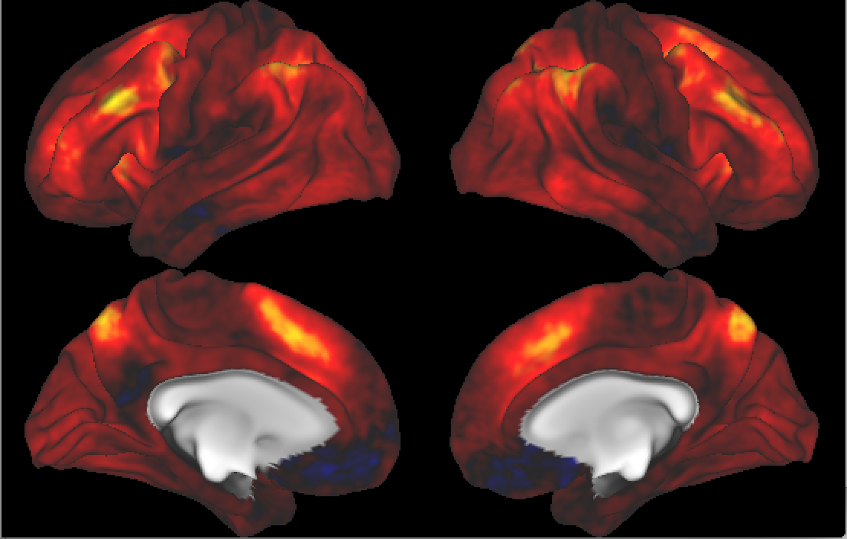

Case 1: wm 2bk vs 0 bk
Separate image
PC1 loadings
~ all positive

Slide 11
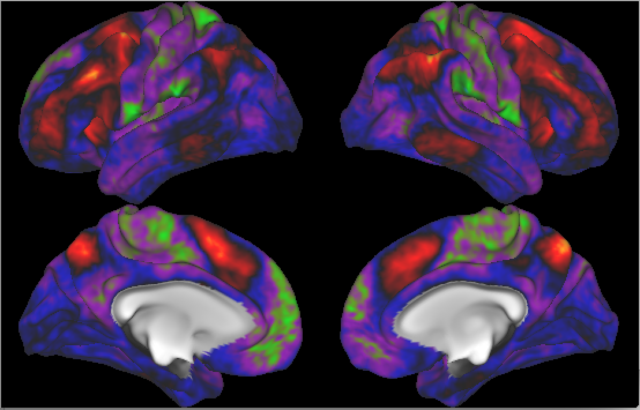
Case 1: wm 2bk vs 0 bk
Separate image
PC2 loadings
Areas that are interesting?

Slide 12
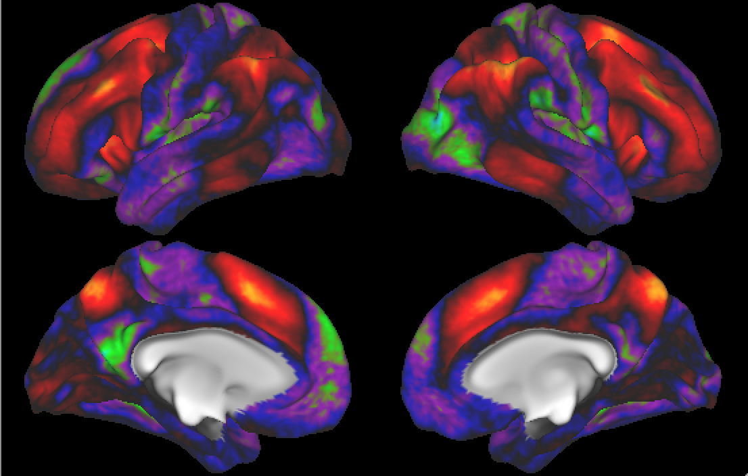
Case 1: wm 2bk vs 0 bk
Compare it to the
result from group
analysis by the HCP
working memory
related brain area

Slide 13
Case 1: wm 2bk vs 0 bk
Separate image
PC2 loadings
Working memory system
PC2 → a small part of WM
system

Slide 14
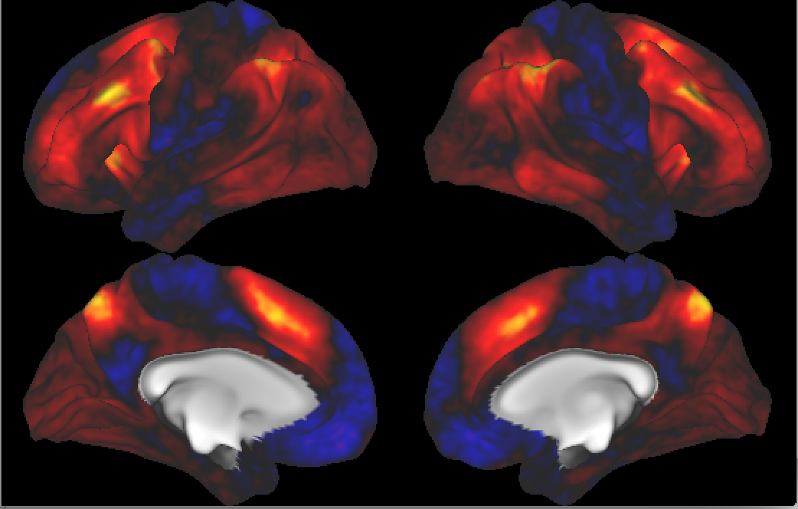
Case 1: wm 2bk vs 0 bk
Joint image
PC1 loadings
strong signals
for the WM
related areas.

Slide 15
Case 1: wm 2bk vs 0 bk
Compare it to the
result from group
analysis by the HCP
working memory
related brain area

Slide 16
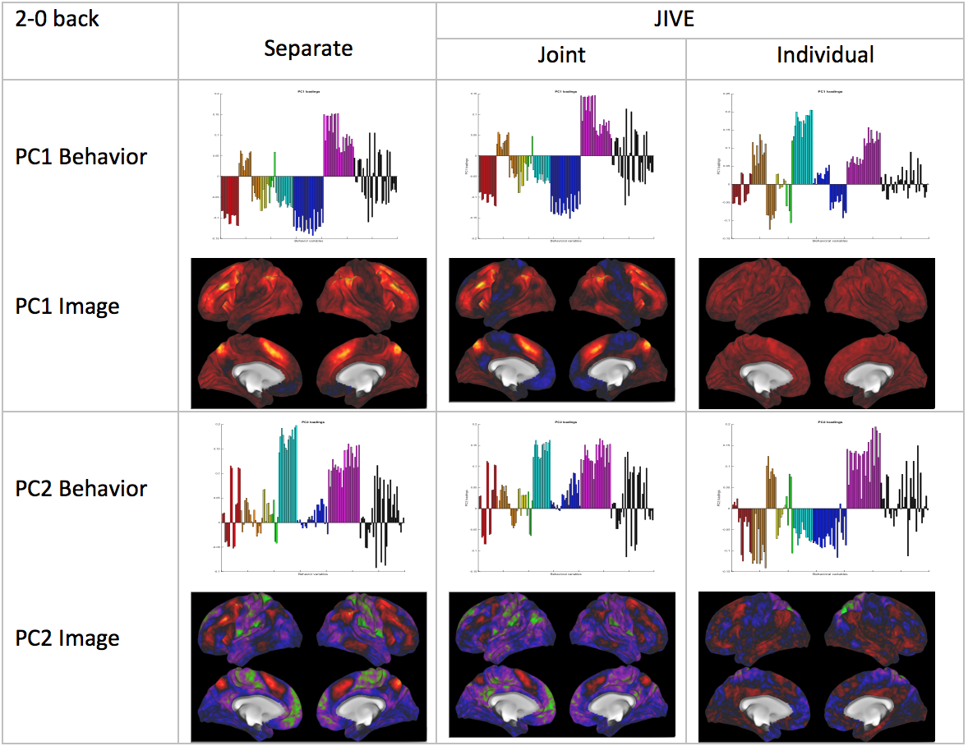
Case 1: wm 2bk vs 0 bk

Slide 17
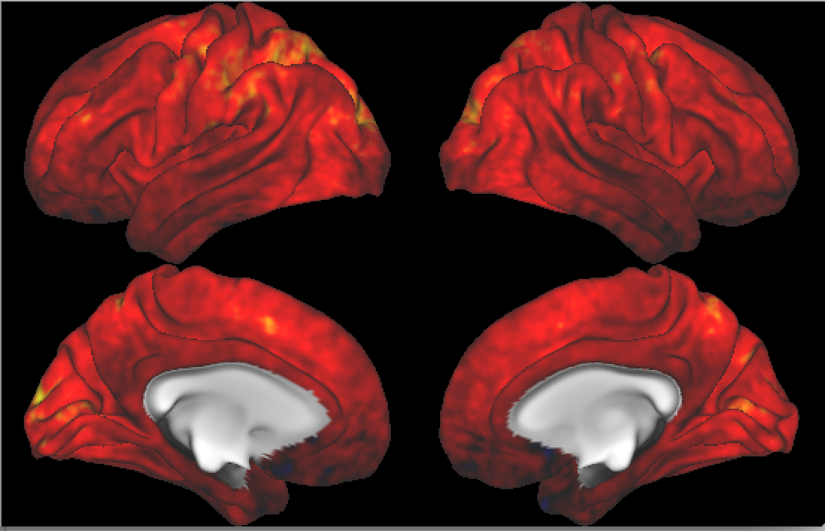
Case 2: wm 2bk tool
Separate image
PC1 loadings
overall effect

Slide 18
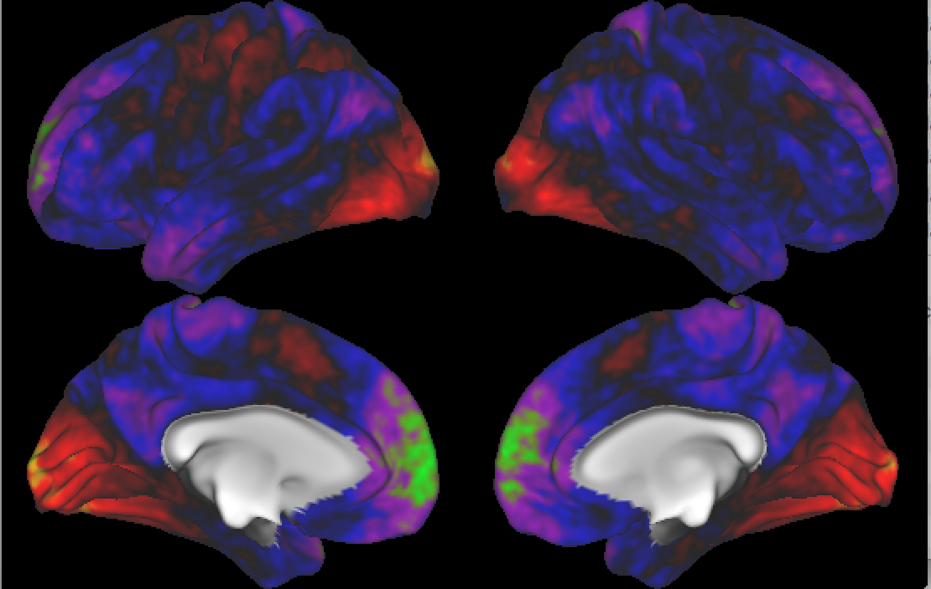
Case 2: wm 2bk tool
Separate image
PC2 loadings
vision effect
None of PCs give strong
highlight of the wm

Slide 19
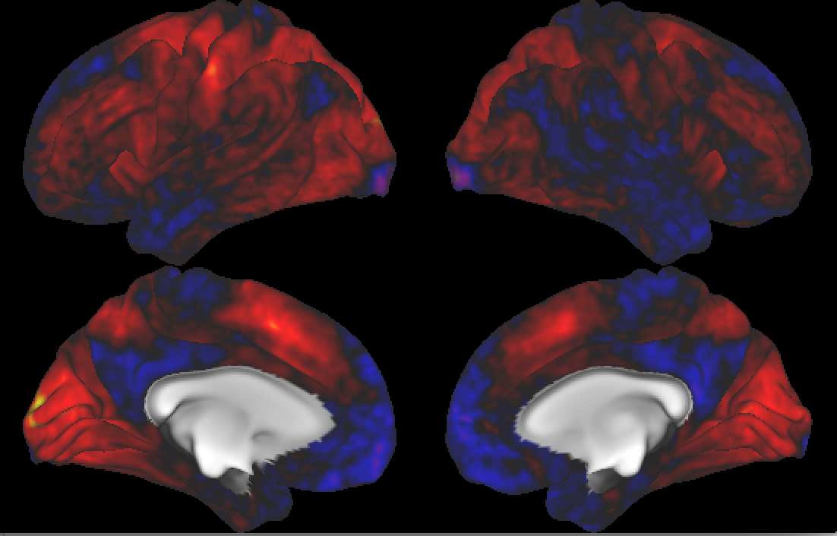
Case 2: wm 2bk tool
Joint image
PC1 loadings
Working memory
Vision

Slide 20
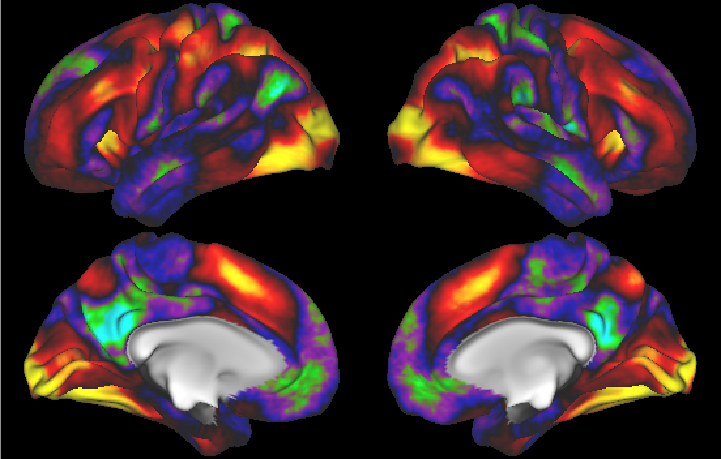
Case 2: wm 2bk tool
Compare it to the
result from group
analysis derived by
the HCP community.

Slide 21
Case 3: motor right hand
Behavioral data: same
Image → motor task activity score image
Behavioral data is thought to be weakly related to image.
Expect → no signals of motor system show up in the joint?

Slide 22
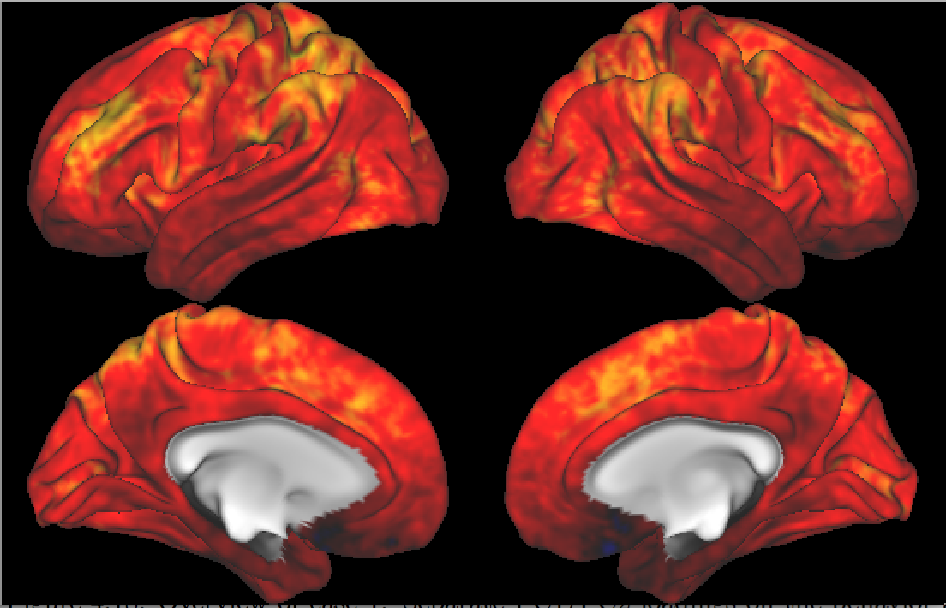
Case 3: motor right hand
Separate image
PC1 loadings
Overall low for the locations

Slide 23
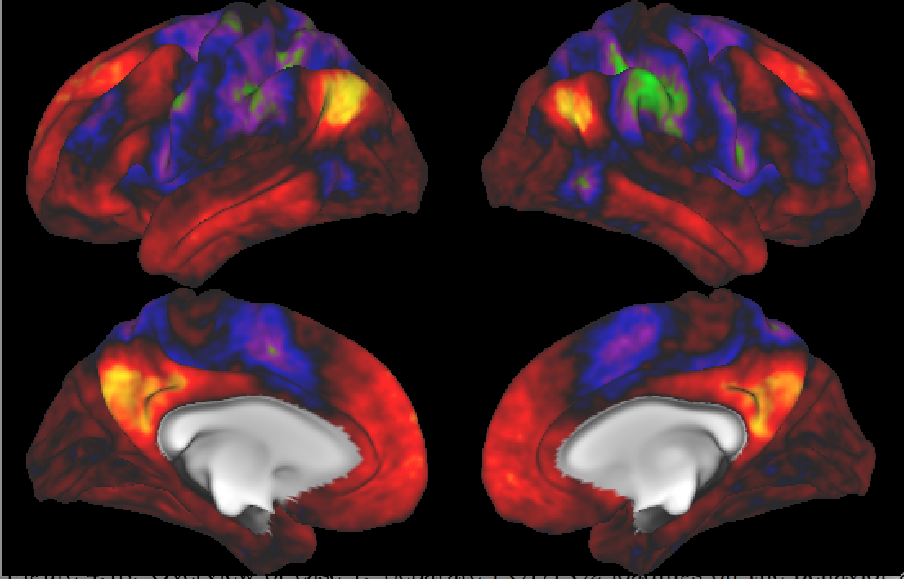
Case 3: motor right hand
Separate image
PC2 loadings
default mode network

Slide 24
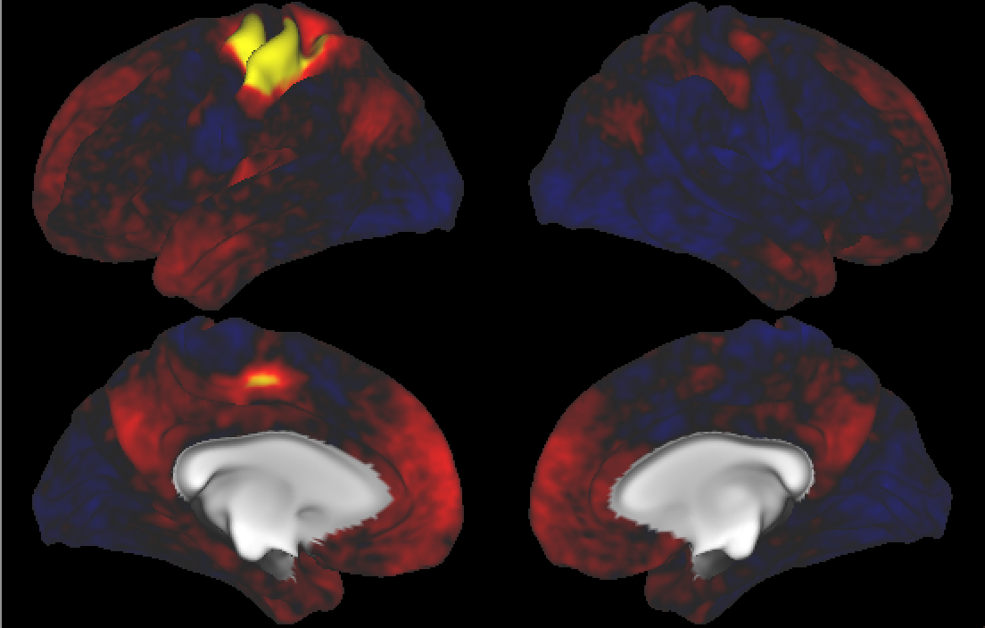
Case 3: motor right hand
Separate image
PC3 loadings
the motor cortex

Slide 25
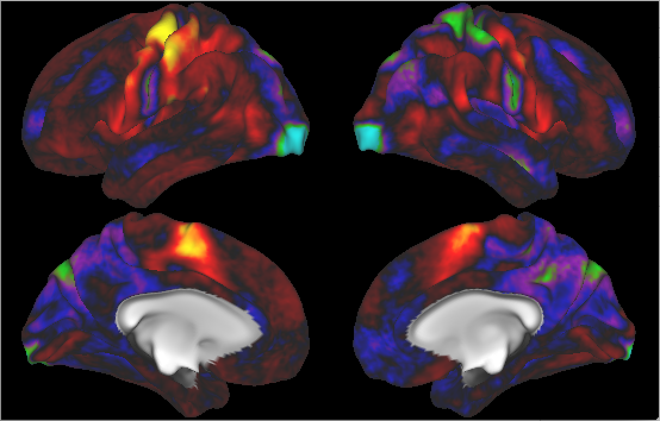
Case 3: motor right hand
Compare it to the
group level results
by HCP community.
the motor cortex

Slide 26
Case 3: motor right hand
Separate image
PC3 loadings
the motor cortex

Slide 27
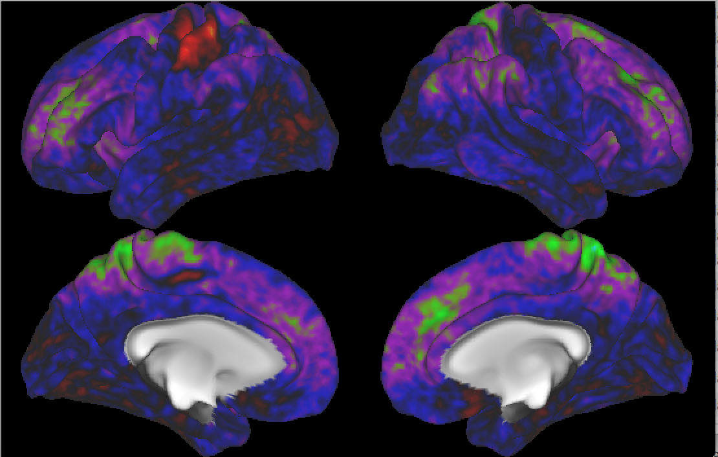
Case 3: motor right hand
Joint image
PC1 loadings
the signal for the motor
very weak
But still some, why?

Slide 28
Case 3: motor right hand
Joint behavior
PC1 loadings
motor:
(dexterity, gait speed,
endurance, strength)

Slide 29
Case 3: motor right hand
Joint behavior
PC1 loadings
for case 1: 2 bk vs 0 bk

Slide 30
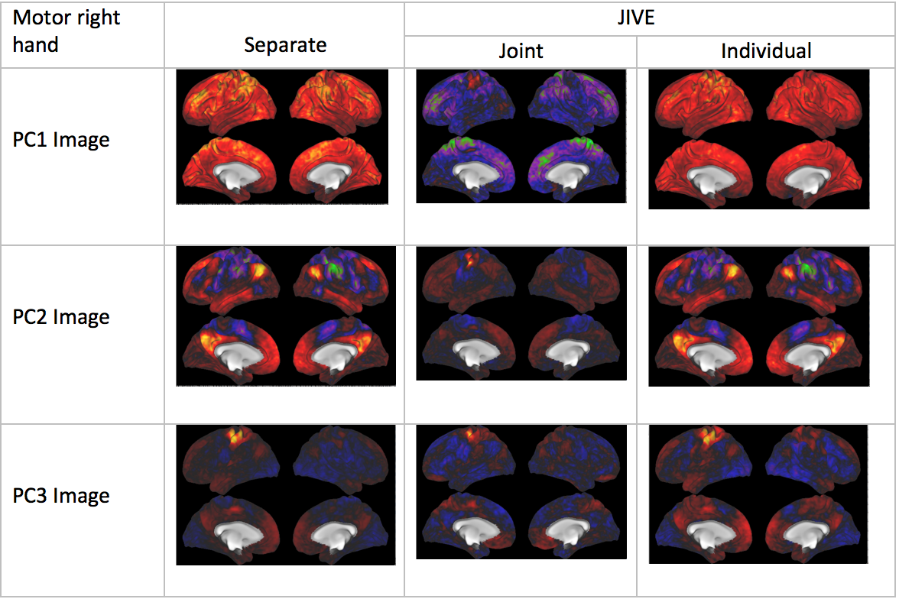
Case 3: motor right hand
Very weak
motor related
signals in joint
Important motor
related
signals goes to
Individual

Slide 31
Recap
Case 1: behavior + 2-0 back image
WM effect strongest, PC -> weak signal, JIVE joint -> strong signals
Case 2: behavior + 2 back tool image
Vision major effect, PC -> no wm signal, JIVE joint -> pretty strong wm signals
Case 3: behavior + motor
Reference case: JIVE joint -> no motor signals. JIVE indpen’t -> motor signal

Slide 32
Conclusion
JIVE can separate the joint and individual variation very well.
This separation helps us discover the important brain areas.

Slide 33
Thank you!

Slide 34
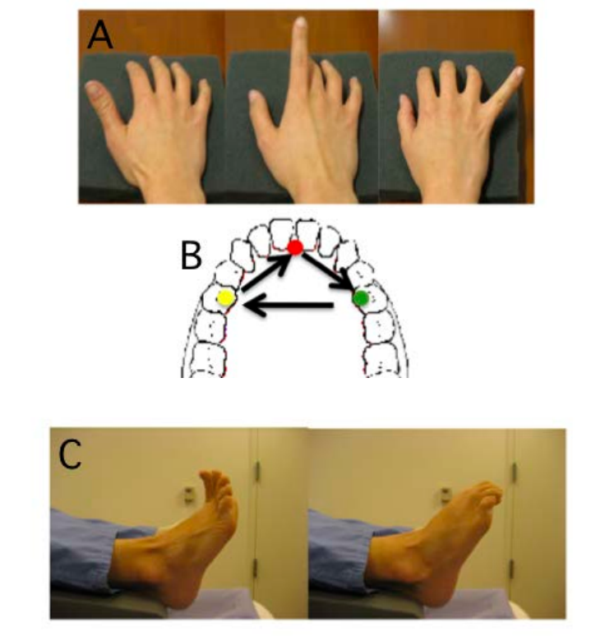
Motor task
http://humanconnectome.org/courses/2015/exploring-the-human-connectome.php

Slide 35



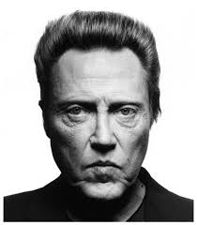
2-back face task block
2-back target
10 trials per block
Notes:
The participants were given 10 pictures of faces sequentially. Whenever he saw a picture that appeared two back, he should response in some way.

Slide 36
Appendix A: Image activity scores
First level: GLM for
the fMRI for each
subject
$θ^{(1)}$ 9-d: includes the
effects for constant,
0bk body, …., 0bk tool,
2bk body,…, 2bk tool.
Graph based on Darren Gitelman’s slides

Slide 37
Appendix A: Image activity scores
Second level:
Fixed-effects analyses
across runs (not
subjects).
$θ^{(2)}$ 1-d:
effect of constant
→ one sample t test

Slide 38
Appendix A: Image activity scores
Test:
0bk face:
$c={\left(0,0,1,0,0,0,0,0,0\right)}^{T}$
0bk face vs 0bk tool
$c={\left(0,0,1,0,−1,0,0,0,0\right)}^{T}$
0bk vs 2 bk: $c={\left(0,1,1,1,1,−1,−1,−1,−1\right)}^{T}$

Slide 39
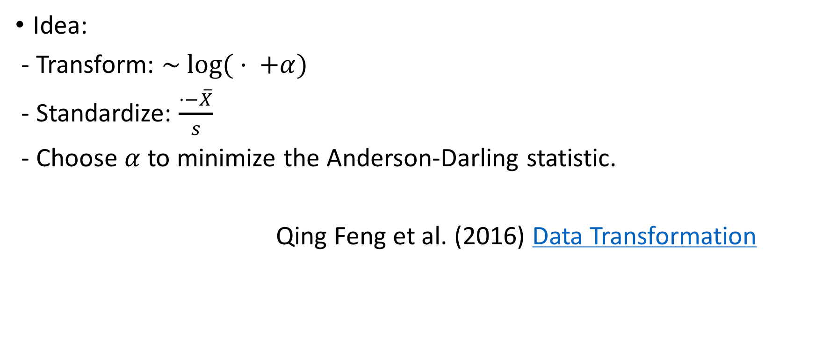
Appendix B: Shifted log and standardize transformation
Idea:
- Transform: $\sim log⁡( ⋅ +α)$
- Standardize: $\frac{⋅−\overline{X}}{s}$
- Choose $α$ to minimize the Anderson-Darling statistic.
Qing Feng et al. (2016) Data Transformation
Notes:
I briefly introduce the idea here.
First,…
Second,…
More complex things are going on that I am not going to explain in detail, but this is enough to express the idea.

