Slide 1
Participant Presentations
Draft Schedule Now on Course Web Page:
https://stor893spring2016.web.unc.edu/

Slide 2
Object Oriented Data Analysis
Three Major Parts of OODA Applications:
I. Object Definition
“What are the Data Objects?”
Exploratory Analysis
“What Is Data Structure / Drivers?”
III. Confirmatory Analysis / Validation
Is it Really There (vs. Noise Artifact)?

Slide 3
HDLSS Asymptotics
Personal Observations:
HDLSS world is…
Surprising (many times!)
[Think I’ve got it, and then …]
Mathematically Beautiful (?)
Practically Relevant

Slide 4
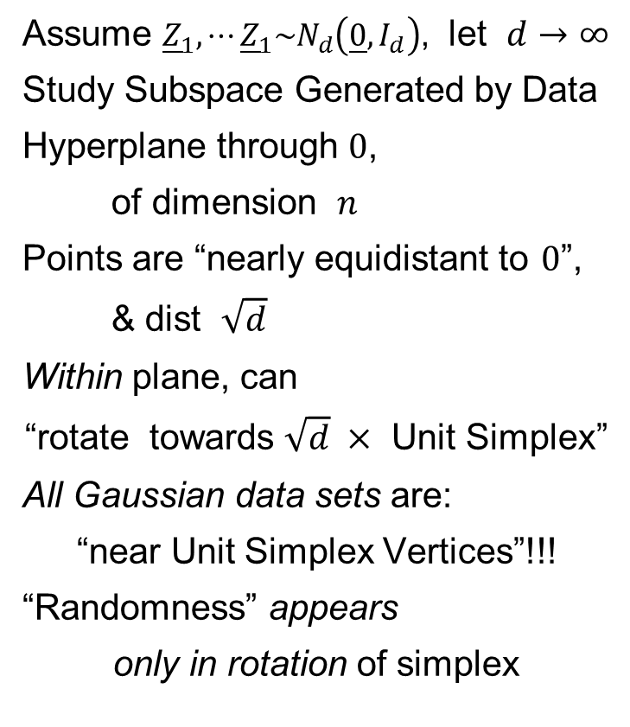
HDLSS Asy’s: Geometrical Represent’n
Assume ${\underline{Z}}_{1},⋯{\underline{Z}}_{1}\sim N_{d}\left(\underline{0},I_{d}\right)$, let $d→∞$
Study Subspace Generated by Data
Hyperplane through $0$,
of dimension $n$
Points are “nearly equidistant to $0$”,
& dist $\sqrt{d}$
Within plane, can
“rotate towards $\sqrt{d} ×$ Unit Simplex”
All Gaussian data sets are:
“near Unit Simplex Vertices”!!!
“Randomness” appears
only in rotation of simplex
Hall, Marron & Neeman (2005)

Slide 5
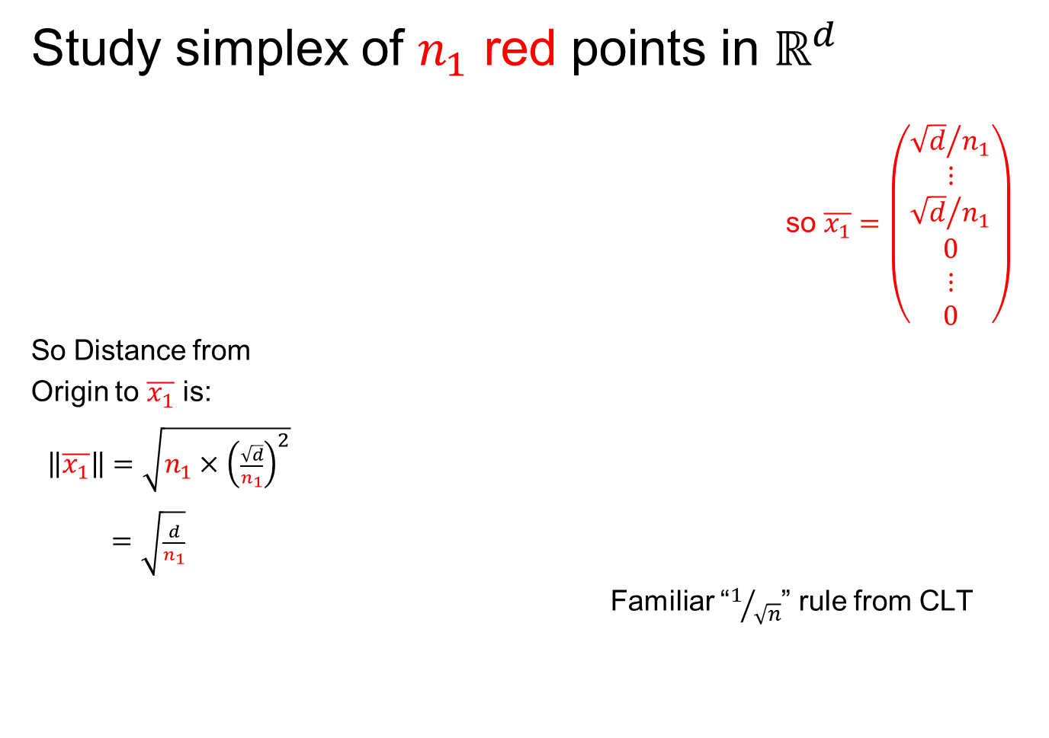
An Interesting HDLSS Explanation
Study simplex of $n_{1}$ red points in $ℝ^{d}$
so $\overline{x_{1}}=\left(\begin{matrix}\begin{matrix}{\sqrt{d}}/{n_{1}} \\ ⋮ \\ {\sqrt{d}}/{n_{1}}\end{matrix} \\ \begin{matrix}0 \\ ⋮ \\ 0\end{matrix}\end{matrix}\right)$
So Distance from
Origin to $\overline{x_{1}}$ is:
$\left\|\overline{x_{1}}\right\|=\sqrt{n_{1}×{\left(\frac{\sqrt{d}}{n_{1}}\right)}^{2}}$
$=\sqrt{\frac{d}{n_{1}}}$
Familiar “$1/{\sqrt{n}}$” rule from CLT

Slide 6
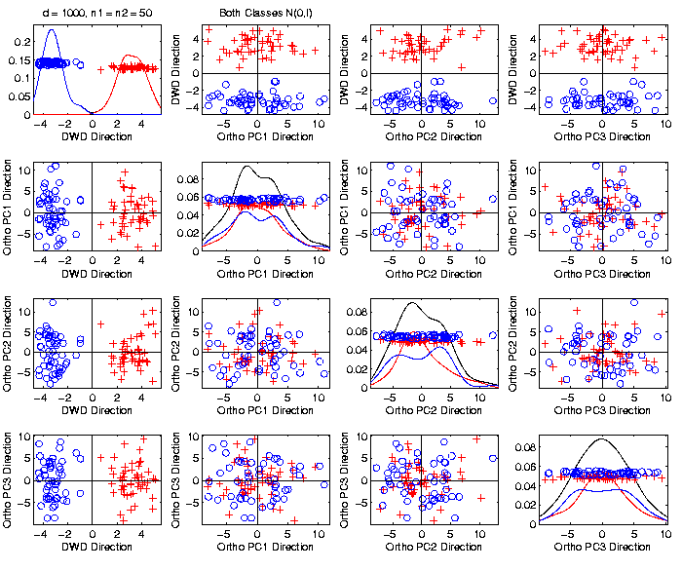

An Interesting HDLSS Explanation
Recall Two
Class $N\left(0,I\right)$
Example
$\left\|\overline{x_{1}}−\overline{x_{2}}\right\|$
$≈6.3$

Slide 7
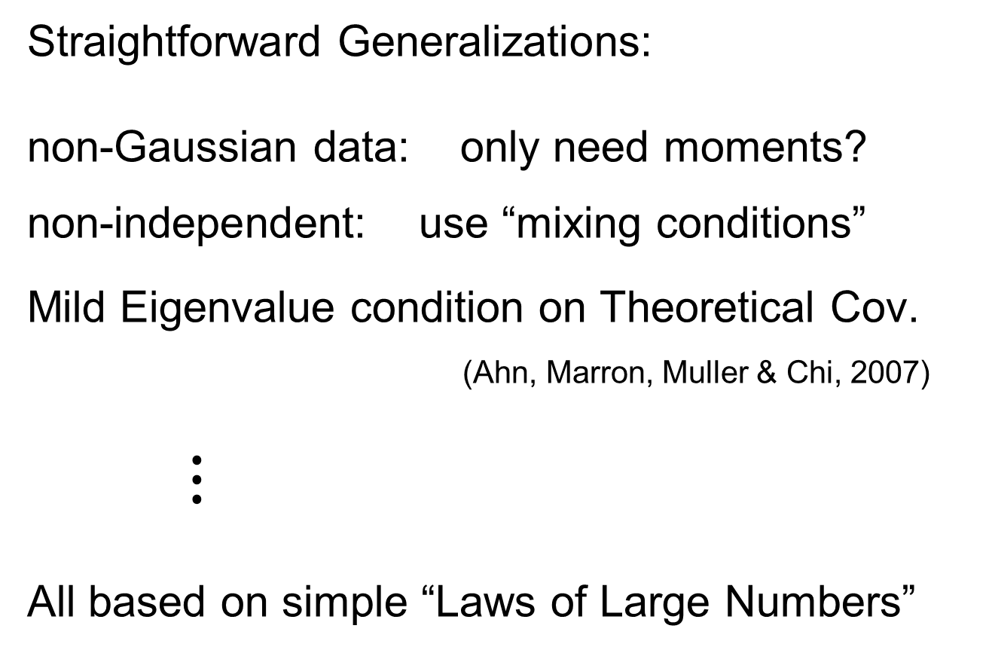
HDLSS Asy’s: Geometrical Represen’tion
Straightforward Generalizations:
non-Gaussian data: only need moments?
non-independent: use “mixing conditions”
Mild Eigenvalue condition on Theoretical Cov.
(Ahn, Marron, Muller & Chi, 2007)
$⋮$
All based on simple “Laws of Large Numbers”

Slide 8
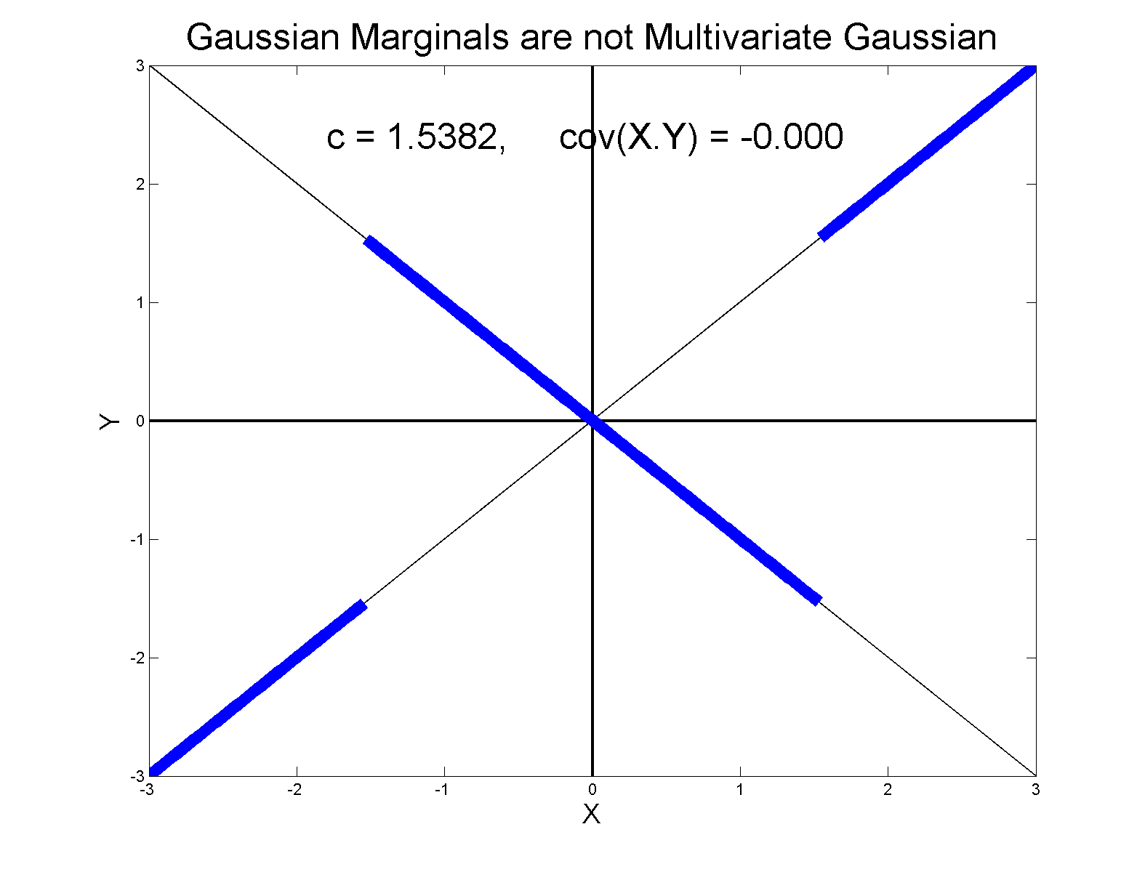
0 Covariance is not independence
Simple Example, c to make cov(X,Y) = 0

Slide 9
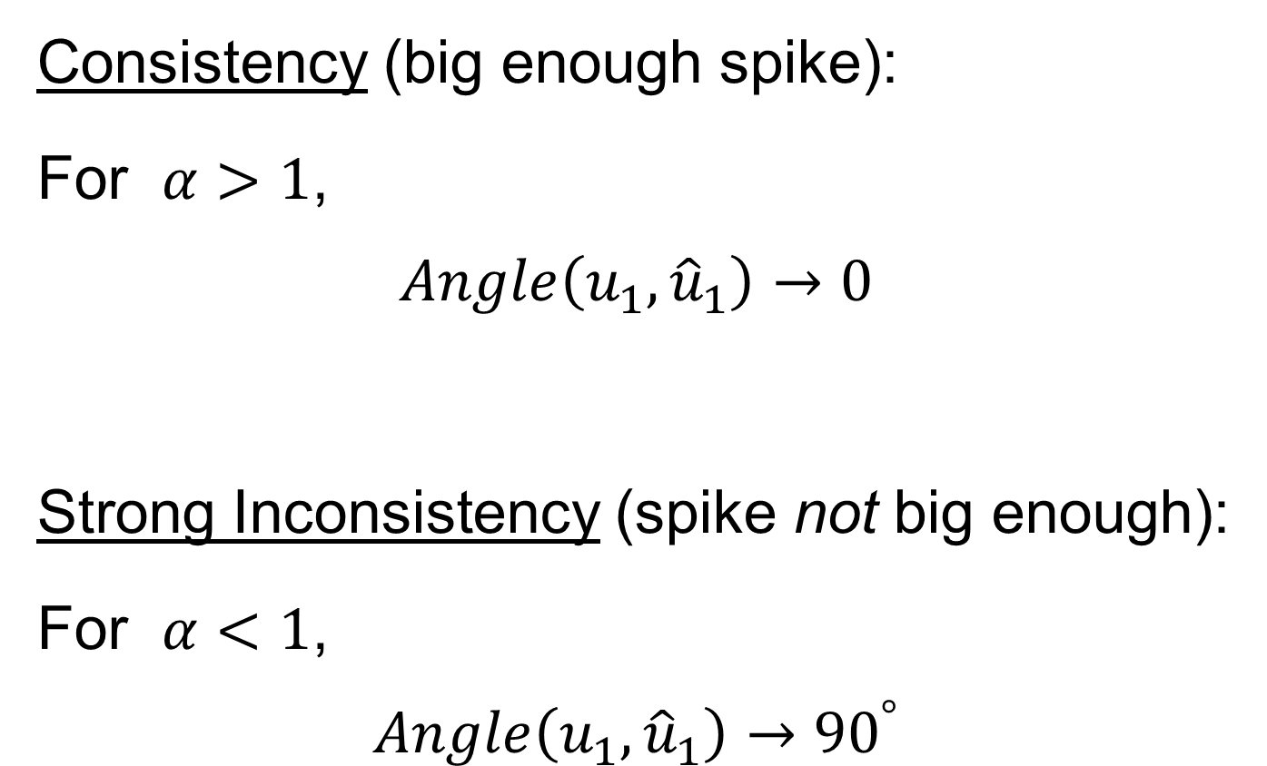
HDLSS Math. Stat. of PCA
Consistency (big enough spike):
For $α>1$,
$$Angle\left(u_{1},{\hat{u}}_{1}\right)→0$$
Strong Inconsistency (spike not big enough):
For $α<1$,
$$Angle\left(u_{1},{\hat{u}}_{1}\right)→{90}^{°}$$

Slide 10
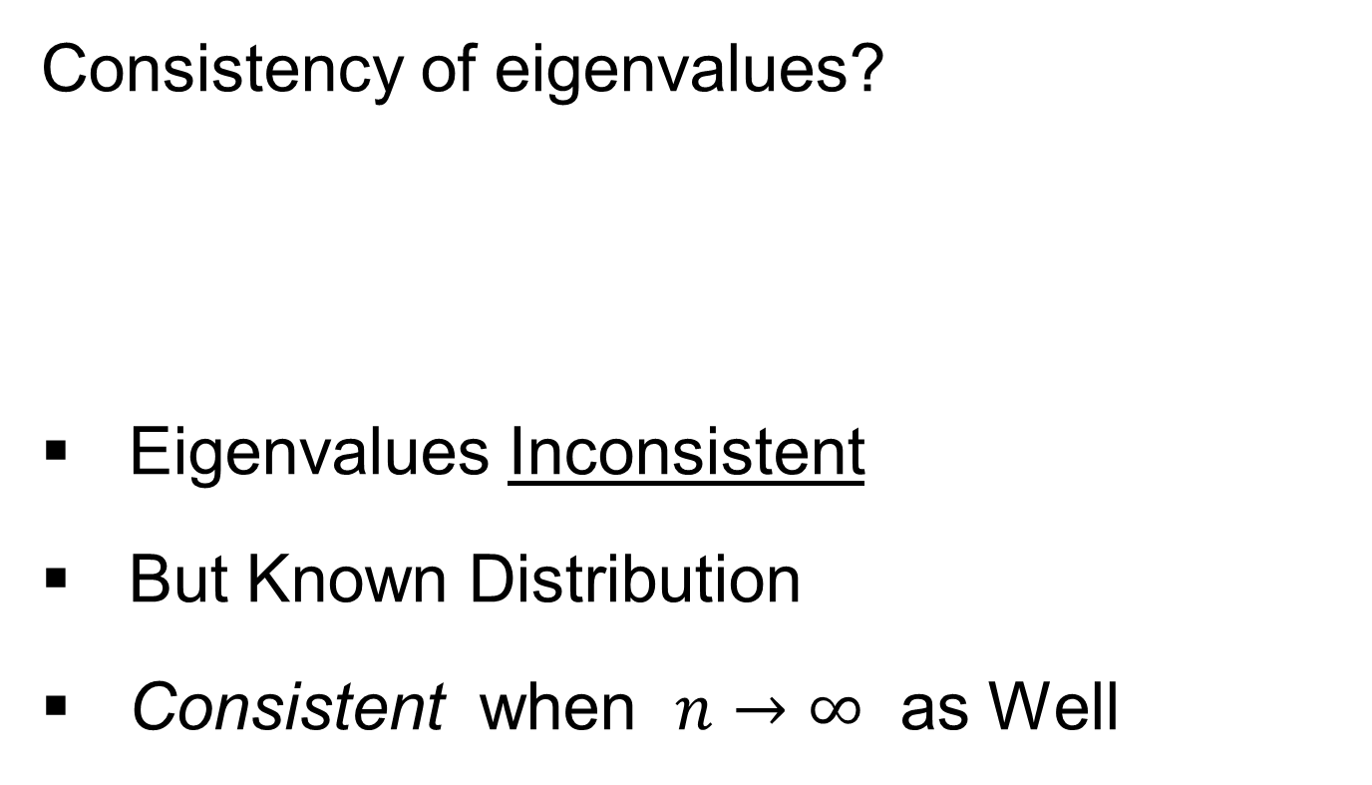
HDLSS Math. Stat. of PCA
Consistency of eigenvalues?
Eigenvalues Inconsistent
But Known Distribution
Consistent when $n→∞$ as Well

Slide 11
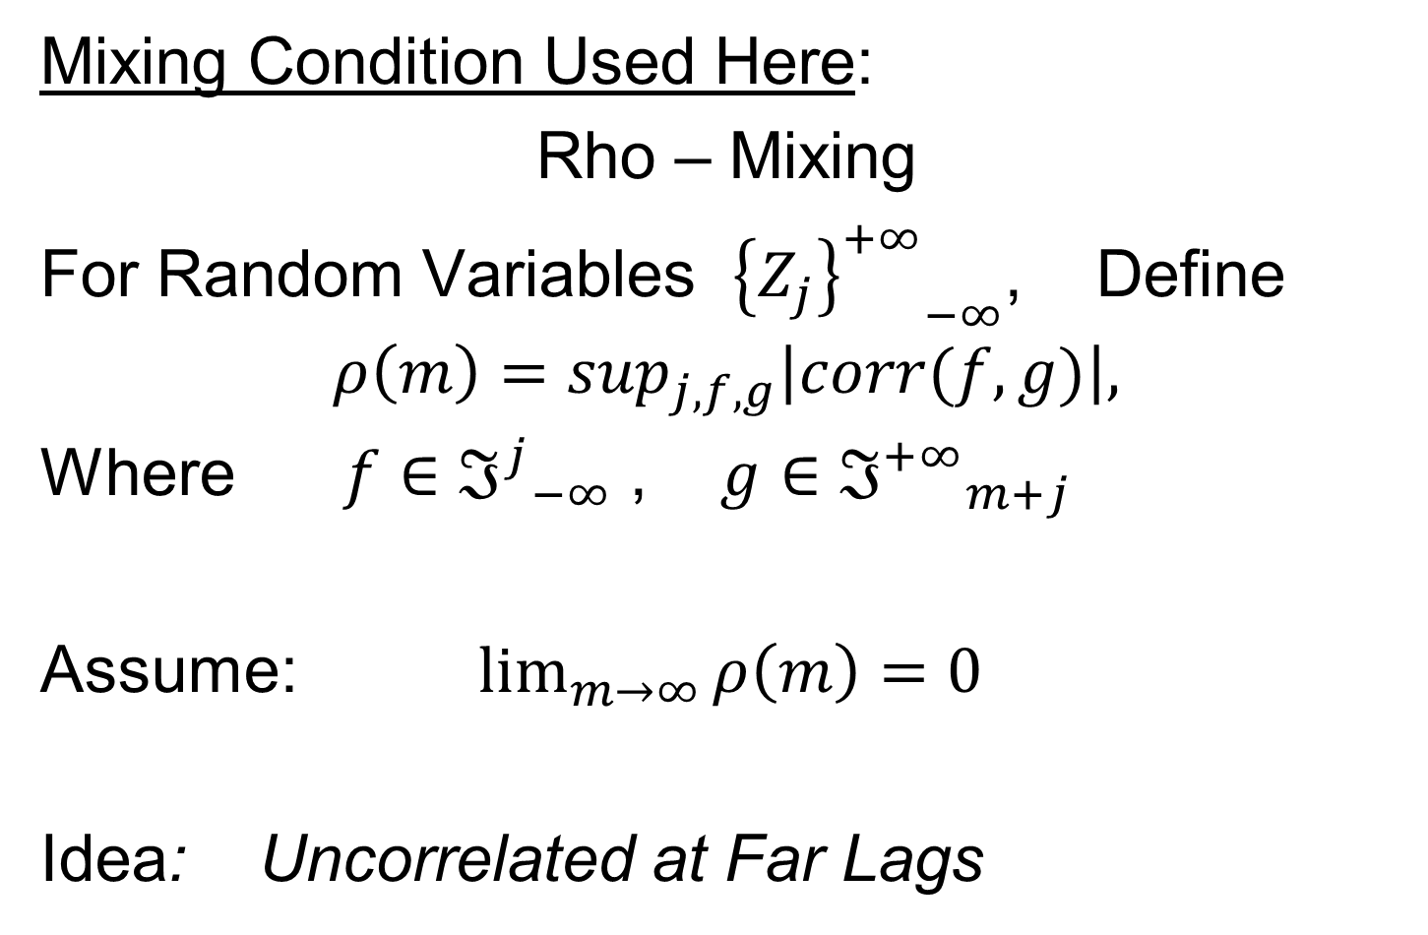
Mixing Conditions
Mixing Condition Used Here:
Rho – Mixing
For Random Variables ${{\left\{Z_{j}\right\}}^{+∞}}_{−∞}^{}$, Define
$$ρ\left(m\right)=\sup_{j,f,g}\left|corr(f,g)\right|,$$
Where $f∈{ℑ^{j}}_{−∞}^{}$ , $g∈{ℑ^{+∞}}_{m+j}^{}$
Assume: $\lim_{m→∞}{ρ\left(m\right)=0}$
Idea: Uncorrelated at Far Lags

Slide 12
HDLSS Math. Stat. of PCA
Conditions for Geo. Rep’n:
Condition from Jung & Marron (2009):
where
Define:
Assume: Ǝ a permutation,
So that is ρ-mixing

Slide 13
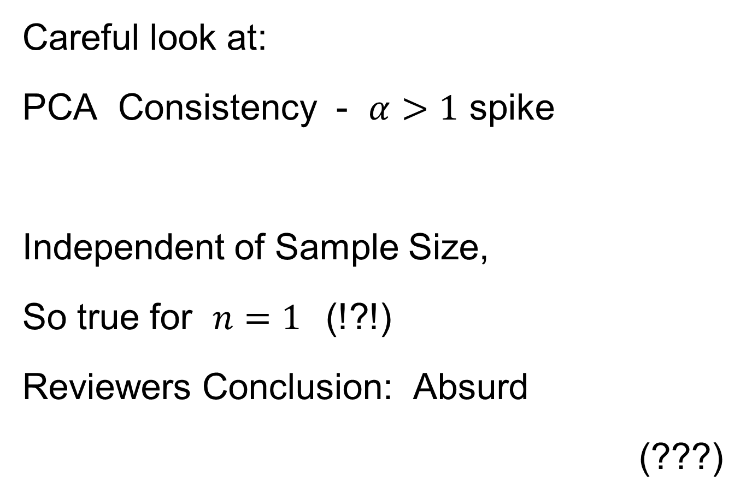
HDLSS Math. Stat. of PCA
Careful look at:
PCA Consistency - $α>1$ spike
Independent of Sample Size,
So true for $n=1$(!?!)
Reviewers Conclusion: Absurd
(???)
Shows assumption too strong for practice

Slide 14
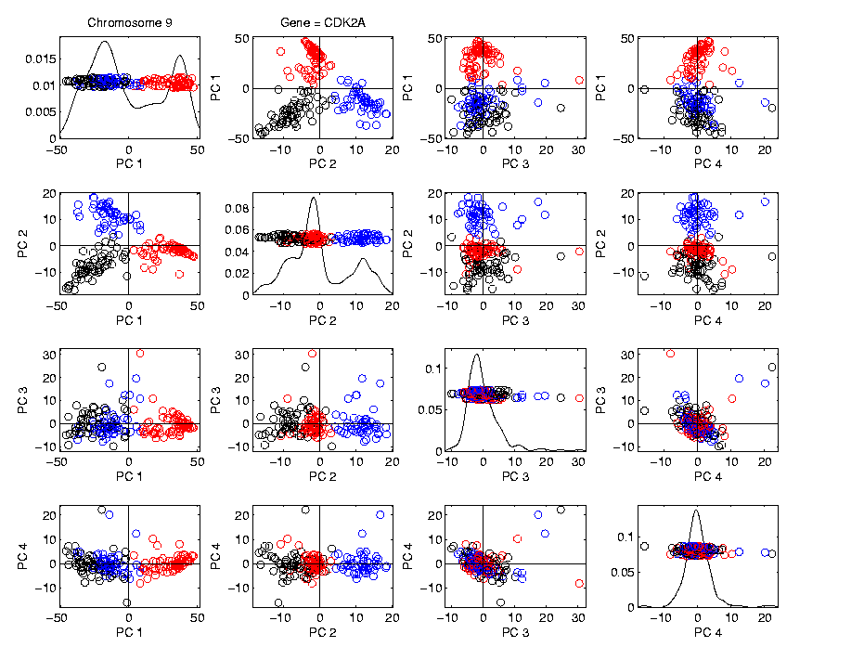
HDLSS Math. Stat. of PCA
HDLSS
PCA
Often
Finds
Signal,
Not Pure
Noise

Slide 15
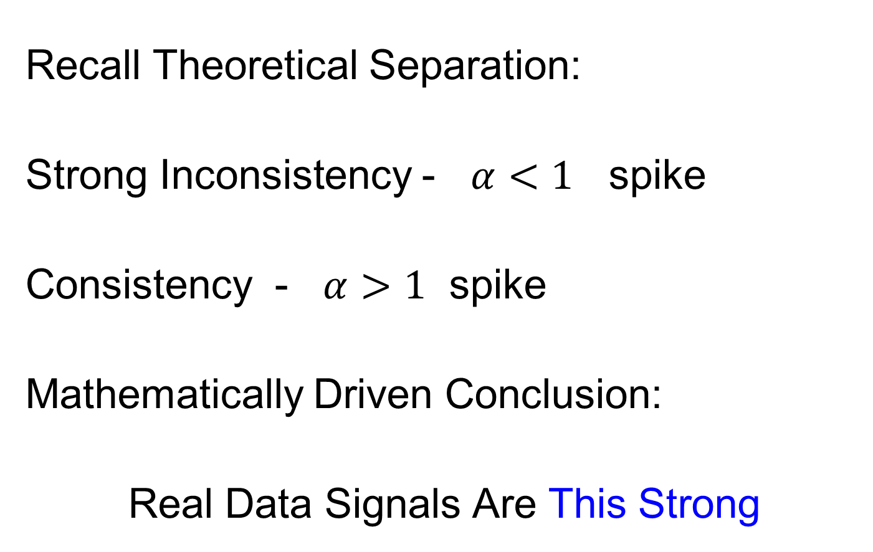
HDLSS Math. Stat. of PCA
Recall Theoretical Separation:
Strong Inconsistency - $α<1$ spike
Consistency - $α>1$ spike
Mathematically Driven Conclusion:
Real Data Signals Are This Strong

Slide 16
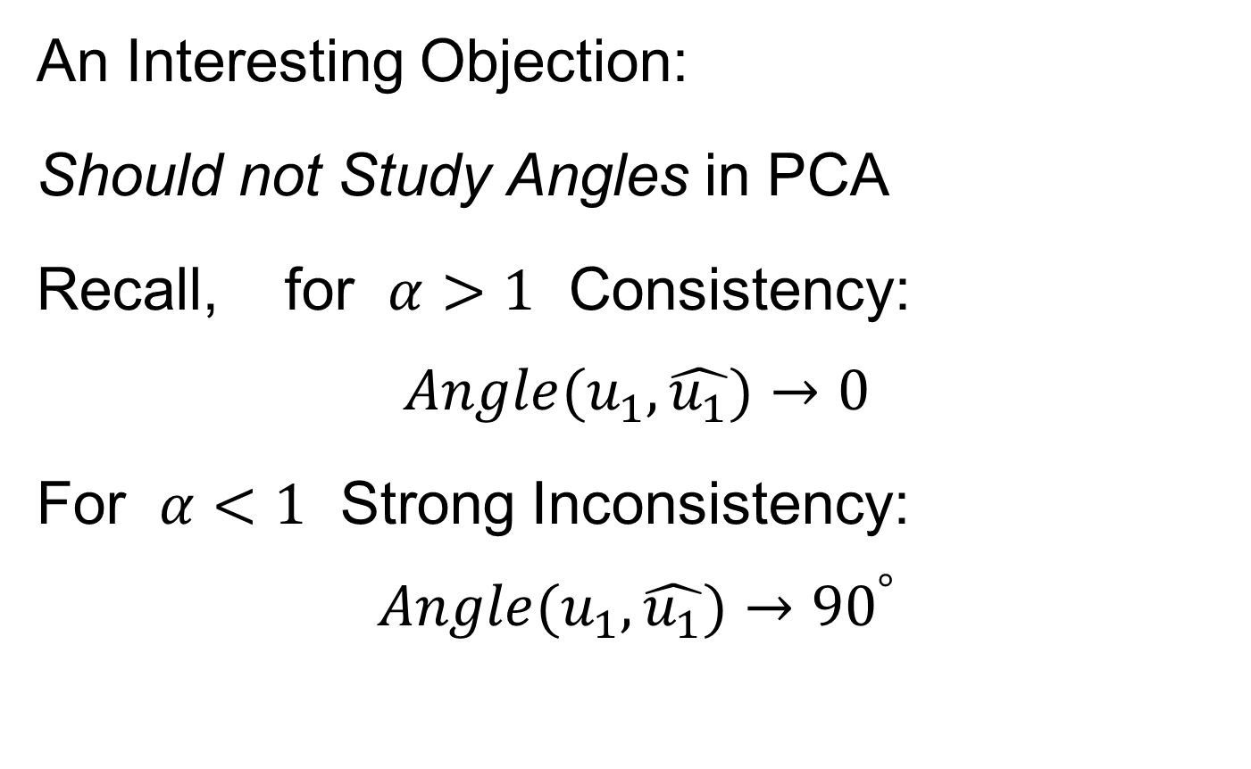
HDLSS Math. Stat. of PCA
An Interesting Objection:
Should not Study Angles in PCA
Recall, for $α>1$ Consistency:
$$Angle(u_{1},\hat{u_{1}})→0$$
For $α<1$ Strong Inconsistency:
$$Angle(u_{1},\hat{u_{1}})→{90}^{°}$$

Slide 17
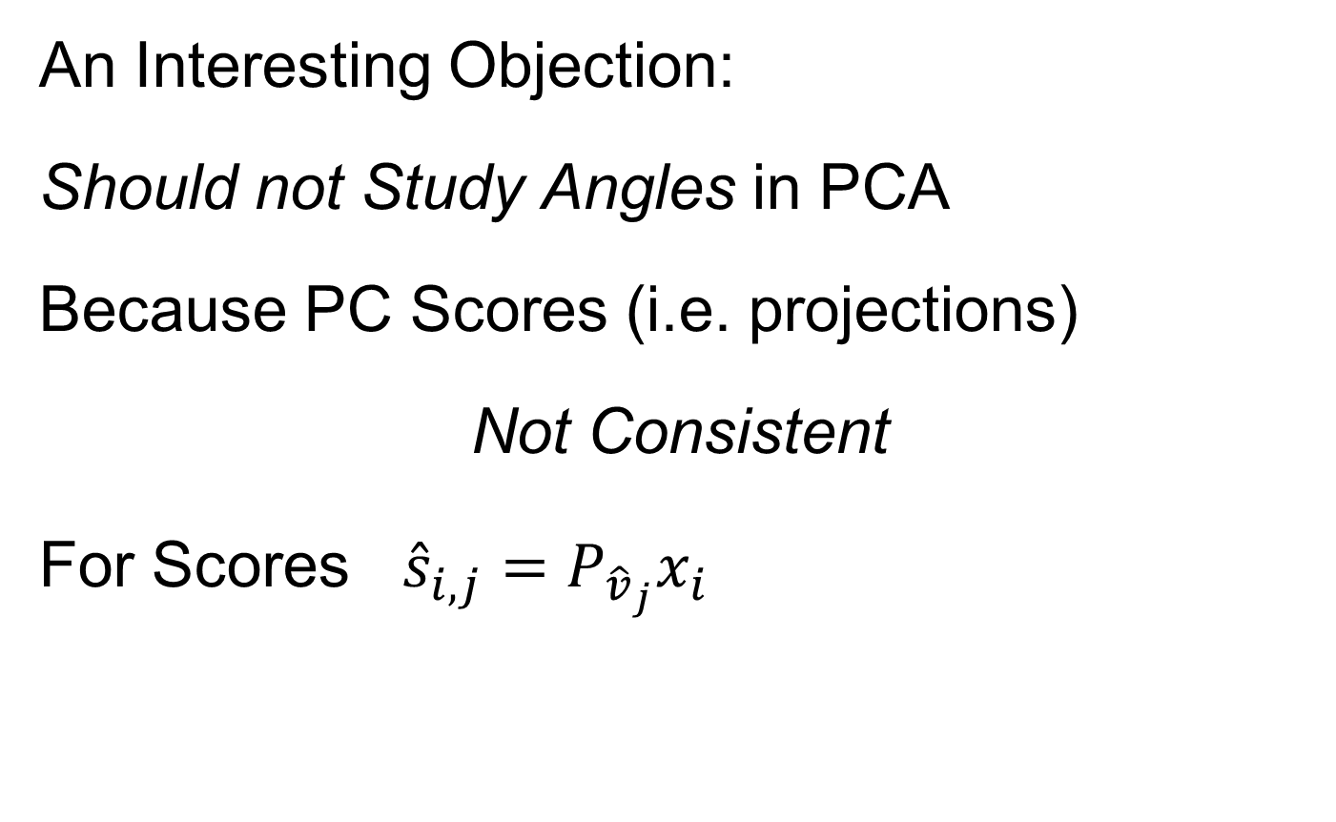
HDLSS Math. Stat. of PCA
An Interesting Objection:
Should not Study Angles in PCA
Because PC Scores (i.e. projections)
Not Consistent
For Scores ${\hat{s}}_{i,j}=P_{{\hat{v}}_{j}}x_{i}$
What we study in PCA scatterplots

Slide 18

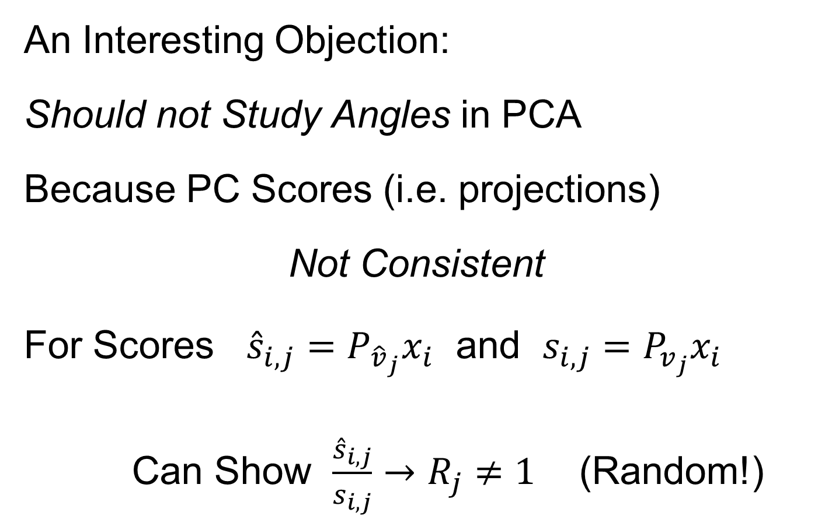
HDLSS Math. Stat. of PCA
An Interesting Objection:
Should not Study Angles in PCA
Because PC Scores (i.e. projections)
Not Consistent
For Scores ${\hat{s}}_{i,j}=P_{{\hat{v}}_{j}}x_{i}$ and $s_{i,j}=P_{v_{j}}x_{i}$
Can Show $\frac{{\hat{s}}_{i,j}}{s_{i,j}}→R_{j}≠1$ (Random!)
Due to Dan Shen

Slide 19
HDLSS Math. Stat. of PCA
PC Scores (i.e. projections)
Not Consistent
So how can PCA find Useful Signals in Data?

Slide 20
HDLSS Math. Stat. of PCA
HDLSS
PCA
Often
Finds
Signal,
Not Pure
Noise

Slide 21
HDLSS Math. Stat. of PCA
PC Scores (i.e. projections)
Not Consistent
So how can PCA find Useful Signals in Data?
Key is “Proportional Errors”

Slide 22
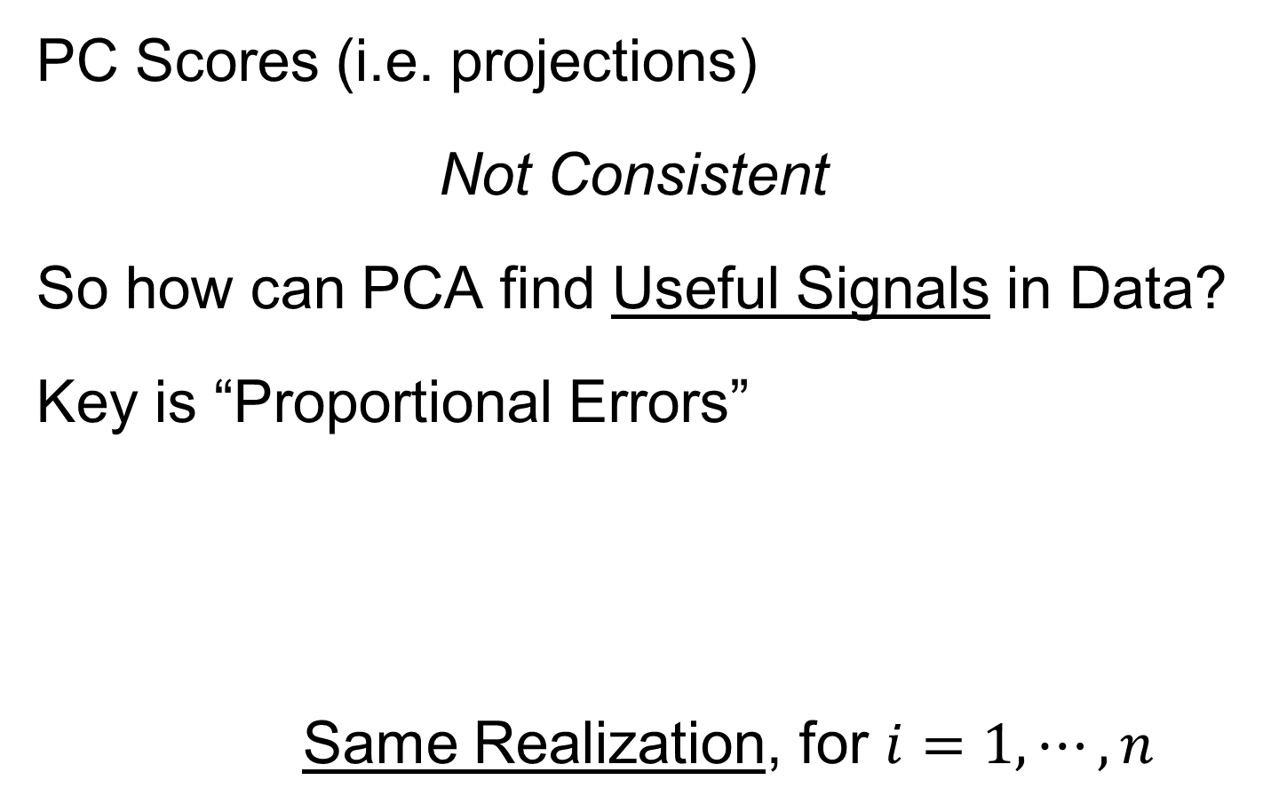
HDLSS Math. Stat. of PCA
PC Scores (i.e. projections)
Not Consistent
So how can PCA find Useful Signals in Data?
Key is “Proportional Errors”
Same Realization, for $i=1,⋯,n$

Slide 23
HDLSS Math. Stat. of PCA
PC Scores (i.e. projections)
Not Consistent
So how can PCA find Useful Signals in Data?
Key is “Proportional Errors”
Axes have Inconsistent Scales,
But Relationships are Still Useful

Slide 24
HDLSS Math. Stat. of PCA
Numbers
On Axes
Are Wrong
But
Relationships
Are Right

Slide 25
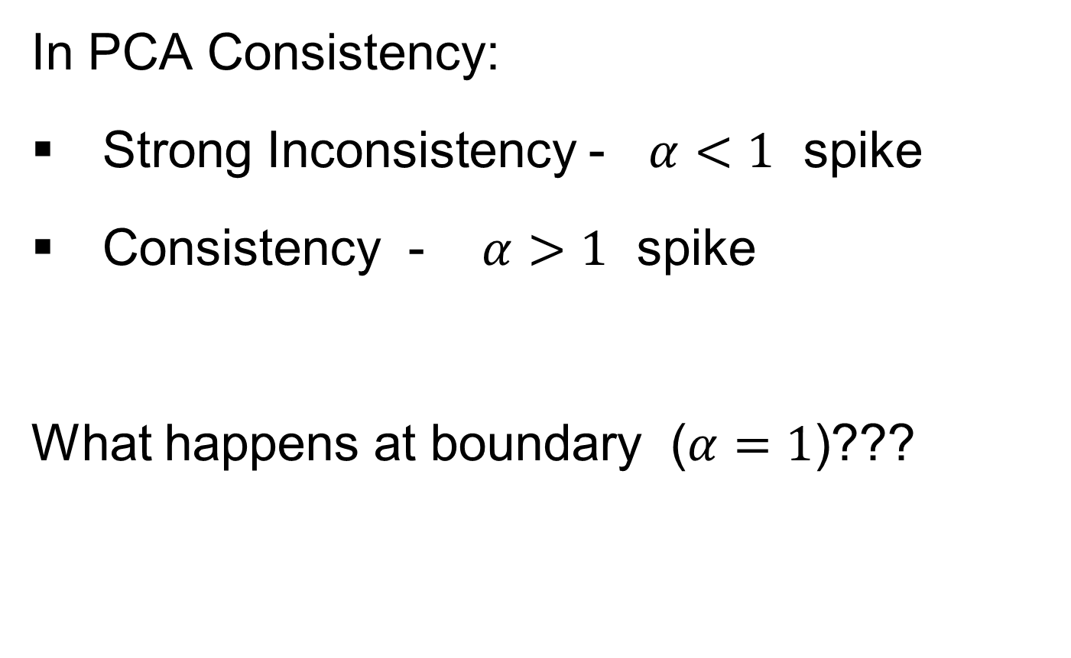
HDLSS Deep Open Problem
In PCA Consistency:
Strong Inconsistency - $α<1$ spike
Consistency - $α>1$ spike
What happens at boundary ($α=1$)???

Slide 26
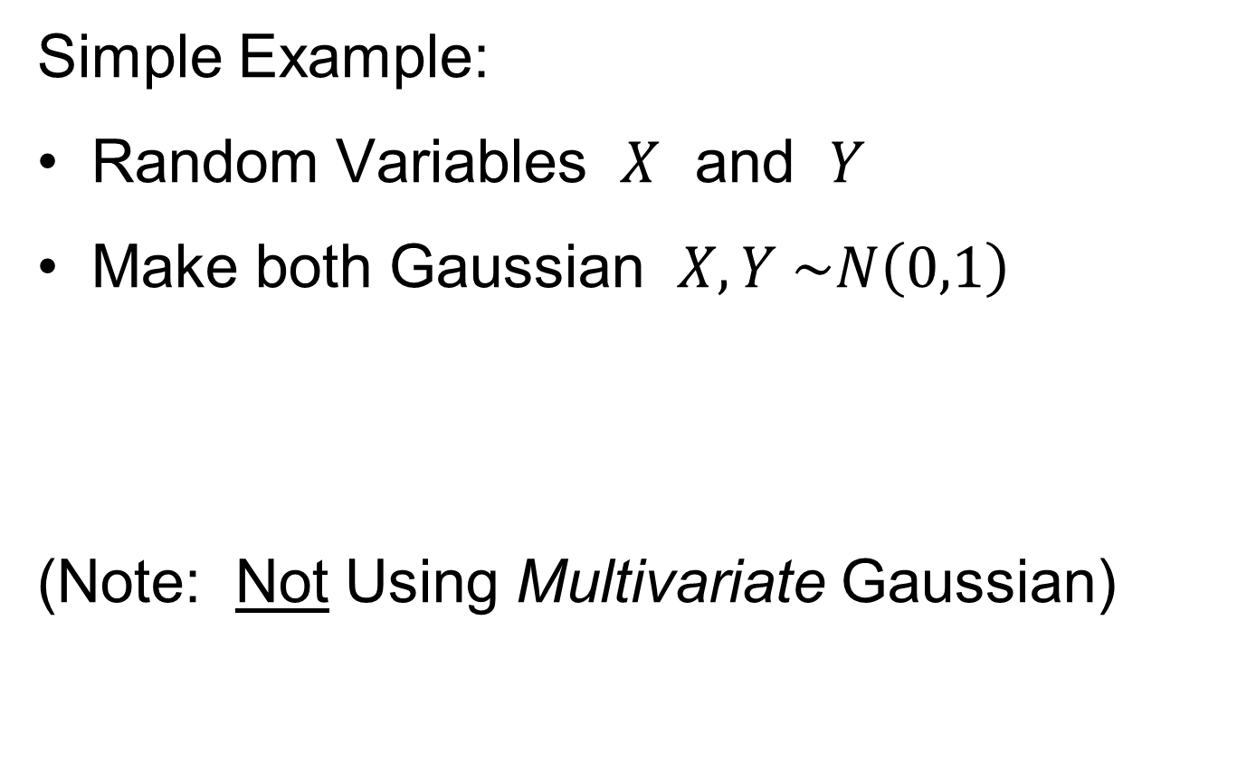
HDLSS Deep Open Problem
Result
In PCA Consistency:
Strong Inconsistency - $α<1$ spike
Consistency - $α>1$ spike
What happens at boundary ($α=1$)???
Ǝ interesting Limit Distn’s
Jung, Sen & Marron (2012)

Slide 27
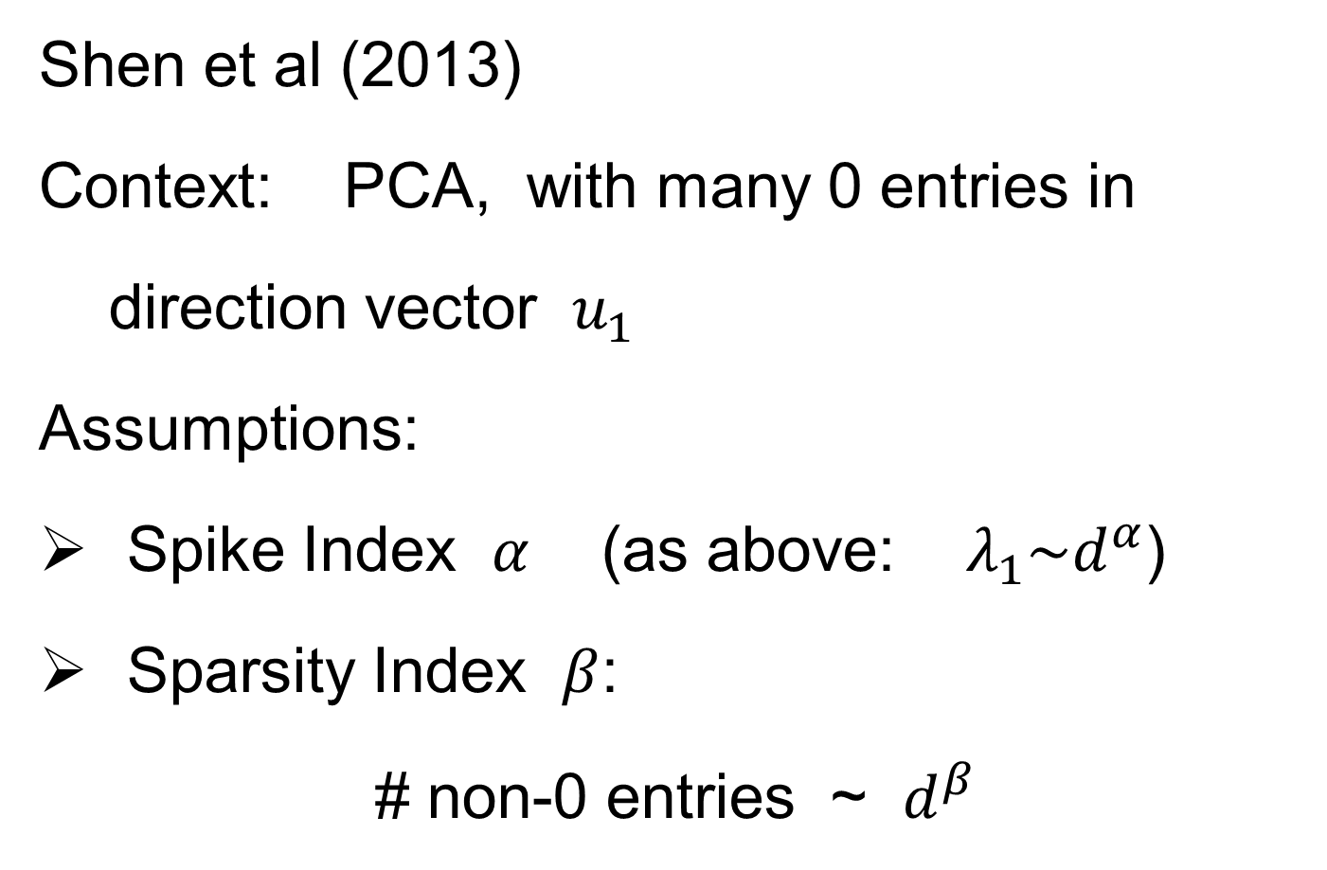
HDLSS & Sparsity
Shen et al (2013)
Context: PCA, with many 0 entries in
direction vector $u_{1}$
Assumptions:
Spike Index $α$ (as above: $λ_{1}\sim d^{α}$)
Sparsity Index $β$:
# non-0 entries ~ $d^{β}$

Slide 28
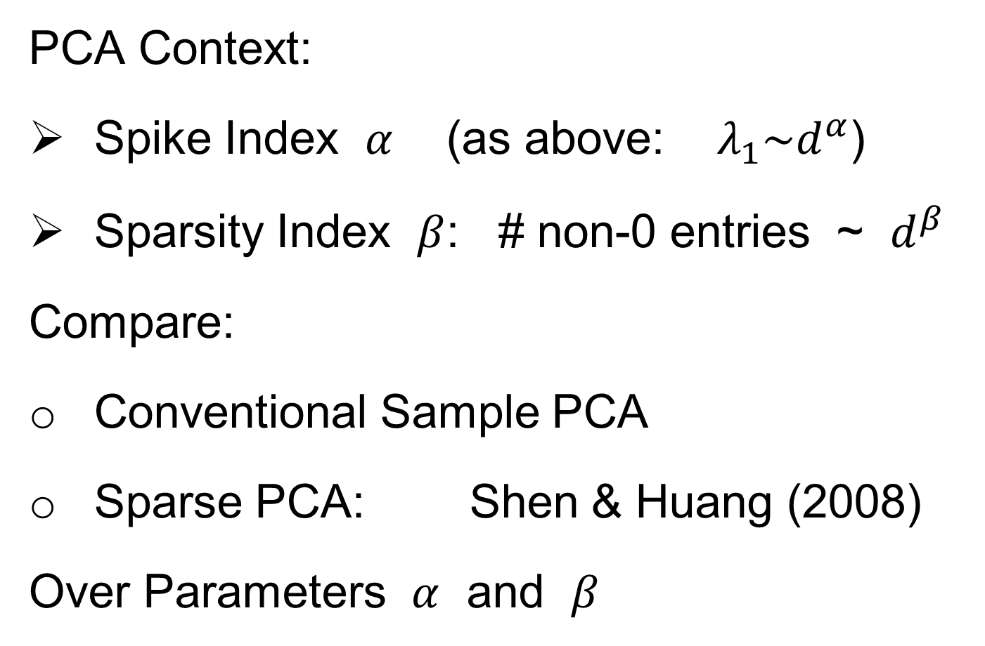
HDLSS & Sparsity
PCA Context:
Spike Index $α$ (as above: $λ_{1}\sim d^{α}$)
Sparsity Index $β$: # non-0 entries ~ $d^{β}$
Compare:
Conventional Sample PCA
Sparse PCA: Shen & Huang (2008)
Over Parameters $α$ and $β$

Slide 29
1
0≤ α < β ≤1
0.7
β
0≤ α = β ≤1
Sparsity Index
α>1
0 ≤ β ≤1
0.5
0.3
0≤β<α≤1
0.1
0
0
0.2
0.4
0.6
0.8
1
Jung and Marron
α
Spike Index
Regular PCA: Inconsistent & Consistent

Slide 30
1
0≤ α < β ≤1
0.7
β
0≤ α = β ≤1
Sparsity Index
α>1
0 ≤ β ≤1
0.5
0.3
0≤β<α≤1
0.1
0
0
0.2
0.4
0.6
0.8
1
Jung and Marron
α
Spike Index
Sparse PCA: Inconsistent & New Consistency Region

Slide 31
HDLSS & Sparsity
Sparse PCA Opens Up Whole New
Region of Consistency

Slide 32
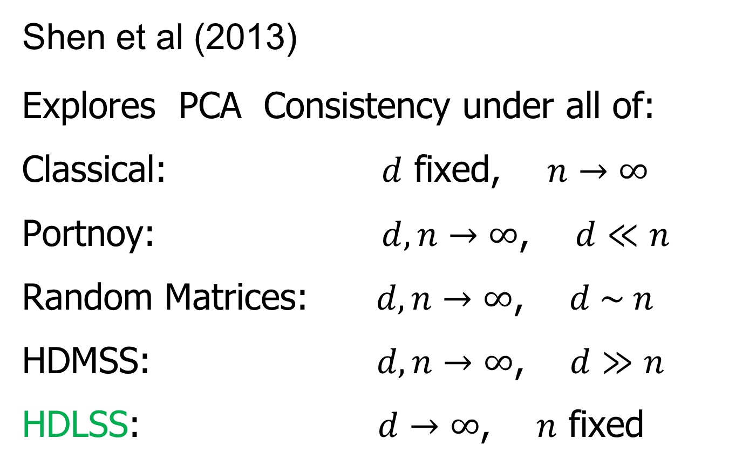
HDLSS & Other Asymptotics
Shen et al (2013)
Explores PCA Consistency under all of:
Classical: $d$ fixed, $n→∞$
Portnoy: $d, n→∞$, $d≪n$
Random Matrices: $d, n→∞$, $d \sim n$
HDMSS: $d, n→∞$, $d≫n$
HDLSS: $d→∞$, $n$ fixed

Slide 33
(A) Single Spike - Example 1.1
(B) Multi Spike - Example 1.2
Consistency
1
1
Sample Index
α + γ >1
γ
α + γ >1, γ >0
Sample Index (Johnstone and Lu (2009))
γ
Strong Inconsistency
0≤ α + γ <1
0≤ α + γ <1
(0,0)
Strong Inconsistency
1
Consistency
(0,0)
Strong Inconsistency
1
α
α
Subspace Consistency
Spike Index (Jung and Marron (2009))
Spike Index (Jung and Marron (2009))

Slide 34
(A) Single Spike - Example 1.1
(B) Multi Spike - Example 1.2
Consistency
1
1
Sample Index
α + γ >1
γ
α + γ >1, γ >0
Sample Index (Johnstone and Lu (2009))
γ
Strong Inconsistency
0≤ α + γ <1
0≤ α + γ <1
(0,0)
Strong Inconsistency
1
Consistency
(0,0)
Strong Inconsistency
1
α
α
Subspace Consistency
Spike Index (Jung and Marron (2009))
Spike Index (Jung and Marron (2009))

Slide 35
More HDLSS Asymptotics
Aoshima & Yata (2009,…,2012)
Natural Covariance Matrix Assumptions
(non-Gaussian)
Improvements on PCA
(Milder Consistency Cond.)
Using Clever Dual Space Calculations

Slide 36
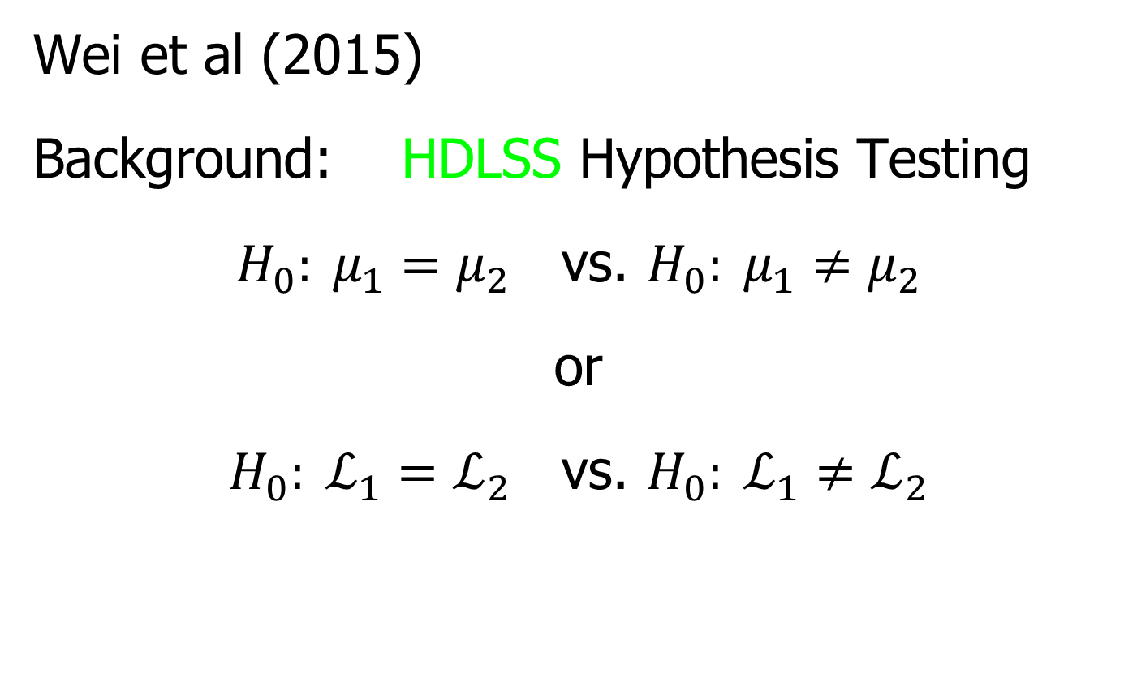
HDLSS Analysis of DiProPerm
Wei et al (2015)
Background: HDLSS Hypothesis Testing
$H_{0}: μ_{1}=μ_{2}$ vs. $H_{0}: μ_{1}≠μ_{2}$
or
$H_{0}: ℒ_{1}=ℒ_{2}$ vs. $H_{0}: ℒ_{1}≠ℒ_{2}$

Slide 37
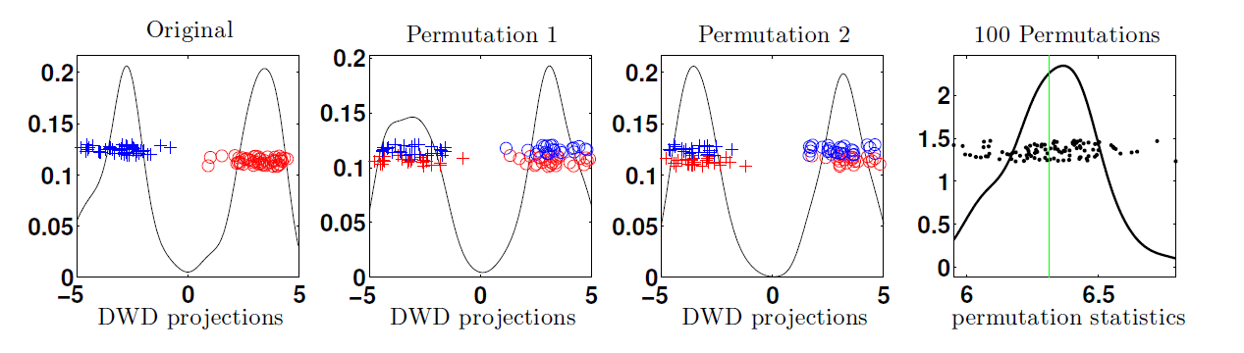
HDLSS Analysis of DiProPerm
Wei et al (2015)
Recall: N(0,1) data (both classes)

Slide 38
HDLSS Analysis of DiProPerm
Question:
Which Statistic to Summarize Projections?
2 – Sample t statistic
Mean Difference

Slide 39
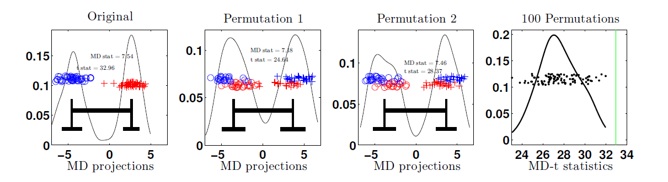
HDLSS Analysis of DiProPerm
Which Statistic to Summarize Projections?
Does it Matter?
E.g. Both i.i.d with t(5) marginal
t-test summary rejects

Slide 40
HDLSS Analysis of DiProPerm
Yet both have mean 0
Reason: Less spread for original projection
E.g. Both i.i.d with t(5) marginal
t-test summary rejects

Slide 41
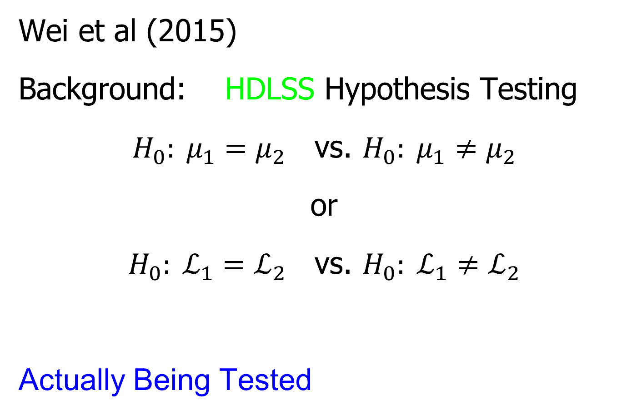
HDLSS Analysis of DiProPerm
Wei et al (2015)
Background: HDLSS Hypothesis Testing
$H_{0}: μ_{1}=μ_{2}$ vs. $H_{0}: μ_{1}≠μ_{2}$
or
$H_{0}: ℒ_{1}=ℒ_{2}$ vs. $H_{0}: ℒ_{1}≠ℒ_{2}$
Actually Being Tested

Slide 42
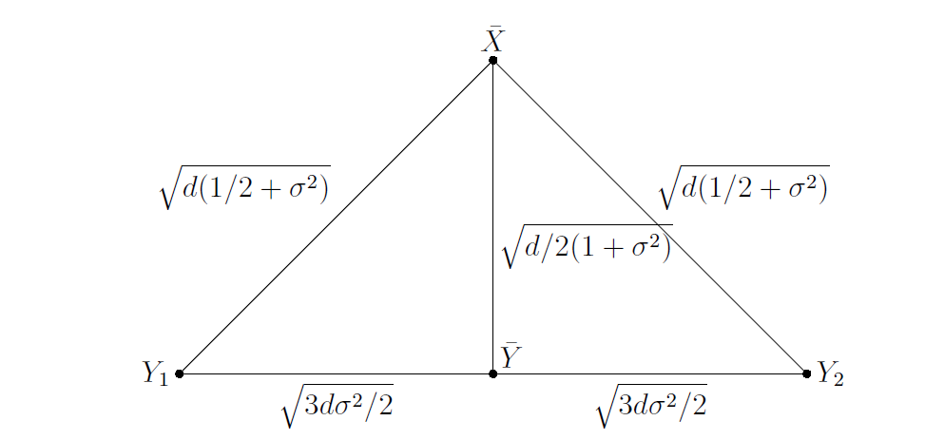
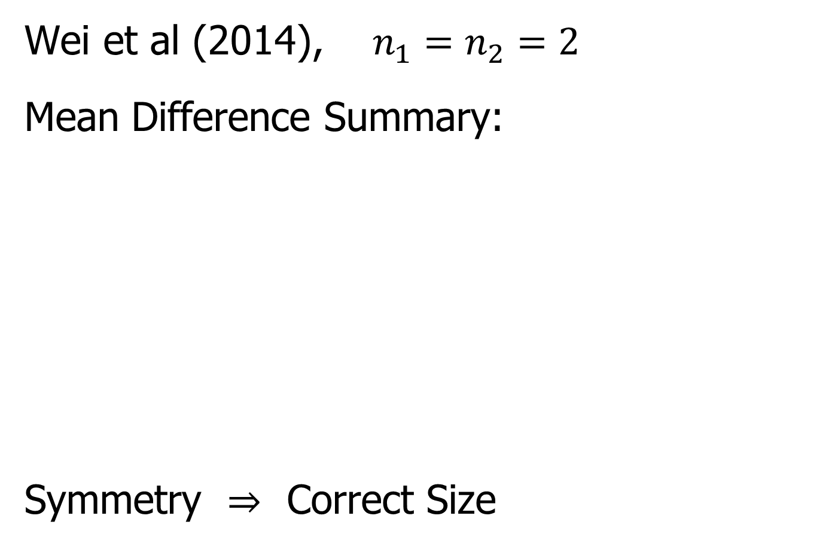
HDLSS Analysis of DiProPerm
Wei et al (2014), $n_{1}=n_{2}=2$
Mean Difference Summary:
Symmetry $⇒$ Correct Size

Slide 43
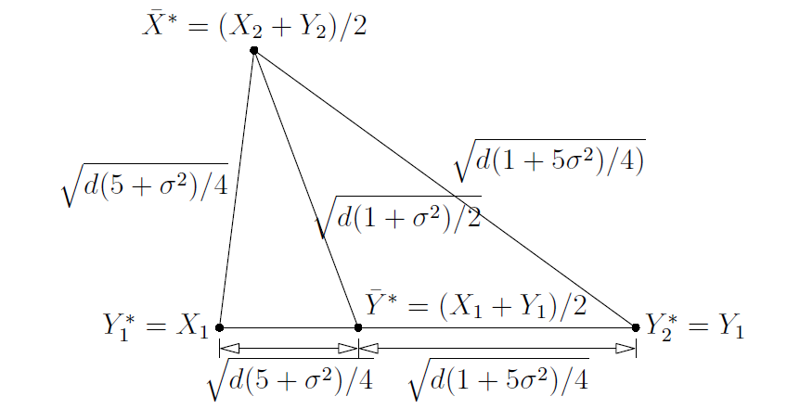
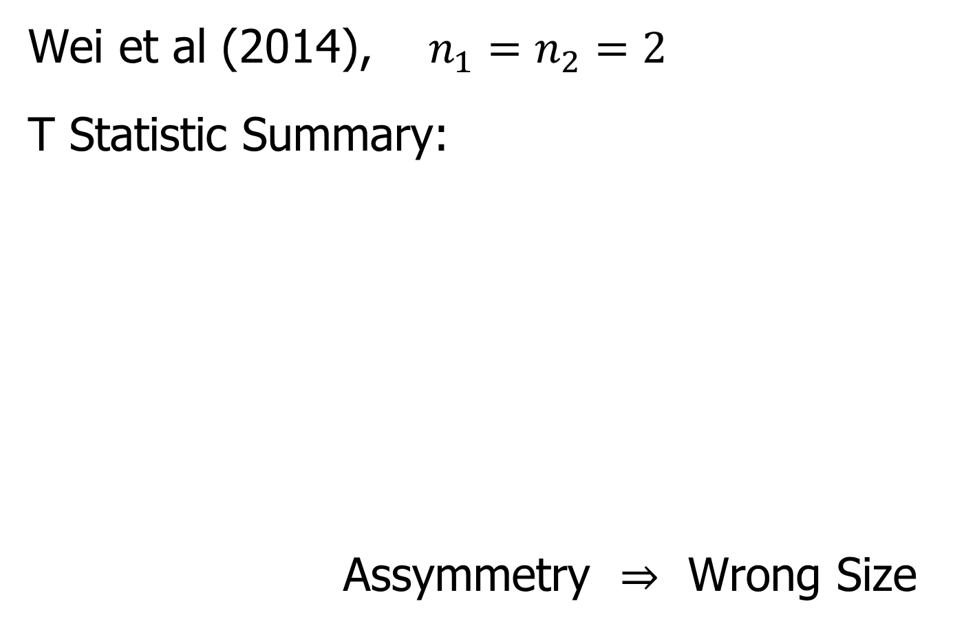
HDLSS Analysis of DiProPerm
Wei et al (2014), $n_{1}=n_{2}=2$
T Statistic Summary:
Assymmetry $⇒$ Wrong Size

Slide 44
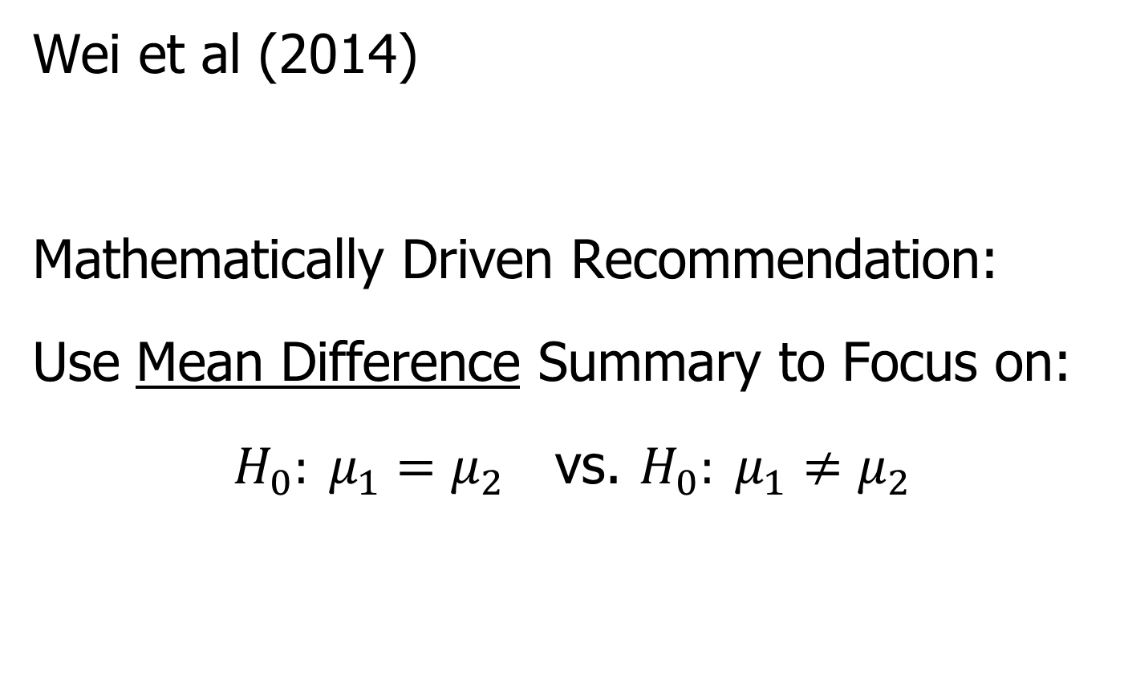
HDLSS Analysis of DiProPerm
Wei et al (2014)
Mathematically Driven Recommendation:
Use Mean Difference Summary to Focus on:
$H_{0}: μ_{1}=μ_{2}$ vs. $H_{0}: μ_{1}≠μ_{2}$

Slide 45
HDLSS Asymptotics
Personal Observations:
HDLSS world is…
Surprising (many times!)
[Think I’ve got it, and then …]
Mathematically Beautiful (?)
Practically Relevant

Slide 46
The Future of HDLSS Asymptotics
“Contiguity” in Hypo Testing?
Rates of Convergence?
Improvements of DWD?
(e.g. other functions of distance than inverse)
Many Others?
It is still early days …
(Will do more later in course)

Slide 47

State of HDLSS Research?
Development
Of Methods
Mathematical
Assessment
…
(thanks to:
defiant.corban.edu/gtipton/net-fun/iceberg.html)

Slide 48
Cornea Data
Main Point: OODA Beyond FDA
Recall Interplay:
Object Space ←→ Descriptor Space

Slide 49
Cornea Data
Cornea: Outer surface of the eye
Driver of Vision: Curvature of Cornea
Data Objects: Images on the unit disk
Radial Curvature as “Heat Map”
Special Thanks to K. L. Cohen, N. Tripoli,
UNC Ophthalmology

Slide 50
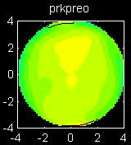
Cornea Data
Cornea Data:
Raw Data
Decompose
Into
Modes of
Variation?

Slide 51
Cornea Data
Reference: Locantore, et al (1999)
Visualization (generally true for images):
More challenging than for curves
(since can’t overlay)
Instead view sequence of images
Harder to see “population structure”
(than for curves)
So PCA type decomposition of variation is more important

Slide 52
Cornea Data
Nature of images
(on the unit disk, not usual rectangle)
Color is “curvature”
Along radii of circle
(direction with most effect on vision)
Hotter (red, yellow) for “more curvature”
Cooler (blue, green) for “less curvature”
Descriptor vector is coefficients of Zernike expansion
Zernike basis: ~ Fourier basis, on disk
Conveniently represented in polar coord’s

Slide 53
Cornea Data
Data Representation - Zernike Basis
Pixels as features is large and wasteful
Natural to find more efficient represent’n
Polar Coordinate Tensor Product of:
  Fourier basis (angular)
  Special Jacobi (radial, to avoid singularities)
See:
  Schwiegerling, Greivenkamp & Miller (1995)
  Born & Wolf (1980)

Slide 54
Cornea Data
Data Representation - Zernike Basis
Descriptor Space is Vector Space of Zernike Coefficients
So Perform PCA There

Slide 55
PCA of Cornea Data
Recall: PCA can find (often insightful)
direction of greatest variability
Main problem: display of result (no overlays for images)
Solution: show movie of “marching along the direction vector”

Slide 56
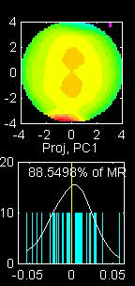
PCA of Cornea Data
PC1 Movie:

Slide 57
PCA of Cornea Data
PC1 Summary:
Mean (1st image): mild vert’l astigmatism
known pop’n structure called “with the rule”
Main dir’n: “more curved” & “less curved”
Corresponds to first optometric measure
(89% of variat’n, in Mean Resid. SS sense)
Also: “stronger astig’m” & “no astig’m”
Found corr’n between astig’m and curv’re
Scores (cyan): Apparent Gaussian dist’n

Slide 58
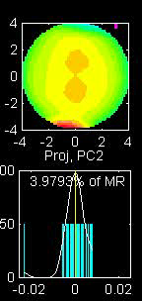
PCA of Cornea Data
PC2 Movie:

Slide 59
PCA of Cornea Data
PC2 Movie:
Mean: same as above
Common centerpoint of point cloud
Are studying “directions from mean”
Images along direction vector:
Looks terrible???
Why?

Slide 60
PCA of Cornea Data
PC2 Movie:
Reason made clear in Scores Plot (cyan):
Single outlying data object drives PC dir’n
A known problem with PCA
Recall finds direction with “max variation”
In sense of variance
Easily dominated by single large observat’n

Slide 61
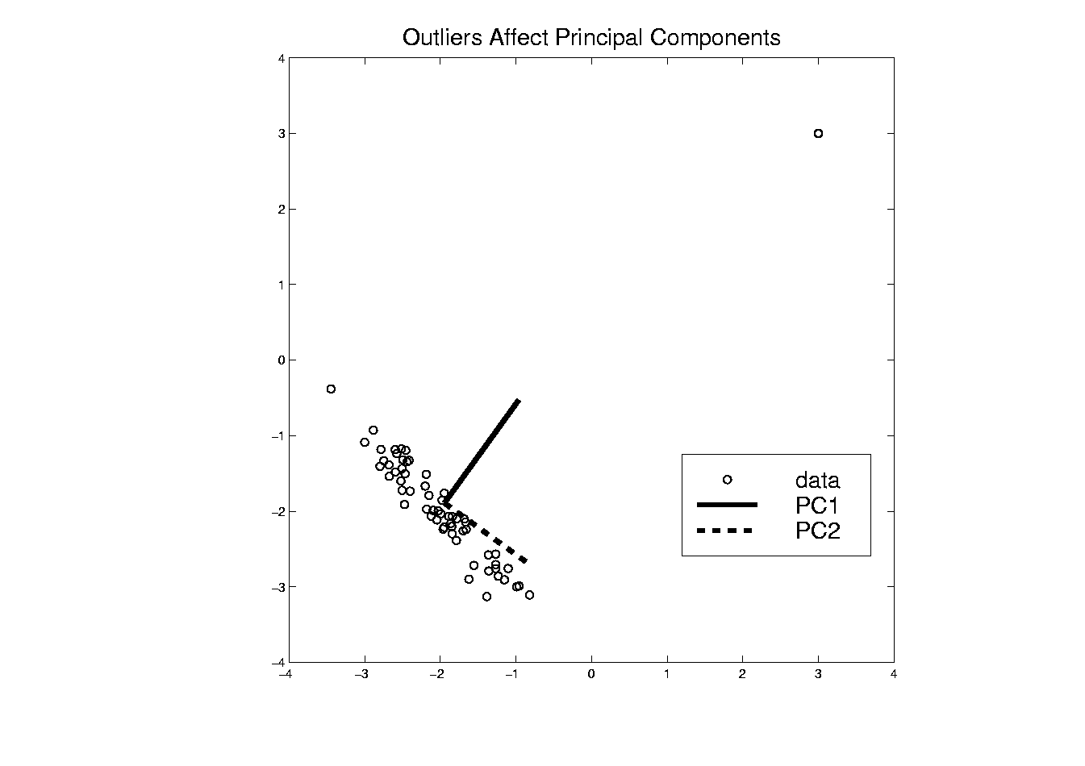
PCA of Cornea Data
Toy Example: Single Outlier Driving PCA

Slide 62
PCA of Cornea Data
PC2 Affected by Outlier:
How bad is this problem?
View 1: Statistician: Arrggghh!!!!
Outliers are very dangerous
Can give arbitrary and meaningless dir’ns

Slide 63
PCA of Cornea Data
PC2 Affected by Outlier:
How bad is this problem?
View 2: Ophthalmologist: No Problem
Driven by “edge effects” (see raw data)
Artifact of “light reflection” data gathering
(“eyelid blocking”, and drying effects)
Routinely “visually ignore” those anyway
Found interesting (& well known) dir’n:
steeper superior vs steeper inferior

Slide 64
Cornea Data
Cornea Data:
Raw Data
Which one
is the outlier?
Will say more
later …

Slide 65
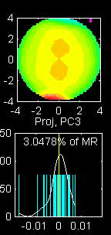
PCA of Cornea Data
PC3 Movie

Slide 66
PCA of Cornea Data
PC3 Movie (ophthalmologist’s view):
Edge Effect Outlier is present
But focusing on “central region” shows changing dir’n of astig’m (3% of MR SS)
“with the rule” (vertical) vs. “against the rule” (horizontal)
most astigmatism is “with the rule”
most of rest is “against the rule”
(known folklore)

Slide 67
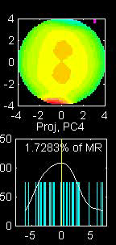
PCA of Cornea Data
PC4 movie

Slide 68
PCA of Cornea Data
Continue with ophthalmologists view…
PC4 movie version:
Other direction of astigmatism???
Location (i.e. “registration”) effect???
Harder to interpret …
OK, since only 1.7% of MR SS
Substantially less than for PC2 & PC3

Slide 69
PCA of Cornea Data
Ophthalmologists View (cont.)
Overall Impressions / Conclusions:
Useful decomposition of population variation
Useful insight into population structure

Slide 70

PCA of Cornea Data
Now return to Statistician’s View:
How can we handle these outliers?
Even though not fatal here, can be for other examples…
Simple Toy
Example
(in 2d):

Slide 71
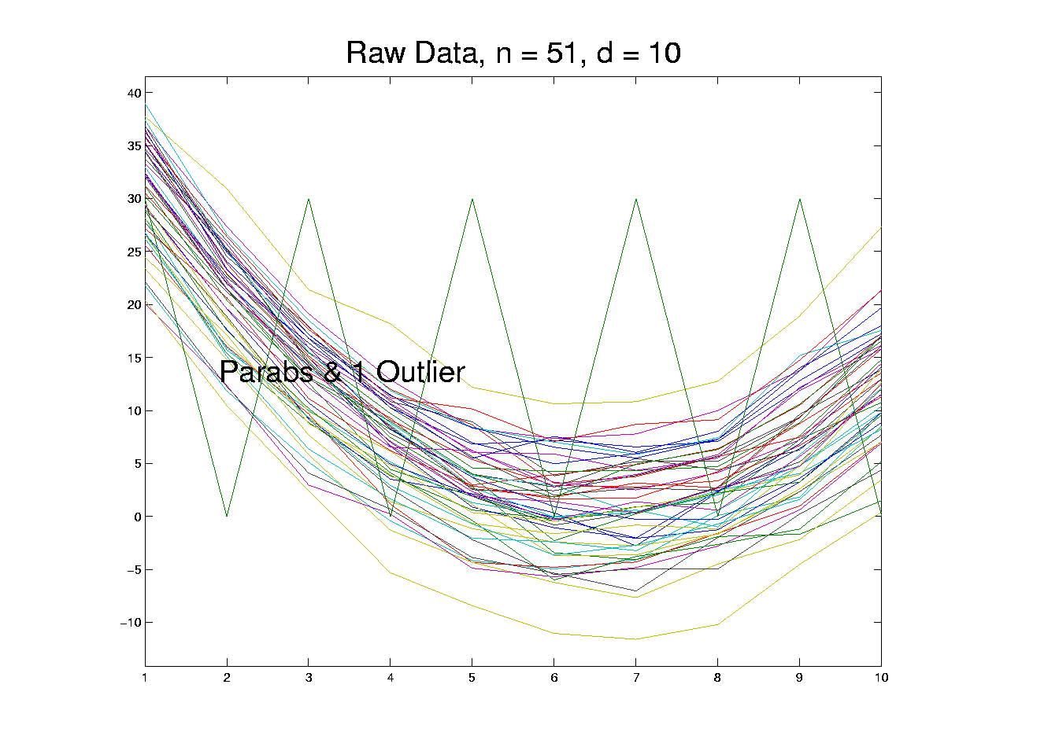
Outliers in PCA
Deeper Toy Example:

Slide 72
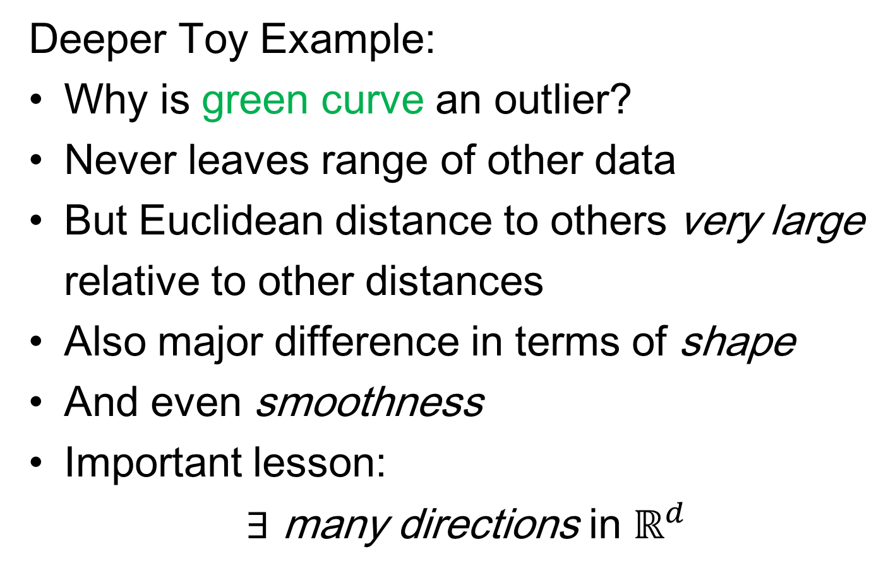
Outliers in PCA
Deeper Toy Example:
Why is green curve an outlier?
Never leaves range of other data
But Euclidean distance to others very large
relative to other distances
Also major difference in terms of shape
And even smoothness
Important lesson:
$∃$ many directions in $ℝ^{d}$

Slide 73
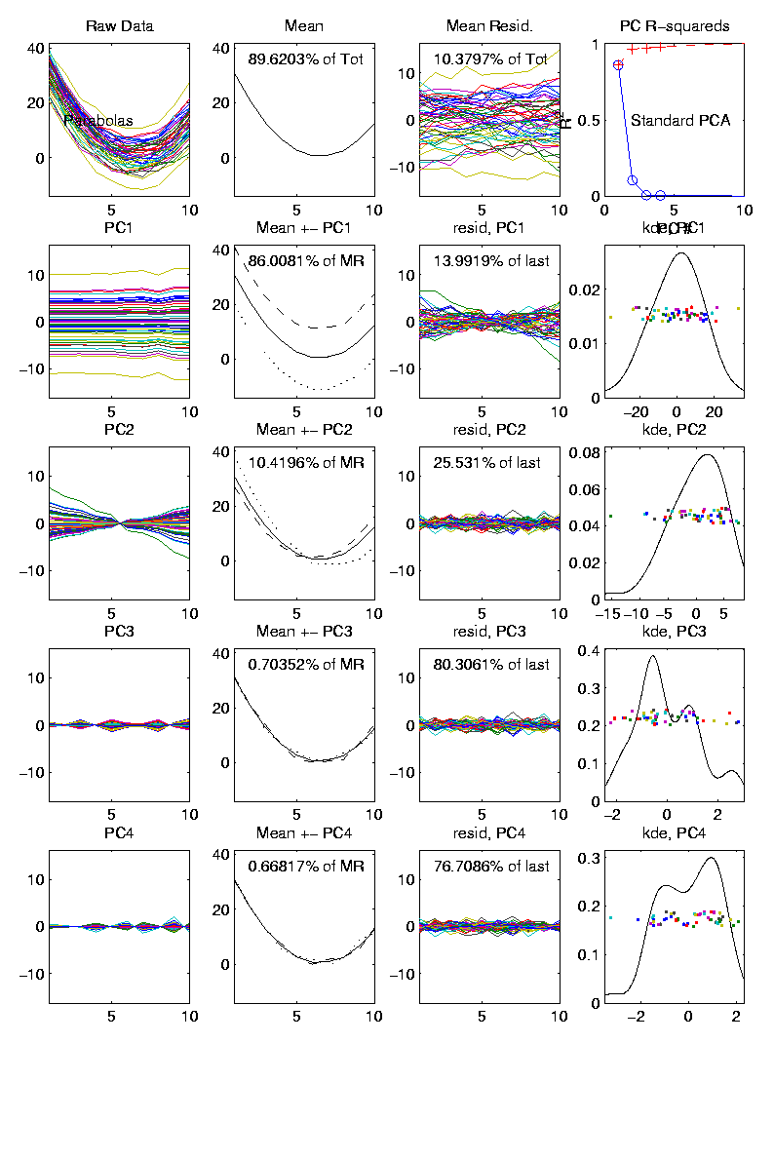
Outliers in PCA
Much like
earlier
Parabolas
Example
But with
1 “outlier”
thrown in

Slide 74
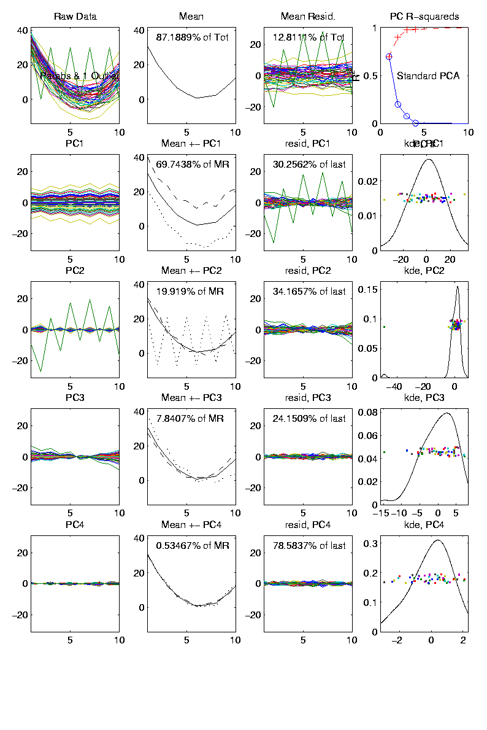
Outliers in PCA
PCA for
Deeper
Toy E.g.
Data:

Slide 75
Outliers in PCA
Deeper Toy Example:
At first glance, mean and PC1 look similar to no outlier version
PC2 clearly driven completely by outlier
PC2 scores plot (on right) gives clear outlier diagnostic
Outlier does not appear in other directions
Previous PC2, now appears as PC3
Total Power (upper right plot) now “spread farther”

Slide 76
Outliers in PCA
Closer Look at Deeper Toy Example:
Mean “influenced” a little, by the outlier
Appearance of “corners” at every other coordinate
PC1 substantially “influenced” by the outlier
Clear “wiggles”

Slide 77
Outliers in PCA
What can (should?) be done about outliers?
Context 1: Outliers are important aspects of the population
  They need to be highlighted in the analysis
  Although could separate into subpopulations
Context 2: Outliers are “bad data”, of no interest
  recording errors? Other mistakes?
  Then should avoid distorted view of PCA

Slide 78
Outliers in PCA
Standard Statistical Approaches to Dealing with Outliers:
Outlier Deletion:
Kick out “bad data”
Robust Statistical methods:
Work with full data set,
but downweight “bad data”
Reduce influence, instead of “deleting”

Slide 79
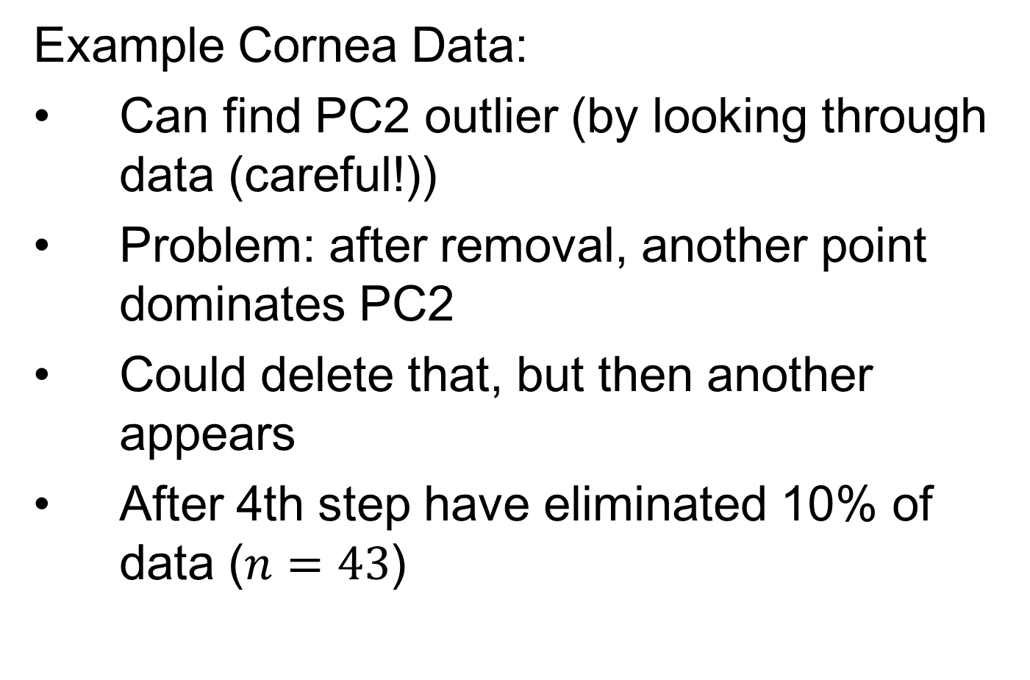
Outliers in PCA
Example Cornea Data:
Can find PC2 outlier (by looking through data (careful!))
Problem: after removal, another point dominates PC2
Could delete that, but then another appears
After 4th step have eliminated 10% of data ($n=43$)

Slide 80
Outliers in PCA
Example
Cornea
Data

Slide 81
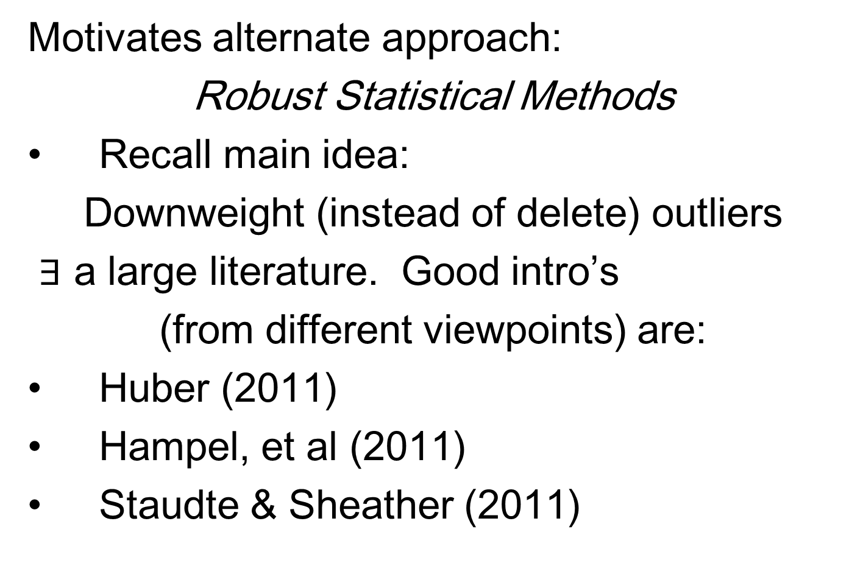
Outliers in PCA
Motivates alternate approach:
Robust Statistical Methods
Recall main idea:
Downweight (instead of delete) outliers
$∃$ a large literature. Good intro’s
(from different viewpoints) are:
Huber (2011)
Hampel, et al (2011)
Staudte & Sheather (2011)

Slide 82
Outliers in PCA
Simple robustness concept: breakdown point
how much of data “moved to ”
will “destroy estimate”?
Usual mean has breakdown 0
Median has breakdown ½ (best possible)
Conclude:
Median much more robust than mean
Median uses all data
Median gets good breakdown from
“equal vote”

Slide 83
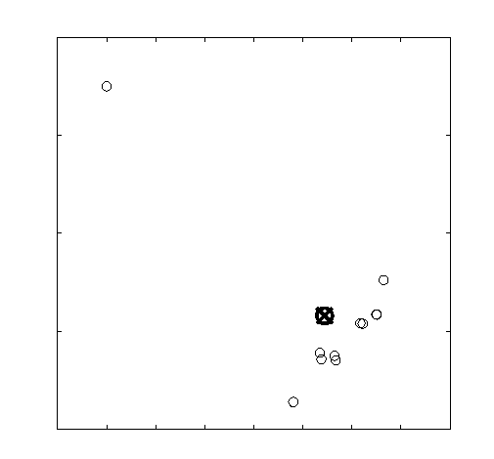
Outliers in PCA
Mean has
breakdown 0
Single
Outlier
Pulls Mean
Outside
range
of data

Slide 84
Outliers in PCA
Controversy:
Is median’s “equal vote” scheme good or bad?
Huber:
Outliers contain some information,
So should only control “influence”
(e.g. median)
Hampel, et. al.:
Outliers contain no useful information
Should be assigned weight 0
(not done by median)
Using “proper robust method”
(not simply deleted)

Slide 85
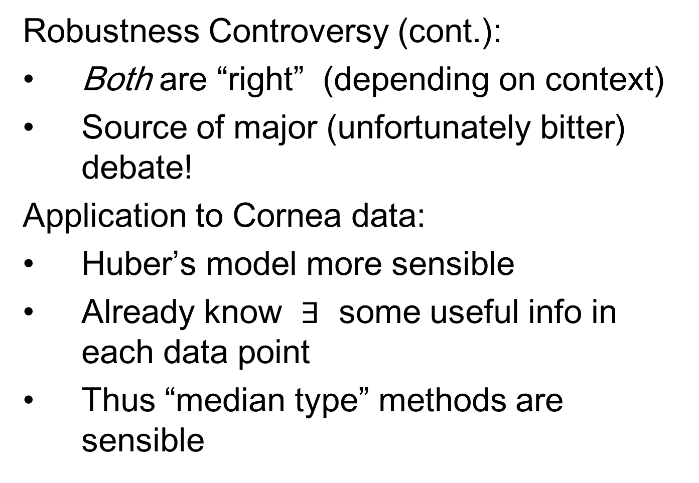
Outliers in PCA
Robustness Controversy (cont.):
Both are “right” (depending on context)
Source of major (unfortunately bitter) debate!
Application to Cornea data:
Huber’s model more sensible
Already know $∃$ some useful info in each data point
Thus “median type” methods are sensible

