Slide 1
Participant Presentations
Draft Schedule Now on Course Web Page:
https://stor893spring2016.web.unc.edu/
When You Present: Please Load Talk on
Classroom Computer Before Class

Slide 2
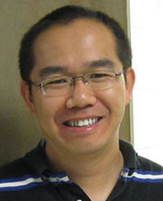
HDLSS Math. Stat. of PCA
An Interesting Objection:
Should not Study Angles in PCA
Because PC Scores (i.e. projections)
Not Consistent
For Scores ${\hat{s}}_{i,j}=P_{{\hat{v}}_{j}}x_{i}$ and $s_{i,j}=P_{v_{j}}x_{i}$
Can Show $\frac{{\hat{s}}_{i,j}}{s_{i,j}}→R_{j}≠1$ (Random!)
Due to Dan Shen

Slide 3
HDLSS Math. Stat. of PCA
PC Scores (i.e. projections)
Not Consistent
So how can PCA find Useful Signals in Data?
Key is “Proportional Errors”
Axes have Inconsistent Scales,
But Relationships are Still Useful

Slide 4
HDLSS & Sparsity
PCA Context:
Spike Index $α$ (as above: $λ_{1}\sim d^{α}$)
Sparsity Index $β$: # non-0 entries ~ $d^{β}$
Compare:
Conventional Sample PCA
Sparse PCA: Shen & Huang (2008)
Over Parameters $α$ and $β$

Slide 5
1
0≤ α < β ≤1
0.7
β
0≤ α = β ≤1
Sparsity Index
α>1
0 ≤ β ≤1
0.5
0.3
0≤β<α≤1
0.1
0
0
0.2
0.4
0.6
0.8
1
Jung and Marron
α
Spike Index
Sparse PCA: Inconsistent & New Consistency Region

Slide 6
HDLSS & Sparsity
Sparse PCA Opens Up Whole New
Region of Consistency

Slide 7
HDLSS & Other Asymptotics
Shen et al (2013)
Explores PCA Consistency under all of:
Classical: $d$ fixed, $n→∞$
Portnoy: $d, n→∞$, $d≪n$
Random Matrices: $d, n→∞$, $d \sim n$
HDMSS: $d, n→∞$, $d≫n$
HDLSS: $d→∞$, $n$ fixed

Slide 8
HDLSS Analysis of DiProPerm
Question:
Which Statistic to Summarize Projections?
2 – Sample t statistic
Mean Difference

Slide 9
HDLSS Analysis of DiProPerm
Yet both have mean 0
Reason: Less spread for original projection
E.g. Both i.i.d with t(5) marginal
t-test summary rejects

Slide 10
HDLSS Analysis of DiProPerm
Wei et al (2015)
Mathematically Driven Recommendation:
Use Mean Difference Summary to Focus on:
$H_{0}: μ_{1}=μ_{2}$ vs. $H_{0}: μ_{1}≠μ_{2}$

Slide 11
Cornea Data
Main Point: OODA Beyond FDA
Recall Interplay:
Object Space ←→ Descriptor Space

Slide 12
Cornea Data
Cornea: Outer surface of the eye
Driver of Vision: Curvature of Cornea
Data Objects: Images on the unit disk
Radial Curvature as “Heat Map”
Special Thanks to K. L. Cohen, N. Tripoli,
UNC Ophthalmology

Slide 13
Cornea Data
Cornea Data:
Raw Data
Decompose
Into
Modes of
Variation?

Slide 14
Cornea Data
Data Representation - Zernike Basis
Pixels as features is large and wasteful
Natural to find more efficient represent’n
Polar Coordinate Tensor Product of:
Fourier basis (angular)
Special Jacobi (radial, to avoid singularities)
See:
Schwiegerling, Greivenkamp & Miller (1995)
Born & Wolf (1980)

Slide 15
Cornea Data
Data Representation - Zernike Basis
Descriptor Space is Vector Space of Zernike Coefficients
So Perform PCA There

Slide 16
PCA of Cornea Data
Recall: PCA can find (often insightful)
direction of greatest variability
Main problem: display of result (no overlays for images)
Solution: show movie of “marching along the direction vector”

Slide 17
PCA of Cornea Data
PC1 Movie:

Slide 18
PCA of Cornea Data
PC1 Summary:
Mean (1st image): mild vert’l astigmatism
known pop’n structure called “with the rule”
Main dir’n: “more curved” & “less curved”
Corresponds to first optometric measure
(89% of variat’n, in Mean Resid. SS sense)
Also: “stronger astig’m” & “no astig’m”
Found corr’n between astig’m and curv’re
Scores (cyan): Apparent Gaussian dist’n

Slide 19
PCA of Cornea Data
PC2 Movie:

Slide 20
PCA of Cornea Data
PC2 Movie:
Mean: same as above
Common centerpoint of point cloud
Are studying “directions from mean”
Images along direction vector:
Looks terrible???
Why?

Slide 21
PCA of Cornea Data
PC2 Movie:
Reason made clear in Scores Plot (cyan):
Single outlying data object drives PC dir’n
A known problem with PCA
Recall finds direction with “max variation”
In sense of variance
Easily dominated by single large observat’n

Slide 22
PCA of Cornea Data
Toy Example: Single Outlier Driving PCA

Slide 23
PCA of Cornea Data
PC2 Affected by Outlier:
How bad is this problem?
View 1: Statistician: Arrggghh!!!!
Outliers are very dangerous
Can give arbitrary and meaningless dir’ns

Slide 24
PCA of Cornea Data
PC2 Affected by Outlier:
How bad is this problem?
View 2: Ophthalmologist: No Problem
Driven by “edge effects” (see raw data)
Artifact of “light reflection” data gathering
(“eyelid blocking”, and drying effects)
Routinely “visually ignore” those anyway
Found interesting (& well known) dir’n:
steeper superior vs steeper inferior

Slide 25
Outliers in PCA
PCA for
Deeper
Toy E.g.
Data:

Slide 26
Outliers in PCA
What can (should?) be done about outliers?
Context 1: Outliers are important aspects of the population
They need to be highlighted in the analysis
Although could separate into subpopulations
Context 2: Outliers are “bad data”, of no interest
recording errors? Other mistakes?
Then should avoid distorted view of PCA

Slide 27
Outliers in PCA
Motivates alternate approach:
Robust Statistical Methods
Recall main idea:
Downweight (instead of delete) outliers
$∃$ a large literature. Good intro’s
(from different viewpoints) are:
Huber (2011)
Hampel, et al (2011)
Staudte & Sheather (2011)

Slide 28
Outliers in PCA
Controversy:
Is median’s “equal vote” scheme good or bad?
Huber:
Outliers contain some information,
So should only control “influence”
(e.g. median)
Hampel, et. al.:
Outliers contain no useful information
Should be assigned weight 0
(not done by median)
Using “proper robust method”
(not simply deleted)

Slide 29
Outliers in PCA
Robustness Controversy (cont.):
Both are “right” (depending on context)
Source of major (unfortunately bitter) debate!
Application to Cornea data:
Huber’s model more sensible
Already know $∃$ some useful info in each data point
Thus “median type” methods are sensible

Slide 30
Robust PCA
What is multivariate median?
There are several!
(“median” generalizes in different ways)
Coordinate-wise median
Often worst
Not rotation invariant
(2-d data uniform on “L”)
Can lie on convex hull of data
(same example)
Thus poor notion of “center”

Slide 31
Robust PCA
Coordinate-wise median
Not rotation invariant
Thus poor notion of “center”

Slide 32
Robust PCA
Coordinate-wise median
Can lie on convex hull of data
Thus poor notion of “center”

Slide 33
Robust PCA
What is multivariate median (cont.)?
ii. Simplicial depth (a. k. a. “data depth”):
Liu (1990)
“Paint Thickness” of $d+1$ dim “simplices” with corners at data
Nice idea
Good invariance properties
Slow to compute

Slide 34
Robust PCA
What is multivariate median (cont.)?
iii. Huber’s $L^{p}$ M-estimate:
Given data $X_{1},⋯,X_{n}∈ℝ^{d}$,
Estimate “center of population” by
$$\hat{θ}={argmin}_{θ}\sum_{i=1}^{n}{{\left\|X_{i}−θ\right\|}_{2}^{p}}$$
Where ${\left\|∙\right\|}_{2}$ is the usual Euclidean norm
Here: use only $p=1$
(minimal impact by outliers)

Slide 35
Robust PCA
Huber’s M-estimate (cont):
Estimate “center of population” by
$$\hat{θ}={argmin}_{θ}\sum_{i=1}^{n}{{\left\|X_{i}−θ\right\|}_{2}^{p}}$$
Case $p=2$:
Can show $\hat{θ}=\overline{X}$ (sample mean)
(also called “Fréchet Mean”, …)
Again Here: use only $p=1$
(minimal impact by outliers)

Slide 36
Robust PCA
M-estimate (cont.):
A view of minimizer: solution of
$$0=\frac{∂}{∂θ}\sum_{i=1}^{n}{{\left\|X_{i}−θ\right\|}_{2}}=\sum_{i=1}^{n}{\frac{X_{i}−θ}{{\left\|X_{i}−θ\right\|}_{2}}}$$
A useful viewpoint is based on:
$P_{Sph(θ,1)}$ = “Proj’n of data onto sphere
centered at $θ$ with radius $1$”
And representation: $P_{Sph(θ,1)}X_{i}=θ+\frac{X_{i}−θ}{{\left\|X_{i}−θ\right\|}_{2}}$

Slide 37
Robust PCA
M-estimate (cont.):
Thus the solution of
$$0=\sum_{i=1}^{n}{\frac{X_{i}−θ}{{\left\|X_{i}−θ\right\|}_{2}}}$$
is the solution of:
$$0=avg\left\{P_{Sph(0,1)}X_{i}−θ:i=1,⋯,n\right\}$$
So $\hat{θ}$ is location where projected data are centered
“Slide sphere around until mean (of projected data) is at center”

Slide 38
Robust PCA
M-estimate (cont.):
Data are
+ signs

Slide 39
Robust PCA
M-estimate (cont.):
Data are
+ signs
Sample Mean, $\overline{X}$
outside “hot dog”
of data

Slide 40
Robust PCA
M-estimate (cont.):
Candidate
Sphere Center, $θ$

Slide 41
Robust PCA
M-estimate (cont.):
Candidate
Sphere Center, $θ$
Projections
Of Data

Slide 42
Robust PCA
M-estimate (cont.):
Candidate
Sphere Center, $θ$
Projections
Of Data
Mean of
Projections

Slide 43
Robust PCA
M-estimate (cont.):
“Slide sphere
around until
mean (of
projected data)
is at center”

Slide 44
Robust PCA
M-estimate (cont.):
Additional literature:
Called “geometric median” (long before Huber) by: Haldane (1948)
Shown unique for $d>1$ by: Milasevic and Ducharme (1987)
Useful iterative algorithm: Gower (1974)
(see also Sec. 3.2 of Huber (2011)).
Cornea Data experience:
works well for $d=66$

Slide 45
Robust PCA
M-estimate for Cornea Data:
Sample Mean M-estimate
Definite improvement
But outliers still have some influence
Improvement? (will suggest one soon)

Slide 46
Robust PCA
Now have robust measure of “center”,
how about
“spread”?
I.e. how
can we
do robust
PCA?

Slide 47
Robust PCA
Now have robust measure of “center”,
how about
“spread”?
Parabs e.g.
from above
With an
“outlier” (???)
Added in

Slide 48
Robust PCA
Now have robust measure of “center”,
how about
“spread”?
Small Impact on Mean

Slide 49
Robust PCA
Now have robust measure of “center”,
how about
“spread”?
Small Impact on Mean
More on PC1 Dir’n

Slide 50
Robust PCA
Now have robust measure of “center”,
how about
“spread”?
Small Impact on Mean
More on PC1 Dir’n
Dominates Residuals
Thus PC2 Dir’n
& PC2 scores

Slide 51
Robust PCA
Now have robust measure of “center”,
how about
“spread”?
Small Impact on Mean
More on PC1 Dir’n
Dominates Residuals
Thus PC2 Dir’n
& PC2 scores
Tilt now in PC3
Viualization is very
Useful diagnostic

Slide 52
Robust PCA
Now have robust measure of “center”,
how about
“spread”?
How
can we
do robust
PCA?

Slide 53
Robust PCA
Approaches to Robust PCA:
Robust Estimation of Covariance Matrix
Projection Pursuit
Spherical PCA

Slide 54
Robust PCA
Robust PCA 1: Robust Estimation of Covariance Matrix
A. Component-wise Robust Covariances:
Major problem:
Hard to get non-negative definiteness
Minimum Volume Ellipsoid:
Rousseeuw & Leroy (2005)
Requires $n>d$ (in available software)
Needed for simple definition of affine invariant

Slide 55
Important Aside
Major difference between FDA (OODA)
& Classical Multivariate Analysis
High Dimension, Low Sample Size Data
(sample size $n$ < dimension $d$)
Classical Multivariate Analysis:
start with “sphering data” (multiply by ${\hat{Σ}}^{−1/2}$)
but ${\hat{Σ}}^{−1/2}$ doesn’t exist for HDLSS data

Slide 56
Important Aside
Classical Approach to HDLSS data: “Don’t have enough data for analysis, get more”
Unworkable (and getting worse) for many modern settings:
Medical Imaging (e.g. Cornea Data)
Micro-arrays & gene expression
Chemometric spectra data

Slide 57
Robust PCA
Robust PCA 2: Projection Pursuit
Idea: focus on
“finding direction of greatest variability”
Reference: Li and Chen (1985)
Problems:
Robust estimates of “spread” are nonlinear
Results in many local optima

Slide 58
Robust PCA
Robust PCA 2: Projection Pursuit (cont.)
Problems:
Results in many local optima
Makes search problem very challenging
Especially in very high dimensions
Most examples have $d=4,5$
Guoying Li:
“I’ve heard of $d=20$,
but 60 seems too big”

Slide 59
Robust PCA
Robust PCA 3:
Spherical
PCA
Locantore et al (1999)

Slide 60
Robust PCA
Robust PCA 3: Spherical PCA
Idea: use “projection to sphere” idea from M-estimation
In particular project data to centered sphere
“Hot Dog” of data becomes “Ice Caps”
Easily found by PCA (on proj’d data)
Outliers pulled in to reduce influence
Radius of sphere unimportant
Notes:
60

Slide 61
Robust PCA
Robust PCA 3: Spherical PCA
Independent Derivation & Alternate Name:
PCA of Spatial Signs
(think: multivariate extension of “sign test”)
Idea: test $H_{0}:μ=0$ using #(+) & #(-)
Notes:
61

Slide 62
Robust PCA
Robust PCA 3: Spherical PCA
Independent Derivation & Alternate Name:
PCA of Spatial Signs
1st Paper:
Möttönen & Oja (1995)
Complete Description:
Oja (2010)
Notes:
62

Slide 63
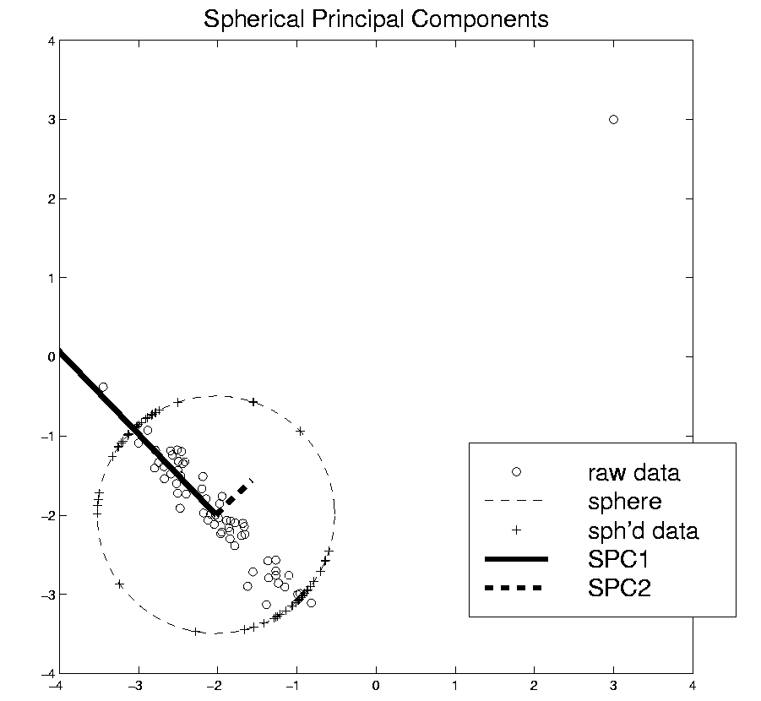
Robust PCA
Spatial Signs
Interesting Variation:
Spatial Ranks
Idea: Keep
Track of “Depth”
Via Ranks of Radii
Notes:
63

Slide 64
Robust PCA
Spherical PCA for Toy Example:
Curve Data
With an
Outlier
First recall
Conventional
PCA
Notes:
64

Slide 65
Robust PCA
Spherical PCA for Toy Example:
Now do
Spherical
PCA
Better result?
Notes:
65

Slide 66
Robust PCA
Spherical PCA for Toy Data:
Mean looks “smoother”
PC1 nearly “flat” (unaffected by outlier)
PC2 is nearly “tilt” (again unaffected by outlier)
PC3 finally strongly driven by outlier
OK, since all other directions “about equal in variation”
Energy Plot, no longer ordered
(outlier drives SS, but not directions)
Notes:
66

Slide 67
Robust PCA
Spherical PCA for Toy Example:
Check out
Later
Components
Notes:
67

Slide 68
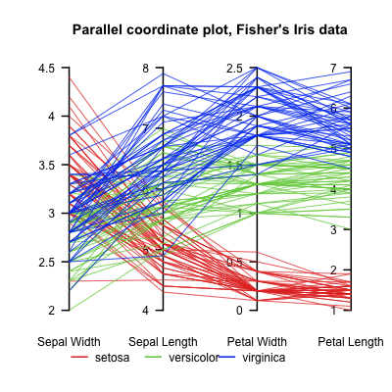
Aside On Visualization
Recall Multivariate Data Visualization Tool:
Parallel Coordinates
E.g. Fisher Iris Data
$d=4$
Named Variables
(thanks to Wikipedia)
Notes:
68

Slide 69
Aside On Visualization
Recall Multivariate Data Visualization Tool:
Parallel Coordinates
E.g. Fisher Iris Data
$d=4$
Named Variables
Curves are Data Objects
(4-vectors)
Inselberg (1985, 2009)
Notes:
69

Slide 70
Robust PCA
Useful View: Parallel Coordinates Plot
X-axis:
Zernike
Coefficient
Number
Y-axis:
Coefficient
Notes:
70

Slide 71
Robust PCA
Cornea Data, Parallel Coordinates Plot:
Top Plot: Zernike
Coefficients
Notes:
71

Slide 72
Robust PCA
Cornea Data, Parallel Coordinates Plot:
Top Plot: Zernike
Coefficients
All n = 43 very
Similar
.
Notes:
72

Slide 73
Robust PCA
Cornea Data, Parallel Coordinates Plot:
Top Plot: Zernike
Coefficients
All n = 43 very
Similar
Most Action in few
Low Freq. Coeffs.
Notes:
73

Slide 74
Robust PCA
Cornea Data, Parallel Coordinates Plot
Middle Plot: (Zernike Coefficients – median)
Most Variation in lowest frequencies
E.g. as in Fourier compression of smooth signals
Projecting on sphere will destroy this
By magnifying high frequency behavior
Bottom Plot: discussed later
Notes:
74

Slide 75
Robust PCA
Spherical PCA Problem :
Magnification of High Freq. Coeff’s
Solution : Elliptical Analysis
Main idea: project data onto suitable ellipse, not sphere
Which ellipse? (in general, this is problem that PCA solves!)
Simplification: Consider ellipses parallel to coordinate axes
Notes:
75

Slide 76
Robust PCA
Spherical PCA Problem :
Magnification of High Freq. Coeff’s
Solution : Elliptical Analysis
Background (Univariate):
MAD = Median Absolute Deviation
MAD = $median\left|X_{i}−median\left(X_{i}\right)\right|$
Simple, High Breakdown, Outlier Resistant, Measure of “Scale”
Notes:
76

Slide 77
Robust PCA
Rescale
Coords
Spherical PCA
Unscale
Coords

Slide 78
Robust PCA
Elliptical Analysis (cont.):
Simple Implementation,
via coordinate axis rescaling
Divide each axis by MAD
Project Data to sphere (in transformed space)
Return to original space (mul’ply by orig’l MAD) for analysis
Do PCA on Projections

Slide 79
Robust PCA
Elliptical Estimate of “center”:
Do M-estimation in transformed space
(then transform back)
Results for cornea data:
Sample Mean Spherical Center Elliptical Center
Elliptical clearly best
Nearly no edge effect

Slide 80
Robust PCA
Elliptical PCA for cornea data:
Original PC1, Elliptical PC1

Slide 81
Robust PCA
Elliptical PCA for cornea data:
Original PC1, Elliptical PC1
Still finds overall curvature & correlated astigmatism
Minor edge effects almost completely gone

Slide 82
Robust PCA
Elliptical PCA for cornea data:
Original PC2, Elliptical PC2

Slide 83
Robust PCA
Elliptical PCA for cornea data:
Original PC1, Elliptical PC1
Still finds overall curvature & correlated astigmatism
Minor edge effects almost completely gone
Original PC2, Elliptical PC2
Huge edge effects dramatically reduced
Still finds steeper superior vs. inferior

Slide 84
Robust PCA
Elliptical PCA for cornea data:
Original PC3, Elliptical PC3

Slide 85
Robust PCA
Elliptical PCA for Cornea Data (cont.):
Original PC3, Elliptical PC3
-Edge effects greatly diminished
But some of against the rule astigmatism also lost
Price paid for robustness

Slide 86
Robust PCA
Elliptical PCA for cornea data:
Original PC4, Elliptical PC4

Slide 87
Robust PCA
Elliptical PCA for Cornea Data (cont.):
Original PC3, Elliptical PC3
-Edge effects greatly diminished
But some of against the rule astigmatism also lost
Price paid for robustness
Original PC4, Elliptical PC4
Now looks more like variation on astigmatism???

Slide 88
Robust PCA
Current state of the art:
Spherical & Elliptical PCA are a kludge
Put together by Robustness Amateurs
To solve this HDLSS problem
Good News: Robustness Pros are now in the game:
Maronna, et al (2006), Sec. 6.10.2

Slide 89
Robust PCA
Disclaimer on robust analy’s of Cornea Data:
Critical parameter is “radius of analysis”,
$R_{0}=4mm$: Shown above, Elliptical PCA very effective
$R_{0}=4.2mm$: Stronger edge effects, Elliptical PCA less useful
$R_{0}=3.5mm$: Edge effects weaker, don’t need robust PCA

Slide 90
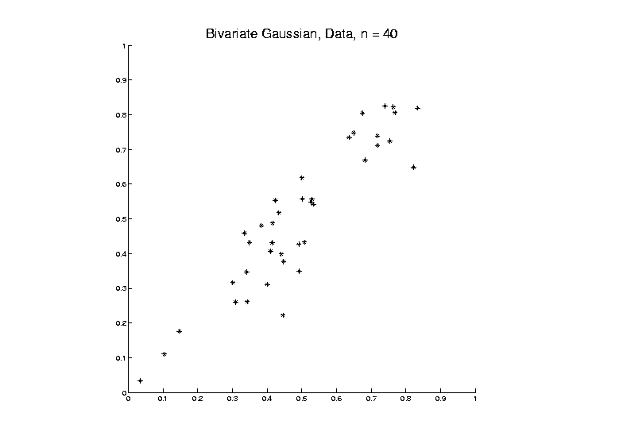
Big Picture View of PCA
Above View:
PCA finds optimal directions in point cloud

Slide 91
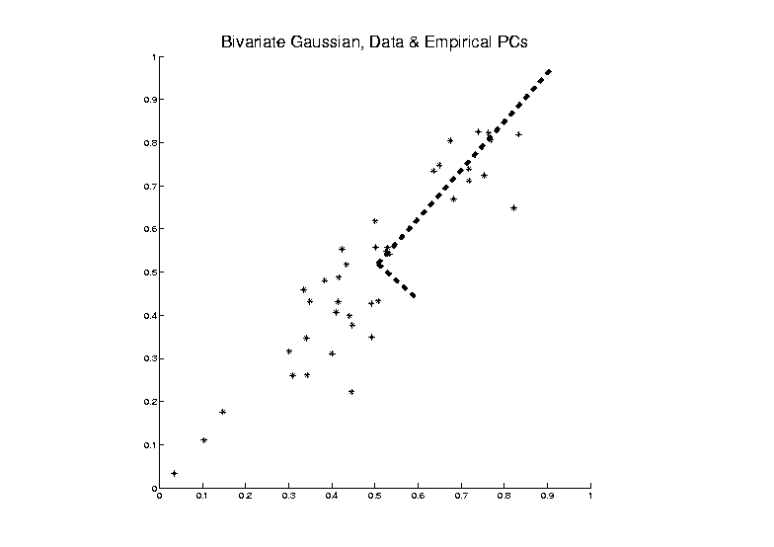
Big Picture View of PCA
Above View:
PCA finds optimal directions in point cloud

Slide 92
Big Picture View of PCA
Above View:
PCA finds optimal directions in point cloud
Maximize projected variation
Minimize residual variation
(same by Pythagorean Theorem)
Notes:
Get useful insights about data
Can compute for any point cloud
But there are other views.

Slide 93
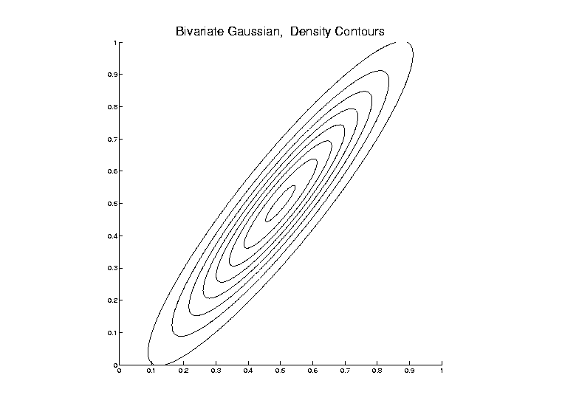
Big Picture View of PCA
Alternate Viewpoint: Gaussian Likelihood

Slide 94
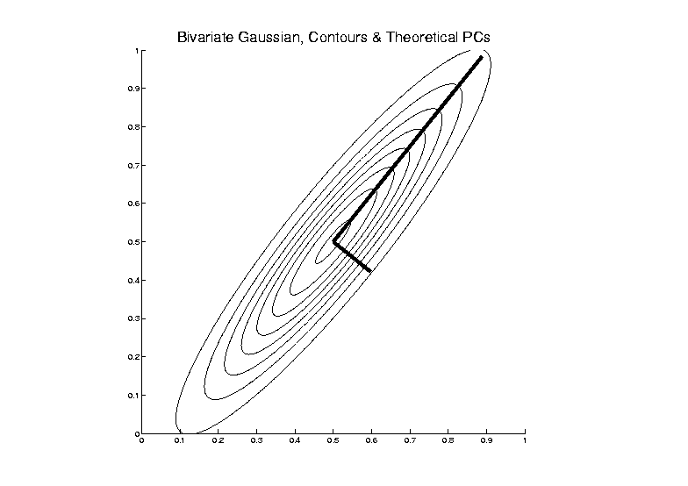
Big Picture View of PCA
Alternate Viewpoint: Gaussian Likelihood

Slide 95
Big Picture View of PCA
Alternate Viewpoint: Gaussian Likelihood
When data are multivariate Gaussian
PCA finds major axes of ellipt’al contours
of Probability Density
Maximum Likelihood Estimate

Slide 96
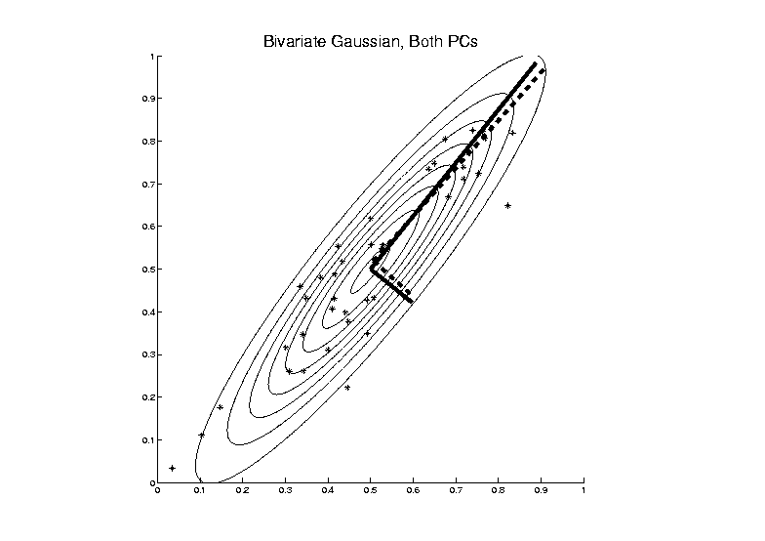
Big Picture View of PCA
Alternate Viewpoint: Gaussian Likelihood
Maximum Likelihood Estimate

Slide 97
Big Picture View of PCA
Alternate Viewpoint: Gaussian Likelihood
When data are multivariate Gaussian
PCA finds major axes of ellipt’al contours
of Probability Density
Maximum Likelihood Estimate
Mistaken idea:
PCA only useful for Gaussian data

Slide 98
Big Picture View of PCA
Simple check for Gaussian distribution:
Standardized parallel coordinate plot
Subtract coordinate wise median
(robust version of mean)
(not good as “point cloud center”,
but now only looking at coordinates)
Divide by MAD / MAD(N(0,1))
(put on same scale as “standard deviation”)
See if data stays in range –3 to +3

Slide 99
Big Picture View of PCA
E.g.
Cornea Data:
Standardized
Parallel
Coordinate
Plot
Shown before

Slide 100
Big Picture View of PCA
Raw Cornea Data:
Data – Median
(Data – Median)
-------------------
MAD

Slide 101
Big Picture View of PCA
Check for Gaussian dist’n:
Stand’zed Parallel Coord. Plot
E.g. Cornea data
(recall image view of data)
Several data points > 20 “s.d.s” from the center
Distribution clearly not Gaussian
Strong kurtosis (“heavy tailed”)
But PCA still gave strong insights

Slide 102
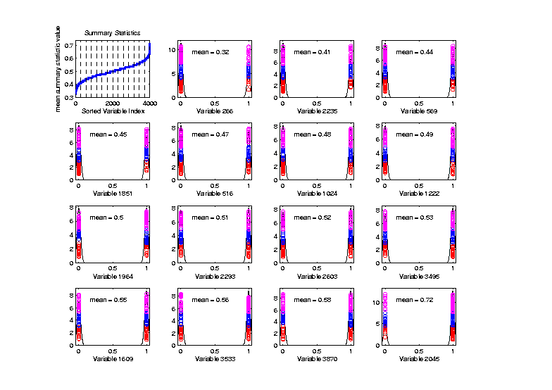
Big Picture View of PCA
Mistaken idea:
PCA only useful for Gaussian data
Toy Example:
Each Marginal
Binary
Clearly NOT
Gaussian
n = 100, d = 4000

Slide 103
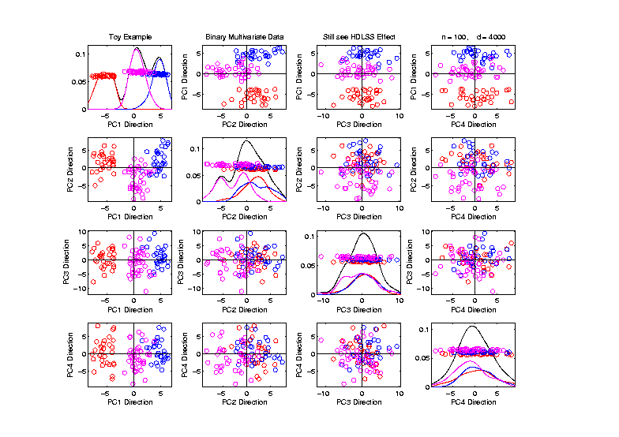
Big Picture View of PCA
Mistaken idea:
PCA only useful for Gaussian data
But PCA
Reveals
Trimodal
Structure

Slide 104
GWAS Data Analysis
Genome Wide Association Study (GWAS)
Data Objects: Vectors of Genetic Variants, at known chromosome locations
(Called SNPs)
Discrete (takes on 2 or 3 values)
Dimension $d$ as large as ~5 million
(can be reduced, e.g. $d\sim 20000)$

Slide 105
GWAS Data Analysis
Genome Wide Association Study (GWAS)
Cystic Fibrosis Study: Wright et al (2011)
Interesting Feature:
Some Subjects are Close Relatives
(e.g. ~half SNPs are same)

Slide 106
GWAS Data Analysis
PCA View
Clear Ethnic
Groups

Slide 107
GWAS Data Analysis
PCA View
Clear Ethnic
Groups
And Several
Outliers!
Eliminate With
Spherical PCA?

Slide 108
GWAS Data Analysis
Spherical
PCA
Looks Same?!?
What is
going on?

Slide 109
GWAS Data Analysis
Explanation:
HDLSS geometric representation
Recall in limit as $d→∞$ with $n$ fixed,
Data lie near surface of $\sqrt{d}$-sphere
Data tend to be ~orthogonal
Family members are half the same
Thus relatively small angle $\left(\sim {60}^{°}\right)$
Enough for families to dominate PCs
Spherical PC doesn’t change anything!

Slide 110
GWAS Data Analysis
Alternate Approach:
L1 PCA
Idea replace $L^{2}$ norm, ${\left\|\underline{v}\right\|}_{2}=\sqrt{\sum_{j=1}^{d}{{v_{j}}^{2}}}$
By $L^{1}$ norm: ${\left\|\underline{v}\right\|}_{1}=\sum_{j=1}^{d}{\left|v_{j}\right|}$
More robust, since no square

Slide 111
L1 Statistics
E.g. Simple Linear Regression
Replace
Best L2 Fit

Slide 112
L1 Statistics
E.g. Simple Linear Regression
Replace
Best L2 Fit
With
Best L1 Fit

Slide 113
L1 Statistics
E.g. Simple Linear Regression
Best L1 Fit
Advantages:
Robust Against Outliers
Good “Sparsity” Properties

Slide 114
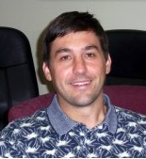
L1 PCA
Calculation:
Clever “backwards” algorithm
Brooks, Dulá, Boone (2013)

Slide 115
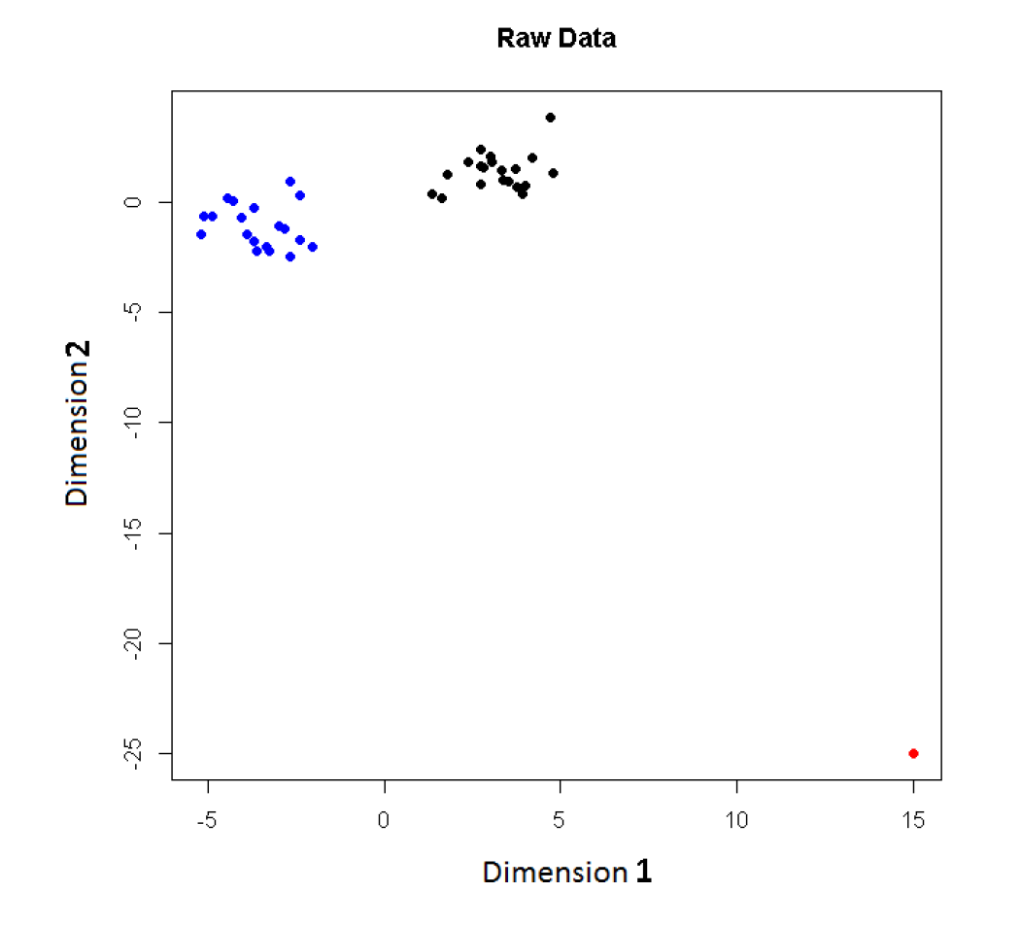
L1 PCA
Challenge:
L1 Projections
Hard to
Interpret
2-d Toy
Example
Note
Outlier

Slide 116
L1 PCA
Challenge:
L1 Projections
Hard to
Interpret
Parallel
Coordinate
View

Slide 117
L1 PCA
Conventional
L2 PCA
Outlier Pulls
Off PC1
Direction

Slide 118
L1 PCA
L1 PCA
Much Better
PC1 Direction

Slide 119
L1 PCA
L1 PCA
Much Better
PC1 Direction
But Vary Strange
Projections
(i.e. Little
Data Insight)

Slide 120
L1 PCA
L1 PCA
Reason:
SVD Rotation
Before L1
Computation
Note: L1 Methods
Not Rotation Invariant

