Slide 1
Cornea Data
Main Point: OODA Beyond FDA
Recall Interplay:
Object Space ←→ Descriptor Space

Slide 2
Robust PCA
What is multivariate median?
There are several!
(“median” generalizes in different ways)
Coordinate-wise median
Often worst
Not rotation invariant
(2-d data uniform on “L”)
Can lie on convex hull of data
(same example)
Thus poor notion of “center”

Slide 3
Robust PCA
Huber’s M-estimate (cont):
Estimate “center of population” by
$$\hat{θ}={argmin}_{θ}\sum_{i=1}^{n}{{\left\|X_{i}−θ\right\|}_{2}^{p}}$$
Case $p=2$:
Can show $\hat{θ}=\overline{X}$ (sample mean)
(also called “Fréchet Mean”, …)
Again Here: use only $p=1$
(minimal impact by outliers)

Slide 4
Robust PCA
M-estimate (cont.):
“Slide sphere
around until
mean (of
projected data)
is at center”

Slide 5
Robust PCA
Robust PCA 3: Spherical PCA
Idea: use “projection to sphere” idea from M-estimation
In particular project data to centered sphere
“Hot Dog” of data becomes “Ice Caps”
Easily found by PCA (on proj’d data)
Outliers pulled in to reduce influence
Radius of sphere unimportant
Notes:
5

Slide 6
Robust PCA
Spherical PCA for Toy Example:
Curve Data
With an
Outlier
First recall
Conventional
PCA
Notes:
6

Slide 7
Robust PCA
Spherical PCA for Toy Example:
Now do
Spherical
PCA
Better result?
Notes:
7

Slide 8
Robust PCA
Rescale
Coords
Spherical PCA
Unscale
Coords

Slide 9
Robust PCA
Elliptical PCA for cornea data:
Original PC2, Elliptical PC2

Slide 10
Big Picture View of PCA
Alternate Viewpoint: Gaussian Likelihood
When data are multivariate Gaussian
PCA finds major axes of ellipt’al contours
of Probability Density
Maximum Likelihood Estimate
Mistaken idea:
PCA only useful for Gaussian data

Slide 11
Big Picture View of PCA
Raw Cornea Data:
Data – Median
(Data – Median)
-------------------
MAD

Slide 12
Big Picture View of PCA
Check for Gaussian dist’n:
Stand’zed Parallel Coord. Plot
E.g. Cornea data
(recall image view of data)
Several data points > 20 “s.d.s” from the center
Distribution clearly not Gaussian
Strong kurtosis (“heavy tailed”)
But PCA still gave strong insights

Slide 13
GWAS Data Analysis
Genome Wide Association Study (GWAS)
Data Objects: Vectors of Genetic Variants, at known chromosome locations
(Called SNPs)
Discrete (takes on 2 or 3 values)
Dimension $d$ as large as ~5 million
(can be reduced, e.g. $d\sim 20000)$

Slide 14
GWAS Data Analysis
Genome Wide Association Study (GWAS)
Cystic Fibrosis Study: Wright et al (2011)
Interesting Feature:
Some Subjects are Close Relatives
(e.g. ~half SNPs are same)

Slide 15
GWAS Data Analysis
PCA View
Clear Ethnic
Groups
And Several
Outliers!
Eliminate With
Spherical PCA?

Slide 16
GWAS Data Analysis
Spherical
PCA
Looks Same?!?
What is
going on?

Slide 17
GWAS Data Analysis
Explanation:
HDLSS geometric representation
Recall in limit as $d→∞$ with $n$ fixed,
Data lie near surface of $\sqrt{d}$-sphere
Data tend to be ~orthogonal
Family members are half the same
Thus relatively small angle $\left(\sim {60}^{°}\right)$
Enough for families to dominate PCs
Spherical PC doesn’t change anything!

Slide 18
GWAS Data Analysis
Alternate Approach:
L1 PCA
Idea replace $L^{2}$ norm, ${\left\|\underline{v}\right\|}_{2}=\sqrt{\sum_{j=1}^{d}{{v_{j}}^{2}}}$
By $L^{1}$ norm: ${\left\|\underline{v}\right\|}_{1}=\sum_{j=1}^{d}{\left|v_{j}\right|}$
More robust, since no square

Slide 19
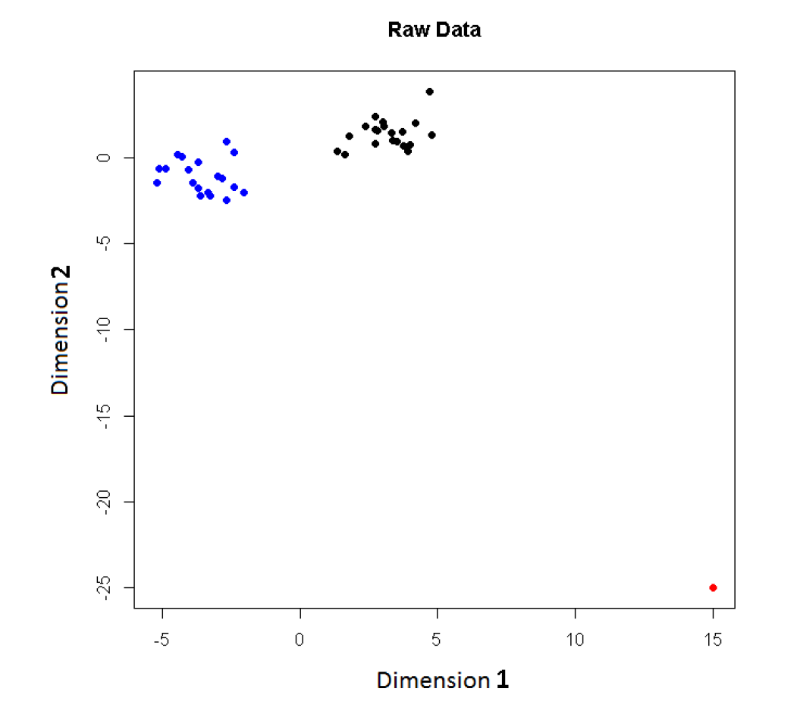
L1 PCA
Challenge:
L1 Projections
Hard to
Interpret
2-d Toy
Example
Note
Outlier

Slide 20
L1 PCA
Conventional
L2 PCA
Outlier Pulls
Off PC1
Direction

Slide 21
L1 PCA
L1 PCA
Much Better
PC1 Direction

Slide 22
L1 PCA
L1 PCA
Much Better
PC1 Direction
But Very Strange
Projections
(i.e. Little
Data Insight)

Slide 23
L1 PCA
L1 PCA
Reason:
SVD Rotation
Before L1
Computation
Note: L1 Methods
Not Rotation Invariant

Slide 24
L1 PCA
Challenge: L1 Projections Hard to Interpret
(i.e. Little Data Insight)
Solution:
Compute PC Directions Using L1
Compute Projections (Scores) Using L2
Called “Visual L1 PCA” (VL1PCA)
Recent work with Yihui Zhou

Slide 25
L1 PCA
VL1 PCA
Excellent PC
Directions
Interpretable
Scores

Slide 26
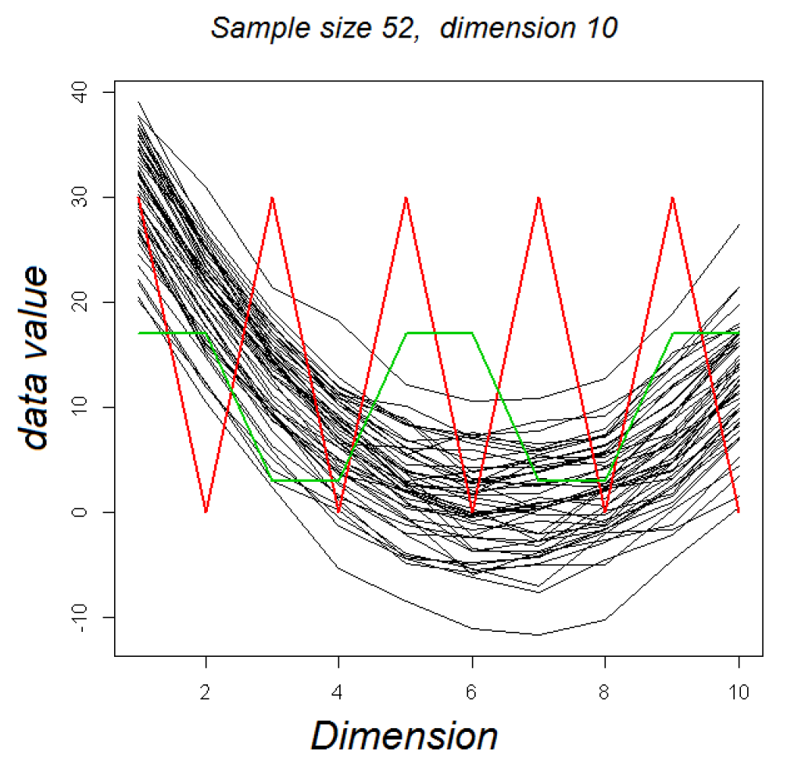
VL1 PCA
10-d Toy Example:
Parabolas
From Before
With Two
Outliers

Slide 27
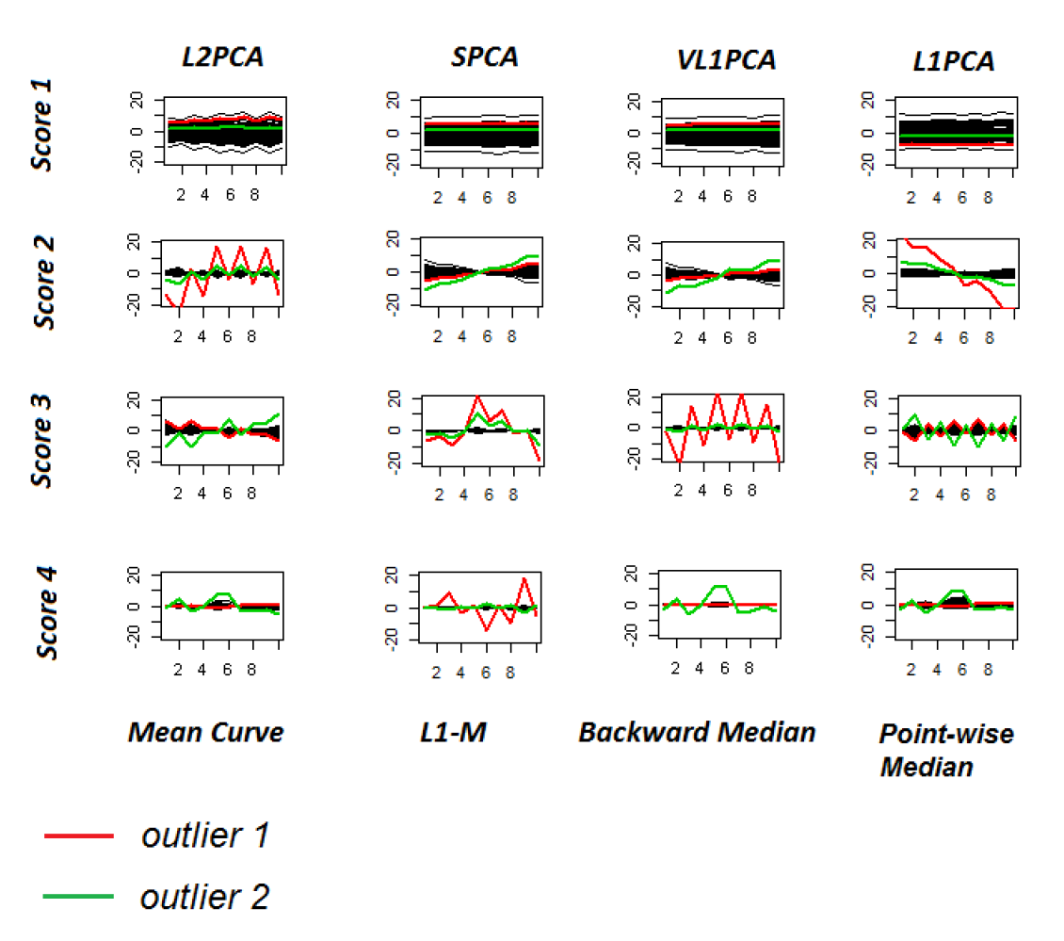
VL1 PCA
10-d Toy Example:
L2PCA
Strongly
Impacted
(In All
Components)

Slide 28
VL1 PCA
10-d Toy Example:
SCPA &
VL1PCA
Nicely
Robust
(Vl1PCA
Slightly
Better)

Slide 29
VL1 PCA
10-d Toy Example:
L1PCA
Hard To
Interpret

Slide 30
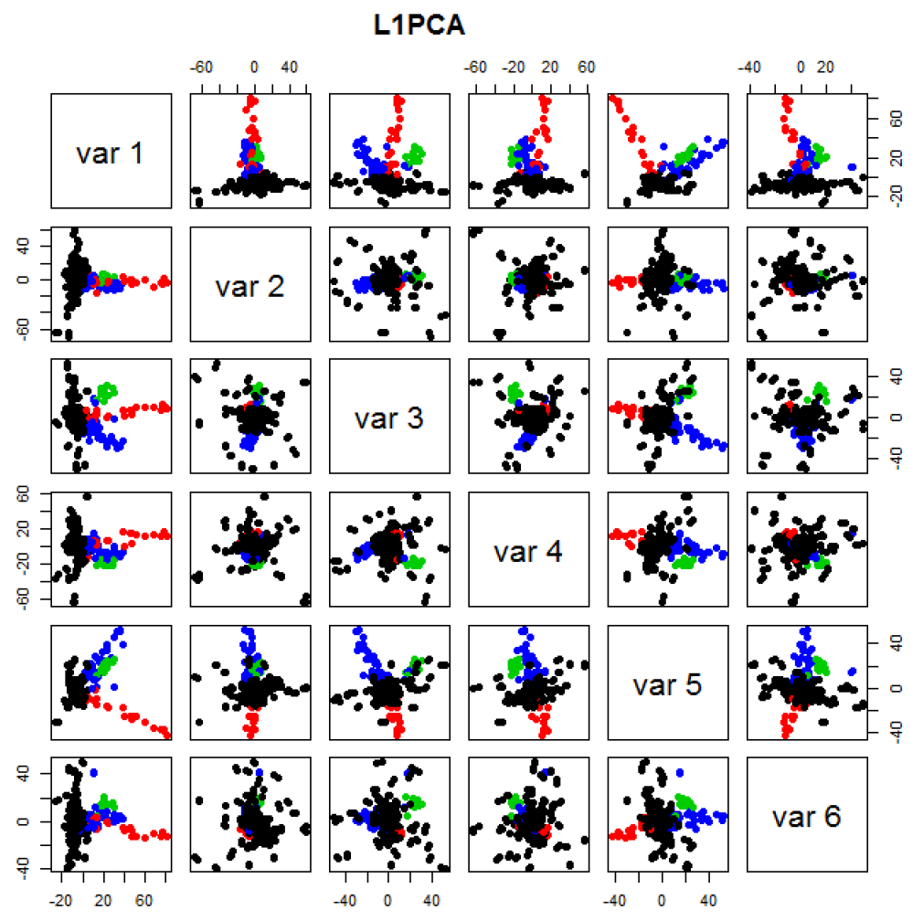
GWAS Data
L1 PCA
No Longer
Feels Outliers
But Still
Highlights
Individuals

Slide 31
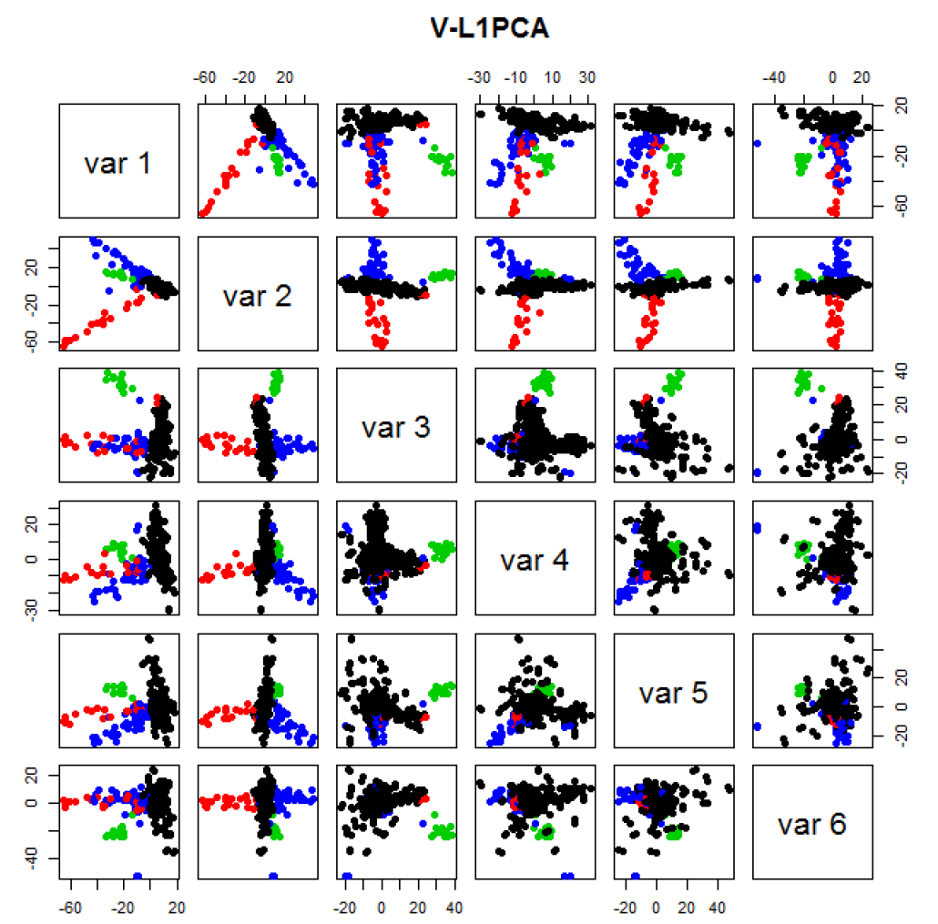
GWAS Data
VL1 PCA
Best Focus
On Ethnic
Groups

Slide 32
GWAS Data
VL1 PCA
Best Focus
On Ethnic
Groups
Seems To
Find Unlabelled
Clusters

Slide 33
Detailed Look at PCA
Now Study “Folklore” More Carefully
BackGround
History
Underpinnings
(Mathematical & Computational)
Good Overall Reference: Jolliffe (2002)

Slide 34
PCA: Rediscovery – Renaming
Statistics:
Principal Component Analysis (PCA)
Social Sciences:
Factor Analysis (PCA is a subset)
Probability / Electrical Eng:
Karhunen – Loeve expansion
Applied Mathematics:
Proper Orthogonal Decomposition (POD)
Geo-Sciences:
Empirical Orthogonal Functions (EOF)

Slide 35
An Interesting Historical Note
The 1st (?) application of PCA to Functional Data Analysis:
Rao (1958)
1st Paper with “Curves as Data Objects” viewpoint

Slide 36
Detailed Look at PCA
Three Important (& Interesting) Viewpoints:
Mathematics
Numerics
Statistics
Goal: Study Interrelationships

Slide 37
Detailed Look at PCA
Three Important (& Interesting) Viewpoints:
Mathematics
Numerics
Statistics
1st: Review Linear Alg. and Multivar. Prob.

Slide 38
Review of Linear Algebra
Singular Value Decomposition (SVD):
For a Matrix $X_{d×n}$
Find a Diagonal Matrix $S_{d×n}$,
with Entries $s_{1},⋯,s_{min\left(d,n\right)}$
called Singular Values
And Unitary (Rotation) Matrices $U_{d×d}$, $V_{n×n}$
(recall $U^{t}U=I$, $V^{t}V=I$)
So That $X=USV^{t}$

Slide 39
Review of Linear Algebra (Cont.)
SVD Full Representation:
=
Graphics Display Assumes

Slide 40
Review of Linear Algebra (Cont.)
SVD Full Representation:
=
Full Rank Basis Matrix

Slide 41
Review of Linear Algebra (Cont.)
SVD Full Representation:
=
Full Rank Basis Matrix
All 0s in Bottom (and off diagonal)

Slide 42
Review of Linear Algebra (Cont.)
SVD Reduced Representation:
=
These Columns Get 0ed Out

Slide 43
Review of Linear Algebra (Cont.)
SVD Reduced Representation:
=

Slide 44
Review of Linear Algebra (Cont.)
SVD Reduced Representation:
=
Also, Some of These May be 0

Slide 45
Review of Linear Algebra (Cont.)
SVD Compact Representation:
=

Slide 46
Review of Linear Algebra (Cont.)
SVD Compact Representation:
=
These Get 0ed Out

Slide 47
Review of Linear Algebra (Cont.)
SVD Compact Representation:
=

Slide 48
Review of Linear Algebra (Cont.)
Eigenvalue Decomposition:
For a (Symmetric) Square Matrix $X_{d×d}$
Find a Diagonal Matrix $D=\left(\begin{matrix}λ_{1} & ⋯ & 0 \\ ⋮ & ⋱ & ⋮ \\ 0 & ⋯ & λ_{d}\end{matrix}\right)$
And an Orthonormal (Unitary) Matrix $B_{d×d}$
(i.e. $B^{t}∙B=B∙B^{t}=I_{d×d}$)
So that: $X∙B=B∙D$, i.e. $X=B∙D∙B^{t}$

Slide 49
Review of Linear Algebra (Cont.)
Eigenvalue Decomposition (cont.):
Relation to Singular Value Decomposition
(looks similar?):
Eigenvalue Decomposition “Looks Harder”
Since Needs $B=U=V$
Price is Eigenvalue Decomp’n is Generally Complex (uses $i=\sqrt{−1}$)
Except for $X$ Square and Symmetric
Then Eigenvalue Decomp. is Real Valued
Thus is the Sing’r Value Decomp. with:
$U=V=B$

Slide 50
Review of Linear Algebra (Cont.)
Better View of Relationship:
Singular Value Dec. $⟺$ Eigenvalue Dec.
(better than on previous page)

Slide 51
Review of Linear Algebra (Cont.)
Better View of Relationship:
Singular Value Dec. $⟺$ Eigenvalue Dec.
Start with $d×n$ data matrix: $X$
Note SVD: $X=U∙S∙V^{t}$
Create square, symmetric matrix: $X∙X^{t}$
Terminology: “Outer Product”
In Contrast to: “Inner Product” $x^{t}∙x$

Slide 52
Review of Linear Algebra (Cont.)
Better View of Relationship:
Singular Value Dec. $⟺$ Eigenvalue Dec.
Start with $d×n$ data matrix: $X$
Note SVD: $X=U∙S∙V^{t}$
Create square, symmetric matrix: $X∙X^{t}$
Note that: $XX^{t}=\left(USV^{t}\right)\left(VSU^{t}\right)=US^{2}U^{t}$
Gives Eigenanalysis, $B=U$ & $D=S^{2}$

Slide 53
Review of Linear Algebra (Cont.)
Computation of Singular Value and Eigenvalue Decompositions:
Details too complex to spend time here
A “primitive” of good software packages
Eigenvalues $λ_{1},⋯,λ_{d}$ are Unique
(Often Ordered as $λ_{1}≥λ_{2}≥⋯≥λ_{d}$)

Slide 54
Review of Linear Algebra (Cont.)
Computation of Singular Value and Eigenvalue Decompositions:
Details too complex to spend time here
A “primitive” of good software packages
Eigenvalues $λ_{1},⋯,λ_{d}$ are Unique
Col’s of $B=\left(\underline{v_{1}},⋯,\underline{v_{d}}\right)$ are “Eigenvectors”
Eigenvectors are “$λ$-Stretched” by $X$ as a
Linear Transform: $X∙\underline{v_{i}}=λ_{i}∙\underline{v_{i}}$

Slide 55
Review of Linear Algebra (Cont.)
Eigenvalue Decomp. Solves Matrix Problems:
Inversion: $X^{−1}=B∙\left(\begin{matrix}{λ_{1}}^{−1} & ⋯ & 0 \\ ⋮ & ⋱ & ⋮ \\ 0 & ⋯ & {λ_{d}}^{−1}\end{matrix}\right)∙B^{t}$

Slide 56
Review of Linear Algebra (Cont.)
Eigenvalue Decomp. Solves Matrix Problems:
Sq. Root: $X^{\frac{1}{2}}=B∙\left(\begin{matrix}{λ_{1}}^{\frac{1}{2}} & ⋯ & 0 \\ ⋮ & ⋱ & ⋮ \\ 0 & ⋯ & {λ_{d}}^{\frac{1}{2}}\end{matrix}\right)∙B^{t}$
$$⟺$$

Slide 57
Review of Linear Algebra (Cont.)
Eigenvalue Decomp. Solves Matrix Problems:
$X$ is Positive (Nonn’ve, i.e. Semi) Definite $⟺$
$⟺$ all $λ_{i}>\left(≥\right) 0$
$$⟺$$

Slide 58
Recall Linear Algebra (Cont.)
Moore-Penrose Generalized Inverse:
For

Slide 59
Recall Linear Algebra (Cont.)
Easy to see this satisfies the definition of
Generalized (Pseudo) Inverse
symmetric
symmetric

Slide 60
Recall Linear Algebra (Cont.)
Moore-Penrose Generalized Inverse:
Idea: Matrix Inverse on Non-Null Space
of the Corresponding Linear Transformation
Reduces to Ordinary Inverse, in Full Rank case,
i.e. for $r=d$, so could just Always Use This
Tricky aspect:
“$>0$ vs. $=0$” & Floating Point Arithmetic

Slide 61
Recall Linear Algebra (Cont.)
Moore-Penrose Generalized Inverse:
Folklore: most multivariate formulas involving matrix inversion “still work” when Generalized Inverse is used instead
E.g. Least Squares Projection Formula:
$$X{\left(X^{t}X\right)}^{−1}X^{t}$$

Slide 62
Recall Multivar. Prob.
Estimate the “Theoretical Cov.” $Σ$,
with the “Sample Cov.”:
Normalizations:
$\frac{1}{n−1}$ Gives Unbiasedness
$\frac{1}{n}$ Gives MLE in Gaussian Case

Slide 63
Recall Multivar. Prob.
Outer Product Representation:
,
Where:

Slide 64
Recall Multivar. Prob.
Aside on Terminology,
Inner Product: Outer Product:
${\underline{x}}^{t}\underline{y}$ $\underline{x}{\underline{y}}^{t}$
= =
(scalar) (matrix)

Slide 65
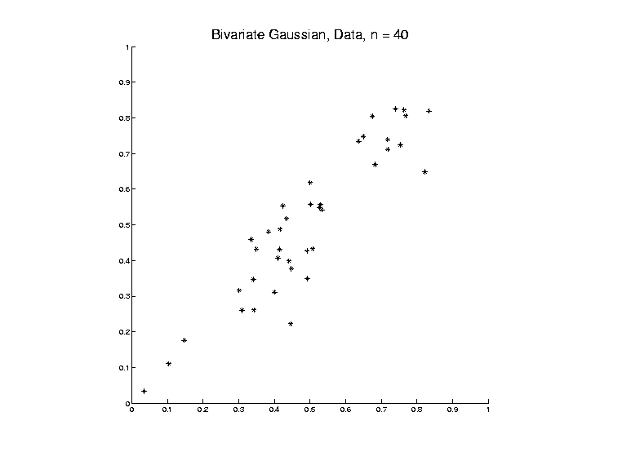
PCA as an Optimization Problem
Find Direction of Greatest Variability:

Slide 66
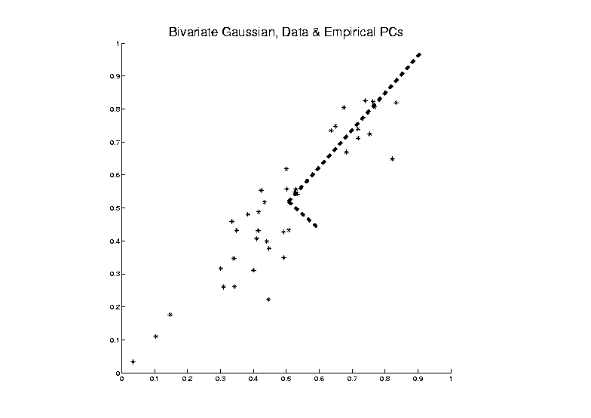
PCA as an Optimization Problem
Find Direction of Greatest Variability:

Slide 67
PCA as an Optimization Problem
Find Direction of Greatest Variability:
Raw Data

Slide 68
PCA as an Optimization Problem
Find Direction of Greatest Variability:
Mean
Residuals
(Shift to
Origin)

Slide 69
PCA as an Optimization Problem
Find Direction of Greatest Variability:
Mean
Residuals
(Shift to
Origin)

Slide 70
PCA as an Optimization Problem
Find Direction of Greatest Variability:
Centered
Data

Slide 71
PCA as an Optimization Problem
Find Direction of Greatest Variability:
Centered
Data
Projections

Slide 72
PCA as an Optimization Problem
Find Direction of Greatest Variability:
Centered
Data
Projections
Direction
Vector

Slide 73
PCA as Optimization (Cont.)
Find Direction of Greatest Variability:
Given a Direction Vector, (i.e. )
(Variable, Over Which Will Optimize)

Slide 74
PCA as Optimization (Cont.)
Find Direction of Greatest Variability:
Given a Direction Vector, (i.e. )
Projection of in the Direction :

Slide 75
PCA as Optimization (Cont.)
Find Direction of Greatest Variability:
Given a Direction Vector, (i.e. )
Projection of in the Direction :
Variability in the Direction :

Slide 76
PCA as Optimization (Cont.)
Find Direction of Greatest Variability:
Given a Direction Vector, (i.e. )
Projection of in the Direction :
Variability in the Direction :

Slide 77
PCA as Optimization (Cont.)
Find Direction of Greatest Variability:
Given a Direction Vector, (i.e. )
Projection of in the Direction :
Variability in the Direction :

Slide 78
PCA as Optimization (Cont.)
Variability in the Direction :

Slide 79
PCA as Optimization (Cont.)
Variability in the Direction :
i.e. (Proportional to) a
Quadratic Form in the Covariance Matrix

Slide 80
PCA as Optimization (Cont.)
Variability in the Direction :
i.e. (Proportional to) a
Quadratic Form in the Covariance Matrix
Simple Solution Comes from the Eigenvalue Representation of :

Slide 81
PCA as Optimization (Cont.)
Variability in the Direction :
i.e. (Proportional to) a
Quadratic Form in the Covariance Matrix
Simple Solution Comes from the Eigenvalue Representation of :
Where is Orthonormal, &

Slide 82
PCA as Optimization (Cont.)
Variability in the Direction :

Slide 83
PCA as Optimization (Cont.)
Variability in the Direction :
But

Slide 84
PCA as Optimization (Cont.)
Variability in the Direction :
But = “ Transform of ”

Slide 85
PCA as Optimization (Cont.)
Variability in the Direction :
But = “ Transform of ”
= “ Rotated into Coordinates”,

Slide 86
PCA as Optimization (Cont.)
Variability in the Direction :
But = “ Transform of ”
= “ Rotated into Coordinates”,
and the Diagonalized Quadratic Form Becomes

Slide 87
PCA as Optimization (Cont.)
Now since is an Orthonormal Basis Matrix,
and

Slide 88
PCA as Optimization (Cont.)
Now since is an Orthonormal Basis Matrix,
and
So the Rotation Gives a Distribution of the Energy of Over the Eigen-Directions

Slide 89
PCA as Optimization (Cont.)
Now since is an Orthonormal Basis Matrix,
and
So the Rotation Gives a Distribution of the Energy of Over the Eigen-Directions
And is Max’d (Over ), by Putting all Energy in the “Largest Direction”, i.e. ,
Where “Eigenvalues are Ordered”,

Slide 90
PCA as Optimization (Cont.)
Notes:
Solution is Unique when $λ_{1}<λ_{2}<⋯<λ_{d}$
Else have Sol’ns in Subsp. Gen’d by $\underline{v}$s
Projecting onto Subspace $⊥$ to $\underline{v_{1}}$,
Gives $\underline{v_{2}}$ as Next Direction
Continue Through $\underline{v_{3}},⋯,\underline{v_{d}}$

Slide 91
Iterated PCA Visualization

Slide 92
PCA as Optimization (Cont.)
Notes:
Solution is Unique when $λ_{1}<λ_{2}<⋯<λ_{d}$
Else have Sol’ns in Subsp. Gen’d by $\underline{v}$s
Projecting onto Subspace $⊥$ to $\underline{v_{1}}$,
Gives $\underline{v_{2}}$ as Next Direction
Continue Through $\underline{v_{3}},⋯,\underline{v_{d}}$
Replace $\hat{Σ}$ by $Σ$ to get Theoretical PCA
Estimated by the Empirical Version

Slide 93
PCA as Optimization (Cont.)
Recall Toy
Example

Slide 94
PCA as Optimization (Cont.)
Recall Toy
Example
Empirical (Sample)
EigenVectors

Slide 95
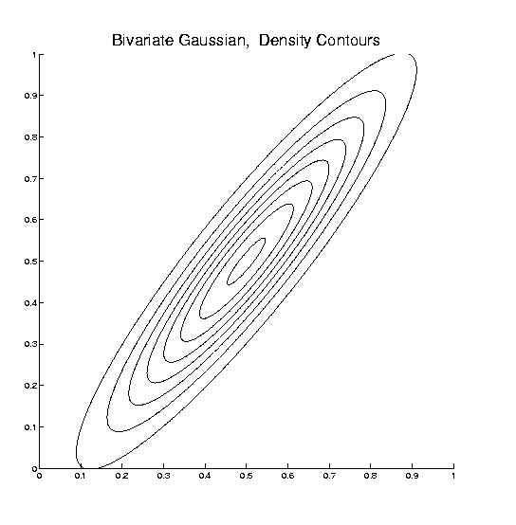
PCA as Optimization (Cont.)
Recall Toy
Example
Theoretical
Distribution

Slide 96
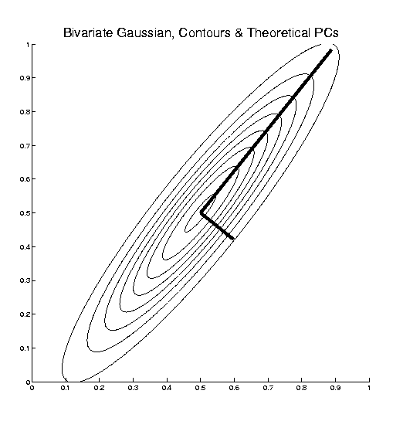
PCA as Optimization (Cont.)
Recall Toy
Example
Theoretical
Distribution
& Eigenvectors

Slide 97
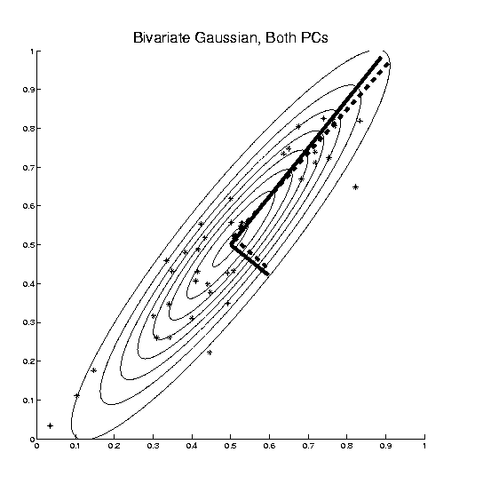
PCA as Optimization (Cont.)
Recall Toy
Example
Empirical (Sample)
EigenVectors
Theoretical
Distribution
& Eigenvectors
Different!

Slide 98
Connect Math to Graphics
2-d Toy Example
From First Class Meeting
2-d Curves as Data In Object Space
Simple, Visualizable Descriptor Space

Slide 99
Connect Math to Graphics
2-d Toy Example
Data Points
(Curves)
are columns of $2×25$ matrix, $X$

Slide 100
Connect Math to Graphics (Cont.)
2-d Toy Example
Sample Mean, $\overline{X}$

Slide 101
Connect Math to Graphics (Cont.)
2-d Toy Example
Residuals from Mean = Data - Mean

Slide 102
Connect Math to Graphics (Cont.)
2-d Toy Example
Recentered Data = Mean Residuals, shifted to 0
= (recentering of $X$) $\tilde{X}$

Slide 103
Connect Math to Graphics (Cont.)
2-d Toy Example
PC1 Direction follows $v_{1}$ = Eigvec (w/ biggest $λ=λ_{1}$)

Slide 104
Connect Math to Graphics (Cont.)
2-d Toy Example
PC1 Projections
Best 1-d Approximations of Data

Slide 105
Connect Math to Graphics (Cont.)
2-d Toy Example
PC1 Residuals

Slide 106
Connect Math to Graphics (Cont.)
2-d Toy Example
PC2 Direction follows $v_{2}$ = Eigvec (w/ 2nd $λ=λ_{2}$)

Slide 107
Connect Math to Graphics (Cont.)
2-d Toy Example
PC2 Projections (= PC1 Resid’s)
2nd Best 1-d Approximations of Data

Slide 108
Connect Math to Graphics (Cont.)
2-d Toy Example
PC2 Residuals = PC1 Projections

Slide 109
Connect Math to Graphics (Cont.)
Note for this 2-d Example:
PC1 Residuals = PC2 Projections
PC2 Residuals = PC1 Projections
(i.e. colors common across these pics)

Slide 110
PCA Redistribution of Energy
Convenient Summary of Amount of Structure:
Total Sum of Squares $\sum_{i=1}^{n}{{\left\|X_{i}\right\|}^{2}}$
Physical Interpetation:
Total Energy in Data
(Signal Processing Literature)

Slide 111
PCA Redistribution of Energy
Convenient Summary of Amount of Structure:
Total Sum of Squares $\sum_{i=1}^{n}{{\left\|X_{i}\right\|}^{2}}$
Physical Interpetation:
Total Energy in Data
Insight comes from decomposition
Statistical Terminology:
ANalysis Of VAriance (ANOVA)

Slide 112
PCA Redist’n of Energy (Cont.)
ANOVA Mean Decomposition:
Total Variation =
$\sum_{i=1}^{n}{{\left\|X_{i}\right\|}^{2}}$= $\sum_{i=1}^{n}{{\left\|\overline{X}\right\|}^{2}}$

Slide 113
PCA Redist’n of Energy (Cont.)
ANOVA Mean Decomposition:
Total Variation =
= Mean Variation + Mean Residual Variation
$\sum_{i=1}^{n}{{\left\|X_{i}\right\|}^{2}}$= $\sum_{i=1}^{n}{{\left\|\overline{X}\right\|}^{2}}+\sum_{i=1}^{n}{{\left\|X_{i}−\overline{X}\right\|}^{2}}$
Mathematics: Pythagorean Theorem
Intuition Quantified via Sums of Squares

Slide 114
Connect Math to Graphics (Cont.)
2-d Toy Example

Slide 115
Connect Math to Graphics (Cont.)
2-d Toy Example
Total Sum of Squares $=\sum_{i=1}^{n}{{\left\|X_{i}\right\|}^{2}}$

Slide 116
Connect Math to Graphics (Cont.)
2-d Toy Example
Total Sum of Squares $=\sum_{i=1}^{n}{{\left\|X_{i}\right\|}^{2}}=861$

Slide 117
Connect Math to Graphics (Cont.)
2-d Toy Example
Total Sum of Squares $=\sum_{i=1}^{n}{{\left\|X_{i}\right\|}^{2}}=861$
Quantifies Overall Variation (from 0)

Slide 118
Connect Math to Graphics (Cont.)
2-d Toy Example
Mean Sum of Squares $=\sum_{i=1}^{n}{{\left\|\overline{X}\right\|}^{2}}$

Slide 119
Connect Math to Graphics (Cont.)
2-d Toy Example
Mean Sum of Squares $=\sum_{i=1}^{n}{{\left\|\overline{X}\right\|}^{2}}=606$
$=92\%$ of Total Sum

Slide 120
Connect Math to Graphics (Cont.)
2-d Toy Example
Mean Sum of Squares $=\sum_{i=1}^{n}{{\left\|\overline{X}\right\|}^{2}}=606$
$=92\%$ of Total Sum
Quantifies Variation Due to Mean (from 0)

Slide 121
Connect Math to Graphics (Cont.)
2-d Toy Example
Mean Resid Sum of Sq’s $=\sum_{i=1}^{n}{{\left\|X_{i}−\overline{X}\right\|}^{2}}$

Slide 122
Connect Math to Graphics (Cont.)
2-d Toy Example
Mean Resid Sum of Sq’s $=\sum_{i=1}^{n}{{\left\|X_{i}−\overline{X}\right\|}^{2}}=55$
$=8\%$ of Total Sum
Quantifies Variation About Mean

Slide 123
PCA Redist’n of Energy (Cont.)
Have already studied this decomposition (recall curve e.g.)
Notes:
123

Slide 124
PCA Redist’n of Energy (Cont.)
Have already studied this decomposition (recall curve e.g.)
Variation (SS) due to Mean (% of total)
Notes:
124

Slide 125
PCA Redist’n of Energy (Cont.)
Have already studied this decomposition (recall curve e.g.)
Variation (SS) due to Mean (% of total)
Variation (SS) of Mean Residuals (% of total)
Notes:
125

Slide 126
PCA Redist’n of Energy (Cont.)
Now Decompose SS About the Mean
where:
Note Inner Products this time
Notes:
126

Slide 127
PCA Redist’n of Energy (Cont.)
Now Decompose SS About the Mean
where:
Recall: Can Commute Matrices Inside Trace
Notes:
127

Slide 128
PCA Redist’n of Energy (Cont.)
Now Decompose SS About the Mean
where:
Recall: Cov Matrix is Outer Product
Notes:
128

Slide 129
PCA Redist’n of Energy (Cont.)
Now Decompose SS About the Mean
where:
i.e. Energy is Expressed in Trace of Cov Matrix
Notes:
129

Slide 130
PCA Redist’n of Energy (Cont.)
(Using Eigenvalue Decomp. Of Cov Matrix)
Notes:
130

Slide 131
PCA Redist’n of Energy (Cont.)
(Commute Matrices Within Trace)
Notes:
131

Slide 132
PCA Redist’n of Energy (Cont.)
(Since Basis Matrix is Orthonormal)
Notes:
132

Slide 133
PCA Redist’n of Energy (Cont.)
Eigenvalues Provide Atoms of SS Decompos’n
Notes:
133

Slide 134
Connect Math to Graphics (Cont.)
2-d Toy Example
PC1 Sum of Squares $=51$
$=93\%$ of Mean Res. Sum

Slide 135
Connect Math to Graphics (Cont.)
2-d Toy Example
PC1 Sum of Squares $=51$
$=93\%$ of Mean Res. Sum
Quantifies PC1 Component of Variation

Slide 136
Connect Math to Graphics (Cont.)
2-d Toy Example
PC1 Residual SS $=$3.8
$=7\%$ of Mean Residual Sum

Slide 137
Connect Math to Graphics (Cont.)
2-d Toy Example
PC1 Sum of Squares $=3.8$
$=7\%$ of Mean Res. Sum

Slide 138
Connect Math to Graphics (Cont.)
2-d Toy Example
PC2 Sum of Squares $=3.8$
$=7\%$ of Mean Res. Sum
Quantifies PC2 Component of Variation

Slide 139
Connect Math to Graphics (Cont.)
2-d Toy Example
PC2 Residual SS $=51$
$=93\%$ of Mean Residual Sum

Slide 140
PCA Redist’n of Energy (Cont.)
Eigenvalues Provide Atoms of SS Decompos’n
Notes:
140

Slide 141
PCA Redist’n of Energy (Cont.)
Eigenvalues Provide Atoms of SS Decompos’n
Useful Plots are:
Power Spectrum: vs.
Notes:
141

Slide 142
PCA Redist’n of Energy (Cont.)
Eigenvalues Provide Atoms of SS Decompos’n
Useful Plots are:
Power Spectrum: vs.
log Power Spectrum: vs.
(Very Useful When Are Orders of Mag. Apart)
Notes:
142

Slide 143
PCA Redist’n of Energy (Cont.)
Eigenvalues Provide Atoms of SS Decompos’n
Useful Plots are:
Power Spectrum: vs.
log Power Spectrum: vs.
Cumulative Power Spectrum: vs.
Notes:
143

Slide 144
PCA Redist’n of Energy (Cont.)
Eigenvalues Provide Atoms of SS Decompos’n
Useful Plots are:
Power Spectrum: vs.
log Power Spectrum: vs.
Cumulative Power Spectrum: vs.
Note PCA Gives SS’s for Free (As Eigenval’s),
But Watch Factors of
Notes:
144

Slide 145
PCA Redist’n of Energy (Cont.)
Note, have already considered some of these Useful Plots:
Notes:
145

Slide 146
PCA Redist’n of Energy (Cont.)
Note, have already considered some of these Useful Plots:
Power Spectrum
Notes:
146

Slide 147
PCA Redist’n of Energy (Cont.)
Note, have already considered some of these Useful Plots:
Power Spectrum
Cumulative Power Spectrum
Notes:
147

Slide 148
PCA Redist’n of Energy (Cont.)
Note, have already considered some of these Useful Plots:
Power Spectrum
Cumulative Power Spectrum
Common Terminology:
Power Spectrum is Called
“Scree Plot”
Kruskal (1964) Cattell (1966)
(all but name “scree”) (1st Appearance of name???)
Notes:
148

Slide 149
Participant Presentation
Anna Zhao
Surviving in the NBA

