Slide 1
Statistical Smoothing
In 1 Dimension, 2 Major Settings:
Density Estimation
“Histograms”
Nonparametric Regression
“Scatterplot Smoothing”

Slide 2
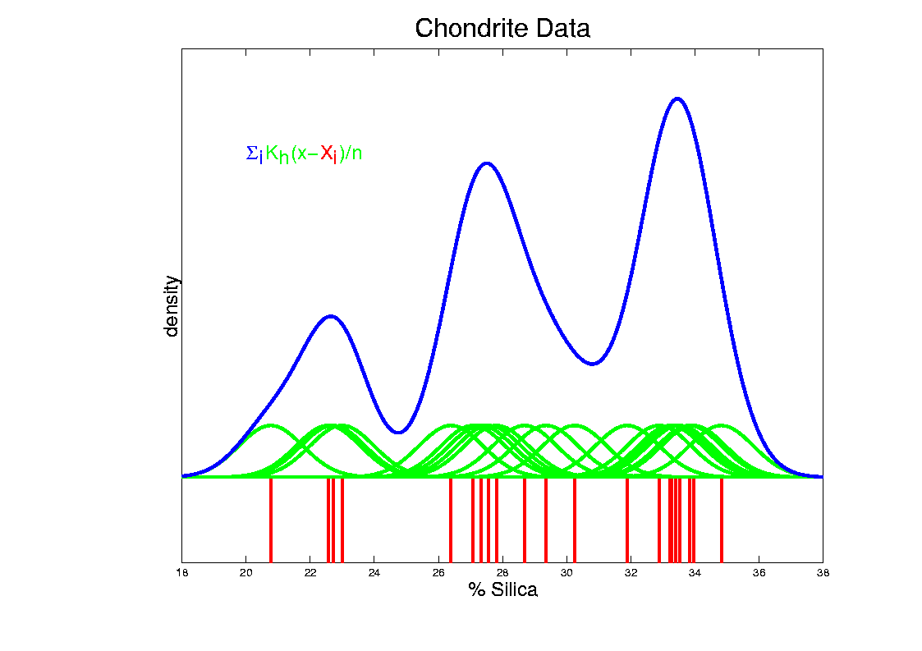
Kernel Density Estimation
Chondrite Data:
Sum pieces to estimate density
Suggests 3 modes (rock sources)

Slide 3
Scatterplot Smoothing
E.g. Bralower Fossil Data – some smooths

Slide 4
SiZer Background
Fun Scale Space Views (Incomes Data)
Surface View

Slide 5
SiZer Background
SiZer Visual presentation:
Color map over scale space:
Blue: slope significantly upwards
(derivative CI above 0)
Red: slope significantly downwards
(derivative CI below 0)
Purple: slope insignificant
(derivative CI contains 0)

Slide 6
SiZer Background
E.g. - Marron & Wand (1992) Trimodal #9
Increasing n
Only 1 Signif’t Mode
Now 2 Signif’t Modes
Finally all 3 Modes

Slide 7
SiZer Background
Extension to 2-d:
Significance in Scale Space
Main Challenge: Visualization
References:
Godtliebsen et al (2002, 2004, 2006)

Slide 8
SiZer Overview
Would you like to try smoothing & SiZer?
Marron Software Website as Before
In “Smoothing” Directory:
kdeSM.m
nprSM.m
sizerSM.m
Recall: “>> help sizerSM” for usage

Slide 9
PCA to find clusters
Return to PCA of Mass Flux Data:
Notes:
MassFlux1d1p1.ps

Slide 10
PCA to find clusters
SiZer analysis of Mass Flux, PC1
Notes:
MassFlux1d1p1s.ps

Slide 11
Clustering
Idea: Given data ${\underline{X}}_{1},⋯,{\underline{X}}_{n}$
Assign each object to a class
Of similar objects
Completely data driven
I.e. assign labels to data
“Unsupervised Learning”
Contrast to Classification (Discrimination)
With predetermined given classes
“Supervised Learning”

Slide 12
Clustering
Important References:
MacQueen (1967)
Hartigan (1975)
Gersho and Gray (1992)
Kaufman and Rousseeuw (2005)
See Also: Wikipedia

Slide 13
K-means Clustering
Main Idea: for data ${\underline{X}}_{1},⋯,{\underline{X}}_{n}$
Partition indices $i=1,⋯,n$
among classes $C_{1},⋯$, $C_{K}$
Given index sets $C_{1},⋯$, $C_{K}$
that partition $\left\{1,⋯,n\right\}$
represent clusters by “class means”
i.e, ${\overline{\underline{X}}}_{j}=\frac{1}{\#\left(C_{j}\right)}\sum_{i∈C_{j}}{{\underline{X}}_{i}}$ (within class means)

Slide 14
K-means Clustering
Given index sets $C_{1},⋯$, $C_{K}$
Measure how well clustered, using
Within Class Sum of Squares

Slide 15
K-means Clustering
Common Variation:
Put on scale of proportions (i.e. in [0,1])
By dividing “within class SS”
by “overall SS”
Gives Cluster Index:

Slide 16
K-means Clustering
Notes on Cluster Index:
CI = 0 when all data at cluster means
CI small when $C_{1},⋯$,$C_{K}$ gives tight clusters
(within SS contains little variation)
CI big when $C_{1},⋯$, $C_{K}$ gives poor clustering
(within SS contains most of variation)
CI = 1 when all cluster means are same

Slide 17
K-means Clustering
Clustering Goal:
Given data
Choose classes
To miminize

Slide 18
2-means Clustering
Study CI, using simple 1-d examples
Varying Standard Deviation

Slide 19
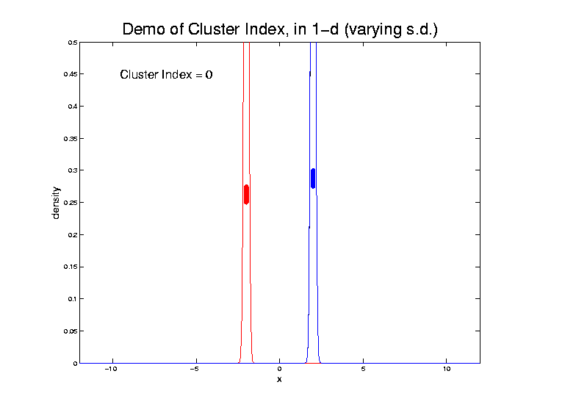
2-means Clustering

Slide 20
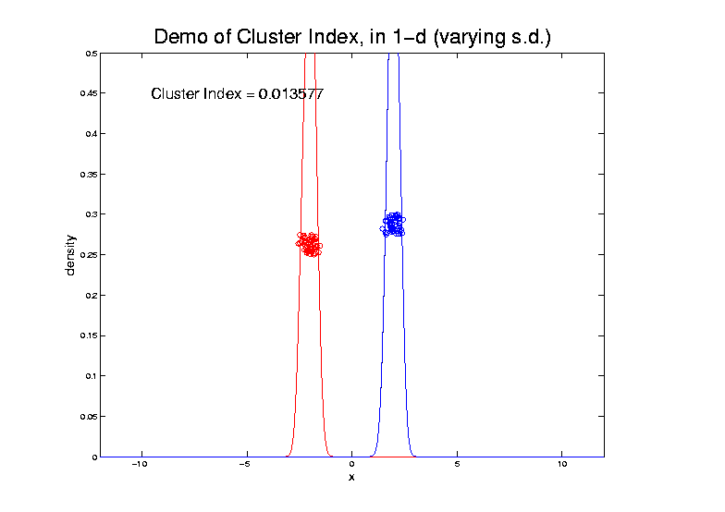
2-means Clustering

Slide 21
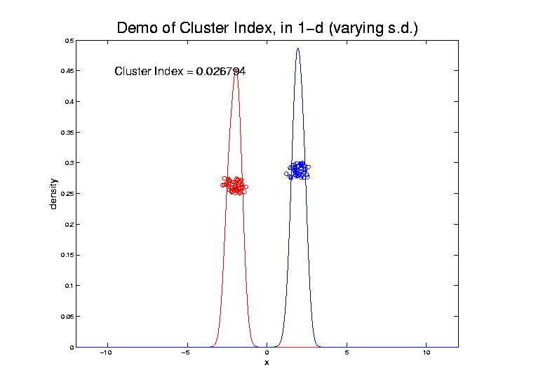
2-means Clustering

Slide 22
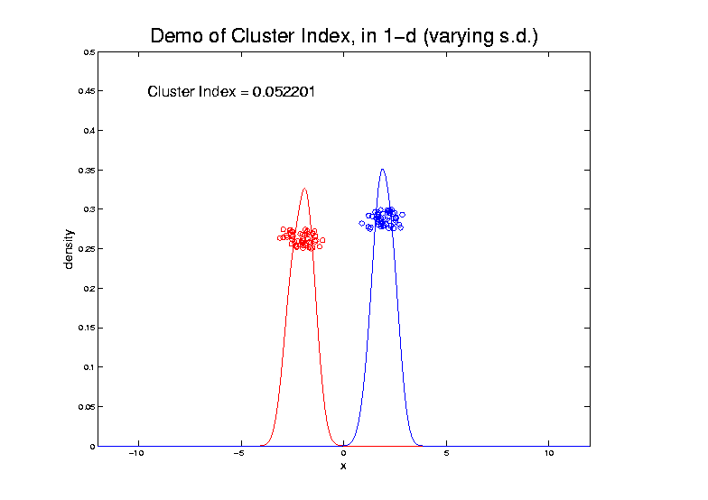
2-means Clustering

Slide 23
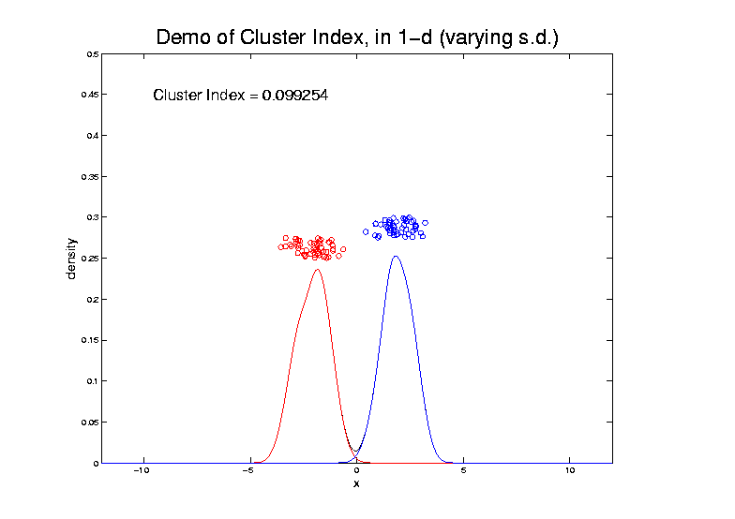
2-means Clustering

Slide 24
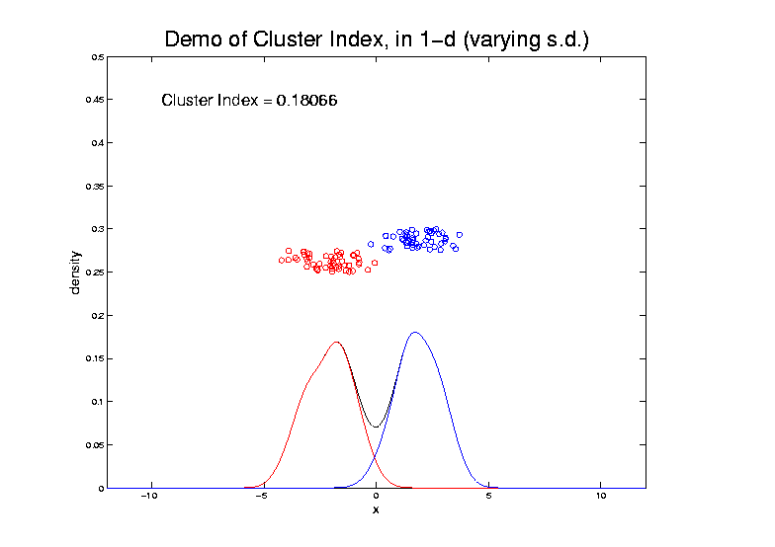
2-means Clustering

Slide 25
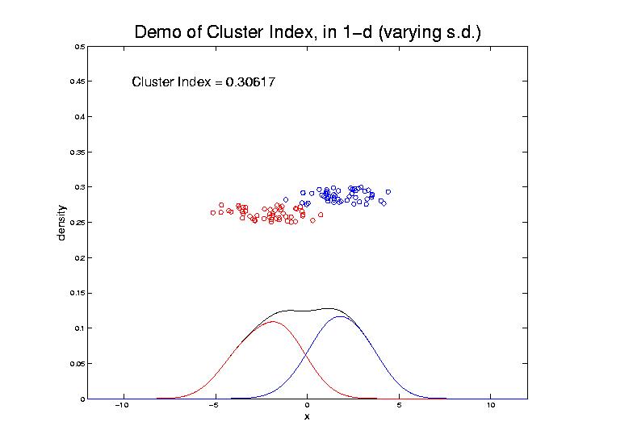
2-means Clustering

Slide 26
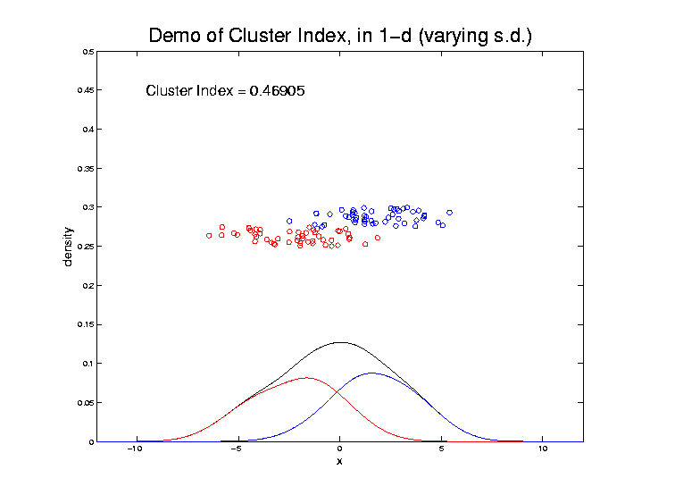
2-means Clustering

Slide 27
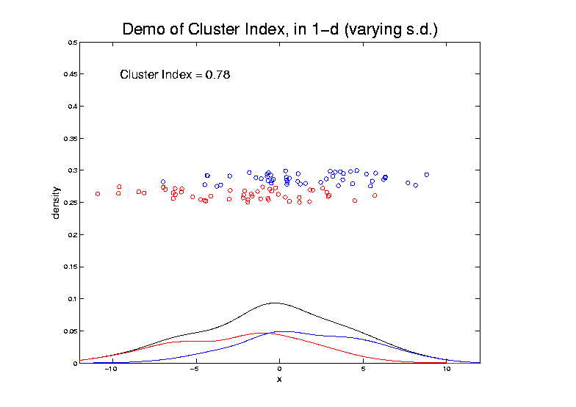
2-means Clustering

Slide 28
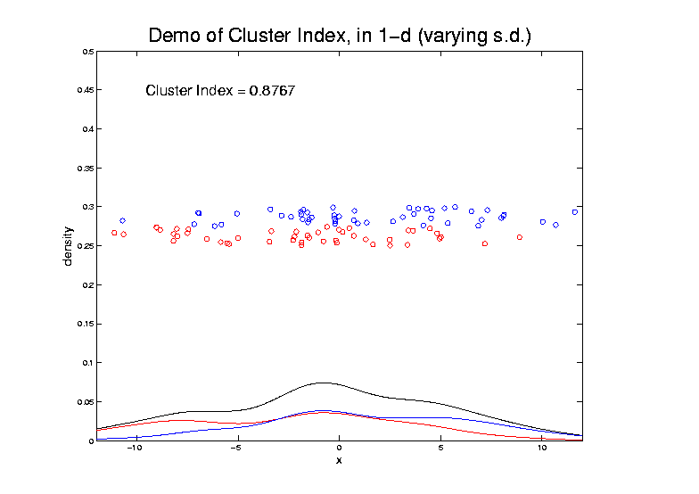
2-means Clustering

Slide 29
2-means Clustering
Study CI, using simple 1-d examples
Varying Standard Deviation
Varying Mean

Slide 30
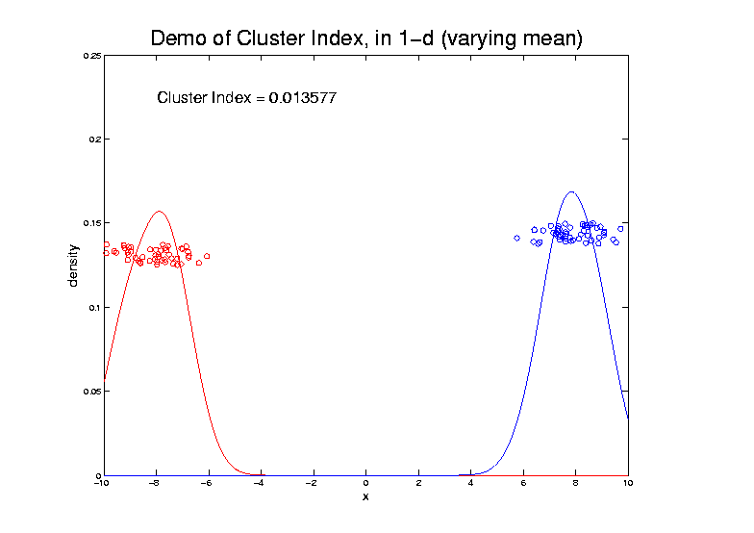
2-means Clustering

Slide 31
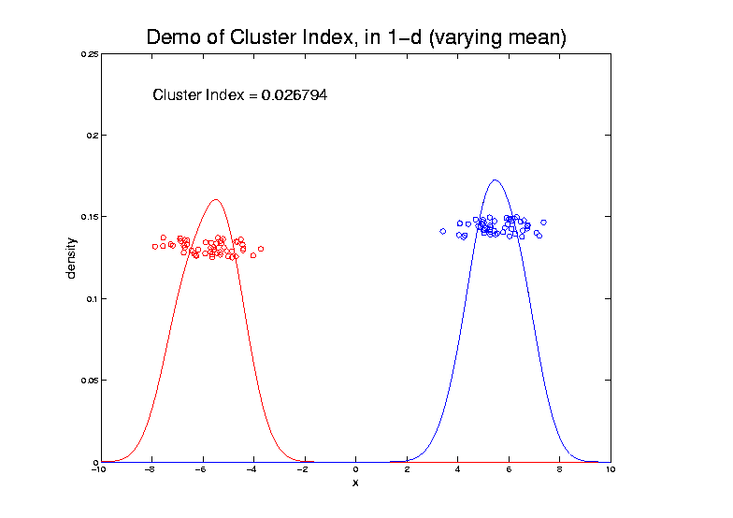
2-means Clustering

Slide 32
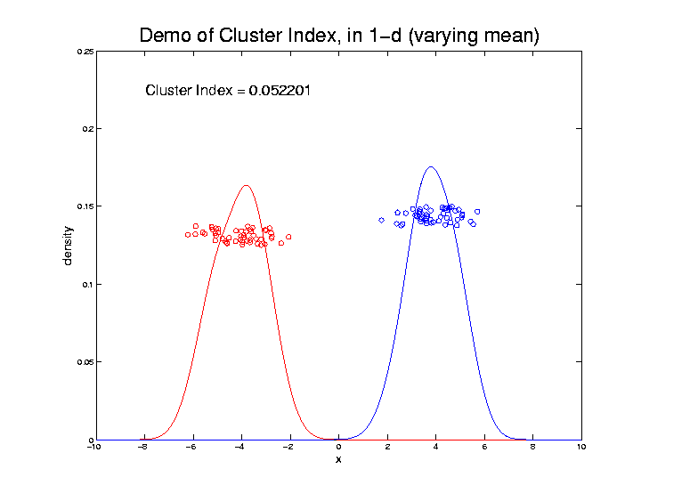
2-means Clustering

Slide 33
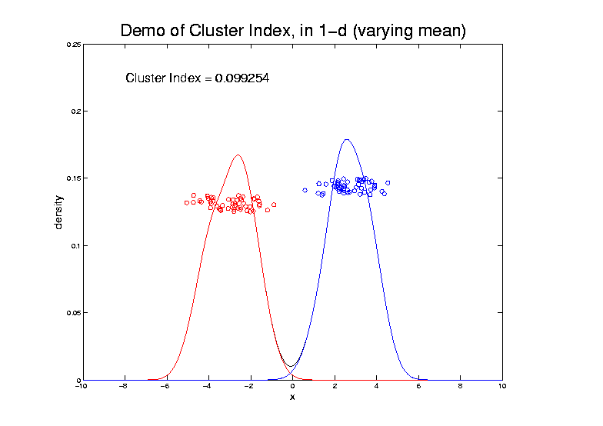
2-means Clustering

Slide 34
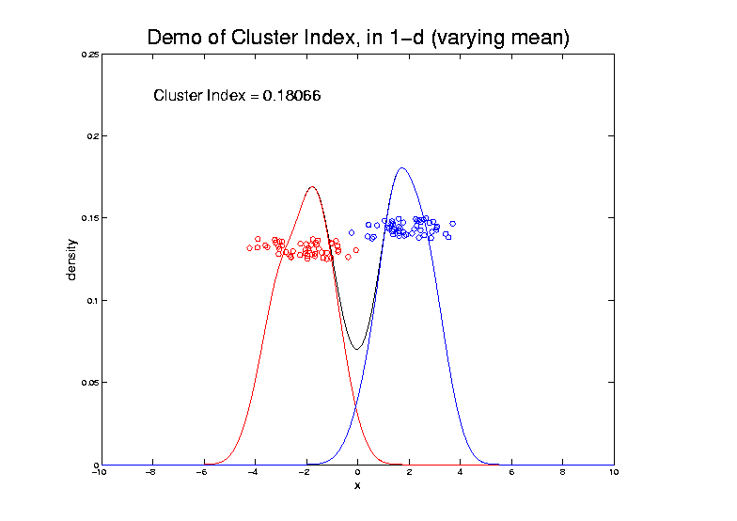
2-means Clustering

Slide 35
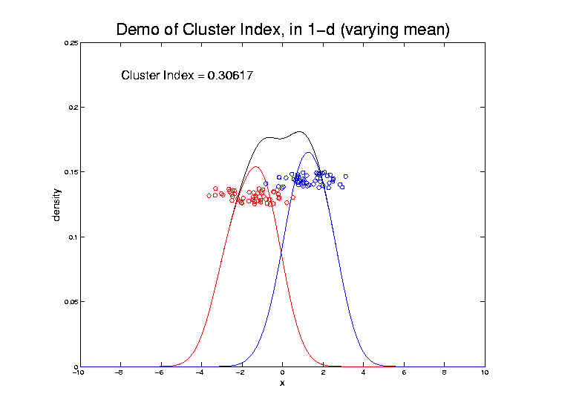
2-means Clustering

Slide 36
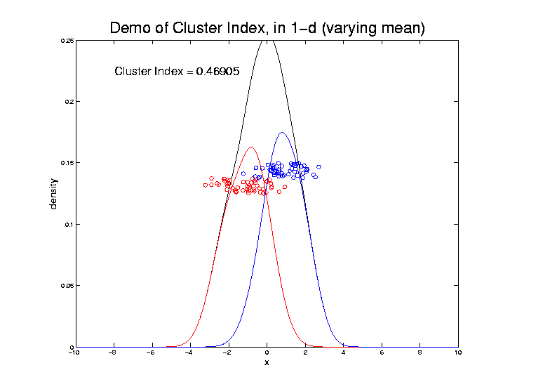
2-means Clustering

Slide 37
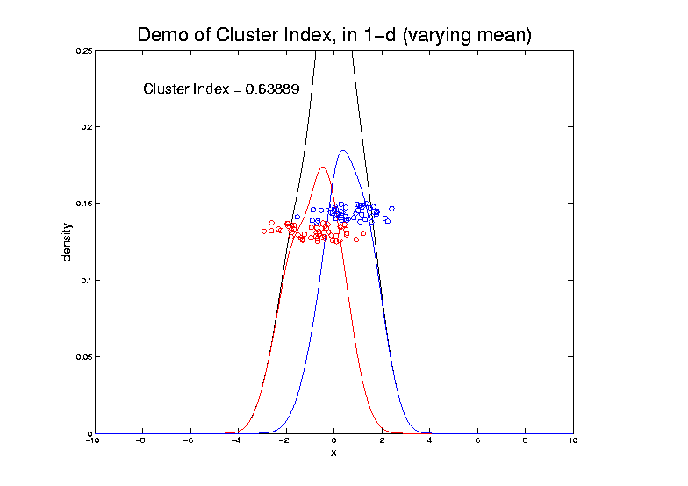
2-means Clustering

Slide 38
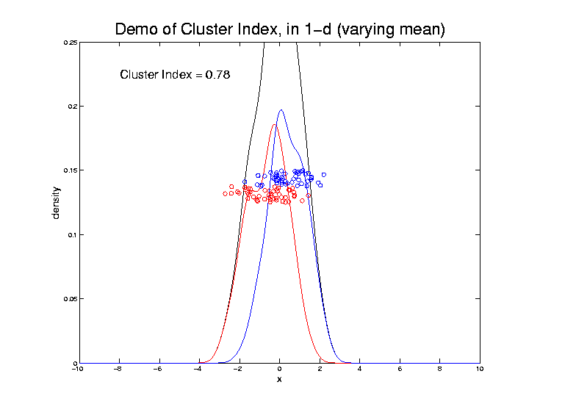
2-means Clustering

Slide 39
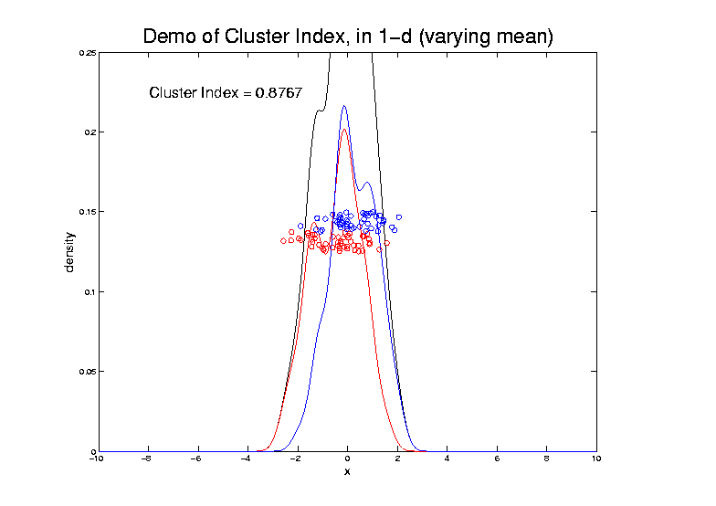
2-means Clustering

Slide 40
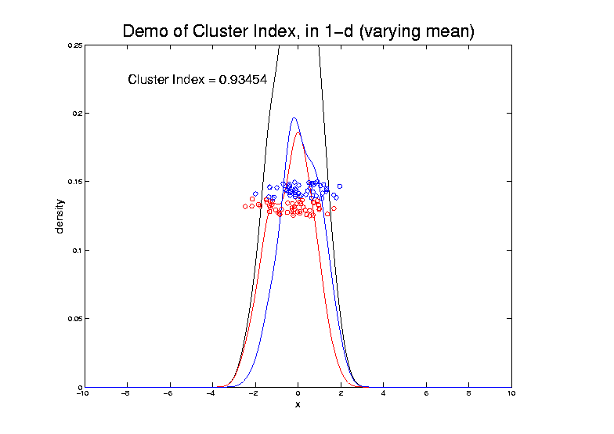
2-means Clustering

Slide 41
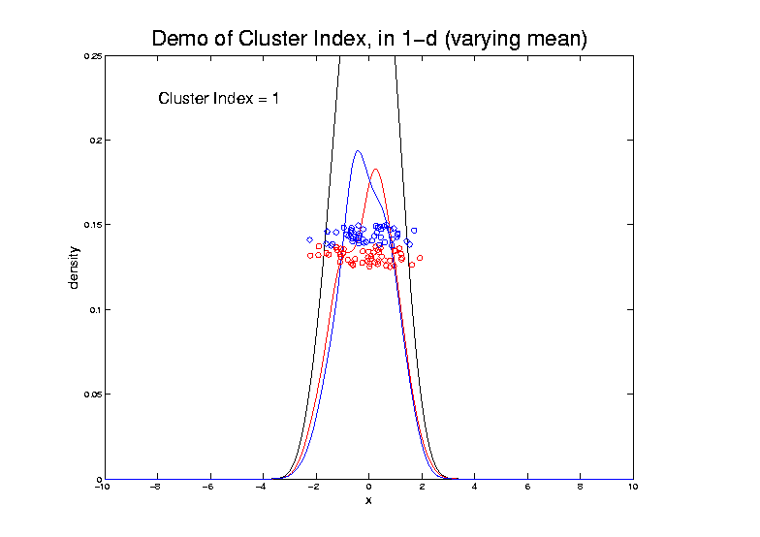
2-means Clustering

Slide 42
2-means Clustering
Study CI, using simple 1-d examples
Varying Standard Deviation
Varying Mean
Varying Proportion

Slide 43
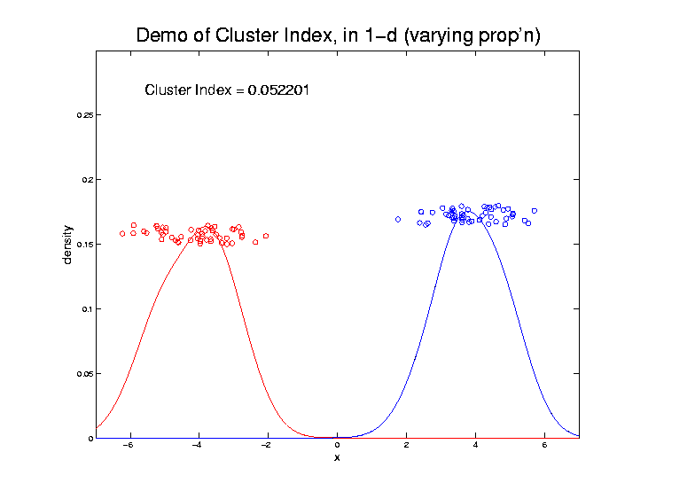
2-means Clustering

Slide 44
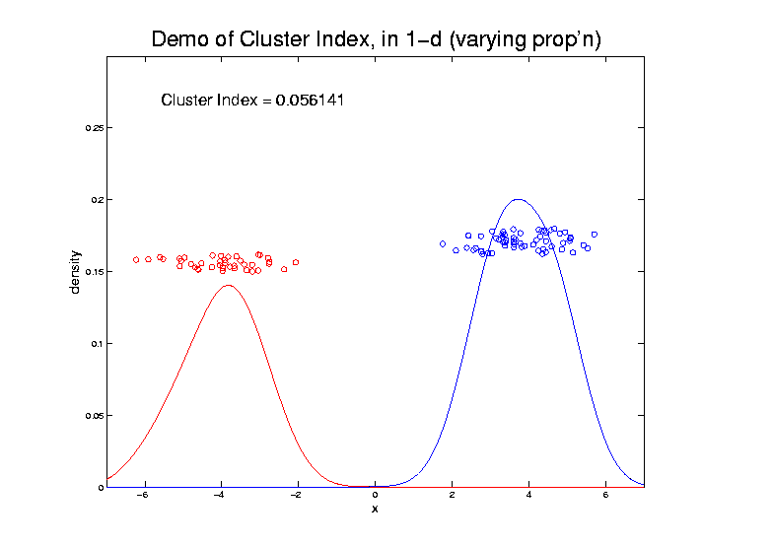
2-means Clustering

Slide 45
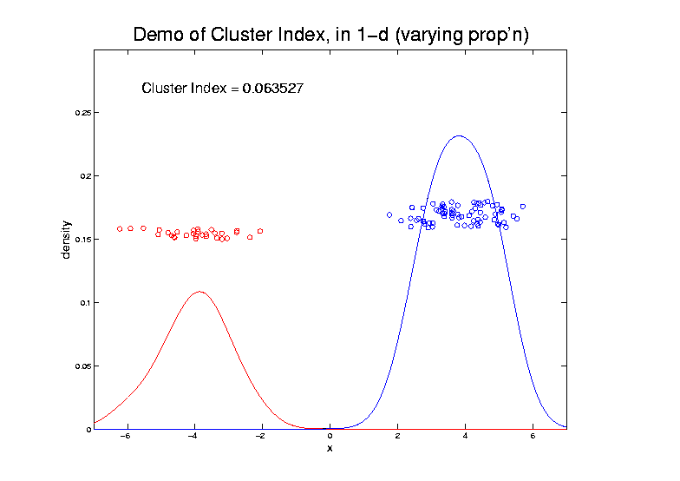
2-means Clustering

Slide 46
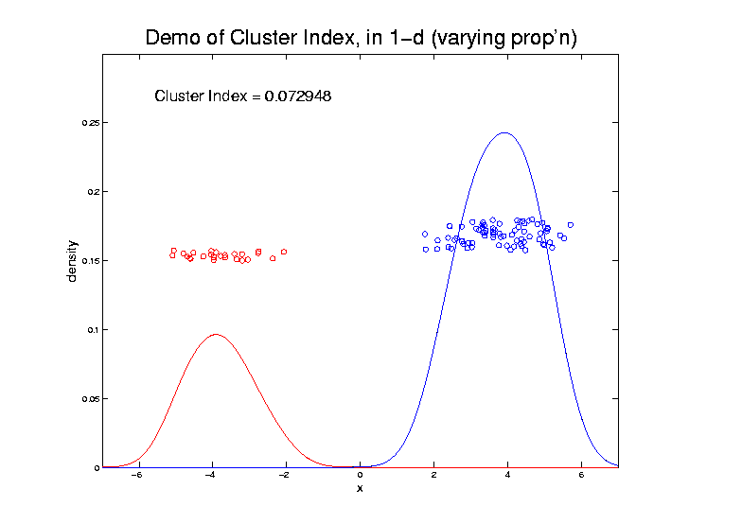
2-means Clustering

Slide 47
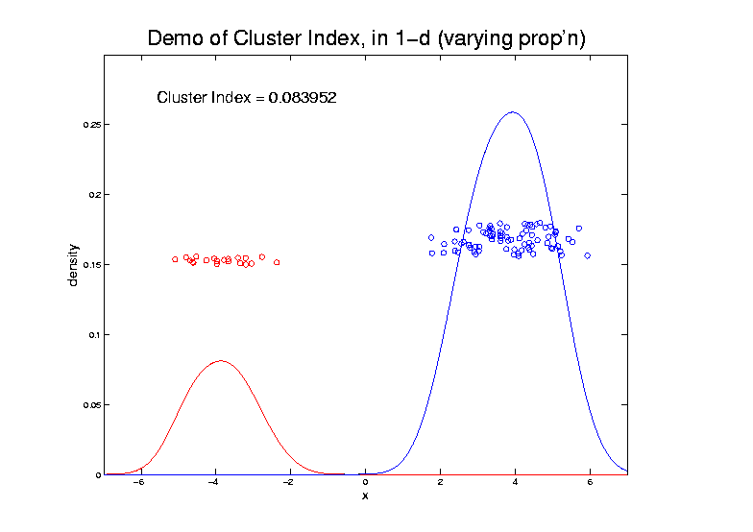
2-means Clustering

Slide 48
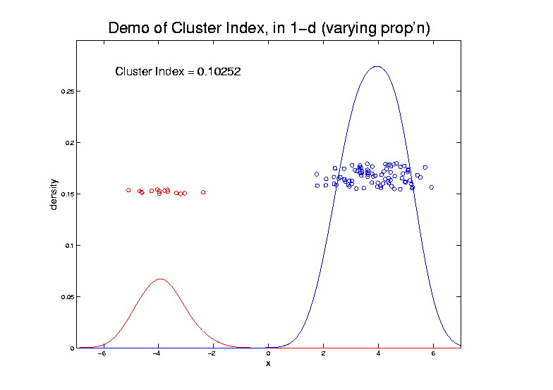
2-means Clustering

Slide 49
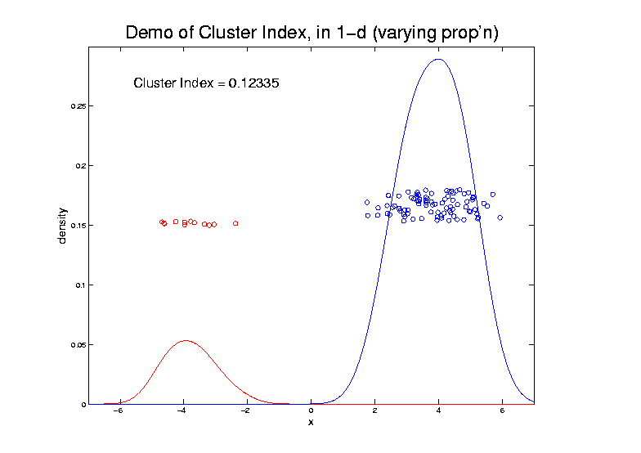
2-means Clustering

Slide 50
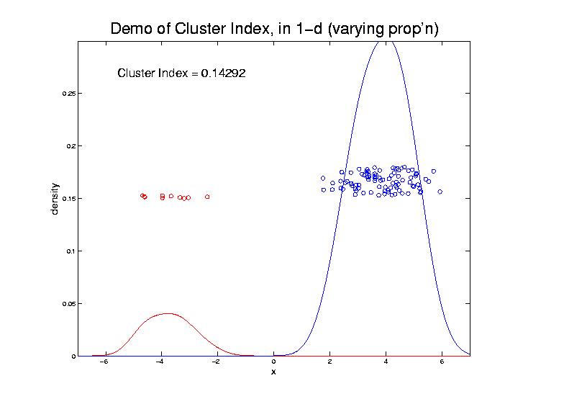
2-means Clustering

Slide 51
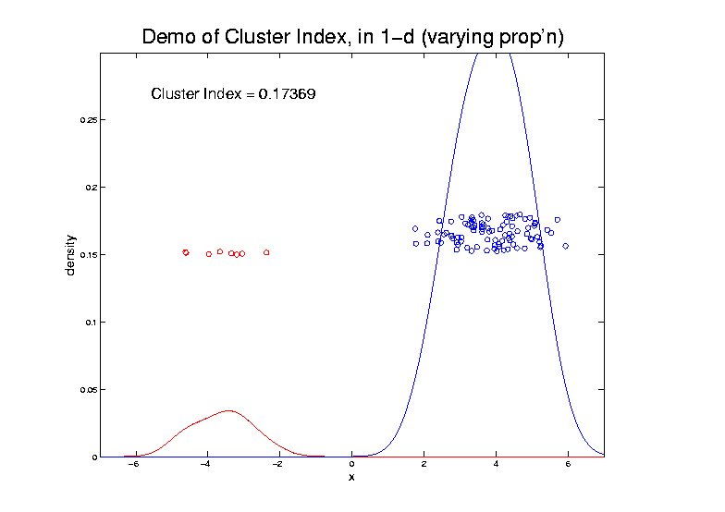
2-means Clustering

Slide 52
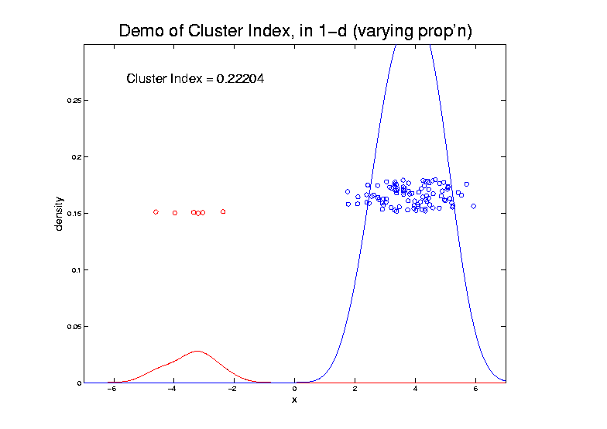
2-means Clustering

Slide 53
2-means Clustering

Slide 54
2-means Clustering

Slide 55
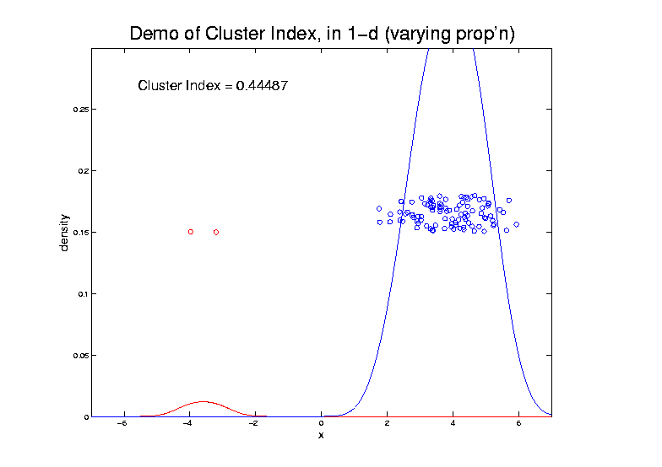
2-means Clustering

Slide 56
2-means Clustering

Slide 57
2-means Clustering
Study CI, using simple 1-d examples
Over changing Classes (moving b’dry)

Slide 58
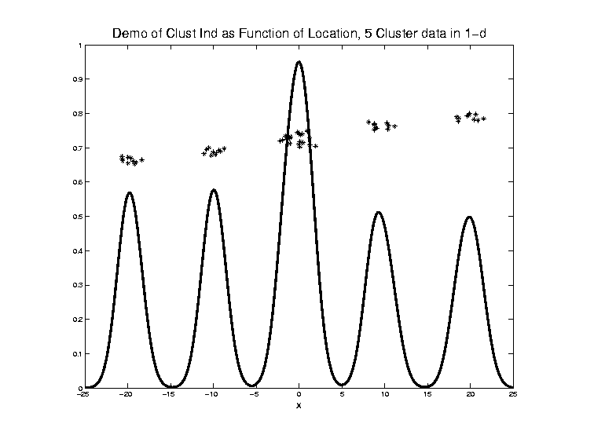
2-means Clustering

Slide 59
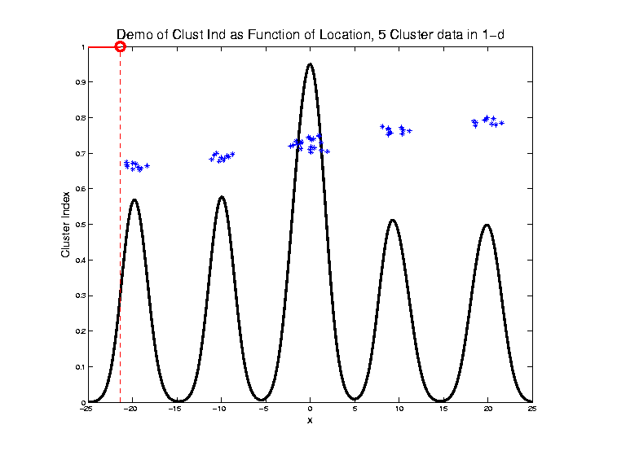
2-means Clustering

Slide 60
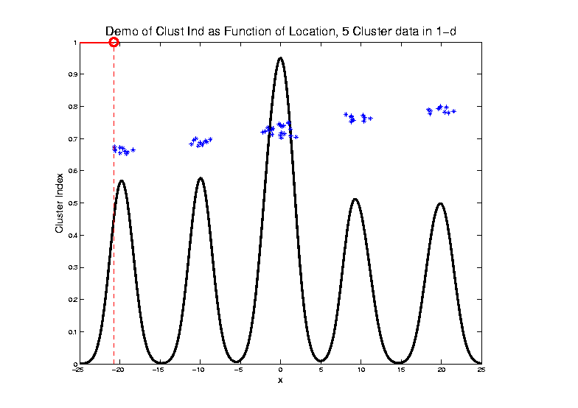
2-means Clustering

Slide 61
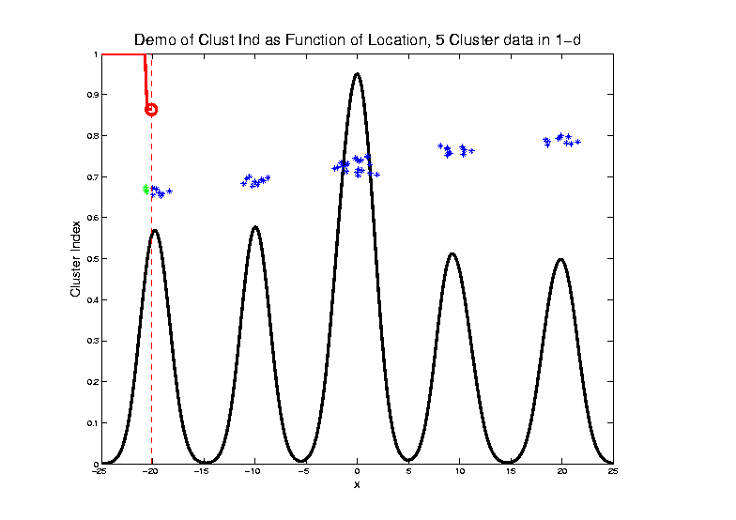
2-means Clustering
C. Index for
Clustering
Greens
& Blues

Slide 62
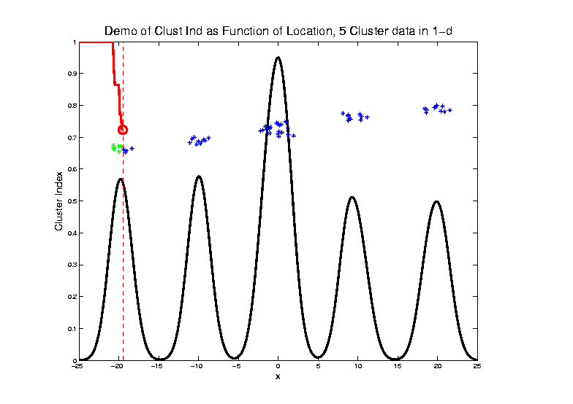
2-means Clustering

Slide 63
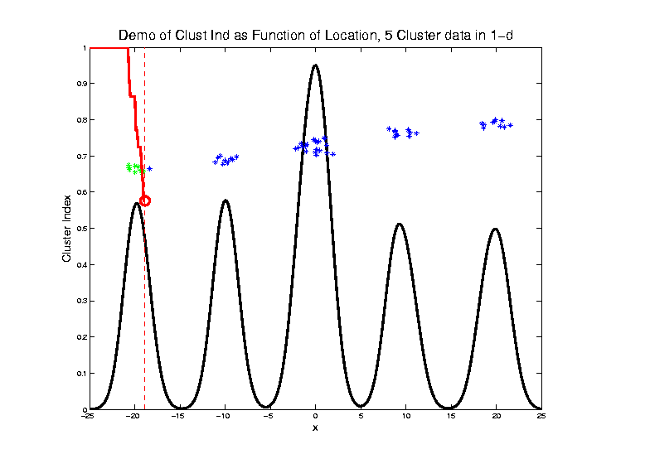
2-means Clustering

Slide 64
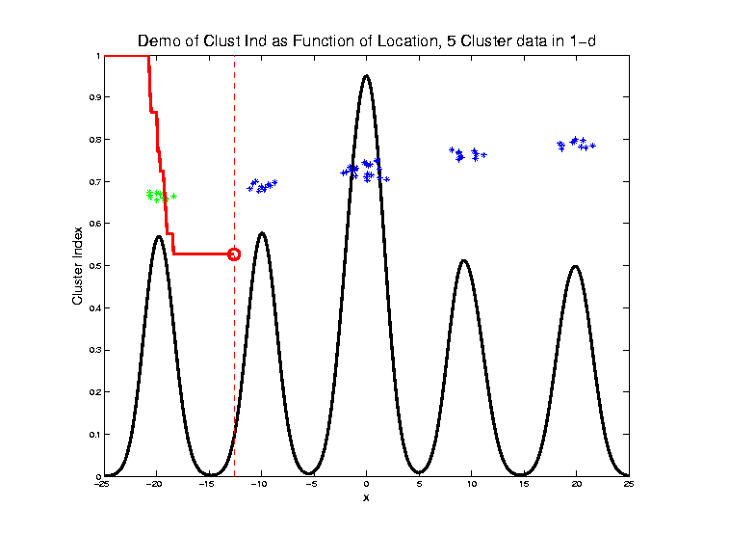
2-means Clustering

Slide 65
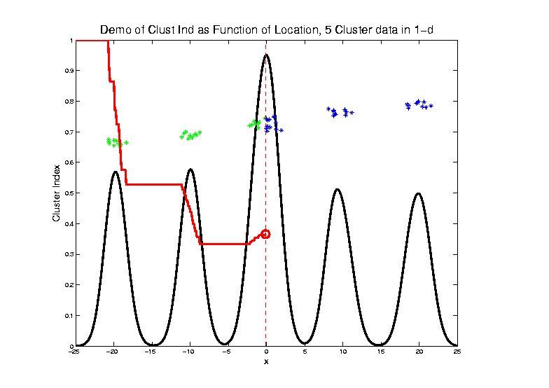
2-means Clustering

Slide 66
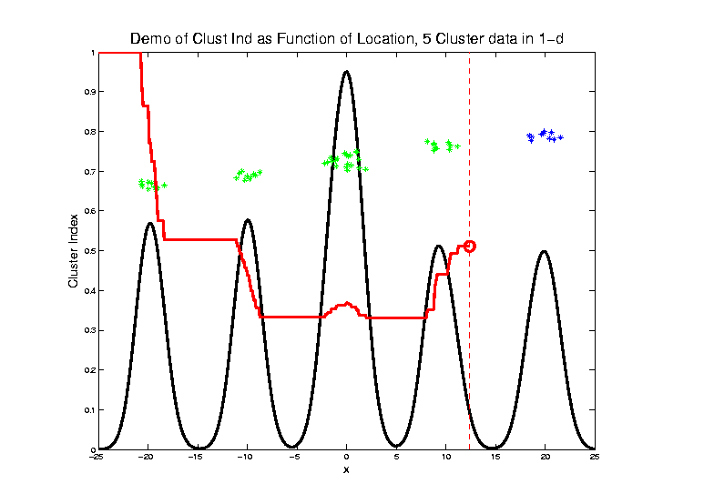
2-means Clustering

Slide 67
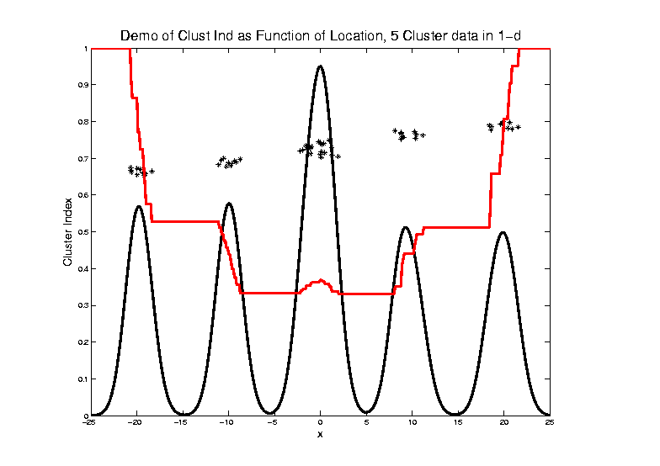
2-means Clustering
Curve Shows CI for Many
Reasonable Clusterings

Slide 68
2-means Clustering
Study CI, using simple 1-d examples
Over changing Classes (moving b’dry)
Multi-modal data → interesting effects
Multiple local minima (large number)
Maybe disconnected
Optimization (over $C_{1},⋯$, $C_{K}$) can be tricky…
(even in 1 dimension, with $K=2$)

Slide 69
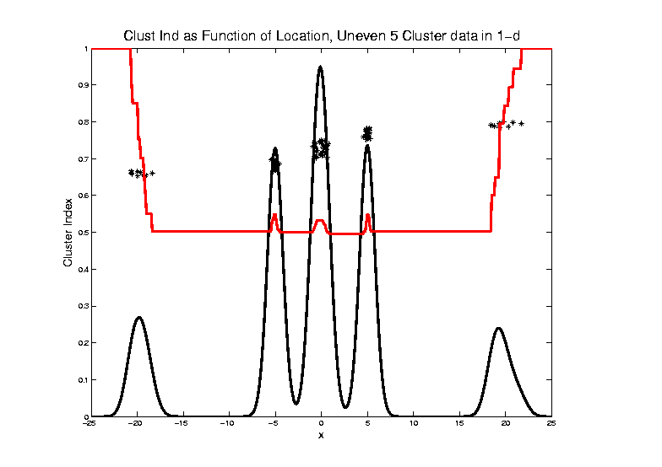
2-means Clustering

Slide 70
2-means Clustering
Study CI, using simple 1-d examples
Over changing Classes (moving b’dry)
Multi-modal data → interesting effects
Can have 4 (or more) local mins
(even in 1 dimension, with K = 2)

Slide 71
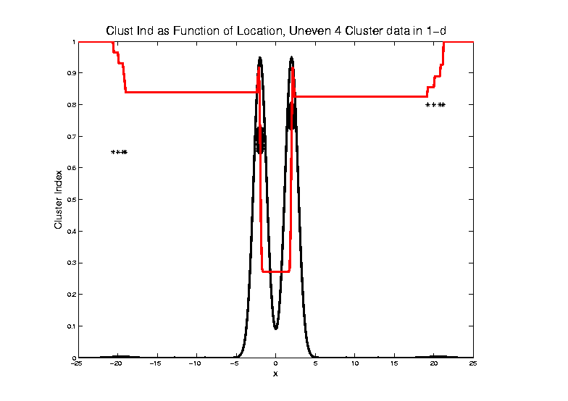
2-means Clustering

Slide 72
2-means Clustering
Study CI, using simple 1-d examples
Over changing Classes (moving b’dry)
Multi-modal data → interesting effects
Local mins can be hard to find
i.e. iterative procedures can “get stuck”
(even in 1 dimension, with K = 2)

Slide 73
2-means Clustering
Study CI, using simple 1-d examples
Effect of a single outlier?

Slide 74
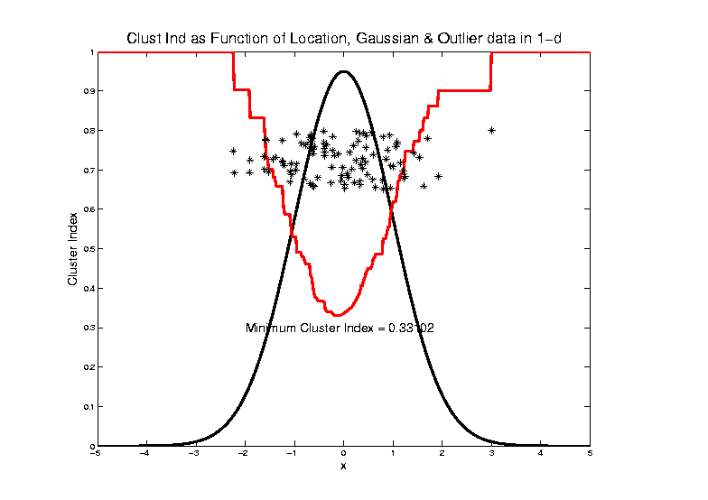
2-means Clustering

Slide 75
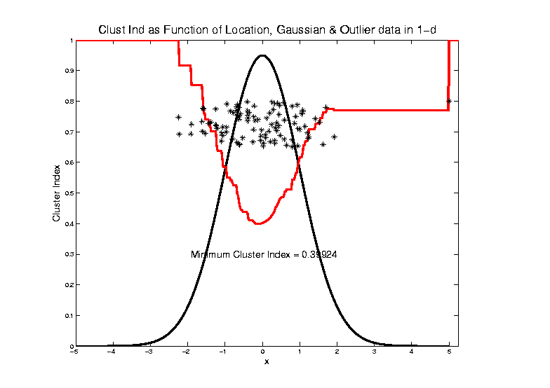
2-means Clustering

Slide 76
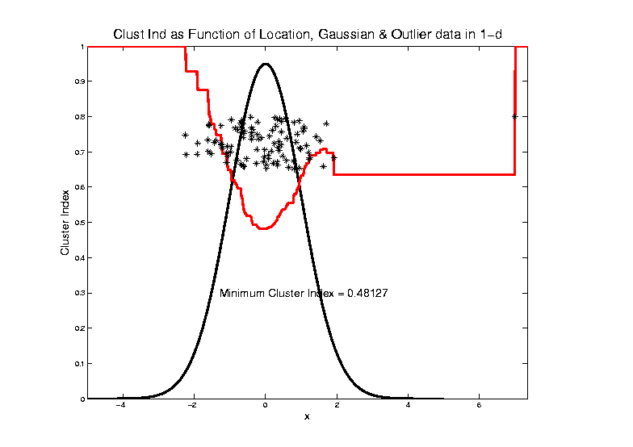
2-means Clustering

Slide 77
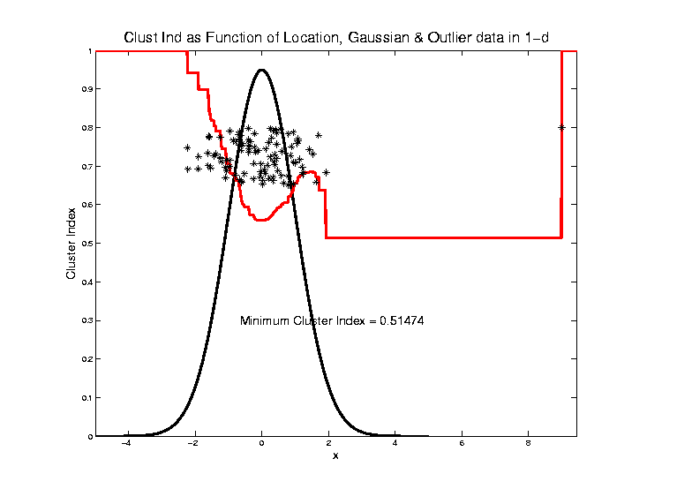
2-means Clustering

Slide 78
2-means Clustering

Slide 79
2-means Clustering

Slide 80
2-means Clustering

Slide 81
2-means Clustering

Slide 82
2-means Clustering

Slide 83
2-means Clustering

Slide 84
2-means Clustering

Slide 85
2-means Clustering
Study CI, using simple 1-d examples
Effect of a single outlier?
Can create local minimum
Can also yield a global minimum
This gives a one point class
Can make CI arbitrarily small
(really a “good clustering”???)

Slide 86
SWISS Score
Another Application of CI (Cluster Index)
Cabanski et al (2010)
Idea: Use CI in bioinformatics to
“measure quality of data preprocessing”
Philosophy: Clusters Are Scientific Goal
So Want to Accentuate Them

Slide 87
SWISS Score
Toy Examples (2-d):
Which are “More Clustered?”

Slide 88
SWISS Score
Toy Examples (2-d):
Which are “More Clustered?”

Slide 89
SWISS Score
SWISS =
Standardized Within class Sum of Squares

Slide 90
SWISS Score
SWISS =
Standardized Within class Sum of Squares

Slide 91
SWISS Score
SWISS =
Standardized Within class Sum of Squares

Slide 92
SWISS Score
SWISS =
Standardized Within class Sum of Squares

Slide 93
SWISS Score
Nice Graphical Introduction:

Slide 94
SWISS Score
Nice Graphical Introduction:

Slide 95
SWISS Score
Revisit Toy Examples (2-d):
Which are “More Clustered?”

Slide 96
SWISS Score
Toy Examples (2-d):
Which are “More Clustered?”

Slide 97
SWISS Score
Toy Examples (2-d):
Which are “More Clustered?”

Slide 98
SWISS Score
Now Consider K > 2:
How well does it work?

Slide 99
SWISS Score
K = 3, Toy Example:

Slide 100
SWISS Score
K = 3, Toy Example:

Slide 101
SWISS Score
K = 3, Toy Example:

Slide 102
SWISS Score
K = 3, Toy Example:
But C
Seems
“Better
Clustered”

Slide 103
SWISS Score
K-Class SWISS:
Instead of using K-Class CI
Use Average of Pairwise SWISS Scores

Slide 104
SWISS Score
K-Class SWISS:
Instead of using K-Class CI
Use Average of Pairwise SWISS Scores
(Preserves [0,1] Range)

Slide 105
SWISS Score
Avg. Pairwise SWISS – Toy Examples

Slide 106
SWISS Score
Additional Feature:
Ǝ Hypothesis Tests:
H₁: SWISS₁ < 1
H₁: SWISS₁ < SWISS₂
Permutation Based
See Cabanski et al (2010)

Slide 107
Clustering
A Very Large Area
K-Means is Only One Approach
Has its Drawbacks
(Many Toy Examples of This)
Ǝ Many Other Approaches
Important (And Broad) Class
Hierarchical Clustering

Slide 108
Hiearchical Clustering
Idea: Consider Either:
Bottom Up Aggregation:
One by One Combine Data
Top Down Splitting:
All Data in One Cluster & Split
Through Entire Data Set, to get Dendogram

Slide 109
Hiearchical Clustering
Aggregate or Split, to get Dendogram
Thanks to US EPA: water.epa.gov

Slide 110
Hiearchical Clustering
Aggregate or Split, to get Dendogram
Aggregate:
Start With
Individuals

Slide 111
Hiearchical Clustering
Aggregate or Split, to get Dendogram
Aggregate:
Start With
Individuals,
Move Up

Slide 112
Hiearchical Clustering
Aggregate or Split, to get Dendogram
Aggregate:
Start With
Individuals,
Move Up

Slide 113
Hiearchical Clustering
Aggregate or Split, to get Dendogram
Aggregate:
Start With
Individuals,
Move Up

Slide 114
Hiearchical Clustering
Aggregate or Split, to get Dendogram
Aggregate:
Start With
Individuals,
Move Up

Slide 115
Hiearchical Clustering
Aggregate or Split, to get Dendogram
Aggregate:
Start With
Individuals,
Move Up,
End Up With
All in 1 Cluster

Slide 116
Hiearchical Clustering
Aggregate or Split, to get Dendogram
Split:
Start With
All in 1 Cluster

Slide 117
Hiearchical Clustering
Aggregate or Split, to get Dendogram
Split:
Start With
All in 1 Cluster,
Move Down

Slide 118
Hiearchical Clustering
Aggregate or Split, to get Dendogram
Split:
Start With
All in 1 Cluster,
Move Down,
End With
Individuals

Slide 119
Hiearchical Clustering
Vertical Axis in Dendogram:
Based on:
Distance Metric
(Ǝ many, e.g. L², L¹, L∞, …)
Linkage Function
(Reflects Clustering Type)
A Lot of “Art” Involved

Slide 120
Hiearchical Clustering
Dendogram Interpretation
Branch
Length
Reflects
Cluster
Strength

Slide 121
Participant Presentations
Xiao Yang
Analysis of Climate Data
Huijun Qian
Quantitative Analysis of Non-muscle
Myosin II Minifilaments

