Slide 1
Clustering
Idea: Given data ${\underline{X}}_{1},⋯,{\underline{X}}_{n}$
Assign each object to a class
Of similar objects
Completely data driven
I.e. assign labels to data
“Unsupervised Learning”
Contrast to Classification (Discrimination)
With predetermined given classes
“Supervised Learning”

Slide 2
K-means Clustering
Clustering Goal:
Given data
Choose classes
To miminize

Slide 3
2-means Clustering
Study CI, using simple 1-d examples
Varying Standard Deviation
Varying Mean
Varying Proportion

Slide 4
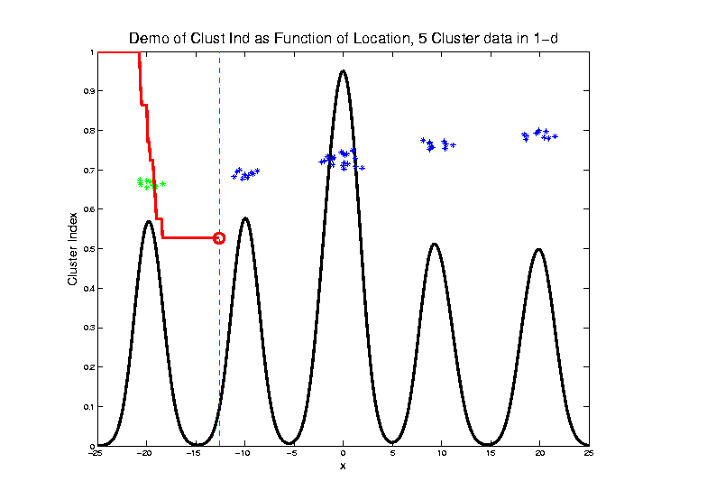
2-means Clustering

Slide 5
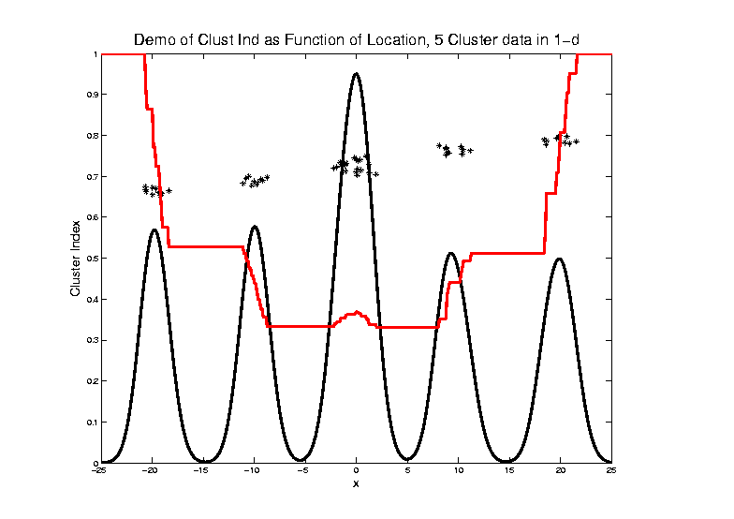
2-means Clustering
Curve Shows CI for Many
Reasonable Clusterings

Slide 6
2-means Clustering
Study CI, using simple 1-d examples
Over changing Classes (moving b’dry)
Multi-modal data → interesting effects
Multiple local minima (large number)
Maybe disconnected
Optimization (over $C_{1},⋯$, $C_{K}$) can be tricky…
(even in 1 dimension, with $K=2$)

Slide 7
2-means Clustering
Study CI, using simple 1-d examples
Effect of a single outlier?

Slide 8
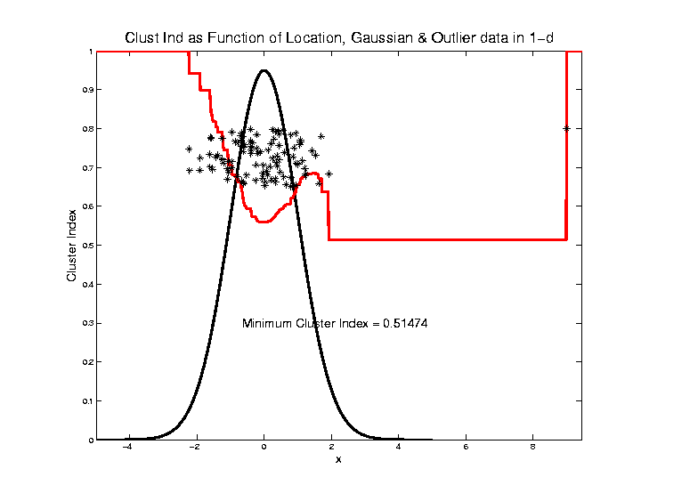
2-means Clustering

Slide 9
SWISS Score
Another Application of CI (Cluster Index)
Cabanski et al (2010)
Idea: Use CI in bioinformatics to
“measure quality of data preprocessing”
Philosophy: Clusters Are Scientific Goal
So Want to Accentuate Them

Slide 10
SWISS Score
Nice Graphical Introduction:

Slide 11
SWISS Score
Nice Graphical Introduction:

Slide 12
SWISS Score
Revisit Toy Examples (2-d):
Which are “More Clustered?”

Slide 13
SWISS Score
Toy Examples (2-d):
Which are “More Clustered?”

Slide 14
SWISS Score
Avg. Pairwise SWISS – Toy Examples

Slide 15
Hiearchical Clustering
Idea: Consider Either:
Bottom Up Aggregation:
One by One Combine Data
Top Down Splitting:
All Data in One Cluster & Split
Through Entire Data Set, to get Dendogram

Slide 16
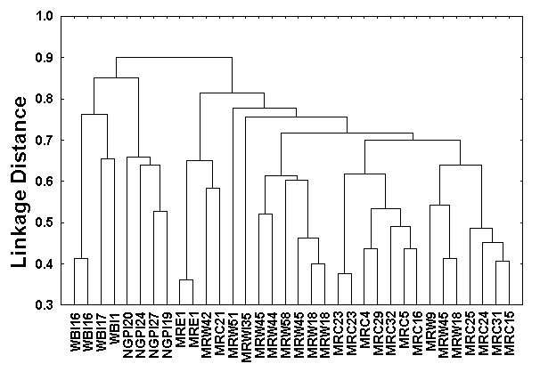
Hiearchical Clustering
Dendogram Interpretation
Branch
Length
Reflects
Cluster
Strength

Slide 17
SigClust
Statistical Significance of Clusters
in HDLSS Data
When is a cluster “really there”?
Liu et al (2007), Huang et al (2014)

Slide 18
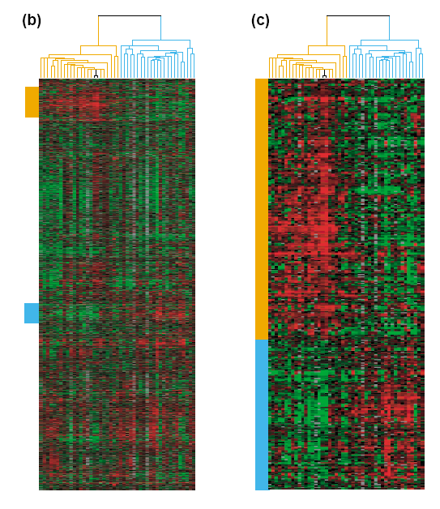
Common Microarray Analytic Approach: Clustering
From: Perou et al (2000)
d = 1161 genes
Zoomed to “relevant”
Gene subsets

Slide 19
Interesting Statistical Problem
For HDLSS data:
When clusters seem to appear
E.g. found by clustering method
How do we know they are really there?
Question asked by Neil Hayes
Define appropriate statistical significance?
Can we calculate it?

Slide 20
First Approaches: Hypo Testing
e.g. Direction, Projection, Permutation
Hypothesis test of:
Significant difference between sub-populations

Slide 21
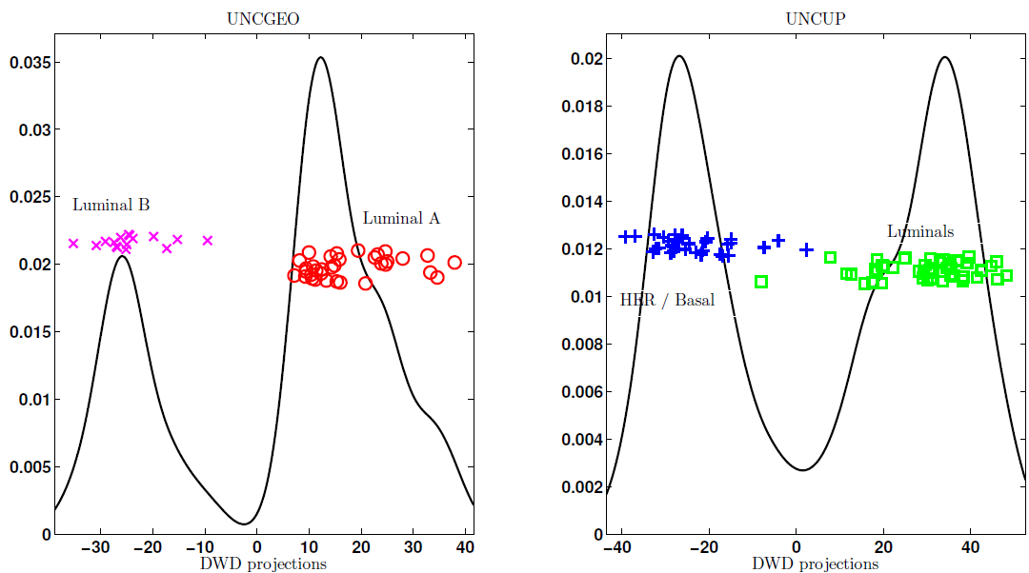
DiProPerm Hypothesis Test
Two
Examples
Which Is
“More
Distinct”?
Visually Better Separation?
Thanks to Katie Hoadley

Slide 22
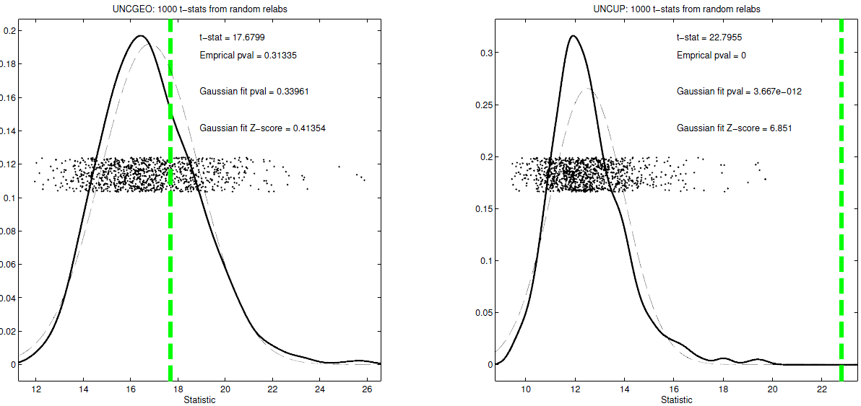
DiProPerm Hypothesis Test
Two
Examples
Which Is
“More
Distinct”?
Stronger Statistical Significance!
Thanks to Katie Hoadley

Slide 23
First Approaches: Hypo Testing
e.g. Direction, Projection, Permutation
Hypothesis test of:
Significant difference between sub-populations
Effective and Accurate
I.e. Sensitive and Specific
There exist several such tests
But critical point is:
What result implies about clusters

Slide 24
Clarifying Simple Example
Why Population Difference Tests cannot indicate clustering
Andrew Nobel Observation
For Gaussian Data (Clearly 1 Cluster!)
Assign Extreme Labels
(e.g. by clustering)
Subpopulations are signif’ly different

Slide 25
Simple Gaussian Example
Clearly only 1 Cluster in this Example
But Extreme Relabelling looks different
Extreme T-stat strongly significant
Indicates 2 clusters in data

Slide 26
Simple Gaussian Example
Results:
Random relabelling T-stat is not significant
But extreme T-stat is strongly significant
This comes from clustering operation
Conclude sub-populations are different
Now see that:
Not the same as clusters really there
Need a new approach to study clusters

Slide 27
Statistical Significance of Clusters
Basis of SigClust Approach:
What defines: A Single Cluster?
A Gaussian distribution (Sarle & Kou 1993)
So define SigClust test based on:
2-means cluster index (measure) as statistic
Gaussian null distribution
Currently compute by simulation
Possible to do this analytically???

Slide 28
SigClust Statistic – 2-Means Cluster Index
Measure of non-Gaussianity:
2-means Cluster Index
Familiar Criterion from k-means Clustering
Within Class Sum of Squared Distances to Class Means
Prefer to divide (normalize) by Overall Sum of Squared Distances to Mean
Puts on scale of proportions

Slide 29
SigClust Statistic – 2-Means Cluster Index
Measure of non-Gaussianity:
2-means Cluster Index:
Class Index Sets Class Means
“Within Class Var’n” / “Total Var’n”

Slide 30
SigClust Gaussian null distribut’n
Which Gaussian (for null)?
Standard (sphered) normal?
No, not realistic
Rejection not strong evidence for clustering
Could also get that from a-spherical Gaussian
Need Gaussian more like data:
Need Full $N_{d}\left(μ,Σ\right)$ model
Challenge: Parameter Estimation
Recall HDLSS Context

Slide 31
SigClust Gaussian null distribut’n
Estimated Mean, $μ$ (of Gaussian dist’n)?
1st Key Idea: Can ignore this
By appealing to shift invariance of CI
When Data are (rigidly) shifted
CI remains the same
So enough to simulate with mean 0
Other uses of invariance ideas?

Slide 32
SigClust Gaussian null distribut’n
Challenge: how to estimate cov. Matrix $Σ$?
Number of parameters: $\frac{d\left(d+1\right)}{2}$
E.g. Perou 500 data:
Dimension $d=9674$
so $\frac{d\left(d+1\right)}{2}=46,797,975$
But Sample Size $n=533$
Impossible in HDLSS settings????
Way around this problem?

Slide 33
SigClust Gaussian null distribut’n
2nd Key Idea: Mod Out Rotations
Replace full Cov. by diagonal matrix
As done in PCA eigen-analysis
$$Σ=MDM^{t}$$
But then “not like data”???
OK, since k-means clustering (i.e. CI) is
rotation invariant
(assuming e.g. Euclidean Distance)

Slide 34
SigClust Gaussian null distribut’n
2nd Key Idea: Mod Out Rotations
Only need to estimate diagonal matrix
But still have HDLSS problems?
E.g. Perou 500 data:
Dimension $d=9674$
Sample Size $n=533$
Still need to estimate $d=9674$ param’s

Slide 35
SigClust Gaussian null distribut’n
3rd Key Idea: Factor Analysis Model
Model Covariance as: Biology + Noise
$$Σ=Σ_{B}+{σ_{N}}^{2}×I$$
Where
$Σ_{B}$ is “fairly low dimensional”
${σ_{N}}^{2}$ is estimated from background noise

Slide 36
SigClust Gaussian null distribut’n
Estimation of Background Noise ${σ_{N}}^{2}$:
Reasonable model (for each gene):
Expression = Signal + Noise
“noise” is roughly Gaussian
“noise” terms essentially independent
(across genes)

Slide 37
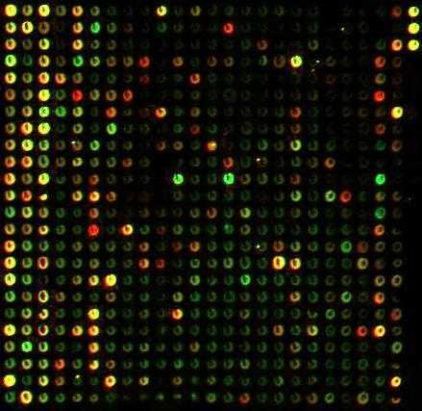
SigClust Gaussian null distribut’n
Estimation of Background Noise ${σ_{N}}^{2}$:
Model OK, since
data come from
light intensities
at colored spots

Slide 38
SigClust Gaussian null distribut’n
Estimation of Background Noise ${σ_{N}}^{2}$:
For all expression values (as numbers)
(Each Entry of $d×n$ Data matrix)

Slide 39
SigClust Gaussian null distribut’n
Estimation of Background Noise ${σ_{N}}^{2}$:
For all expression values (as numbers)
Use robust estimate of scale
Median Absolute Deviation (MAD)
(from the median)
$${median}_{i}\left|X_{i}−{median}_{i}\left(X_{i}\right)\right|$$

Slide 40
SigClust Gaussian null distribut’n
Estimation of Background Noise ${σ_{N}}^{2}$:
For all expression values (as numbers)
Use robust estimate of scale
Median Absolute Deviation (MAD)
(from the median)
Rescale to put on same scale as s. d.:
$$\hat{σ}=\frac{{MAD}_{data}}{{MAD}_{N\left(0,1\right)}}$$

Slide 41
SigClust Estimation of Background Noise
n = 533, d = 9456

Slide 42
SigClust Estimation of Background Noise
Hope: Most
Entries are
“Pure Noise,
(Gaussian)”

Slide 43
SigClust Estimation of Background Noise
Hope: Most
Entries are
“Pure Noise,
(Gaussian)”
A Few (<< ¼)
Are Biological
Signal –
Outliers

Slide 44
SigClust Estimation of Background Noise
Hope: Most
Entries are
“Pure Noise,
(Gaussian)”
A Few (<< ¼)
Are Biological
Signal –
Outliers
How to Check?

Slide 45
Q-Q plots
An aside:
Fitting probability distributions to data
Does Gaussian distribution “fit”???
If not, why not?
Fit in some part of the distribution?
(e.g. in the middle only?)

Slide 46
Q-Q plots
Approaches to:
Fitting probability distributions to data
Histograms
Kernel Density Estimates
Drawbacks: often not best view
(for determining goodness of fit)

Slide 47
Q-Q plots
Consider Testbed of 4 Toy Examples:
non-Gaussian!
non-Gaussian(?)
Gaussian
Gaussian?
(Will use these names several times)

Slide 48
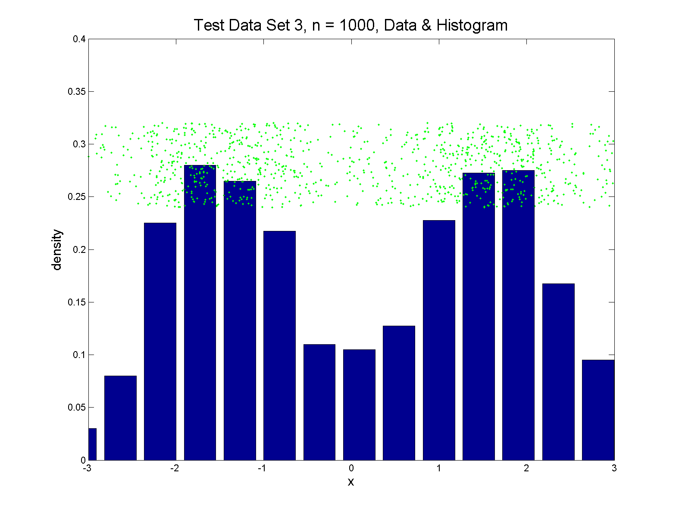
Q-Q plots
Simple Toy Example, non-Gaussian!

Slide 49
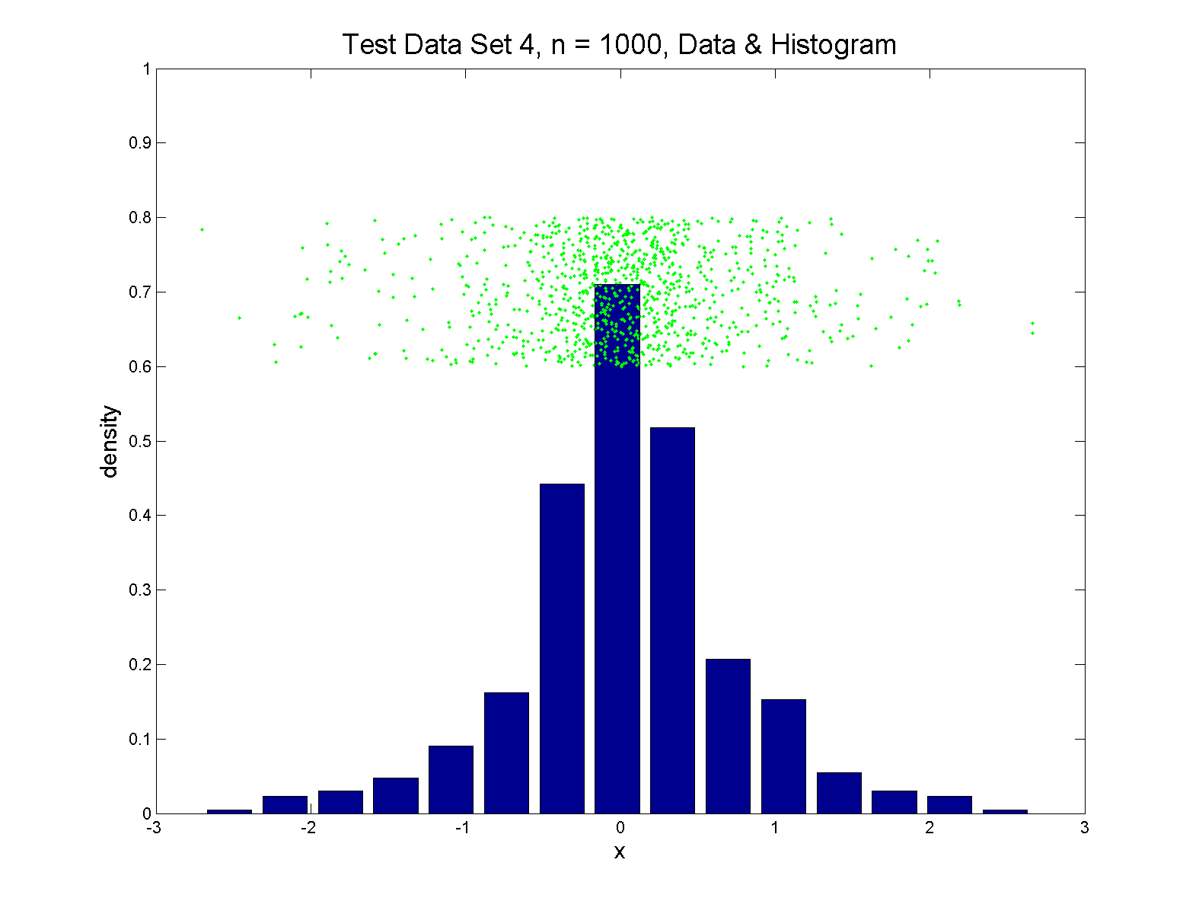
Q-Q plots
Simple Toy Example, non-Gaussian(?)

Slide 50
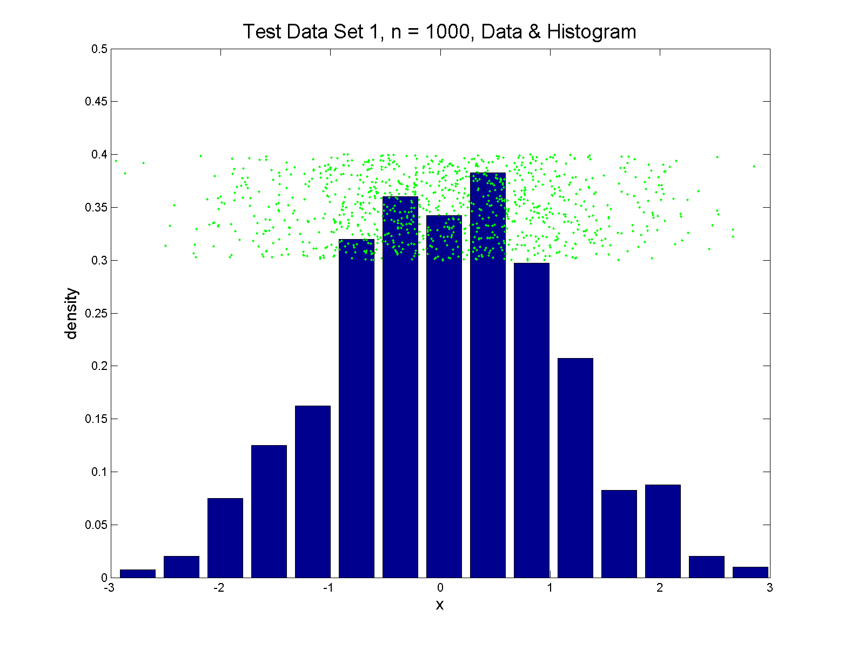
Q-Q plots
Simple Toy Example, Gaussian

Slide 51
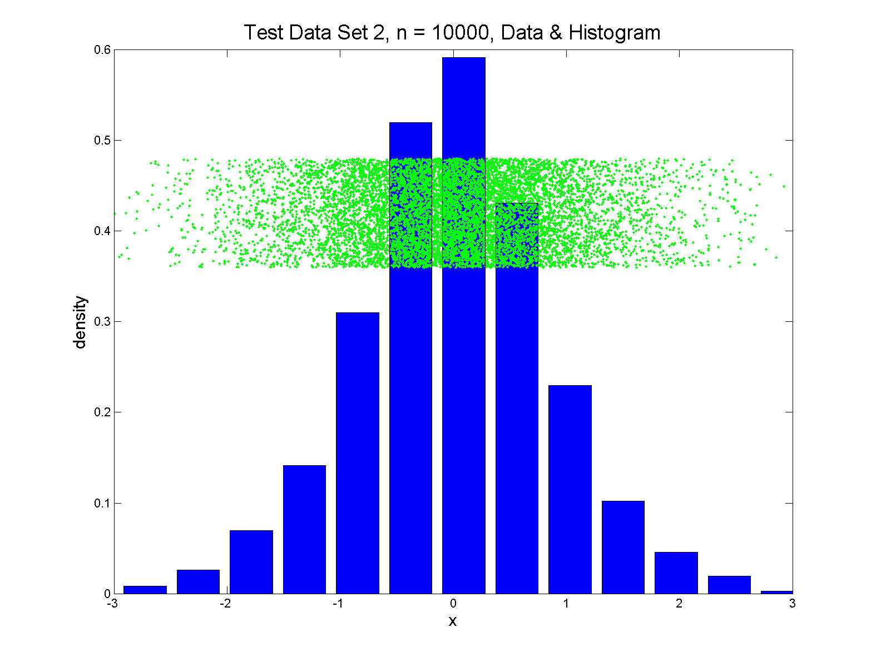
Q-Q plots
Simple Toy Example, Gaussian?

Slide 52
Q-Q plots
Notes:
Bimodal → see non-Gaussian with histo
Other cases: hard to see
Conclude:
Histogram poor at assessing Gauss’ity

Slide 53
Q-Q plots
Standard approach to checking Gaussianity
QQ – plots
Background:
Graphical Goodness of Fit
Fisher (1983)

Slide 54
Q-Q plots
Background: Graphical Goodness of Fit
Basis:
Cumulative Distribution Function (CDF)
$$F\left(x\right)=P\left\{X≤x\right\}$$
Probability quantile notation:
for "probability” $p$ and "quantile" $q$
$p=F\left(q\right)$ $q=F^{−1}\left(p\right)$

Slide 55
Q-Q plots
Probability quantile notation:
for "probability” $p$ and "quantile" $q$
$p=F\left(q\right)$ $q=F^{−1}\left(p\right)$
Thus $F^{−1}$ is called the quantile function

Slide 56
Q-Q plots
Two types of CDF:
Theoretical
$$p=F\left(q\right)=P\left\{X≤q\right\}$$
Empirical, based on data $X_{1},⋯,X_{n}$
$$\hat{p}=\hat{F}\left(q\right)=\frac{\#\left\{i:X_{i}≤q\right\}}{n}$$

Slide 57
Q-Q plots
Direct Visualizations:
Empirical CDF plot:
plot $\hat{p}=\frac{i}{n}, i=1,⋯,n$
vs. grid of $\hat{q}$ (sorted data) values
Quantile plot (inverse):
plot $\hat{q}$
vs. $\hat{p}$

Slide 58
Q-Q plots
Comparison Visualizations:
(compare a theoretical with an empirical)
P-P plot:
plot $\hat{p}$ vs. $p$
for a grid of $q$ values
Q-Q plot:
plot $\hat{q}$ vs. $q$
for a grid of $p$ values

Slide 59
Q-Q plots
Illustrative graphic (toy data set):
From $N\left(0,1\right)$ Distribution

Slide 60
Q-Q plots
Illustrative graphic (toy data set):
Generated $n=5$ data points

Slide 61
Q-Q plots
Illustrative graphic (toy data set):
So Consider
$$p_{5}$$
$$p_{4}$$
$$p_{3}$$
$$p_{2}$$
$$p_{1}$$

Slide 62
Q-Q plots
Empirical Quantiles (sorted data points)

Slide 63
Q-Q plots
Corresponding ( matched) Theoretical Quantiles

Slide 64
Q-Q plots
Illustrative graphic (toy data set):
Main goal of Q-Q Plot:
Display how well quantiles compare
${\hat{q}}_{i}$ vs. $q_{i}$ for $i=1,⋯,n$

Slide 65
Q-Q plots
Illustrative graphic (toy data set):

Slide 66
Q-Q plots
Illustrative graphic (toy data set):

Slide 67
Q-Q plots
Illustrative graphic (toy data set):

Slide 68
Q-Q plots
Illustrative graphic (toy data set):

Slide 69
Q-Q plots
Illustrative graphic (toy data set):

Slide 70
Q-Q plots
Illustrative graphic (toy data set):
Empirical Qs near Theoretical Qs
when
Q-Q curve is near 45⁰ line
(general use of Q-Q plots)

Slide 71
Alternate Terminology
Q-Q Plots = ROC Curves
Recall “Receiver Operator Characteristic”
Applied to
Empirical Distribution
vs.
Theoretical Distribution

Slide 72
Alternate Terminology
Q-Q Plots = ROC Curves
Recall “Receiver Operator Characteristic”
But Different Goals:
Q-Q Plots: Look for “Equality”
ROC curves: Look for “Differences”

Slide 73
Alternate Terminology
Q-Q Plots = ROC Curves
P-P Plot = Curve that Highlights Different Distributional Aspects
Statistical Folklore: Q-Q Highlights Tails,
So Usually More Useful

Slide 74
Alternate Terminology
Q-Q Plots = ROC Curves
Related Measures:
Precision & Recall

Slide 75
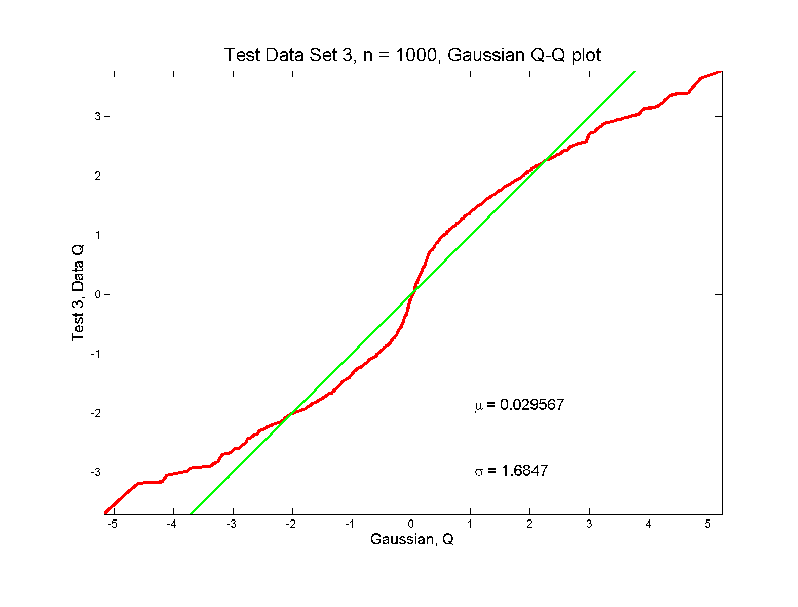
Q-Q plots
non-Gaussian! departures from line?

Slide 76
Q-Q plots
non-Gaussian! departures from line?
Seems different from line?
2 modes turn into wiggles?
Less strong feature
Been proposed to study modality

Slide 77
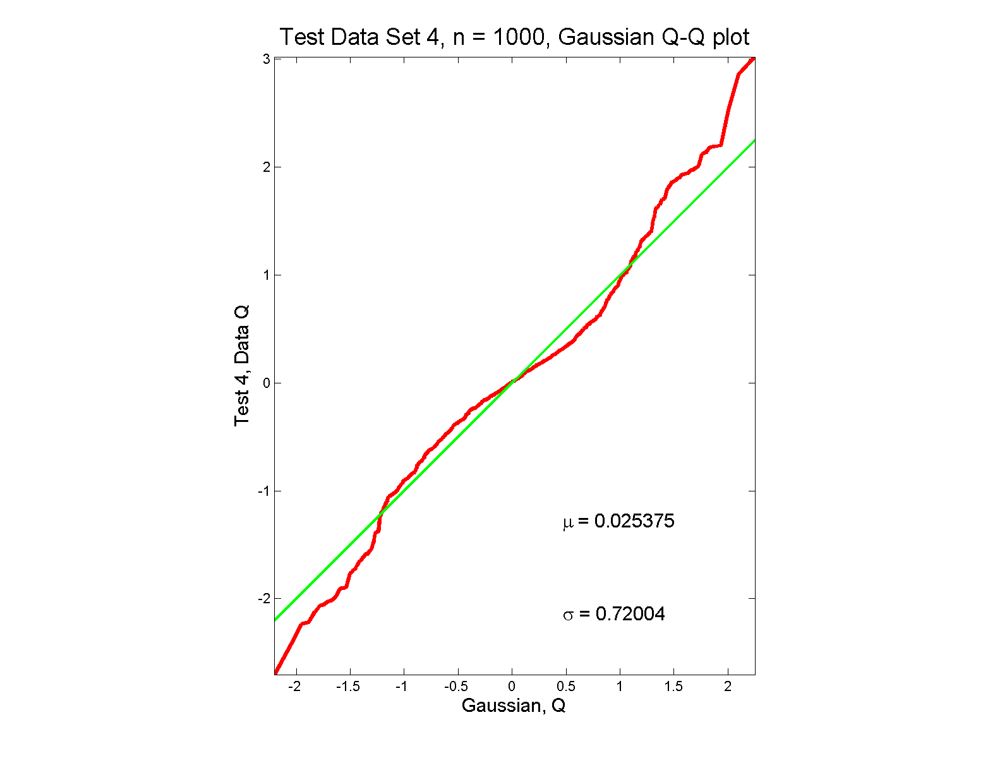
Q-Q plots
non-Gaussian (?) departures from line?

Slide 78
Q-Q plots
non-Gaussian (?) departures from line?
Seems different from line?
Harder to say this time?
What is signal & what is noise?
Need to understand sampling variation

Slide 79
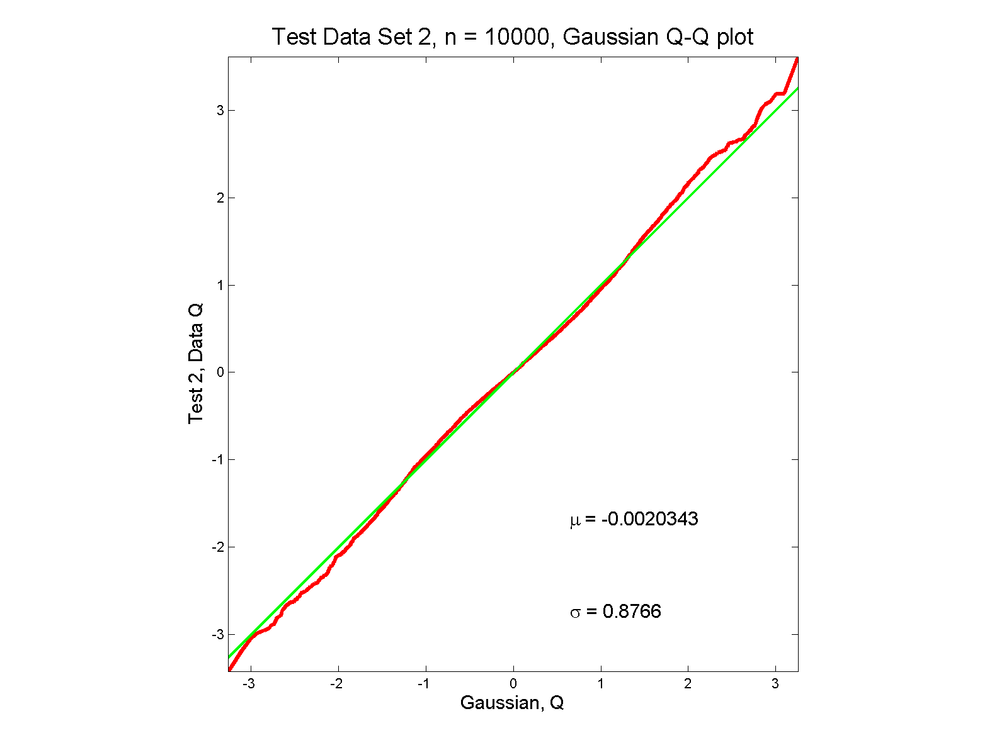
Q-Q plots
Gaussian? departures from line?

Slide 80
Q-Q plots
Gaussian? departures from line?
Looks much like?
Wiggles all random variation?
But there are n = 10,000 data points…
How to assess signal & noise?
Need to understand sampling variation

Slide 81
Q-Q plots
Need to understand sampling variation
Approach: Q-Q envelope plot
Simulate from Theoretical Dist’n
Samples of same size
About 100 samples gives
“good visual impression”
Overlay resulting 100 QQ-curves
To visually convey natural sampling variation

Slide 82
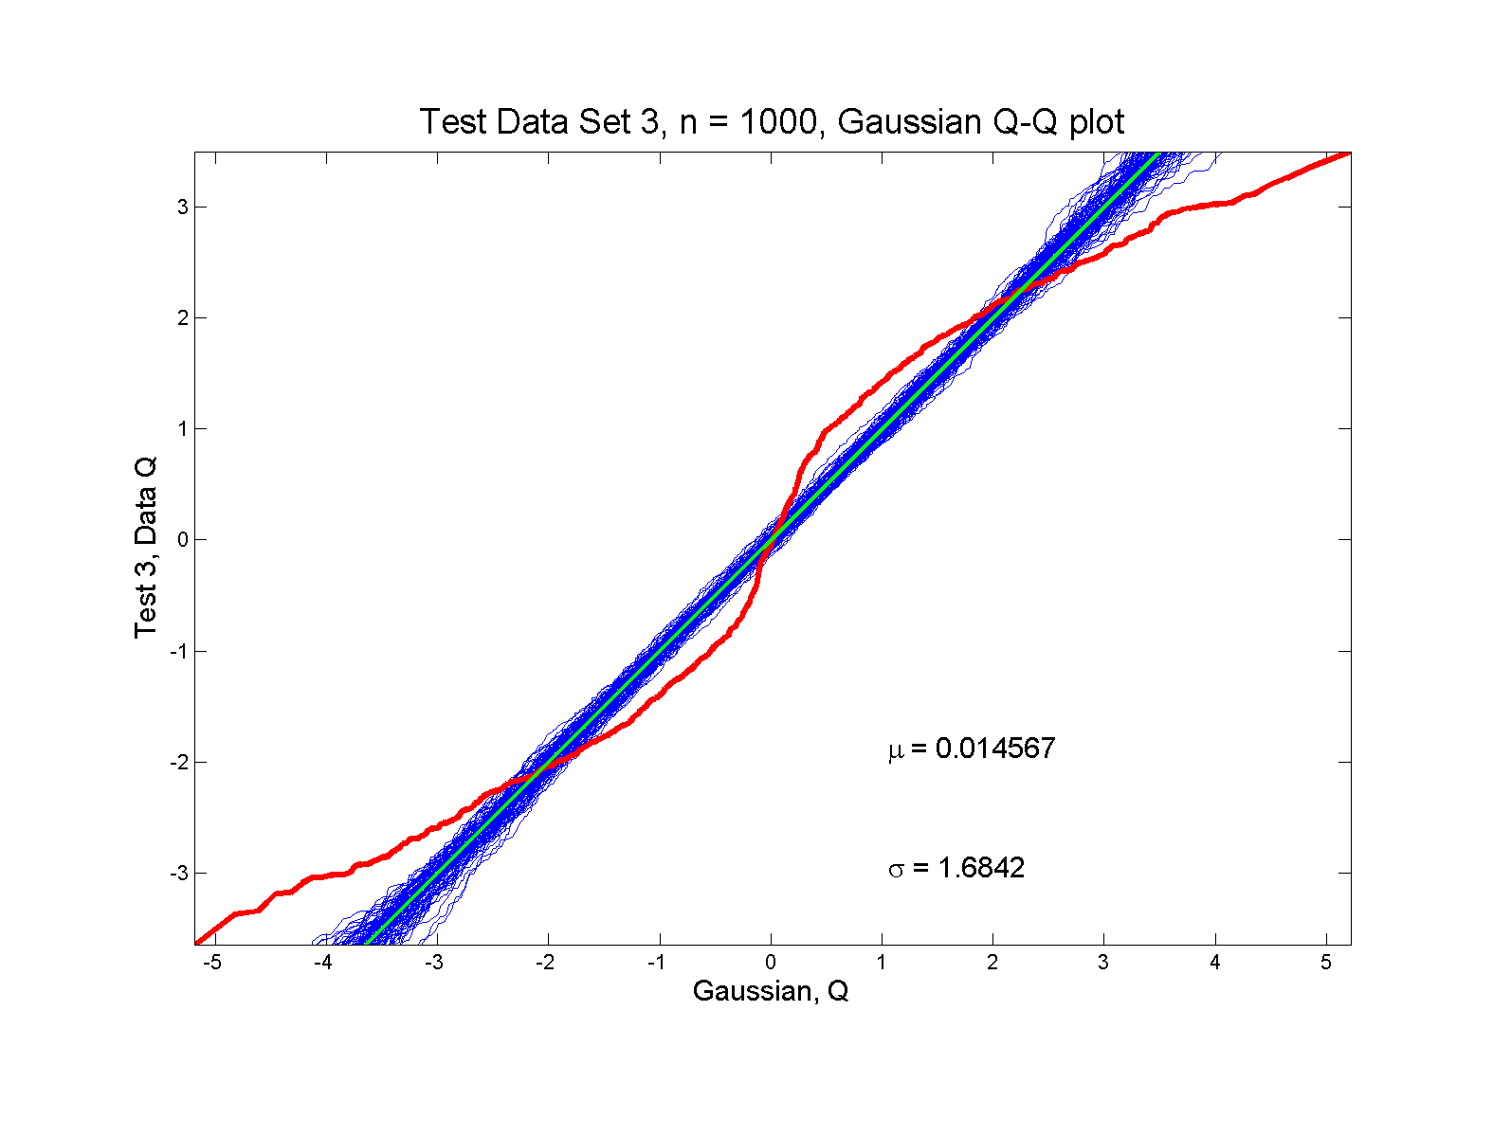
Q-Q plots
non-Gaussian! departures from line?

Slide 83
Q-Q plots
non-Gaussian! departures from line?
Envelope Plot shows:
Departures are significant
Clear these data are not Gaussian
Q-Q plot gives clear indication

Slide 84
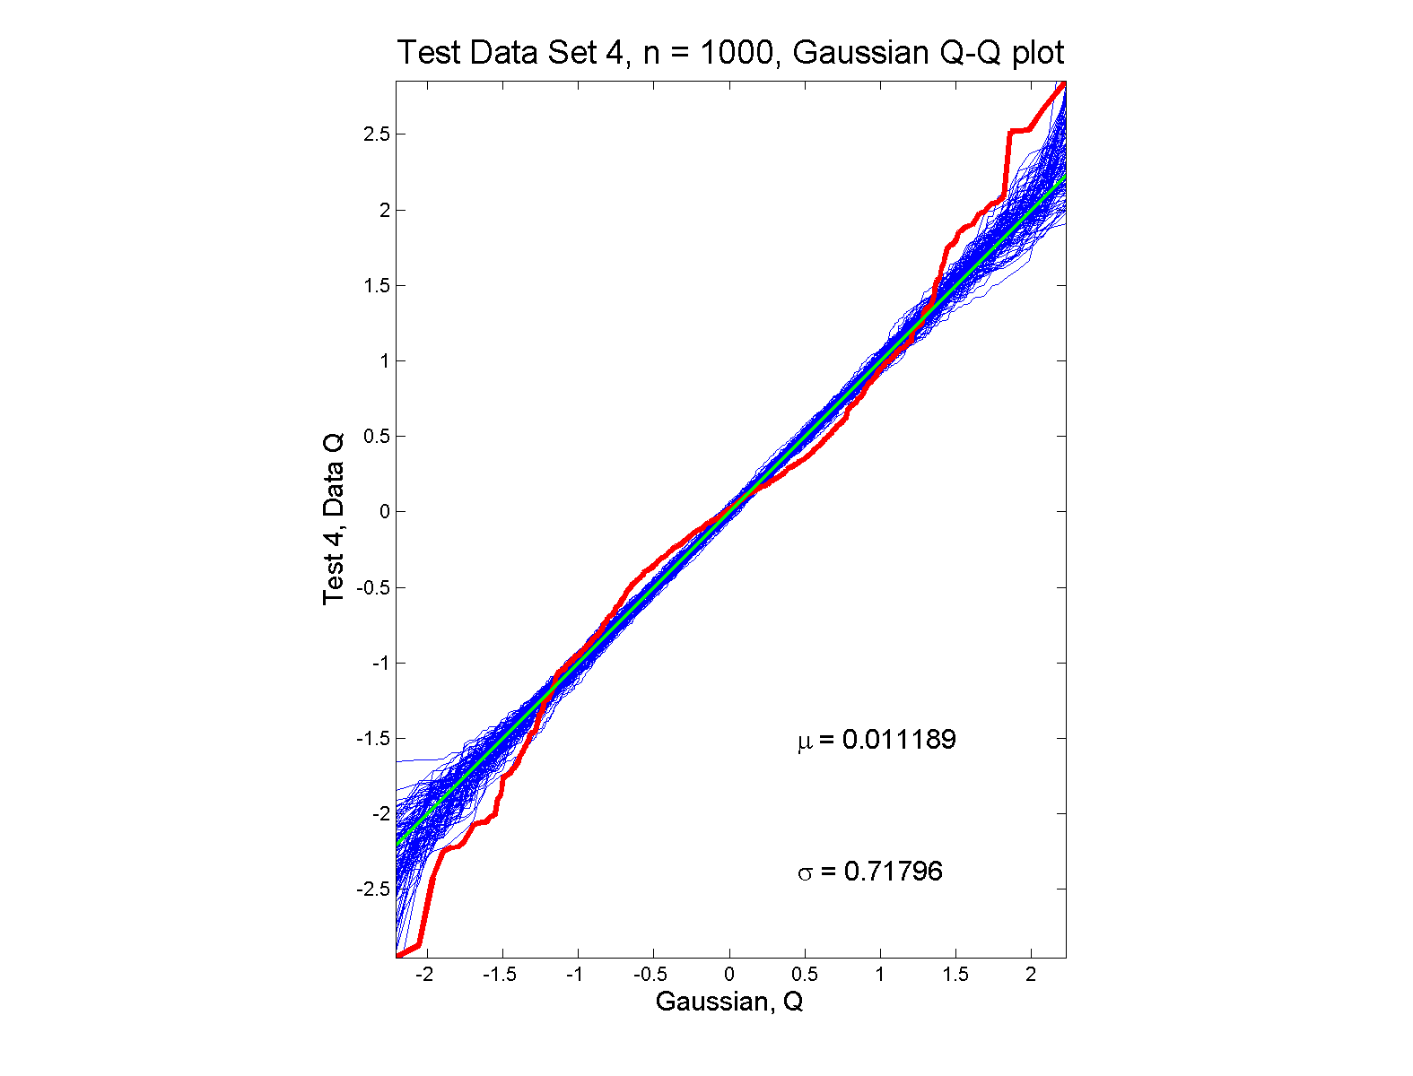
Q-Q plots
non-Gaussian (?) departures from line?

Slide 85
Q-Q plots
non-Gaussian (?) departures from line?
Envelope Plot shows:
Departures are significant
Clear these data are not Gaussian
Recall not so clear from e.g. histogram
Q-Q plot gives clear indication
Envelope plot reflects sampling variation

Slide 86
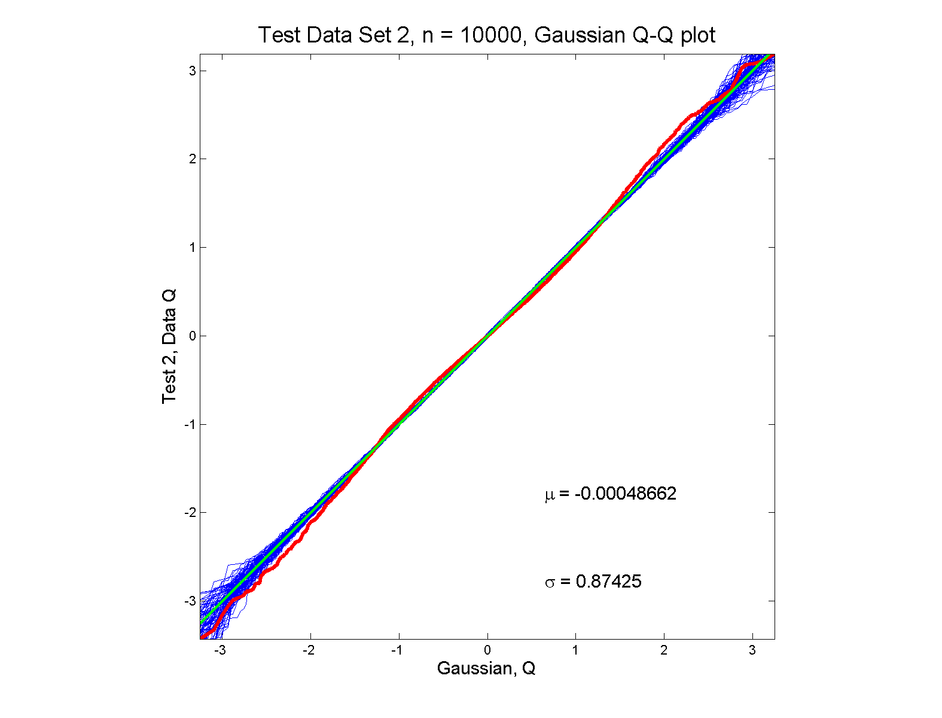
Q-Q plots
Gaussian? departures from line?

Slide 87
Q-Q plots
Gaussian? departures from line?
Harder to see
But clearly there
Conclude non-Gaussian
Really needed n = 10,000 data points…
(why bigger sample size was used)
Envelope plot reflects sampling variation

Slide 88
Q-Q plots
What were these distributions?
Non-Gaussian!
0.5 N(-1.5,0.75²) + 0.5 N(1.5,0.75²)
Non-Gaussian (?)
0.4 N(0,1) + 0.3 N(0,0.5²) + 0.3 N(0,0.25²)
Gaussian
Gaussian?
0.7 N(0,1) + 0.3 N(0,0.5²)

Slide 89
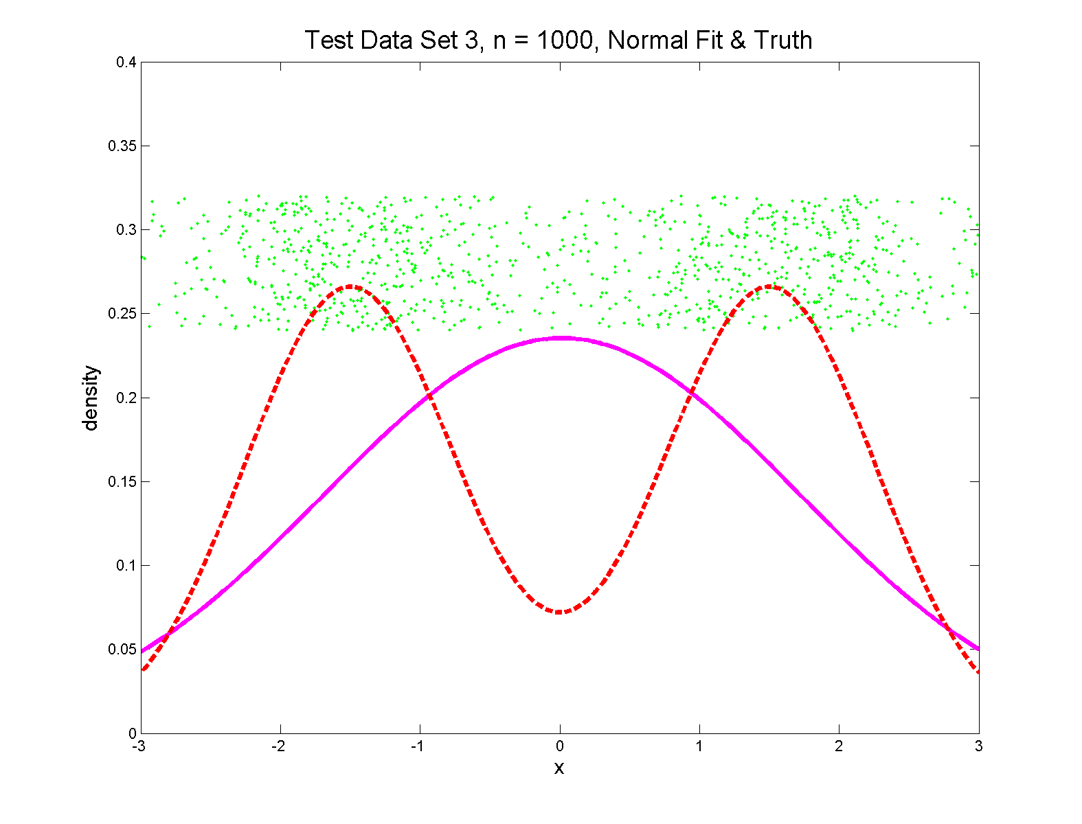
Q-Q plots
Non-Gaussian! .5 N(-1.5,0.75²) + 0.5 N(1.5,0.75²)

Slide 90
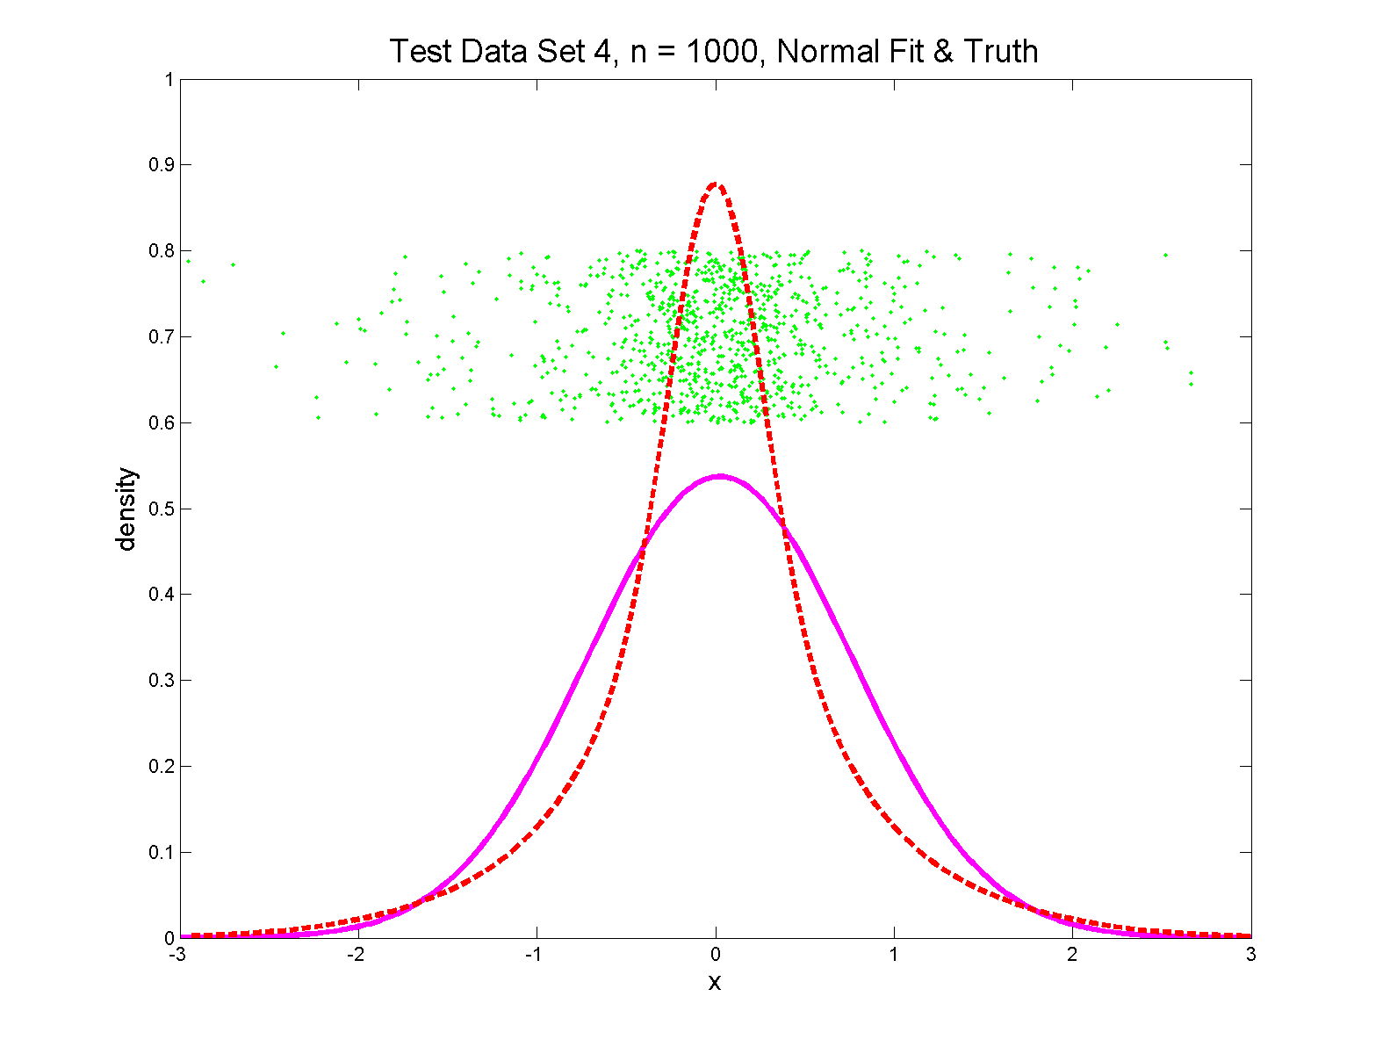
Q-Q plots
Non-Gaussian (?) 0.4 N(0,1) + 0.3 N(0,0.5²) + 0.3 N(0,0.25²)

Slide 91
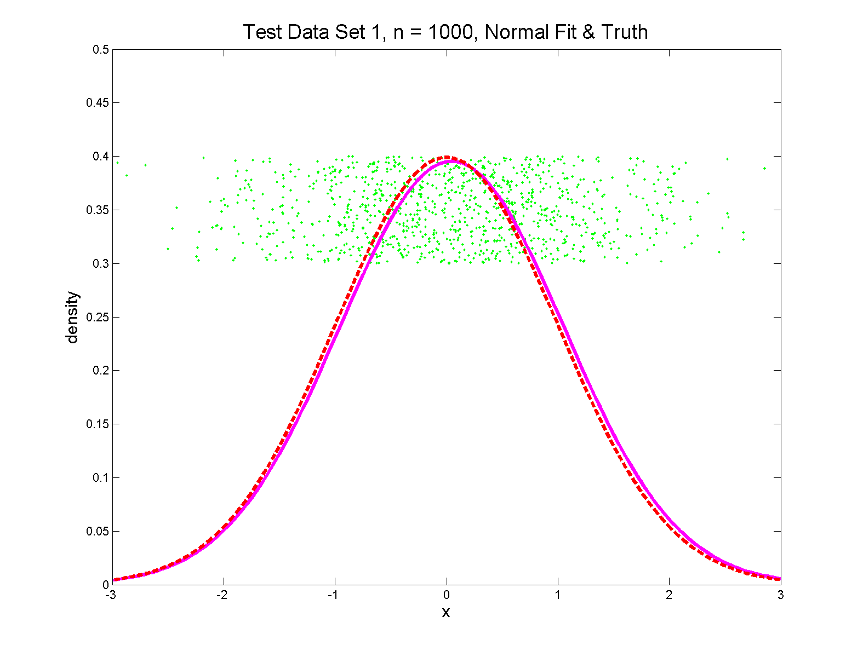
Q-Q plots
Gaussian

Slide 92
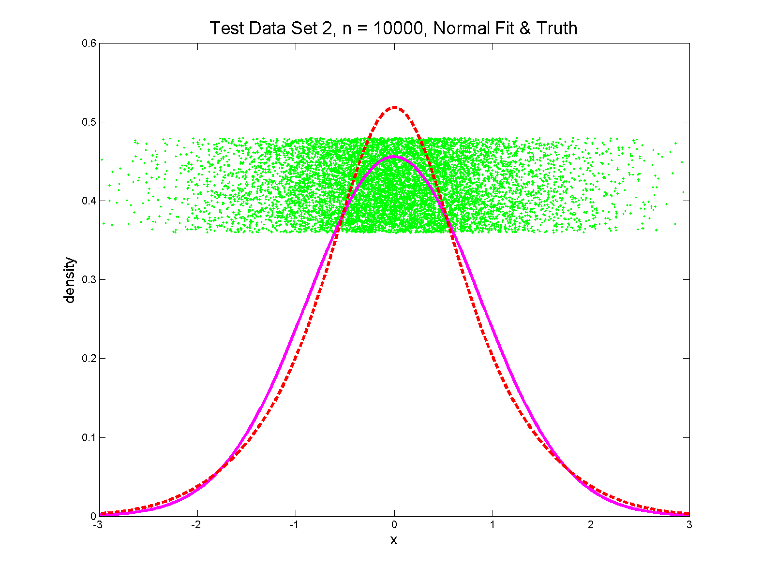
Q-Q plots
Gaussian? 0.7 N(0,1) + 0.3 N(0,0.5²)

Slide 93
Q-Q plots
Variations on Q-Q Plots:
For $N\left(μ,σ^{2}\right)$ theoretical distribution:
$$p=P\left\{X≤q\right\}=Φ\left(\frac{q−μ}{σ}\right)$$
Solving for $q$ gives
$$q=μ+σΦ^{−1}\left(p\right)=μ+σz$$
Where $z$ is the Standard Normal Quantile

Slide 94
Q-Q plots
Variations on Q-Q Plots:
Solving for $q$ gives
$$q=μ+σΦ^{−1}\left(p\right)=μ+σz$$
So Q-Q plot against Standard Normal
is linear
With slope $σ$ and intercept $μ$

Slide 95
Q-Q plots
Variations on Q-Q Plots:
Can replace Gaussian with other dist’ns
Can compare 2 theoretical distn’s
Can compare 2 empirical distn’s
(i.e. 2 sample version of Q-Q Plot)
( = ROC curve)

Slide 96
SigClust Estimation of Background Noise
n = 533, d = 9456

Slide 97
SigClust Estimation of Background Noise
Overall distribution has strong kurtosis
Shown by height of kde relative to
MAD based Gaussian fit
Mean and Median both ~ 0
SD ~ 1, driven by few large values
MAD ~ 0.7, driven by bulk of data

Slide 98
SigClust Estimation of Background Noise
Central part of distribution
“seems to look Gaussian”
But recall density does not provide
great diagnosis of Gaussianity
Better to look at Q-Q plot

Slide 99
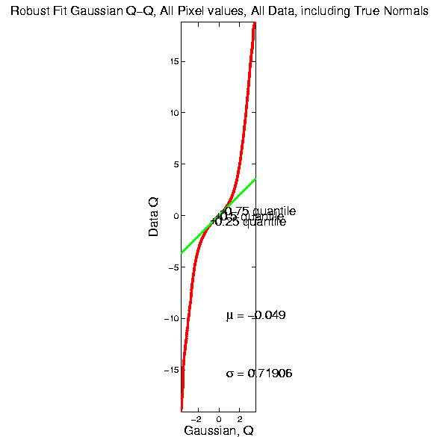
SigClust Estimation of Background Noise

Slide 100
SigClust Estimation of Background Noise
Distribution clearly not Gaussian
Except near the middle
Q-Q curve is very linear there
(closely follows 45º line)
Suggests Gaussian approx. is good there
And that MAD scale estimate is good
(Always a good idea to do such diagnostics)

Slide 101
SigClust Estimation of Background Noise
Now Check Effect of
Using SD, not MAD

Slide 102
SigClust Estimation of Background Noise
Checks that estimation of $σ$ matters
Show sample s.d. is indeed too large
As expected
Variation assessed by Q-Q envelope plot
Shows variation not negligible
Not surprising with n ~ 5 million

Slide 103
SigClust Gaussian null distribut’n
Estimation of Biological Covariance $Σ_{B}$:
Keep only “large” eigenvalues $λ_{1},λ_{2},⋯,λ_{d}$
Defined as $>{σ_{N}}^{2}$
So for null distribution, use eigenvalues:
$$\max_{}\left(λ_{1},{σ_{N}}^{2}\right),⋯,\max_{}\left(λ_{d},{σ_{N}}^{2}\right)$$

Slide 104
SigClust Estimation of Eigenval’s

Slide 105
SigClust Estimation of Eigenval’s
All eigenvalues $>{σ_{N}}^{2}$!
Suggests biology is very strong here!
I.e. very strong signal to noise ratio
Have more structure than can analyze
(with only 533 data points)
Data are very far from pure noise
So don’t actually use Factor Anal. Model
Instead end up with estim’d eigenvalues

Slide 106
SigClust Estimation of Eigenval’s
Do we need the factor model?
Explore this with another data set
(with fewer genes)
This time:
n = 315 cases
d = 306 genes

Slide 107
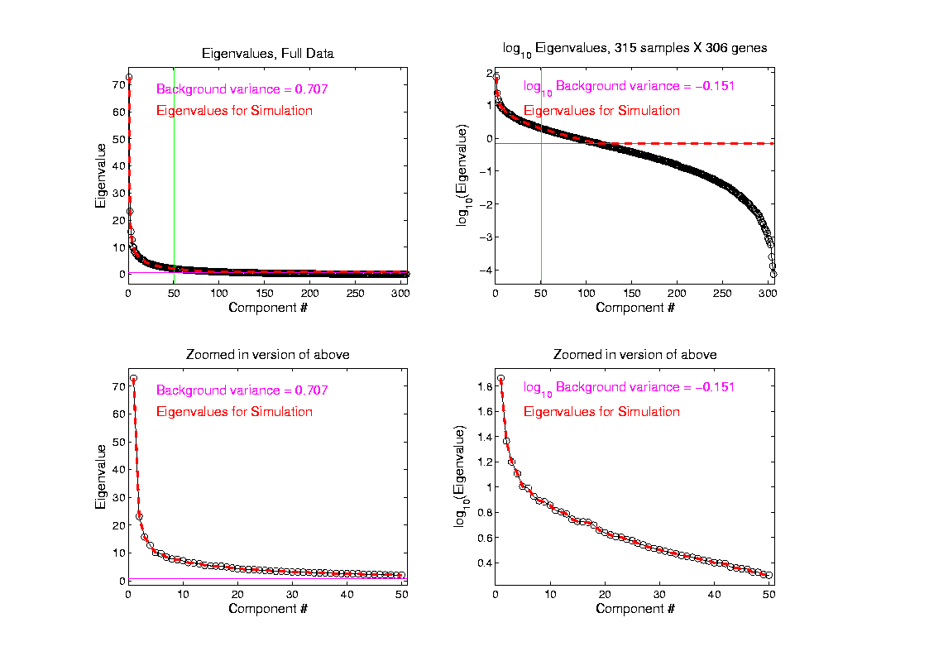
SigClust Estimation of Eigenval’s

Slide 108
SigClust Estimation of Eigenval’s
Try another data set, with fewer genes
This time:
First ~110 eigenvalues $>{σ_{N}}^{2}$
Rest are negligible
So threshold smaller ones at ${σ_{N}}^{2}$

Slide 109
SigClust Gaussian null distribution - Simulation
Now simulate from null distribution using:
$\left(\begin{matrix}X_{1,i} \\ ⋮ \\ X_{d,i}\end{matrix}\right)$ where $X_{j,i} \sim N\left(0,λ_{j}\right)$ (indep.)
Again rotation invariance makes this work
(and location invariance)

Slide 110
SigClust Gaussian null distribution - Simulation
Then compare data CI,
With simulated null population CIs
Spirit similar to DiProPerm
But now significance happens for
smaller values of CI

Slide 111
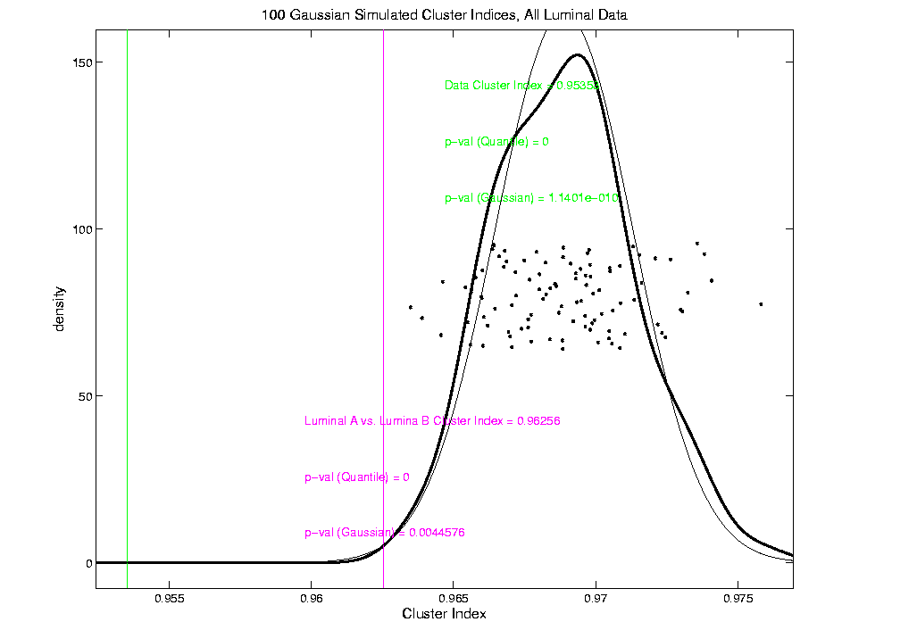
An example (details to follow)
P-val = 0.0045

Slide 112
SigClust Modalities
Two major applications:
Test significance of given clusterings
(e.g. for those found in heat map)
(Use given class labels)
Test if known cluster can be further split
(Use 2-means class labels)

Slide 113
SigClust Real Data Results
Analyze Perou 500 breast cancer data
(large cross study combined data set)
Current folklore: 5 classes
Luminal A
Luminal B
Normal
Her 2
Basal

Slide 114
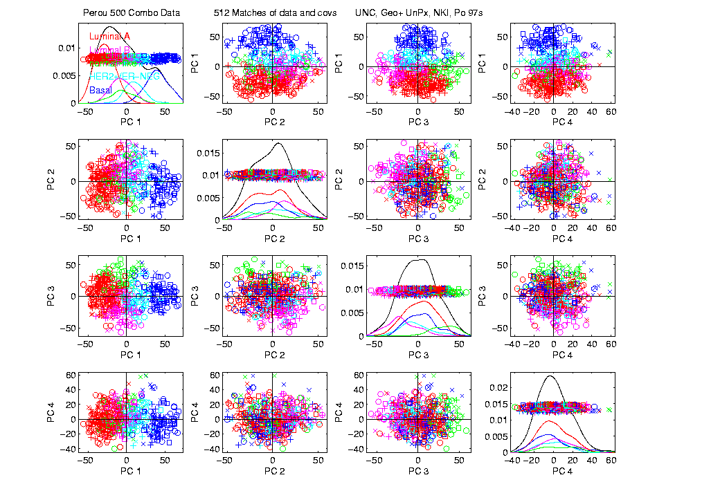
Perou 500 PCA View – real clusters???

Slide 115
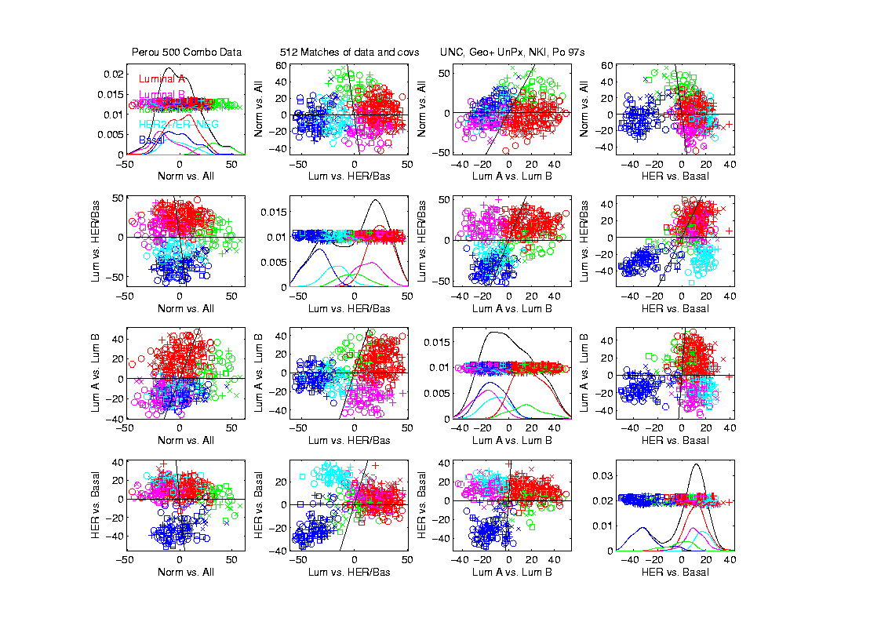
Perou 500 DWD Dir’ns View – real clusters???

Slide 116
Perou 500 – Fundamental Question
Are Luminal A &
Luminal B really
distinct clusters?
Famous for
Far Different
Survivability

Slide 117
SigClust Results for Luminal A vs. Luminal B
P-val = 0.0045

Slide 118
SigClust Results for Luminal A vs. Luminal B
Get p-values from:
Empirical Quantile
From simulated sample CIs
Fit Gaussian Quantile
Don’t “believe these”
But useful for comparison
Especially when Empirical Quantile = 0
Note: Currently Replaced by “Z-Scores”

Slide 119
SigClust Results for Luminal A vs. Luminal B
Test significance of given clusterings
Empirical p-val = 0
Definitely 2 clusters
Gaussian fit p-val = 0.0045
same strong evidence
Conclude these really are two clusters

Slide 120
SigClust Results for Luminal A vs. Luminal B
Test if known cluster can be further split
Empirical p-val = 0
definitely 2 clusters
Gaussian fit p-val = 10⁻¹⁰
Stronger evidence than above
Such comparison is value of Gaussian fit
Makes sense (since CI is min possible)
Conclude these really are two clusters

Slide 121
SigClust Real Data Results
Summary of Perou 500 SigClust Results:
Lum & Norm vs. Her2 & Basal, p-val = 10⁻¹⁹
Luminal A vs. B, p-val = 0.0045
Her 2 vs. Basal, p-val = 10⁻¹⁰
Split Luminal A, p-val = 10⁻⁷
Split Luminal B, p-val = 0.058
Split Her 2, p-val = 0.10
Split Basal, p-val = 0.005

Slide 122
SigClust Real Data Results
Summary of Perou 500 SigClust Results:
All previous splits were real
Most not able to split further
Exception is Basal, already known
Chuck Perou has good intuition!
(insight about signal vs. noise)
How good are others???

Slide 123
SigClust Real Data Results
Experience with Other Data Sets: Similar
Smaller data sets: less power
Gene filtering: more power
Lung Cancer: more distinct clusters

Slide 124
SigClust Real Data Results
Some Personal Observations
Experienced Analysts Impressively Good
SigClust can save them time
SigClust can help them with skeptics
SigClust essential for non-experts

Slide 125
SigClust Overview
Works Well When Factor Part Not Used

Slide 126
SigClust Overview
Works Well When Factor Part Not Used
Sample Eigenvalues Always Valid
But Can be Too Conservative

Slide 127
SigClust Overview
Works Well When Factor Part Not Used
Sample Eigenvalues Always Valid
But Can be Too Conservative
Above Factor Threshold Anti-Conservative

Slide 128
SigClust Overview
Works Well When Factor Part Not Used
Sample Eigenvalues Always Valid
But Can be Too Conservative
Above Factor Threshold Anti-Conservative
Problem Fixed by Soft Thresholding
(Huang et al, 2014)

Slide 129
SigClust Open Problems
Improved Eigenvalue Estimation
(Random Matrix Theory)
More attention to Local Minima in 2-means Clustering
Theoretical Null Distributions
Inference for k > 2 means Clustering
Multiple Comparison Issues

Slide 130
Big Picture
Object Oriented Data Analysis
Have done detailed study of Data Objects
In Euclidean Space, $ℝ^{d}$
Next: OODA in Non-Euclidean Spaces

Slide 131
Shapes As Data Objects
Several Different Notions of Shape
Oldest and Best Known (in Statistics):
Landmark Based

Slide 132
Shapes As Data Objects
Landmark Based Shape Analysis:
Kendall (et al 1999)
Bookstein (1991)
Dryden & Mardia (1998, revision coming)
(Note: these are summarizing
Monographs, $∃$ many papers)

Slide 133
Shapes As Data Objects
Landmark Based Shape Analysis:
Kendall (et al 1999)
Bookstein (1991)
Dryden & Mardia (1998, revision coming)
Recommended as Most Accessible

Slide 134
Landmark Based Shape Analysis
Start by Representing Shapes

Slide 135
Landmark Based Shape Analysis
Start by Representing Shapes by
Landmarks (points in R² or R³)
$$\left(x_{1},y_{1}\right)$$
$$\left(x_{2},y_{2}\right)$$
$$\left(x_{3},y_{3}\right)$$

Slide 136
Landmark Based Shape Analysis
Start by Representing Shapes by
Landmarks (points in R² or R³)
$$\left(x_{1},y_{1}\right)$$
$$\left(x_{2},y_{2}\right)$$
$$\left(x_{3},y_{3}\right)$$

Slide 137
Landmark Based Shape Analysis
Clearly different shapes:

Slide 138
Landmark Based Shape Analysis
Clearly different shapes:
But what about: ?

Slide 139
Landmark Based Shape Analysis
Clearly different shapes:
But what about: ?
(just translation and rotation of,
but different points in R⁶)

Slide 140
Landmark Based Shape Analysis
Note: Shape should be same over different:
Translations

Slide 141
Landmark Based Shape Analysis
Note: Shape should be same over different:
Translations
Rotations

Slide 142
Landmark Based Shape Analysis
Note: Shape should be same over different:
Translations
Rotations
Scalings

Slide 143
Landmark Based Shape Analysis
Approach: Identify objects that are:
Translations
Rotations
Scalings
of each other

Slide 144
Landmark Based Shape Analysis
Approach: Identify objects that are:
Translations
Rotations
Scalings
of each other
Mathematics: Equivalence Relation

Slide 145
Equivalence Relations
Useful Mathematical Device
Weaker generalization of “=“ for a set
Main consequence:
Partitions Set Into Equivalence Classes
For “=“, Equivalence Classes Are Singletons

Slide 146
Equivalence Relations
Common Example: Modulo Arithmetic
(E.g. Clock Arithmetic, mod 12)
3 hours after 11:00 is 2:00 …

Slide 147
Equivalence Relations
Common Example: Modulo Arithmetic
(E.g. Clock Arithmetic, mod 12)
For $a, b, c ∈ ℤ$, Say $a≡b (mod c)$
When $\left(b −a\right)$ is divisible by $c$
E.g. Binary Arithmetic, mod $2$
Equivalence classes: $\left\{0\right\}$, $\left\{1\right\}$
(just evens and odds)

Slide 148
Equivalence Relations
Another Example: Vector Subspaces
E.g. Say $\left(\begin{matrix}x_{1} \\ y_{1}\end{matrix}\right)≈\left(\begin{matrix}x_{2} \\ y_{2}\end{matrix}\right)$ when $y_{1}=y_{2}$
Equiv. Classes are indexed by $y∈ℝ^{1},$
And are: $\left\{y\right\}=\left\{\left(\begin{matrix}x \\ y\end{matrix}\right)∈ℝ^{2}:x∈ℝ^{1}\right\}$
i.e. Horizontal lines (same $y$ coordinate)

Slide 149
Equivalence Relations
Deeper Example: Transformation Groups
For $g∈G$, operating on a set $S$
Say $s_{1}≈s_{2}$ when $∃$ $g$ where $g\left(s_{1}\right)=s_{2}$
Equivalence Classes:
$$\left\{s_{i}\right\}=\left\{s_{j}∈S:s_{j}=g\left(s_{i}\right), for some g∈G\right\}$$
Terminology: Also called orbits

Slide 150
Equivalence Relations
Deeper Example: Group Transformations
Above Examples Are Special Cases
Modulo Arithmetic
$$G= \left\{g:ℤ→ℤ :g\left(z\right)=z+kc, for k∈ℤ\right\}$$

Slide 151
Equivalence Relations
Deeper Example: Group Transformations
Above Examples Are Special Cases
Modulo Arithmetic
Vector Subspace of $ℝ^{2}$
$$G=\left\{g:ℝ^{2}{→ℝ}^{2} :g\left(\begin{matrix}x \\ y\end{matrix}\right)=\left(\begin{matrix}x′ \\ y\end{matrix}\right), x′∈ℝ\right\}$$
(orbits are horizontal lines, shifts of $ℝ$)

Slide 152
Equivalence Relations
Deeper Example: Group Transformations
Above Examples Are Special Cases
Modulo Arithmetic
Vector Subspace of $ℝ^{2}$
General Vector Subspace $V$
$G$ maps $V$ into $V$
Orbits are Shifts of $V$, indexed by $V^{⊥}$

Slide 153
Equivalence Relations
Deeper Example: Group Transformations
Above Examples Are Special Cases
Modulo Arithmetic
Vector Subspace of $ℝ^{2}$
General Vector Subspace $V$
Shape: $G=$ Group of “Similarities”
(translations, rotations, scalings)

Slide 154
Equivalence Relations
Deeper Example: Group Transformations
Mathematical Terminology:
Quotient Operation
Set of Equiv. Classes = Quotient Space
Denoted $S/G$

Slide 155
Landmark Based Shape Analysis
Approach: Identify objects that are:
Translations
Rotations
Scalings
of each other
Mathematics: Equivalence Relation
Results in: Equivalence Classes (orbits)
Which become the Data Objects

Slide 156
Landmark Based Shape Analysis
Equivalence Classes become Data Objects
Mathematics: Called “Quotient Space”
Intuitive Representation: Manifold
(curved surface)
, , , , , ,

Slide 157
Landmark Based Shape Analysis
Triangle Shape Space: Represent as Sphere
, , , , , ,

Slide 158
Landmark Based Shape Analysis
Triangle Shape Space: Represent as Sphere:
R⁶ → R⁴
translation
, , , , , ,

Slide 159
Landmark Based Shape Analysis
Triangle Shape Space: Represent as Sphere:
R⁶ → R⁴ → R³
rotation
, , , , , ,

Slide 160
Landmark Based Shape Analysis
Triangle Shape Space: Represent as Sphere:
R⁶ → R⁴ → R³ →
scaling
(thanks to Wikipedia)
, , , , , ,

Slide 161
Shapes As Data Objects
Common Property of Shape Data Objects:
Natural Feature Space is Curved
I.e. a Manifold (from Differential Geometry)

Slide 162
Participant Presentation
Rui Wang
???

