Slide 1
SigClust
Statistical Significance of Clusters
in HDLSS Data
When is a cluster “really there”?
Liu et al (2007), Huang et al (2014)

Slide 2
SigClust Estimation of Background Noise
Central part of distribution
“seems to look Gaussian”
But recall density does not provide
great diagnosis of Gaussianity
Better to look at Q-Q plot

Slide 3
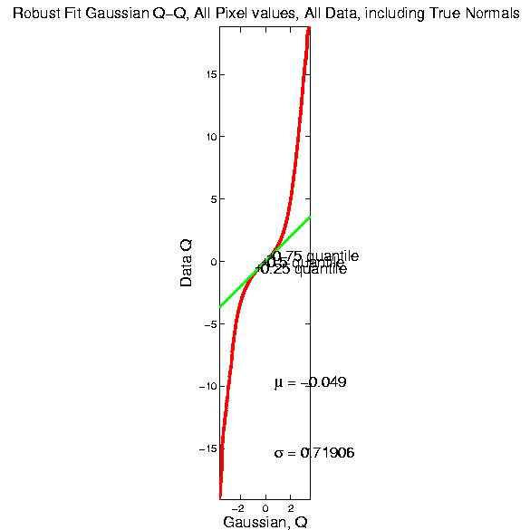
SigClust Estimation of Background Noise

Slide 4
SigClust Estimation of Background Noise
Distribution clearly not Gaussian
Except near the middle
Q-Q curve is very linear there
(closely follows 45º line)
Suggests Gaussian approx. is good there
And that MAD scale estimate is good
(Always a good idea to do such diagnostics)

Slide 5
SigClust Gaussian null distribution - Simulation
Now simulate from null distribution using:
$\left(\begin{matrix}X_{1,i} \\ ⋮ \\ X_{d,i}\end{matrix}\right)$ where $X_{j,i} \sim N\left(0,λ_{j}\right)$ (indep.)
Again rotation invariance makes this work
(and location invariance)

Slide 6
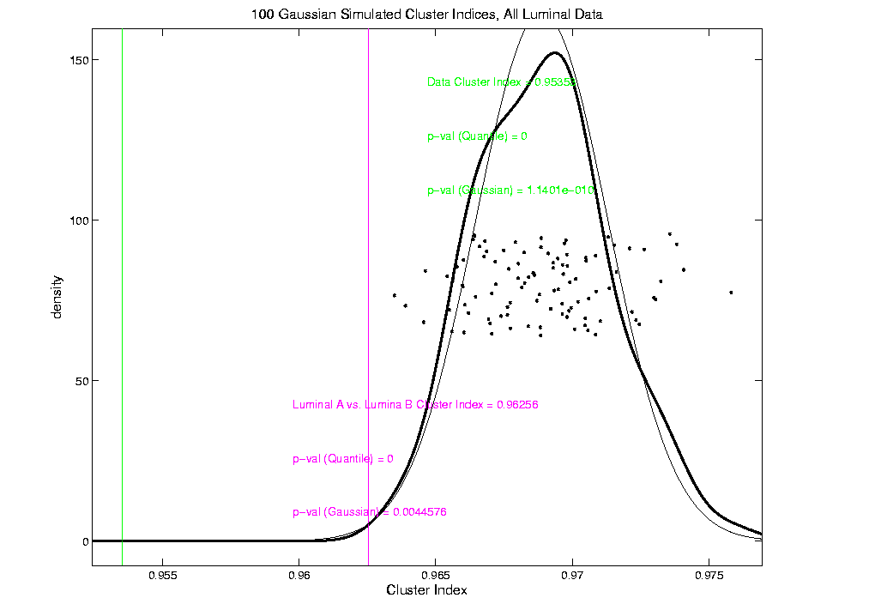
An example (details to follow)
P-val = 0.0045

Slide 7
SigClust Modalities
Two major applications:
Test significance of given clusterings
(e.g. for those found in heat map)
(Use given class labels)
Test if known cluster can be further split
(Use 2-means class labels)

Slide 8
SigClust Real Data Results
Summary of Perou 500 SigClust Results:
Lum & Norm vs. Her2 & Basal, p-val = 10⁻¹⁹
Luminal A vs. B, p-val = 0.0045
Her 2 vs. Basal, p-val = 10⁻¹⁰
Split Luminal A, p-val = 10⁻⁷
Split Luminal B, p-val = 0.058
Split Her 2, p-val = 0.10
Split Basal, p-val = 0.005

Slide 9
SigClust Overview
Works Well When Factor Part Not Used
Sample Eigenvalues Always Valid
But Can be Too Conservative
Above Factor Threshold Anti-Conservative
Problem Fixed by Soft Thresholding
(Huang et al, 2014)

Slide 10
Big Picture
Object Oriented Data Analysis
Have done detailed study of Data Objects
In Euclidean Space, $ℝ^{d}$
Next: OODA in Non-Euclidean Spaces

Slide 11
Shapes As Data Objects
Several Different Notions of Shape
Oldest and Best Known (in Statistics):
Landmark Based

Slide 12
Landmark Based Shape Analysis
Start by Representing Shapes by
Landmarks (points in R² or R³)
$$\left(x_{1},y_{1}\right)$$
$$\left(x_{2},y_{2}\right)$$
$$\left(x_{3},y_{3}\right)$$

Slide 13
Landmark Based Shape Analysis
Clearly different shapes:
But what about: ?
(just translation and rotation of,
but different points in R⁶)

Slide 14
Landmark Based Shape Analysis
Note: Shape should be same over different:
Translations
Rotations
Scalings

Slide 15
Landmark Based Shape Analysis
Approach: Identify objects that are:
Translations
Rotations
Scalings
of each other

Slide 16
Landmark Based Shape Analysis
Approach: Identify objects that are:
Translations
Rotations
Scalings
of each other
Mathematics: Equivalence Relation

Slide 17
Equivalence Relations
Useful Mathematical Device
Weaker generalization of “=“ for a set
Main consequence:
Partitions Set Into Equivalence Classes
For “=“, Equivalence Classes Are Singletons

Slide 18
Equivalence Relations
Deeper Example: Transformation Groups
For $g∈G$, operating on a set $S$
Say $s_{1}≈s_{2}$ when $∃$ $g$ where $g\left(s_{1}\right)=s_{2}$
Equivalence Classes:
$$\left\{s_{i}\right\}=\left\{s_{j}∈S:s_{j}=g\left(s_{i}\right), for some g∈G\right\}$$
Terminology: Also called orbits

Slide 19
Equivalence Relations
Deeper Example: Group Transformations
Above Examples Are Special Cases
Modulo Arithmetic
$$G= \left\{g:ℤ→ℤ :g\left(z\right)=z+kc, for k∈ℤ\right\}$$

Slide 20
Equivalence Relations
Deeper Example: Group Transformations
Above Examples Are Special Cases
Modulo Arithmetic
Vector Subspace of $ℝ^{2}$
$$G=\left\{g:ℝ^{2}{→ℝ}^{2} :g\left(\begin{matrix}x \\ y\end{matrix}\right)=\left(\begin{matrix}x′ \\ y\end{matrix}\right), x′∈ℝ\right\}$$
(orbits are horizontal lines, shifts of $ℝ$)

Slide 21
Equivalence Relations
Deeper Example: Group Transformations
Above Examples Are Special Cases
Modulo Arithmetic
Vector Subspace of $ℝ^{2}$
General Vector Subspace $V$
$G$ maps $V$ into $V$
Orbits are Shifts of $V$, indexed by $V^{⊥}$

Slide 22
Equivalence Relations
Deeper Example: Group Transformations
Above Examples Are Special Cases
Modulo Arithmetic
Vector Subspace of $ℝ^{2}$
General Vector Subspace $V$
Shape: $G=$ Group of “Similarities”
(translations, rotations, scalings)

Slide 23
Equivalence Relations
Deeper Example: Group Transformations
Mathematical Terminology:
Quotient Operation
Set of Equiv. Classes = Quotient Space
Denoted $S/G$

Slide 24
Landmark Based Shape Analysis
Approach: Identify objects that are:
Translations
Rotations
Scalings
of each other
Mathematics: Equivalence Relation
Results in: Equivalence Classes (orbits)
Which become the Data Objects

Slide 25
Landmark Based Shape Analysis
Equivalence Classes become Data Objects
Mathematics: Called “Quotient Space”
Intuitive Representation: Manifold
(curved surface)
, , , , , ,

Slide 26
Landmark Based Shape Analysis
Triangle Shape Space: Represent as Sphere
, , , , , ,

Slide 27
Landmark Based Shape Analysis
Triangle Shape Space: Represent as Sphere:
R⁶ → R⁴
translation
, , , , , ,

Slide 28
Landmark Based Shape Analysis
Triangle Shape Space: Represent as Sphere:
R⁶ → R⁴ → R³
rotation
, , , , , ,

Slide 29
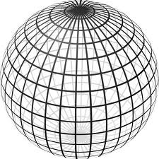
Landmark Based Shape Analysis
Triangle Shape Space: Represent as Sphere:
R⁶ → R⁴ → R³ →
scaling
(thanks to Wikipedia)
, , , , , ,

Slide 30
Shapes As Data Objects
Common Property of Shape Data Objects:
Natural Feature Space is Curved
I.e. a Manifold (from Differential Geometry)

Slide 31
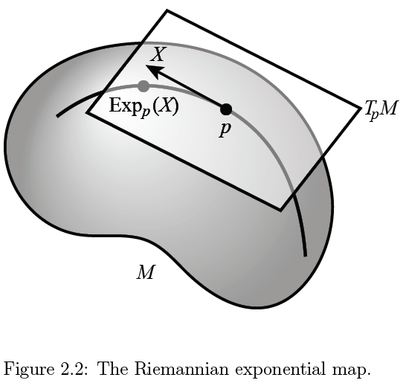
Manifold Descriptor Spaces
(Elegant
Illustrative
Graphic)
Thanks to P. T. Fletcher

Slide 32
Manifold Descriptor Spaces
Data Lie in Curved
Surface

Slide 33
Manifold Descriptor Spaces
At Each Point

Slide 34
Manifold Descriptor Spaces
At Each Point,
$∃$ Approx’ing
Tangent Plane
(in limit of shrinking
neighborhoods of p)

Slide 35
Manifold Descriptor Spaces
Important Mappings:
Plane → Surface:
$\exp_{p}$

Slide 36
Manifold Descriptor Spaces
Important Mappings:
Plane → Surface:
$\exp_{p}$
Important Point:
Common Length
(along surface)

Slide 37
Manifold Descriptor Spaces
Important Mappings:
Plane → Surface:
$\exp_{p}$
Surface → Plane
$\log_{p}$

Slide 38
Manifold Descriptor Spaces
Important Mappings:
Plane → Surface:
$\exp_{p}$
Surface → Plane
$\log_{p}$
(matrix versions)

Slide 39
Manifold Descriptor Spaces
Log & Exp Memory Device:
Complex Numbers

Slide 40
Manifold Descriptor Spaces
Log & Exp Memory Device:
Complex Numbers
Exponential:
Tangent Plane → Manifold

Slide 41
Manifold Descriptor Spaces
Log & Exp Memory Device:
Complex Numbers
Exponential:
Tangent Plane → Manifold
Logarithm:
Manifold → Tangent Plane

Slide 42
Manifold Descriptor Spaces
Standard Statistical Example:
Directional Data (aka Circular Data)
Idea: Angles as Data Objects
Wind Directions
Magnetic Compass Headings
Cracks in Mines

Slide 43
Manifold Descriptor Spaces
Standard Statistical Example:
Directional Data (aka Circular Data)
Mardia (1972)
Mardia & Jupp (2000)
Fisher, Lewis & Engleton (1987)
Fisher (1993)
(Again Monographs, $∃$ Large Literature)

Slide 44
Manifold Descriptor Spaces
Standard Statistical Example:
Directional Data (aka Circular Data)
Reasonable View:
Points on Unit Circle

Slide 45
Manifold Descriptor Spaces
Directional Data
(Already Challenging)

Slide 46
Manifold Descriptor Spaces
Directional Data
E.g. “average” of: $2^{°}$, $3^{°}$, ${358}^{°}$, ${359}^{°}$, = ???
$\sum_{i}{{θ_{i}}/4}$ ?

Slide 47
Manifold Descriptor Spaces
Directional Data
E.g. “average” of: $2^{°}$, $3^{°}$, ${358}^{°}$, ${359}^{°}$, = ???
$\sum_{i}{{θ_{i}}/4}$
Clearly Inappropriate
x
x
x
x

Slide 48
Manifold Descriptor Spaces
Directional Data
E.g. “average” of: $2^{°}$, $3^{°}$, ${358}^{°}$, ${359}^{°}$, = ???
Should
Use Unit
Circle
Structure
x
x
x
x

Slide 49
Manifold Descriptor Spaces
Directional Data
E.g. “average” of: $2^{°}$, $3^{°}$, ${358}^{°}$, ${359}^{°}$, = ???
Recommended Approach:
(There are a Number of Others)

Slide 50
Manifold Descriptor Spaces
Directional Data
E.g. “average” of: $2^{°}$, $3^{°}$, ${358}^{°}$, ${359}^{°}$, = ???
Recommended Approach:
Fréchet Mean
Fréchet (1948)

Slide 51
Manifold Descriptor Spaces
Fréchet Mean
Synonyms:
Geodesic Mean
Barycenter
Karcher Mean
$⋮$

Slide 52
Manifold Descriptor Spaces
Fréchet Mean of Numbers:
Point Nearest to Data Points in L. S. Sense

Slide 53
Manifold Descriptor Spaces
Fréchet Mean of Numbers:
(Easy to Check by Calculus)

Slide 54
Manifold Descriptor Spaces
Fréchet Mean of Numbers:
Fréchet Mean in Euclidean Space ($ℝ^{d}$):
(Also Can Check with Calculus)

Slide 55
Manifold Descriptor Spaces
Fréchet Mean of Numbers:
Fréchet Mean in Euclidean Space ($ℝ^{d}$):
Fréchet Mean on a Manifold:
Replace Euclidean by Geodesic

Slide 56
Manifold Descriptor Spaces
Geodesics:
Idea:
March Along Manifold Without Turning

Slide 57
Manifold Descriptor Spaces
Geodesics:
Idea:
March Along Manifold Without Turning
(Defined in Tangent Plane)

Slide 58
Manifold Descriptor Spaces
Geodesics:
Idea:
March Along Manifold Without Turning
(Defined in Tangent Plane)
E.g. Surface of the Earth: Great Circle
(but not small circles)

Slide 59
Manifold Descriptor Spaces
Geodesics:
Idea:
March Along Manifold Without Turning
(Defined in Tangent Plane)
E.g. Surface of the Earth: Great Circle
E.g. Lines of Longitude (Not Latitude…)

Slide 60
Manifold Descriptor Spaces
Geodesic Distance:
Given Points $x$ & $y$, define
$$d\left(x,y\right)=\min_{g:geodesic from x to y}{length(g)}$$
Can Show:
$d$ is a metric (distance)

Slide 61
Manifold Descriptor Spaces
Fréchet Mean of Numbers:
Fréchet Mean in Euclidean Space ($ℝ^{d}$):
Fréchet Mean on a Manifold:
Replace Euclidean by Geodesic

Slide 62
Manifold Descriptor Spaces
Fréchet Mean of Numbers:
Well Known in Robust Statistics
(Recall Resistant to Outliers)

Slide 63
Manifold Descriptor Spaces
Fréchet Mean of Numbers:
Well Known in Robust Statistics:
Replace Euclidean Distance
With Robust Distance, e.g. $L^{2}$ with $L^{1}$
Reduces Influence of Outliers
Gives Other Notions of Robust Median

Slide 64
Manifold Descriptor Spaces
Fréchet Mean in General:
Big Advantage:
Works in Any Metric Space

Slide 65
Manifold Descriptor Spaces
Directional Data Examples of Fréchet Mean

Slide 66
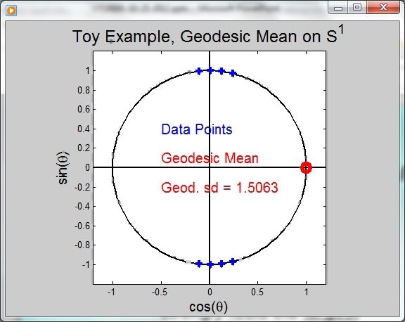
Manifold Descriptor Spaces
Directional Data Examples of Fréchet Mean:
Not always easily interpretable

Slide 67
Manifold Descriptor Spaces
Directional Data Examples of Fréchet Mean:
Not always easily interpretable
Think about distances along arc
Not about “points in $ℝ^{2}$”
Sum of squared distances
strongly feels the largest
Not always unique
But unique with probability one
(for data from distribution absolutely
continuous w. r. t. Lebesgue Measure)

Slide 68
Manifold Descriptor Spaces
Directional Data Examples of Fréchet Mean:
Not always easily interpretable
Think about distances along arc
Not about “points in $ℝ^{2}$”
Sum of squared distances
strongly feels the largest
Not always unique
But unique with probability one
Non-unique requires strong symmetry
But possible to have many means

Slide 69
Manifold Descriptor Spaces
Directional Data Examples of Fréchet Mean:
Not always sensible notion of center

Slide 70
Manifold Descriptor Spaces
Directional Data Examples of Fréchet Mean:
Not always sensible notion of center
Sometimes prefer top & bottom?
At end: farthest points from data
Not continuous Function of Data
Jump from 1 – 2
Jump from 2 – 8
All False for Euclidean Mean
But all happen generally for Manifold Data

Slide 71
Manifold Descriptor Spaces
Directional Data Examples of Fréchet Mean:
Also of interest is Fréchet Variance:
Works like Euclidean sample variance
Note values in movie, reflecting spread in data
Note theoretical version:
Useful for Laws of Large Numbers, etc.

Slide 72
OODA in Image Analysis
First Generation Problems:
Denoising
(extract signal from noise)

Slide 73
OODA in Image Analysis
First Generation Problems:
Denoising
Segmentation
(find object boundary)

Slide 74
OODA in Image Analysis
First Generation Problems:
Denoising
Segmentation
Registration
(align same object in 2 images)

Slide 75
OODA in Image Analysis
First Generation Problems:
Denoising
Segmentation
Registration
(all about single images,
still interesting challenges)

Slide 76
OODA in Image Analysis
Second Generation Problems:
Populations of Images
Understanding Population Variation
Discrimination (a.k.a. Classification)
Complex Data Structures (& Spaces)
HDLSS Statistics

Slide 77
Image Object Representation
Major Approaches for Image Data Objects:
Landmark Representations
Boundary Representations
Medial Representations

Slide 78
Landmark Representations
Landmarks for Fly Wing Data:
Thanks to George Gilchrist

Slide 79
Landmark Representations
Major Drawback of Landmarks:
Need to always find each landmark
Need same relationship
I.e. Landmarks need to correspond
Often fails for medical images
E.g. How many corresponding landmarks on a set of kidneys, livers or brains???

Slide 80
Boundary Representations
Traditional Major Sets of Ideas:
Triangular Meshes
Survey: Owen (1998)
Active Shape Models
Cootes, et al (1993)
Fourier Boundary Representations
Keleman, et al (1997 & 1999)

Slide 81
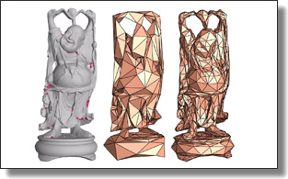
Boundary Representations
Example of triangular mesh rep’n:
From:www.geometry.caltech.edu/pubs.html

Slide 82
Boundary Representations
Main Drawback:
Correspondence
For OODA (on vectors of parameters):
Need to “match up points”
Easy to find triangular mesh
Lots of research on this driven by gamers
Challenge to match mesh across objects
There are some interesting ideas…
Notes:
82

Slide 83
Boundary Representations
Correspondence for Mesh Objects:
Active Shape Models (PCA – like)
Automatic Landmark Choice
Cates, et al (2007)
Based on Optimization Problem:
Good Correspondence & Separation
(Formulate via Entropy)
Notes:
83

