Slide 1
Shapes As Data Objects
Several Different Notions of Shape
Oldest and Best Known (in Statistics):
Landmark Based

Slide 2
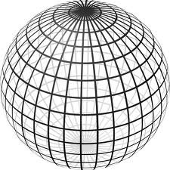
Landmark Based Shape Analysis
Triangle Shape Space: Represent as Sphere:
R⁶ → R⁴ → R³ →
scaling
(thanks to Wikipedia)
, , , , , ,

Slide 3
Shapes As Data Objects
Common Property of Shape Data Objects:
Natural Feature Space is Curved
I.e. a Manifold (from Differential Geometry)

Slide 4
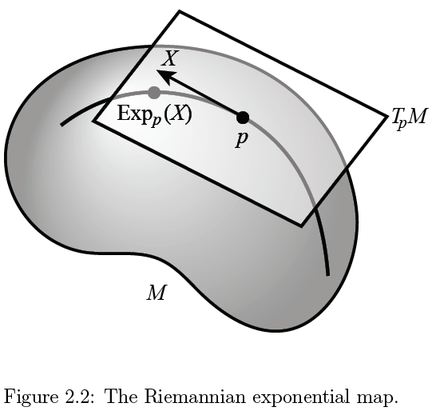
Manifold Descriptor Spaces
Important Mappings:
Plane → Surface:
$\exp_{p}$
Surface → Plane
$\log_{p}$
(matrix versions)

Slide 5
Manifold Descriptor Spaces
Fréchet Mean of Numbers:
Fréchet Mean in Euclidean Space ($ℝ^{d}$):
Fréchet Mean on a Manifold:
Replace Euclidean by Geodesic

Slide 6
OODA in Image Analysis
First Generation Problems:
Denoising
Segmentation
Registration
(all about single images,
still interesting challenges)

Slide 7
OODA in Image Analysis
Second Generation Problems:
Populations of Images
Understanding Population Variation
Discrimination (a.k.a. Classification)
Complex Data Structures (& Spaces)
HDLSS Statistics

Slide 8
Image Object Representation
Major Approaches for Image Data Objects:
Landmark Representations
Boundary Representations
Medial Representations

Slide 9
Medial Representations
Main Idea:
Represent Objects as:
Discretized skeletons (medial atoms)
Plus spokes from center to edge
Which imply a boundary
Very accessible early reference:
Yushkevich, et al (2001)

Slide 10
Medial Representations
2-d M-Rep Example:
Corpus Callosum
(Yushkevich)
Notes:
CCMsciznormRaw.avi

Slide 11
Medial Representations
2-d M-Rep Example:
Corpus Callosum
(Yushkevich)
Atoms
Notes:
CCMsciznormRaw.avi

Slide 12
Medial Representations
2-d M-Rep Example:
Corpus Callosum
(Yushkevich)
Atoms
Spokes
Notes:
CCMsciznormRaw.avi

Slide 13
Medial Representations
2-d M-Rep Example:
Corpus Callosum
(Yushkevich)
Atoms
Spokes
Implied
Boundary
Notes:
CCMsciznormRaw.avi

Slide 14
Medial Representations
3-d M-Rep Example: From Ja-Yeon Jeong
Bladder – Prostate - Rectum
Notes:
OODA.ppt

Slide 15
Medial Representations
3-d M-Rep Example: From Ja-Yeon Jeong
Bladder – Prostate - Rectum
In Male Pelvis
Valve on Bladder
Notes:
OODA.ppt

Slide 16
Medial Representations
3-d M-Rep Example: From Ja-Yeon Jeong
Bladder – Prostate - Rectum
In Male Pelvis
Valve on Bladder
Common Area for Cancer in Males
Notes:
OODA.ppt

Slide 17
Medial Representations
3-d M-Rep Example: From Ja-Yeon Jeong
Bladder – Prostate - Rectum
In Male Pelvis
Valve on Bladder
Common Area for Cancer in Males
Goal: Design Radiation Treatment
Hit Prostate
Miss Bladder & Rectum
Over Course of Many Days
Notes:
OODA.ppt

Slide 18
Medial Representations
3-d M-Rep Example: From Ja-Yeon Jeong
Bladder – Prostate - Rectum
Atoms (yellow dots)
Notes:
OODA.ppt

Slide 19
Medial Representations
3-d M-Rep Example: From Ja-Yeon Jeong
Bladder – Prostate - Rectum
Atoms - Spokes (line segments)
Notes:
OODA.ppt

Slide 20
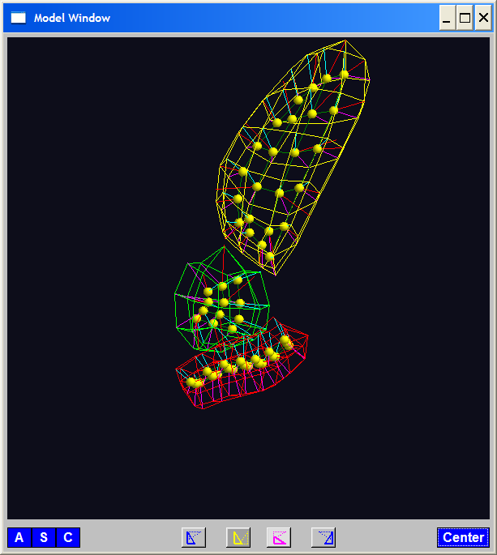
Medial Representations
3-d M-Rep Example: From Ja-Yeon Jeong
Bladder – Prostate - Rectum
Atoms - Spokes - Implied Boundary
Notes:
OODA.ppt

Slide 21
Medial Representations
3-d M-Rep Example: From Ja-Yeon Jeong
Bladder – Prostate - Rectum
Atoms - Spokes - Implied Boundary
Notes:
OODA.ppt

Slide 22
Medial Representations
3-d M-reps: there are several variations
Two choices:
From
Fletcher
(2004)
Notes:
fletcher_thesis.pdf

Slide 23
Medial Representations
Detailed discussion of M-reps:
Siddiqi, K. and Pizer, S. M. (2008)
Notes:
fletcher_thesis.pdf

Slide 24
Medial Representations
Statistical Challenge
M-rep parameters are:
Locations $∈ ℝ^{2}$, $ℝ^{3}$
Radii
Angles (not comparable)
Stuffed into a long vector
I.e. many direct products of these

Slide 25
Medial Representations
Statistical Challenge
Many direct products of:
Locations $∈ ℝ^{2}$, $ℝ^{3}$
Radii
Angles (not comparable)
Appropriate View:
Data Lie on Curved Manifold
Embedded in higher dim’al Eucl’n Space

Slide 26
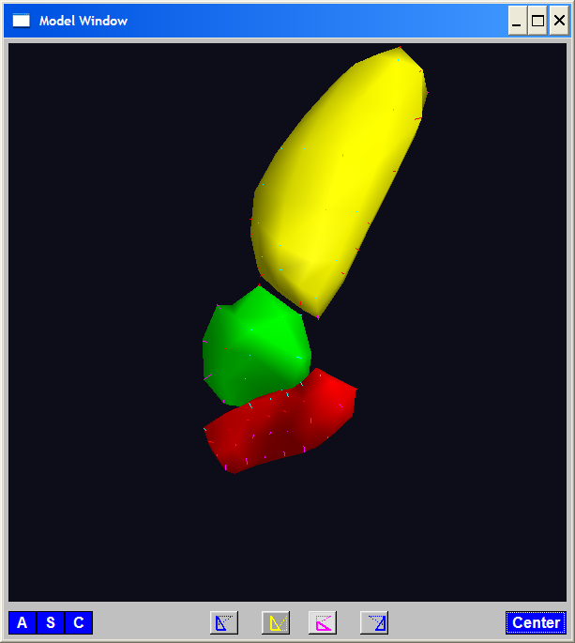
A Challenging Example
Male Pelvis
Bladder – Prostate – Rectum

Slide 27
A Challenging Example
Male Pelvis
Bladder – Prostate – Rectum
How do they move over time (days)?
(all within same person)

Slide 28
A Challenging Example
Male Pelvis
Bladder – Prostate – Rectum
How do they move over time (days)?
Critical to Radiation Treatment (cancer)
Work with 3-d CT
(“Computed Tomography”,
= 3d version of X-ray)

Slide 29
A Challenging Example
Male Pelvis
Bladder – Prostate – Rectum
How do they move over time (days)?
Critical to Radiation Treatment (cancer)
Work with 3-d CT
Very Challenging to Segment
Find boundary of each object?
Represent each Object?

Slide 30
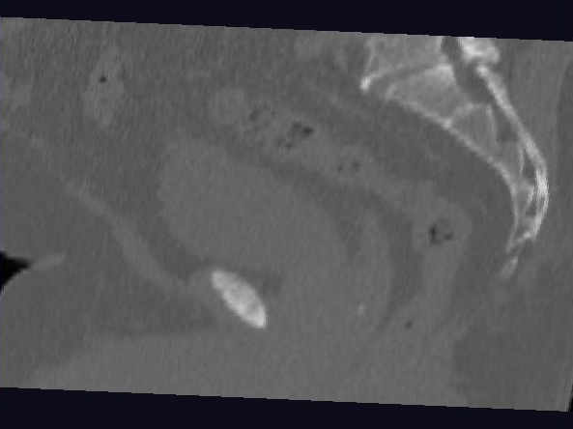
Male Pelvis – Raw Data
One CT Slice
(in 3d image)
Like X-ray:
White = Dense
(Bone)
Black = Gas

Slide 31
Male Pelvis – Raw Data
One CT Slice
(in 3d image)
Tail Bone

Slide 32
Male Pelvis – Raw Data
One CT Slice
(in 3d image)
Tail Bone
Rectum

Slide 33
Male Pelvis – Raw Data
One CT Slice
(in 3d image)
Tail Bone
Rectum
Bladder

Slide 34
Male Pelvis – Raw Data
One CT Slice
(in 3d image)
Tail Bone
Rectum
Bladder
Prostate

Slide 35
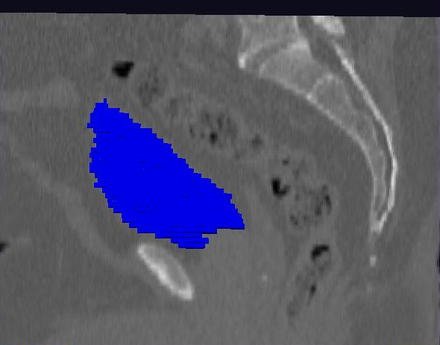
Male Pelvis – Raw Data
Bladder:
manual segmentation
Slice by slice
Reassembled

Slide 36
Male Pelvis – Raw Data
Bladder:
Slices:
Reassembled in 3d
How to represent?
Thanks: Ja-Yeon Jeong

Slide 37
Object Representation
Landmarks (hard to find)
Boundary Rep’ns (no correspondence)
Medial representations
Find “skeleton”
Discretize as “atoms” called S-reps
(for Skeletal Representation)

Slide 38
3-d s-reps
Bladder – Prostate – Rectum (multiple objects, J. Y. Jeong)
Medial Atoms provide “skeleton”
Implied Boundary from “spokes” → “surface”

Slide 39
3-d s-reps
S-rep model fitting
Easy, when starting from binary (blue)
But very expensive (30 – 40 minutes technician’s time)
Want automatic approach
Challenging, because of poor contrast, noise, …
Need to borrow information across training sample
Use Bayes approach: prior & likelihood → posterior
(A surrogate for “anatomical knowledge”)

Slide 40
3-d s-reps
S-rep model fitting
Easy, when starting from binary (blue)
But very expensive (30 – 40 minutes technician’s time)
Want automatic approach
Challenging, because of poor contrast, noise, …
Need to borrow information across training sample
Use Bayes approach: prior & likelihood → posterior
~Conjugate Gaussians
(Embarassingly Straightforward?)

Slide 41
3-d s-reps
S-rep model fitting
Easy, when starting from binary (blue)
But very expensive (30 – 40 minutes technician’s time)
Want automatic approach
Challenging, because of poor contrast, noise, …
Need to borrow information across training sample
Use Bayes approach: prior & likelihood → posterior
~Conjugate Gaussians, but there are issues:
Major HLDSS challenges
Manifold aspect of data

Slide 42
3-d s-reps
S-rep model fitting
Very Successful
Jeong (2009)

Slide 43
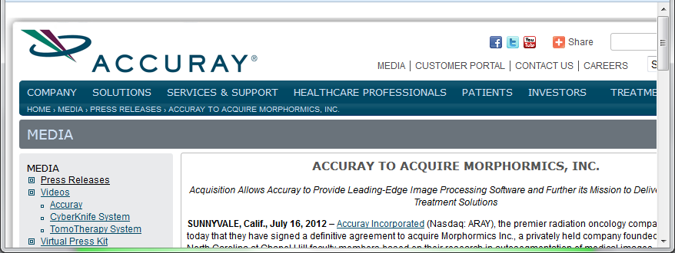
3-d s-reps
S-rep model fitting
Very Successful
Jeong (2009)
Basis of Startup Company: Morphormics

Slide 44
Mildly Non-Euclidean Spaces
Statistical Analysis of M-rep Data
Recall: Many direct products of:
Locations
Radii
Angles
I.e. points on smooth manifold
Data in non-Euclidean Space
But only mildly non-Euclidean

Slide 45
PCA for m-reps, II
PCA on non-Euclidean spaces?
(i.e. on Lie Groups / Symmetric Spaces)
T. Fletcher: Principal Geodesic Analysis
(2004 UNC CS PhD Dissertation)

Slide 46
PCA for m-reps, II
PCA on non-Euclidean spaces?
(i.e. on Lie Groups / Symmetric Spaces)
T. Fletcher: Principal Geodesic Analysis
Idea: replace “linear summary of data”
With “geodesic summary of data”…

Slide 47
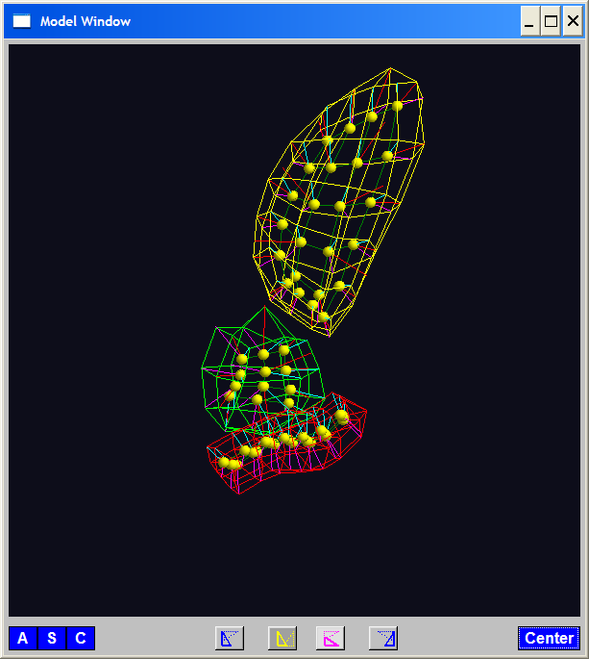
PGA for m-reps, Bladder-Prostate-Rectum
Bladder – Prostate – Rectum, 1 person, 17 days
PG 1 PG 2 PG 3
(analysis by Ja Yeon Jeong)

Slide 48
PGA for m-reps, Bladder-Prostate-Rectum
Bladder – Prostate – Rectum, 1 person, 17 days
PG 1 PG 2 PG 3
(analysis by Ja Yeon Jeong)

Slide 49
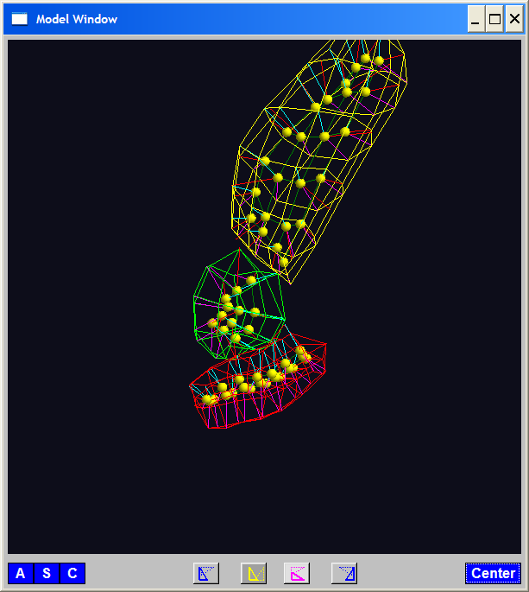
PGA for m-reps, Bladder-Prostate-Rectum
Bladder – Prostate – Rectum, 1 person, 17 days
PG 1 PG 2 PG 3
(analysis by Ja Yeon Jeong)

Slide 50
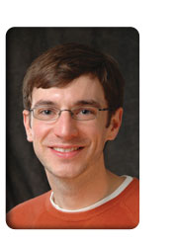
PCA Extensions for Data on Manifolds
Fletcher (Principal Geodesic Anal.)
Best fit of geodesic to data

Slide 51
PCA Extensions for Data on Manifolds
Fletcher (Principal Geodesic Anal.)
Best fit of geodesic to data
Constrained to go through geodesic mean

Slide 52
PCA Extensions for Data on Manifolds
Fletcher (Principal Geodesic Anal.)
Best fit of geodesic to data
Constrained to go through geodesic mean
Happens mean
Naturally contained
in $ℝ^{d}$ in best
fit line

Slide 53
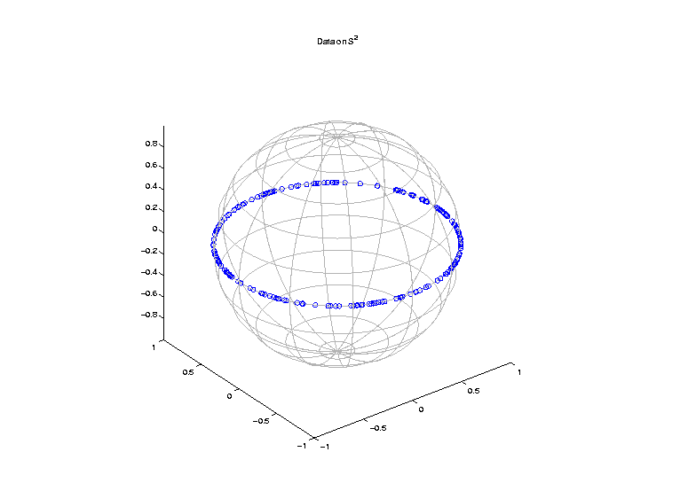
PCA Extensions for Data on Manifolds
Fletcher (Principal Geodesic Anal.)
Best fit of geodesic to data
Constrained to go through geodesic mean
But Not In
Non-Euclidean
Spaces

Slide 54
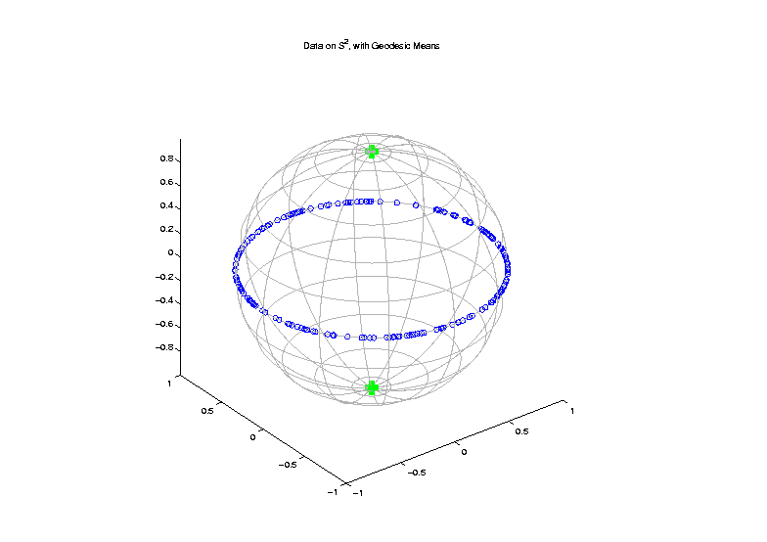
PCA Extensions for Data on Manifolds
Fletcher (Principal Geodesic Anal.)
Best fit of geodesic to data
Constrained to go through geodesic mean
Counterexample:
Data on sphere,
along equator

Slide 55
PCA Extensions for Data on Manifolds
Fletcher (Principal Geodesic Anal.)
Best fit of geodesic to data
Constrained to go through geodesic mean
Extreme
3 Point
Examples

Slide 56
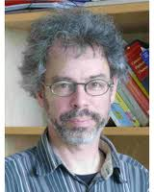
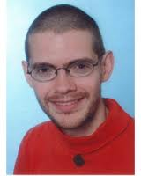
PCA Extensions for Data on Manifolds
Fletcher (Principal Geodesic Anal.)
Best fit of geodesic to data
Constrained to go through geodesic mean
Huckemann, Hotz & Munk (Geod. PCA)
Huckemann et al (2011)

Slide 57
PCA Extensions for Data on Manifolds
Fletcher (Principal Geodesic Anal.)
Best fit of geodesic to data
Constrained to go through geodesic mean
Huckemann, Hotz & Munk (Geod. PCA)
Best fit of any geodesic to data

Slide 58
PCA Extensions for Data on Manifolds
Fletcher (Principal Geodesic Anal.)
Best fit of geodesic to data
Constrained to go through geodesic mean
Huckemann, Hotz & Munk (Geod. PCA)
Best fit of any geodesic to data
Counterexample:
Data follows Tropic of Capricorn

Slide 59
PCA Extensions for Data on Manifolds
Fletcher (Principal Geodesic Anal.)
Best fit of geodesic to data
Constrained to go through geodesic mean
Huckemann, Hotz & Munk (Geod. PCA)
Best fit of any geodesic to data
Jung, Foskey & Marron (Princ. Arc Anal.)
Jung et al (2011)

Slide 60
PCA Extensions for Data on Manifolds
Fletcher (Principal Geodesic Anal.)
Best fit of geodesic to data
Constrained to go through geodesic mean
Huckemann, Hotz & Munk (Geod. PCA)
Best fit of any geodesic to data
Jung, Foskey & Marron (Princ. Arc Anal.)
Best fit of any circle to data
(motivated by conformal maps)

Slide 61
PCA Extensions for Data on Manifolds

Slide 62
Principal Arc Analysis
Jung, Foskey & Marron (2011)
Best fit of any circle to data
Can give better fit than geodesics

Slide 63
Principal Arc Analysis
Jung, Foskey & Marron (2011)
Best fit of any circle to data
Can give better fit than geodesics
Observed for simulated s-rep example

Slide 64
Challenge being addressed

Slide 65
Composite Principal Nested Spheres
Idea: Use Principal Arc Analysis
Over Large Products of $S^{2}$ and $ℝ^{d}$
Vectors whose entries are
Angles on sphere an reals

Slide 66
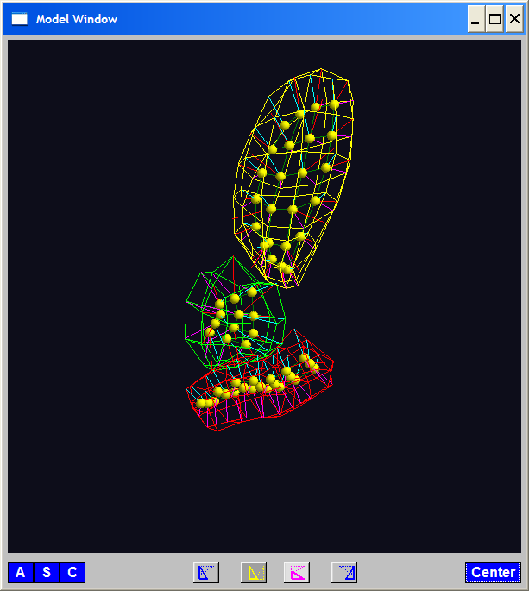
Composite Principal Nested Spheres
Idea: Use Principal Arc Analysis
Over Large Products of $S^{2}$ and $ℝ^{d}$
Motivation:
m-reps
&
s-reps

Slide 67
Composite Principal Nested Spheres
Idea: Use Principal Arc Analysis
Over Large Products of $S^{2}$ and $ℝ^{d}$
Approach: Use Principal Arc Analysis
to Linearize $S^{2}$ Components

Slide 68
Composite Principal Nested Spheres
Idea: Use Principal Arc Analysis
Over Large Products of $S^{2}$ and $ℝ^{d}$
Approach: Use Principal Arc Analysis
to Linearize $S^{2}$ Components
Then Concatenate All & Use PCA
HDLSS asymptotics?
(When have many s-rep atoms?)

Slide 69
Composite Principal Nested Spheres
HDLSS asymptotics?
Simple Case: $S^{2}×S^{2}×⋯×S^{2}$
$d$

Slide 70
Composite Principal Nested Spheres
HDLSS asymptotics?
Simple Case: $S^{2}×S^{2}×⋯×S^{2}$
Study $\lim_{d→∞}{}$
Get Geometric Representation?
Distances $\sim d^{\frac{1}{2}}$
Random ~ Rotation
Modulo Rotation → Unit Simplex $×d^{\frac{1}{2}}$

Slide 71
Composite Principal Nested Spheres
HDLSS asymptotics?
Simple Case: $S^{2}×S^{2}×⋯×S^{2}$
Study $\lim_{d→∞}{}$
Get Geometric Representation?
Apparent Challenge: $S^{2}$ is Bounded
(So Can’t Have Distances ${\sim d}^{\frac{1}{2}}→∞$???)

Slide 72
Composite Principal Nested Spheres
HDLSS asymptotics?
Simple Case: $S^{2}×S^{2}×⋯×S^{2}$
Study $\lim_{d→∞}{}$
Get Geometric Representation?
Apparent Challenge: $S^{2}$ is Bounded
(So Can’t Have Distances ${\sim d}^{\frac{1}{2}}→∞$???)
Careful, Have Big Product of $S^{2}$s

Slide 73
Composite Principal Nested Spheres
HDLSS asymptotics?
Even Simpler (But Bounded) Case: $\left[0,1\right]×\left[0,1\right]×⋯×\left[0,1\right]$
Unit Cube in $ℝ^{d},$Study $\lim_{d→∞}{}$
Diagonal Length = $d^{\frac{1}{2}}$
Length Between Random Points $\sim d^{\frac{1}{2}}$
Note: # Edges $\sim 2d$, # Diagonals $\sim 2^{d}$

Slide 74
Composite Principal Nested Spheres
HDLSS asymptotics?
Even Simpler (But Bounded) Case: $\left[0,1\right]×\left[0,1\right]×⋯×\left[0,1\right]$
Unit Cube in $ℝ^{d},$Study $\lim_{d→∞}{}$
Diagonal Length = $d^{\frac{1}{2}}$
Length Between Random Points $\sim d^{\frac{1}{2}}$
Get Similar Geometric Representation

Slide 75
Composite Principal Nested Spheres
HDLSS asymptotics?
Simple Case: $S^{2}×S^{2}×⋯×S^{2}$
Study $\lim_{d→∞}{}$
Get Geometric Representation?
Yes, Sen et al (2008)

Slide 76
Composite Principal Nested Spheres
HDLSS asymptotics?
Simple Case: $S^{2}×S^{2}×⋯×S^{2}$
Study $\lim_{d→∞}{}$
Get Geometric Representation?
Consistency of CPNS???
(Open Problem)

Slide 77
Landmark Based Shape Analysis
Kendall
Bookstein
Dryden &
Mardia
(recall major monographs)

Slide 78
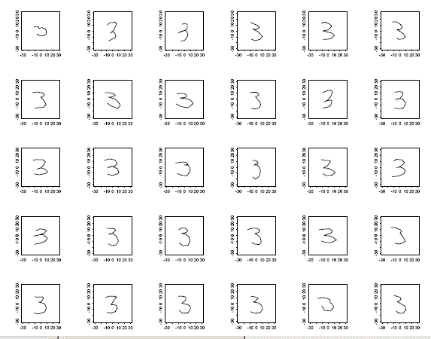
Landmark Based Shape Analysis
Kendall
Bookstein
Dryden &
Mardia
Digit 3 Data

Slide 79
Landmark Based Shape Analysis
Kendall
Bookstein
Dryden &
Mardia
Digit 3 Data
(digitized to 13 landmarks)

Slide 80
Variation on Landmark Based Shape
Typical Viewpoint:
Variation in Shape is Goal
Other Variation+ is Nuisance
Recall Main Idea:
Represent Shapes as Coordinates
“Mod Out” Transl’n, Rotat’n, Scale

Slide 81
Variation on Landmark Based Shape
Typical Viewpoint:
Variation in Shape is Goal
Other Variation+ is Nuisance
Interesting Alternative:
Study Variation in Transformation
Treat Shape as Nuisance

Slide 82
Variation on Landmark Based Shape
Context: Study of Tectonic Plates
Movement of Earth’s Crust (over time)
Take Motions as Data Objects
Interesting Alternative:
Study Variation in Transformation
Treat Shape as Nuisance

Slide 83
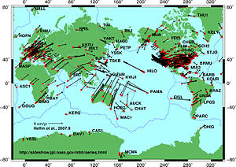
Variation on Landmark Based Shape
Context: Study of Tectonic Plates
Movement of Earth’s Crust (over time)
Take Motions as Data Objects
Royer & Chang (1991)
Thanks to Wikipedia

Slide 84
Landmark Based Shape Analysis
Kendall
Bookstein
Dryden &
Mardia
Digit 3 Data

Slide 85
Landmark Based Shape Analysis
Key Step: mod out
Translation
Scaling
Rotation
Result:
Data Objects ←→
←→ points on Manifold ( ~ S^{2k-4})

Slide 86
Landmark Based Shape Analysis
Currently popular approaches to PCA on S^{k}:
Early: PCA on projections
(Tangent Plane Analysis)

Slide 87
Landmark Based Shape Analysis
Currently popular approaches to PCA on S^{k}:
Early: PCA on projections
Fletcher: Geodesics through mean
Huckemann, et al: Any Geodesic
New Approach:
Principal Nested Sphere Analysis
Jung, Dryden & Marron (2012)

Slide 88
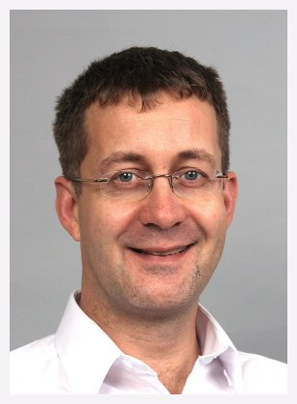
Principal Nested Spheres Analysis
Main Goal:
Extend Principal Arc Analysis (S² to S^{k})
Jung, Dryden & Marron (2012)

Slide 89
Principal Nested Spheres Analysis
Main Goal:
Extend Principal Arc Analysis (S² to S^{k})

Slide 90
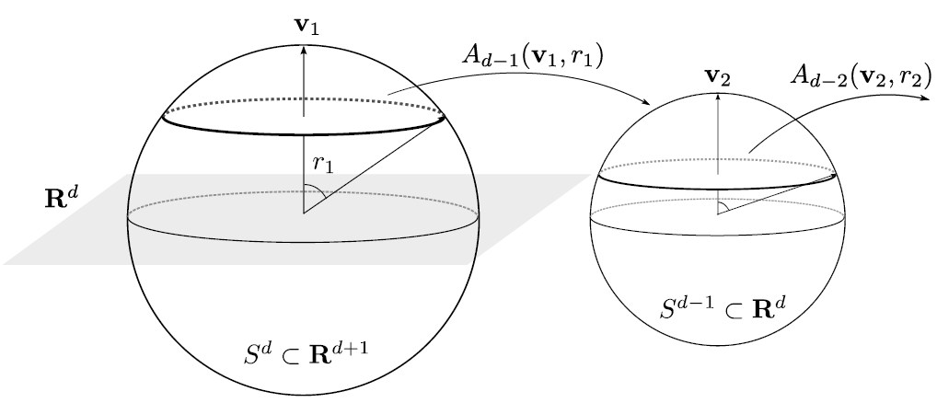
Principal Nested Spheres Analysis
Top Down Nested (small) spheres

Slide 91
Digit 3 data: Principal variations of the shape
Princ. geodesics by PNS
Principal arcs by PNS

Slide 92
Principal Nested Spheres Analysis
Main Goal:
Extend Principal Arc Analysis (S² to S^{k})
Jung, Dryden & Marron (2012)
Impact on Segmentation:
PGA Segmentation: used ~20 comp’s
PNS Segmentation: only need ~13
Resulted in visually better fits to data

Slide 93
Principal Nested Spheres Analysis
Main Goal:
Extend Principal Arc Analysis (S² to S^{k})
Jung, Dryden & Marron (2012)
Important Landmark: This Motivated
Backwards PCA

Slide 94
Participant Presentations
Mahmoud Mostapha
Fast Editing of Many Object Segmentation,
Megan Quinn
Smoothing in Human Growth Data

