Slide 1
Today is Last Class Meeting
Marron out of town next week.
Please fill out Course Review

Slide 2
Image Object Representation
Major Approaches for Image Data Objects:
Landmark Representations
Boundary Representations
Medial Representations

Slide 3
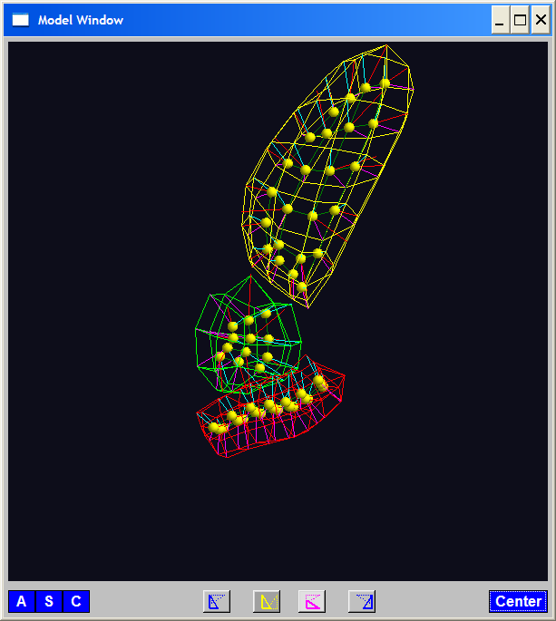
Medial Representations
3-d M-Rep Example: From Ja-Yeon Jeong
Bladder – Prostate - Rectum
Atoms - Spokes - Implied Boundary
Notes:
OODA.ppt

Slide 4
PCA Extensions for Data on Manifolds
Fletcher (Principal Geodesic Anal.)
Best fit of geodesic to data
Constrained to go through geodesic mean
Huckemann, Hotz & Munk (Geod. PCA)
Best fit of any geodesic to data
Jung, Foskey & Marron (Princ. Arc Anal.)
Best fit of any circle to data
(motivated by conformal maps)

Slide 5
Composite Principal Nested Spheres
HDLSS asymptotics?
Even Simpler (But Bounded) Case: $\left[0,1\right]×\left[0,1\right]×⋯×\left[0,1\right]$
Unit Cube in $ℝ^{d},$Study $\lim_{d→∞}{}$
Diagonal Length = $d^{\frac{1}{2}}$
Length Between Random Points $\sim d^{\frac{1}{2}}$
Get Similar Geometric Representation

Slide 6
Variation on Landmark Based Shape
Context: Study of Tectonic Plates
Movement of Earth’s Crust (over time)
Take Motions as Data Objects
Interesting Alternative:
Study Variation in Transformation
Treat Shape as Nuisance

Slide 7
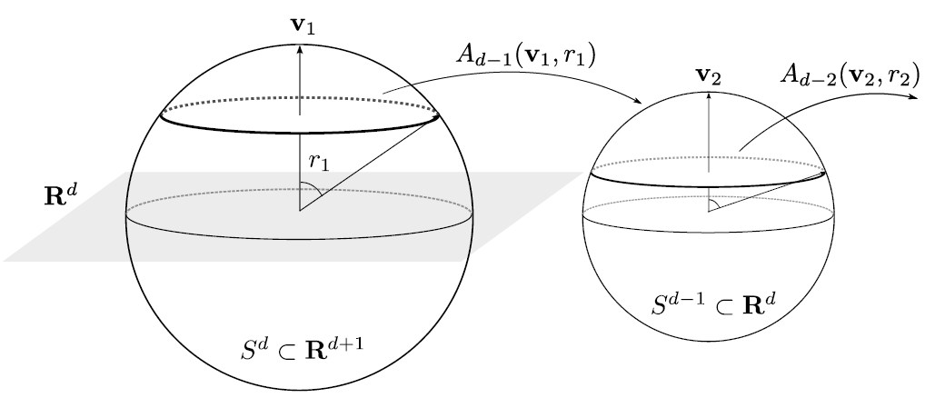
Principal Nested Spheres Analysis
Top Down Nested (small) spheres

Slide 8
Principal Nested Spheres Analysis
Main Goal:
Extend Principal Arc Analysis (S² to S^{k})
Jung, Dryden & Marron (2012)
Important Landmark: This Motivated
Backwards PCA

Slide 9
Principal Nested Spheres Analysis
Key Idea:
Replace usual forwards view of PCA
With a backwards approach to PCA

Slide 10
Terminology
Multiple linear regression:
Stepwise approaches:
Forwards: Start small, iteratively add variables to model
Backwards: Start with all, iteratively remove variables from model

Slide 11
Illust’n of PCA View: Recall Raw Data
Notes:
EgView1p1RawData.ps

Slide 12
Illust’n of PCA View: PC1 Projections
Notes:
EgView1p51proj3dPC1.ps

Slide 13
Illust’n of PCA View: PC2 Projections
Notes:
EgView1p52proj3dPC2.ps

Slide 14
Illust’n of PCA View: Projections on PC1,2 plane
Notes:
EgView1p54proj3dPC12.ps

Slide 15
Principal Nested Spheres Analysis
Replace usual forwards view of PCA
Data → PC1 (1-d approx)
→ PC2 (1-d approx of Data-PC1)
→ PC1 U PC2 (2-d approx)
$⋱$
→ PC1 U … U PCr
(r-d approx)

Slide 16
Principal Nested Spheres Analysis
With a backwards approach to PCA
Data → PC1 U … U PCr (r-d approx)
→ PC1 U … U PC(r-1)
$⋱$
→ PC1 U PC2 (2-d approx)
→ PC1 (1-d approx)

Slide 17
Principal Component Analysis
Euclidean Settings:
Forwards PCA = Backwards PCA
(Pythagorean Theorem,
ANOVA Decomposition)
So Not Interesting
But Very Different in Non-Euclidean Settings
(Backwards is Better !?!)

Slide 18
Principal Component Analysis
Important Property of PCA:
Nested Series of Approximations
$$\left\{{PC}_{1}\right\}⊆\left\{{PC}_{1}{,PC}_{2}\right\}⊆\left\{{PC}_{1}{,PC}_{2},{PC}_{3}\right\}⊆⋯$$
(Often taken for granted)
(Desirable in Non-Euclidean Settings)

Slide 19
Non-Euclidean PCA
Desirability of Nesting:
Multi-Scale Analysis Makes Sense
Scores Visualization Makes Sense

Slide 20
An Interesting Question
How generally applicable is
Backwards approach to PCA?
Discussion:
Jung et al (2010)
Pizer et al (2013)

Slide 21
An Interesting Question
How generally applicable is
Backwards approach to PCA?
Anywhere this is already being done???

Slide 22
An Interesting Question
How generally applicable is
Backwards approach to PCA?
An Application:
Nonnegative Matrix Factorization
= PCA in Positive Orthant
Think $X ≈LS$
With ≥ 0 Constraints (on both $L$ & $S$)

Slide 23
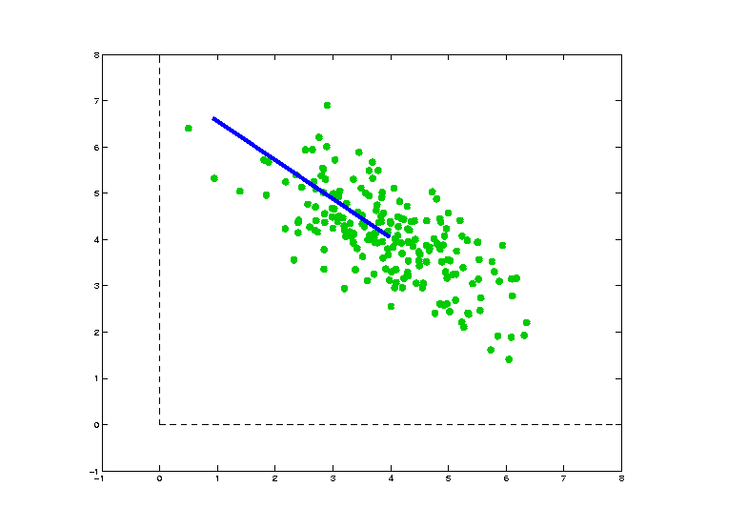
Nonnegative Matrix Factorization
Isn’t This
Just PCA?
In the
Nonnegative
Orthant?
No, Most PC Directions Leave Orthant

Slide 24
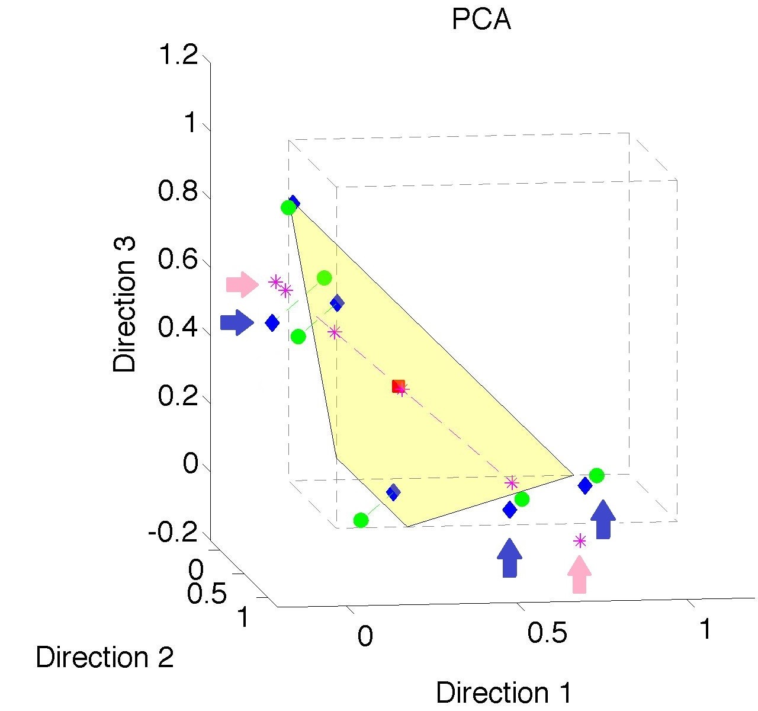
Nonnegative Matrix Factorization
Isn’t This
Just PCA?
Data
(Near
Orthant
Faces)

Slide 25
Nonnegative Matrix Factorization
Isn’t This
Just PCA?
Data
Mean
(Centered
Analysis)

Slide 26
Nonnegative Matrix Factorization
Isn’t This
Just PCA?
Data
Mean
PC1 Projections
Leave Orthant!

Slide 27
Nonnegative Matrix Factorization
Isn’t This
Just PCA?
Data
Mean
PC1 Projections
PC1 $⋃$ 2 Proj’ns
Leave Orthant!

Slide 28
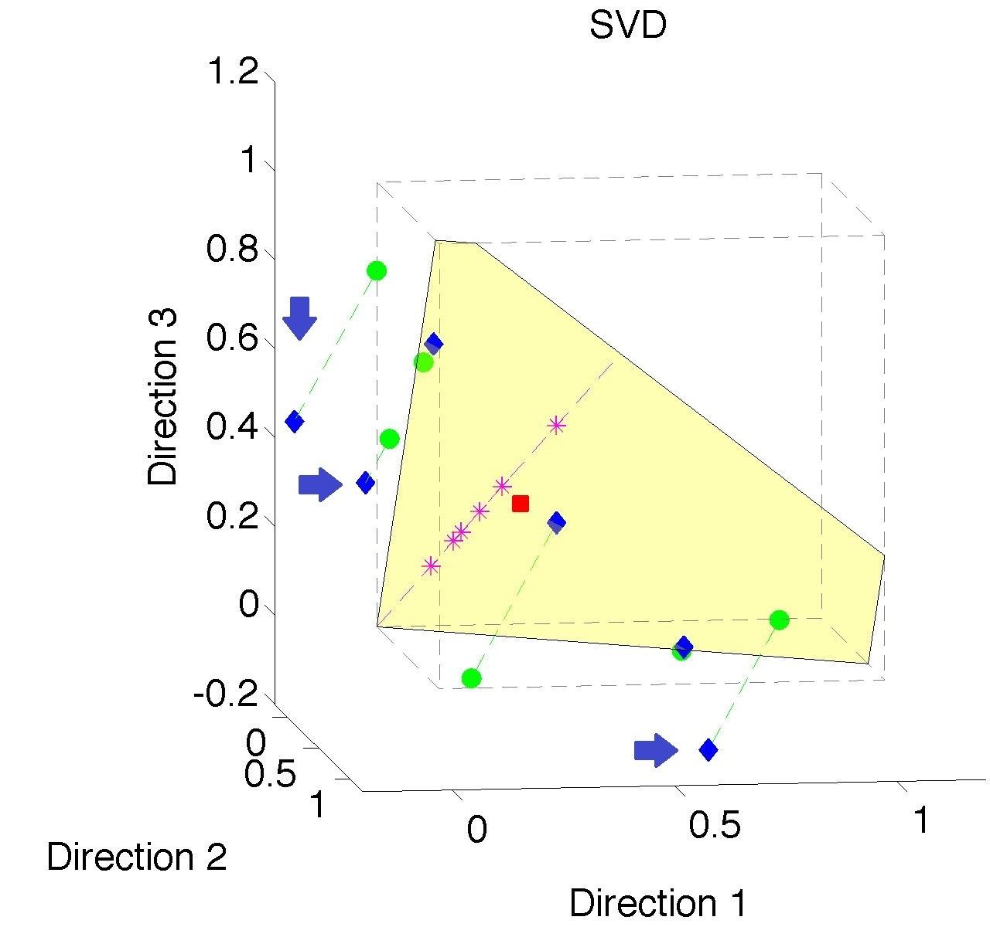
Nonnegative Matrix Factorization
Note:
Problem not
Fixed by
SVD
(“Uncentered
PCA”)
Orthant Leaving Gets Worse

Slide 29
Nonnegative Matrix Factorization
Standard Approach:
Lee & Seung (1999):
Formulate & Solve Optimization
Major Challenge:
Not Nested, ($k=3 ≉ k=4$)

Slide 30
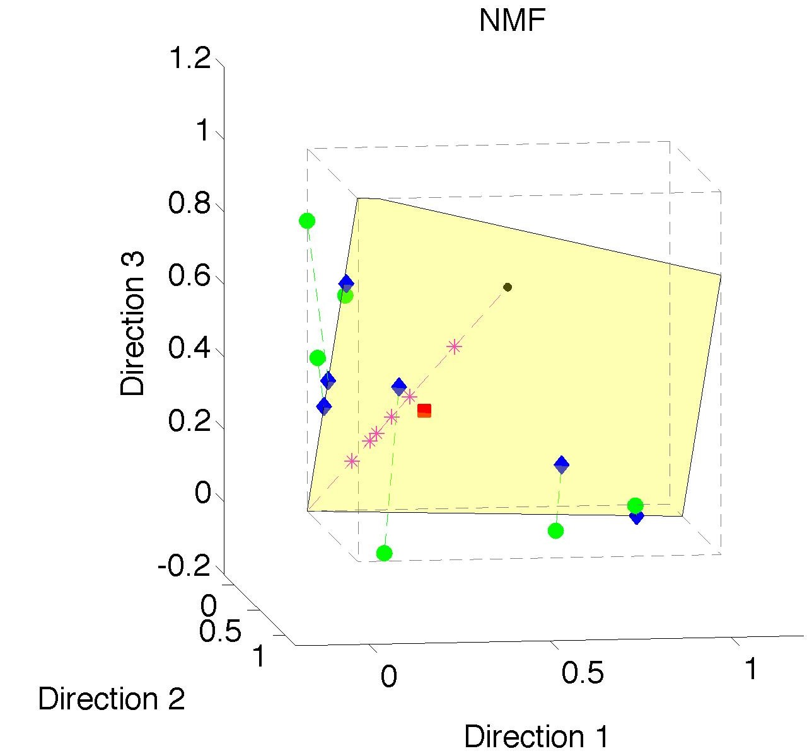
Nonnegative Matrix Factorization
Standard NMF
(Projections
All Inside
Orthant)

Slide 31
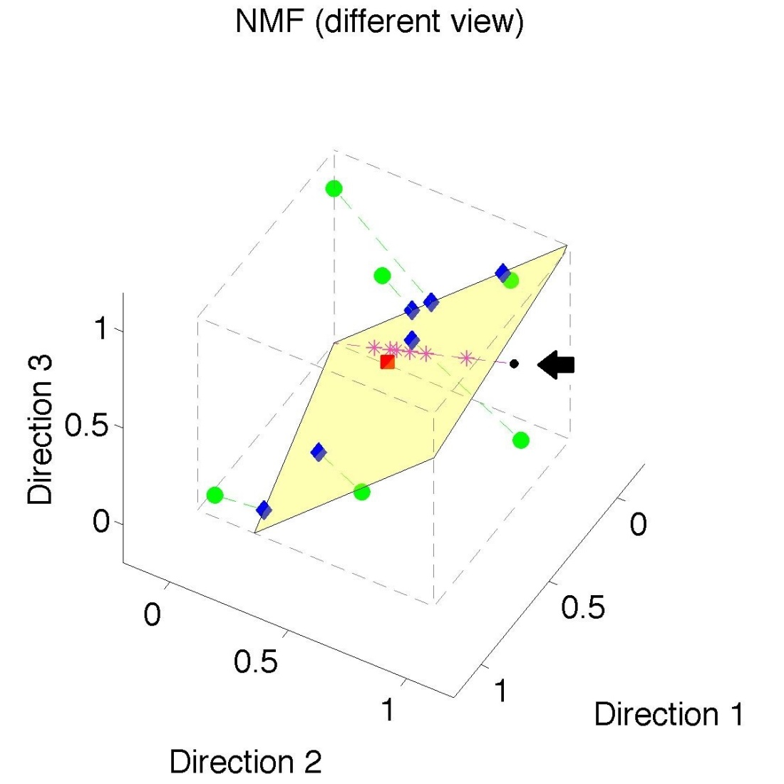
Nonnegative Matrix Factorization
Standard NMF
But Note
Not Nested
No “Multi-scale”
Analysis Possible
(Scores Plot?!?)

Slide 32
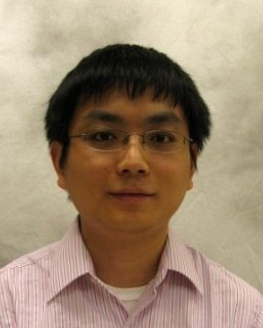
Nonnegative Matrix Factorization
Improved Version:
Use Backwards PCA Idea
“Nonnegative Nested Cone Analysis”
Collaborator:
Lingsong Zhang (Purdue)
Zhang, Lu, Marron (2015)

Slide 33
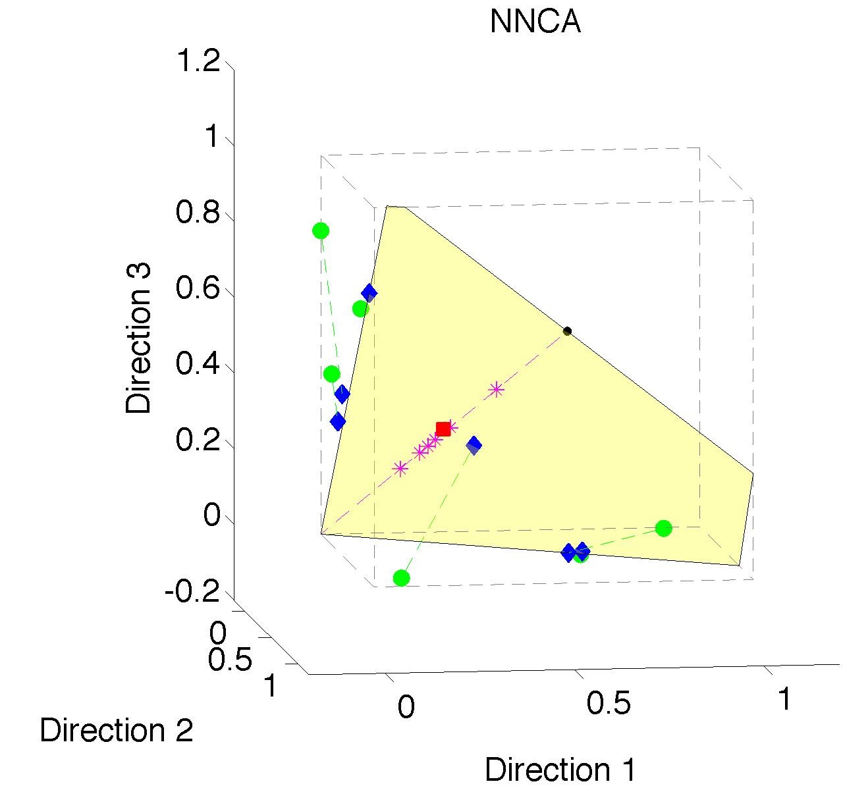
Nonnegative Nested Cone Analysis
Same Toy
Data Set
All
Projections
In Orthant

Slide 34
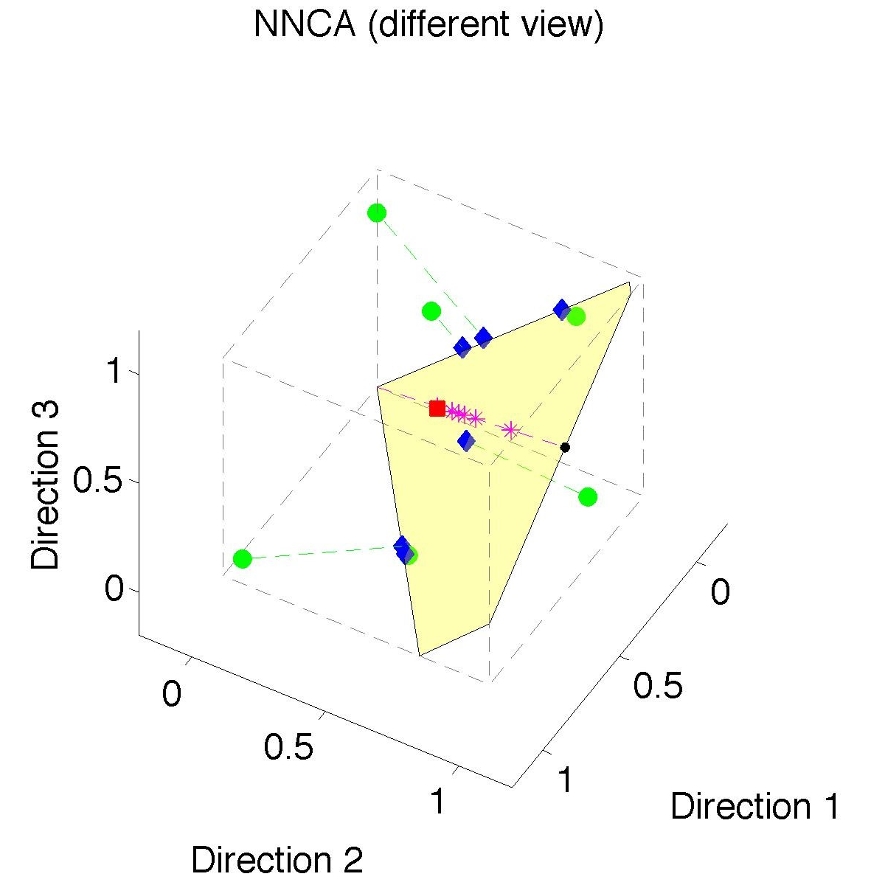
Nonnegative Nested Cone Analysis
Same Toy
Data Set
Rank 1
Approx.
Properly
Nested

Slide 35
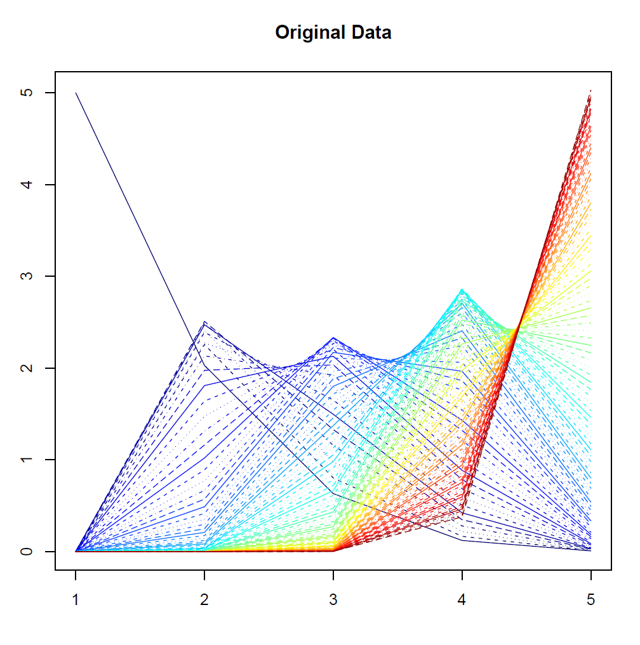
Nonnegative Nested Cone Analysis
5-d Toy
Example
(Rainbow
Colored
by Peak
Order)

Slide 36
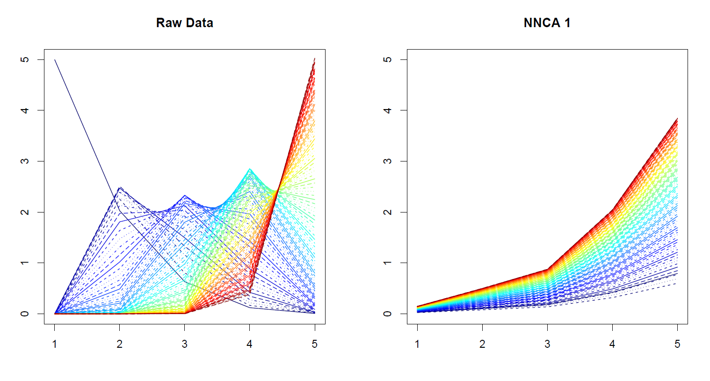
Nonnegative Nested Cone Analysis
5-d Toy Example Rank 1 NNCA Approx.

Slide 37
Nonnegative Nested Cone Analysis
5-d Toy Example Rank 2 NNCA Approx.

Slide 38
Nonnegative Nested Cone Analysis
5-d Toy Example Rank 2 NNCA Approx.
Nonneg.
Basis
Elements
(Not Trivial)

Slide 39
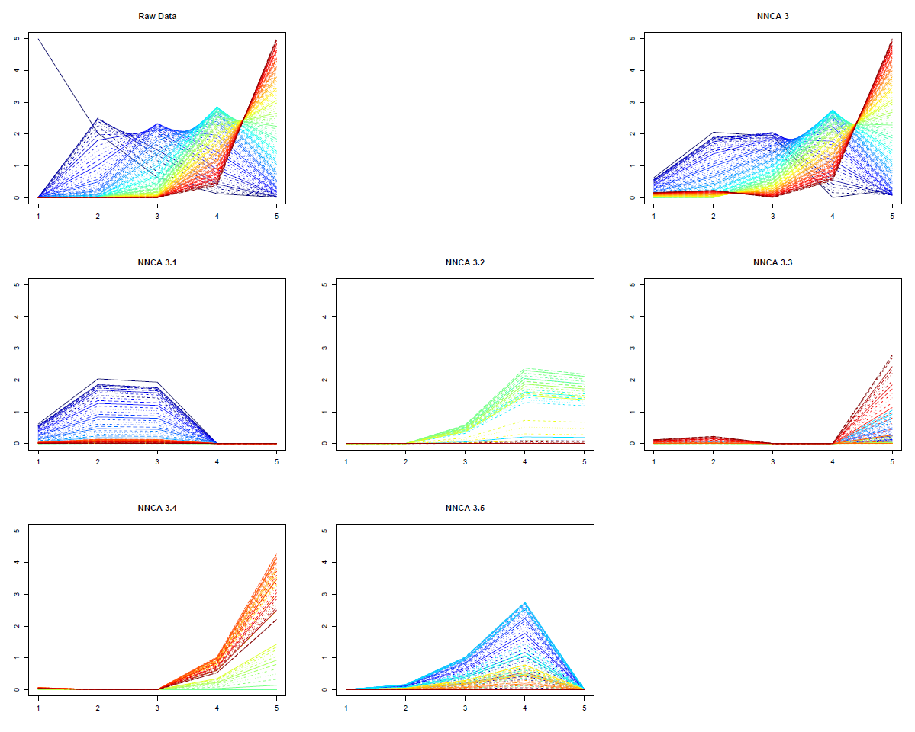
Nonnegative Nested Cone Analysis
5-d Toy Example Rank 3 NNCA Approx.
Current
Research:
How Many
Nonneg.
Basis El’ts
Needed?

Slide 40
An Interesting Question
How generally applicable is
Backwards approach to PCA?
Potential Application: Principal Curves
Hastie & Stuetzle, (1989)
(Foundation of Manifold Learning)

Slide 41
Manifold Learning
Goal: Find lower dimensional manifold that well approximates data
ISOmap
Tenenbaum, et al (2000)
Local Linear Embedding
Roweis & Saul (2000)

Slide 42
1st Principal Curve
Linear Reg’n
Usual Smooth

Slide 43
1st Principal Curve
Linear Reg’n
Proj’s Reg’n
Usual Smooth

Slide 44
1st Principal Curve
Linear Reg’n
Proj’s Reg’n
Usual Smooth
Princ’l Curve

Slide 45
An Interesting Question
How generally applicable is
Backwards approach to PCA?
Potential Application: Principal Curves
Perceived Major Challenge:
How to find 2nd Principal Curve?

Slide 46
An Interesting Question
Key Component:
Principal Surfaces
LeBlanc & Tibshirani (1996)
Challenge:
Can have any dimensional surface,
But how to nest???
Proposal: Backwards Approach

Slide 47
An Interesting Question
How generally applicable is
Backwards approach to PCA?
Another Potential Application:
Trees as Data
(early days)

Slide 48
An Interesting Question
How generally applicable is
Backwards approach to PCA?
An Attractive Answer

Slide 49
An Interesting Question
How generally applicable is
Backwards approach to PCA?
An Attractive Answer:
James Damon, UNC Mathematics
Geometry
Singularity
Theory

Slide 50
An Interesting Question
How generally applicable is
Backwards approach to PCA?
An Attractive Answer:
James Damon, UNC Mathematics
Damon and Marron (2014)

Slide 51
An Interesting Question
How generally applicable is
Backwards approach to PCA?
An Attractive Answer:
James Damon, UNC Mathematics
Key Idea: Express Backwards PCA as
Nested Series of Constraints

Slide 52
General View of Backwards PCA
Define Nested Spaces via Constraints
Satisfying More Constraints $⇒$
$⇒$ Smaller Subspaces

Slide 53
General View of Backwards PCA
Define Nested Spaces via Constraints
E.g. SVD
(Singular Value Decomposition =
= Not Mean Centered PCA)
(notationally very clean)

Slide 54
General View of Backwards PCA
Define Nested Spaces via Constraints
E.g. SVD
Have $k$ Nested Subspaces:
$$S_{1}⊆S_{2}⊆⋯⊆S_{d}$$

Slide 55
General View of Backwards PCA
Define Nested Spaces via Constraints
E.g. SVD $S_{k}=\left\{x :x=\sum_{j=1}^{k}{c_{j}\vec{u_{j}}}\right\}$
$k$-th SVD Subspace
Scores
Loading Vectors

Slide 56
General View of Backwards PCA
Define Nested Spaces via Constraints
E.g. SVD $S_{k}=\left\{x :x=\sum_{j=1}^{k}{c_{j}\vec{u_{j}}}\right\}$
Now Define:
$$S_{k−1}=\left\{x∈S_{k} :\left\langle x,\vec{u_{k}}\right\rangle =0\right\}$$

Slide 57
General View of Backwards PCA
Define Nested Spaces via Constraints
E.g. SVD $S_{k}=\left\{x :x=\sum_{j=1}^{k}{c_{j}\vec{u_{j}}}\right\}$
Now Define:
$$S_{k−1}=\left\{x∈S_{k} :\left\langle x,\vec{u_{k}}\right\rangle =0\right\}$$
Constraint Gives Nested Reduction of Dim’n

Slide 58
General View of Backwards PCA
Define Nested Spaces via Constraints
Backwards PCA
Reduce Using Affine Constraints

Slide 59
General View of Backwards PCA
Define Nested Spaces via Constraints
Backwards PCA
Principal Nested Spheres
Use Affine Constraints (Planar Slices)
In Ambient Space

Slide 60
General View of Backwards PCA
Define Nested Spaces via Constraints
Backwards PCA
Principal Nested Spheres
Principal Surfaces
Spline Constraint Within Previous?

Slide 61
General View of Backwards PCA
Define Nested Spaces via Constraints
Backwards PCA
Principal Nested Spheres
Principal Surfaces
Spline Constraint Within Previous?
{Been Done Already???}

Slide 62
General View of Backwards PCA
Define Nested Spaces via Constraints
Backwards PCA
Principal Nested Spheres
Principal Surfaces
Other Manifold Data Spaces
Sub-Manifold Constraints??
(Algebraic Geometry)

Slide 63
General View of Backwards PCA
Define Nested Spaces via Constraints
Backwards PCA
Principal Nested Spheres
Principal Surfaces
Other Manifold Data Spaces
Tree Spaces
Suitable Constraints???

Slide 64
Topics Not Covered
(Due to lack of time)

Slide 65
Topics Not Covered
Functional Data Analysis:
Amplitude vs. Phase Variation
(“Horizontal” vs. “Vertical”)
Useful concept: Data Objects

Slide 66
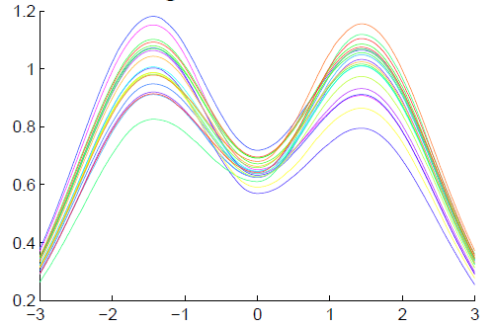
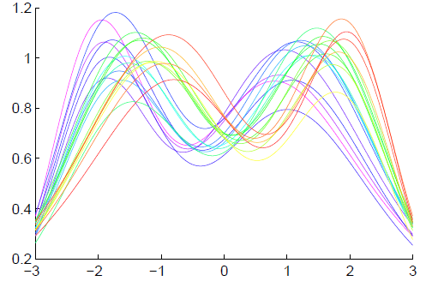
Functional Data Analysis
Insightful
Decomposition
Vertical Variation
Horiz’l
Var’n

Slide 67
Topics Not Covered
Functional Data Analysis:
Amplitude vs. Phase Variation
(“Horizontal” vs. “Vertical”)
Useful concept: Data Objects
Overview Ref: Marron et al (2015)

Slide 68
Topics Not Covered
Independent Component Analysis:
Find Directions as in PCA
But Maximize “Non-Gaussianity”
(Not Variation)
Tends to find “Interesting Directions”
Many Applications (fMRI + others)

Slide 69
Topics Not Covered
Tree Structured Data Objects
Brain Artery Data:
, , … ,

Slide 70
Topics Not Covered
For Very Challenging Object Spaces
Purely Metric Analysis:
Multi-Dimensional Scaling
(Works Like PCA, on Matrix
Of Pairwise Distances)

Slide 71
Carry Away Concept
OODA is more than a “framework”
It Provides a Focal Point
Highlights Pivotal Choices:
What should be the Data Objects?
How should they be Represented?

Slide 72
Participant Presentations
Heejoon Jo
Clustering using RNAseq & Junction Info
Whitney Zheng
Device usage anomaly detection
Iain Carmichael
Connections: SVM & other linear classifiers

